Slide 1

Fakultät für Elektrotechnik und Informatik
Institut für Verteilte Systeme
Fachgebiet Wissensbasierte Systeme (KBS)
Seminar: Topics in Data Mining
Summer semester 2016
A framework to monitor clusters evolution applied to economy and finance problems
Zijian Zhang
May. 23. 2016

Slide 2
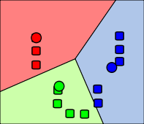
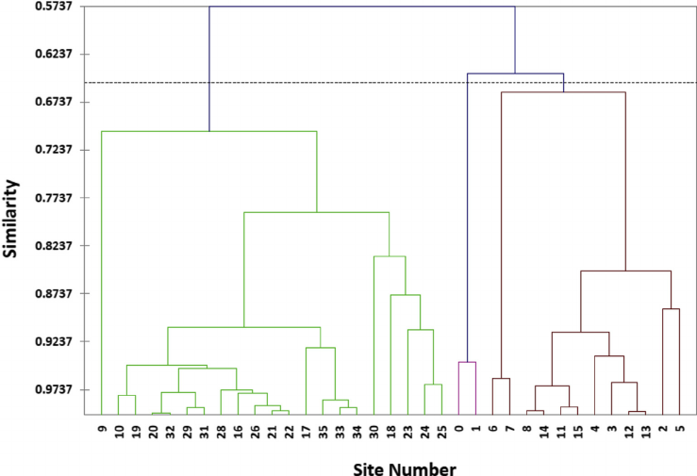
Clustering
The research about clusters has gone deep
k-means Hierachical Clustering
Zijian Zhang, Present, A framework to monitor clusters evolution applied to economy and finance problems

Slide 3
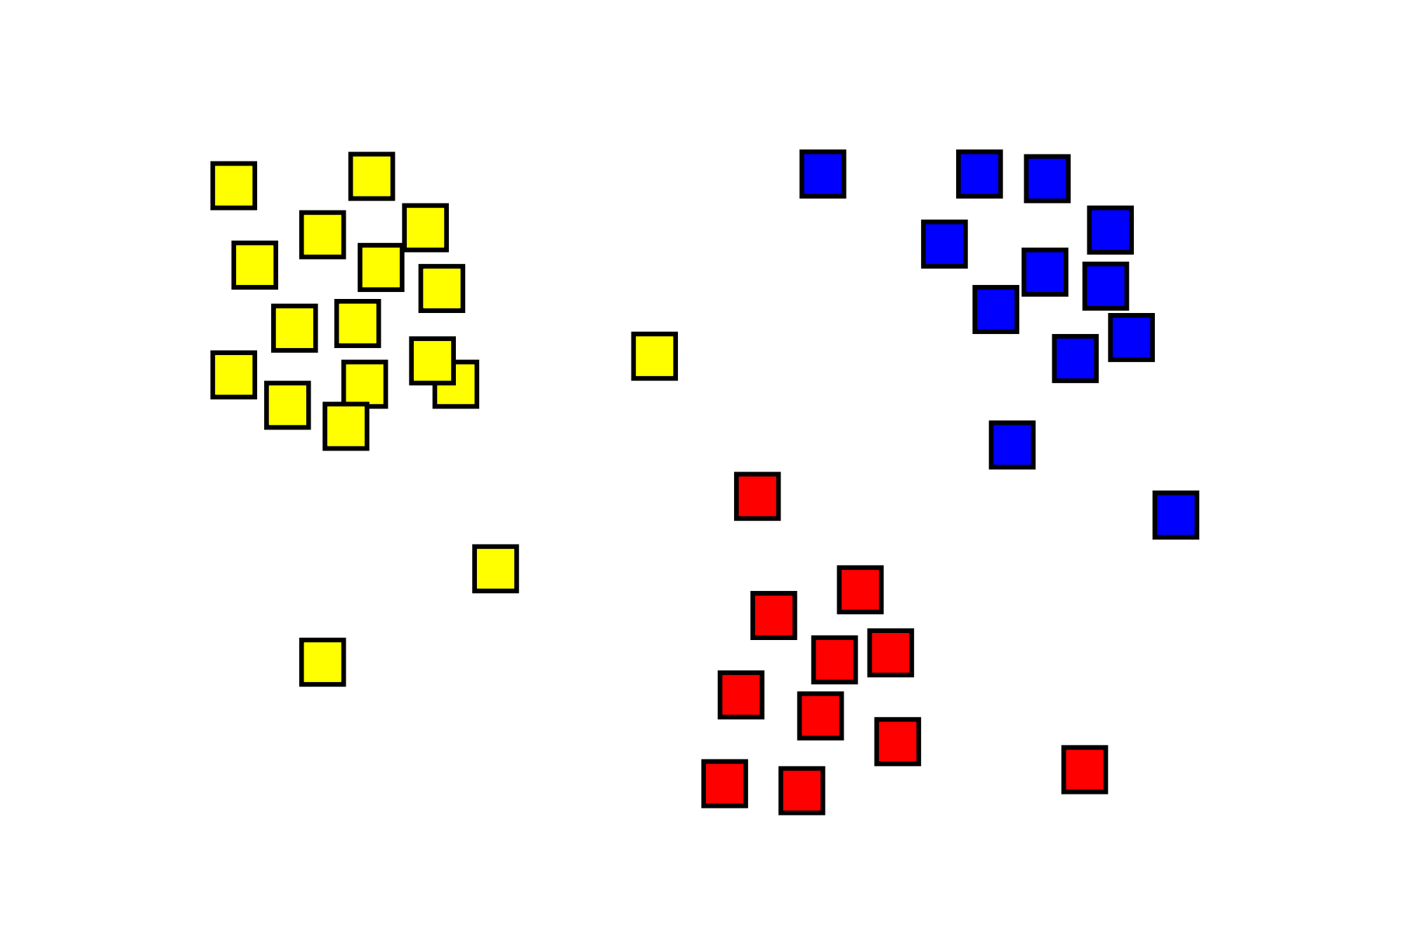
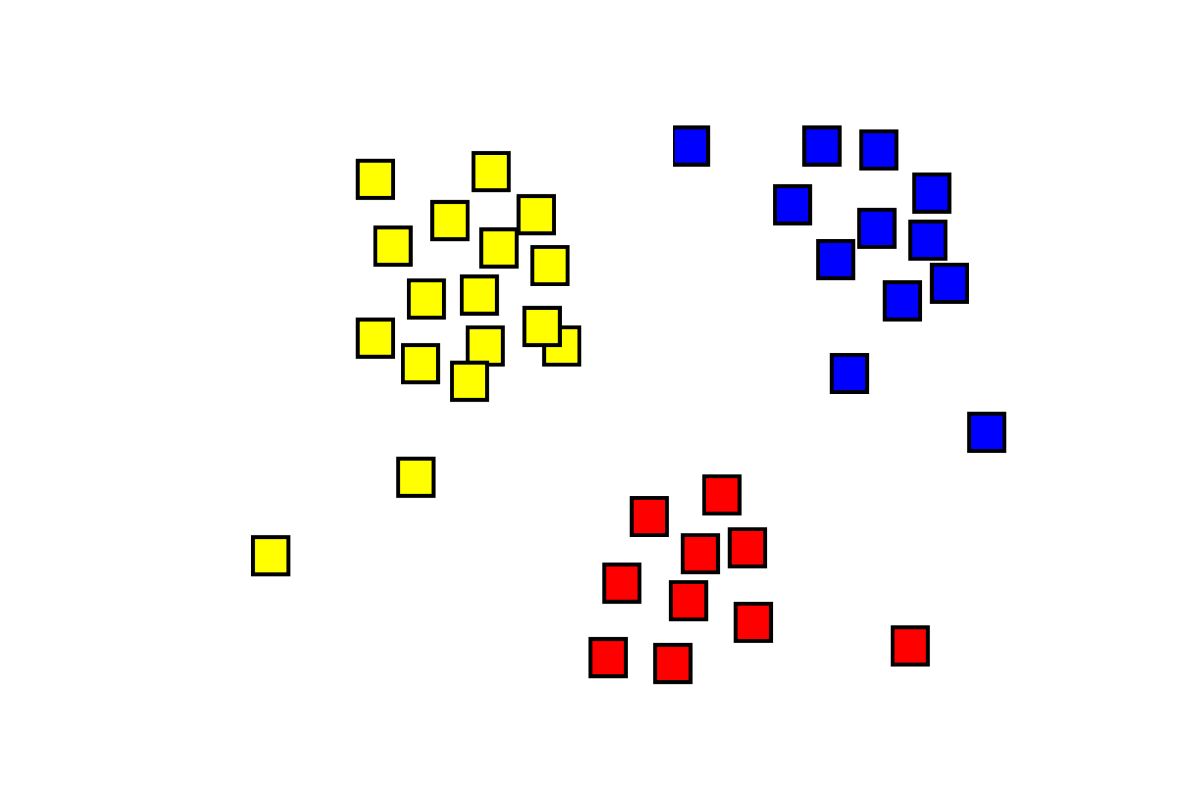
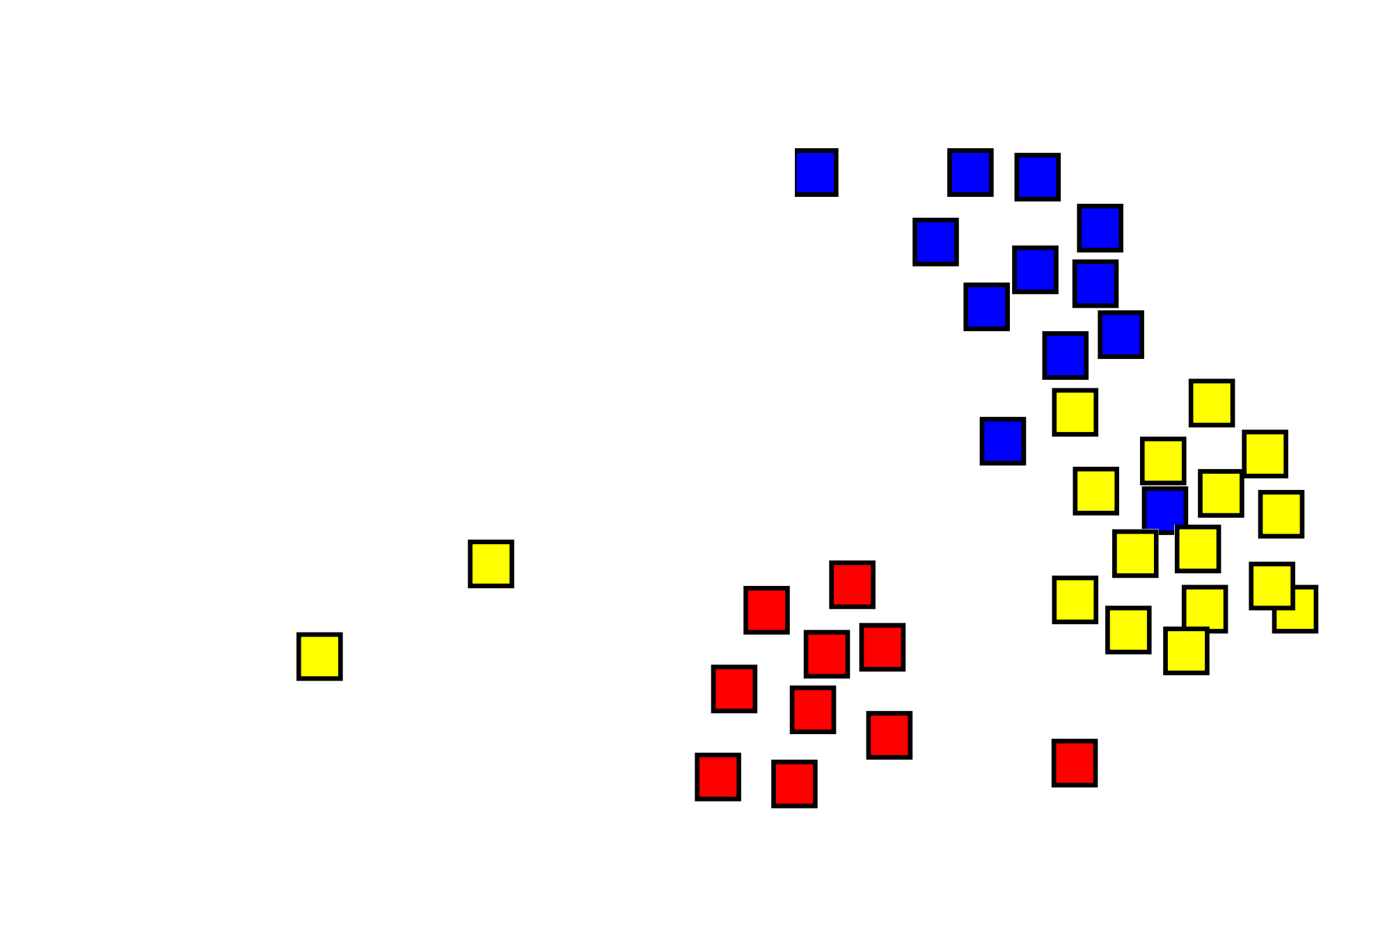
4th Dimension
But in the real world...
t=0 t=1 t=2
Zijian Zhang, Present, A framework to monitor clusters evolution applied to economy and finance problems

Slide 4
Interesting points of temporal variations
(re)detection of clusters
K-means
Hierachical cluster detection
MST clustering
...
temporal transitions
Zijian Zhang, Present, A framework to monitor clusters evolution applied to economy and finance problems

Slide 5
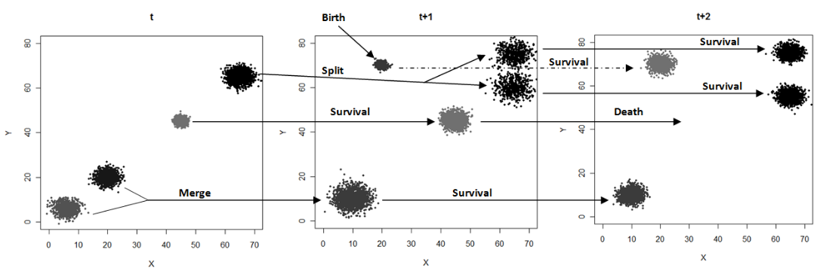
Toxonomy of transitions
according to the paper, all types of transitions of clustering are roughly categorized into five types:
  birth
  death
  merge
  split
  survive
Zijian Zhang, Present, A framework to monitor clusters evolution applied to economy and finance problems

Slide 6
Tracking the points
Extensional defination of clusters
x₃
x₆
x₄
x₆
x₃
x₅
x₅
x₂
x₂
x₄
x₁
x₁
Cluster (x₁,x₂,x₃,x₄,x₅,x₆)
Cluster (x₁,x₂,x₃) and Cluster(x₄,x₅,x₆)
Zijian Zhang, Present, A framework to monitor clusters evolution applied to economy and finance problems
Notes:
Although tracking of each points sounds not so efficient, but easy to measure the familarity of clusters and thus determin the transitions.

Slide 7
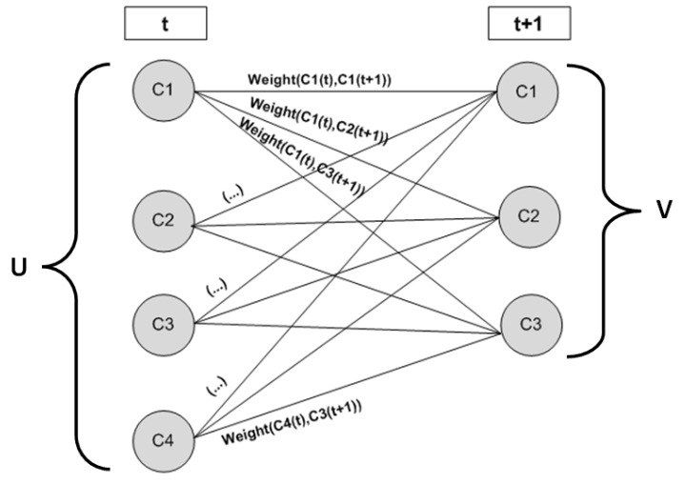
Matching the clusters
Zijian Zhang, Present, A framework to monitor clusters evolution applied to economy and finance problems
Notes:
Although tracking of each points sounds not so efficient, but easy to measure the familarity of clusters and thus determin the transitions.

Slide 8
Caculation of weight
x₃
x₆
x₃
x₅
x₇
x₂
x₂
x₆
x₁
x₄
x₁
x₄
x₅
Zijian Zhang, Present, A framework to monitor clusters evolution applied to economy and finance problems
Notes:
Although tracking of each points sounds not so efficient, but easy to measure the familarity of clusters and thus determin the transitions.

Slide 9
Birth
x₃
x₆
x₅
x₂
x₁
x₄
t_{i}
t_{i+Δt}
Zijian Zhang, Present, A framework to monitor clusters evolution applied to economy and finance problems

Slide 10
Death
x₃
x₆
x₅
x₂
x₄
x₁
t_{i}
t_{i+Δt}
Zijian Zhang, Present, A framework to monitor clusters evolution applied to economy and finance problems

Slide 11
Split
x₃
x₃
x₆
x₅
x₅
x₆
x₂
x₁
x₄
x₁
x₄
x₂
t_{i}
t_{i+Δt}
Zijian Zhang, Present, A framework to monitor clusters evolution applied to economy and finance problems

Slide 12
Merge
x₆
x₁
x₄
x₆
x₃
x₂
x₅
x₂
x₃
x₁
x₄
x₅
t_{i}
t_{i+Δt}
Zijian Zhang, Present, A framework to monitor clusters evolution applied to economy and finance problems

Slide 13
Survive
x₆
x₃
x₆
x₄
x₅
x₂
x₃
x₅
x₁
x₁
x₄
x₂
t_{i}
t_{i+Δt}
Zijian Zhang, Present, A framework to monitor clusters evolution applied to economy and finance problems

Slide 14
Learning from realworld
the author has conducted a learning of threshold with two different data set：
  Banco de Portugal's Central Balance-Sheet Database and
  The Data Page of New York University - Leonard N. Stern School of Business
with starting condition that the two arguments vary in correspondly interval:
  τin [0.5, 1]
  λin [0, 0.4]
final assignment:
  τ=0.6
  λ=0.2
also the affectivness of two thresholds：
  split threshold values is not critical
  number of transitions are more volatile and sensitive to small variations of τ
Zijian Zhang, Present, A framework to monitor clusters evolution applied to economy and finance problems

Slide 15
Case Study 1: Portuguese Activity Sectors
Metric: Z-scores using standardized 9 continuous attributes
Using agglomerative
hierarchical algorithm
Observations: 12 Principal Activity Sectors
(Education, Manufacturing, etc.)
Time: over 3 years (2005, 2006, 2007)
Zijian Zhang, Present, A framework to monitor clusters evolution applied to economy and finance problems

Slide 16
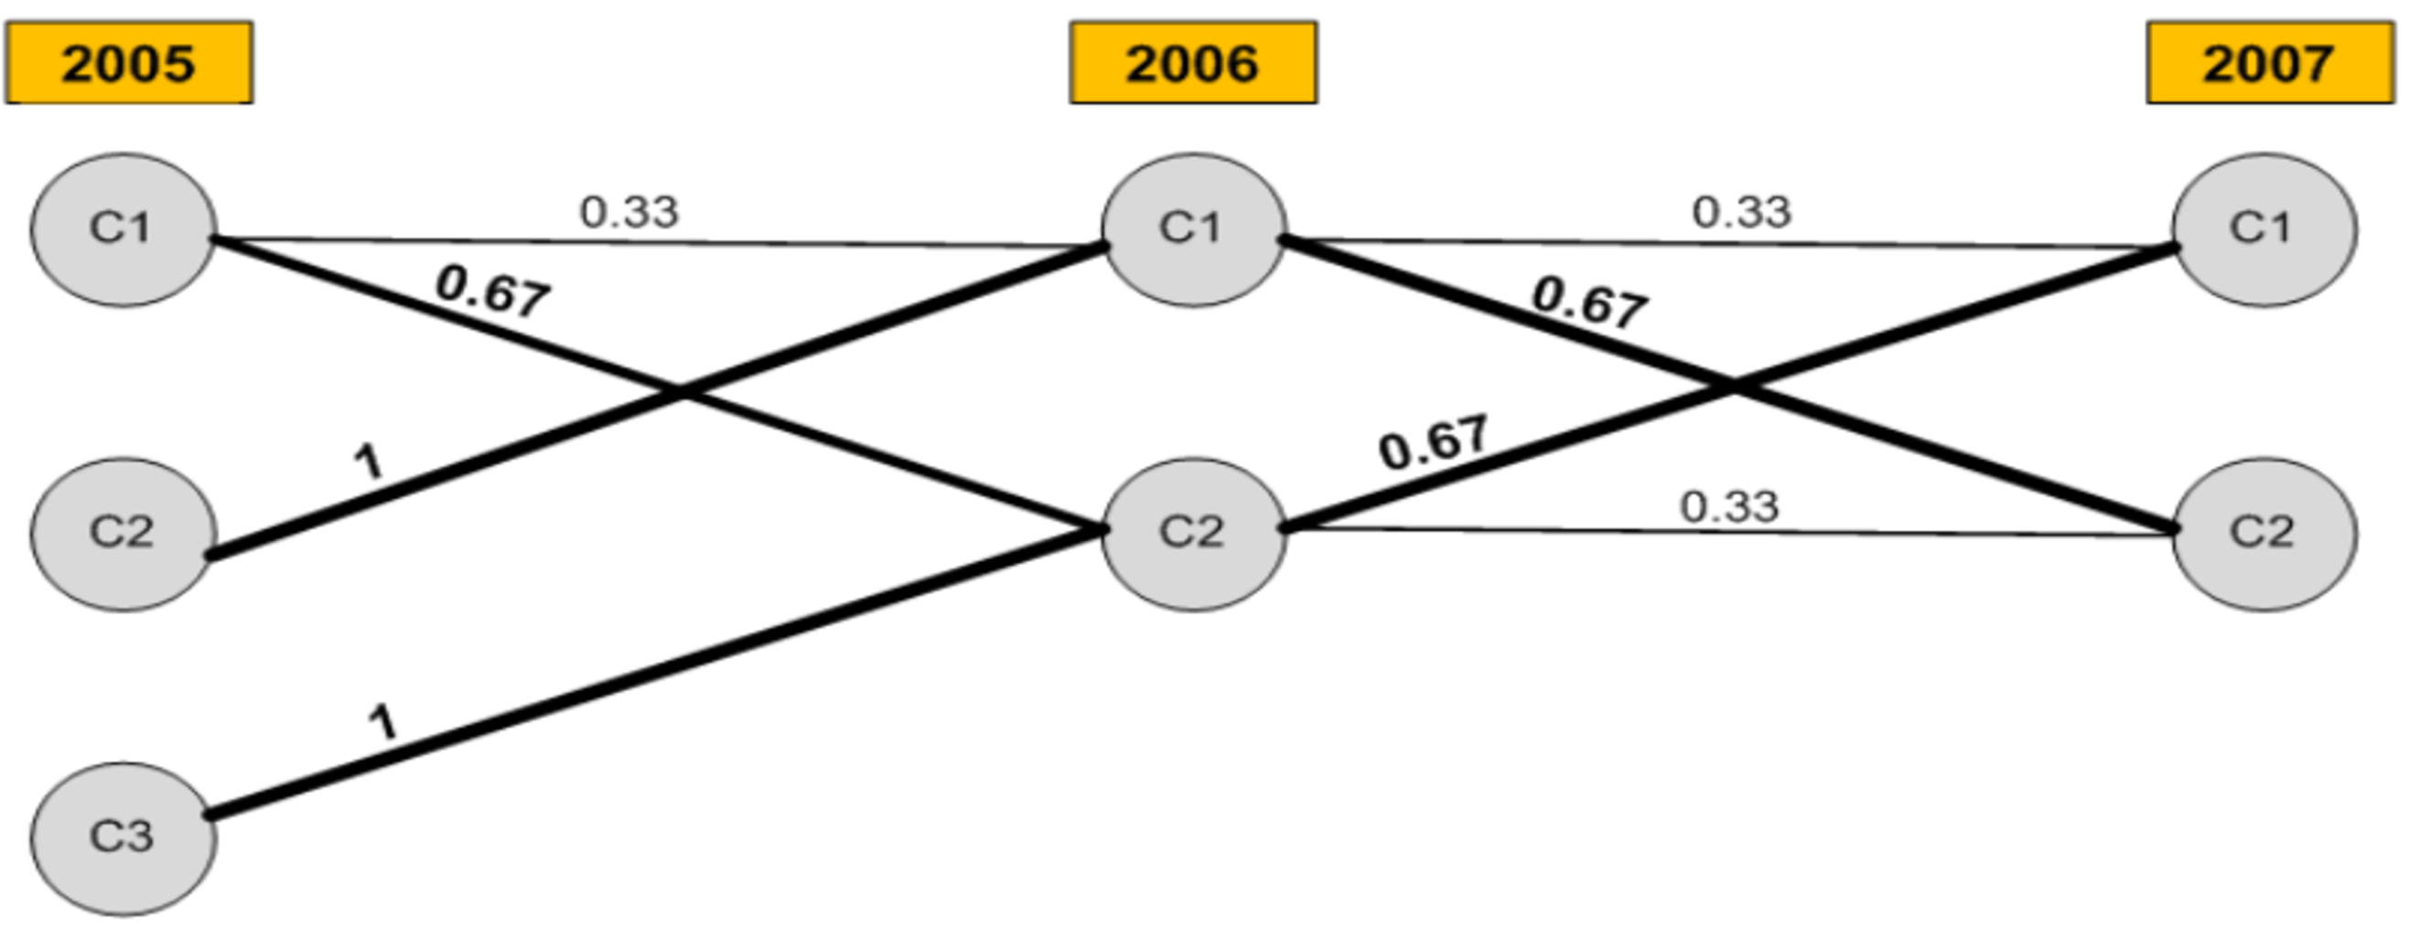
Case Study 1: Portuguese Activity Sectors – Result
Fishing
Production and
distribution of electricity,
gas and water
...
Fishing
Manufacturing
...
Fishing
Manufacturing
Education
...
Production and
distribution of electricity,
gas and water
Manufacturing
Construction
Education
...
Construction
Production and
Distribution of electricity,
Gas and water
...
Construction
Education
…
Zijian Zhang, Present, A framework to monitor clusters evolution applied to economy and finance problems

Slide 17
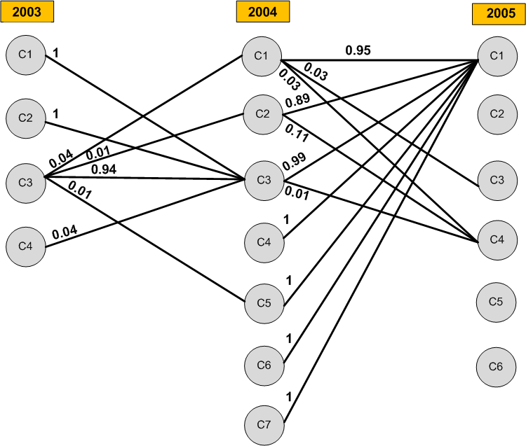
Case Study 2: European Companies
We are only interested in such activities that rarely happens.
e.g. merging and bankruptcy of companies
Zijian Zhang, Present, A framework to monitor clusters evolution applied to economy and finance problems

Slide 18
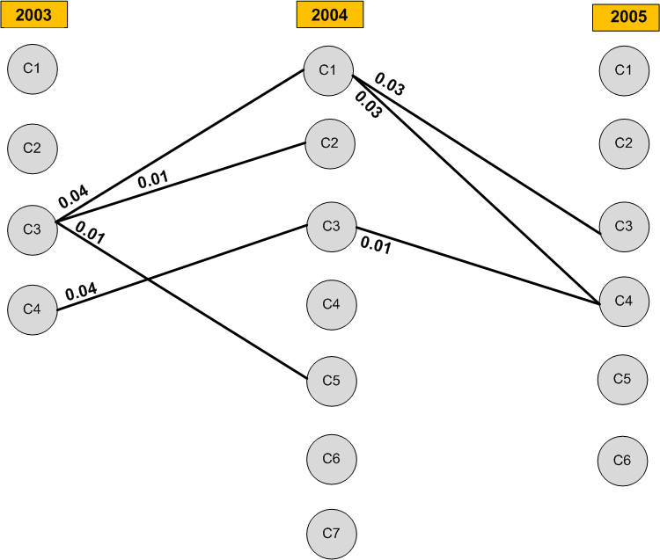
Case Study 2: European Companies
Maintained because
edge weight
lower than
some threshold
*
expected probability
Zijian Zhang, Present, A framework to monitor clusters evolution applied to economy and finance problems

Slide 19
One Step Further
Fuzzy Clustering...
for the formuler:
re-define the defination of intersection and join, as such:
Zijian Zhang, Present, A framework to monitor clusters evolution applied to economy and finance problems

Slide 20
Pros and Cons
Pros:
  Summarized several kinds of application of monitoring cluster activities.
  Defined a whole framework which could guide the implementation of cluster activity monitoring
Contras:
  Data set too small while making the experiments(12 observations with 9 attributes) .
  High cost of recolonization of clusters: exclusive definition is quite too verbose, using statistical expression more efficient?
Zijian Zhang, Present, A framework to monitor clusters evolution applied to economy and finance problems

Slide 21
Acknowledgment
Thank you for your attention.
Feel free to raise questions to me.
Have fun in following presentations.
Zijian Zhang, Present, A framework to monitor clusters evolution applied to economy and finance problems

