Slide 1
Presentation for Seminar:
Aspekte Verteilter Systeme
Energy consumption and computational performance for Odroid-XU3 Multicore System.
Presentor: Zhang, Zijian Matrikelnummer: 3184680

Slide 2
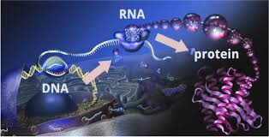
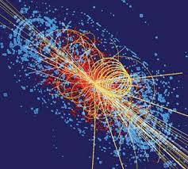
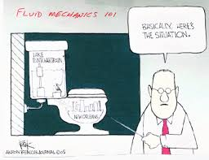
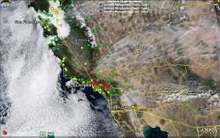
Large scale computation requires...
Molecular biology Particle physics
Fluid mechanics Atmospheric particular matter
Presentor: Zhang, Zijian Matrikelnummer: 3184680

Slide 3
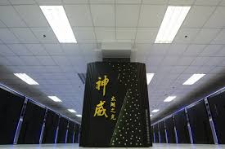
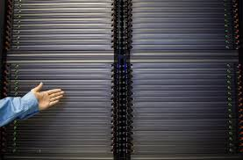
...HPC-High performance Computation
Which:
Is capable of parallel computation
Contains whale of calculation and communication units
...
#1 Top500 06/2016:
Sunway TaihuLight
Presentor: Zhang, Zijian Matrikelnummer: 3184680

Slide 4
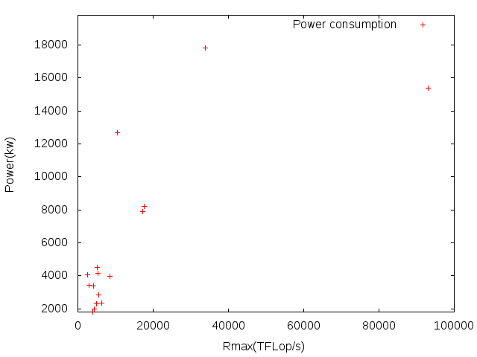
...And also consumes lots ENERGY
Data source: https://www.top500.org/statistics/sublist/
Presentor: Zhang, Zijian Matrikelnummer: 3184680

Slide 5


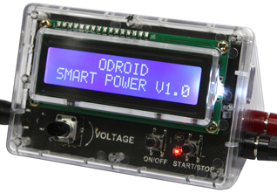
Experiment environment
With Power consumption and
integrated energy of
whole device among:
Different activating core number
Different computing tasks
Different task scales
Different Parallelization solution
And:
Power rate among
Different device parts
Along with:
Thermal loss of CPU
NASA Parallel Benchmarks
ODROID-XU3
Heterogeneous Multi-Processing solution
ODROID Smart Power USB Energy Measurement Package
Presentor: Zhang, Zijian Matrikelnummer: 3184680

Slide 6
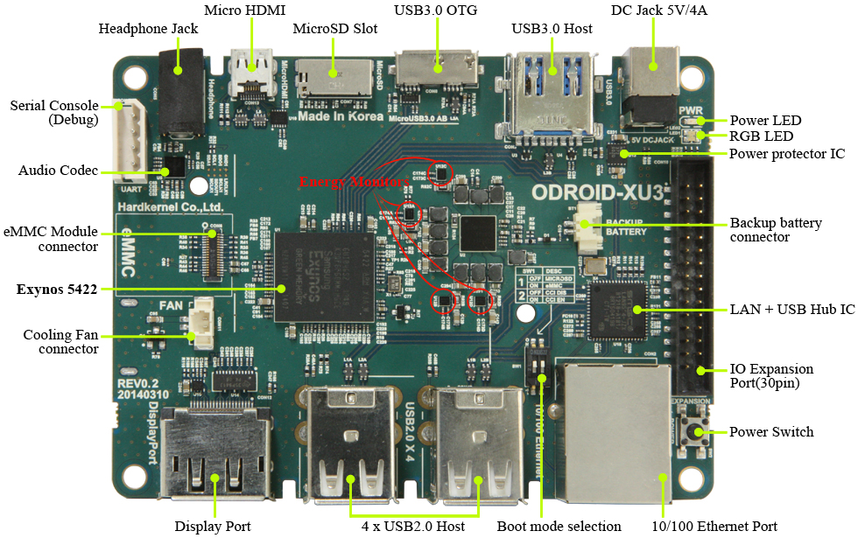
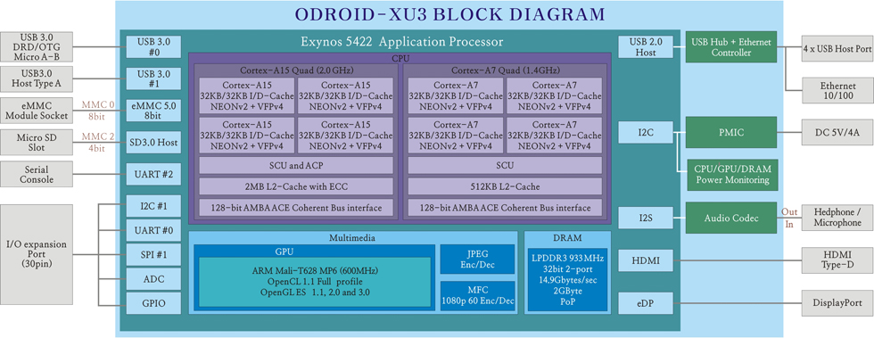
Energy consumption varies
Among architectures:
Presentor: Zhang, Zijian Matrikelnummer: 3184680

Slide 7
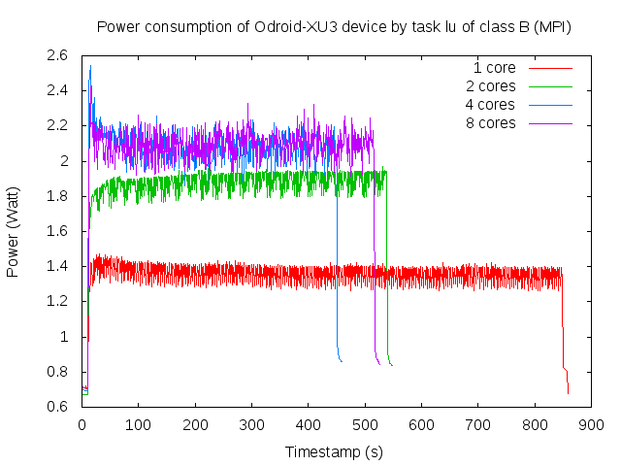
Architecture aspects
Presentor: Zhang, Zijian Matrikelnummer: 3184680

Slide 8
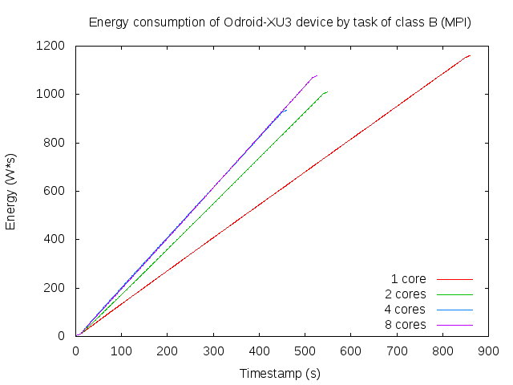
Architecture aspects
Presentor: Zhang, Zijian Matrikelnummer: 3184680

Slide 9
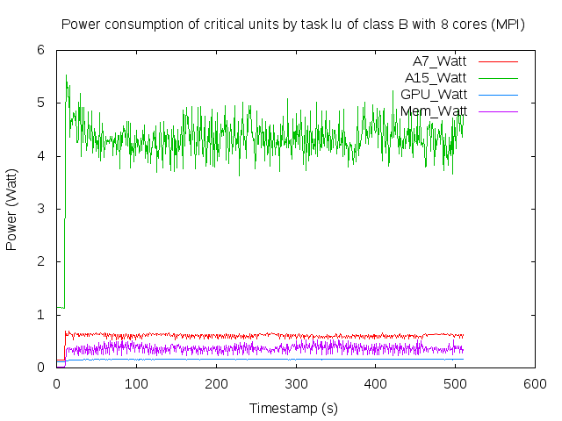
Power consumption per unit: MPI
Presentor: Zhang, Zijian Matrikelnummer: 3184680

Slide 10
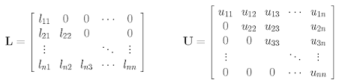
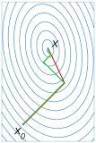
Energy consumption varies
Among computation tasks
LU decomposition and Gauss elimination
Conjugate gradient
Presentor: Zhang, Zijian Matrikelnummer: 3184680

Slide 11
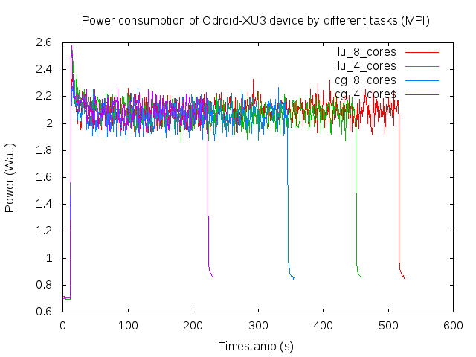
Task taxonomy aspects
Presentor: Zhang, Zijian Matrikelnummer: 3184680

Slide 12
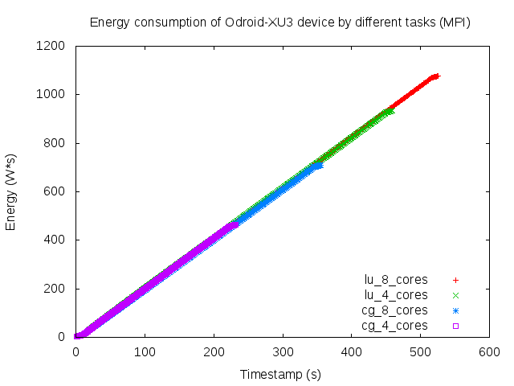
Task taxonomy aspects
Presentor: Zhang, Zijian Matrikelnummer: 3184680

Slide 13
Energy consumption varies
Among scale of tasks
Class A:
Class B:
4X
Presentor: Zhang, Zijian Matrikelnummer: 3184680

Slide 14
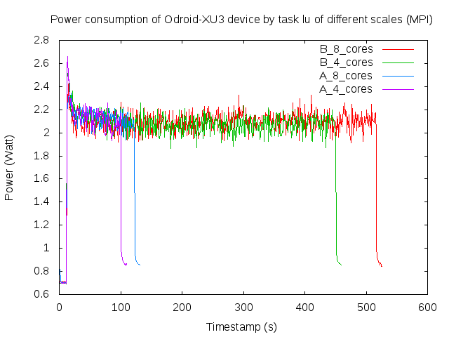
Scale aspect
Presentor: Zhang, Zijian Matrikelnummer: 3184680

Slide 15
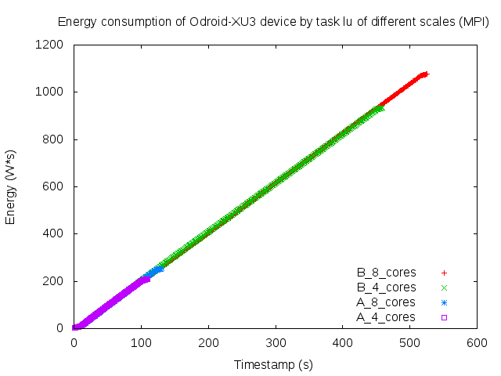
Scale aspect
Presentor: Zhang, Zijian Matrikelnummer: 3184680

Slide 16
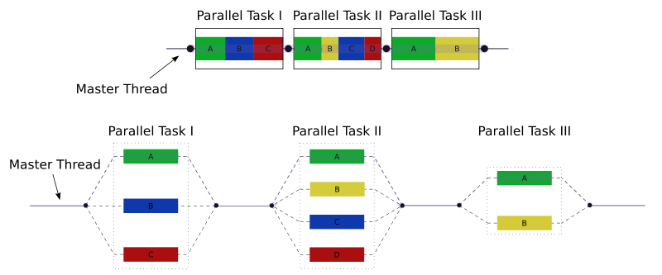

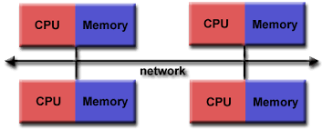

Energy consumption varies
Among Implementation methods
Presentor: Zhang, Zijian Matrikelnummer: 3184680

Slide 17
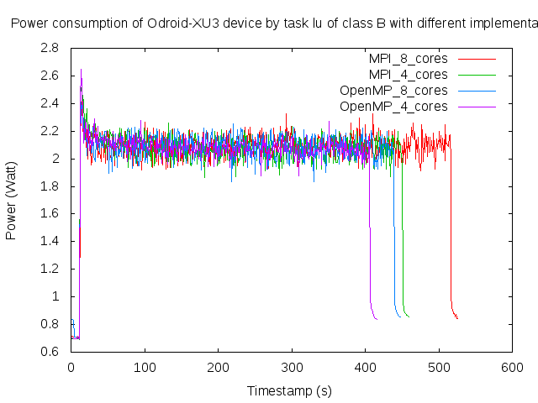
Implementation aspect
Power consumption of ODROID-XU3 device by task lu of class B with different implementations
Presentor: Zhang, Zijian Matrikelnummer: 3184680

Slide 18
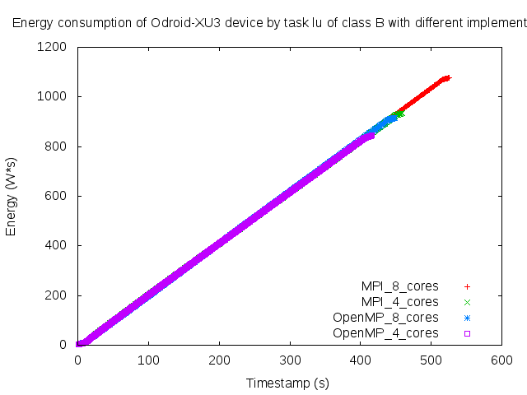
Implementation aspect
Energy consumption of ODROID-XU3 device by task lu of class B with different implementations
Presentor: Zhang, Zijian Matrikelnummer: 3184680

Slide 19
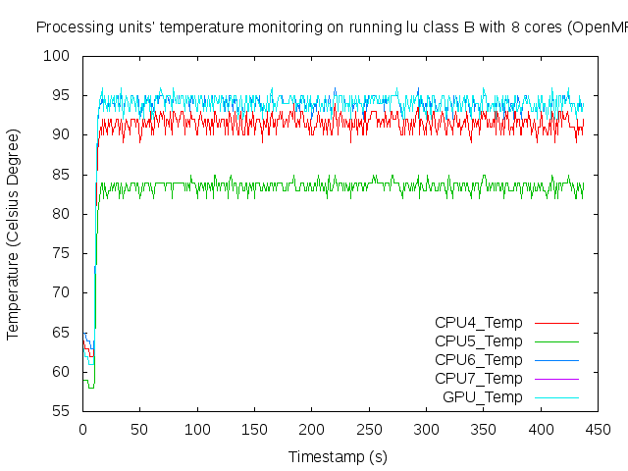
Energy waste: thermal aspect (OpenMP)
Processing units’ temperature monitoring by task lu class B with 8 cores activated (OpenMP)
Presentor: Zhang, Zijian Matrikelnummer: 3184680

Slide 20
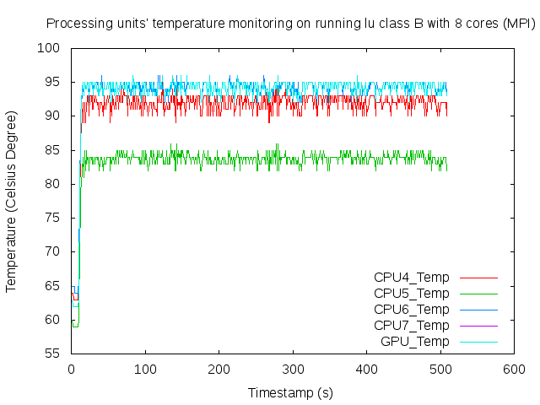
Energy waste: thermal aspect (MPI)
Presentor: Zhang, Zijian Matrikelnummer: 3184680

Slide 21
Conclusion and Problems occured
Energy consumption mainly depends on:
  Numbers of activated CPUs (4 the best)
  Parallelization solution (OpenMP the better)
  Second-best configuration varies among tasks
Problems and Supplementation
  Measuring time should be long enough
  Gap time should be also not too short
  Many environment variables could be test
  CPU only disabled logically, instead of physical off-line
Presentor: Zhang, Zijian Matrikelnummer: 3184680

Slide 22
Thank you for your attention
Any recommends will be appreciated
Presentor: Zhang, Zijian Matrikelnummer: 3184680

