Slide 1
Presentation for Seminar:
Aspecte Vertelter Systeme
Energy consumption and computational performance for Odroid-XU3 Multicore System.
Presentor: Zhang, Zijian Matrikelnummer: 3184680
Notes:
<Foliennummer>
Spelling: Aspekte Verteilter Systeme
Or use the english title:
Aspects of Distributed Systems

Slide 2
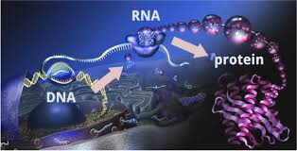
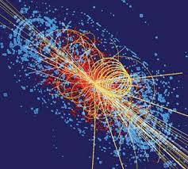
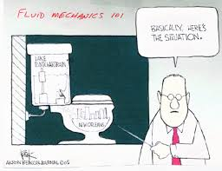
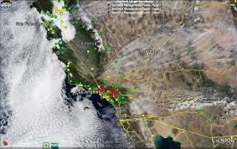
Large scale computation requires...
Molecular biology Particle physics
Fluid mechanics Atmospheric particular matter
Presentor: Zhang, Zijian Matrikelnummer: 3184680
Notes:
<Foliennummer>
Very good intro

Slide 3
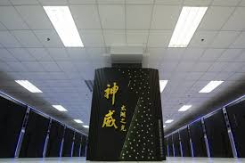
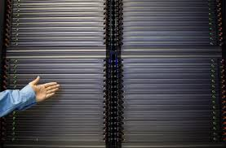
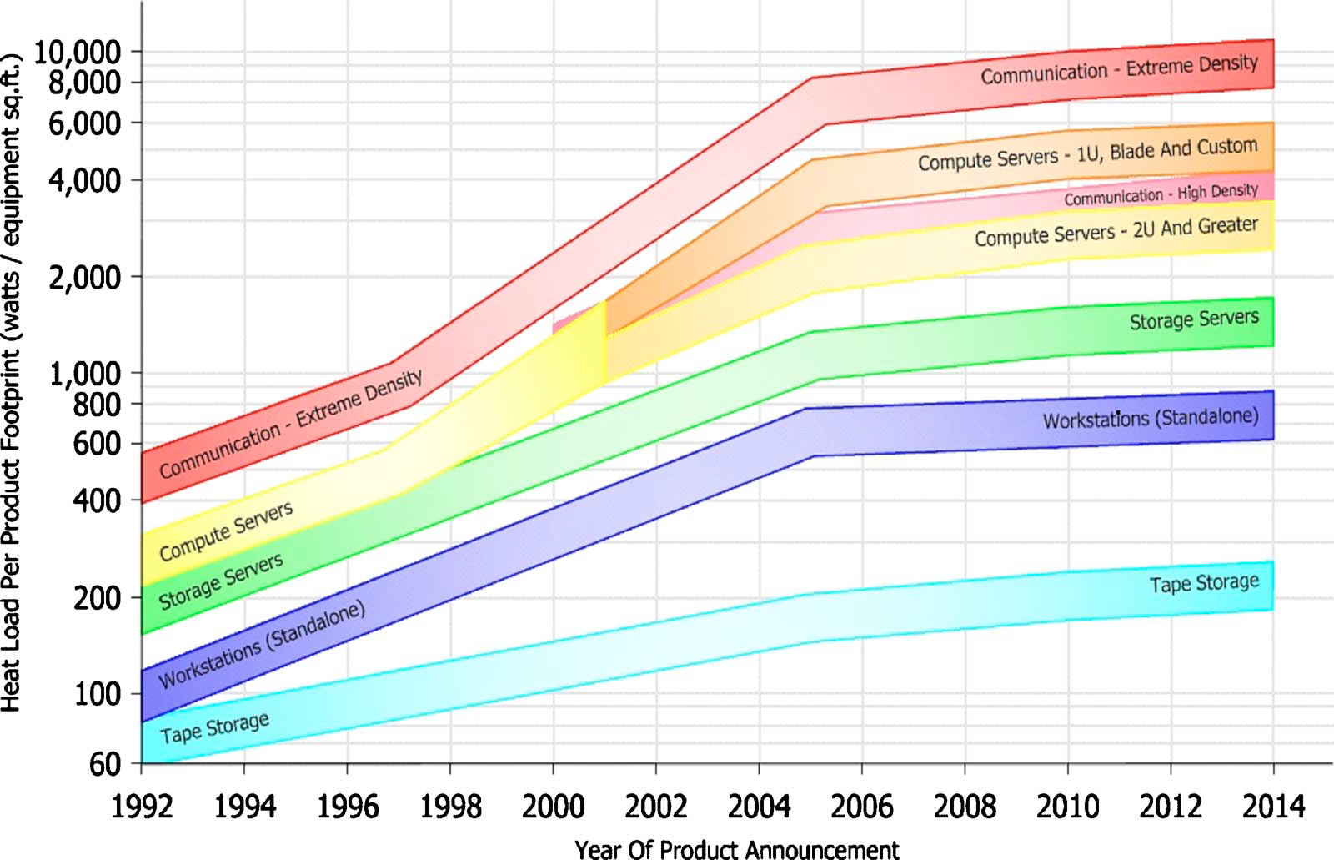
...HPC-High performance Computation
Which:
Is capable of parallel computation
Contains whale of calculation and communication units
And also consume high quantity of ENERGY!
Presentor: Zhang, Zijian Matrikelnummer: 3184680
Notes:
<Foliennummer>
I would label the picture of Sunway TaihuLight, for instance:
#1 Top500 06/2016: Sunway TaihuLight
The Source of the diagram is missing

Slide 4
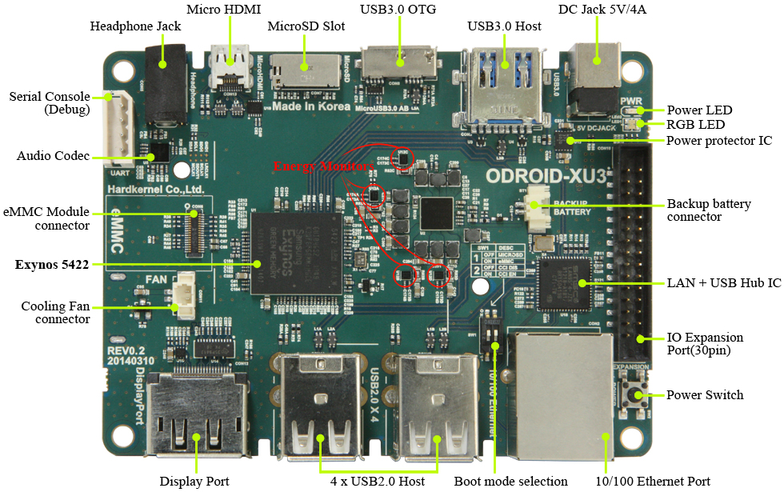
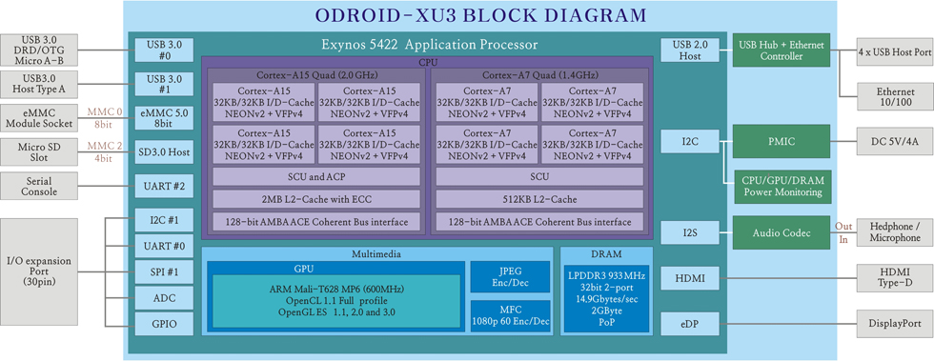
Energy consumption varies
Among architectures:
Presentor: Zhang, Zijian Matrikelnummer: 3184680
Notes:
<Foliennummer>

Slide 5
Notes:
I would insert here an overview slide about:
Which benchmarks did you use?
What did you test?
How did you measure? (external/internal/both?)

Slide 6
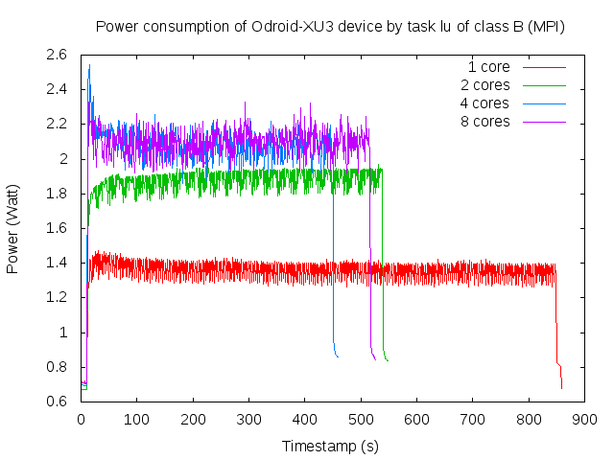
Architecture aspects
Presentor: Zhang, Zijian Matrikelnummer: 3184680
Notes:
<Foliennummer>

Slide 7
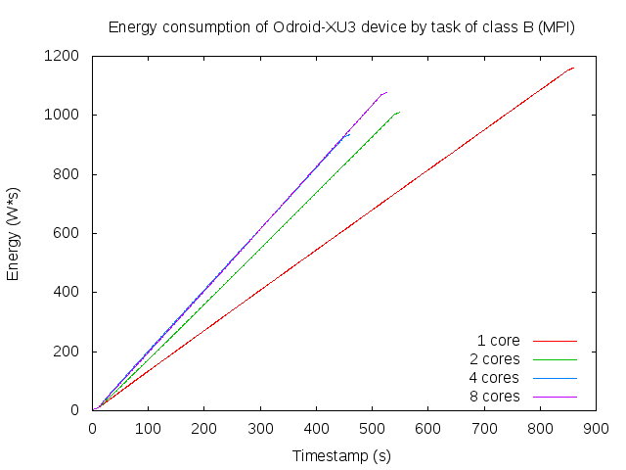
Architecture aspects
Presentor: Zhang, Zijian Matrikelnummer: 3184680
Notes:
<Foliennummer>

Slide 8
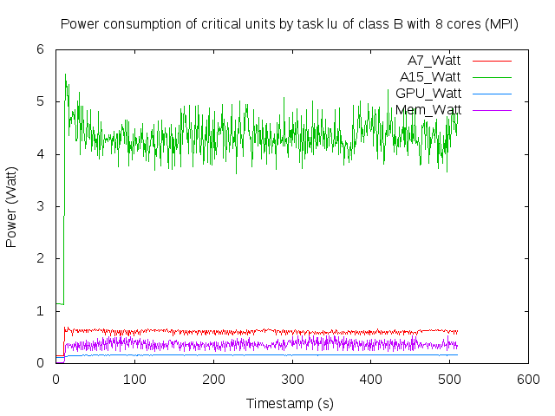
Power consumption per unit: MPI
Presentor: Zhang, Zijian Matrikelnummer: 3184680
Notes:
<Foliennummer>

Slide 9
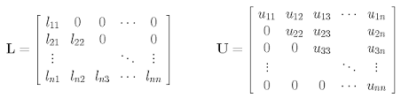
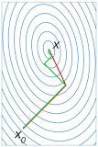
Energy consumption varies
Among computation tasks
LU decomposition and Gauss elimination
Conjugate gradient
Presentor: Zhang, Zijian Matrikelnummer: 3184680
Notes:
<Foliennummer>

Slide 10
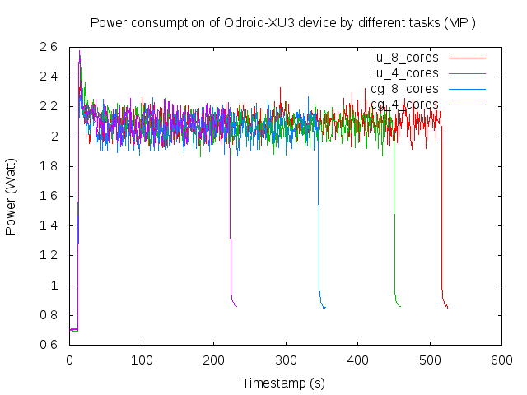
Task taxonomy aspects
Presentor: Zhang, Zijian Matrikelnummer: 3184680
Notes:
<Foliennummer>

Slide 11
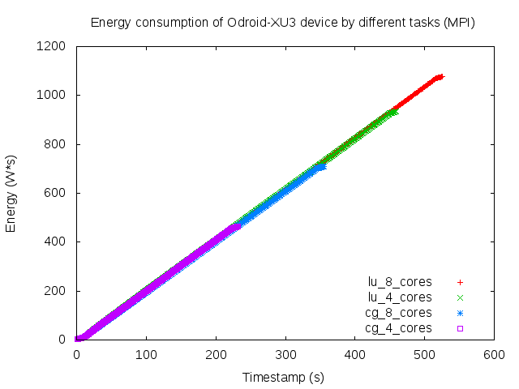
Task taxonomy aspects
Presentor: Zhang, Zijian Matrikelnummer: 3184680
Notes:
<Foliennummer>

Slide 12
Energy consumption varies
Among scale of tasks
Class A:
Class B:
4X
Presentor: Zhang, Zijian Matrikelnummer: 3184680
Notes:
<Foliennummer>

Slide 13
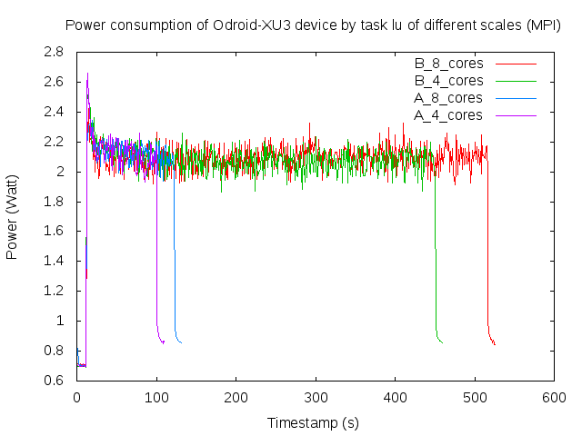
Scale aspect
Presentor: Zhang, Zijian Matrikelnummer: 3184680
Notes:
<Foliennummer>

Slide 14
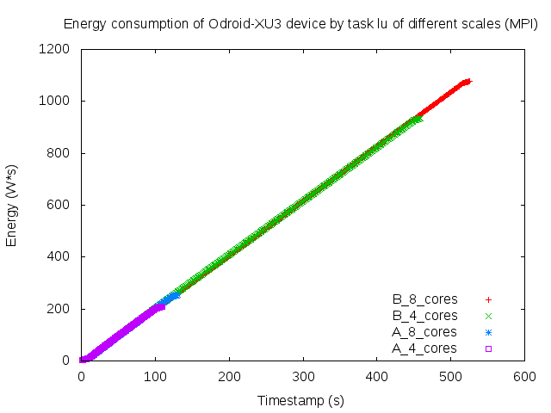
Scale aspect
Presentor: Zhang, Zijian Matrikelnummer: 3184680
Notes:
<Foliennummer>

Slide 15
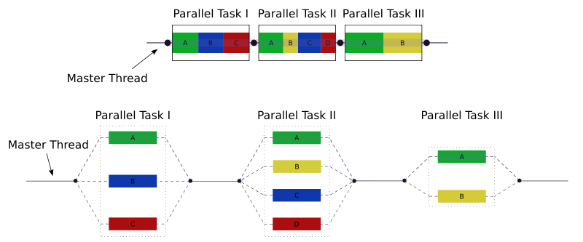

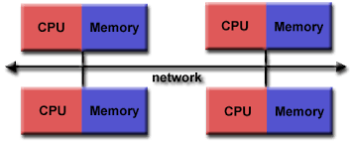

Energy consumption varies
Among Implementation methods
Presentor: Zhang, Zijian Matrikelnummer: 3184680
Notes:
<Foliennummer>

Slide 16
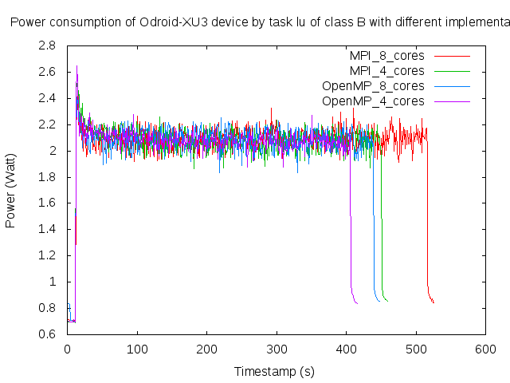
Implementation aspect
Presentor: Zhang, Zijian Matrikelnummer: 3184680
Notes:
<Foliennummer>
Title of the diagram is truncated

Slide 17
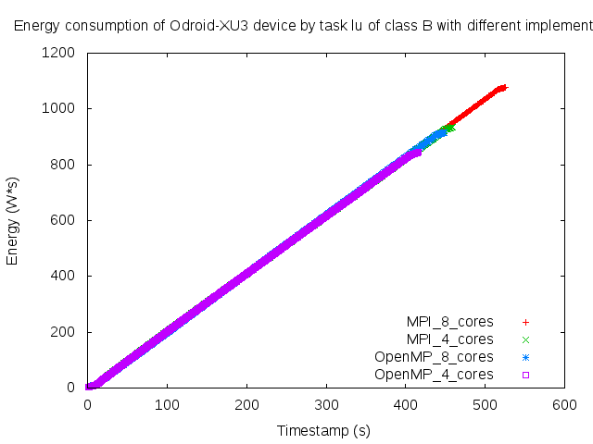
Implementation aspect
Presentor: Zhang, Zijian Matrikelnummer: 3184680
Notes:
<Foliennummer>
Title of the diagram is truncated

Slide 18
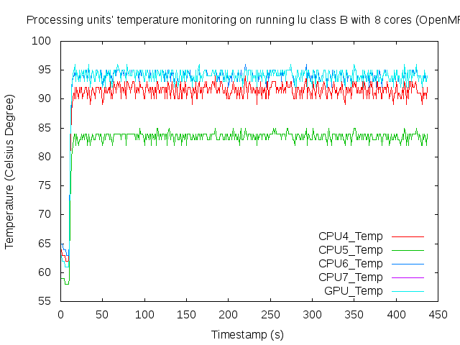
Energy waste: thermal aspect (OpenMP)
Presentor: Zhang, Zijian Matrikelnummer: 3184680
Notes:
<Foliennummer>
Title of the diagram is truncated

Slide 19
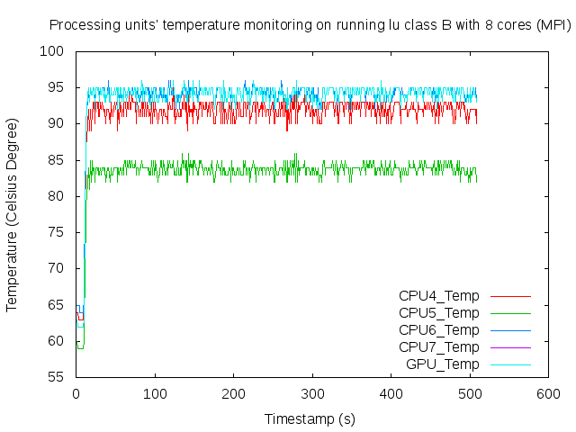
Energy waste: thermal aspect (MPI)
Presentor: Zhang, Zijian Matrikelnummer: 3184680
Notes:
<Foliennummer>

Slide 20
Notes:
I would suggest to insert here an additional slide about the conclusion and perhaps the problems that occur

Slide 21
Thank you for your attention
Any recommends will be appreciated
Presentor: Zhang, Zijian Matrikelnummer: 3184680
Notes:
<Foliennummer>

