Slide 1
FPGA设计原理和应用
蔡觉平
Microelectronics School
Xidian University

Slide 2
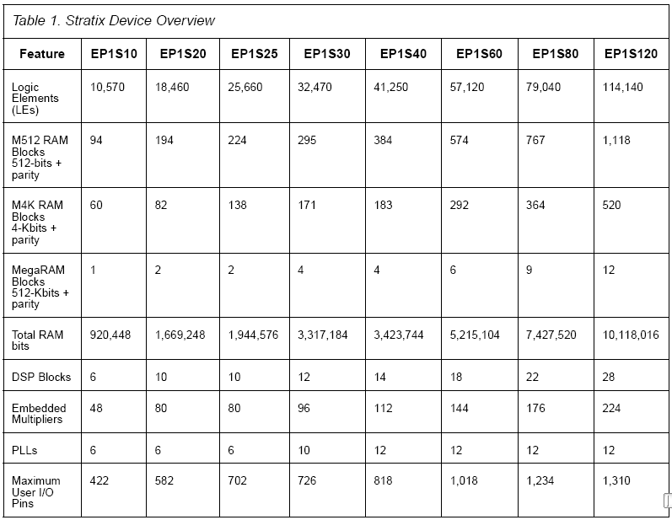
FPGA概述
Microelectronics School Xidian University

Slide 3
可编程逻辑器件的自顶向下设计方法
系统设计
系统验证
算法设计
算法验证
可综合的设计
RTL设计
RTL验证
EDA工具辅助完成
逻辑综合
结构综合
后仿真
编程数据下载
硬件验证

Slide 4




开发软件：集成开发环境
这类软件都是由PLD芯片厂家提供，基本都可以完成所有的设计输入（原理图或HDL)，综合，仿真，布局布线，下载等工作。
Altera公司上一代PLD开发软件，使用者众多。目前Altera已经停止开发MaxplusII，而转向QuartusII软件平台。
Altera公司新一代PLD开发软件，适合大规模FPGA的开发。
Xilinx公司上一代的PLD开发软件，目前Xilinx已经停止开发Foundation，而转向ISE软件平台。
Xilinx公司目前的PLD开发软件。

Slide 5
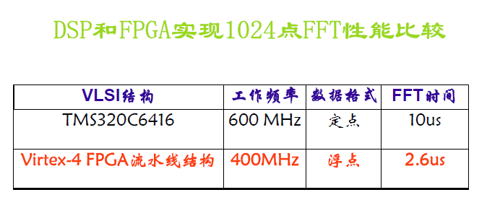
为什么要采用FPGA
FPGA主要用于固定的、运算量大的数值计算和控制

Slide 6

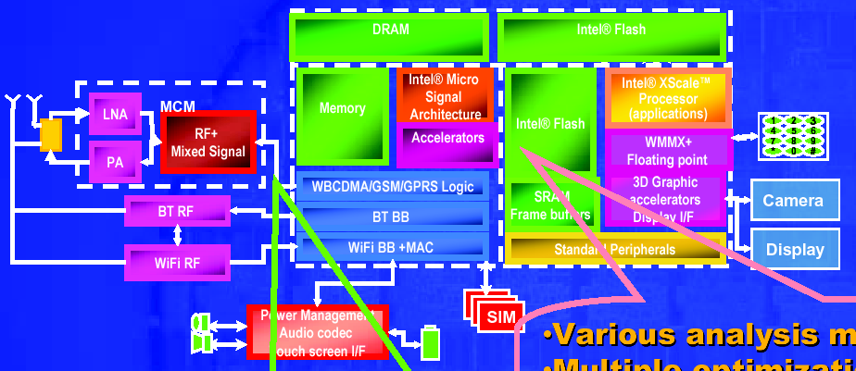
FPGA设计结构
Microelectronics School Xidian University

Slide 7
FPGA设计方法
原理图方法
硬件描述语言方法
IP设计和使用
Microelectronics School Xidian University

Slide 8
硬件描述语言设计方法
Microelectronics School Xidian University

Slide 9
第14章 Verilog HDL数字逻辑电路设计方法
1 Verilog HDL 语言的设计思想和可综合特性
用Verilog HDL设计模256（8bits）计数器
（b）常见的错误描述方式
module counter (count,clk,reset);
output count;
input reset,clk;
reg [7:0] count;
reg out;
integer i;
always @(posedge clk,reset)
begin
if (!reset) count<=0;
else
for (i=0;i<=255;i=i+1)
count<=count+1;
end
endmodule
（a）可综合程序描述方式
module counter (count,clk,reset);
output count;
input clk,reset;
reg [7:0] count;
reg out;
always @(posedge clk)
if (!reset) count<=0;
else if (count==8'b11111111) count<=0;
else count<=count+1;
endmodule

Slide 10
Verilog HDL的电路描述方式具有多样性
例2: 用Verilog HDL设计数字多路选择器
（b）采用逻辑表达式形式
module MUX (out,data,sel);
output out;
input [3:0] data;
input [1:0] sel;
wire w1,w2,w3,w4;
assign w1=(~sel[1])&(~sel[0])&data[0];
assign w2=(~sel[1])&sel[0]&data[1];
assign w3=sel[1]&(~sel[0])&data[2];
assign w4=sel[1]&sel[0]&data[3];
assign out=w1|w2|w3|w4;
endmodule
（c）采用结构性描述
module MUX (out,data,sel);
output out;
input [3:0] data;
input [1:0] sel;
wire w1,w2,w3,w4;
not
U1 (w1,sel[1]);
U2 (w2,sel[0]);
and
U3 (w3,w1,w2,data[0]);
U4 (w4,w1,sel[0],data[1]);
U5 (w5,sel[1],w2,data[2]);
U6 (w6,sel[1],sel[0],data[3]);
or
U7 (out,w3,w4,w5,w6);
endmodule
（a）采用真值表形式
module MUX (out,data,sel);
output out;
input [3:0] data;
input [1:0] sel;
reg out;
always @(data or sel)
case (sel)
2'b00 : out<=data[0];
2'b01 : out<=data[1];
2'b10 : out<=data[2];
2'b11 : out<=data[3];
endcase
endmodule

Slide 11
Verilog HDL组合电路设计
描述组合逻辑电路有四种方式：结构描述、逻辑代数、真值表、抽象描述。采用Verilog HDL进行组合逻辑电路设计主要采用这几种方式。
例3：设计一个3个裁判的表决电路，当两个或两个以上裁判同意时，判决器输出“1”，否则输出“0”。
module desingn (OUT,A,B,C);
output OUT;
input A,B,C;
reg OUT;
always @(A or B or C)
case ({A,B,C})
3'b000 : OUT<=0;
3'b001 : OUT<=0;
3'b010 : OUT<=0;
3'b100 : OUT<=0;
3'b011 : OUT<=1;
3'b101 : OUT<=1;
3'b110 : OUT<=1;
3'b111 : OUT<=1;
endcase
endmodule
方法1：真值表方式
真值表
A | B | C | OUT
0 | 0 | 0 | 0
0 | 0 | 1 | 0
0 | 1 | 0 | 0
1 | 0 | 0 | 0
0 | 1 | 1 | 1
1 | 0 | 1 | 1
1 | 1 | 0 | 1
1 | 1 | 1 | 1

Slide 12
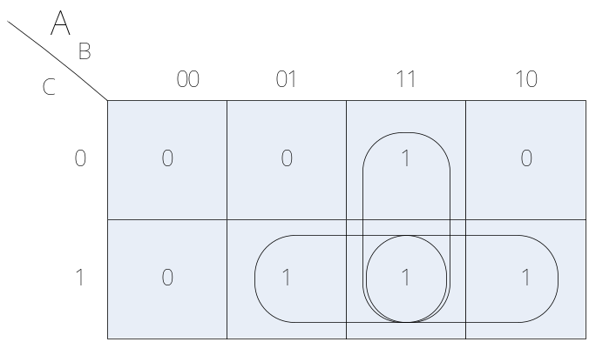
方法2：逻辑代数方式
module desingn (OUT,A,B,C);
output OUT;
input A,B,C;
assign OUT=(A&B)|(B&C)|(A&C);
endmodule
卡诺图

Slide 13
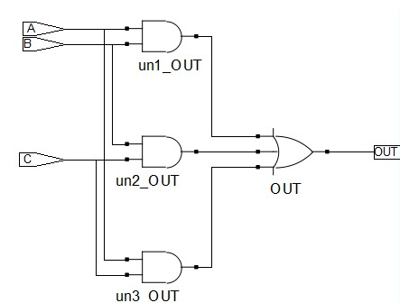
方法3：结构描述方式
module desingn (OUT,A,B,C);
output OUT;
input A,B,C;
and U1 (w1,A,B);
and U2 (w2,B,C);
and U3 (w3,A,C);
or U4 (OUT,w1,w2,w3);
endmodule

Slide 14
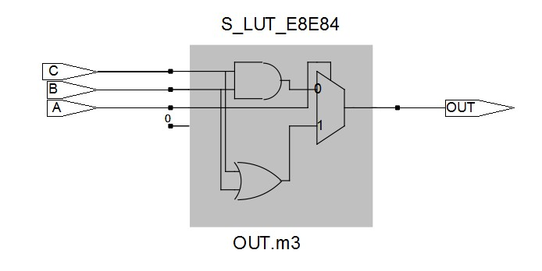
方法4：抽象描述方式
module desingn (OUT,A,B,C);
output OUT;
input A,B,C;
wire [1:0] sum;
reg OUT;
assign sum=A+B+C;
always @(sum)
if (sum>1) OUT=1;
else OUT=0;
endmodule
综合优化后电路

Slide 15
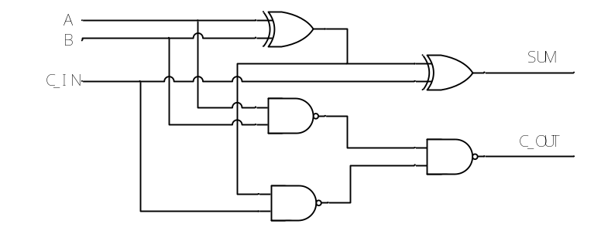
数字加法器
2输入1bit信号全加器
A | B | C_IN | SUM | C_OUT
0 | 0 | 0 | 0 | 0
0 | 0 | 1 | 1 | 0
0 | 1 | 0 | 1 | 0
0 | 1 | 1 | 0 | 1
1 | 0 | 0 | 1 | 0
1 | 0 | 1 | 0 | 1
1 | 1 | 0 | 0 | 1
1 | 1 | 1 | 1 | 1
SUM=A⊕B⊕C_IN
C_OUT=

Slide 16
（1）利用连续赋值语句实现
module one_bit_fulladder ( SUM, C_OUT, A, B, C_IN );
input A, B, C_IN;
output SUM, C_OUT;
assign SUM=(A^B)^C_IN;
assign C_OUT=(A&B)|((A^B)&C_IN); //function of output
endmodule
（2）利用行为描述实现
module one_bit_fulladder ( SUM, C_OUT, A, B, C_IN );
output SUM, C_OUT;
input A, B, C_IN;
assign {C_OUT,SUM}=A+B+C_IN;
endmodule

Slide 17
2输入8bits加法器
module eight_bit_fulladder ( SUM, C_OUT, A, B, C_IN );
output[7:0] SUM;
output C_OUT;
input [7:0] A, B;
input C_IN;
assign {C_OUT,SUM}=A+B+C_IN;
endmodule

Slide 18
数据比较器
4位数值比较器
输入 |  |  |  |  |  |  | 输出
A₃ B₃ | A₂ B₂ | A₁ B₁ | A₀ B₀ | C_{A>B} | C_{A=B} | C_{A<B} | F_{A>B} | F_{A=B} | F_{A<B}
A₃>B₃ | x x | x x | x x | x | x | x | 1 | 0 | 0
A₃<B₃ | x x | x x | x x | x | x | x | 0 | 0 | 1
A₃=B₃ | A₂>B₂ | x x | x x | x | x | x | 1 | 0 | 0
A₃=B₃ | A₂<B₂ | x x | x x | x | x | x | 0 | 0 | 1
A₃=B₃ | A₂=B₂ | A₁>B₁ | x x | x | x | x | 1 | 0 | 0
A₃=B₃ | A₂=B₂ | A₁<B₁ | x x | x | x | x | 0 | 0 | 1
A₃=B₃ | A₂=B₂ | A₁=B₁ | A₀>B₀ | x | x | x | 1 | 0 | 0
A₃=B₃ | A₂=B₂ | A₁=B₁ | A₀<B₀ | x | x | x | 0 | 0 | 1
A₃=B₃ | A₂=B₂ | A₁=B₁ | A₀=B₀ | C_{A>B} | C_{A=B} | C_{A<B} | C_{A>B} | C_{A=B} | C_{A<B}

Slide 19
module four_bits_comp1 ( F, A, B, C );
parameter comp_width=4;
output [2:0] F;
input [2:0] C;
input [comp_width-1:0] A;
input [comp_width-1:0] B;
reg [2:0] F;
always @(A or B or C)
if (A>B) F=3'b100;
else if (A<B) F=3'b001;
else F=C;
endmodule
Microelectronics School Xidian University

Slide 20
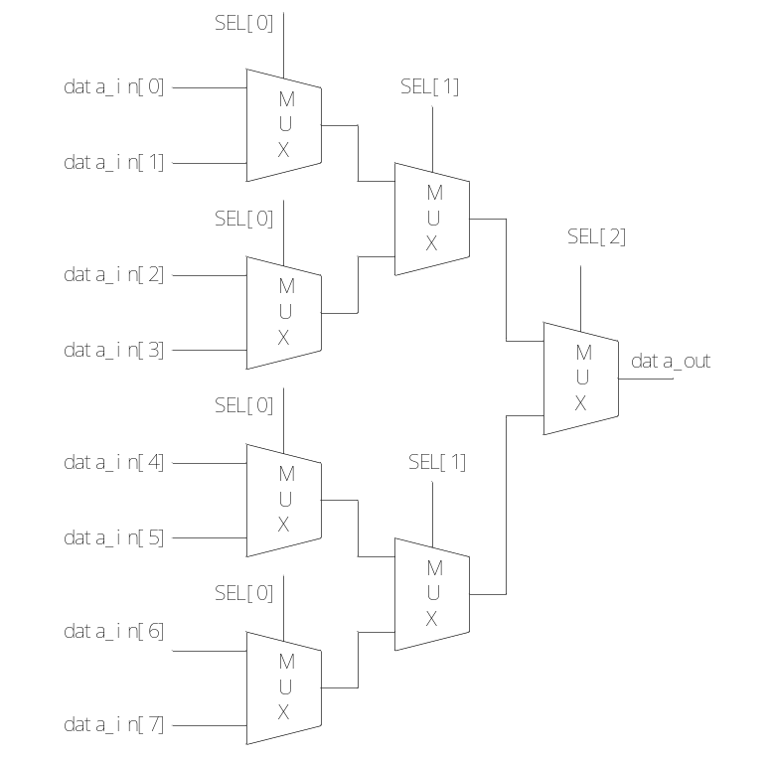
数据数据选择器
8选1数据选择器
（1）多个2选1数据选择器的结构级描述
module mux8to1_2( d_out, d_in, sel );
output d_out;
input [7:0] d_in;
input [2:0] sel;
wire[3:0] w1;
wire[1:0] w2;
assign w1=sel[0]? {d_in[7],d_in[5],d_in[3],d_in[1]} :{d_in[6],d_in[4],d_in[2],d_in[0]};
assign w2=sel[1]? {w1[3],w1[1]} :{w1[2],w1[0]};
assign d_out=sel[2]?w2[1]:w2[0];
endmodule

Slide 21
（2）抽象描述方式
module mux8to1 (out,sel,data_in);
output out;
input [7:0] data_in;
input [3:0] sel;
reg out;
always @ (data_in or sel)
case (sel)
3'b000 : out<=data_in[0];
3'b001 : out<=data_in[1];
3'b010 : out<=data_in[2];
3'b011 : out<=data_in[3];
3'b100 : out<=data_in[4];
3'b101 : out<=data_in[5];
3'b110 : out<=data_in[6];
3'b111 : out<=data_in[7];
endcase
endmodule
Microelectronics School Xidian University

Slide 22
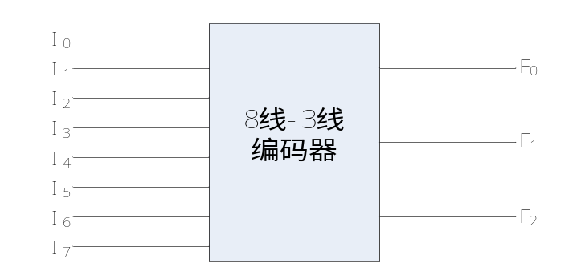
数字编码器
3位二进制8-3线编码器
输入 |  |  |  |  |  |  |  | 输出
I₀ | I₁ | I₂ | I₃ | I₄ | I₅ | I₆ | I₇ | F₂ | F₁ | F₀
1 | 0 | 0 | 0 | 0 | 0 | 0 | 0 | 0 | 0 | 0
0 | 1 | 0 | 0 | 0 | 0 | 0 | 0 | 0 | 0 | 1
0 | 0 | 1 | 0 | 0 | 0 | 0 | 0 | 0 | 1 | 0
0 | 0 | 0 | 1 | 0 | 0 | 0 | 0 | 0 | 1 | 1
0 | 0 | 0 | 0 | 1 | 0 | 0 | 0 | 1 | 0 | 0
0 | 0 | 0 | 0 | 0 | 1 | 0 | 0 | 1 | 0 | 1
0 | 0 | 0 | 0 | 0 | 0 | 1 | 0 | 1 | 1 | 0
0 | 0 | 0 | 0 | 0 | 0 | 0 | 1 | 1 | 1 | 1

Slide 23
module code_8to3 (F,I);
output [2:0] F;
input [7:0] I;
reg [2:0] F;
always @ (I)
case (I)
8'b00000001: F=3'b000;
8'b00000010: F=3'b001;
8'b00000100: F=3'b010;
8'b00001000: F=3'b011;
8'b00010000: F=3'b100;
8'b00100000: F=3'b101;
8'b01000000: F=3'b110;
8'b10000000: F=3'b111;
default : F=3'bx;
endcase
endmodule
Microelectronics School Xidian University

Slide 24
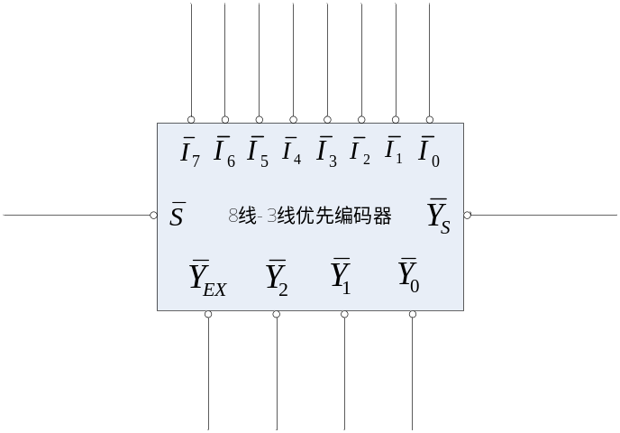
数字编码器
8线—3线优先编码器
输 入 |  |  |  |  |  |  |  |  | 输 出
1 | x | x | x | x | X | x | x | x | 1 | 1 | 1 | 1 | 1
0 | x | x | x | x | X | x | x | 0 | 0 | 0 | 0 | 1 | 0
0 | x | x | x | x | X | x | 0 | 1 | 0 | 0 | 1 | 1 | 0
0 | x | x | x | x | X | 0 | 1 | 1 | 0 | 1 | 0 | 1 | 0
0 | x | x | x | x | 0 | 1 | 1 | 1 | 0 | 1 | 1 | 1 | 0
0 | x | x | x | 0 | 1 | 1 | 1 | 1 | 1 | 0 | 0 | 1 | 0
0 | x | x | 0 | 1 | 1 | 1 | 1 | 1 | 1 | 0 | 1 | 1 | 0
0 | x | 0 | 1 | 1 | 1 | 1 | 1 | 1 | 1 | 1 | 0 | 1 | 0
0 | 0 | 1 | 1 | 1 | 1 | 1 | 1 | 1 | 1 | 1 | 1 | 1 | 0
0 | 1 | 1 | 1 | 1 | 1 | 1 | 1 | 1 | 1 | 1 | 1 | 0 | 1

Slide 25
module mux8to3_p ( data_out, Ys, Yex, sel, data_in );
output [2:0] data_out;
output Ys, Yex;
input [7:0] data_in;
input sel;
reg [2:0] data_out;
reg Ys,Yex;
always @ (data_in or sel)
if (sel) {data_out, Ys, Yex} ={3'b111,1'b1,1'b1};
else
begin
casex (data_in)
8'b0??????? : {data_out, Ys, Yex} ={3'b000,1'b1,1'b0};
8'b10?????? : {data_out, Ys, Yex} ={3'b001,1'b1,1'b0};
8'b110????? : {data_out, Ys, Yex} ={3'b010,1'b1,1'b0};
8'b1110???? : {data_out, Ys, Yex}={3'b011,1'b1,1'b0};
8'b11110??? : {data_out, Ys, Yex}={3'b100,1'b1,1'b0};
8'b111110?? : {data_out, Ys, Yex}={3'b101,1'b1,1'b0};
8'b1111110? : {data_out, Ys, Yex}={3'b110,1'b1,1'b0};
8'b11111110 : {data_out, Ys, Yex}={3'b111,1'b1,1'b0};
8'b11111111 : {data_out, Ys, Yex}={3'b111,1'b0,1'b1};
endcase
end
endmodule
Microelectronics School Xidian University

Slide 26
数字编码器
module BCD8421 ( data_out, data_in );
output [3:0] data_out;
input [8:0] data_in;
reg [3:0] data_out;
always @ (data_in)
case (data_in)
9'b000000000 : data_out=4'b0000;
9'b000000001 : data_out=4'b0001;
9'b000000010 : data_out=4'b0010;
9'b000000100 : data_out=4'b0011;
9'b000001000 : data_out=4'b0100;
9'b000010000 : data_out=4'b0101;
9'b000100000 : data_out=4'b0110;
9'b001000000 : data_out=4'b0111;
9'b010000000 : data_out=4'b1000;
9'b100000000 : data_out=4'b1001;
default : data_out=4'b0000;
endcase
endmodule
二进制转化十进制8421BCD编码器
十进制数 | D | C | B | A
0（Y₀） | 0 | 0 | 0 | 0
1（Y₁） | 0 | 0 | 0 | 1
2（Y₂） | 0 | 0 | 1 | 0
3（Y₃） | 0 | 0 | 1 | 1
4（Y₄） | 0 | 1 | 0 | 0
5（Y₅） | 0 | 1 | 0 | 1
6（Y₆） | 0 | 1 | 1 | 0
7（Y₇） | 0 | 1 | 1 | 1
8（Y₈） | 1 | 0 | 0 | 0
9（Y₉） | 1 | 0 | 0 | 1

Slide 27
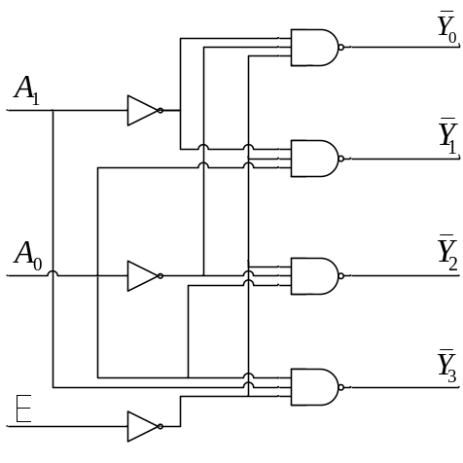
数字译码器
2线—4线译码器
E | A₁ | A₂
1 | X | X | 1 | 1 | 1 | 1
0 | 0 | 0 | 0 | 1 | 1 | 1
0 | 0 | 1 | 1 | 0 | 1 | 1
0 | 1 | 0 | 1 | 1 | 0 | 1
0 | 1 | 1 | 1 | 1 | 1 | 0
Microelectronics School Xidian University

Slide 28
module decode_2to4 ( Y, E, A );
output [3:0] Y;
input [1:0] A;
input E;
reg [3:0] Y;
always @(E or A)
case ({E,A})
3'b1?? : Y=4'b0000;
3'b000 : Y=4'b0001;
3'b001 : Y=4'b0010;
3'b010 : Y=4'b0100;
3'b011 : Y=4'b1000;
default : Y=4'b0000;
endcase
endmodule
module decode_2to4 ( Y, E, A );
output [3:0] Y;
input [1:0] A;
input E;
assign Y[0]=~(~E&~A[1]&~A[0]);
assign Y[1]=~(~E&~A[1]&A[0]);
assign Y[2]=~(~E&A[1]&~A[0]);
assign Y[3]=~(~E&A[1]&A[0]);
endmodule
Microelectronics School Xidian University

Slide 29
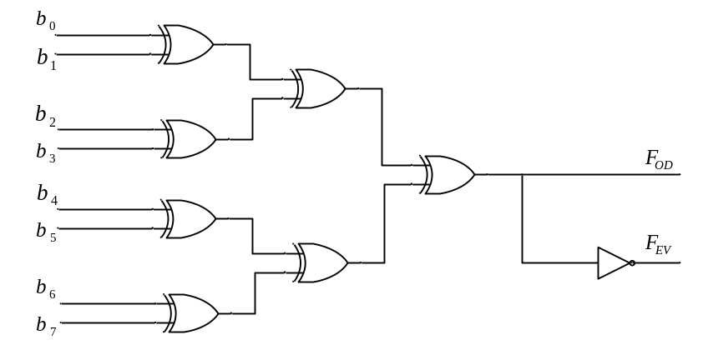
奇偶校验器
8bits奇偶校验器
采用奇校验检测“1100111”，数据包含5个“1”，校验位为“0”，校验器的输入b₀~b₇为“11001110” F_{OD}=1，F_{EV}=0。
module checker (Fod,Fev,b);
output Fod,Fev;
input [7:0] b;
wire w1,w2,w3,w4,w5,w6;
xor U1 (w1,b[0],b[1]);
xor U2 (w2,b[2],b[3]);
xor U3 (w3,b[4],b[5]);
xor U4 (w4,b[6],b[7]);
xor U5 (w5,w1,w2);
xor U6 (w6,w3,w4);
xor U7 (Fod,w5,w6);
not U8 (Fev,Fod);
endmodule
Microelectronics School Xidian University

Slide 30
module checker (Fod,Fev,b);
output Fod,Fev;
input [7:0] b;
assign Fod=^b;
assign Fev=^~Fod;
endmodule
Microelectronics School Xidian University

Slide 31
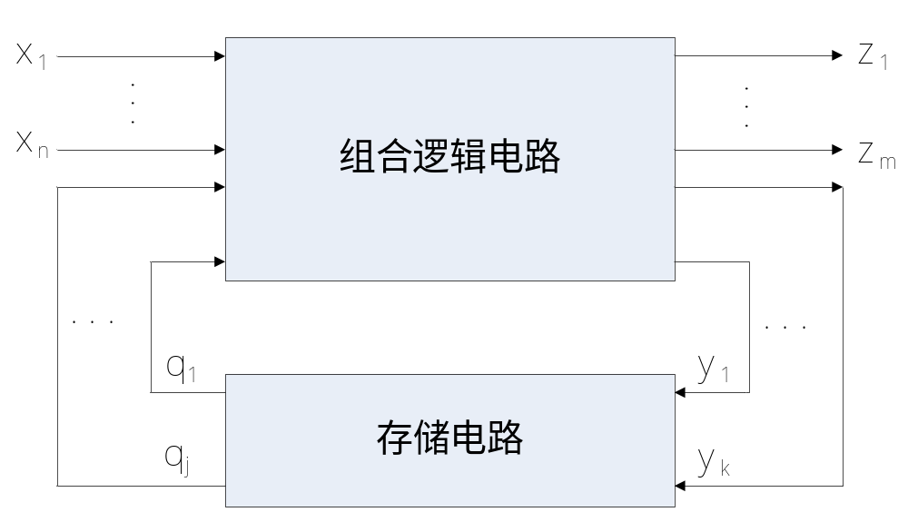
时序电路设计
时序逻辑电路的结构框图
Microelectronics School Xidian University

Slide 32
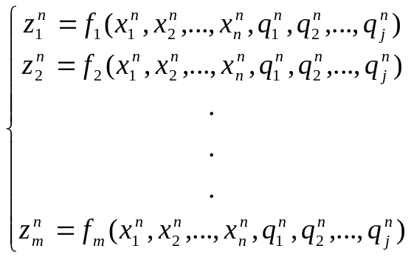
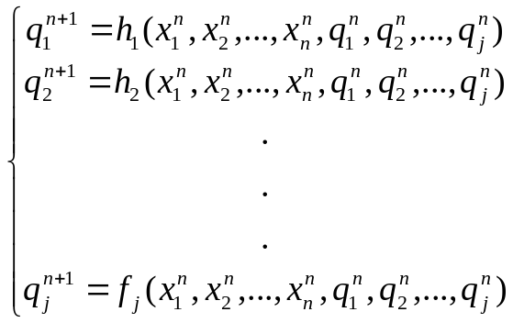
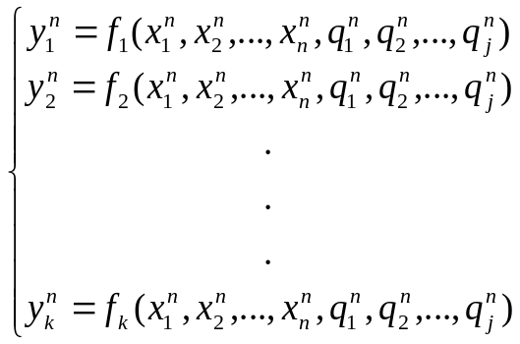
输出方程
状态方程
驱动方程
Microelectronics School Xidian University

Slide 33
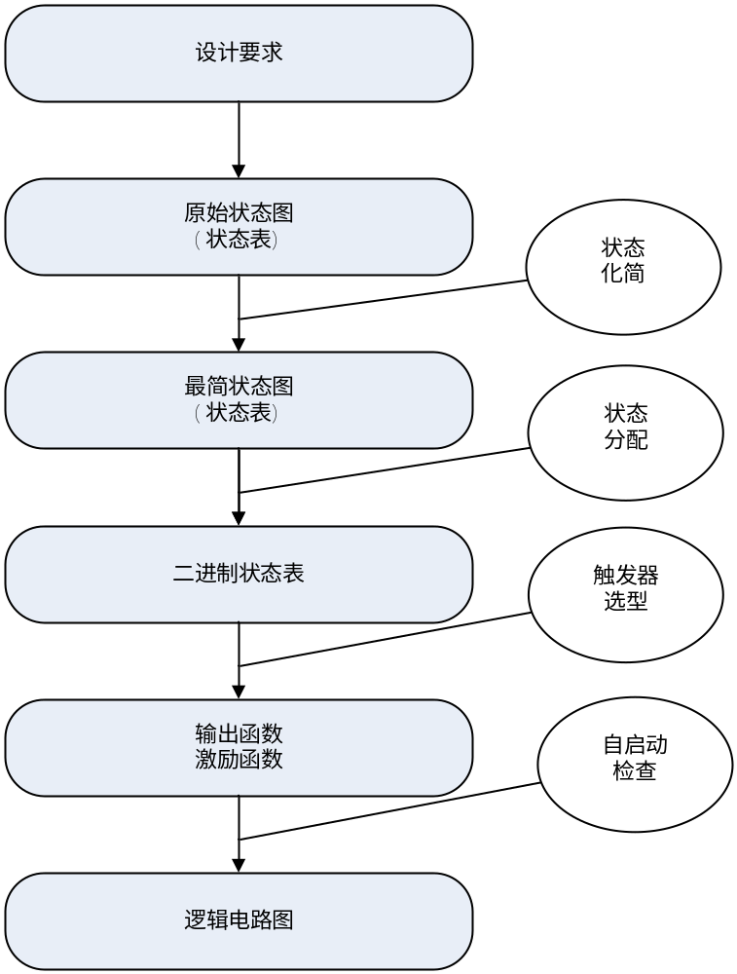
同步时序电路设计流程
对于时序电路的功能描述主要有三种方式：
（1）逻辑方程；
（2）状态转移表和状态转移图；
（3）时序图。
采用Verilog HDL对时序电路进行设计的描述也有不同的方式，归纳起来主要有三种方式：
（1）状态转移图描述；
（2）基于状态化简的结构性描述；
（3）Verilog HDL抽象描述。
Microelectronics School Xidian University

Slide 34
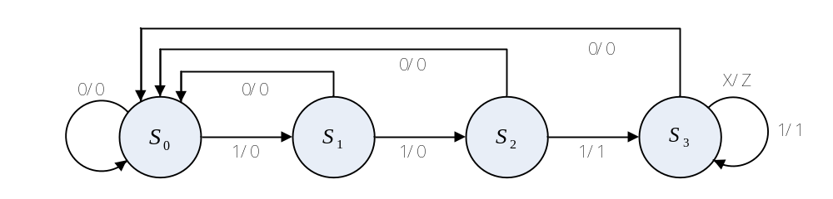
例4.3-1：用Verilog HDL设计一个“111”的序列检测器，当输入三个或三个以上“1”时，电路输出为1，否则为0。
（1）状态转移图方法
Microelectronics School Xidian University

Slide 35
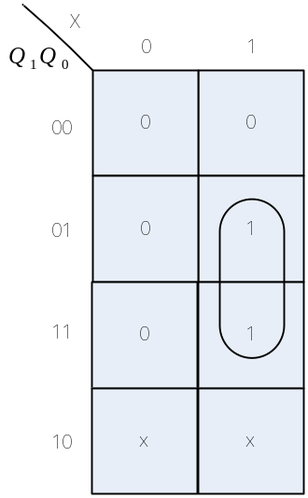
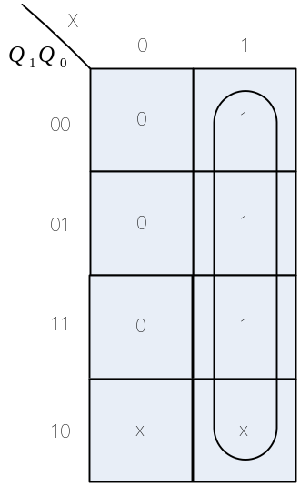
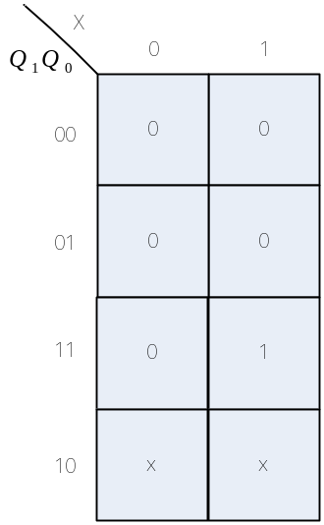
（2）基于状态化简的结构性描述方法
Q₁^{n+1}=Q
Q₀^{n+1}=X
Z=Q₁Q₀X
（a） （b） （c）
Microelectronics School Xidian University

Slide 36
module checker (z,x,clk);
output z;
input x,clk;
wire w1,w2;
DFF U1 (.clk(clk),.D(x),.Q(w1));
DFF U2 (.clk(clk),.D(w1),.Q(w2));
assign z=x & w1 & w2;
Endmodule
//D触发器模块
module DFF (Q,D,clk);
output Q;
input D,clk;
reg Q;
always @(posedge clk) Q<=D;
endmodule
Microelectronics School Xidian University

Slide 37
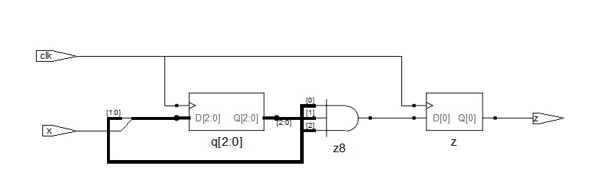
（3）Verilog HDL 抽象性描述方法
module checker (z,x,clk);
output z;
input x,clk;
reg [2:0] q;
reg z;
always @(posedge clk) q<={q[1:0],x};
always @(posedge clk)
if (q==3'b111) z=1;
else z=0;
endmodule
Microelectronics School Xidian University

Slide 38
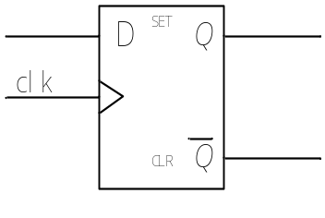
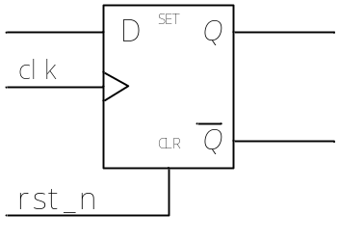
触发器
module DFF ( q, clk, data_in );
output q;
input clk, data_in;
reg q;
always @(posedge clk) q<=data_in;
endmodule
最简D触发器
module DFF_rst ( q, clk, rst_n, data_in );
output q;
input clk, rst_n, data_in;
reg q;
always @(posedge clk)
if (!rst_n) q<=0;
else q<=data_in;
endmodule
同步清0的D触发器
module DFF_srst ( q, clk, rst_n, data_in, );
output q;
input clk, rst_n, data_in;
reg q;
always @(posedge clk or rst_n)
if (!rst_n) q<=0;
else q<=data_in;
endmodule
异步清0的D触发器
Microelectronics School Xidian University

Slide 39
步清零、置1和异步清零、置1共同在一个触发器上的复杂D触发器
module DFF_1 ( q, qb, clk, rst_n1, set1, rst_n2, set2, data_in, );
output q,qb;
input clk, rst_n1,rst_n2, set1,set2, data_in;
reg q,qb;
always @(posedge clk)
if (!rst_n1) q<=0;
else q<=data_in;
always @(posedge clk or rst_n2)
if (!rst_n2) q<=0;
else q<=data_in;
endmodule
Microelectronics School Xidian University

Slide 40
T触发器
module TFF ( data_out, T, clk, rst_n );
output data_out;
input T,clk, rst_n;
reg data_out;
always @(posedge clk or rst_n)
if (!rst_n) data_out<=1'b0;
else if (T) data_out<=~data_out;
endmodule
Microelectronics School Xidian University

Slide 41
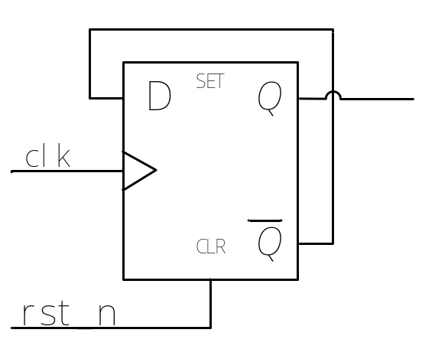
计数器
2进制的计数器
module comp2bit ( Q, clk, rst_n);
output Q;
input clk, rst_n;
reg Q;
always @ (posedge clk or rst_n)
if (!rst_n)
Q<=1'b0;
else
Q<= ~Q;
endmodule
Microelectronics School Xidian University

Slide 42
任意模值的计数器
模11计数器
module comp_11 ( count, clk, rst );
output [3:0] count;
input clk,rst;
reg [3:0] count;
always @ (posedge clk)
if (rst) count<=4'b0000;
else
if (count==4'b 1010)
count<=1'b0;
else
count<=count+1;
endmodule
Microelectronics School Xidian University

Slide 43
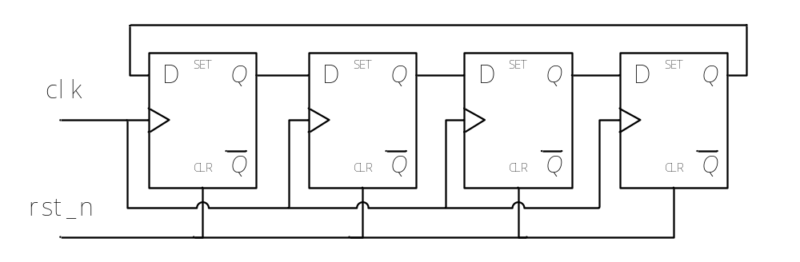
移位寄存器
环形移位寄存器
module shiftregist1 (D,clk,rst_n);
parameter shiftregist_width=4;
output [shiftregist_width-1:0] D;
input clk,rst_n;
reg [shiftregist_width-1:0] D;
always @(posedge clk)
if (!rst_n)
D<=4'b0000;
else
D<={D[shiftregist_width-2:0],D[shiftregist_width-1] };
endmodule
Microelectronics School Xidian University

Slide 44
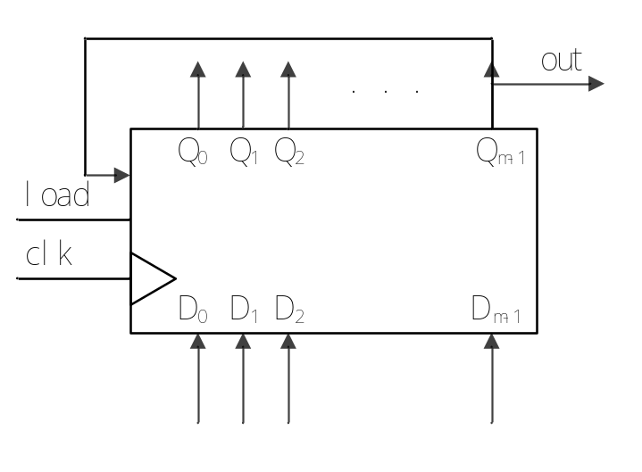
序列信号发生器
例4.3-9:用Verilog HDL设计一个产生10011序列的信号发生器
方法（1）：由移位寄存器构成
module signal_maker(out,clk,load,D);
parameter M=6;
output out;
input clk,load;
input [M-1:0] D;
reg [M-1:0] Q;
initial Q=6'b10011;
always @( posedge clk)
if (load) Q<=D;
else Q<={Q[M-2:0],Q[M-1]};
assign out=Q[M];
endmodule
Microelectronics School Xidian University

Slide 45
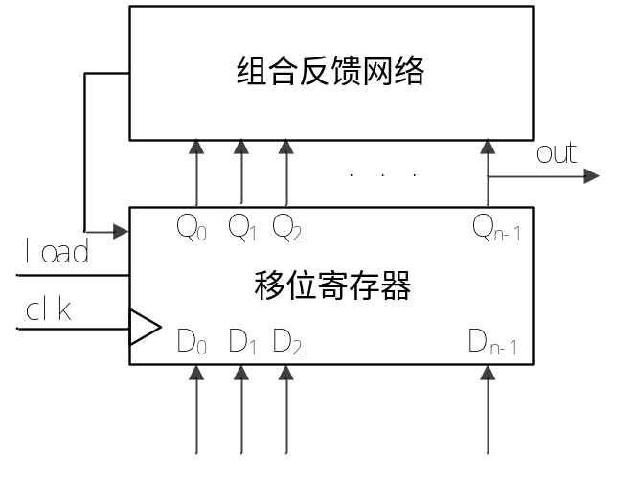
方法（2）：由移位寄存器和组合逻辑电路构成
module signal_maker( OUT,clk,load,D );
parameter M=4;
output OUT;
input clk,load;
input [M-1:0] D;
reg [M-1:0] Q;
wire w1;
always @( posedge clk) //时序电路部分，移位寄存器
if (load) Q<=D;
else Q<={Q[M-2:0],w1};
assign w1=(~Q[0])|((~Q[0])&Q[3]); //组合逻辑电路，反馈网络
assign OUT=Q[M];
endmodule
Microelectronics School Xidian University

Slide 46
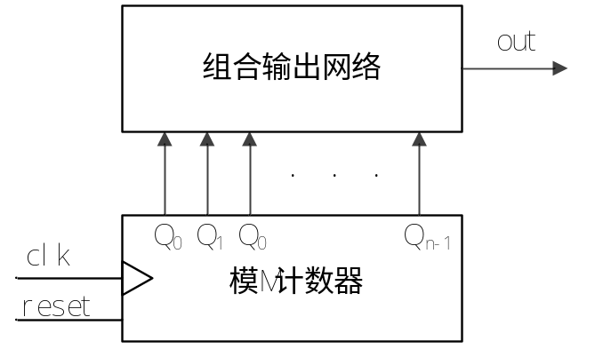
方法（3）：由计数器构成
输出组合逻辑真值表
Q₂ | Q₁ | Q₀ | OUT
0 | 0 | 0 | 1
0 | 0 | 1 | 0
0 | 1 | 0 | 0
0 | 1 | 1 | 1
1 | 0 | 0 | 1
1 | 0 | 1 | 1
Microelectronics School Xidian University

Slide 47
module signal_maker( OUT, clk,reset );
parameter M=3;
output OUT;
input clk,reset;
reg [M-1:0] counter;
always @(posedge clk)
if (!reset) counter<=3'b000;
else counter<=counter+1;
assign OUT=counter[2]|((~counter[1])&(~counter[0]))|(counter[1]&counter[0]);
endmodule
Microelectronics School Xidian University

Slide 48
例4.3-10:用Verilog HDL设计伪随机码发生器
m序列反馈函数表
例如N=4，则反馈函数如下：
N | F
1 | 0
2 | 1，0
3 | 1，0
4 | 1，0
5 | 2，0
6 | 1，0
7 | 1，0
在15位最长线性序列移存型计数器中，有一个由“0000”构成的死循环，为了打破死循环，可以修改式为
Microelectronics School Xidian University

Slide 49
module signal15 ( out, clk, load_n, D_load );
output out;
input load_n,clk;
input [3:0] D_load;
reg [3:0] Q;
wire F;
always @(posedge clk)
if (~load_n) Q<=D_load;
else Q<={Q[2:0],F};
assign F=(Q[1]^Q[0])|(~Q[3]&~Q[2]&~Q[1]&~Q[0]);
assign out=Q[3];
endmodule
Microelectronics School Xidian University

Slide 50
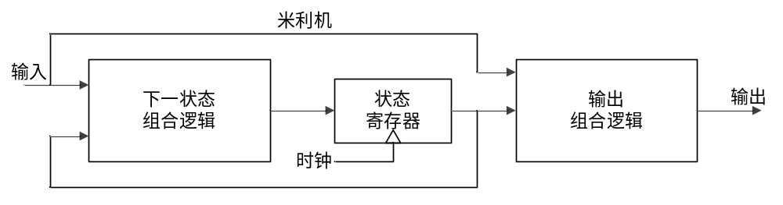
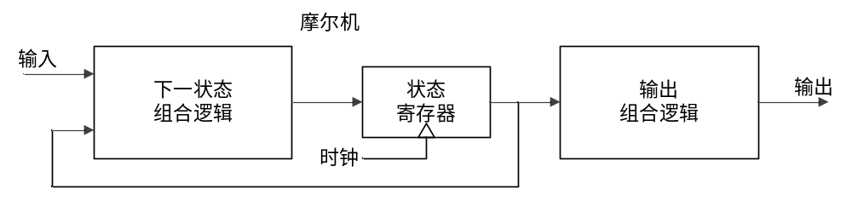
有限同步状态机
Mealy型状态机结构图
Moore型状态机结构图
Microelectronics School Xidian University

Slide 51
状态机编码方式很多，由此产生的电路也不相同，常见的编码方式有三种：二进制编码、格雷编码和一位独热编码。
（1）二进制编码：状态寄存器是由触发器组成的。N个触发器可以构成2^{n}个状态。二进制编码的优点是使用的触发器个数较少，节省资源；缺点是状态跳转时可能有多个bit位同时变化，引起毛刺，造成逻辑错误。
（2）格雷编码：格雷编码和二进制编码类似。格雷编码状态跳转时只有一个bit位发生变化，减少了产生毛刺和一些暂态的可能。
（3）One hot编码：是对于n个状态采用n个bit位来编码，每个状态编码中只有一个bit位为1，如：0001，0010，0100，1000。One hot编码增加了使用触发器的个数，但是这种编码方便译码，可以有效地节省和化简组合电路。
Microelectronics School Xidian University

Slide 52
状态机两段式描述方式
//第一个进程，同步时序always模块，格式化描述次态寄存器迁移到现态寄存器
always @ (posedge clk or negedge rst_n) //异步复位
if(!rst_n) current_state <= IDLE;
else current_state <= next_state;//注意，使用的是非阻塞赋值
//第二个进程，组合逻辑always模块，描述状态转移条件判断
always @ (current_state) //电平触发
begin
next_state = x; //要初始化，使得系统复位后能进入正确的状态
case(current_state)
S1: if(...)
next_state = S2; //阻塞赋值
out1 <= 1'b1; //注意是非阻塞逻辑
...
endcase
end
Microelectronics School Xidian University

Slide 53
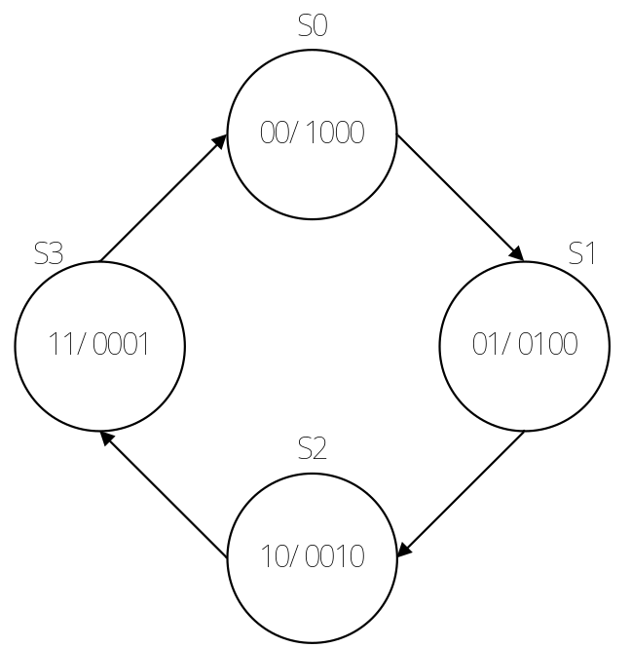
例4.4-1:用Verilog HDL设计顺序脉冲发生器
always @(STATE)
case (STATE)
2'b00:
begin
OUT<=4'b1000;
next_STATE<=2'b01;
end
2'b01:
begin
OUT<=4'b0100;
next_STATE<=2'b10;
end
2'b10:
begin
OUT<=4'b0010;
next_STATE<=2'b11;
end
2'b11:
begin
OUT<=4'b0001;
next_STATE<=2'b00;
end
endcase
endmodule
module state4 ( OUT, clk );
output [3:0] OUT;
input clk;
reg [3:0] OUT;
reg [1:0] STATE, next_STATE;
always @(posedge clk)
STATE<=next_STATE;
Microelectronics School Xidian University

Slide 54
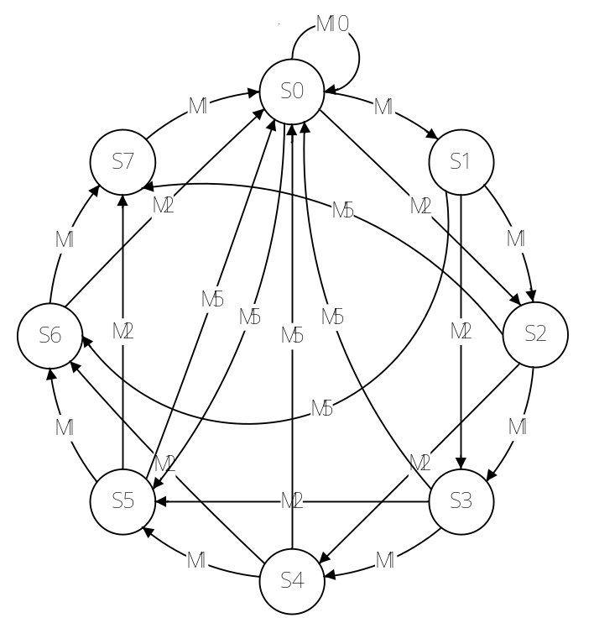
例4.4-2:设计一个卖报机，报纸价钱八角，纸币有1角，2角，5角，一元。该卖报机不考虑投币为大额面值等特殊情况。
Microelectronics School Xidian University

Slide 55
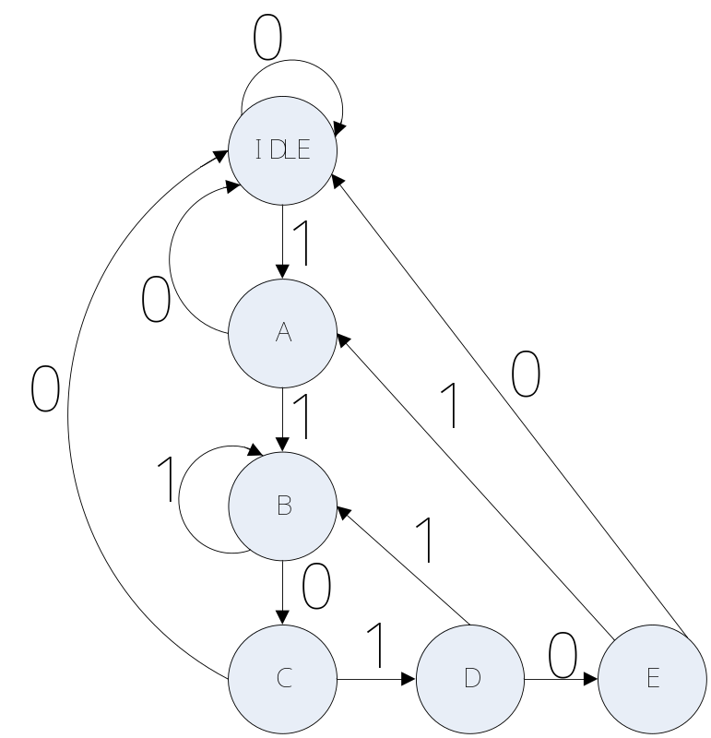
例4.4-3: “11010”序列检测器
Microelectronics School Xidian University

Slide 56
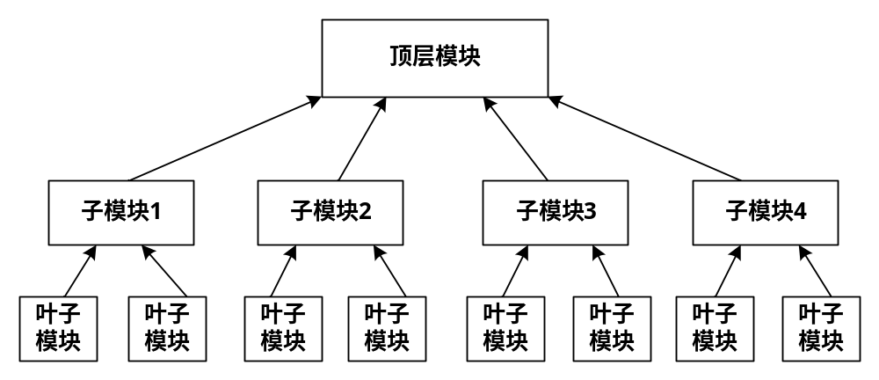
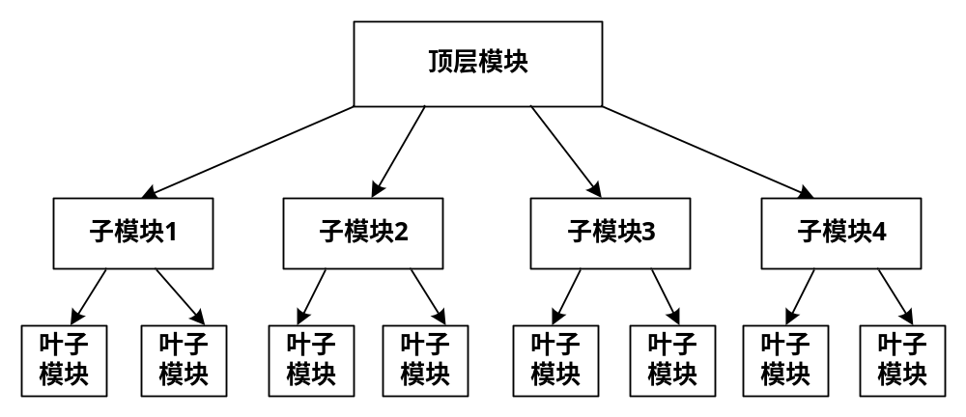
Verilog HDL高级程序设计举例
数字电路系统设计的层次化描述方法
Bottom-Up设计方法
Up-Bottom设计方法
Microelectronics School Xidian University

Slide 57
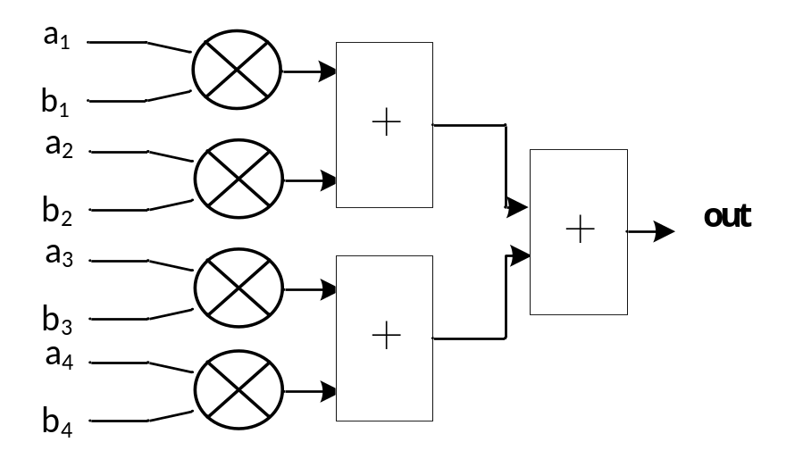

采用模块层次化设计方法，设计4维向量点积乘法器，其中向量a=（a₁，a₂，a₃，a₄）；b=（b₁，b₂，b₃，b₄）。
Microelectronics School Xidian University

Slide 58
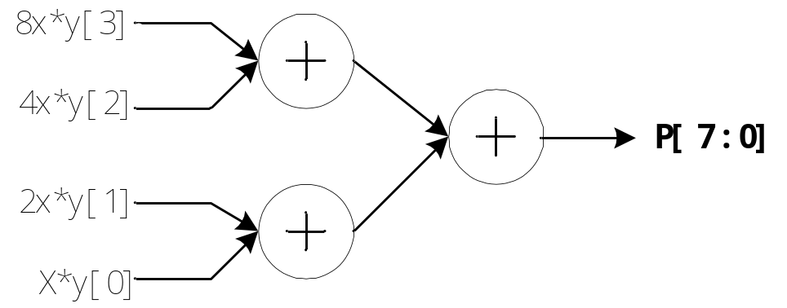
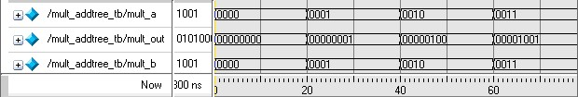
加法器树乘法器
用Verilog HDL设计一个加法器树4位乘法器
Microelectronics School Xidian University

Slide 59
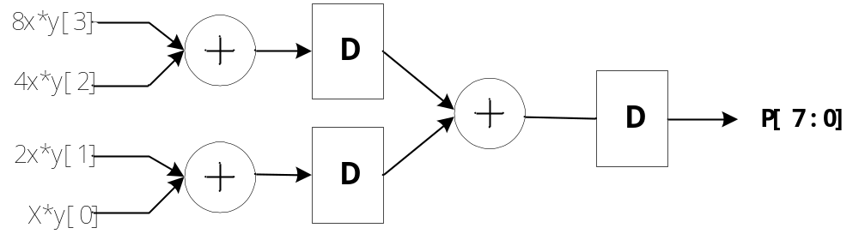
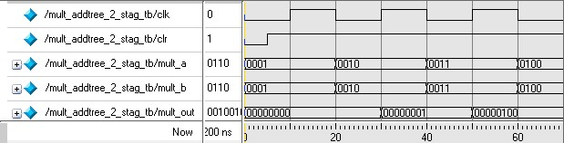
用Verilog HDL设计一个2级流水线加法器树4位乘法器。
Microelectronics School Xidian University

Slide 60
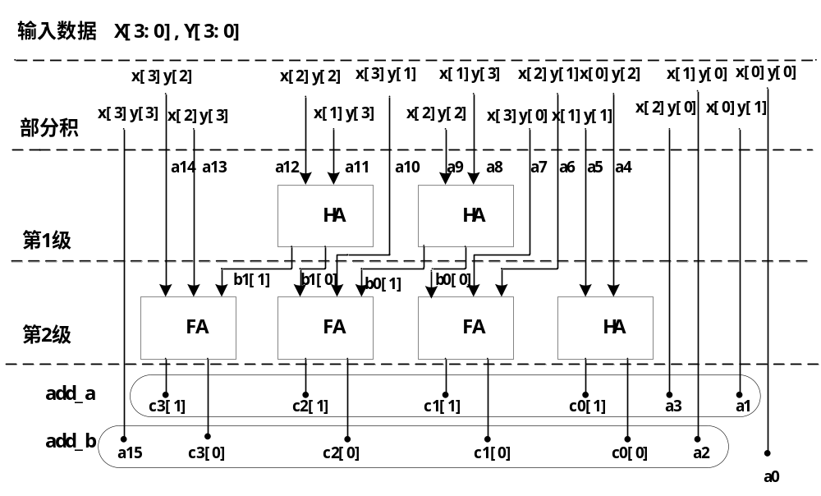
Wallace 树乘法器
Microelectronics School Xidian University

Slide 61
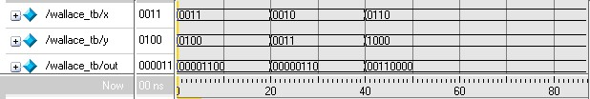
Microelectronics School Xidian University

Slide 62

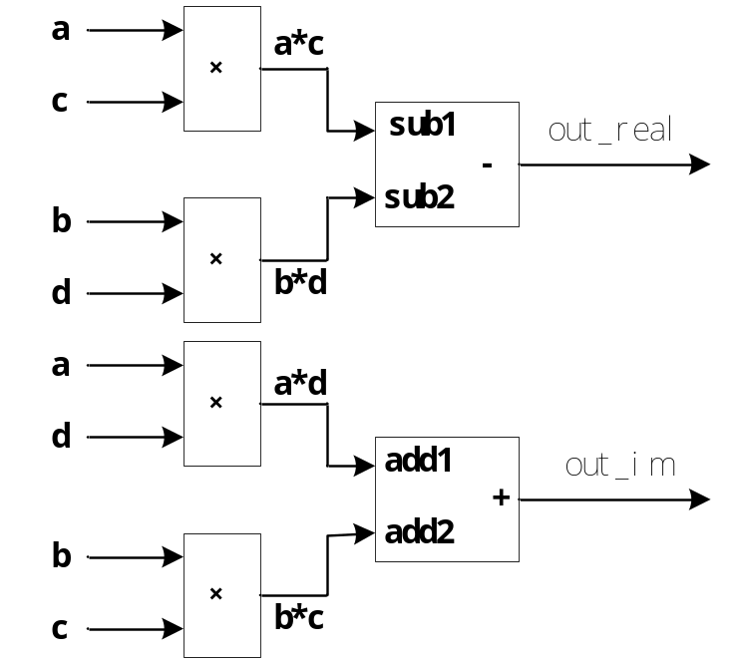
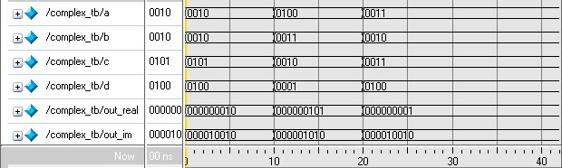
复数乘法器
Microelectronics School Xidian University

Slide 63

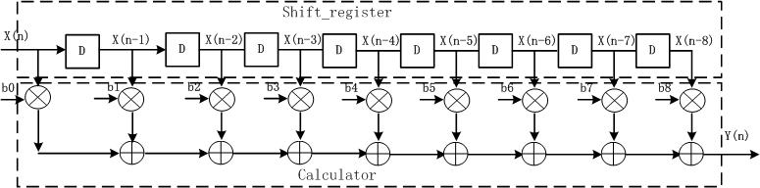
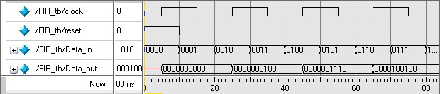
FIR滤波器设计
Microelectronics School Xidian University

Slide 64
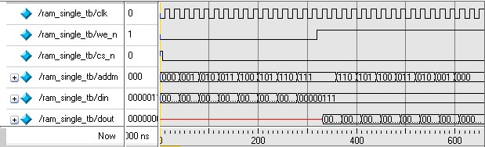
片内存储器的设计
用Verilog HDL设计深度为256，位宽为8的单端口RAM。
Microelectronics School Xidian University

Slide 65
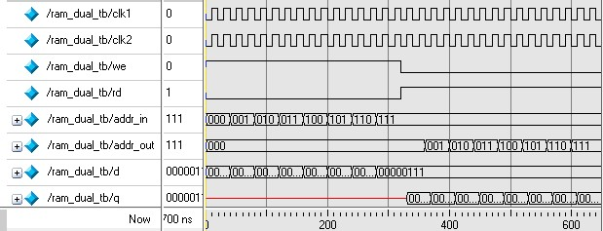
用Verilog HDL设计深度为256，位宽为8的双端口RAM
Microelectronics School Xidian University

Slide 66
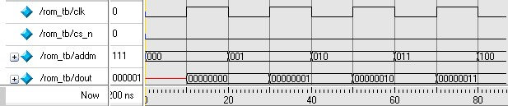
用Verilog HDL设计深度为8，位宽为8的ROM
Microelectronics School Xidian University

Slide 67

键盘扫描和编码器
Microelectronics School Xidian University

Slide 68

Microelectronics School Xidian University

Slide 69


log函数的Verilog HDL设计
用Verilog HDL设计采用查找表方式的log函数，输入信号位宽4bits，输出信号位宽8bits
输入数据 | 运算结果
1000 | 00000000
1001 | 00000111
1010 | 00001110
1011 | 00010101
1100 | 00011001
1101 | 00100000
1110 | 00100100
1111 | 00101000
Microelectronics School Xidian University

Slide 70



UART接口控制器
Microelectronics School Xidian University

Slide 71

FPGA中的IP
Microelectronics School Xidian University

Slide 72
Altera PLL 与 Xilinx DLL 的区别
PLL：Phase Lock Loop，锁相环，是模拟电路；
DLL：Delay Lock Loop，延时锁定环，是纯数字电路，通过内部的延时模块来调节相位。
二者各有优缺点，一般来说，DLL使用简单，在对时钟要求不是很高时，做时钟管理比较方便，PLL的锁相输出时钟质量要高一些。
Microelectronics School Xidian University

Slide 73

锁相环特性
Notes:
Clock Multiplication & Division
Each Stratix device enhanced PLL provides clock synthesis for PLL output ports using m/(n × post-scale counter) scaling factors. The input clock is divided by a pre-scale divider, n, and is then multiplied by the m feedback factor. The control loop drives the VCO to match fIN × (m/n). Each output port has a unique post-scale counter that divides down the high- frequency VCO. For multiple PLL outputs with different frequencies, the VCO is set to the least common multiple of the output frequencies that meets its frequency specifications. Then, the post-scale dividers scale down the output frequency for each output port. For example, if output frequencies required from one PLL are 33 and 66 MHz, set the VCO to 330 MHz (the least common multiple in the VCO’s range). There is one pre-scale counter, n, and one multiply counter, m, per PLL, with a range of 1 to 512 on each. There are two post- cale counters (l) for regional clock output ports, four counters (g) for global clock output ports, and up to four counters (e) for external clock outputs, all ranging from 1 to 1024 with a 50% duty cycle setting. The post-scale counters range from 1 to 512 with any non-50% duty cycle setting. The Quartus II software automatically chooses the appropriate scaling factors according to the input frequency, multiplication, and division values entered.
Clock Switchover
To effectively develop high-reliability network systems, clocking schemes must support multiple clocks to provide redundancy. For this reason, Stratix device enhanced PLLs support a flexible clock switchover capability. The switchover circuit is configurable, so you can define how to implement it. Clock-sense circuitry automatically switches from the primary to secondary clock for PLL reference when the primary clock signal is not present.
PLL Reconfiguration
The PLL reconfiguration feature enables system logic to change Stratix device enhanced PLL counters and delay elements without reloading a Programmer Object File (.pof). This provides considerable flexibility for frequency synthesis, allowing real-time PLL frequency and output clock delay variation. You can sweep the PLL output frequencies and clock delay in prototype environments. The PLL reconfiguration feature can also dynamically or intelligently control system clock speeds or tCO delays in end systems.
Clock delay elements at each PLL output port implement variable delay. The configuration time is less than 20 μs for the enhanced PLL using a input shift clock rate of 22 MHz. The charge pump, loop filter components, and phase shifting using VCO phase taps cannot be dynamically adjusted.
PLL reconfiguration data is shifted into serial registers from the logic array or external devices. The PLL input shift data uses a reference input shift clock. Once the last bit of the serial chain is clocked in, the register chain is synchronously loaded into the PLL configuration bits. The shift circuitry also provides an asynchronous clear for the serial registers.
Lock Detect
The lock output indicates that there is a stable clock output signal in phase with the reference clock. Without any additional circuitry, the lock signal may toggle as the PLL begins tracking the reference clock. You may need to gate the lock signal for use as a system control. The lock signal from the locked port can drive the logic array or an output pin. Whenever the PLL loses lock (for example, inclk jitter, clock switchover, PLL reconfiguration, power supply noise, and so on), the PLL must be reset with the areset signal to guarantee correct phase relationship between the PLL output clocks. If the phase relationship between the input clock versus output clock, and between different output clocks from the PLL is not important in the design, then the PLL need not be reset.
Phase & Delay Shifting
Stratix device enhanced PLLs provide advanced programmable phase and clock delay shifting. These parameters are set in the Quartus II software.
Phase Delay
The Quartus II software automatically sets the phase taps and counter settings according to the phase shift entry. You enter a desired phase shift and the Quartus II software automatically sets the closest setting achievable. This type of phase shift is not reconfigurable during system operation. For phase shifting, enter a phase shift (in degrees or time units) for each PLL clock output port or for all outputs together in one shift. You can select phase-shifting values in time units with a resolution of 156.25 to 416.66 ps. This resolution is a function of frequency input and the multiplication and division factors (that is, it is a function of the VCO period), with the finest step being equal to an eighth (×0.125) of the VCO period. Each clock output counter can choose a different phase of the VCO period from up to eight taps for individual fine step selection. Also, each clock output counter can use a unique initial count setting to achieve individual coarse shift selection in steps of one VCO period. The combination of coarse and fine shifts allows phase shifting for the entire input clock period.
The equation to determine the precision of the phase shifting in degrees is: 45° ÷ post-scale counter value. Therefore, the maximum step size is 45° , and smaller steps are possible depending on the multiplication and division ratio necessary on the output counter port.
This type of phase shift provides the highest precision since it is the least sensitive to process, supply, and temperature variation.
Clock Delay
In addition to the phase shift feature, the ability to fine tune the Δt clock delay provides advanced time delay shift control on each of the four PLL outputs. There are time delays for each post-scale counter (e, g, or l) from the PLL, the n counter, and m counter. Each of these can shift in 250-ps increments for a range of 3.0 ns. The m delay shifts all outputs earlier in time, while n delay shifts all outputs later in time. Individual delays on post-scale counters (e, g, and l) provide positive delay for each output. Table 2–21 shows the combined delay for each output for normal or zero delay buffer mode where Δte, Δtg, or Δtl is unique for each PLL output.
The tOUTPUT for a single output can range from –3 ns to +6 ns. The total delay shift difference between any two PLL outputs, however, must be less than ±3 ns. For example, shifts on two outputs of –1 and +2 ns is allowed, but not –1 and +2.5 ns because these shifts would result in a difference of 3.5 ns. If the design uses external feedback, the Δte delay will remove delay from outputs, represented by a negative sign (see Table 2–21). This effect occurs because the Δte delay is then part of the feedback loop.
The variation due to process, voltage, and temperature is about ±15% on the delay settings. PLL reconfiguration can control the clock delay shift elements, but not the VCO phase shift multiplexers, during system operation.
Programmable Duty Cycle
The programmable duty cycle allows enhanced PLLs to generate clock outputs with a variable duty cycle. This feature is supported on each enhanced PLL post-scale counter (g0..g3, l0..l3, e0..e3). The duty cycle setting is achieved by a low and high time count setting for the post-scale dividers. The Quartus II software uses the frequency input and the required multiply or divide rate to determine the duty cycle choices.

Slide 74

混合时钟模式：Independent Clock Mode
在真双口模式下，A、B两端口可以使用不同的时钟。
Notes:
Independent Clock Mode
The TriMatrix memory blocks can implement independent clock mode for true dual-port memory. In this mode, a separate clock is available for each port (A and B). Clock A controls all registers on the port A side, while clock B controls all registers on the port B side. Each port also supports independent clock enables and asynchronous clear signals for port A and B registers.

Slide 75

混合时钟模式：Input/Output Clock Mode
在真双口模式及简单双口模式下，输入、输出可以使用不同的时钟。
真双口输入输出时钟模式
Notes:
Input/Output Clock Mode
The TriMatrix memory blocks can implement input/output clock mode for true and simple dual-port memory. On each of the two ports, A and B, one clock controls all registers for inputs into the memory block: data input, wren, and address. The other clock controls the block’s data output registers. Each memory block port also supports independent clock enables and asynchronous clear signals for input and output registers.

Slide 76

混合时钟模式：Input/Output Clock Mode
简单双口输入输出时钟模式

Slide 77

混合时钟模式：Read/Write Clock Mode
在简单双口模式下，读、写操作可以使用不同的时钟。
Notes:
Read/Write Clock Mode
The TriMatrix memory blocks can implement read/write clock mode for simple dual-port memory. This mode can use up to two clocks. The write clock controls the block’s data inputs, wraddress, and wren. The read clock controls the data output, rdaddress, and rden. The memory blocks support independent clock enables for each clock and asynchronous clear signals for the read- and write-side registers.

Slide 78
中断控制
接口电路设计
Microelectronics School Xidian University

