Slide 1
Flow Processing
Future Internet Communications Technologies
Prof. Dr. Panagiotis Papadimitriou

Slide 2
Outline
Flow Processing
Flow Processing on Commodity Hardware
Programmable Switches
Accelerated Software Routers
Distributed Flow Processing
In-Network Processing

Slide 3
Flow Processing

Slide 4
Flow Processing with Middleboxes
The Internet infrastructure includes a large number of “appliances”, known as middleboxes, with flow processing functionalities at layers L3–L7:
  Intrusion detection
  Intrusion inspection
  Encryption
  Access control
  Filtering
  Measurement and logging
  Application acceleration
Some routers also have packet processing capabilities (besides IPv4 forwarding) and can be used for flow processing

Slide 5



Middlebox Deployment Example
Private network with 2 middleboxes:
  Firewall: permits/filters flows according to security policy
  Load balancer: balances traffic across servers
Internet
Firewall
Load balancer

Slide 6
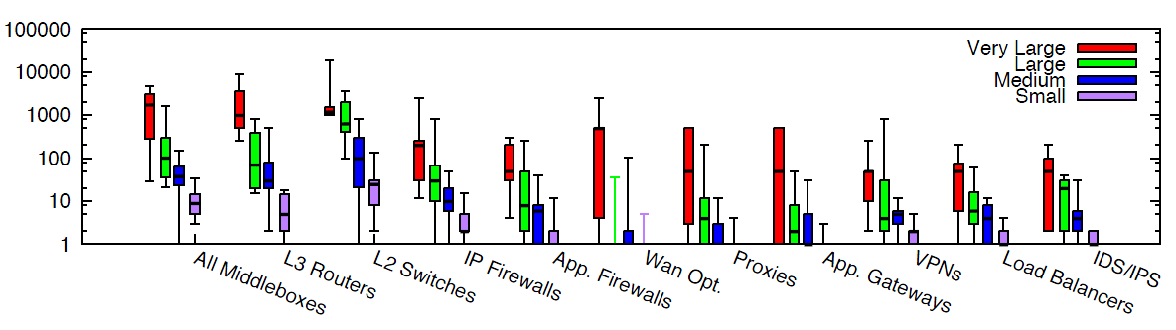
Statistics of Middlebox Deployments
Enterprise networks:
  Small: < 1k hosts
  Medium: 1k-10k hosts
  Large: 10k-100k hosts
  Very large: > 100k hosts
J. Sherry and S. Ratnasamy, “A Survey of Enterprise Middlebox Deployments”, 2012

Slide 7
Flow Processing
Flow processing may require “deep-packet inspection” (DPI):
  Many middleboxes examine the packet payload
IP routers examine only the IP header of the packet
DPI is computationally intensive:
  encryption (AES)
  intrusion detection
IP Header | Payload
IP Header | Payload

Slide 8

What is a Network Flow?
How can a network flow be defined?
  Naive definition: The sequence of packets from a source to a destination
  However, multiple streams or connections can be established between a given pair of end-points
    How can these streams/connections be distinguished as separate flows?

Slide 9
Defining Flows (1)
A flow can be identified by combinations of the following:
  Transport layer:
    Source / destination port
    Protocol (TCP or UDP)
  Network layer:
    Source / destination IP address

Slide 10
Defining Flows (2)
Transport Protocol:
UDP
TCP
Port Numbers:
(SP: 8080, DP: 8100)
(SP: 1010, DP: 7603)

Slide 11
Defining Flows (3)
IP Addresses:
(SA: 10.10.10.1, DA: 20.20.20.1)
(SA: 10.10.10.2, DA: 20.20.20.2)
10.10.10.1
20.20.20.1
10.10.10.2
20.20.20.2

Slide 12
Defining Flows (4)
In many cases, flows are identified based on the 5-tuple:
  Source IP address
  Destination IP address
  Source Port
  Destination Port
  Protocol (TCP or UDP)

Slide 13
Flow Processing on Commodity Hardware

Slide 14
Limitations of Flow Processing with Middleboxes
Middleboxes are built of special-purpose hardware and lack:
  Programmability
  Extensibility for future network services
The deployment of a new network service or application might require some new functionality:
  Existing middleboxes cannot be extended/upgraded to support additional processing operations
  Additional middleboxes may have to be deployed in the network
  The deployment cost of new middleboxes is substantial
  This costly upgrade may discourage an ISP from offering new services, despite potential user demand

Slide 15
Flow Processing on Commodity Hardware (1)
Commodity servers can be used as a platform for flow processing
Middleboxes built of commodity hardware are:
  Extensible
  Inexpensive
Commodity servers can achieve high-performance with computational-/memory-intensive traffic workloads, exploiting:
  Multi-core CPUs
  Large caches
  Faster interconnects (PCIe bus)
  GPUs that provide a large number of (small) cores and higher memory bandwidth
    Very efficient for parallelizable packet processing

Slide 16
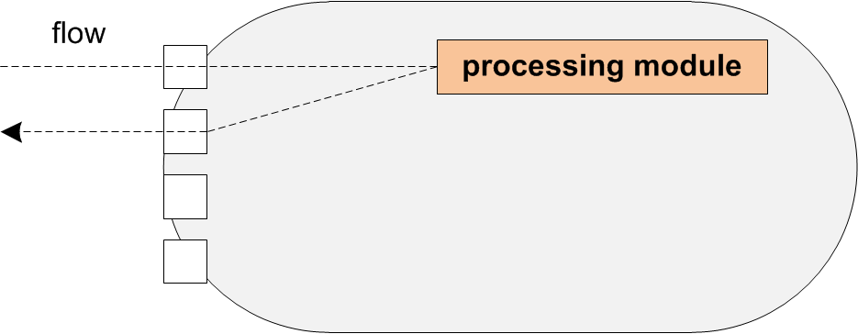
Flow Processing on Commodity Hardware (2)
The processing module provides a packet processing function, e.g.:
  encryption
  packet filtering
  load balancing
  intrusion detection
  intrusion prevention

Slide 17
Flow Processing Software
Click Modular Router
  Plenty of available packet processing elements
  Extensible
  Multi-core
Snort
  Multi-mode packet analysis tool
    3 operational modes: Sniffer, packet logger and intrusion detection
  Widely used for intrusion detection and prevention
  Packet capture using the “libpcap” library
  Logging and real-time alerting for traffic that matches given rules or patterns

Slide 18
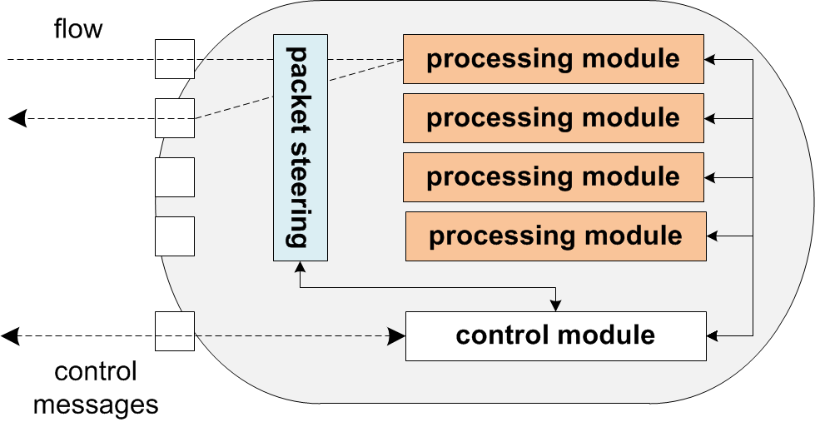
Flow Processing on Commodity Hardware
The abundance of CPU resources and server virtualization technologies can turn a commodity server into a multi-purpose flow processing platform:
  Consolidation of multiple processing modules using virtualization
  A control module is responsible for:
    Managing processing modules (i.e., instantiation, configuration termination)
    Resource monitoring (e.g. CPU load)
Resource isolation is required for processing modules
Admission control can be employed to reject flow processing requests when resources are no longer available

Slide 19
Programmable Switches

Slide 20
Programmable Switches
Recent trends in switching hardware allow the modification of the switch control software:
  Much flexibility within data-centers and enterprise networks
    Easier to apply network configurations and policies (e.g., traffic redirection)
  Innovation in smaller (e.g. campus) networks (e.g., OpenFlow):
    Experimentation within the production network
    Administrators can configure the switch to separate the production from the experimental flows
    Users can control their own flows

Slide 21
OpenFlow
  Separation of control and data plane
  OpenFlow exposes an API to control how packets are forwarded
  OpenFlow is already adopted by many vendors (e.g., HP, NEC)
OpenFlow Controller
OpenFlow Protocol (SSL/TCP)
Control Path
Control Path
OpenFlow
SW Layer
HW Layer
Data Path
Data Path
Ethernet Switch
OpenFlow Switch

Slide 22
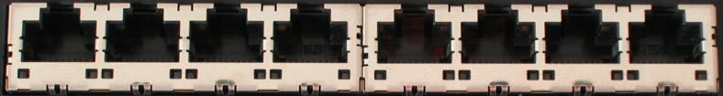
Flow Table Abstraction
OpenFlow Controller
SW Layer
OpenFlow Firmware
Input Port | VLAN ID | Ethernet |  |  | IP |  |  | TCP |  | Action
 |  | Src | Dst | Type | Src | Dst | Proto | Src | Dst
* | * | * | * | * | * | 5.1.1.6 | * | * | * | port 1
* | * | * | * | * | * | * | * | * | 80 | port 4
HW Layer

Slide 23
Flow Entry Operations and Supported Actions
Flows entry operations:
  Add
  Modify
  Remove
Supported actions:
  Forward to one or more output ports
  Encapsulate and send to the controller (typical action for the 1st packet of a new flow)
  Drop

Slide 24
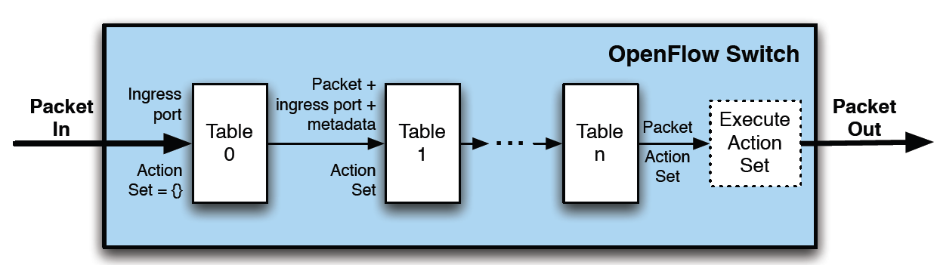
Latest OpenFlow Specification (v1.2)
New features:
  Multiple flow tables
  User-defined matching (masking)
  MPLS
  Time-to-Live (TTL)

Slide 25
Flow Control Examples
Switching:
IP Routing:
Firewall:
Input Port | VLAN ID | Ethernet |  |  | IP |  |  | TCP |  | Action
 |  | Src | Dst | Type | Src | Dst | Proto | Src | Dst
* | * | * | 1D-6.. | * | * | * | * | * | * | port 3
Input Port | VLAN ID | Ethernet |  |  | IP |  |  | TCP |  | Action
 |  | Src | Dst | Type | Src | Dst | Proto | Src | Dst
* | * | * | * | * | * | 5.1.1.6 | * | * | * | port 1
Input Port | VLAN ID | Ethernet |  |  | IP |  |  | TCP |  | Action
 |  | Src | Dst | Type | Src | Dst | Proto | Src | Dst
* | * | * | * | * | * | * | * | * | 22 | drop

Slide 26


Flow Rerouting with OpenFlow
IP: 8.1.1.5
Port: 1050
OF Controller
1
OF Switch
2
3
Input Port | VLAN ID | Ethernet |  |  | IP |  |  | TCP |  | Action
 |  | Src | Dst | Type | Src | Dst | Proto | Src | Dst
* | * | * | * | * | 8.1.1.5 | * | * | 1050 | * | port 2

Slide 27
Flow Rerouting with OpenFlow
IP: 8.1.1.5
Port: 1050
OF Controller
1
OF Switch
2
3
Input Port | VLAN ID | Ethernet |  |  | IP |  |  | TCP |  | Action
 |  | Src | Dst | Type | Src | Dst | Proto | Src | Dst

Slide 28
Flow Rerouting with OpenFlow
IP: 8.1.1.5
Port: 1050
OF Controller
1
OF Switch
2
3
Input Port | VLAN ID | Ethernet |  |  | IP |  |  | TCP |  | Action
 |  | Src | Dst | Type | Src | Dst | Proto | Src | Dst
* | * | * | * | * | 8.1.1.5 | * | * | 1050 | * | port 3

Slide 29





Software-Defined Network (SDN)
Centralized control
Network-wide visibility
Control functions (e.g., routing, access control) in software
  Easy deployment of updates
Network abstraction
  Faster development cycles
Controller
OpenFlow
Switch
OpenFlow
Protocol
OpenFlow
Switch
OpenFlow
Switch

Slide 30
SDN Abstraction
How can access control be easily configured?

Slide 31
SDN Abstraction
How can access control be easily configured?
Abstract network view

Slide 32

Slicing OpenFlow
Controller C
Controller B
Flow Table
Controller A
Flow Table
Flow Table
OpenFlow Switch

Slide 33
Slicing OpenFlow Networks with FlowVisor (1)
FlowVisor is a versatile solution for slicing OpenFlow
FlowVisor acts as a proxy between the switch and the controller, offering:
  Flow table isolation
  Switch CPU isolation
  Control message filtering and rewriting
Controller
FlowVisor
OpenFlow
Protocol
OpenFlow
Switch

Slide 34
Slicing OpenFlow Networks with FlowVisor (2)
Controller A
Controller B
Controller C
OpenFlow
Protocol
OpenFlow
Switch
FlowVisor
OpenFlow
Protocol
OpenFlow
Switch
OpenFlow
Switch

Slide 35
Slicing OpenFlow Networks with FlowVisor (2)
Controller A
Controller B
Controller C
OpenFlow
Protocol
OpenFlow
Switch
FlowVisor
Packet is sent only to controller C, because this flow is owned by the controller C’s operator
OpenFlow
Protocol
OpenFlow
Switch
OpenFlow
Switch
Packet

Slide 36
Slicing OpenFlow Networks with FlowVisor (2)
Controller A
Controller B
Controller C
OpenFlow
Protocol
OpenFlow
Switch
FlowVisor
OpenFlow
Protocol
OpenFlow
Switch
OpenFlow
Switch

Slide 37
Slicing OpenFlow Networks with FlowVisor (2)
Controller A
Controller B
Controller C
Entry
OpenFlow
Protocol
OpenFlow
Switch
FlowVisor
Controller C is permitted to install a new flow entry
OpenFlow
Protocol
OpenFlow
Switch
OpenFlow
Switch

Slide 38
Accelerated Software Routers

Slide 39
Towards High-Performance Programmable Routers
Requirements for high-performance programmable software routers:
  Control plane:
    Extensibility
  Forwarding plane:
    Performance
    Programmability
    High port density
Software routers on commodity servers:
  Programmability
  Respectable packet forwarding performance
  Limited port density
  Insufficient packet forwarding rates for the Internet core (≥ 40 Gbps)

Slide 40
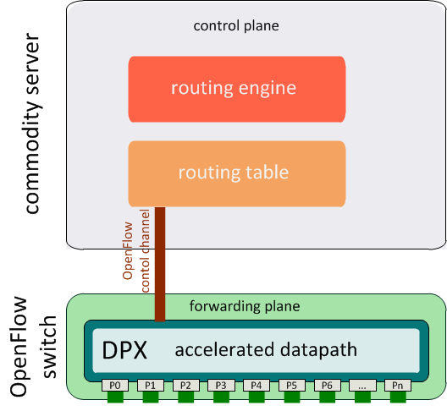
Accelerating Software Routers (1)
A commodity server does not satisfy the requirements for the forwarding plane
How about using an OpenFlow switch for packet forwarding:
  OpenFlow offers:
    Programmability
    High port density
    Packet forwarding at line rates

Slide 41
Accelerating Software Routers (2)
  Main idea:
    Packet forwarding in the OpenFlow switch
      Forwarding table stored in the switch flow table (i.e., as flow entries)
    Control plane (routing protocols and routing table) hosted on a commodity server
    Routing table is copied to the switch flow table
    Routing updates received and processed by the control plane trigger the corresponding switch flow table updates

Slide 42
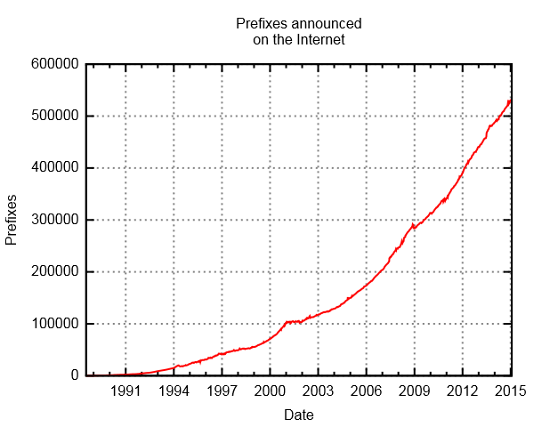
Limitations of Accelerated Software Routers
  OpenFlow switch flow table has small size (a few Mbytes)
    can store only a few thousands of flow entries
  This limitation seems to make such a platform infeasible:
    A full BGP routing table includes nearly 600K entries

Slide 43
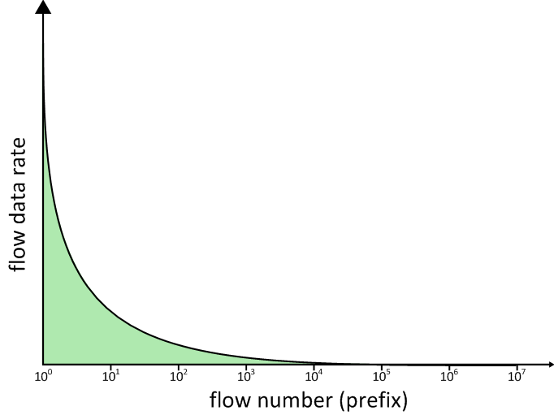
Flow Distribution in the Internet
  Flow distribution in the Internet:
    A small subset of flows carries most of Internet traffic
      Statistics from a residential ISP:
        100 prefixes → 50% of total traffic
        1000 prefixes → 80% of total traffic

Slide 44
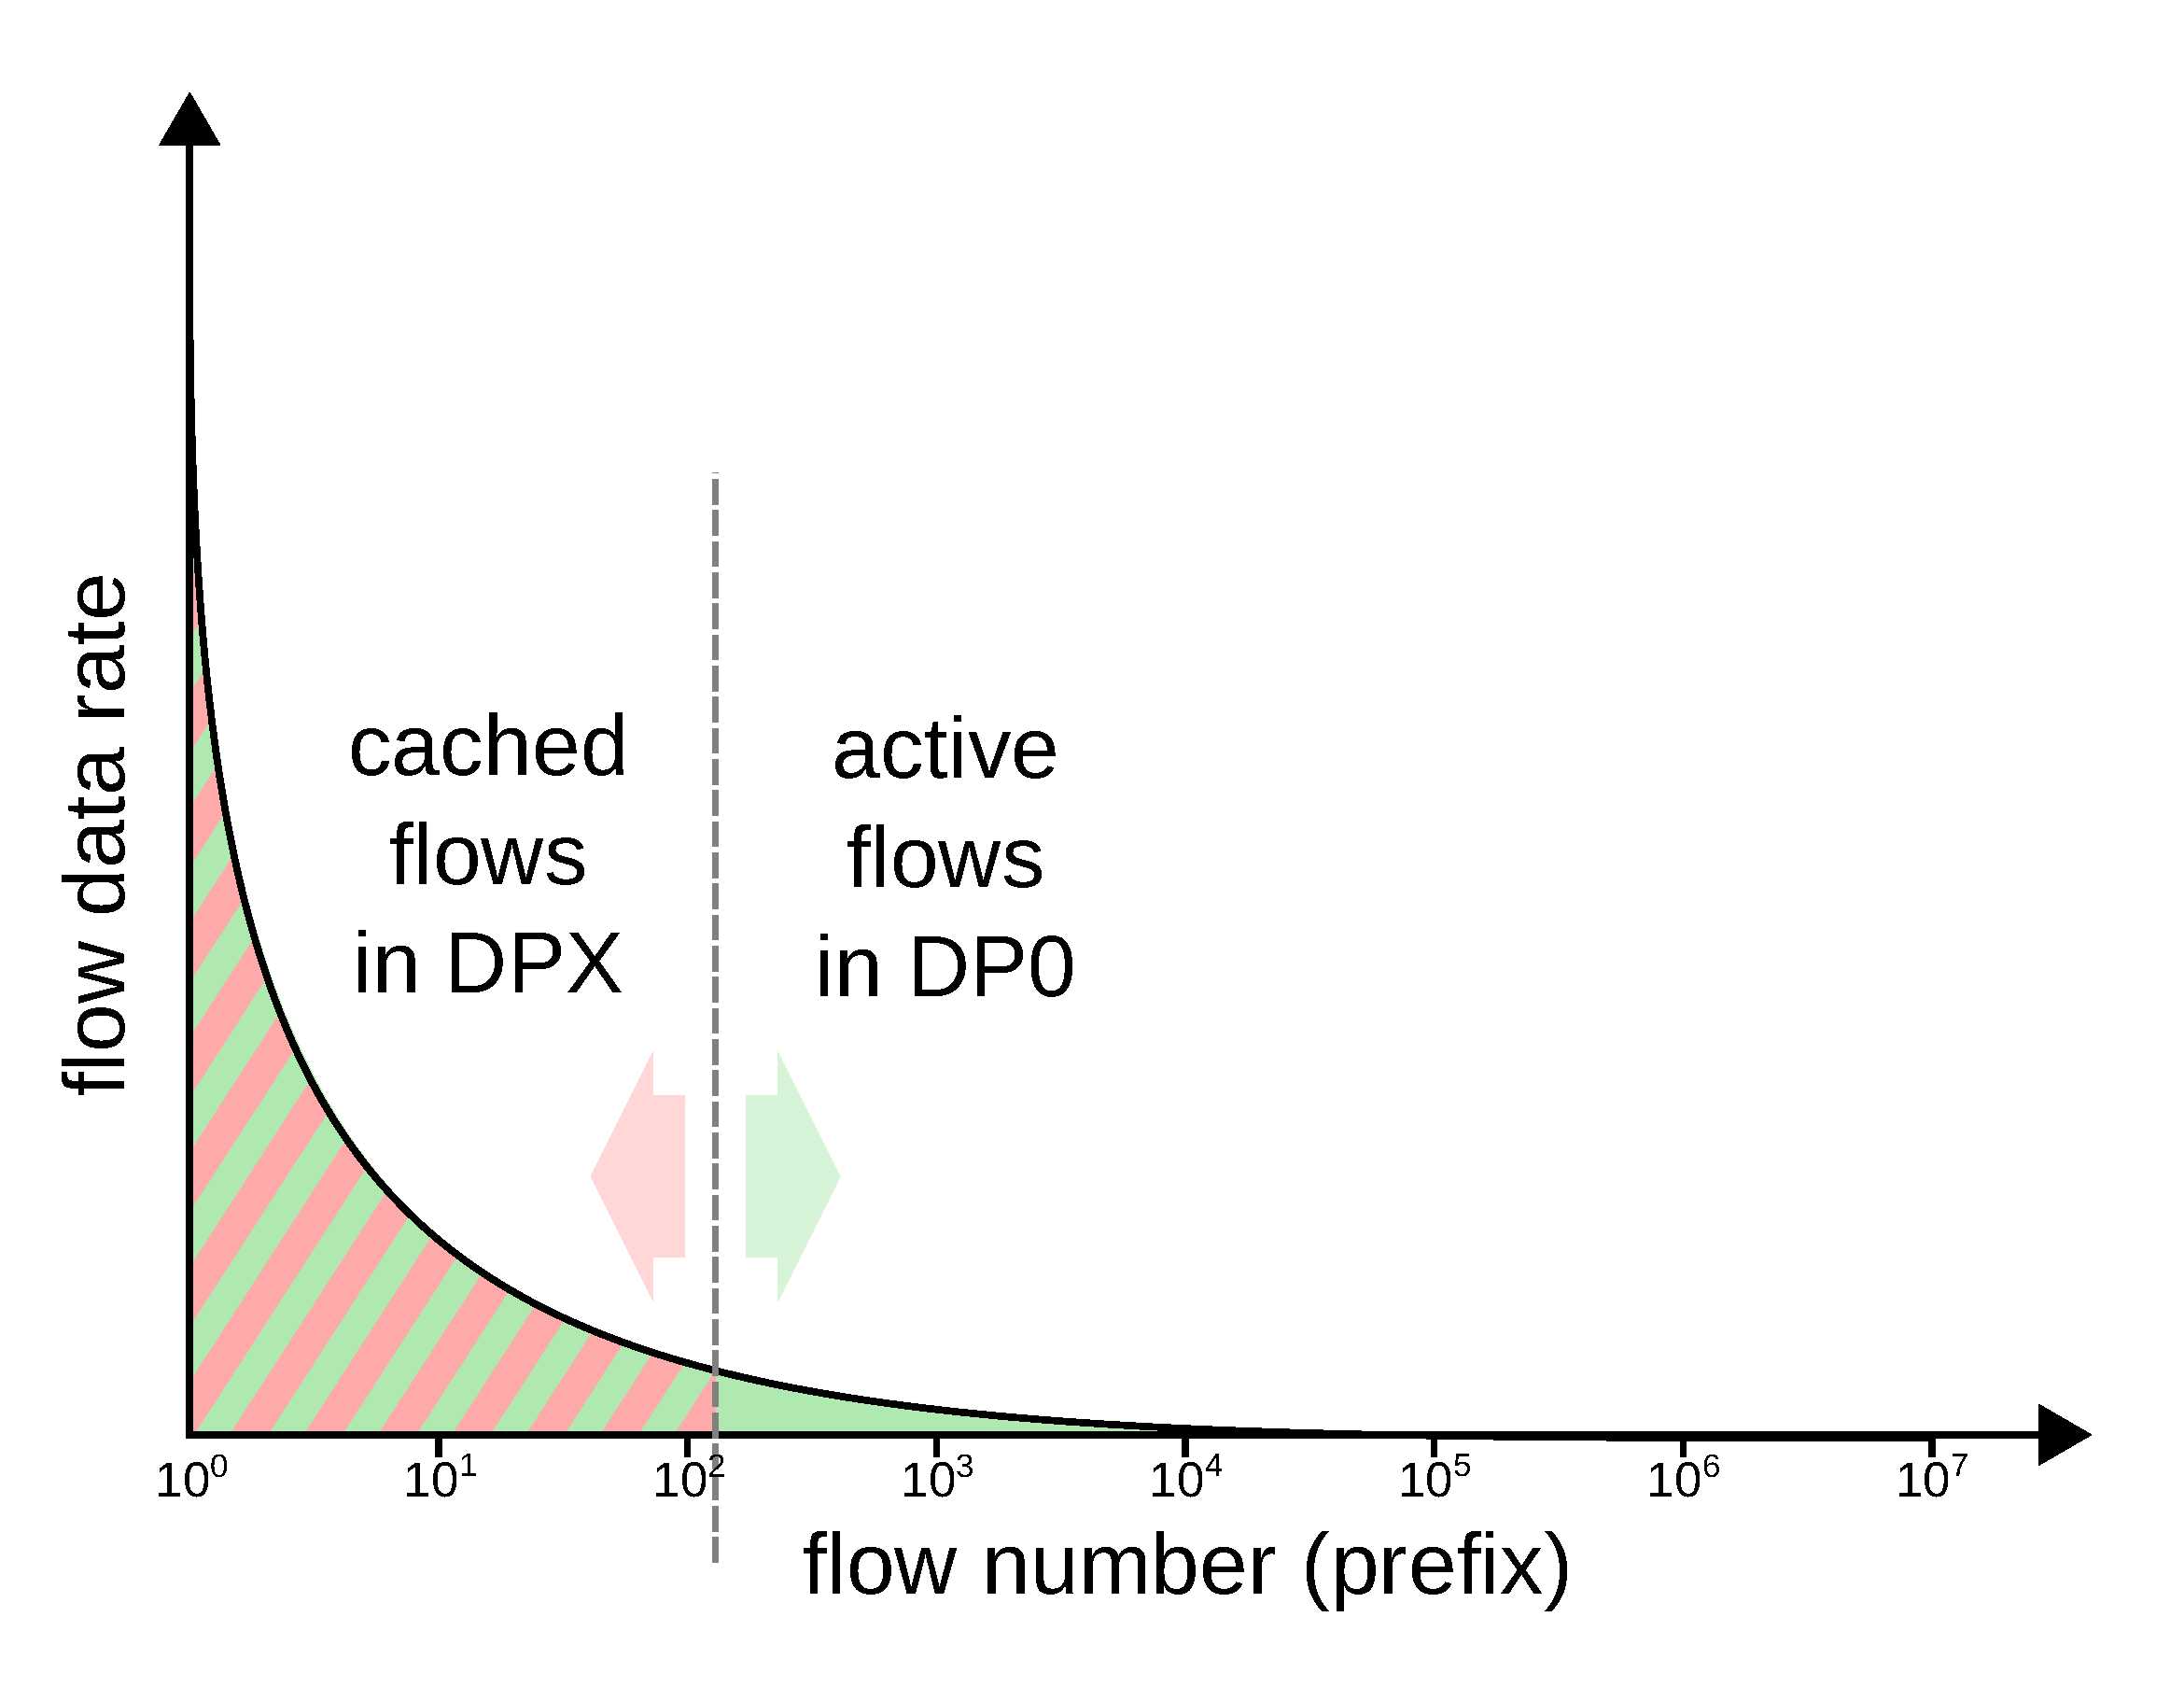
Towards an Accelerated Software Router
  Leverage on Internet flow distribution:
    Dual-datapath approach:
      Primary datapath (DP0) on a commodity server with forwarding entries for all flows
      Accelerated datapath (DPX) on OpenFlow switch with forwarding entries for the subset of high-volume flows

Slide 45
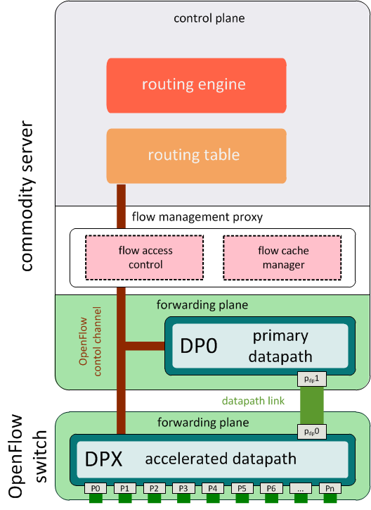
Accelerated Software Router
  Components:
    Forwarding plane composed of primary and accelerated datapath
    Control plane
    Flow management proxy:
      Transparent layer between the forwarding and control plane
      Selection of flows that will be cached in the DPX
        Caching mechanisms, e.g., LRU, LFU

Slide 46
Forwarding at DPX

Slide 47
Forwarding at DP0

Slide 48
Handling Routing Updates
routing update message

Slide 49
Handling Routing Updates
routing table update

Slide 50
Handling Routing Updates
forwarding table update in DP0

Slide 51
Handling Routing Updates
if the routing entry corresponds to an elephant flow, the entry is cached in DPX

Slide 52
Distributed Flow Processing

Slide 53
Distributed Flow Processing
Building blocks:
  Programmable switch (e.g., OpenFlow)
  Commodity servers
  Virtualization
  Flow processing SW (e.g. Click)
  Control SW (e.g., NOX)
Properties:
  Flexibility
  Scalability
  Fault tolerance
  Low cost
switch
processing module
processing module
Module
Host A
processing module
control module
switch fabric
processing module
NETWORK
processing module
Module
Host B
processing module
control module
processing module
flow table
processing module
Module
Host C
processing module
control module
USER INTERFACE
controller

Slide 54
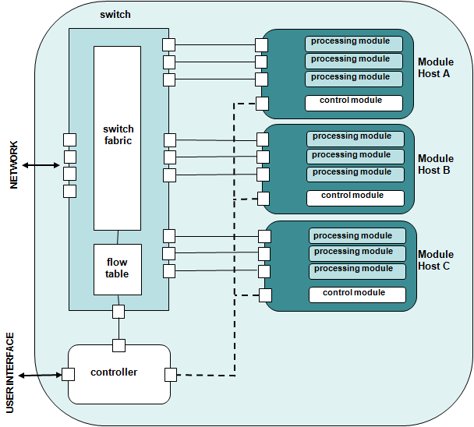
Distributed Flow Processing Scenarios
Typical flow processing scenario:
  The switch forwards a flow to a module hosting a suitable processing element
  Upon processing, the flow is sent back to the switch and then is forwarded onto the network
Other flow processing scenarios:
  Parallel
  Serial
  Traffic splitting (offloading)
  Inclusion of third-party hardware

Slide 55
Parallel Flow Processing
  Different flows are forwarded to different hosts (with the same processing module)
  Traffic load balancing, e.g. using ECMP (Equal Cost Multi-Path) algorithm
  Parallel processing of a single flow might cause packet reordering
switch
Module
Host A
Module
Host B
Module
Host C

Slide 56
Serial Flow Processing
  A flow is processed by more than one modules sequentially
Each module typically carries out a different flow processing operation
Suitable for applications that require different types of flow processing in a given order:
  e.g., VPN
    encryption at host A
    encapsulation at host C
switch
Module
Host A
Module
Host B
Module
Host C

Slide 57
Traffic Splitting
  A processing module can be used to split a subset of flows and forward to another module for further processing
Intrusion detection:
  Inspection of a flow aggregate at host A
  Suspicious flows are forwarded to host B for in-depth intrusion detection
  Remaining flows are sent back to the switch which forwards them to the network
switch
Module
Host A
Module
Host B

Slide 58
Third-party Hardware
Third-party specialized hardware (middleboxes) can be integrated in the platform and used for specific flow processing operations:
  Operators might want to use available middleboxes
  Software for some flow processing operations might be unavailable or unstable
  CPU-intensive processing operations may have to be performed on specialized hardware to achieve line rates
switch
Module
Host A
Specialized
Hardware
Module
Host B

Slide 59
In-Network Processing

Slide 60
In-Network Processing
Flow processing incarnated in the network:
  Packet inspection and filtering
  Intrusion detection
  Packet multiplication
  Video transcoding
  Traffic classification
Datacenter
Internet
Packet inspection

Slide 61
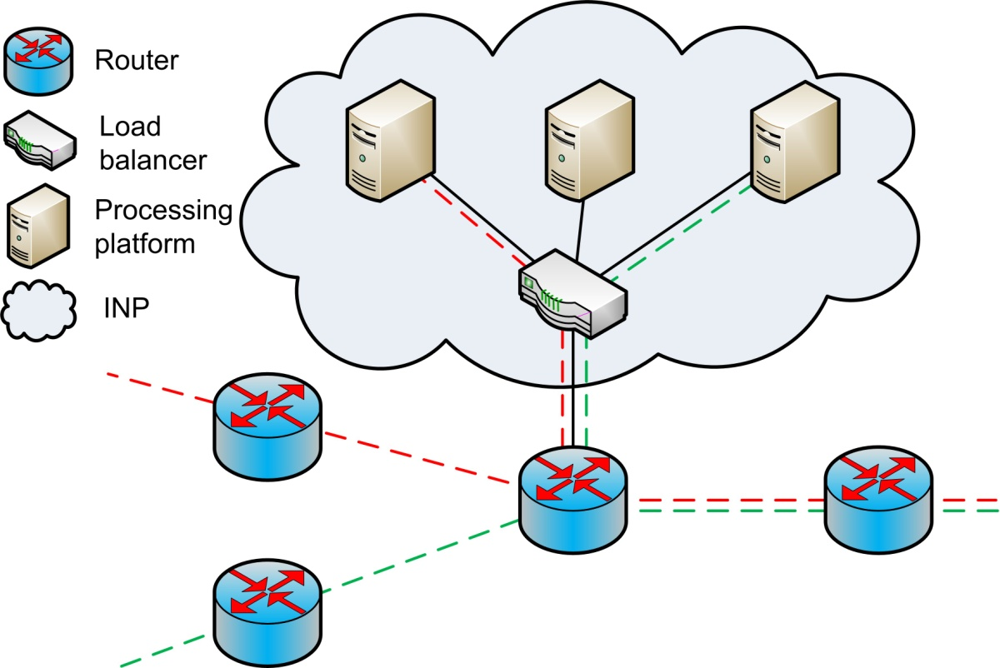
Flow Processing off the Traffic Path
Traffic redirection is required (e.g., OpenFlow)
  Only the traffic that needs processing is redirected to the platforms
    Fewer network devices along the traffic path
  More bandwidth needed along the paths used for traffic redirection

Slide 62
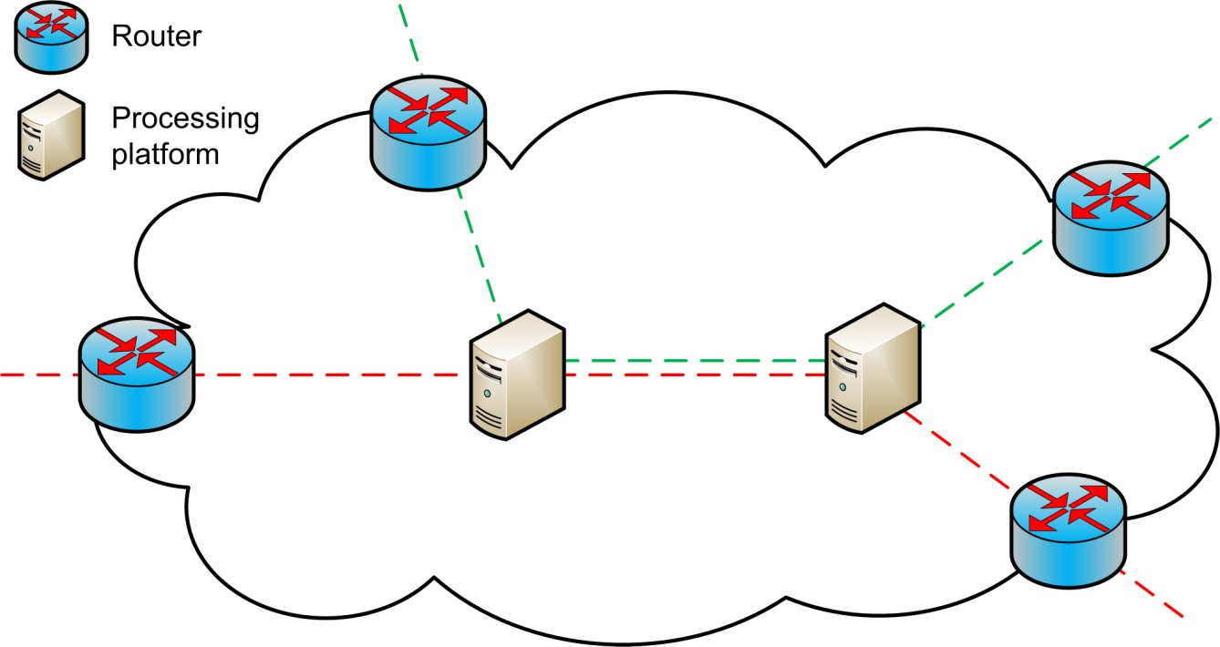
Flow Processing along the Traffic Path
Where each flow should be processed?
  Processing load should be distributed across the processing platforms along the traffic path
  Each processing platform should be aware of the flows assigned to it
    Encoding platform IDs into flows

Slide 63

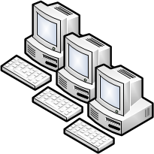


On-Path Flow Processing Across Multiple Providers
Internet
cache
Redundancy elimination
Firewall
Load
balancer
clients
clients
cache
RE
FW
LB
servers
Middlebox selection
Middlebox discovery
clients
servers
NFP 1
NFP 2
NFP 3

Slide 64
MIDAS Components
Main components:
  Consolidated middlebox (CoMB)
  Centralized CoMB controller in each NFP
  Network processing client (NPCL)
NPCL
Controller
Controller
Controller
clients
NFP 1
servers
NFP 2
NFP 3

Slide 65
MIDAS Overview
Middlebox Signaling
Controller Notification
Controller Chaining
Middlebox Selection
NF Setup
clients
cache
RE
FW
LB
servers
Controller A
Controller B
Controller C
NPCL
clients
servers

Slide 66
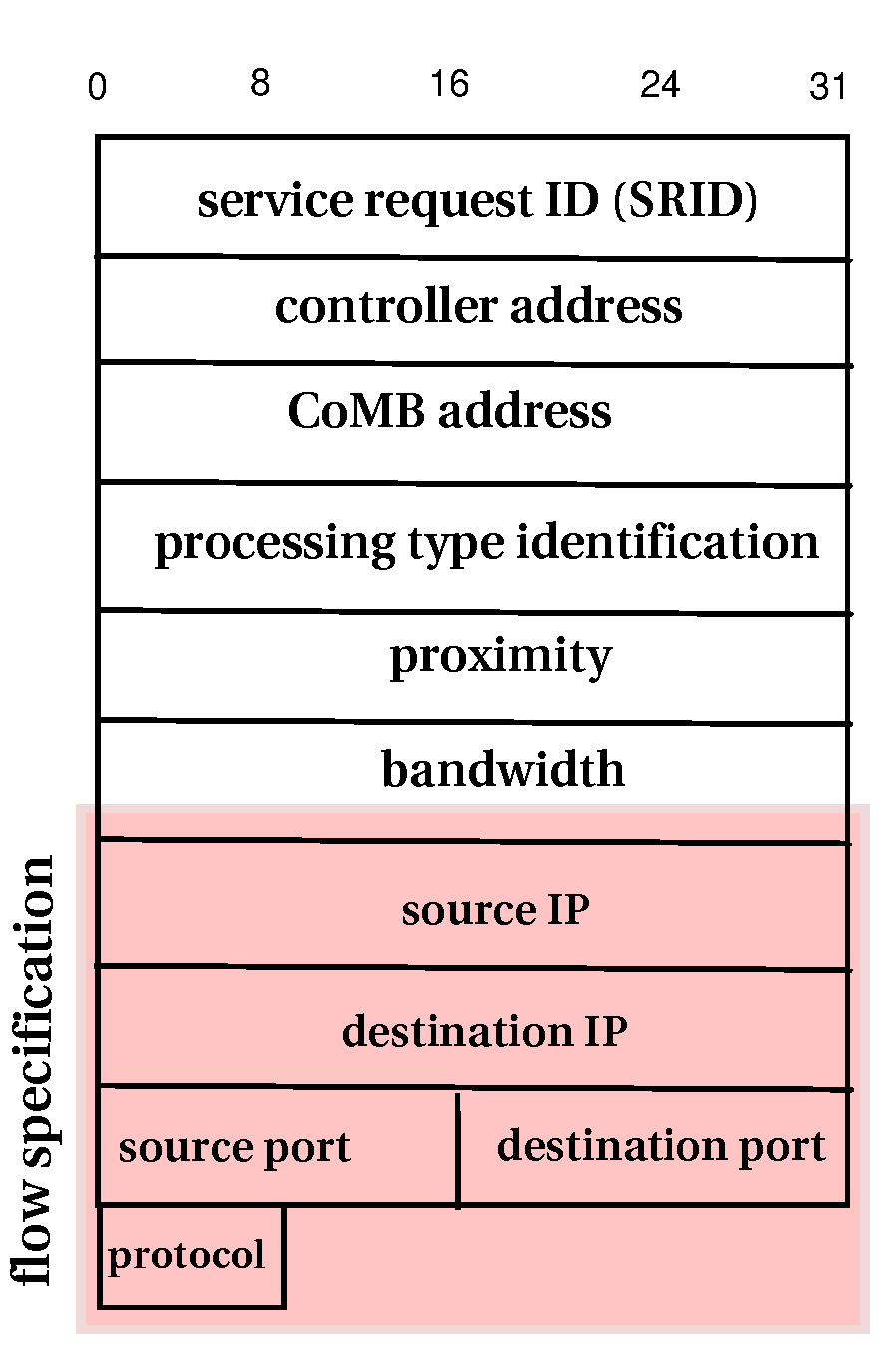
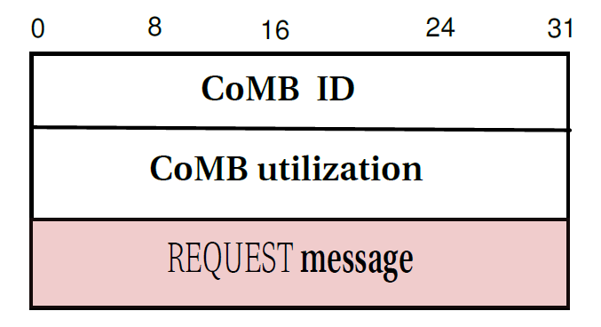
Middlebox Signaling
A
B
Controller A
Controller B
Controller C
NPCL
clients
NFP 1
servers
NFP 2
NFP 3
Extracted by each ingress CoMB and inserted into the DISCOVERY message
Each CoMB inserts its IP address
DISCOVERY message
REQUEST message

Slide 67
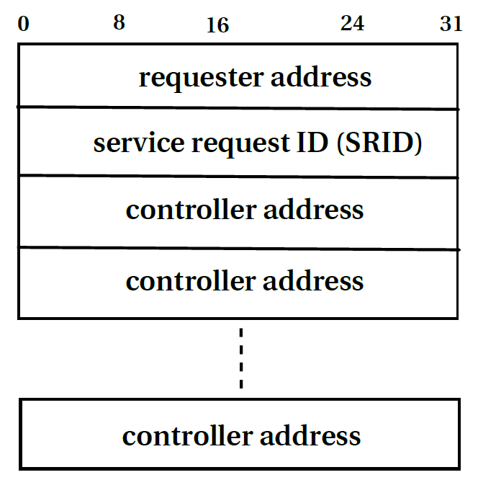
Controller Chaining
A,B
B,C
A,C
C
A,B
Controller A
Controller B
Controller C
end
A
PATHEND
clients
NFP 1
servers
NFP 2
NFP 3
CONTROLLER message

Slide 68
References
B. Carpenter and S. Brim, Middleboxes: Taxonomy and Issues, RFC 3234, 2002
J. Sherry, et al., Making Middleboxes Someone Else’s Problem: Network Processing as a Cloud Service, ACM SIGCOMM 2012
A. Greenhalgh, et al., Flow Processing and the Rise of Commodity Network Hardware, ACM Communication Review, 2009
N. McKeown, et al., OpenFlow: Enabling Innovation in Campus Networks, 2008
B. Nunes, et al., A Survey of Software-Defined Networking: Past, Present, and Future of Programmable Networks
R. Sherwoord, et al., Can the Production Network Be the Testbed?, USENIX OSDI 2010
N. Sarrar, et al., Leveraging Zipf’s Law for Traffic Offloading, ACM Communication Review, 2012
A. Abujoda and P. Papadimitriou, MIDAS: Middlebox Discovery and Selection for On-Path Flow Processing, IEEE COMSNETS 2015

