Slide 1
Ensemble word embedding for large scale corpus
Presented by Zijian Zhang

Slide 2
What is word embedding?
Word embedding is a kind of distributive word representation in a vector space using only stochastic charachteristics between word and context within corpus

Slide 3
What is word embedding?
One-hot representation
... | ... | 0 | 0 | ...
scalar | ... | 1 | 0 | ...
scorpion | ... | 0 | 1 | ...
scrum | ... | 0 | 0 | ...
... | ... | 0 | 0 | ...
|V|
|V|

Slide 4
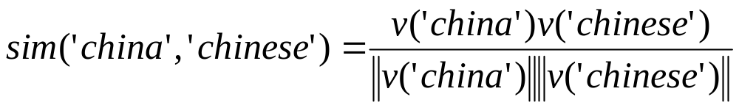
What is word embedding?
representation in vector space
... | ... | .... | ... | ...
China | 0.1 | 0.3 | 0.4 | ...
Chinese | 0.1 | 0.2 | 0.4 | ...
base-ball | 0.7 | 0.4 | -0.9 | ...
... | ... | 0 | 0 | ...
|V|
d

Slide 5
What is word embedding?
word and context (using SGSN)
central word
contextual word
corpus:”...as citizens in China, Chineses can....”
window size = 5

Slide 6
What is word embedding?
distributive representation?
context
negtive samples
chinese
baseball
zebra
...
0
0
1
0
...
0.1
0.3
0.4
...
0.2 | 0.16 | 0.22
0.8 | -0.8 | 0.64
0.4 | 0.07 | 0.02
... | ...
2.3
-1
-2.5
x
China =
word
representation
vector
negtive
context
vector
intermediate
inter-word
similarity

Slide 7
What is word embedding?
distributive representation?
back propagation
2.3
-1
-2.5
0.91
0.27
0.08
1
0
0
0.09
-0.27
-0.08
intermediate
inter-word
similarity
non-linear
function
prediction
sample
label
residual
deviation

Slide 8
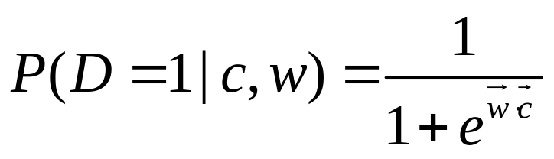
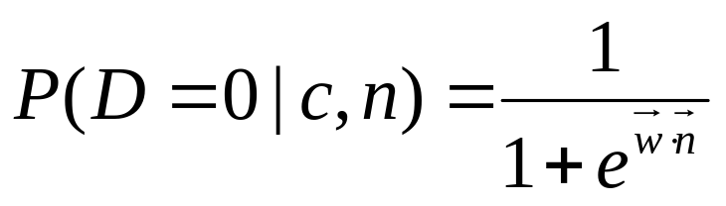
What is word embedding?
stochastic charachteristics (SGNS)
where

Slide 9
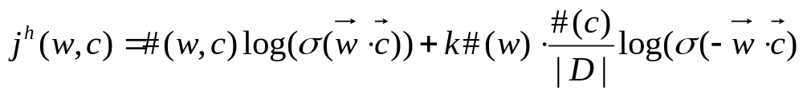
What is word embedding?
stochastic charachteristics (SGNS)
for a very specific word-context(noise) pair

Slide 10
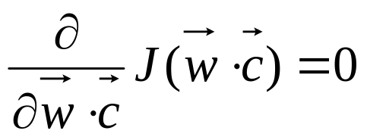
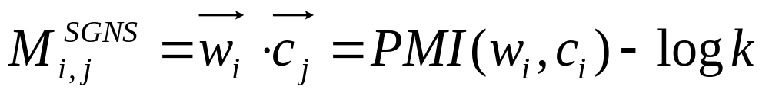
What is word embedding?
stochastic charachteristics (SGNS)

Slide 11
Pros and Cons SGNS
+Reduce calculation expense
for each (w, c) pair from |V| to k
-But training time depends on corpus
-Once trained, hard to transfer to other area
We want it faster, and more universal

Slide 12
Approach 1
corpus 1
model 1
align and find
correspondence
merge
corpus 2
model 2

Slide 13
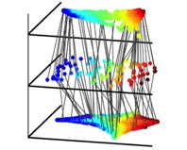
Approach 1
Alignment and correspondence, how to find?
Manifold alignment

Slide 14
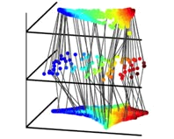
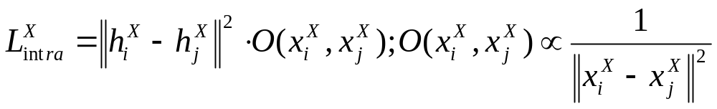
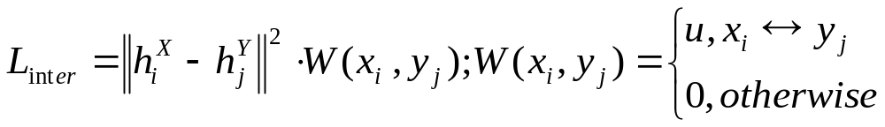
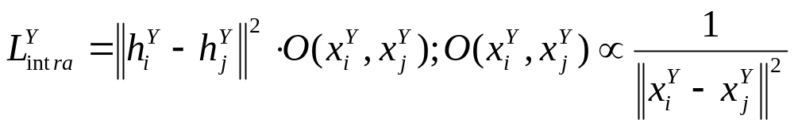
Approach 1
Manifold alignment

Slide 15
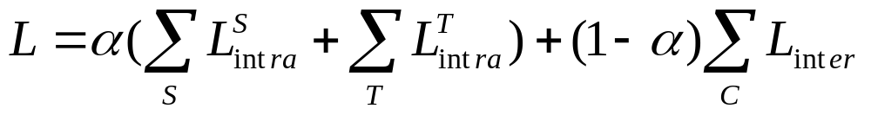
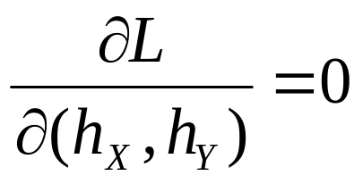
Approach 1
Combine them together
is equivalent to
Laplacian Eigenmaps

Slide 16
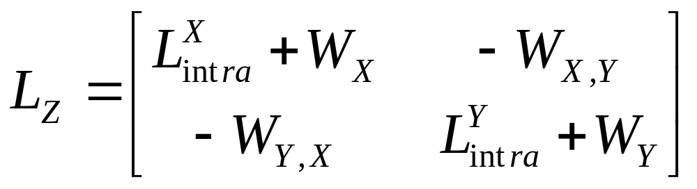
Approach 1
Laplacian Eigenmaps
Where W_{X(Y)} is adjacency Matrix where neighbours are connected with an edge of weight μ
But in practice, W_{X(Y)} is replaced by covariance matrix of
low-rank-representation of each embeddings

Slide 17
Approach 1
Laplacian Eigenmaps
Where W_{X(Y)} is adjacency Matrix where neighbours are connected with an edge of weight μ
But in practice, W_{X(Y)} is replaced by covariance matrix of
low-rank-representation of each embeddings

Slide 18
Approach 2 (unpresented)
(Non-)linear combination using Laglangian

Slide 19
corpus 1
model 1
w and c
combination
w.r.t.
PMI
corpus 2
model 2
w and c

Slide 20
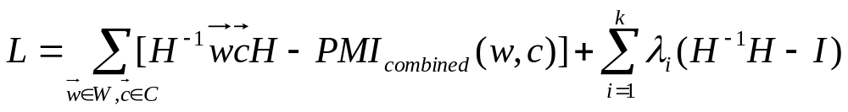
Approach 2 (unpresented)
Laglangian

Slide 21
Approach 2 (unpresented)
Laglangian
W
C
PMI

Slide 22
Approach 3 (unpresented)
Deep Learning: auto-encoder
Autoencoder
combine
Autoencoder

