Slide 1


Master Thesis Defense
Scalable approach for Learning Word Representations
Name: Zhang, Zijian
Matrikelnummer: 3184680
First Examiner: Prof.Dr. Avishek Anand
Second Examiner: Prof. Dr. techn. Dipl.-Ing. Wolfgang Nejdl
Advisor: Prof. Dr. Avishek Anand

Slide 2
Content
-Background Knowledge Introductions
-Structure of our Approach
-Original Corpus Division
-Merging Approaches
  -Concatenation+PCA
  -Manifold Alignment + Vector Averaging
-Experiments Setup
-Performance and Timing
-Conclusion and Future Works

Slide 3
Two Questions
1. Hannover – Berlin + Hamburg = ?

Slide 4

Two Questions
Hannover – Berlin + Hamburg = Neubrandenburg!
According to the map:
Then what is
Berlin – Germany + China?

Slide 5
Two Questions
A map (the one on a paper or in a App):
Map (mathematical jargon) a neighborhood U to a

Slide 6
Background Knowledge Introduction
Word Vector Representation
woman
man
queen
king
Corpus
Representation model
(Local) Euclidean Vector Space

Slide 7
Background Knowledge Introduction
Why Word2Vec:
Word representations:
used to be processed in computer:
One-hot / hash tokenizing (-lose of semantic information)
LSA: directly SVD on word-doc matrix (-linear model)
Bag-of-Word: meaning defined by set of labels (-low semantic accuracy, supervised)
Words co-occurrence matrix: count of word appears together (-sparse)
Therefore Word2Vec: a predictive model
preserves semantic information
dense representations for larger corpus
non-linear dimension reduction, relationship-preserving and robust
unsupervised way
a neural approach is more scalable
popular in downstream applications

Slide 8
Background Knowledge Introduction
Challenge of Word2Vec:
larger corpus: more expressive, longer time
On 14GB English Wikidump: ≈ 36 hours !
(dim: 500 Vocabulary: 300k)
Not scalable w.r.t. large corpus

Slide 9
Background Knowledge Introduction
Skip Gram Negative Sampling
window
quick
blue
paper
quick brown fox jumps over a lazy dog
fox
central word w
predict
context word c
Skip Gram
Negative Sampling

Slide 10
Background Knowledge Introduction
Properties of Word2Vec ^{[1]}
woman
woman
child
woman
man
man
man
queen
airplane
automobile
bicycle
king
~ similarity
categories ⇒ clusters
analogy ⇒ parallelization
[1]: Mikolov T, Yih W, Zweig G.
Linguistic regularities in continuous space word representations
Proceedings of the 2013 Conference of the North American Chapter of the Association for
Computational Linguistics: Human Language Technologies. 2013: 746-751.

Slide 11
Background Knowledge Introduction
Recently work:
Optimizing SGD schema (online, synchronized) :
HogWild!, BLAS-3, optimizing cache usage, column-wise distribution
Adaptive SGD :
SGD-Momentum, AdaGrad, RMSProp
Heterogeneous combination:
Combine vectors from Word2Vec, WordNet, GloVe, ConceptNet etc.
Incremental Word2Vec training

Slide 12
Background Knowledge Introduction
Our contribution:
TBF

Slide 13
Divide Train and Merge
Original
corpus
Merged Model
divide
merge
(asyn para improve)
train
sub-corpora
sub-models

Slide 14
Structure of our Approach
Research Questions:
Original
corpus
Merged Model
sub-corpora
sub-models
1) How do we sample
from the original corpus?
2) How do we
combine sub-models?

Slide 15
Original Corpus Division
Criterion of Division: “Mimicking” the Original Term Distribution
objective function:
local optimum:
final result ^{[1]}:
Depends on distribution of
words/central-contextual pairs only
[1]: Levy O, Goldberg Y.
Neural word embedding as implicit matrix factorization
Advances in neural information processing systems. 2014: 2177-2185.

Slide 16


Original Corpus Division
Distribution preservation through uniform sampling
sampling
partitioning
sampling
partitioning
Word distribution
Central contextual words pair distribution

Slide 17
Merging Approaches
Problem so-far:
?
?
identify the
correlating parts
combine the correlation,
canceling noise by merging

Slide 18
Merging Approaches
1st Approach: Concatenation + Principle Component Analysis
Principle Component Analysis
concatenation

Slide 19
Merging Approaches
Some Comments on PCA ^{[1]}
Law of cosines:
d
b
θ’
θ
a
d
mean
correlation
[1]: Korenius T, Laurikkala J, Juhola M.
On principal component analysis, cosine and Euclidean measures in information retrieval
Information Sciences, 2007, 177(22): 4893-4905.

Slide 20
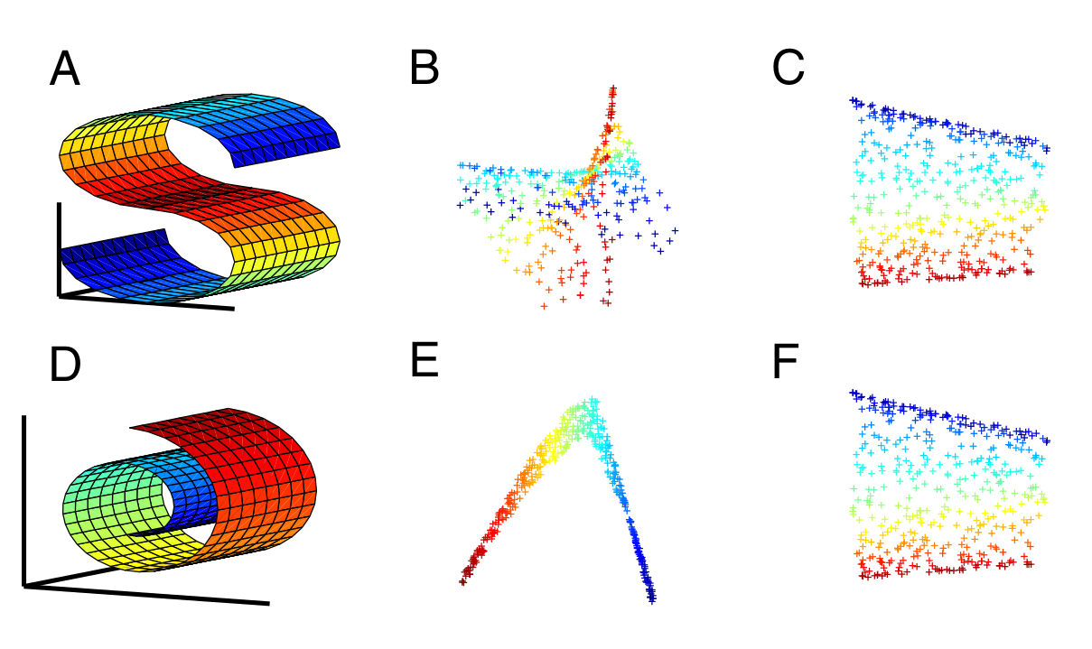
Merging Approaches
2nd Approach: Manifold Alignment + Vector Averaging
[1]
[1]: Ham, Ji Hun, Daniel D. Lee, and Lawrence K. Saul.
Learning high dimensional correspondences from low dimensional manifolds

Slide 21

Merging Approaches
2nd Approach: Manifold Alignment ^{[1]} + Vector Averaging
X
[2]
Find a low-rank correlation of Y
X_{final}, Y_{final} = (1-μ)(low-rank reconstruction)
+μ(inter-manifold correlation)
Y
Find a low-rank correlation of Y
[1]: Boucher, Thomas, et al.
Aligning Mixed Manifolds
AAAI. 2015.
[2]: Ham J, Lee D D, Saul L K.
Semisupervised alignment of manifolds
AISTATS. 2005: 120-127.

Slide 22
Experiments Setup
Data Set:
  Original corpus: English Wikipedia dump file 2016 (14G)
  Cleaner: Wikipedia LineSentences cleaner in Gensim
  Sample/Partition size: 1%, 10% of the original corpus
Baseline Model^{[1]}:
  Vocabulary: 300k words
  Dimension (size of hidden layer): 500
  Training time: 36 hours
Benchmarks:
  Word Similarity: MEN, RW, RG65, WS353, SimLex999, Mturk
  Analogy: Google, SemEval 2012 #2, MSR
  Categorization: AP, BLESS, Battig
[1]: Jastrzebski, Stanisław, Damian Leśniak, and Wojciech Marian Czarnecki
How to evaluate word embeddings? On importance of data efficiency and simple supervised tasks

Slide 23
Performance and Timing
Effect of Dividing (sampling/partitioning):
Conclusions:
Sampling performs overall better than partitioning
Larger division size makes the performance better, but less scalability
Surprisingly, some of our approaches even outperform the baseline!

Slide 24
Performance and Timing
Effect of Merging (concatenation/PCA/LRA):
Conclusions:
PCA performs overall the best
LRA and Vector average is the slowest
To see the information loss in the PCA, we added the concatenation as a single line, it performs surprisingly robust, despite its higher dimensionality

Slide 25
Performance and Timing
Effect of sample count (10% of original corpus):
MEN
Google
Conclusion:
Larger count of sub-models doesn’t help.
8~10 for 10% approach, 20~30 for 1% approach is enough.
After that it goes into flat road.

Slide 26
Performance and Timing
Effect of sample count (1% of original corpus):
MEN
Google
Conclusion:
Larger count of sub-models doesn’t help.
8~10 for 10% approach, 20~30 for 1% approach is enough.
After that it goes into flat road.

Slide 27
Performance and Timing
Timing:
Subject name | Time Elapse (s)
10% partitioning PCA | 10932
1% partitioning PCA | 2093
10% sampling PCA | 12852
1% sampling PCA | 16293
10% sampling LRA | 27385
Baseline | 129015
Conclusions:
m-part division leads to m-folds speed up
Total training time: from 36 hours @ baseline to
3.6 hours @ 10% and
< 1 hour @ 1% approach
Time of merging is in minutes

Slide 28
Conclusion and Future Works
Conclusions:
  Sentence-wise sampling to divide, PCA to merge
  M-fold speed up by M-splitting, sometimes even outperform the baseline.
Future works:
  Works on the go: dealing with missing-word problem between sub-models

Slide 29
Thank you for your attention
Questions and comments are highly appreciated
Zhang, Zijian
Hannover
08. 03. 2018

