Slide 1


Master Thesis Defense
Scalable approach for Learning Word Representations
Name: Zhang, Zijian
Matrikelnummer: 3184680
First Examiner: Prof.Dr. Avishek Anand
Second Examiner: Prof. Dr. techn. Dipl.-Ing. Wolfgang Nejdl
Advisor: Prof. Dr. Avishek Anand

Slide 2
Content
-Background Knowledge Introductions
-Structure of our Approach
-Original Corpus Division
-Merging Approaches
  -Concatenation+PCA
  -Manifold Alignment + Vector Averaging
-Experiments Setup
-Performance and Timing
-Conclusion and Future Works

Slide 3
Background Knowledge Introduction
Word Vector Representation
woman
man
queen
king
Corpus
Representation model
(Local) Euclidean Vector Space

Slide 4
Background Knowledge Introduction
Skip Gram Negative Sampling Word2Vec
window
quick brown fox jumps over a lazy dog
central word w
context word c
Skip Gram

Slide 5
Background Knowledge Introduction
Skip Gram Negative Sampling Word2Vec
softmax with a hard-to-solve
partition function
Noise-Contrastive Estimation
s for signal
d for input data
n for noise
Negative Sampling
for negative samples

Slide 6
Background Knowledge Introduction
Skip Gram Negative Sampling Word2Vec
Objective function:

Slide 7
Background Knowledge Introduction
Skip Gram Negative Sampling Word2Vec
0
0
1
0
0
0
0
3.102
2.44
-11.5
0.03
100.3
-1.2
-2.0
0.001
1.00
0.23
0.22
0.50
quick
context
word
central
word
fox
word
.
.
.
new
negative
samples
.
.
.
lucky
Hidden
layer
logistic
activation
function
One-hot
encoding

Slide 8
Background Knowledge Introduction
Properties of Word2Vec ^{[1]}
woman
woman
child
woman
man
man
man
queen
airplane
automobile
bicycle
king
~ similarity
categories ⇒ clusters
analogy ⇒ parallelization
[1]: Mikolov T, Yih W, Zweig G.
Linguistic regularities in continuous space word representations
Proceedings of the 2013 Conference of the North American Chapter of the Association for
Computational Linguistics: Human Language Technologies. 2013: 746-751.

Slide 9
Background Knowledge Introduction
Challenge:
larger corpus: more expressive, longer time
On 14GB English Wikidump: ≈ 36 hours !
(dim: 500 Vocabulary: 300k)
Not scalable for large corpus

Slide 10
Structure of our Approach
Original
corpus
Merged Model
sub-corpora
sub-models

Slide 11
Structure of our Approach
Research Questions:
Original
corpus
Merged Model
sub-corpora
sub-models
1) How do we sample
from the original corpus?
2) How do we
combine sub-models?

Slide 12
Original Corpus Division
Trivial approaches: Block-wise partitioning and Stripping
Partitioning:
Stripping:
original
corpus
equisized blocks
in e.g. HDFS
original
corpus
interleaving
stripping

Slide 13
Original Corpus Division
Criterion of Division: “Mimicking” the Original Term Distribution
objective function:
local optimum:
final result ^{[1]}:
[1]: Levy O, Goldberg Y.
Neural word embedding as implicit matrix factorization
Advances in neural information processing systems. 2014: 2177-2185.

Slide 14
Original Corpus Division
Final Approach: Reservoir Sampling
original dataset
with S “boxes”
. . .
Total count of “balls”
≫
Count of “balls” in each “box”
. . .
. . .
1st “reservoir” with
k “boxes”
2nd “reservoir” with
k “boxes”

Slide 15


Original Corpus Division
Distribution preservation
sampling
partitioning
sampling
partitioning
Word distribution
Central contextual words pair distribution

Slide 16
Merging Approaches
Problem so-far:
identify the
correlating parts
combine the correlation,
canceling noise by merging

Slide 17
Merging Approaches
1st Approach: Concatenation + Principle Component Analysis
Principle Component Analysis
concatenation

Slide 18
Merging Approaches
Some Comments on PCA ^{[1]}
Law of cosines:
d
b
θ’
θ
a
d
mean
correlation
[1]: Korenius T, Laurikkala J, Juhola M.
On principal component analysis, cosine and Euclidean measures in information retrieval
Information Sciences, 2007, 177(22): 4893-4905.

Slide 19
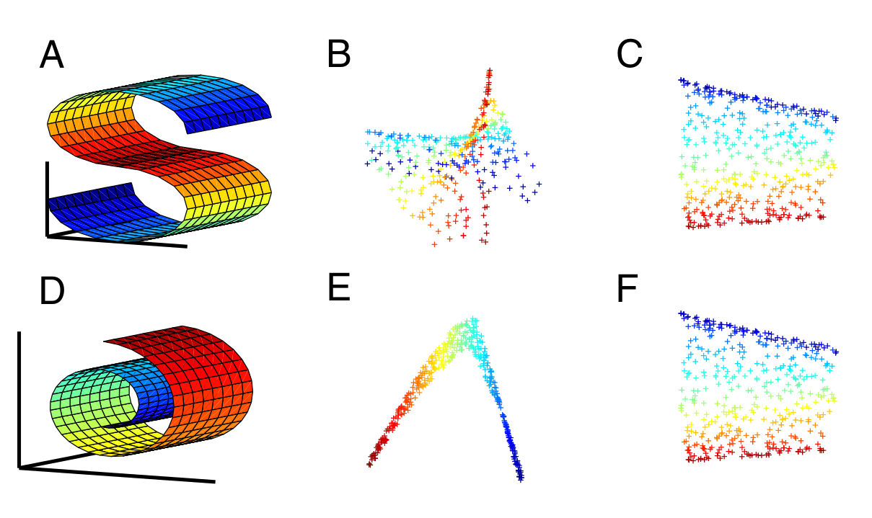
Merging Approaches
2nd Approach: Manifold Alignment + Vector Averaging
[1]
[1]: Ham, Ji Hun, Daniel D. Lee, and Lawrence K. Saul.
Learning high dimensional correspondences from low dimensional manifolds

Slide 20

Merging Approaches
2nd Approach: Manifold Alignment ^{[1]} + Vector Averaging
X
[2]
Y
[1]: Boucher, Thomas, et al.
Aligning Mixed Manifolds
AAAI. 2015.
[2]: Ham J, Lee D D, Saul L K.
Semisupervised alignment of manifolds
AISTATS. 2005: 120-127.

Slide 21
Experiments Setup
Data Set:
  Original corpus: English Wikipedia dump file 2016 (14G)
  Cleaner: Wikipedia LineSentences cleaner in Gensim
  Sample/Partition size: 1%, 10% of the original corpus
Baseline Model:
  Vocabulary: 300k words
  Dimension (size of hidden layer): 500
  Training time: 36 hours
Benchmarks:
  Word Similarity: MEN, RW, RG65, WS353, SimLex999, Mturk
  Analogy: Google, SemEval 2012 #2, MSR
  Categorization: AP, BLESS, Battig

Slide 22
Performance and Timing
Effect of Dividing (sampling/partitioning):
Conclusions:
Sampling performs overall better than partitioning
Larger division size makes the performance better, but less scalability
Surprisingly, some of our approaches even outperform the baseline!

Slide 23
Performance and Timing
Effect of Merging (concatenation/PCA/LRA):
Conclusions:
PCA performs overall the best
LRA and Vector average is the slowest
To see the information loss in the PCA, we added the concatenation as a single line, it performs surprisingly robust, despite its higher dimensionality

Slide 24
Performance and Timing
Effect of sample count (10% of original corpus):
MEN
Google
Conclusion:
Larger count of sub-models doesn’t help.
8~10 for 10% approach, 20~30 for 1% approach is enough.
After that it goes into flat road.

Slide 25
Performance and Timing
Effect of sample count (1% of original corpus):
MEN
Google
Conclusion:
Larger count of sub-models doesn’t help.
8~10 for 10% approach, 20~30 for 1% approach is enough.
After that it goes into flat road.

Slide 26
Performance and Timing
Timing:
Subject name | Time Elapse (s)
10% partitioning PCA | 10932
1% partitioning PCA | 2093
10% sampling PCA | 12852
1% sampling PCA | 16293
10% sampling LRA | 27385
Baseline | 129015
Conclusions:
m-part division leads to m-folds speed up
Total training time: from 36h of baseline to 3.6 hours @ 10% and < 1 hour @ 1% approach
Time of merging is in minutes

Slide 27
Conclusion and Future Works
Conclusions:
  Sentence-wise sampling to divide, PCA to merge
  M-fold speed up by M-splitting, sometimes even outperform the baseline.
Future works:
  Works on the go: dealing with missing-word problem between sub-models

Slide 28
Thank you for your attention
Questions and comments are highly appreciated
Zhang, Zijian
Hannover
08. 03. 2018

