Slide 1


Master Thesis Defense
Scalable approach for Learning Word Representations
Name: Zhang, Zijian
Matrikelnummer: 3184680
First Examiner: Prof.Dr. Avishek Anand
Second Examiner: Prof. Dr. techn. Dipl.-Ing. Wolfgang Nejdl
Advisor: Prof. Dr. Avishek Anand

Slide 2
Agenda
Motivation
Problem Statement
Related Work
Our Contribution
Divide, Train and Merge
  Distribution Preserving Sampling
  Merging Approaches
Experimental Setup
Performance and Timing
Conclusion and Ongoing Works

Slide 3
Agenda
Motivation
Problem Statement
Related Work
Our Contribution
Divide, Train and Merge
  Distribution Preserving Sampling
  Merging Approaches
Experimental Setup
Performance and Timing
Conclusion and Ongoing Works

Slide 4
Motivation
1. Hannover – Berlin + Hamburg = ?

Slide 5

Motivation
Hannover – Berlin + Hamburg = Neubrandenburg!
According to the map:
Then what is
King – Man + Woman?

Slide 6
Motivation
A map (the one on a paper or in an App):
maps (mathematical jargon) the city in an area of the surface of the Earth to a point in E².
If we change “cities” to “words” and the “surface of Earth” to “Language”
King – Man + Woman
seems solvable!

Slide 7
Motivation
Word Vector Representation
woman
man
queen
king
Corpus
Representation model
(Local) Euclidean Vector Space

Slide 8
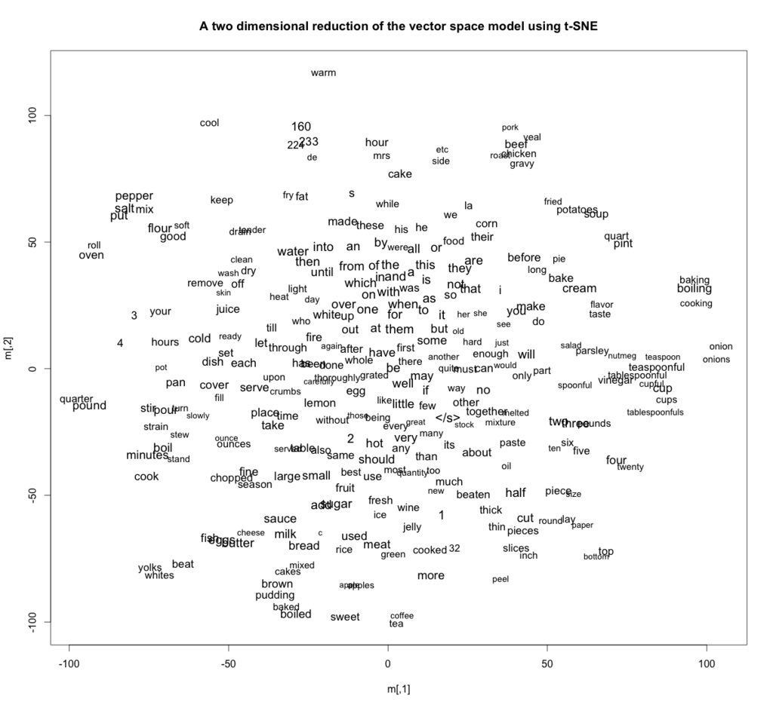
Motivation
Advantages of Word2Vec
(Mikolov2013)
woman
woman
child
woman
man
man
man
queen
airplane
car
bicycle
king
~ similarity
categories ⇒ clusters
analogy ⇒ parallelization
Dimension reduction

Slide 9
Problem Statement
Current Challenge:
larger corpus: more expressive, longer time
On 14GB English Wikidump: ≈ 36 hours !
(dim: 500 Vocabulary: 300k)
Vanilla Word2Vec isn’t scalable

Slide 10
Agenda
Motivation
Problem Statement
Related Work
Our Contribution
Divide, Train and Merge
  Distribution Preserving Sampling
  Merging Approaches
Experimental Setup
Performance and Timing
Conclusion and Ongoing Works

Slide 11
Related Work
Word2Vec uses SGD to optimize its objective
One solution: make SGD faster:
Optimizing SGD schema (online, synchronized) :
HogWild!^{(Recht2011)}, BLAS-3 SGNS^{(Ji2016)}, cache optimized Hierachical Softmax^{(Eickhoff2016)}, column-wise distribution ^{(Ordentlich2016)}
Adaptive SGD learning rate:
SGD-Momentum^{(Rumelhart1986)}, AdaGrad, RMSProp

Slide 12
Our Contribution
We find a
  scalable
  hardware independent
  asynchronous
  distributional paradigm,
  for training word vector representation

Slide 13
Divide, Train and Merge
sub-corpora
sub-models
divide
merge
original corpus
merged model
asynchronous
parallel
training

Slide 14
Divide, Train and Merge
Research Questions:
original corpus
merged model
sub-corpora
sub-models
1) How do divide the original corpus into sub-corpora?
2) How do we
combine sub-models into merged model?

Slide 15
Distribution Preservation Sampling
window
quick
blue
paper
context word c
quick brown fox jumps over a lazy dog
fox
negative samples c_{N}
central word w
predict
context word c
central word w
(w, c) pair
Skip Gram
Negative Sampling

Slide 16
Distribution Preservation Sampling
Criterion of division: approach to the original term distribution
The local optimum^{(Levy2014)}:
Point-wise
Mutual
Information
Depends on distribution of
Words/skip-grams only!

Slide 17


Distribution Preserving Sampling
Distribution preservation through uniform reservoir sampling
KL-divergence of words distribution
from sub-corpus to original corpus
KL-divergence of skip grams distribution
from sub-corpus to original corpus
sampling
partitioning
sampling
partitioning
KL-divergence
KL-divergence
fractional size of original corpus
fractional size of original corpus

Slide 18
Merging Approaches
Problem so-far:
sub-model #1
?
?
merged model
sub-model #2
identify the
correlating parts
combine the correlation,
canceling noise by merging

Slide 19
Merging Approaches
1st Approach: Concatenation + Principle Component Analysis
sub-model B
1st principal component
(merged model)
sub-model B
queen_{B}
woman
queen
woman_{B}
queen
woman
jack_{B}
jack
jack
sub-model A
boat_{B}
boat
sub-model A
boat
boat_{A}
woman_{A}
jack_{A}
queen_{A}

Slide 20

Merging Approaches
2nd Approach: Manifold Alignment ^{(Boucher2015)} + Vector Averaging
X
^{(Ham2005)}
Low-rank reconstruction of X
X_{final}, Y_{final} = (1-μ)(reconstructions)
+μ(correlation)
M_{merged}=(X_{final}+Y_{final})/2
Y
Low-rank reconstruction of Y
[2]: Ham J, Lee D D, Saul L K.
Semisupervised alignment of manifolds
AISTATS. 2005: 120-127.

Slide 21
Agenda
Motivation
Problem Statement
Related Work
Our Contribution
Divide, Train and Merge
  Distribution Preserving Sampling
  Merging Approaches
Experimental Setup
Performance and Timing
Conclusion and Ongoing Works

Slide 22
Experiments Setup
Data Set:
  Original corpus: English Wikipedia dump file 2016 (14G)
  Word2Vec implementation: gensim^{[1]}
  Cleaner: Wikipedia LineSentences cleaner in Gensim
  Sample/Partition size: 1%, 10% of the original corpus
Baseline Model^{(Levy2015)}:
  Vocabulary: 300k words
  Dimension (size of hidden layer): 500
  Training time: 36 hours
Benchmarks^{(Jastrzebski)}:
  Word Similarity: MEN, RW, RG65, WS353, SimLex999, MTurk
  Analogy: Google, SemEval 2012 #2, MSR
  Categorization: AP, BLESS, Battig
[1]: https://radimrehurek.com/gensim/

Slide 23
Performance and Timing
Effect of Dividing (sampling/partitioning):
Conclusions:
Sampling performs overall better than partitioning
Larger division size makes the performance better, but less scalable
Surprisingly, some of our approaches even outperform the baseline!

Slide 24
Performance and Timing
Effect of Merging (concatenation/PCA/LRA):
Conclusions:
PCA performs overall the best
LRA and Vector average is the slowest
To see the information loss in the PCA, we added the concatenation as a single line, it performs surprisingly robust, despite its higher dimensionality

Slide 25
Performance and Timing
Effect of sample count (10% of original corpus):
correlation
MEN (the higher the better)
correlation
Google (the higher the better)
Conclusion:
Larger count of sub-models doesn’t help.
8~10 for 10% approach, 20~30 for 1% approach is enough.
After that it goes into flat road.

Slide 26
Performance and Timing
Effect of sample count (1% of original corpus):
correlation
MEN (the higher the better)
correlation
Google (the higher the better)
Conclusion:
Larger count of sub-models doesn’t help.
8~10 for 10% approach, 20~30 for 1% approach is enough.
After that it goes into flat road.

Slide 27
Performance and Timing
Timing:
Conclusions:
m-part division leads to m-folds speed up
Total training time: from 36 hours @ baseline to
3.6 hours @ 10% and
< 1 hour @ 1% approach
Time of merging is in minutes

Slide 28
Conclusion and Ongoing Works
Conclusions:
  Sentence-wise sampling to divide, PCA to merge
  M-times speed up by M-fold dividing, sometimes even outperform the baseline.
  It’s under review in SIGIR 2018.
Ongoing work:
  dealing with missing-word problem between sub-models
  in preparation for EMNLP 2018

Slide 29
Thank you for your attention
Questions and comments are highly appreciated
Zhang, Zijian
Hannover
08. 03. 2018

Slide 30
References:
Mikolov2013: Mikolov T, Yih W, Zweig G.
Linguistic regularities in continuous space word representations
Proceedings of the 2013 Conference of the North American Chapter of the Association for
Computational Linguistics: Human Language Technologies. 2013: 746-751.
Recht2011: Recht B, Re C, Wright S, et al.
Hogwild: A lock-free approach to parallelizing stochastic gradient descent
Advances in neural information processing systems. 2011: 693-701.
Ji2016: Ji, Shihao, et al.
Parallelizing word2vec in shared and distributed memory
arXiv preprint arXiv:1604.04661 (2016).
Eickhoff2016: Vuurens, Jeroen BP, Carsten Eickhoff, and Arjen P. de Vries
Efficient Parallel Learning of Word2Vec
arXiv preprint arXiv:1606.07822 (2016).
Ordentlich2016: Ordentlich, Erik, et al.
Network-efficient distributed Word2vec training system for large vocabularies
Proceedings of the 25th ACM International on Conference on Information and
Knowledge Management. ACM, 2016.
Rumelhart1986: Rumelhart, David E., Geoffrey E. Hinton, and Ronald J. Williams
Learning representations by back-propagating errors
nature 323.6088 (1986): 533.

Slide 31
References:
Levy2014: Levy O, Goldberg Y.
Neural word embedding as implicit matrix factorization
Advances in neural information processing systems. 2014: 2177-2185.
Korenius2007: Korenius T, Laurikkala J, Juhola M.
On principal component analysis, cosine and Euclidean measures in information retrieval
Information Sciences, 2007, 177(22): 4893-4905.
Boucher2015: Boucher, Thomas et al.
Aligning Mixed Manifolds
AAAI. 2015
Levy2015: Levy, Omer, Yoav Goldberg, and Ido Dagan
Improving distributional similarity with lessons learned from word embeddings
Transactions of the Association for Computational Linguistics 3 (2015): 211-225.
Jastrzebski2017: Jastrzebski, Stanisław, Damian Leśniak, and Wojciech Marian Czarnecki
How to evaluate word embeddings? On importance of data efficiency and simple supervised tasks
arXiv preprint arXiv:1702.02170 (2017).
Ham2005: Ham J, Lee D D, Sau L K
Semisupervised alignment of manifolds
AISTATS. 2006: 120-127

Slide 32
(Appendix) Other reasons why W2V is popular
Other reasons why Word2Vec is popular:
Word representations:
used to be processed in computer:
One-hot / hash tokenizing (-lose of semantic information)
LSA: directly SVD on word-doc matrix (-linear model)
Bag-of-Word: meaning defined by set of labels (-low semantic accuracy, supervised)
Words co-occurrence matrix: count of word appears together (-sparse)
Therefore Word2Vec: a predictive model
preserves semantic information
dense representations for larger corpus
non-linear dimension reduction, relationship-preserving and robust
unsupervised way
a neural approach
popular in downstream applications

Slide 33
(Appendix) Some Comments on PCA ^{(Korenius2007)}
Some Comments on PCA ^{[1]}
d
b
θ’
θ
a
d
, instead of
mean
correlation
[1]: Korenius T, Laurikkala J, Juhola M.
On principal component analysis, cosine and Euclidean measures in information retrieval
Information Sciences, 2007, 177(22): 4893-4905.

