Slide 1
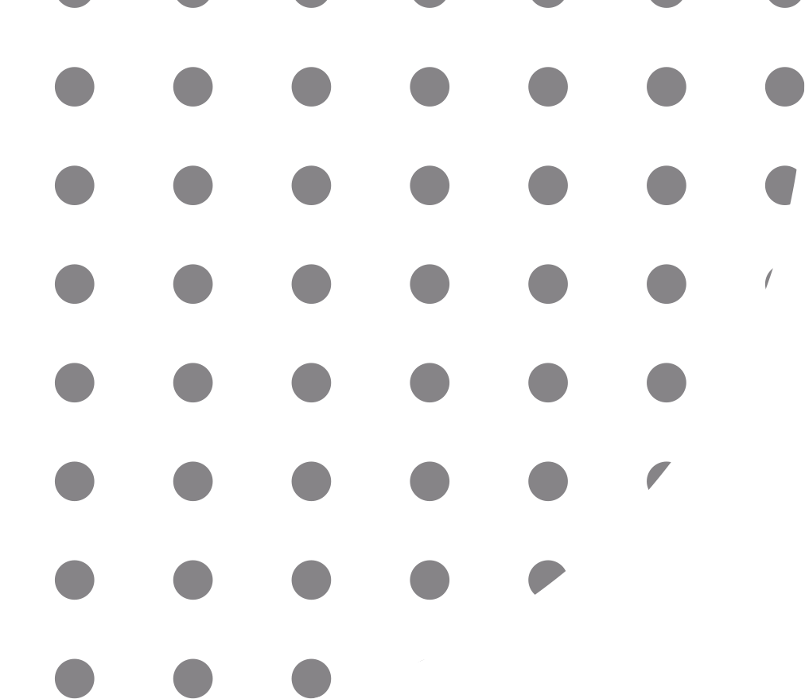
ExPred
Explain and Predict, and then Predict Again
Presented by Zhang, Zijian
Explain and Predict, and then Predict Again
Zijian Zhang, Koustav Rudra and Avishek Anand
L3S Research Centre, Leibniz Universität Hannover, Germany

Slide 2
A. Background
1) Background
2) Related works (1 for pipeline, 1 for end to end)
3) Problems of approaches ↑
B. Approach
3) our approach and its benefit (1 image)
4) Benefit of MTL (social attribute related?)
5) Hard results as bar image
6) Anecdotal examples
C. Next steps
Content(draft, delete when finished)

Slide 3



Overview
Background
Our Approach
On-going Works

Slide 4
Overview
Background
Our Approach
On-going Works

Slide 5


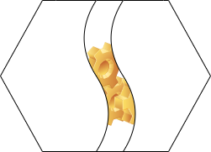
Background
+
Machine Learining models, emnipresent, however
We need
interpretable-by-design models
?
Models are used opaquely
!
Post-hoc approaches emits An Explanation instead of the reason

Slide 6
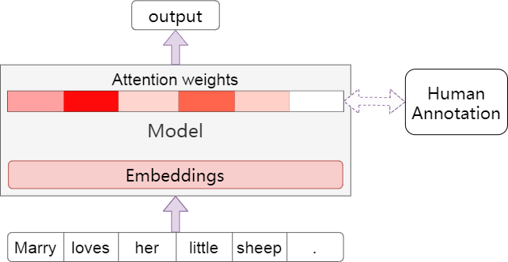

Related Works
A
Inspective interpretable models
+ No additional structures, faithful to the model
- Attention is (sometimes) not
explanation¹
- Nor is attention the reason
¹:Wiegreffe S, Pinter Y. Attention is not not explanation (EMNLP 2019)

Slide 7
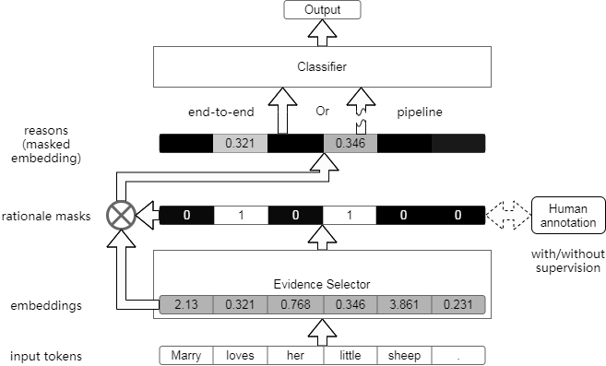
Related Works
B
End-to End models
C
Pipine models
Or
C
+ The evidence found is the evidencebased
- Task-irrelevant selection tends to overfit (pipeline)
- Classifier train and inferences on different
distributions (pipeline)
- Classifier misled by glitches of evidence finder

Slide 8
Overview
Background
Our Approach
On-going Works

Slide 9
Our Approach
TL; DR
Pipeline + Multi-Task Learning
diagram of expred, split into 2+2 pages,
1. highlight the mtl evidence finder, zoom in,
use the simplified mtl image and explain
the benefit of mtl
2. highlight the classifier and explain that
it's trained on those instances, where
the aux cls is correct
+1. (if asked) explain the lambda and searching
of the sweet point (figure 4)
+2. (if asked) explain the re-balancing of
rationale data

Slide 10
Our Approach
TL; DR:
Pipeline + Multi-Task Learning

Slide 11
Our Approach
Pipeline model:

Slide 12
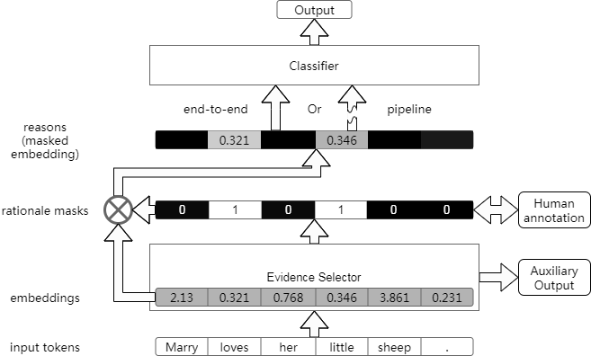
Our Approach
ExPred:

Slide 13
Our Approach
MTL Evidence Selector:

Slide 14
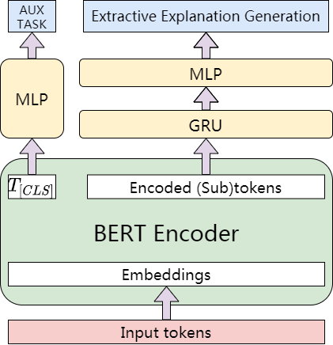
Our Approach
MTL Evidence Selector:

Slide 15
Our Approach
ExPred:

Slide 16
Our Approach
Interpretable Classifier:

Slide 17
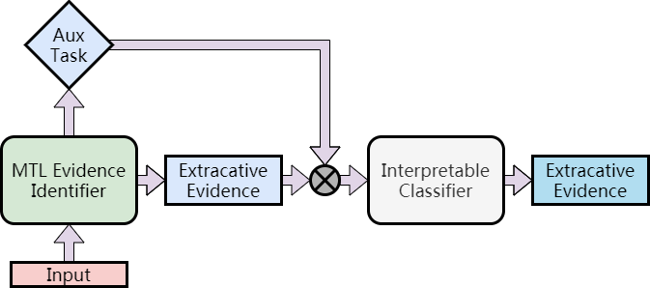
Our Approach
Interpretable Classifier:

Slide 18

Main Results
Ours
Ours
Ours

Slide 19
Main Results
Ours
Ours
Ours

Slide 20
Overview
Background
Our Approach
On-going Works

Slide 21


On-going works
Data:
More efficient way of collecting rational data
Model:
Long-document support
End-to-end version of ExPred

Slide 22
Thank You for Your Attention

