Slide 1
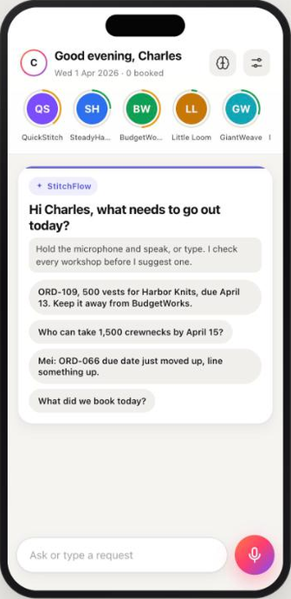
SWEATERCO
GROUP 11 / TRACK 2 / SPRINT 2 REVIEW
StitchFlow
The Quick-Response Subcontracting Desk
Say the order. StitchFlow finds the right workshop.
PRIMARY MINIMISE LATENESS
SECONDARY MINIMISE DEFECTS
Chen Zepeng (A0156784N)
Sridhar Niyanthri Rajeswari (A0351151U)
Present (in person)
Present (in person)
Duong Thanh Nhan (A0296326W)
Sundara Rajan Saadhvika (A0352594W)
Absent: business trip to China
Present (in person)
Joshua Wesley Gloor (A0296944J)
Tang Zheling (A0352177B)
Present (in person)
Present (in person)
GITHUB github.com/JoshuaGloor/dss5105-capstone-project
DEMO VIDEO [YouTube link: add after upload]
DSS5105 CAPSTONE / 30 OCTOBER 2026
Notes:
SLIDE 1 - Cover (0:00-0:13) Joshua
"Hi, we're Group 11, Track 2. This is StitchFlow: say an order, and it finds the right workshop.
Our primary objective is minimising lateness, and our secondary is minimising defects."

Slide 2
02 OBJECTIVE AND FOCUS
The dispatcher decides on the factory floor, in seconds
WHAT CHANGED SINCE SPRINT 1
THE USER
The production dispatcher at SweaterCo
SPRINT 1 | SPRINT 2
Earliest finish tied us on lateness | Default beats it: 1.42% late vs 1.67%, 68% fewer late days
Biggest capacity won on defects | Defects setting wins: 4.90% defective pieces vs 5.28%
Fairness not tuned | Fairness setting: largest share 19.2% vs random 22.6%
Typing at a desk only | Voice on the phone, read aloud, slide to book
No memory between requests | Remembers confirmed constraints, and says when it applies one
On the floor with a phone, not at a desk. Requests arrive in a group chat, and most are messy: missing dates, vague orders, banned workshops.
A REAL REQUEST FROM THE INBOX
"ORD-109, 500 vests for Harbor Knits, due Apr 13. ...and keep it away from BudgetWorks, the last batch came back rough."
WHAT THE DISPATCHER NEEDS
1 A safe workshop, its arrival date and why, in seconds
2 The constraint honoured, and who asked recorded
3 One deliberate step to commit; a record afterwards
Course simulator, mean of 10 normal runs (seeds 5105-5114); presets chosen on development seeds first. docs/OBJECTIVE_STUDY.md
Notes:
SLIDE 2 - Objective and focus (0:13-0:45) Joshua
"Our user is SweaterCo's dispatcher, out on the factory floor. Requests arrive in a group chat.
A wrong pick means a late order or a bad batch, so the dispatcher needs a safe answer in
seconds, with a record of why. That one job is our scope.
Since Sprint 1, we beat earliest finish, which tied us, our defects and fairness settings beat
their baselines, and the dispatcher can now talk to the desk."

Slide 3
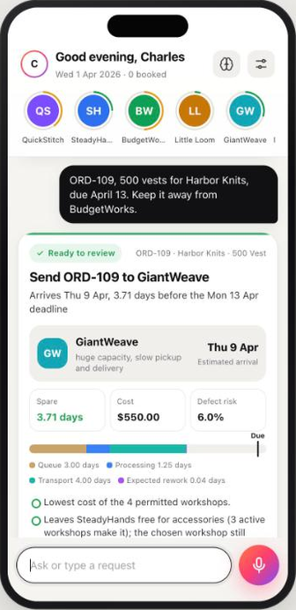
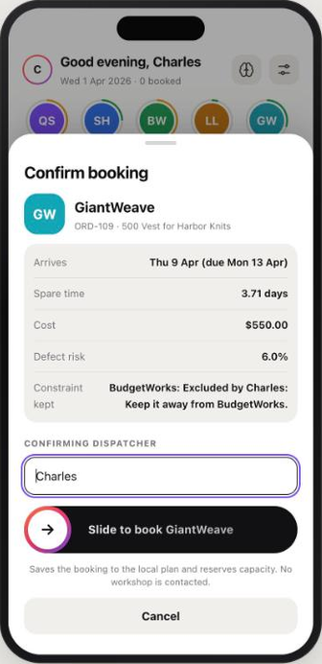
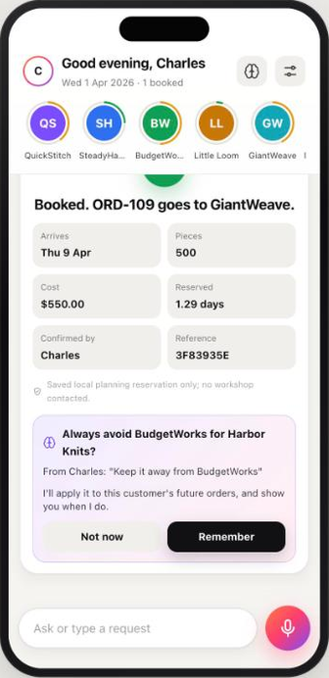
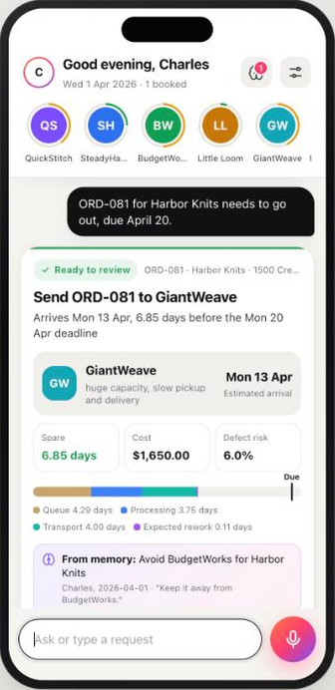
03 THE USER JOURNEY / THINK LIKE THE USER
Say it, check it, slide to book, and it remembers
1
Ask
2
Answer
3
Confirm
4
Remember
5
Reuse
Hold the mic: order, date and any constraint, in plain words.
Best workshop, arrival and spare days, and why. Read aloud.
"Book it" opens one sheet. One slide books it, with a name on it.
It offers to keep the constraint for this customer.
Next order: the rule is applied, and the card says so.
Live screenshots of the running app (local plan, model: the one set in .env). Voice proposes; only the slide commits.
Notes:
SLIDE 3 - The user journey (0:45-1:08) Saadhvika
"We designed the journey for the floor. The dispatcher holds the mic and says the order. The
desk answers on screen and out loud: the best workshop, when it arrives, and why. 'Book it' opens
a sheet, and a slide confirms. It offers to remember the constraint, and uses it on the next
order."

Slide 4
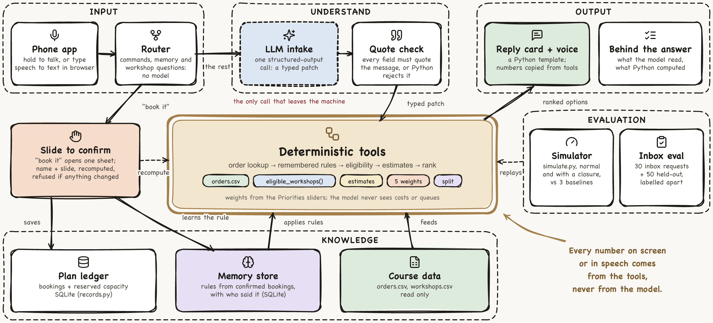
04 ARCHITECTURE AS BUILT
The model reads, Python computes, a person commits
Notes:
SLIDE 4 - Architecture (1:08-1:35) Joshua
"This is what we built. Speech becomes text in the browser, and Python answers commands like
'book it' itself. Everything else is one structured-output call, and every field must quote the
message. Deterministic tools then look up the order, apply remembered rules, check eligibility
and rank, so the model never does arithmetic. A slide confirms, and SQLite keeps the booking and
the rule."

Slide 5
05 KEY CHOICES
Each choice, against the alternative we considered
FOR | WE CHOSE | OVER | BECAUSE
MODEL | One hosted model, named in .env | A fine-tuned or local model | It only extracts quoted fields, so no training is needed; swapping it is one line
ORCHESTRATION | One fixed workflow | A ReAct agent loop | Every request needs the same checks in order: testable, cheaper, no tool-choice errors
RETRIEVAL | Exact lookup by order ID | Embedding retrieval (RAG) | Orders have keys; an exact match cannot fetch the wrong order
DATA STORE | SQLite for records and memory | A vector store | A rule must apply exactly, with who said it, and be auditable in one local file
TOOLS | The course's eligible_workshops() | Our own eligibility rule | Our checks and the course simulator can never disagree
REPLIES | Python templates | Model-written replies | No model arithmetic: dates and costs are copied from tool outputs
SPEECH | Browser speech recognition | Server speech-to-text | Free, live words while speaking, no extra key; typing always works
COMMIT | Slide to confirm | Book on a spoken "yes" | A misheard "yes" on a noisy floor cannot send work out
Trust boundary: the model call is the only thing that leaves the machine. It never sees costs, queues or defect rates.
Notes:
SLIDE 5 - Key choices (1:35-1:53) Niyanthri
"We chose a fixed workflow over a ReAct agent, because every request needs the same checks;
exact lookups over embeddings, so we never fetch the wrong order; exact rules in SQLite over a
vector store; and a slide, never a spoken yes."

Slide 6
06 PROGRESS SINCE THE SPRINT 1 ROADMAP
Every feature, its owner and its status
7/11
FEATURE | OWNER | STATUS
Voice assistant: phone UI, speech in and out, slide to book | Chen Zepeng | Done
Long-term memory: rules from confirmed bookings, log, profile | Chen Zepeng | Done
Four-objective scorer, frozen presets, objective lab | Chen Zepeng | Done
Capacity questions and workshop checks from chat | Chen Zepeng | Done
Chat-first desk redesign | Duong Thanh Nhan | Done
AWS deployment behind HTTPS (demo site) | Joshua Wesley Gloor | Done
Clarification reliability fixes and 247-assertion benchmark | Tang Zheling | In progress
Evaluation sets: 205 generated requests, 140 train and 65 test | Saadhvika and Niyanthri | Done
Independent labels for the 30 inbox requests | Saadhvika and Niyanthri | In progress
Re-run the 65 test requests on the current intake (v3) | Tang Zheling | Planned
Usability test: two people acting as dispatchers, four tasks | Joshua Wesley Gloor | Planned
features done this sprint
2 in progress
2 planned
Code: github.com/JoshuaGloor/dss5105-capstone-project. PRs: #15 and #18 this sprint, #16 and #17 evaluation sets, #14 clarification reliability.
Notes:
SLIDE 6 - Progress (1:53-2:11) Saadhvika
"Every feature has an owner. Seven of eleven are done, including the voice assistant, memory,
the four-objective scorer and 205 generated evaluation requests. In progress: clarification
fixes and independent inbox labels. Planned: Lynn's re-run of the test set, and Joshua's
usability test."

Slide 7
07 VALIDATION PLAN
What we measure, against what, and the hard cases
WHAT WE MEASURE, AND WHY
TODAY, COURSE SEEDS 5105-5114, NORMAL RUNS
Late batches and late days (our objective), defective pieces, largest share, change under a closure: the course simulator's own metrics. For language: the right behaviour on each request, and every number traced to a tool.
OBJECTIVE | OURS | BEST REFERENCE
Lateness (primary) | 1.42% late, 0.057 late days | earliest finish 1.67%, 0.178 | Beats all
Defects | 4.90% defective pieces | biggest capacity 5.28% | Beats all
Fairness | largest share 19.2% | random 22.6% | Beats random
Robustness | +0.083 pts late under closure | random +4.000 | Steadier
HOW THE EVALUATION SET IS BUILT
All 30 inbox requests by the 7 kinds in the data dictionary, plus 205 generated by Saadhvika and Niyanthri: 140 to tune on, 65 held out with new wording. Labels come from how each request was built, never from a model. First live run: test 63/65 passed (96.9%), train 134/140 (95.7%).
BASELINE AND TRACK MINIMUM
Random, biggest capacity and cheapest, plus the earliest-finish rule. Minimum: beat all three baselines on late batches and late days, and handle all 30 requests by kind.
HARD CASES AND HOW WE HANDLE THEM
1
Impossible date
Earliest date, days late, a two-shop split; no booking
2
Workshop that cannot take it
Refused with the reason, plus the best alternative
3
Misheard order on the floor
Order, customer, pieces read back from orders.csv; slide to commit
Allocation: presets chosen on seeds 6000-6029, course seeds run twice (OBJECTIVE_STUDY.md). Language: one gpt-5.6 run; a rubric pass rate, not model accuracy.
Notes:
SLIDE 7 - Validation plan (2:11-2:55) Niyanthri
"We measure late batches and late days, our primary objective, in the course simulator, with and
without a closure, against random, biggest capacity, cheapest and earliest finish. The minimum
is to beat all three baselines and handle all 30 inbox requests. Today: 1.4 percent late against
1.7, and 68 percent fewer late days. For language: the inbox plus 205 generated requests, 65 held
out with new wording; 96.9 percent passed on the first live run. Hard cases: an
impossible date, a workshop that can't take it, and a misheard order. We give options, refuse
with a reason, and read the order back."

Slide 8
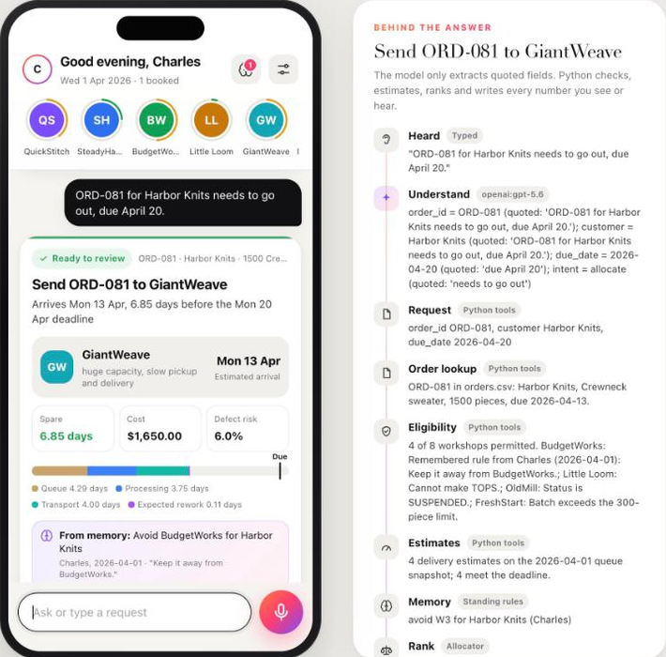
08 DEMO
Charles, as the dispatcher
1
Says a real inbox request out loud
2
Hears the best workshop and why
3
Says "book it" and slides to confirm
4
Lets it remember the constraint
5
A new order: the rule is applied
6
Hard case: a workshop that cannot take it, and an impossible date
7
Behind the answer: what the model read, what Python computed
Notes:
SLIDE 8 - Demo (2:55-4:50) Charles
Take B starts on this slide for two seconds:
Charles: "Now the demo."
Then the app. Times are from the start of the app part. Speak only when the app is quiet.
[0:00] Charles: "I'm Charles, playing the dispatcher. The rings show how busy each workshop is,
and OldMill is grey because it's suspended."
[0:08] Hold the mic and say: "ORD-109, 500 vests for Harbor Knits, due April 13. Keep it away
from BudgetWorks."
Let the answer play: "GiantWeave can deliver order 109 by Thursday 9 April, 3.71 days
early. Cost 550, defect risk 6.0%. Say book it, or tap book, to confirm."
[0:30] Tap "Compare 4 workshops", then "Can't take it", then close them. (optional)
Charles: "Here are the other options, and why the rest can't take it. BudgetWorks is out
because I asked."
[0:40] Hold the mic and say: "Book it." The sheet opens.
Charles: "Nothing is saved until I slide." Slide to confirm.
[0:52] On the receipt, tap "Remember".
Charles: "And it offers to remember that rule."
[0:58] Hold the mic and say: "ORD-081 for Harbor Knits needs to go out, due April 20."
Let the answer play, then point at the memory note on the card.
Charles: "Same customer, so the rule is applied, and the card says it came from memory."
[1:22] Charles: "Now a hard case, straight from the inbox."
Hold the mic and say: "QuickStitch for the scarves on ORD-103?"
Let the answer play: QuickStitch cannot make scarves, no workshop meets 4 April, and the
best alternative is 13.44 days late.
[1:45] Charles: "It refuses, gives the earliest option and a two-shop split, and books nothing."
[1:52] Open "Behind the answer". (optional)
Charles: "This panel shows what the model read, with quotes, and what Python computed."
[1:59] Stop recording.

Slide 9
STITCHFLOW
Thank you.
Questions are welcome.
GITHUB github.com/JoshuaGloor/dss5105-capstone-project
DEMO VIDEO [YouTube link: add after upload]
SAY THE ORDER / PYTHON CHECKS / A PERSON COMMITS
GROUP 11 / DSS5105 CAPSTONE / 30 OCTOBER 2026
Notes:
SLIDE 9 - Thank you (not recorded)
The video ends on the demo, so this slide stays in the deck for the Q&A only.
AFTER RECORDING
- Upload the .mp4 to YouTube as unlisted, then open the link in a private window.
- Put the link on slides 1 and 9:
DEMO_LINK=https://youtu.be/... node scripts/build_sprint2_deck.mjs
then export the PDF again, and open the GitHub link in a private window too.
- One member uploads the .mp4 and the .pptx (or .pdf) to Canvas by 15:00.
Q&A PREPARATION (not read aloud)
- Ruby (Duong Thanh Nhan) cannot attend: Ruby emails Salman and Jack with the reason before the
session, and slide 1 shows "Absent" with that reason. Any member may be asked about Ruby's desk
redesign: one answer at a time, objective panel, saved plan, Show working.
- Who is the user? SweaterCo's dispatcher, the person who handles the dispatch chat. Five
people post requests there (Ravi, Priya, Mei, Chen and the boss). In the demo Charles plays
the dispatcher and says requests from the chat out loud: Mei's R25 and the boss's R14.
- Why "StitchFlow"? Stitch for garments, flow for orders moving to the right workshop.
QuickStitch is one of the eight workshops, not us.
- How was the evaluation set built? 205 requests generated from templates with fixed seeds,
across the seven request kinds: 140 train, 65 test, and the test wording never appears in
train. Labels come from construction (the generator knows the order, date and constraint it
wrote) plus the deterministic dispatch preview, so no model labels them. Results are
behaviour-rubric pass rates from one gpt-5.6 run on intake-v2: train 134/140 (95.7%), test
63/65 (96.9%). They are not model accuracy. The three original train failures (TR053,
TR056, TR059) were an unneeded quantity question blocking a refusal, fixed in intake-v3.
- Is the demo real time? Yes. It is one take with no cuts; only the start and end are trimmed.
- Why voice? The track's bonus asks how a dispatcher would really use it: on the floor, on a
phone. Typing still works everywhere, and the course inbox is still evaluated as text.
- Can a misheard "yes" book something? No. "Book it" only opens the sheet. Saving needs a
name and the slide, and the preview is recomputed and checked for changes first.
- Does the model see costs or queues? No. It sees the message, the conversation, and the
workshop, customer and product names. Python computes every number.
- What does memory store? Constraints from confirmed bookings, with who said them and their
words; a log of answers and bookings; the dispatcher's name and priorities. Nothing is
learned from the model alone, and a rule can be paused.
- Did you tune on the course seeds? Presets were chosen on development seeds 6000-6029. The
course seeds were run twice: after the first run a desk case (R12) showed reservation could
prefer a slightly late shop, so we added an on-time-first charge and re-ran everything. It is
disclosed in docs/OBJECTIVE_STUDY.md; the default's numbers did not change.
- Where do baselines still win? Under the closure our default is 0.17 points worse on late
batches than earliest finish. The Sprint 1 lateness preset moves fewer late days under the
closure than our robustness preset. We do not claim a universal robustness win.

