Slide 1
SWEATERCO
GROUP 11 / TRACK 2 / SPRINT 1 REVIEW
THE NETWORK
The Quick-Response
Subcontracting Desk
QuickStitch
SteadyHands
BudgetWorks
Little Loom
GiantWeave
Nimble Needle
OldMill
FreshStart
Who should make this batch? Answered in minutes, with the reasoning on record.
PRIMARY OBJECTIVE MINIMISE LATENESS
OldMill suspended. FreshStart on trial, max 300.
Chen Zepeng (A0156784N) — Present (in person)
Niyanthri Rajeswari Sridhar (A0351151U) — Present (in person)
Duong Thanh Nhan (A0296326W) — Present (in person)
Sundara Rajan Saadhvika (A0352594W) — Present (in person)
Joshua Wesley Gloor (A0296944J) — Present (in person)
Tang Zheling (A0352177B) — Present (in person)
DSS5105 CAPSTONE / 16 OCTOBER 2026
Notes:
SLIDE 1 - Opening (CHEN ZEPENG, 0:25)
Good evening, we're Group 11. SweaterCo is a knitwear factory that lives on quick reorders. When the factory is full, the next batch has to go to one of these eight workshops within the hour. We built the desk that makes that call, shows its working and keeps the record. Our primary objective is to minimise lateness.

Slide 2
THE PROBLEM
Today, one chat message is the whole decision
“
THREE QUESTIONS, EVERY TIME
@Chen - order 042, 1,500 crewnecks. Send it to QuickStitch, need it back by the 19th.
1
Can they make it?
Four of the eight make tops only, so they cannot take a scarf order.
2
Can they take it now?
HOW ALLOCATION IS DECIDED TODAY / COURSE BRIEF
QuickStitch, “fastest in the region”, already has four days of work queued.
Everything behind it lives in one dispatcher’s head. Nobody can check it, and nothing is written down.
3
Are they allowed to?
OldMill is suspended after an audit. FreshStart is on trial, capped at 300 pieces.
7 of 30
requests in this morning’s inbox are plain allocations. The other 23 need a question, a refusal, a constraint or bad news.
Get one wrong and the batch bounces back a day later. In a ten-day cycle, that is the margin gone.
Notes:
SLIDE 2 - Problem (CHEN ZEPENG, 0:40)
Today, that decision is one line in a group chat: send it to QuickStitch. Behind it, someone is answering three questions from memory. Can they make it? Half of them can't make a scarf. Can they take it now? QuickStitch, the fastest, is booked solid for four days. Are they allowed to? OldMill is suspended, and FreshStart is on trial, capped at 300 pieces. And only 7 of this morning's 30 messages are straightforward. Get one wrong and the batch bounces back a day later, which in a ten-day cycle wipes out the margin.

Slide 3
OUR SOLUTION AND ARCHITECTURE
The model reads. Python calculates. A person approves.
OUTSIDE
OUR MACHINE / ONE PYTHON PROCESS: LOCAL ON 127.0.0.1, OR ON EC2 BEHIND CADDY
Group chat
STREAMLIT DESK
web_app.py chat_ui.py replies.py
the request as typed
The dispatcher’s screen: chat, ranked options, delivery chart and Confirm. Session state is the short-term memory: turns, draft and open questions go back to the model each turn. Replies are built from tool output.
message
preview for review
Confirm, name, retry key
EXTERNAL
1 LLM, VIA LANGCHAIN
2 DETERMINISTIC TOOLS
3 HUMAN IN THE LOOP
LLM provider
intake.py
dispatch.py allocator.py
records.py
Called through LangChain, model set by LLM_MODEL. Sees the message, earlier turns, the draft and names. Never prices, queues or defect rates.
Structured output fills a typed patch. A value is kept only if its exact quote is in the message; a gap gets a fixed Python question.
Order lookup, eligibility check, queue check, delivery estimator, overload probe and split planner, then a ranking by configured weights.
Confirm opens one SQLite transaction: recompute the preview, reject it if anything changed, then save the record and queues.
out: DispatchInput
out: preview, reasons, hashes
out: one audit record
BEGIN IMMEDIATE
TRUST BOUNDARY
evaluate.py
harness.py
track2/data
runtime/ SQLite
The model call is the app’s only outbound call. Streamlit telemetry is off.
Offline: 120 orders x 10 seeds, normal and closure runs. Same allocator, no model.
The course simulate.py, unmodified
orders.csv and workshops.csv, read-only
Long-term memory: audit records and the planning queues later previews read.
Agent pattern today: one well-tooled dispatcher, run as a workflow. The model never picks a tool or does arithmetic.
Notes:
SLIDE 3 - Solution and architecture (CHEN ZEPENG, 0:40)
So instead of one person juggling all that, we built one dispatcher agent, run as a fixed workflow. On the left, the model reads the message through LangChain. It's the only thing beyond this dashed line, and it never sees a price or a queue. Every value must quote the message's exact words, or Python rejects it, and anything missing becomes a question, not a guess. In the middle, Python tools work out who is eligible and when each workshop would deliver. On the right, a person approves. The session remembers the conversation; the database remembers every decision.
Q&A on the agent pattern: a workflow agent, which the track calls a single well-tooled dispatcher: the LLM and the tools run on a fixed code path. Not ReAct: every request needs the same checks in the same order, so letting the model choose tools in a loop adds cost and nondeterminism without accuracy. Not multi-agent: the track says a plain dispatcher with excellent tools beats a multi-agent conversation. Sprint 2 adds tool selection for read-only capacity questions only; Python still runs the tool and writes the answer.
Q&A on LangChain and memory: llm.py builds the model with LangChain init_chat_model (provider-agnostic, LLM_MODEL); intake.py calls with_structured_output against a JSON schema. No LangGraph: a fixed pipeline needs no graph runtime. Short-term memory is Streamlit session state (turns, draft, open questions, provenance, model traces; 16 turns per conversation). Long-term memory is SQLite: audit records and planning queues. No vector store: the data is small and structured, so tools query it directly.
Q&A: one structured-output call per chat turn, not autonomous agents. The model returns a typed patch; each value must appear inside an exact quotation from the latest message, or Python rejects the turn (intake.py). Clarifying questions are fixed Python text, not model prose. get_model() reads LLM_MODEL from .env, with a 30 s timeout and no retries.
Q&A: locally the app binds to 127.0.0.1. On AWS it runs in a container behind Caddy with a password, and its secrets come from Parameter Store, never the repo or GitHub. Streamlit telemetry is off in both (.streamlit/config.toml). The only outbound call the app makes is the model call in intake.py. Its payload is the latest message, earlier user turns, the draft so far, and the workshop, customer and product names. Each turn records the model name, a prompt hash and the returned patch.
Q&A on controls: in banking terms this is maker-checker. The model proposes fields, Python checks them, and a person confirms; the record keeps who set each constraint and who confirmed. The confirming name is self-declared, not authenticated yet.
Q&A: confirming recomputes the preview inside a SQLite BEGIN IMMEDIATE transaction and compares its fingerprint; a changed queue revision or forged estimate is rejected, and an idempotency key makes a double click save once (records.py).

Slide 4
PRIMARY OBJECTIVE
We declare: minimise lateness
WHY
ALL FOUR COURSE OBJECTIVES: WINS AND LOSSES
Quick response sells speed. A defect can be reworked; a missed reorder date loses the sale.
OBJECTIVE | OUR BEST SETTING | VERDICT
Minimise lateness | 1.7% late, vs 34.2% for random | Beats all three baselines
Minimise defects | 5.5% defective pieces, 18.4% late | Biggest-capacity still wins (5.3%)
Robust to failure | Closure adds 0.25 points late; random adds 4.0 | Steadier than random and biggest. Cheapest stays 92% late either way
Fair allocation | Not tuned yet: the busiest workshop takes 26.2% of pieces | Random spreads work more evenly (22.6%)
MEASURED BY
The share of batches that arrive late, and the average days late, from the course simulator.
BAR TO CLEAR
Beat random, biggest-capacity and cheapest on both measures, in normal runs and in the closure test.
Course simulator, mean of 10 runs (seeds 5105-5114). The defects setting was chosen on separate development seeds before this run.
Notes:
SLIDE 4 - Primary objective (0:35)
We declare one objective: minimise lateness. In quick response, speed is the product: a defect can be reworked, a missed reorder date loses the sale. We count late batches and late days. Here is the scoreboard, wins and losses. Lateness: we beat all three baselines. Defects: biggest-capacity still beats us. A surprise closure moves us a quarter of a point; random moves four. Fairness: random spreads work more evenly, but it is late a third of the time.
Q&A: defects setting defects0.5_buffer0 was picked on development seeds 6000-6009, then run once on the course seeds. It beat biggest-capacity on only 2 of 10 course seeds. Evidence: docs/evidence/defects-frontier.json.

Slide 5
BUSINESS VALUE
95% fewer late batches than random allocation
1
Operational efficiency & risk reduction
1.7%
No bounced batches: the course’s own eligibility rule runs before anything is recommended.
2
Transparency & auditability
of batches late, 2 in 120, when queue, processing and transport are checked before choosing
A full record of the request, every option, the estimates, who set each constraint and who approved.
3
Proactive exception management
34.2%
An impossible date gets the earliest achievable date and the options: split, accept late, escalate.
41 in 120 for a random eligible workshop
4
Transparent cost-speed trade-offs
115.6k cost units per run, against 86.0k for always-cheapest (late on 92% of batches) and 111.8k for random.
Course simulator, 10 runs. Not a factory result.
Notes:
SLIDE 5 - Business value (0:30)
What does that buy? Out of 120 batches, 2 arrive late instead of 41: ninety-five percent fewer than random. That's the course simulator, not a factory. And no batch goes where it can't be made, every decision is on record, and an impossible date is flagged on day one, with options. The price: about a third more than the cheapest rule, which is late nine times in ten.
Q&A: cost per replay 115,592 for our desk, 111,780 for random, 85,960 for cheapest; ratio to cheapest 1.34 (source cost units, not dollars).

Slide 6
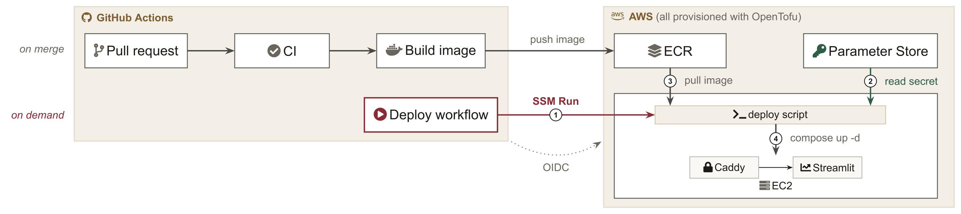
SPRINT 1 PROGRESS
Working allocator, working deployment pipeline
% OF BATCHES LATE, MEAN OF 10 RUNS. LOWER IS BETTER
HONEST FINDING
Normal run
Added by the closure test
Earliest finish ties us. Lateness is near its floor: two batches of 2,000 accessories cannot be made in their window.
Random
34.2 / 38.2
Biggest capacity
84.3 / 84.9
Cheapest
91.8 / 91.8
WHAT OUR ALLOCATOR ADDS
Earliest finish
1.7 / 1.9
The same code, re-weighted: a 10-day buffer cuts cost 7.7%, below random’s, and late days 23%, for about one more late batch per ten runs.
Our desk
1.7 / 1.9
Course simulator, seeds 5105-5114; buffer chosen on seeds 6000-6009 first. Sources: docs/V3_EVALUATION.md, docs/MARGIN_STUDY.md, docs/DEPLOYMENT.md (main).
Notes:
SLIDE 6 - Progress (0:35)
The shipped baselines run a third to nine-tenths late; we're under two percent. The honest part: a ten-second earliest-finish rule ties us, because two batches of 2,000 pieces simply can't be made in their window. So what we add isn't a better formula, it's configuration. The same code, re-weighted, buys 7.7 percent lower cost and 23 percent fewer late days for one more late batch per ten runs. And it's deployed: every merge builds an image to ECR, and one workflow deploys it to AWS.
Q&A: buffer cuts cost 7.7% and late days 23%; % late 1.8% vs 1.7%. The late batches are ORD-062 and ORD-108.
Q&A on deployment: a push to main builds an image and pushes it to ECR. The manual Deploy workflow finds the instance by tag and sends a script over SSM, so there is no SSH. The instance reads its secrets from Parameter Store, pulls the image and runs docker compose: Caddy with a password in front of Streamlit. GitHub assumes an AWS role through OIDC, so no AWS key is stored anywhere, and a curl check confirms the site answers. Confirmed allocations persist in a docker volume. The instance is stopped when unused; the Power workflow starts it.

Slide 7
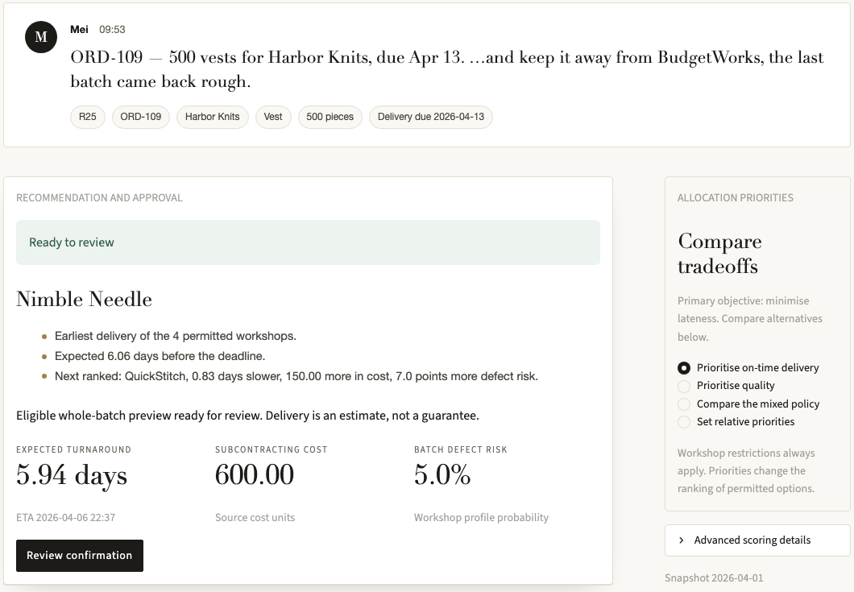
SPRINT 1 PROGRESS / THE DESK TODAY
Candidates, estimates and the choice, at a glance
1
The message stays in view
Request R25: "keep it away from BudgetWorks". The exclusion is applied and recorded against Mei, who asked.
2
It says why, in Python’s words
Earliest of the permitted workshops, days to spare, and how the next option compares. No model writes these lines.
3
Where the days go
A chart splits each option into queue, processing, transport and rework, so a busy “fast” workshop shows up.
4
Review before anything is saved
Confirming rechecks the queues first, then writes one audit record.
ALSO WORKING
All 30 inbox requests reach the right outcome from hand-checked inputs / live chat that asks when unsure / stale-safe saved plan / 300 offline tests
Notes:
SLIDE 7 - The desk today (0:25)
This is the desk on request R25: five hundred vests, keep it away from BudgetWorks. The exclusion is recorded against Mei, who asked. Under the pick, the desk says why, in lines Python writes, not the model. All thirty inbox requests reach the right outcome from hand-checked inputs; testing the live model on them is our first Sprint 2 task.

Slide 8
RISKS AND KEY ASSUMPTIONS
What could go wrong, and what we assume
RISK
CHANCE / IMPACT
WHAT WE DO ABOUT IT
KEY ASSUMPTIONS
The model misreads a request
High / High
Every field must quote the message; Python checks it and asks when unsure. First live run: one needless question blocked a refusal.
Each inbox request is judged on the 1 April queues, on its own.
A message tries to bend the rules
Medium / High
Eligibility is a Python check the model cannot switch off. A suspended workshop is refused; exclusions cannot be relaxed mid-chat.
A defect means half the batch is redone, as in the simulator.
A number no tool produced
Medium / High
Tools format every number, and an automatic check compares each figure on screen with tool output.
Workshop prices are our subcontract cost, not the customer’s price, so price questions are declined.
Tuning to the 120 supplied orders
Medium / Medium
Choose settings on separate development seeds, then run the course seeds once.
A person confirms every allocation. No workshop is contacted automatically.
The simulator is simpler than a factory
Certain / Medium
Say so, keep its default run as the yardstick, and test the desk with dispatchers.
Notes:
SLIDE 8 - Risks and assumptions (0:30)
The worst failure in this track is an invented delivery estimate; our design prevents it and we check it automatically. The likeliest is a misread request: in our first live run, a needless question blocked a refusal. And no message can talk past the rules: eligibility is Python, not the model. Our key assumption: a person confirms every allocation.

Slide 9
SPRINT 2 ROADMAP / DUE 30 OCTOBER
From working tools to an AI-native desk
 | WORK | SUCCESS CRITERION
1 | Evaluation set first | 30+ questions checked against the data, 10 held out, 5+ injection and bait items
2 | Live chat on all 30 inbox requests | Labels two teammates write independently; decision and explanation scored apart
3 | Tool calling for questions | "Who can take 1,500 crewnecks?": the model picks a read-only tool, Python answers
4 | Grounded explanations and replies | The model writes with placeholders; Python fills every number, nothing auto-sends
5 | LLM judge, checked against people | Agreement with both human labellers reported; people stay the ground truth
6 | Freeze the second objective and hybrid | Weights fixed on development seeds, metrics on a common scale, one course run
7 | Demo video | Request, clarify, refuse, impossible date, confirm
OUR SUCCESS CRITERION Live chat gets the right behaviour on at least 27 of 30 inbox requests against independent labels, with no number on screen that lacks a tool source, while the desk still beats all three baselines.
Notes:
SLIDE 9 - Sprint 2 roadmap (0:25)
Sprint 2 makes the desk AI-native, while tools keep every number. The evaluation set comes first, with injection and hallucination bait. Then the model takes on three jobs: choosing a read-only tool for questions, explaining decisions, and drafting replies, with Python filling in every number. Our bar: the right behaviour on at least twenty-seven of thirty, with no untraceable number, while still beating every baseline. Thank you.

Slide 10
SWEATERCO
Thank you.
Questions are welcome.
THE MODEL READS / PYTHON CALCULATES / A PERSON APPROVES
GROUP 11 / DSS5105 CAPSTONE / 16 OCTOBER 2026
Notes:
SLIDE 10 - Questions
Q&A crib notes are in this slide's speaker notes.
Q&A preparation. Keep each answer to one or two sentences, then offer the evidence.
Why use an LLM at all? The input is chat, and only 7 of the 30 inbox requests are plain allocations; the rest need a question, a refusal, a constraint or bad news. The model extracts fields and flags what is missing; it never decides numbers. The allocator itself has no LLM call.
What if the model hallucinates? Model output is a typed patch; every value must appear inside an exact quotation from the message, or Python rejects the turn (fails closed, no repair). Every number on screen is formatted by a tool, and we check that automatically.
What does the model provider see? The chat text, earlier turns in that conversation, and the lists of workshop, customer and product names. Never prices, queues, defect rates or order quantities (intake.py builds the payload).
What if the provider is down? The desk says the model is unavailable and asks for a retry: 30-second timeout, no silent retries. Inbox examples, the workshop register and the simulator keep working with no key.
Is it AI-native? The conversation is the main interface and the model does the language work: it understands, asks, and from Sprint 2 chooses a read-only tool, explains and drafts the reply. Tools own every number; a person owns every commitment. We deliberately skip RAG (8 workshop cards and 120 rows are better served by exact tools), fine-tuning (30 labels is too few) and an LLM inside the allocator (the track forbids it). Plan: docs/AI_NATIVE_PLAN.md.
Why not a multi-agent design? The course says a plain dispatcher with good tools beats a transcript. One structured-output call per turn keeps every decision in deterministic, testable Python.
Scale and security? Single-node SQLite and a self-declared dispatcher name: right for a prototype, not production. Next: real authentication and a server database behind the same record contract.
Earliest finish ties you, so what do you add? Chat intake, enforced constraints with who imposed them, a confirmation and audit trail, and a configurable objective that can trade cost against lateness. On lateness alone the simple rule is as good, and we say so.
Why not defects? Chasing quality sends work to small, slow workshops. Pure defects is 95.1% late. Our best defects setting still loses to biggest-capacity on defective pieces.
Robustness? Closure raises our late rate by 0.25 points. A cheating oracle that knows the closure only improves on us by about one batch in ten runs, so stall detection is not worth building for this simulator.
Cost and latency of the model? One structured-output call per chat turn. The first live run (pre-v3, docs/CHAT_EVALUATION_RESULTS.md) used 34,516 tokens and 135.5 seconds summed over 30 requests: about 1,150 tokens and 4.5 seconds each. Examples mode and the simulator need no API key at all.
Audit six weeks later? Each saved allocation stores the request, constraints and who set them, every candidate estimate, weights, data hashes, who confirmed, and when.

