Slide 1
GROUP 11 / TRACK 2 / SPRINT 1
Quick-Response Subcontracting Desk
Understand the request. Calculate with tools. Confirm with evidence.
Primary objective: minimise lateness
Team members: [add names before upload]
DSS5105 Capstone / 5-min live presentation + 2-min Q&A / 16 Oct 2026
Notes:
0:15. Name the track and the one-line idea: the language model understands, Python tools calculate, a human confirms. Then move on.

Slide 2
PROBLEM AND PROPOSED SOLUTION
Today one chat message is the whole decision
@Chen - order 042, 1,500 crewnecks. Send it to QuickStitch, need it back by the 19th.
Our desk
Understand
1
LLM reads the chat request, asks when an order, number or date is missing
Three questions live in one dispatcher's head
1
Can they make it?
product category
Calculate
2
Python checks eligibility and estimates delivery for every candidate
2
Can they take it now?
queue and daily capacity
3
Are they allowed to?
suspended shop, trial batch cap
Confirm
3
Dispatcher reviews the recommendation; the decision is saved with its evidence
Get one wrong and the batch bounces back a day later. In a ten-day cycle that is the margin gone, and nothing is written down.
Notes:
0:40. The group chat is the interface we replace, so the language layer is not optional. Walk the three questions quickly. Then: the LLM reads and asks; it never calculates. Python answers the three questions; a person confirms.

Slide 3
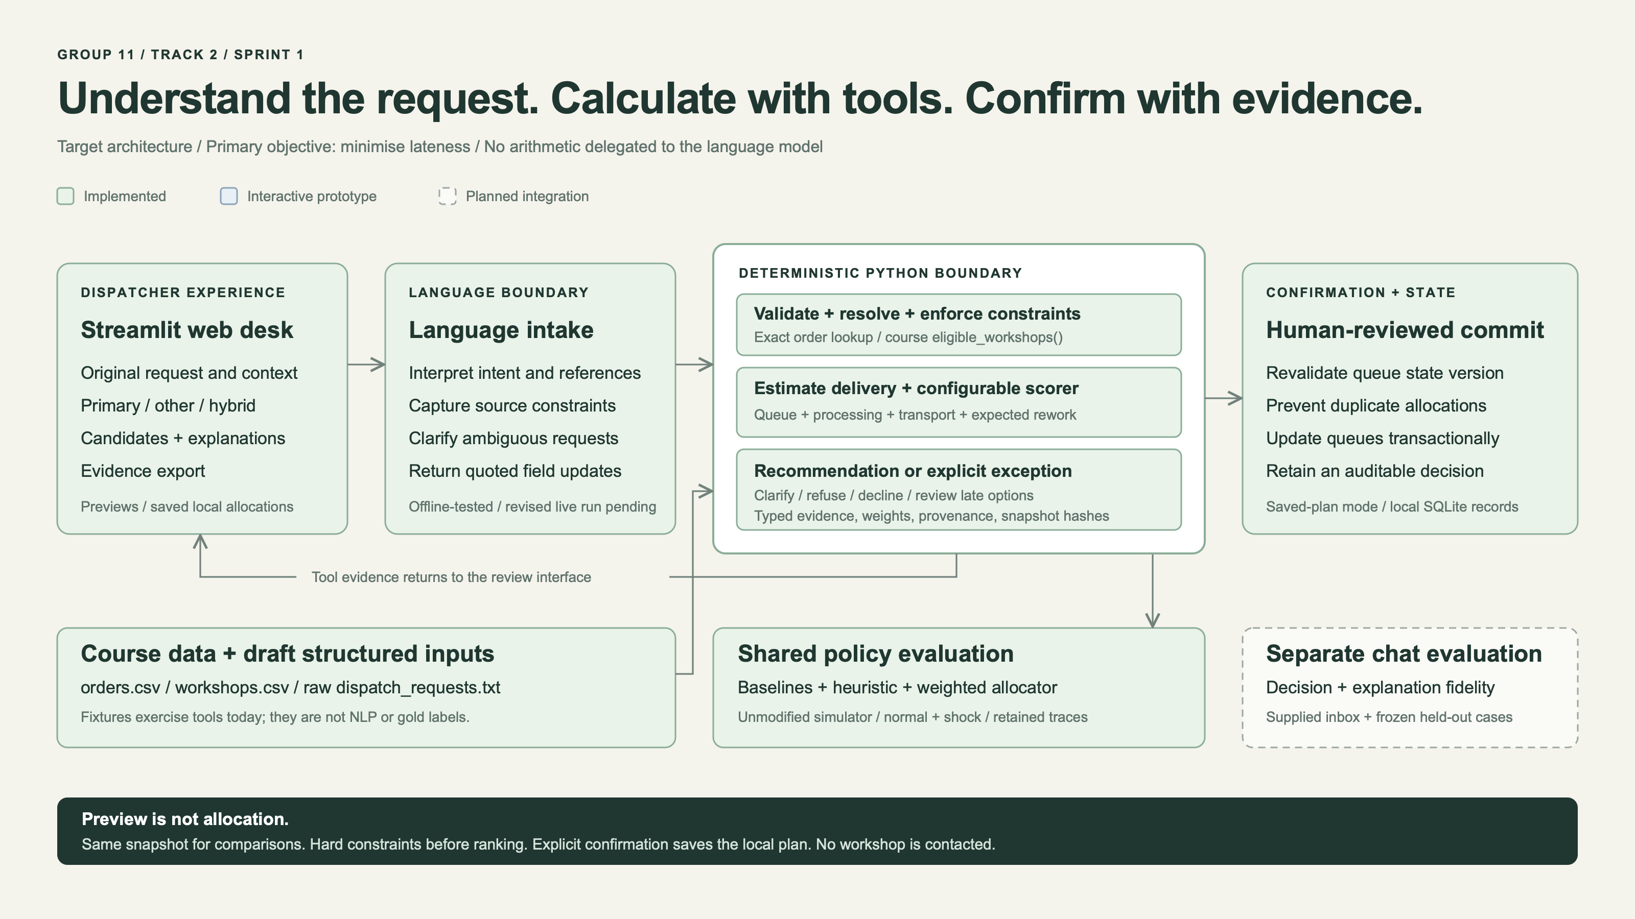
Notes:
0:40. Three boundaries. Language boundary: the LLM extracts intent, references and constraints with quoted source spans; Python validates every field and malformed output fails closed. Deterministic boundary: the course's eligible_workshops(), a delivery estimate of queue + processing + transport + expected rework, and one configurable scorer; every numeral the user sees is formatted by a tool. Confirmation boundary: a preview is not a reservation; confirming revalidates queue state, writes one SQLite record and updates queues atomically. The same scorer runs inside the shared simulator, with no LLM in the allocator.

Slide 4
PRIMARY OBJECTIVE
We declare: minimise lateness
Measured by % late and late days, against random, greedy_biggest and cheapest
Business
Quick response sells speed. A defect can be reworked; a missed reorder date loses the sale.
Candidate | Measured on 10 course seeds | Verdict
Lateness | 1.7% late, 0.18 late days vs random 34.2% / 6.13 | Beats all three
Defects | Pure defects: 2.9% def pcs, but 95.1% late | Fails guardrail
Robustness | Shock change +0.25 pp late; cheapest +0.00 pp, already 92% late | Metric ceiling
Fairness | Max share 26.2% vs random 22.6%; random is near the floor | Not built
Evidence
The only candidate where we beat all three baselines on the course metric, with no asterisk.
Other objective: minimise defects, reported as a comparison.
Hybrid: lateness first, defects second, with a deadline safety buffer. Weights frozen on development seeds in Sprint 2, before the course seeds are run. Our first 0.7/0.3 hybrid ran 18.8% late and is retired.
Sources: docs/V3_EVALUATION.md (paired normal controls, shock-minus-normal), seeds 5105-5114.
Notes:
1:00. Declare it first, then why. Business: quick response sells speed; a defect can be reworked, a missed reorder date cannot. Evidence: walk the table in one breath each. Defects: chasing quality sends work to small, slow shops and 95% of batches go late. Robustness: cheapest is already 92% late, so the shock cannot make it worse; the metric rewards being late already. Fairness: not built, and random already sits near the floor. We still report defects as the other objective and a hybrid, as required. The first hybrid ran 18.8% late on the course seeds, so we retire it and choose the next one on development seeds before touching the course seeds.

Slide 5
BUSINESS VALUE
Fewer late batches, and every decision on record
1
No bounced batches
1.7%
Eligibility is checked with the course's own rule before any recommendation.
2
Decision on record
of batches late when the queue, processing and transport are checked first
Request, candidates, estimates, constraints, who imposed them and who confirmed.
3
Explicit bad news
34.2%
for a random eligible shop
Impossible dates get the earliest achievable date and options: split, accept late, escalate.
4
Honest cost
Shared simulator, 10 seeds; not a field result
Speed is not free: 115,592 per replay vs 85,960 for the cheapest rule.
Sources: docs/V3_EVALUATION.md, paired normal controls (% late, cost), seeds 5105-5114.
Notes:
0:30. Lead with the number, then say what it is: simulator evidence, not a field result. The other three points are what the group chat never gave: no ineligible allocation can be proposed, every decision is recorded, and impossible dates get honest options. Close on the cost: we pay about a third more than the cheapest rule for that speed.

Slide 6
SPRINT 1 PROGRESS
We beat every baseline, and tie a ten-second rule
% of batches late, mean of 10 course seeds
Honest finding
Earliest finish ties us on lateness. Lateness is near its floor: two 2,000-piece accessory batches cannot be made in their window.
Normal
Shock
random
34.2
38.2
greedy_biggest
84.3
What configuration adds
A 10-day deadline buffer that spends slack on price: cost -7.7%, late days -23%, about one more late batch per ten normal runs.
84.9
cheapest
91.8
91.8
earliest finish
1.7
Also working: Streamlit desk; all 30 inbox requests reach their intended state on hand-authored inputs; saved-plan confirmation in SQLite; 278 offline tests.
1.9
ours: lateness
1.7
1.9
Sources: docs/V3_EVALUATION.md (10 course seeds, normal controls and shock); docs/MARGIN_STUDY.md (cost_buffer10).
Notes:
0:45. The chart: the shipped baselines are late on a third to nine-tenths of batches; queue-aware policies on about 2%. Then say it plainly: a ten-second earliest-finish rule ties us, because lateness is near its floor. What our scorer adds is configuration: a deadline buffer cuts cost 7.7% and late days 23% for about one extra late batch per ten normal runs, four under shock. The 30/30 fixture replay uses hand-authored inputs; it tests the tools, not language understanding. The live chat rerun is Sprint 2.

Slide 7
RISK ASSESSMENT AND KEY ASSUMPTIONS
What could go wrong, and what we assume
Risk | Prob. | Impact | Mitigation
LLM states a number no tool produced | Medium | High | LLM only extracts; tools format every numeral; automated check per candidate and field
Misread request (first live run: an unneeded question blocked a refusal, R14) | High | High | Independent gold labels; held-out requests written before tuning; fail closed
Tuning to the 120 supplied orders | Medium | Medium | Choose on development seeds; freeze before course seeds; disclose reuse
Simulator simpler than a factory | Certain | Medium | State it; keep the default run as the yardstick; argue with evidence
Key assumptions
Each inbox request is judged on the 1 April queue snapshot, independently
A defect means half the batch is redone, as in the harness
cost_per_piece is subcontract cost, not customer price, so quote questions are declined
A human confirms every allocation; no workshop is contacted automatically
Notes:
0:40. The worst failure in this track is an invented delivery estimate; our design prevents it structurally, and we check it automatically. The most likely failure is misreading a request: in our first live run one unnecessary question blocked a required refusal. Mitigation is independent labels and a held-out set written before tuning. Assumptions: independent 1 April snapshot per request; defects cost rework as in the harness; cost is subcontract cost, not customer price; a human confirms everything.

Slide 8
SPRINT 2 ROADMAP / DUE 30 OCT
From working tools to a measured chat desk
Work | Owner | Priority | Success criterion
Live chat rerun on the v3 inbox; fix clarification defects | TBD | High | 30/30 run end to end; judged against independent labels, per request kind
Evaluation set | TBD | High | >= 30 questions verified against the data files; >= 10 held out before tuning
Register query and overload probe tools | TBD | High | "Who can take 1,500 crewnecks this week?" answered from tools
Hybrid freeze | TBD | Medium | Weights fixed on development seeds, then one course-seed run
Faithfulness check | TBD | Medium | 0 displayed numerals without a matching tool field
Demo video | TBD | Medium | Request, clarification, refusal, impossible date, confirm
Final success criterion for the primary objective: beat random, greedy_biggest and cheapest on both % late and late days, normal and ten-seed shock, and report where earliest finish and cheapest still win.
Notes:
0:30. Sprint 2 is about measurement: rerun the live chat on the v3 inbox, build the 30-question evaluation set with held-out cases, add the register and overload tools the track asks for, and freeze the hybrid before looking at course seeds. Close with the primary-objective success criterion, including where baselines still win.

