Slide 1
311 Automatic Agency Detection
CS 677 - Machine Learning - Final Project - Pace University
Joshua Gottlieb, Alex Yoo, Aryan Lagalwar, Jinhwi Lee

Slide 2
Project Overview
In New York City, 311 is a non-emergency phone number for access to government services and information. https://portal.311.nyc.gov/about-nyc-311/
Unlike 911, 311 is not meant to report crimes and can be redirected to a number of agencies. This project aims to use the 311 service data for the year of 2024 to create a machine learning model to automatically predict which agency should handle an incoming request. https://data.cityofnewyork.us/Social-Services/311-Service-Requests-from-2010-to-Present/erm2-nwe9/about_data
This corresponds to a multiclass classification problem. Correct assignments to agencies is important to make sure requests are resolved properly and to prevent wasted time and resources.
The 311 data for 2024 contains over 3 million records, representing a robust dataset.

Slide 3
Data Cleaning - Feature Elimination and Engineering
The 311 data had 41 columns. Most of these columns are not relevant to the problem or only apply to a limited number of requests (e.g. Vehicle Type, Taxi Pickup Location).
The first step we performed was to narrow the list of features substantially to 10 features:
Created Date, Closed Date, Agency Name, Complaint Type, Location Type, Incident Zip, City, Borough, Latitude, and Longitude
We then engineered some features using the time columns for the purposes of EDA:
Time of Day (Day, Afternoon, Evening, Night in 6 hour increments)
Day of Week and Month
Resolution Time [hours]
(Closed Date - Created Date, rows with negative resolution time were dropped)
Resolution Status (Whether the complaint was resolved within the 2024 data)
Notes:
Created Date and Closed Date were dropped after using them to create other time-based features
Only ~700 rows had negative resolution time when dropped

Slide 4
Data Cleaning - Feature Cleaning (Agency Name)
The target variable (Agency Name) contained a number of agencies with low representation, so agencies with less than 1% representation were grouped together into a single category of Other, giving the following agencies:
1. New York Police Department (NYPD), 2. Department of Housing Preservation and Development (HPD), 3. Department of Sanitation (DSNY), 4. Department of Transportation (DOT), 5. Department of Environmental Protection (DEP), 6. Department of Parks and Recreation (DPR), 7. Department of Buildings (DOB), 8. Department of Health and Mental Hygiene (DOHMH), 9. Department of Homeless Services (DHS), and 10. Other
Low class representation causes problems for modeling as it causes large class imbalances. Agency names were replaced with their corresponding acronyms for brevity in display.
Notes:
The agencies with <1% representation were: Taxi and Limousine Commission, Economic Development Corporation, Department of Consumer and Worker Protection, Department of Education, Office of Technology and Innovation

Slide 5
Data Cleaning - Feature Cleaning (Complaint and Location Types)
There were 191 unique complaint types. Many of these complaints could be grouped into similar categories, so we created 9 complaint type categories:
1. Noise Complaints, 2. Animal-Related Complaints, 3. Traffic & Parking, 4. Building & Facility Complaints, 5. Public Safety & Legal Issues, 6. Environmental Complaints, 7. Health & Food-Related, 8. Community Services & Outreach, 9. Other
Similarly, there were 141 unique location types. We created 6 location type categories to sort these location types:
1. Street, 2. Residential, 3. Commercial, 4. Residential, 5. Outdoor, 6. Other
This greatly reduces the dimensionality of our data and makes the data easier to interpret.
Notes:
Not all of these mappings are perfect, as there was some human error trying to manually assign this many types to categories.

Slide 6
Data Cleaning - Feature Cleaning (Location Data)
City was used to filter out records outside of NYC. After doing so, it was found that most of the records in City corresponded to the same data as Borough, so the City column was dropped.
Missing ZIP codes were imputed where possible using Latitude and Longitude with the GeoPandas library and a ZCTA shapefile from the US Census (https://www2.census.gov/geo/tiger/TIGER2023/ZCTA520/).
This meant location data could be used to get exact ZIP codes. Any remaining missing ZIP codes were imputed using the mode of ZIP codes from the same borough to try to preserve ZIP codes as close as possible to similar data points.
Notes:
ZIP codes not in NYC were converted to NaN and then imputed, rather than being dropped entirely. There are a total of 283 ZIP codes in the 5 boroughs of NYC, according to Zillow, which is what we used to verify the NYC ZIP codes.

Slide 7
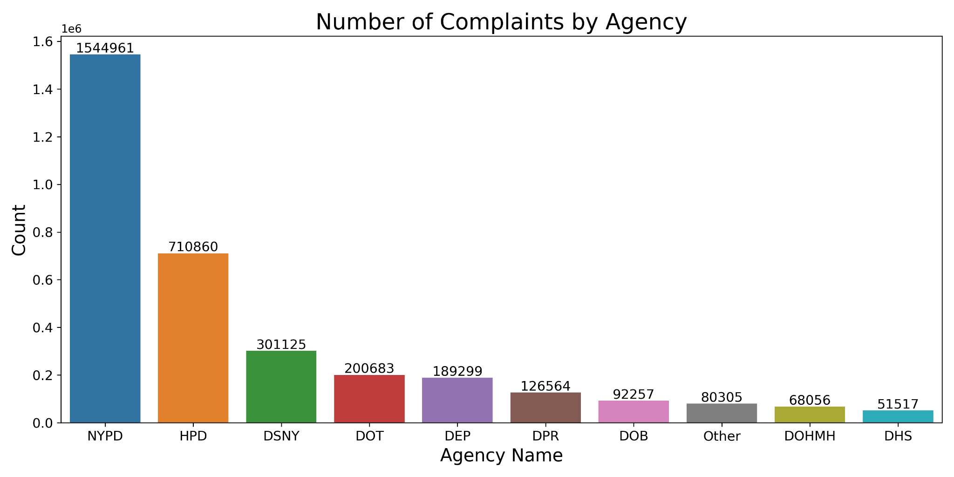
EDA - Complaints by Agency
Notes:
The NYPD comprises ~46% of the data and the HPD ~21%, with a big drop-off of the DSNY at ~9% of the data. This shows large class imbalances that we need to be aware of when modeling.

Slide 8
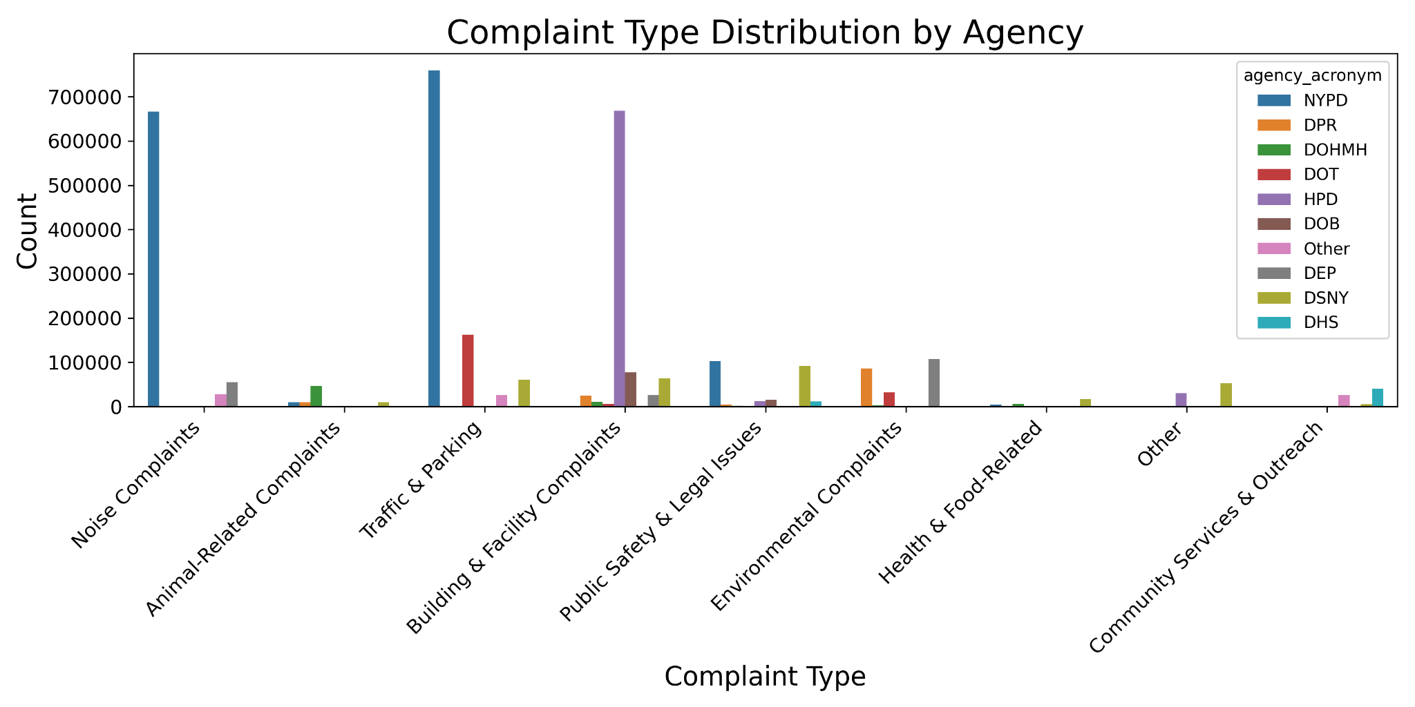
EDA - Complaint Type by Agency
Notes:
Complaint type does a good job at distinguishing classes. NYPD mostly deals with Noise Complaints and Traffic & Parking. HPD (Housing Preservation & Development) mostly deals with Building Complaints. The DHS (Homeless Services) mostly deals with Community Service, and the DEP (Environmental Protection) and DPR (Parks and Recreation) mainly deal with Environmental Complaints.

Slide 9
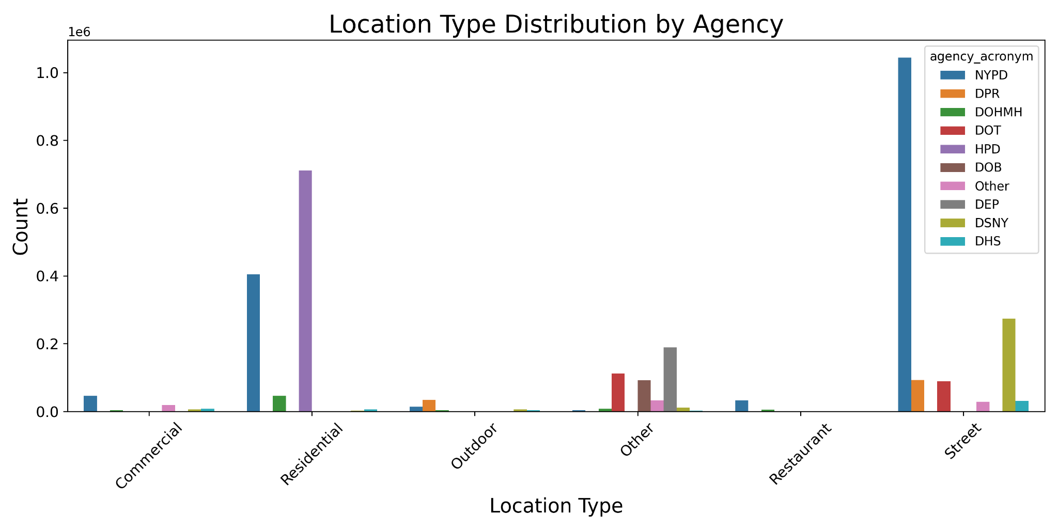
EDA - Location Type by Agency
Notes:
Location Type also does a fairly good job at distinguishing classes. HPD is almost entirely Residential, which makes sense as Building complaints are more likely to happen in Residential locations. DPR is almost entirely outdoor, which again makes sense because Parks are outdoor. Many Street and Residential locations are handled by the NYPD, which makes sense as Noise Complaints are usually Residential and Traffic Complaints are usually on the Street.

Slide 10
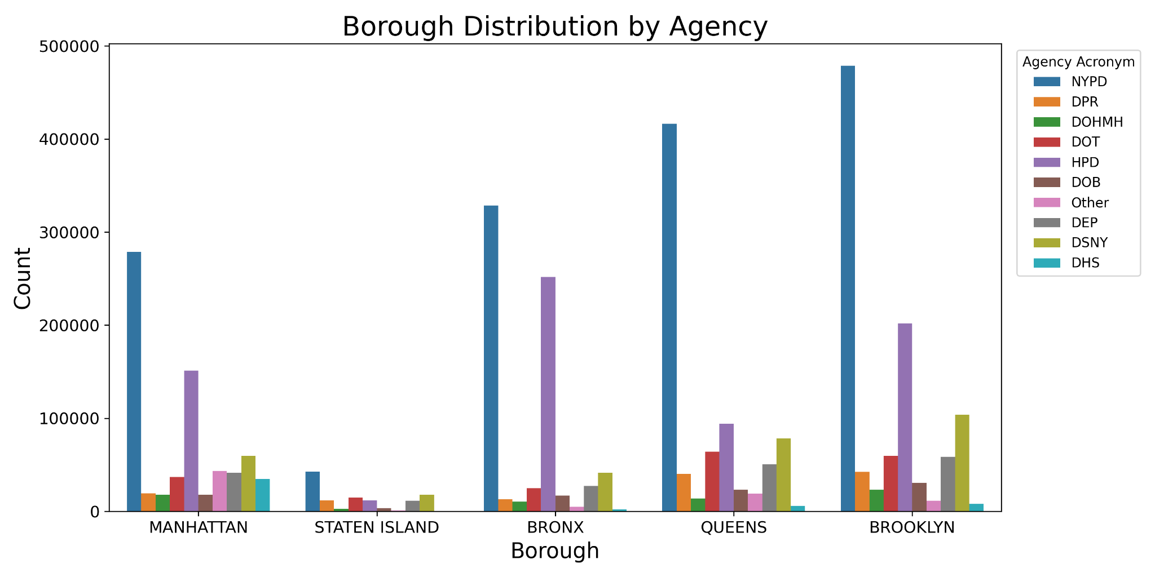
EDA - Agency Distribution by Borough
Notes:
The NYPD is the most common across all boroughs because it is the most common agency in the data. Interestingly, the Bronx has more complaints handled by the HPD compared to the other boroughs.

Slide 11
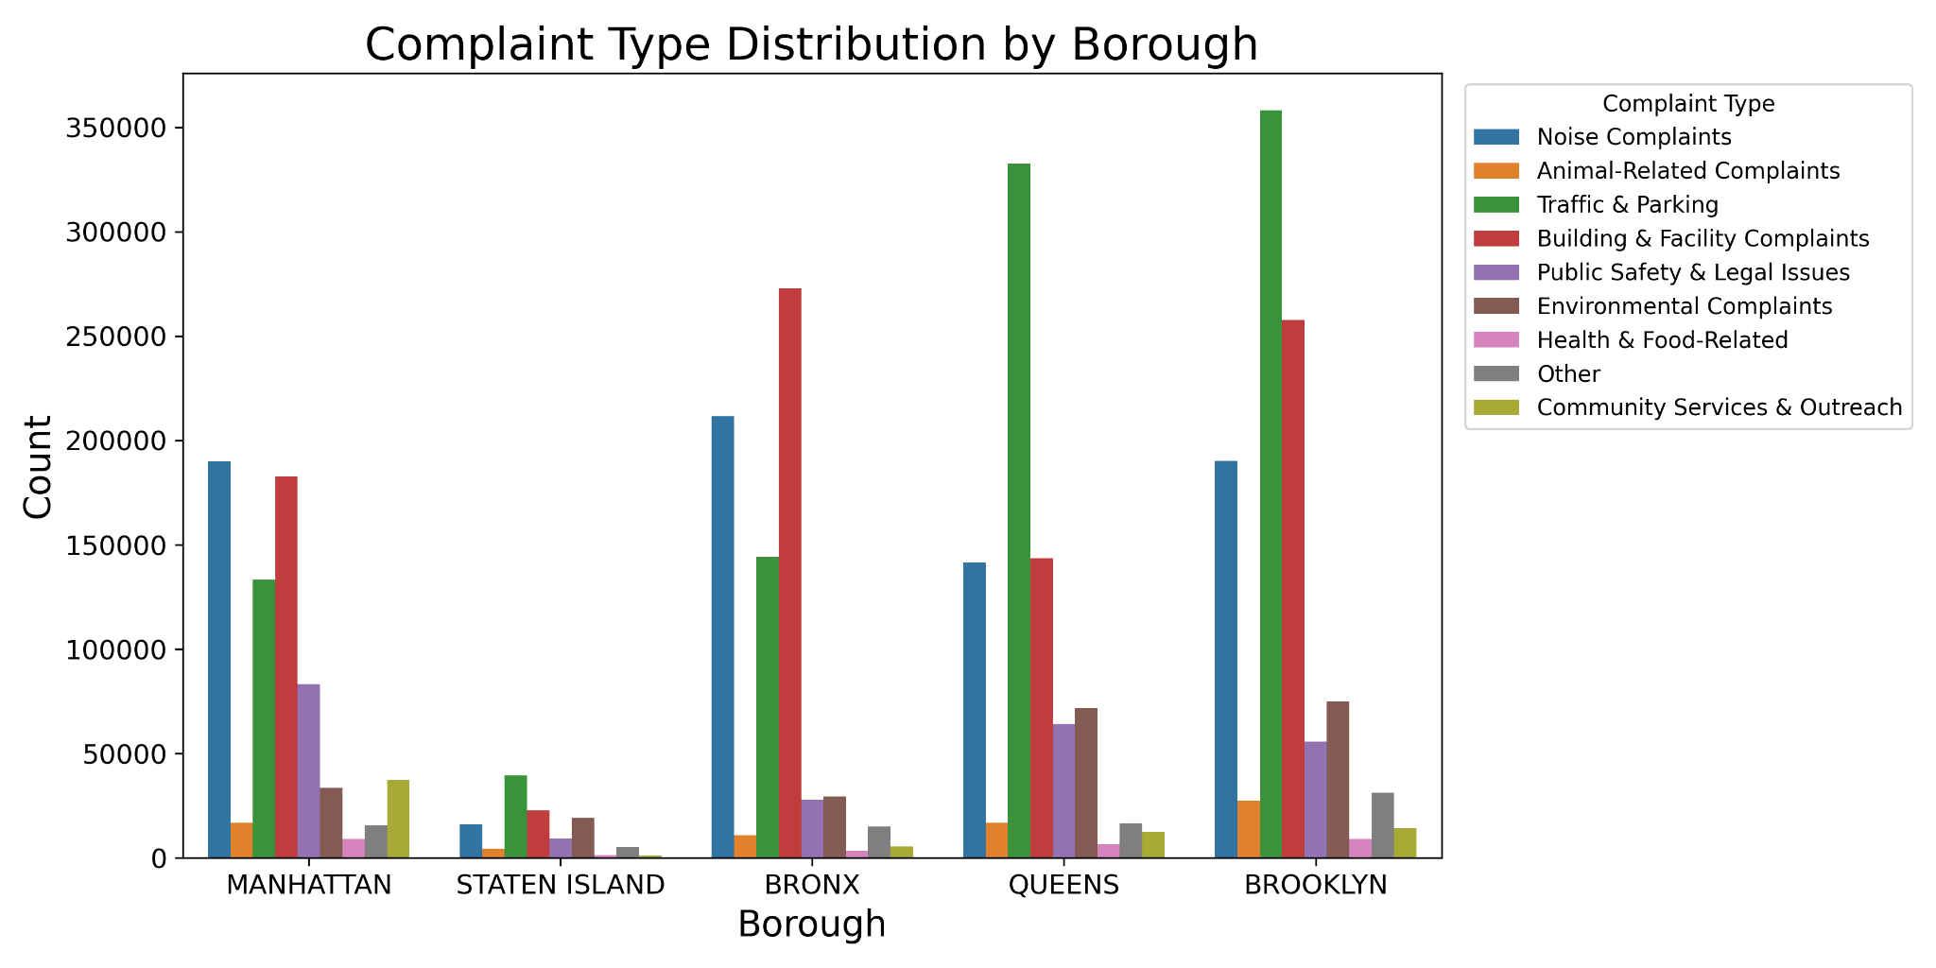
EDA - Complaint Type Distribution by Borough
Notes:
Looking at the complaint type breakdown by borough, it is easy to see why the HPD is so common in the Bronx - they have a high Building Complaint rate which is mainly handled by the HPD. Traffic and Parking are most common in Queens and Brooklyn, which explains the ultra high NYPD rate for those boroughs.

Slide 12
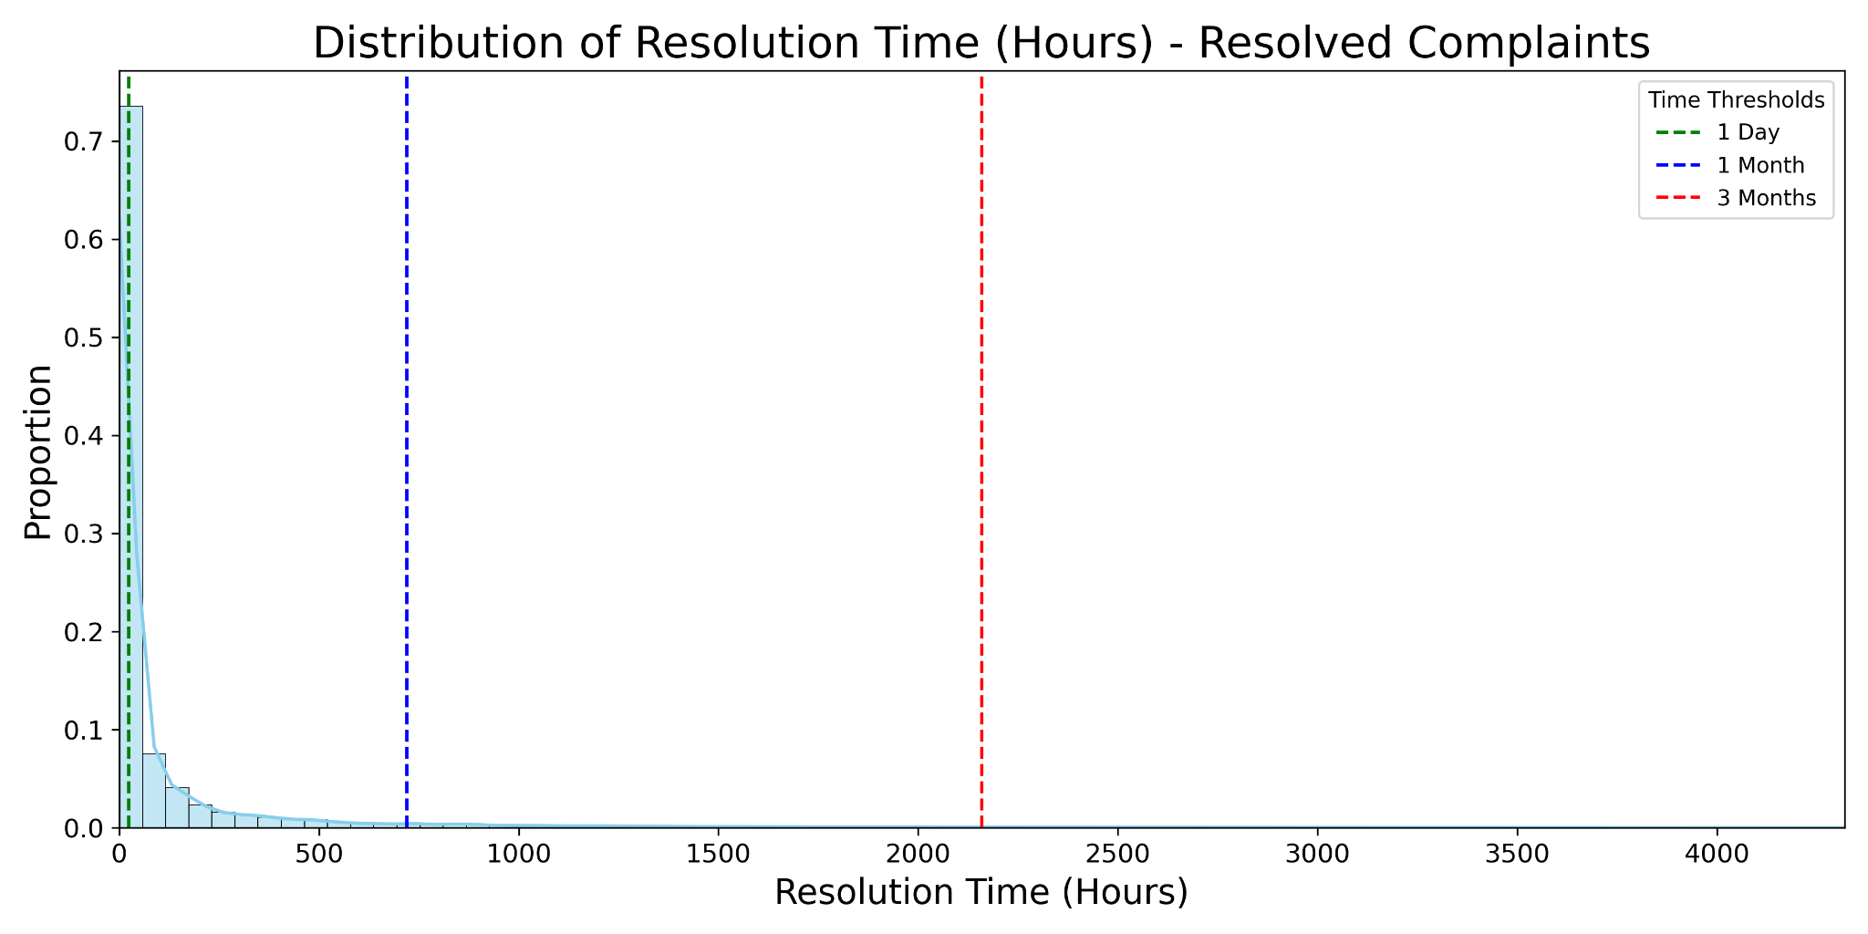
EDA - Resolution Time Distribution (Resolved Complaints Only)
Complaint Completion Rate:
75% in 24 hours
94% in 1 month
98.5% in 3 months
Notes:
75% of complaints were resolved in 24 hours, and 94% in the first month. 98.5% were resolved in 3 months. We decided not to remove the "outliers" above because there were enough of them that they seemed to be legitimate data.

Slide 13
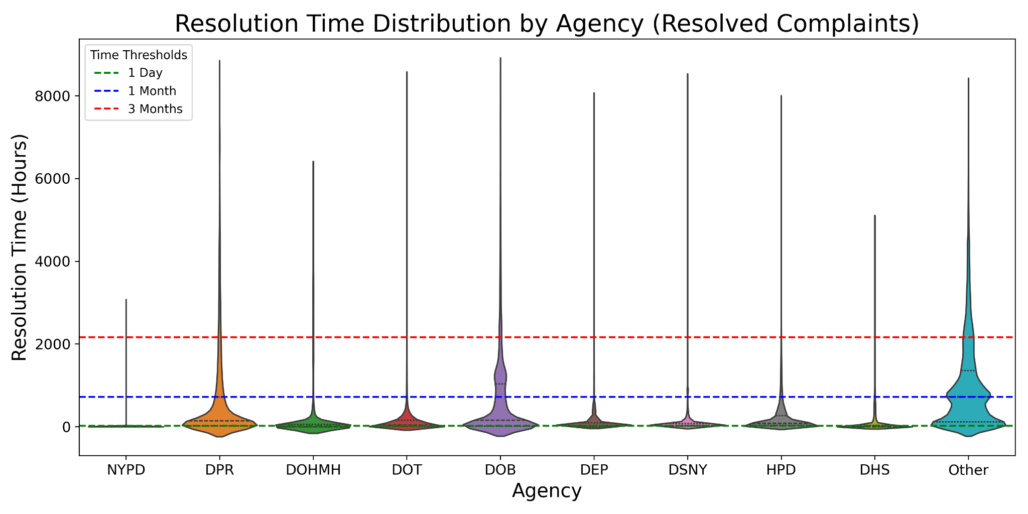
EDA - Resolution Time Distribution by Agency
Notes:
The NYPD has a very fast resolution time, usually under 1 day. Other agencies, like the DPR or DOB take much longer to resolve their requests.

Slide 14
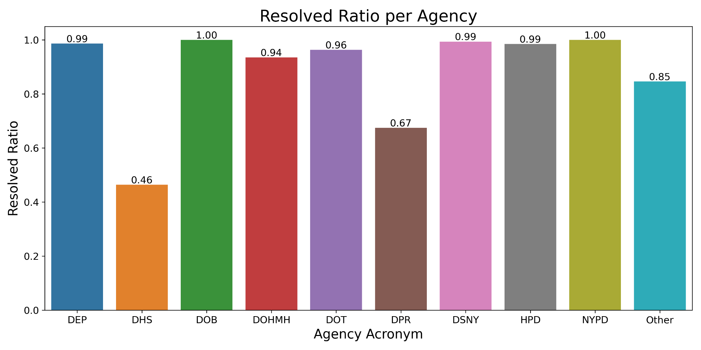
EDA - Resolution Ratio by Agency
Notes:
Most of the Agencies had high resolution rates (>94%), but two agencies in particular are not as efficient in solving their requests: DHS (Homeless Services) at 46%, and DPR (Parks and Recreation) at 67%.
Note that a request was considered resolved if completed in 2024, so requests made near the end of the year are more likely to be counted as unresolved.

Slide 15
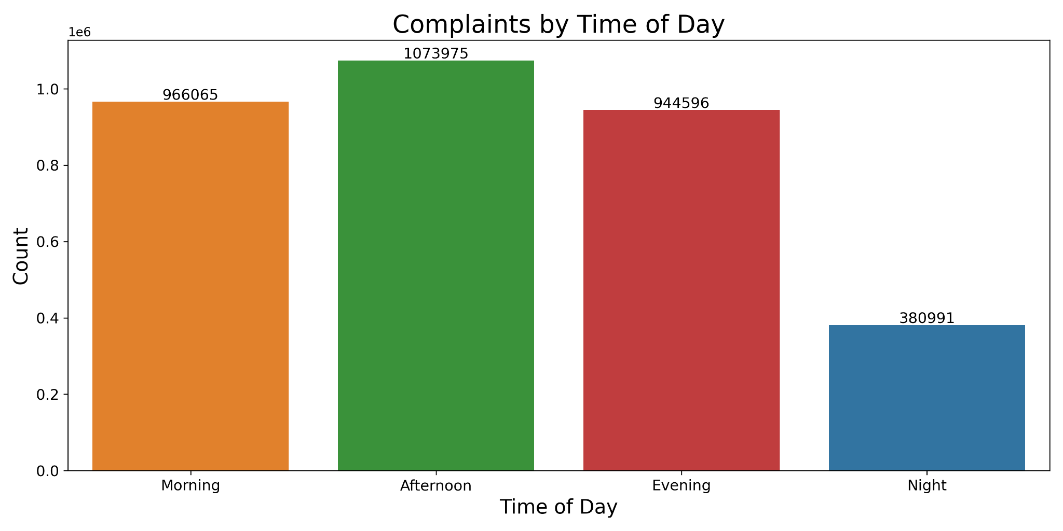
EDA - Complaints by Time of Day
Notes:
Most complaints happen during business hours, with much fewer happening during the night (12:00AM to 5:59AM).

Slide 16
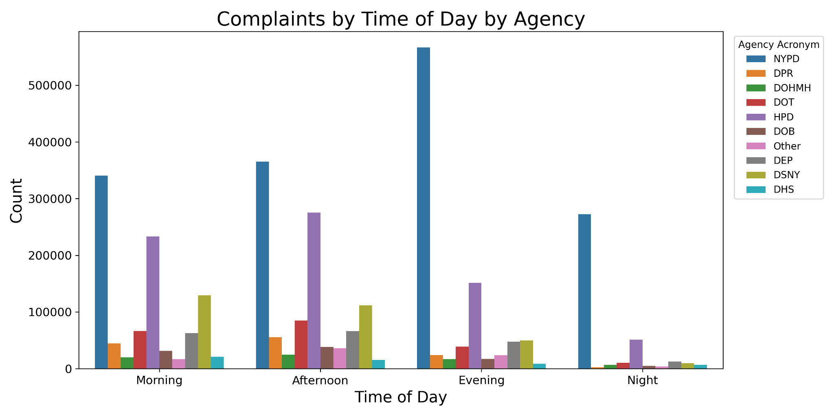
EDA - Complaints by Time of Day by Agency
Notes:
The NYPD is the only agency with significant activity during the night (12:00AM to 5:59AM), which makes sense as they are available 24/7, while most of the other agencies operate only during business hours.

Slide 17
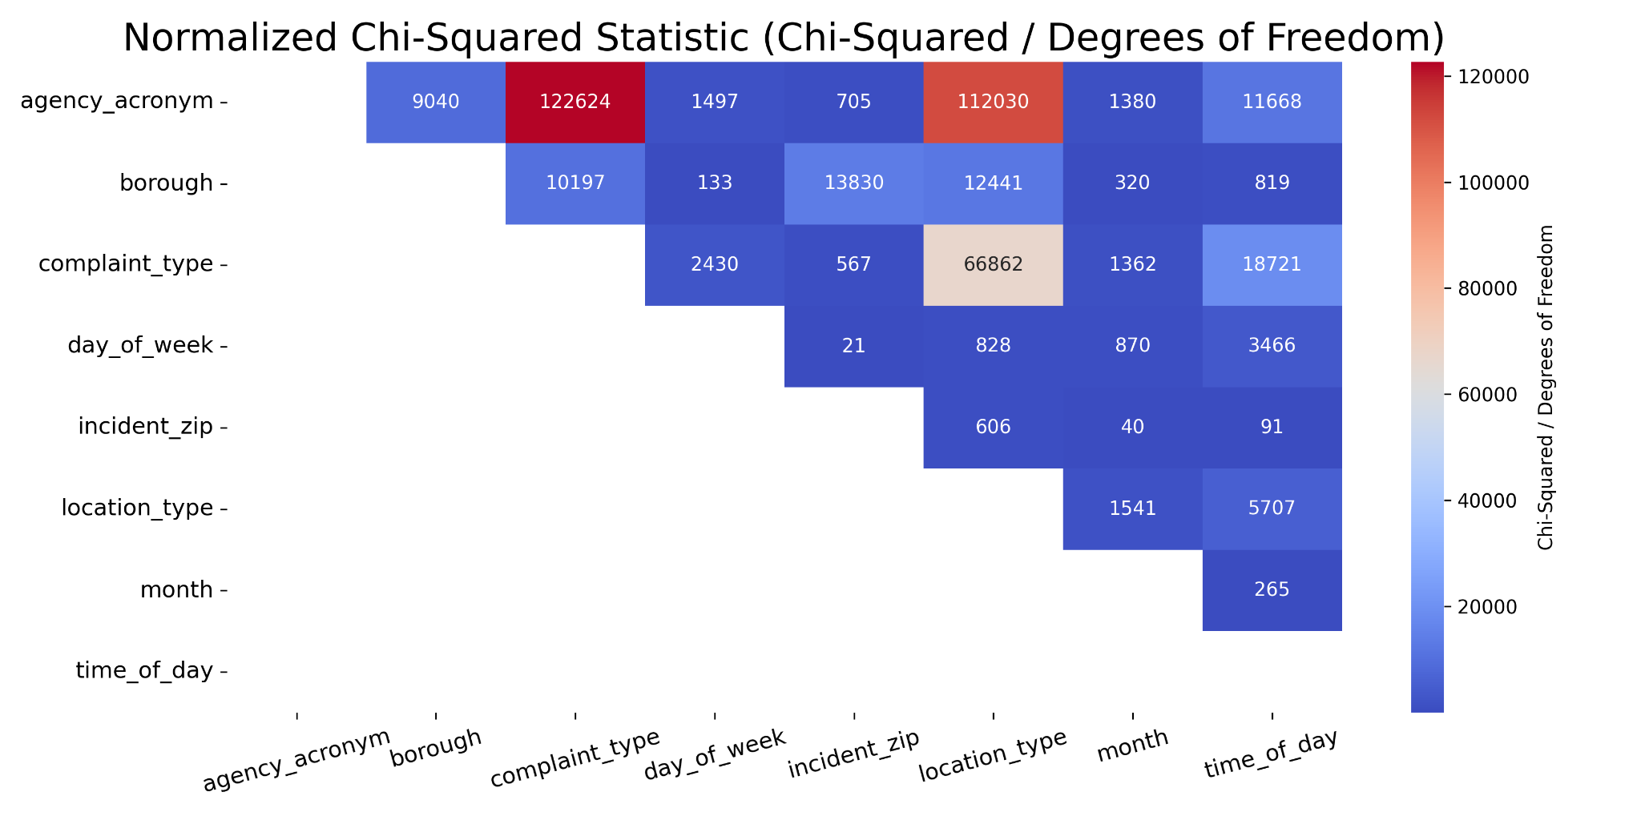
EDA - Chi-Squared Correlation Heatmap
Notes:
We computed the chi-squared statistic between all of the categorical columns to check for correlation. All of the columns had p-values of effectively 0, meaning all of the columns were related with each other. We use the normalized Chi-Squared value to get a sense of the strength of the correlation between columns. Normalized values are used instead of raw values because columns with many different categories inflate the Chi-squared statistic. The best columns for predicting Agency are Complaint Type and Location Type, followed by Time of Day and Borough. Although Day of Week, Incident ZIP, and Month are related, they have much weaker correlation.

Slide 18
Modeling - Final Features, X and y Variables
The final features that were used for modeling were:
X: Borough, Complaint Type, Location Type, Time of Day, Incident ZIP
y: Agency Acronym
The data was split into 80% train (2,692,501 instances) and 20% test (673,126 instances).
The X data is all categorical, so each of the features was one-hot encoded using sklearn's OneHotEncoder(), leading to a total of 268 features. We did not drop any columns when performing one-hot encoding, as the problems of multicollinearity were handled using regularization in the models.
The y column was label encoded using sklearn's LabelEncoder(), with a total of 10 classes.

Slide 19
Modeling - Key Scoring Metric
Our problem is a multi-class classification problem, so the main metrics we considered were Accuracy, Precision, Recall, and F1-Score. The data exhibits heavy class imbalances (NYPD is 46% of the data, HPD 21%, and DSNY is only 9% of the data), so Accuracy is not a reliable metric.
Precision measures the ability of the model to correctly direct the caller to the correct agency. A low Precision means that callers are erroneously directed to that agency and represents wasted time and manpower. Recall measures the ability of the model to correctly capture all of the callers that should be directed to the correct agency. A low Recall means that the callers that should be directed to a given agency are not being directed there and represents low resolution rates and a lack of effectiveness. Thus, both Precision and Recall are important.
Since both Precision and Recall are important, the metric we chose to maximize was the Macro F1-Score. Macro F1-Score is used over Weighted F1-Score because it treats each class as equally important, which is necessary because of the large class imbalances.

Slide 20
Modeling - Hyperparameter Tuning and Cross-Validation
Four different models were tested:
Logistic Regression (implemented via SGDClassifier)
Decision Tree
Random Forest
XGBoost
Each model was tested with a hyperparameter grid using 3-fold cross validation using the GridSearchCV class in sklearn. 3-fold cross validation was used due to the size of the data.
Each model was trained and timed on a Google Colab instance using high memory. The Logistic Regression, Decision Tree, and Random Forest were able to use only the CPU acceleration, but XGBoost supports GPU acceleration and was trained using the A100 GPU. Each model required between 30-60 minutes to fully train using Google Colab, and the best hyperparameters via cross-validation for each of the model types were saved as pickle files to be loaded locally.

Slide 21
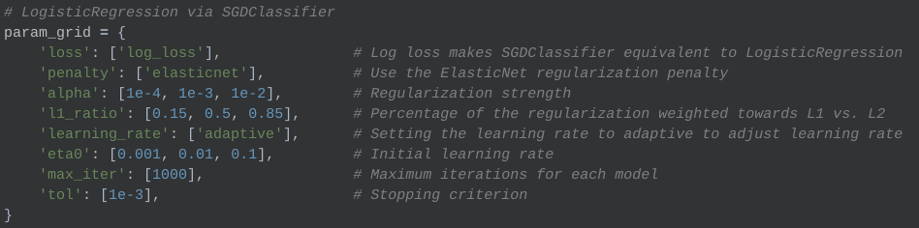
Modeling - Logistic Regression (via SGDClassifier)
Best Model Hyperparameters and Statistics:
L1 Ratio: 0.85, Regularization Strength: 0.0001, Initial Learning Rate: 0.1
27 Models with 3-fold cross-validation (81 models total)
Fit Time (Best Model): 387 seconds (~6.5 minutes)

Slide 22
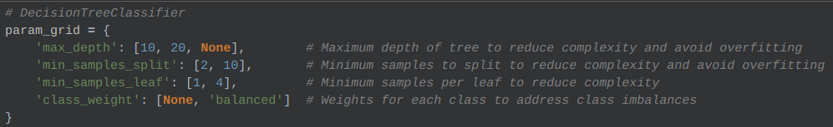
Modeling - Decision Tree
Best Model Hyperparameters and Statistics:
Max Depth: None, Minimum Samples Split: 2
Minimum Samples Leaf: 4, Class Weight: None
24 Models with 3-fold cross-validation (72 models total)
Fit Time (Best Model): 195 seconds (3.25 minutes)

Slide 23
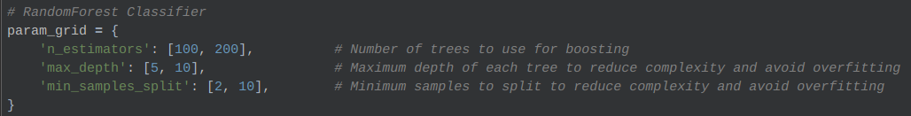
Modeling - Random Forest
Best Model Hyperparameters and Statistics:
Max Depth: 10, Number of Trees: 200, Minimum Samples Split: 2
8 Models with 3-fold cross-validation (24 models total)
Fit Time (Best Model): 673 seconds (~11 minutes)

Slide 24
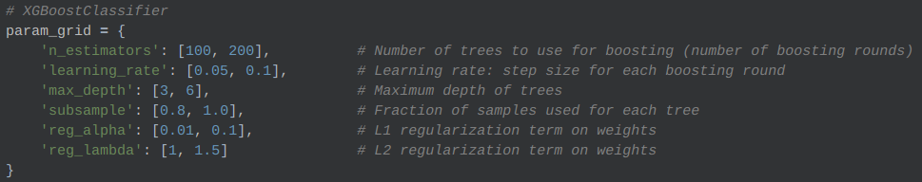
Modeling - XGBoost
Best Model Hyperparameters and Statistics:
Max Depth: 6, Subsample Rate: 0.8, Number of Boosting Rounds: 200
Learning Rate: 0.1, L1 Regularization: 0.01, L2 Regularization: 1.0
64 Models with 3-fold cross-validation (192 models total)
Fit Time (Best Model): 167 (~2.75 minutes) [Able to use GPU Acceleration]

Slide 25
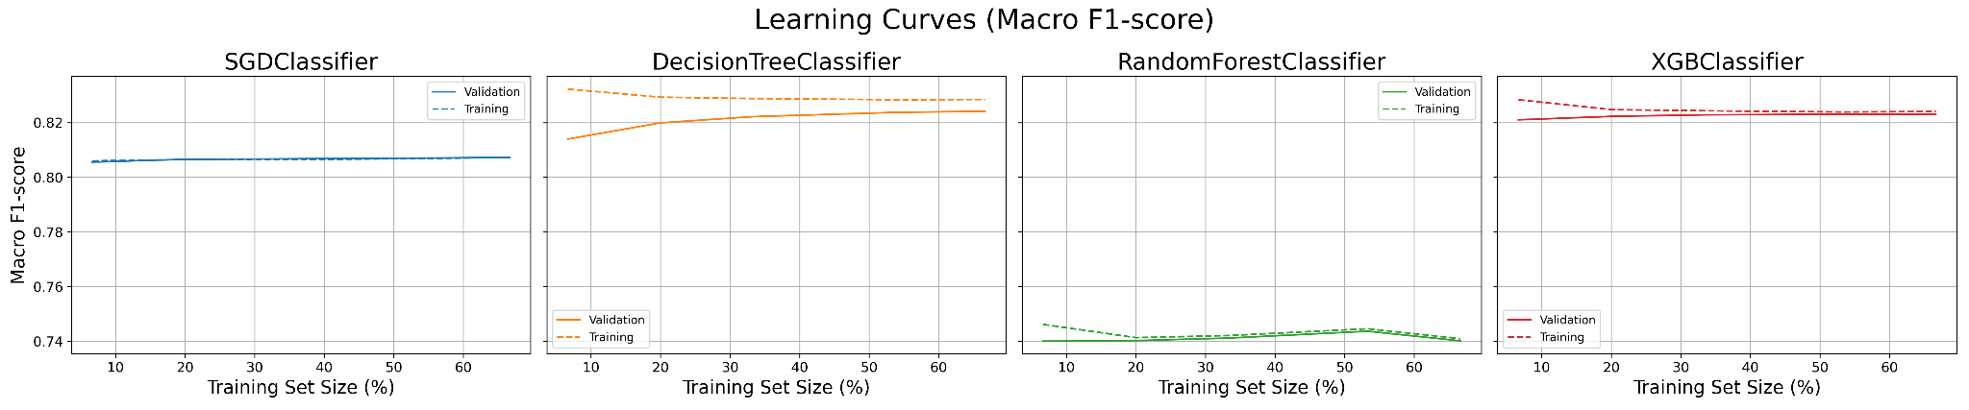
Evaluation - Learning Curves
Flatness of the learning curve indicates that the models are unlikely to learn using more data. Low differences in the training and validation curve indicate low variance in the model. The Logistic Regression and Random Forest are very low variance, while the Decision Tree has moderately high variance. The XGBoost model is in between but has relatively low variance after convergence.
All of the models appear to have converged under these current hyperparameters, except perhaps the Random Forest, which has the lowest overall Macro F1-Score.

Slide 26
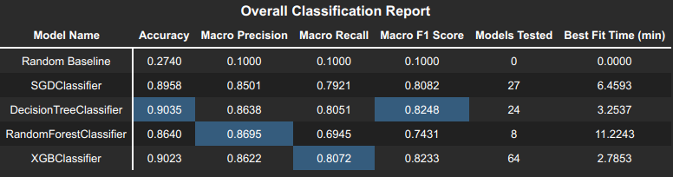
Evaluation - Overall Performance Metrics
Decision Tree and XGBoost models were the best with similar performance.
XGBoost had the fastest fit time with nearly identical performance as the Decision Tree.
Logistic Regression lagged slightly behind and took 2x longer to fit than the Decision Tree.
Random Forest performed the worst in both metrics and fit time, at over 11 minutes to fit.
All models outperformed a baseline that randomly predicted based on class probabilities. The baseline model shows the difficulty of the task and how much the other models learned.

Slide 27
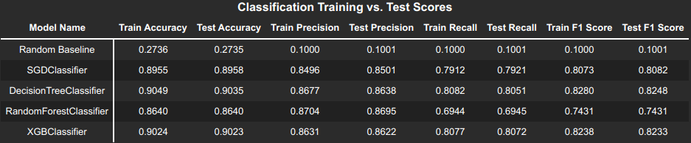
Evaluation - Training versus Testing Scores
There appears to be no evidence of overfitting in any of the models, as the training and testing scores are nearly identical across metrics.
Considering the extremely poor performance of a baseline model that randomly predicts according to class probabilities, it seems safe to say that the models are not underfitting.

Slide 28
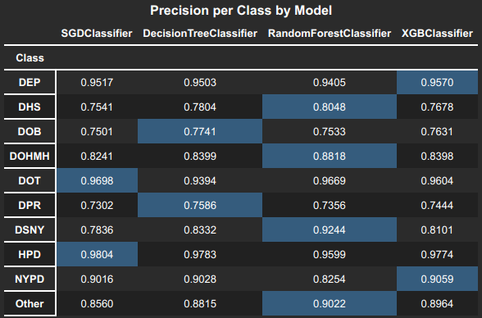
Evaluation - Per Class Precision
Random Forest had highest Precision, especially on low frequency classes. Random Forest performs poorly on the majority class NYPD.
XGBoost has the best precision on the majority class NYPD.
All classes struggled with precision on DOB and DPR.

Slide 29
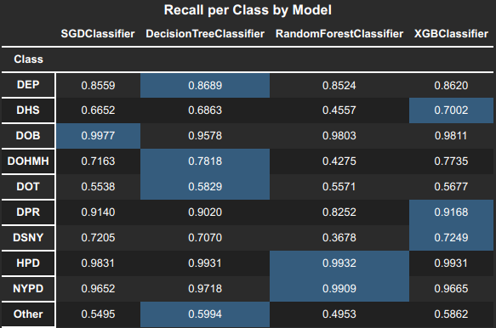
Evaluation - Per Class Recall
Random Forest attains nearly perfect recall on the NYPD and HPD, which is bad because of the low precision on these majority classes.
XGBoost has the best overall recall on all classes, especially on DHS.
All classes struggled with recall on DOT, DHS, and Other.

Slide 30
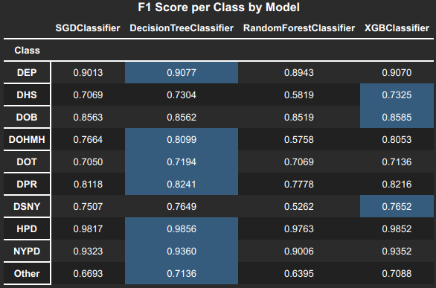
Evaluation - Per Class F1-Scores
The Decision Tree has the best F1-score across classes, followed closely by XGBoost. However, they both have effectively the same performance.
Random Forest lags significantly behind all of the other models.

Slide 31
Conclusion
The purpose of this project was to create a model that had the best macro F1-score for predicting which agency should handle a 311 request based on only a few carefully curated features: borough, zip code, location type, complaint type, and time of day. Careful feature selection and cleaning greatly reduced the dimensionality of the data, leading to shorter training times, less overfitting, and higher interpretability of features.
The best model to satisfy the purpose of the project is the XGBoost model, as it shows very little variance and boasts very high metrics. The XGBoost model was able to attain an impressive 82.33% macro F1-score, including a 93.52% F1-score on the most common and most important agency in the dataset: the New York Police Department.
The XGBoost model was also the most efficient model to train, an important trait for providing scalability of the model into the future, as there are millions of 311 requests every year.

Slide 32
THANK YOU FOR LISTENING

Slide 33
EXTRA SLIDES PAST HERE

Slide 34
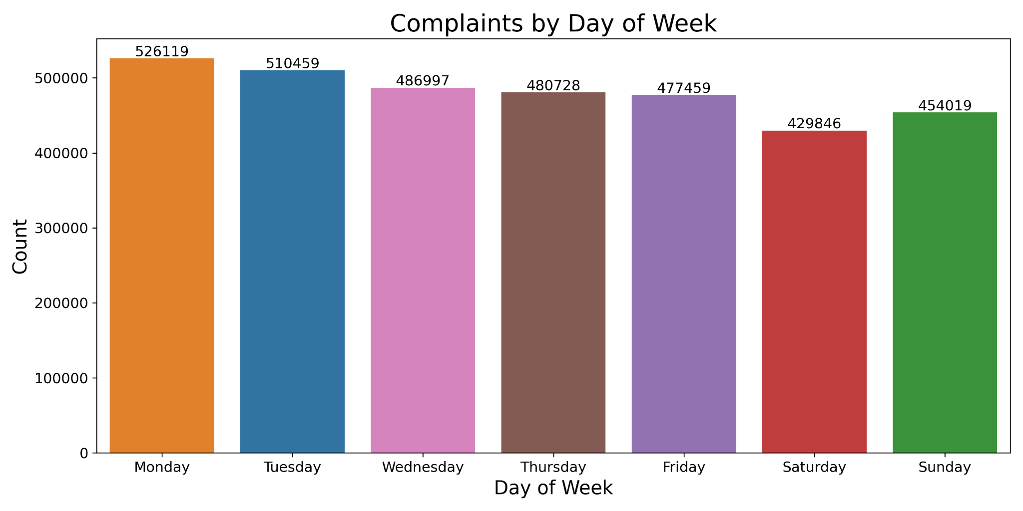
EDA - Complaints by Day of Week

Slide 35
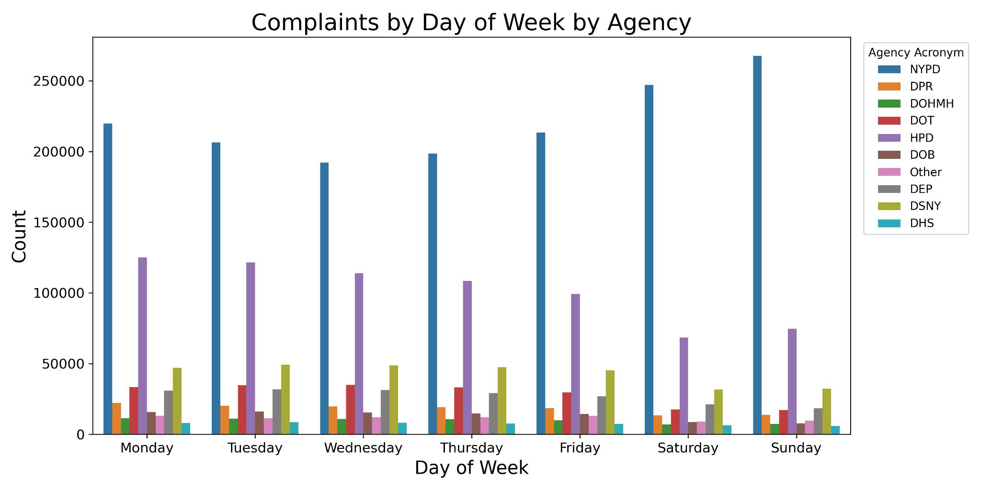
EDA - Complaints by Day of Week by Agency

Slide 36
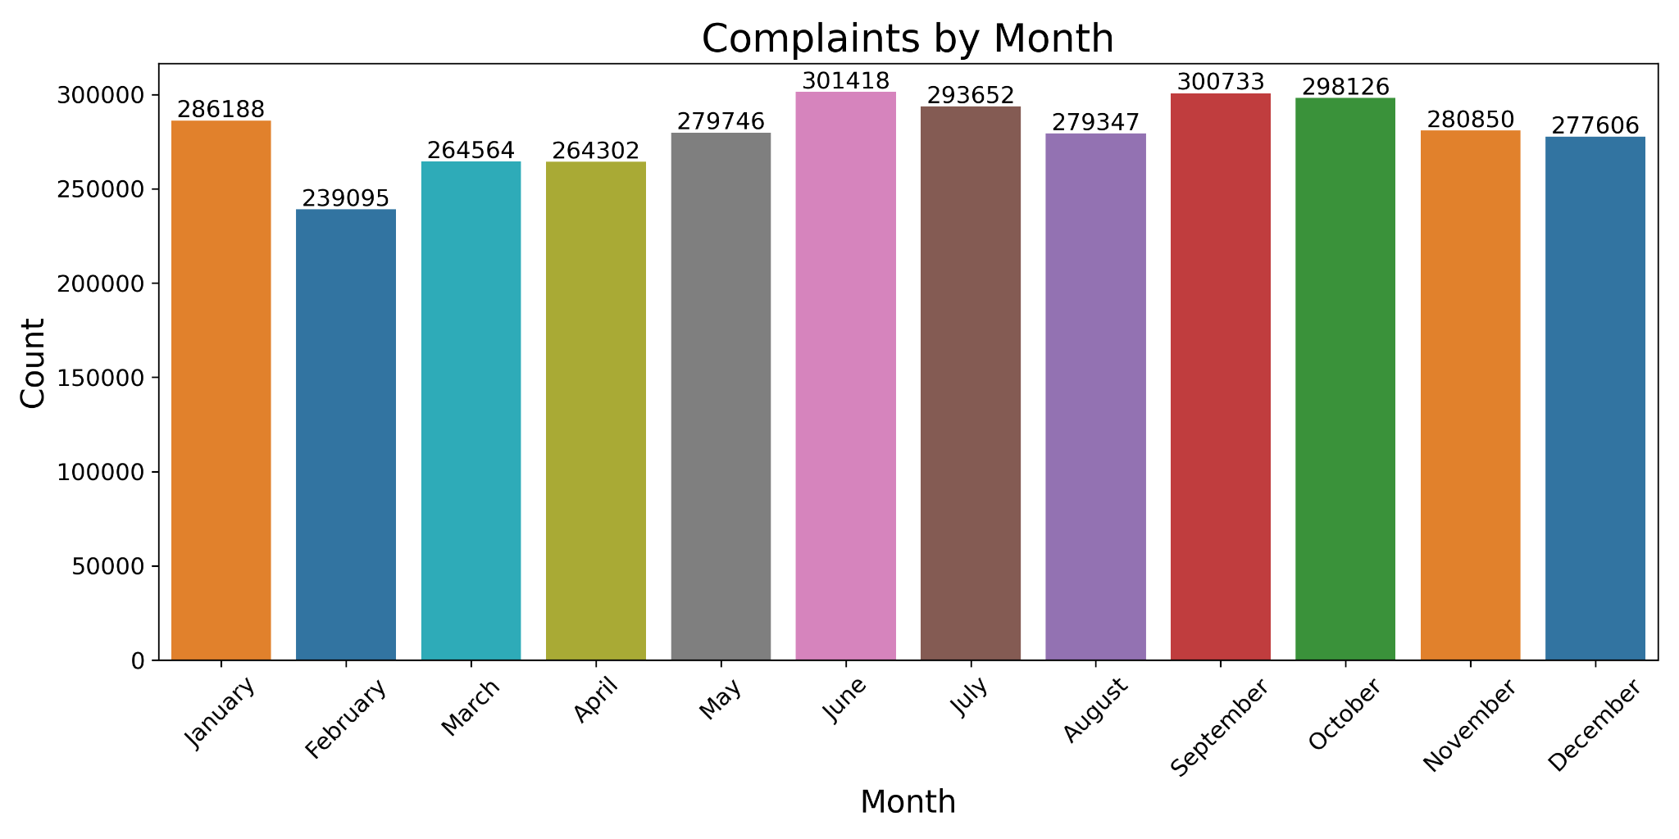
EDA - Complaints by Month

Slide 37
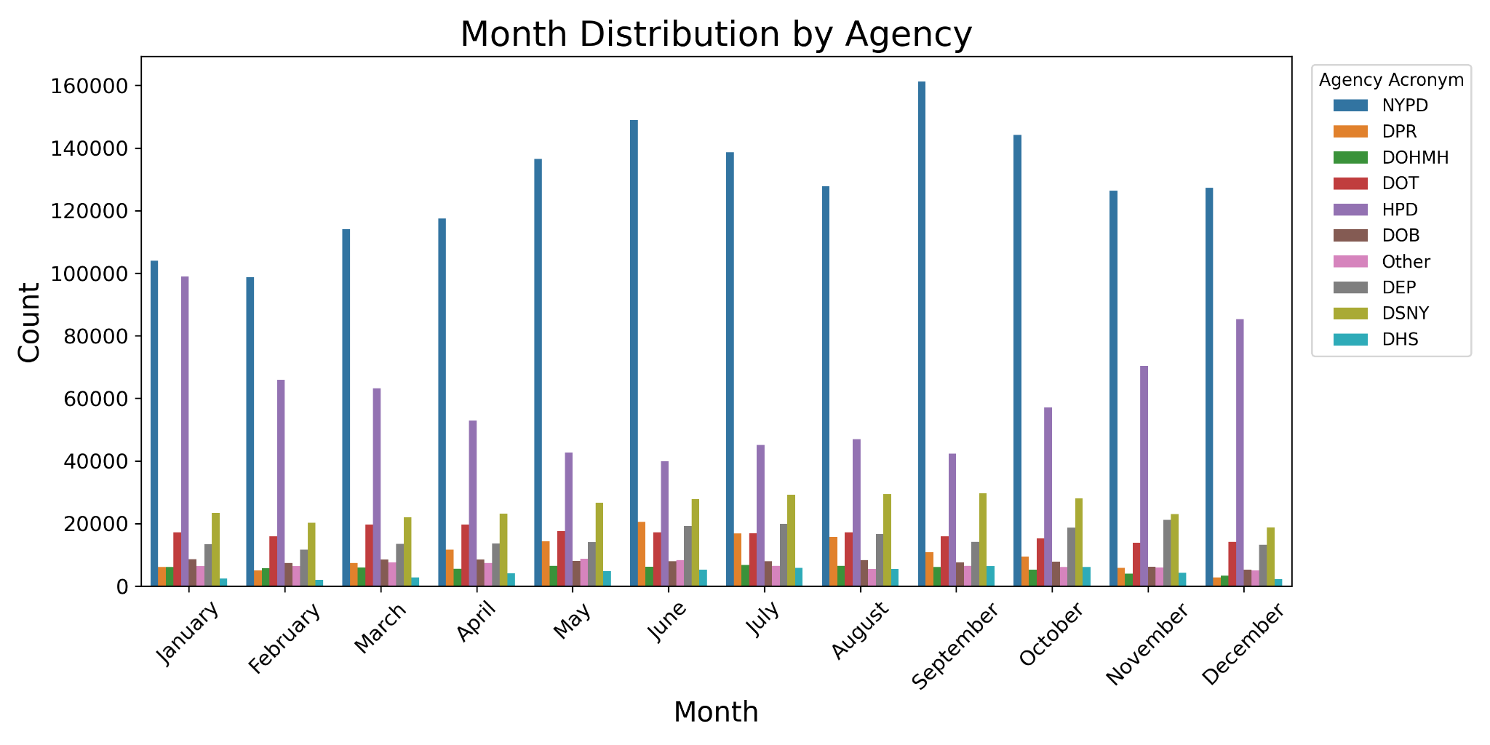
EDA - Complaints by Month by Agency

