Slide 1
Using SHAP Post-Model Explainability
as a Model-Agnostic Feature Selection Technique
Joshua Gottlieb, Martin Sichali Chunsen, and Alexander Yoo
Advised by Dr. Krishna Bathula
Seidenberg Annual Research Day 2025

Slide 2
Feature Selection and SHAP Overview
Feature selection techniques in data science help reduce dimensionality of datasets, remove sparsity, and eliminate noisy patterns, thereby improving generalization.
SHAP is a machine learning explainability technique that is used to evaluate predictions for black-box models. SHAP is an additive model, so each feature is given a SHAP value, similar to the coefficients for a linear model. These coefficients can be used to produce feature rankings, allowing SHAP to be used for feature selection.
Previous work using SHAP as a feature selection technique failed to provide good methods for choosing feature subsets without expensive iterative processes. We aimed to solve this problem with two novel selection algorithms, MAX and SUM, which are designed for simplicity and grounded in intuitive feature selection goals. We tested our algorithms across 5 model types and 10 datasets, to ensure robustness of the technique.

Slide 3
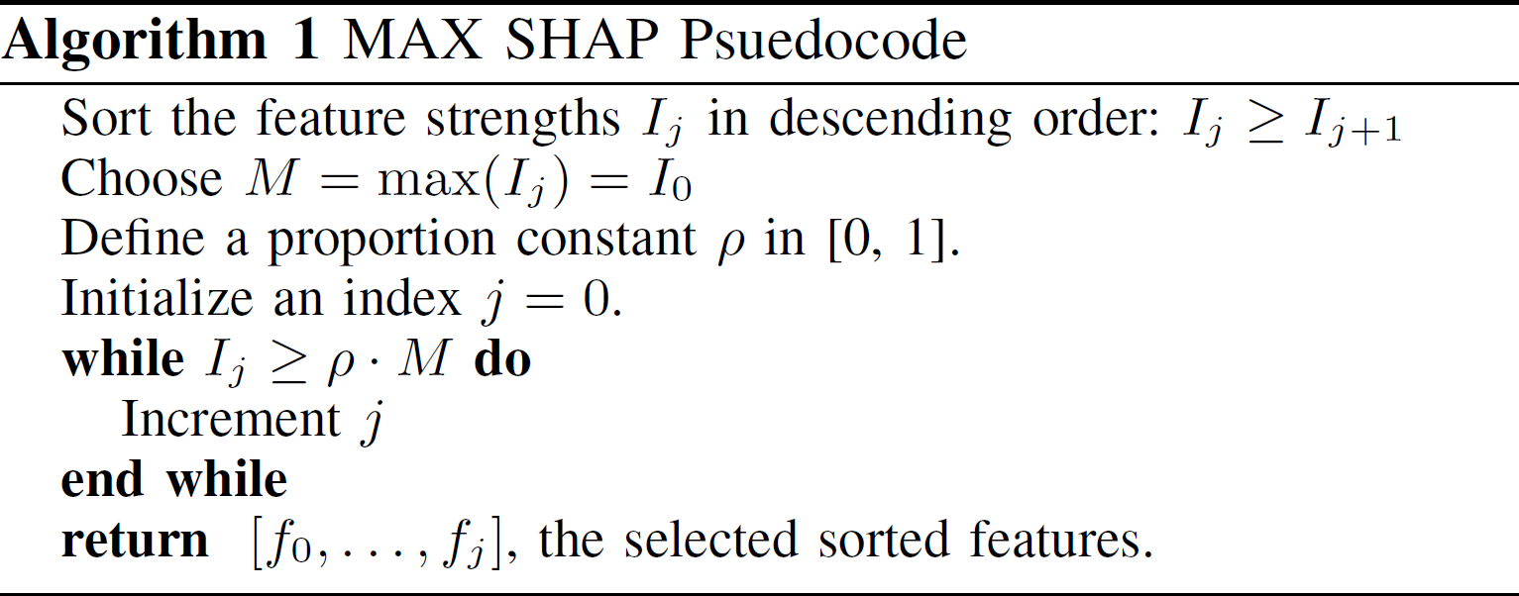
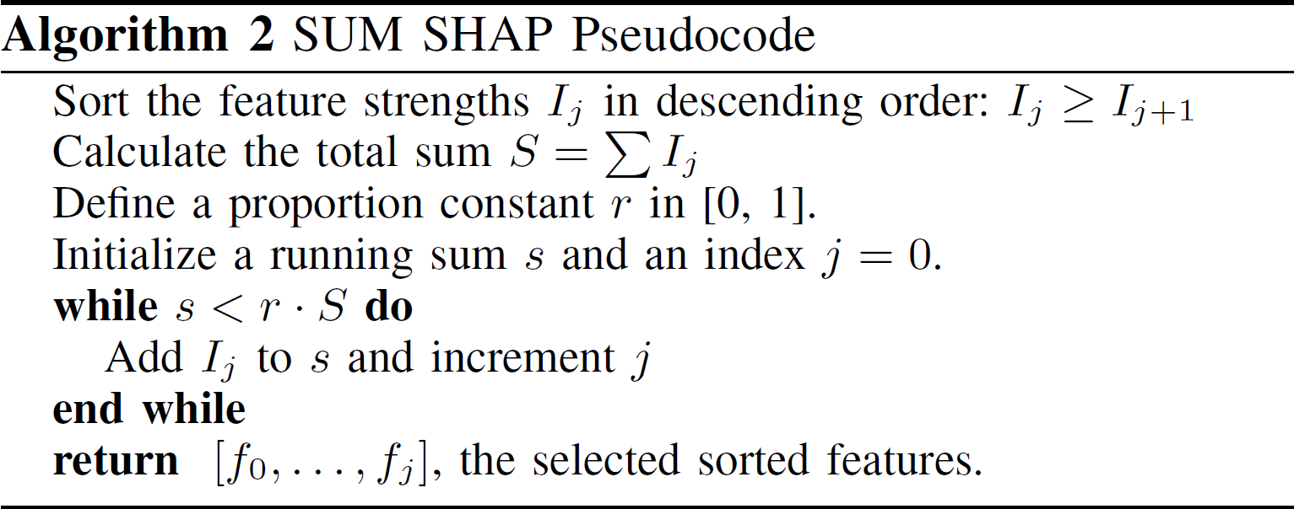
MAX and SUM Algorithms for Feature Selection
The MAX strategy frames features selection in the context of relative feature importance by only keeping features that are as strong as a proportion of the strongest feature.
The SUM strategy frames feature selection in the context of total data explanation by only keeping features with summed importance equal to a proportion of the total summed importances.

Slide 4
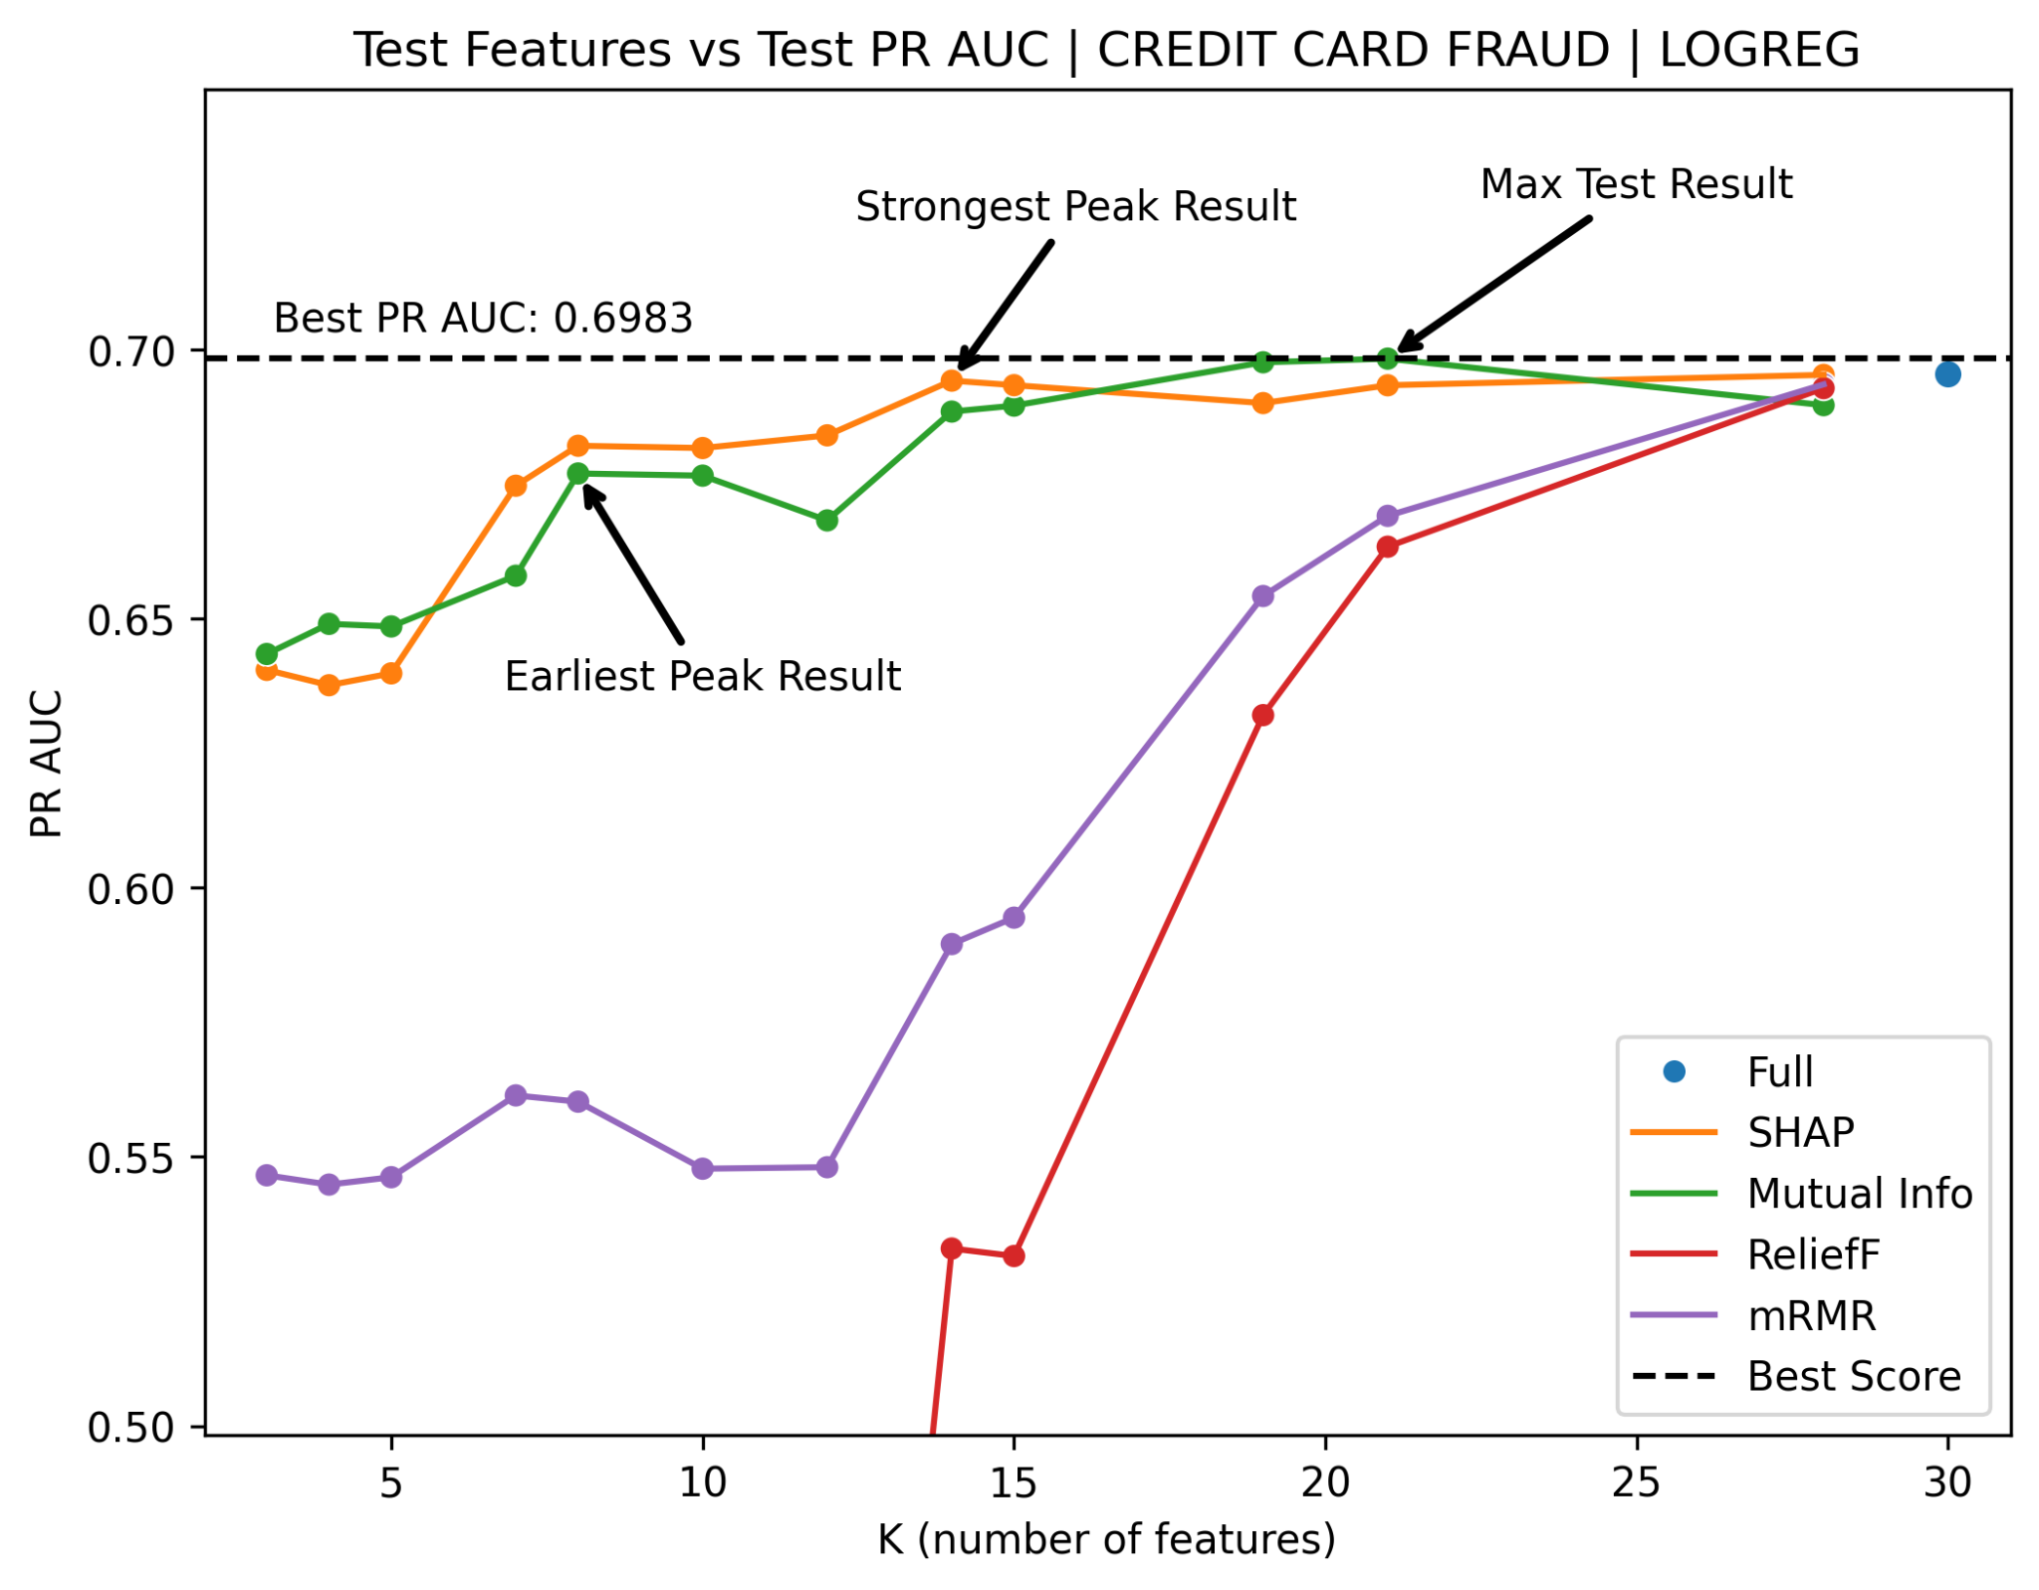
Frameworks for Selecting the Best Feature Subsets from Rankings
Four frameworks were considered for choice of best feature subset.
Minimum Overfitting
Maximum Test Result
Strongest Peak Result
Earliest Peak Result

Slide 5
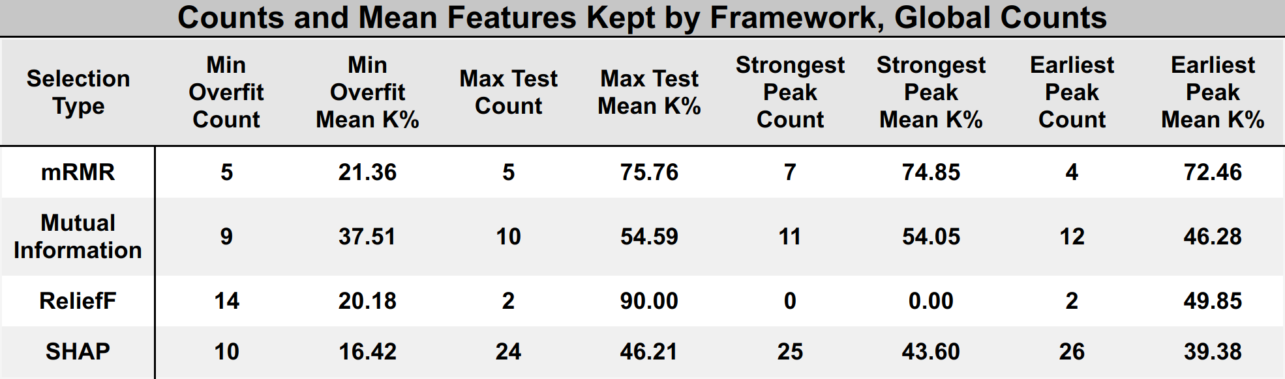
Performance Counts and Mean Features Kept by Technique
Across 50 dataset-model combinations, SHAP performed the best for 3 out of 4 frameworks. SHAP was often the best or second best selection technique for all dataset-model combinations. SHAP consistently keeps the least amount of features on average, indicating that SHAP rankings are superior in quality.

Slide 6
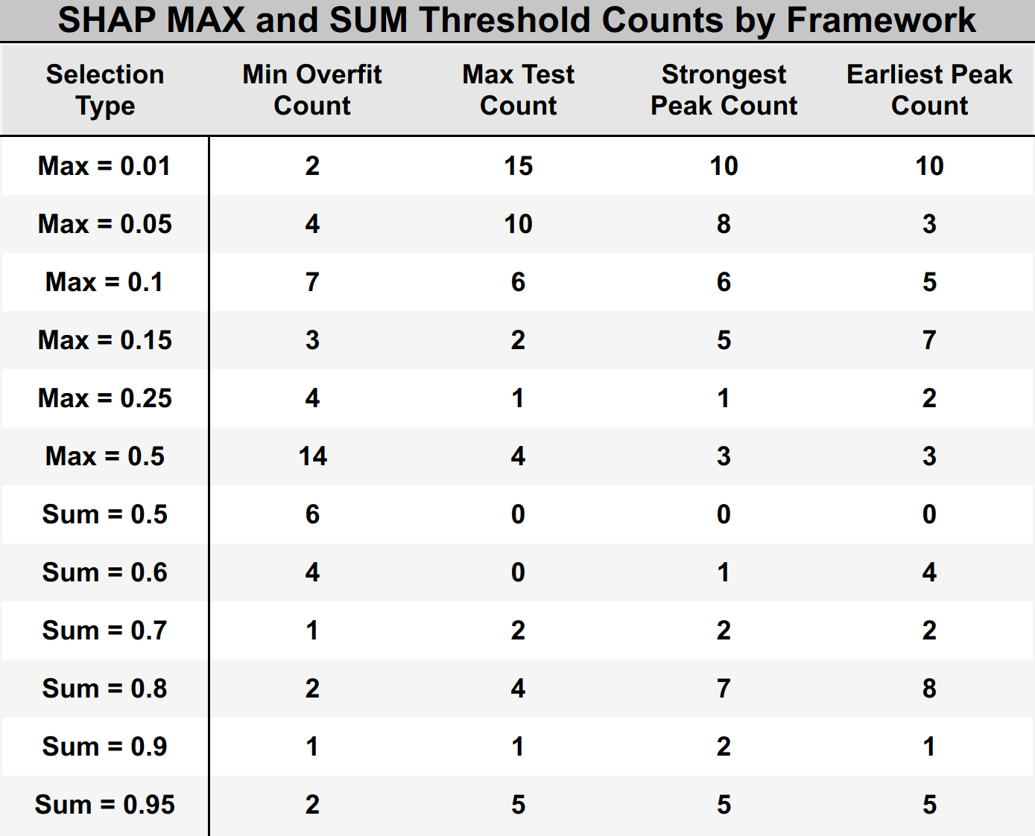
MAX and SUM Threshold Counts Across Datasets and Models
MAX with threshold 0.01 showed the best test performance across 3 out of 4 frameworks.
MAX with threshold 0.5 best minimized overfitting.
SUM performs worse compared to MAX on most dataset-model combinations at all thresholds.

Slide 7
Conclusion
Our experiments show that SHAP is an effective feature selection technique. SHAP feature subsets exhibit equivalent or superior performance to feature subsets selected by common filter-based techniques, while resulting in greater feature reduction.
The MAX and SUM algorithms we created are effective in choosing the number of features in a simple, intuitive, and non-iterative manner. The MAX strategy was especially effective and naturally filters out weak features by directly enforcing feature relevance. MAX thresholds between 0.01 and 0.1 are ideal for most datasets.
Future improvements include updating the SUM algorithm to filter out weak features to increase its effectiveness and the creation of automatic or semi-automatic modes for our MAX and SUM algorithms that require less human input.

