Slide 1

Mobile Architecture Introduction - GraphQL
Last modified by Joshua Devine 02.06.2023
GraphQL
GraphQL is a query language. The optimistic and stronger older brother of REST.
GraphQL is a specification for remote client-server communications.
GraphQL is agnostic to the data source(s) used to retrieve data and persist changes.
GraphQL shapes data objects between a client, a server, and multiple data sources
Created / released by Facebook in 2015, now developed by the GraphQL foundation
https://graphql.org/faq/
Apollo
Is a platform that builds on top of GraphQL.
Keap uses Apollo Server and Apollo Client
Founded in 2016 by independent owners and backed by Series D Funding
https://www.apollographql.com/tutorials/browse
Apollo Client
YASMLjs (Yet Another State Management Library written in JS)
Integrates with many popular frontends
Apollo Server
Implementation of GraphQL
complient and compatible with any GraphQL client
https://www.apollographql.com/docs/react/
Apollo Studio (sandbox / explorer / graphOS / plaformAPI / grpahiql / … / …. )
A UI for GraphQL
Build queries, copy queries into your glq template literals, and explore the schema
https://www.apollographql.com/docs/apollo-server/v3
https://studio.apollographql.com/sandbox/explorer

Slide 2
Mobile Architecture Introduction
Last modified by Joshua Devine 02.06.2023
Core Concepts
Types
Create object types. GrpahQL is strongly 💪 typed! Remind me… why do we use JS for all this stuff?
Queries
A GQL type. GET in REST
Mutations
A GQL type. POST, PUT, PATCH, or DELETE in REST
Resolvers
Generates a response for a query. A query handler. Accepts four arguments, root, args, context, and info.
It can fetch data from any data source, then transforms that data into the shape your client requires.
MUST have the same name as the field that it populates data for.
Data Sources
An extension of the RESTDataSource class that will reach out to the APIs / DBs the server is using
https://www.howtographql.com/basics/0-introduction/
demystifying-the-info-argument-in-graphql-resolvers
https://graphql.org/learn/schema/
https://www.tutorialspoint.com/graphql/graphql_resolver.htm

Slide 3
Mobile Architecture Introduction
Last modified by Joshua Devine 02.06.2023
Example Implementation – Create a server
Server/src/index.js
const { ApolloServer } = require('apollo-server'); const typeDefs = require('./schema'); const resolvers = require('./resolvers'); const TrackAPI = require('./datasources/track-api'); const server = new ApolloServer({ typeDefs, resolvers, dataSources: () => { return { trackAPI: new TrackAPI(), }; }, }); server.listen().then(() => { console.log(` 🚀 Server is running! 🔉 Listening on port 4000 📭 Query at http://localhost:4000 `); });
// Import the Apollo Server // GQL template literals // Functions with four arguments that will return promises from our data sources. Should mirror the typeDefs (or GQL template literals in the schema) // We need to define our data sources. Like setting up a fetch request this is typically defining our rest endpoints. // Create the instance of ApolloServer // a reference to our gql template literals as an option for the server // a reference to our resolver functions as an option for the server // define all our data sources as an option for the server // Start the server

Slide 4
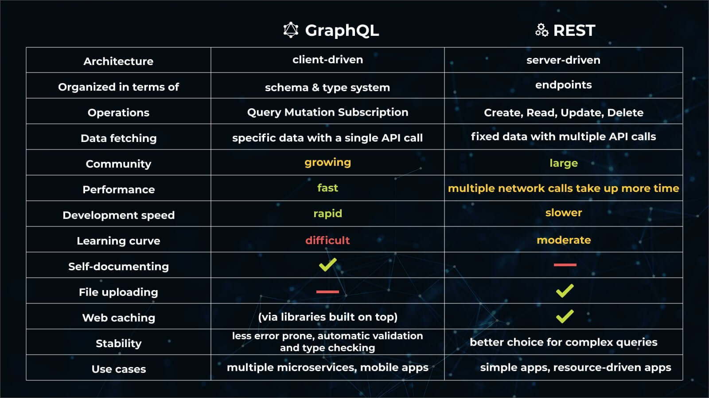
Mobile Architecture Introduction
Last modified by Joshua Devine 02.06.2023
Appendix
GraphQL vs. REST: What You Didn’t Know
https://github.com/JoshuaJDevine/gqlProject

