Slide 1
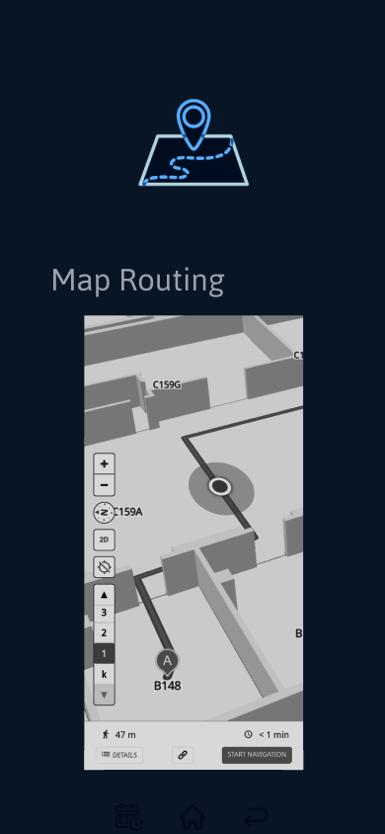


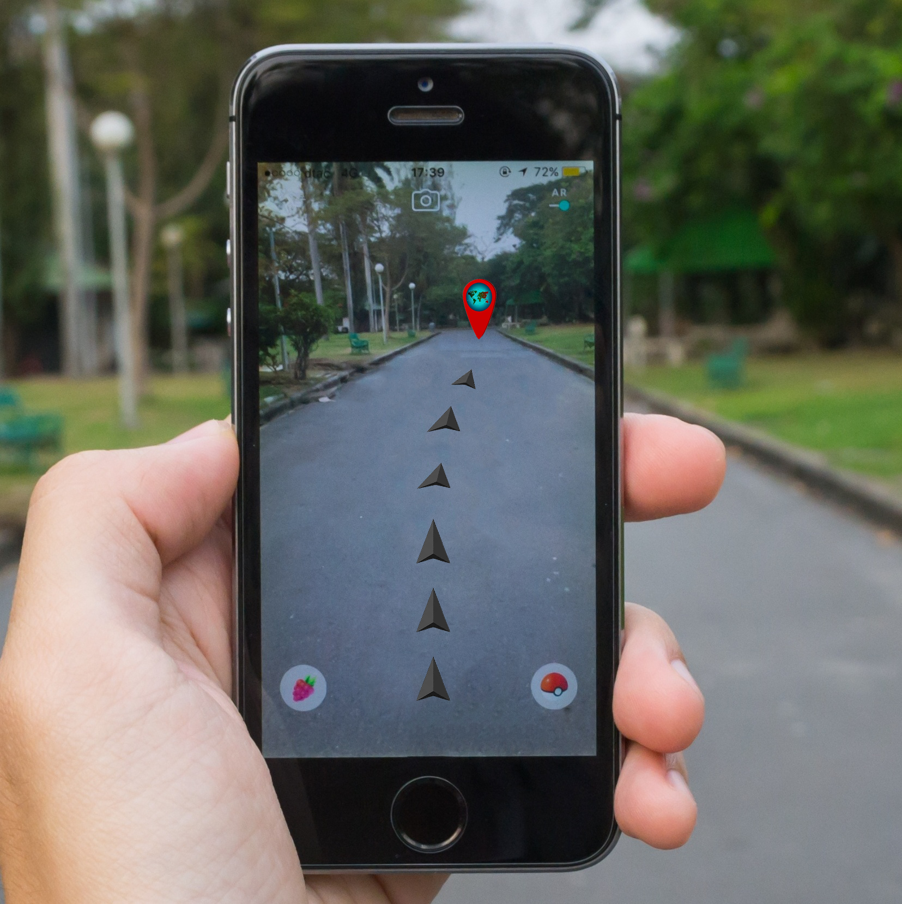
IPCA CLASSROOM FINDER
DIOGO OLIVEIRA | JOSHUA JONES | LEANDRO MATOS
GRADUATION IN COMPUTER SYSTEMS ENGINEERING
Applied Project
Supervisor: Patrícia Leite
BACKGROUND
OBJECTIVES
Going back to our first year in IPCA we found that just looking at a piece of paper called schedule wasn’t enought to find our classroom therefore many times we ended up arriving late. To make sure that no other student goes through this struggles we came up with ‘IPCA Classroom Finder’.
We aimed to an intuitve app that every single academic would be able to use and understand it’s interface.
The objective of this project is to help new students, teachers and other academic entities find classrooms inside Polytechnic Institue of Cávado and Ave more easily.
Using the authenticator’s phone camera an generated IA path will guide the student to his destination.
METHODOLOGY
Sometimes it can be difficult to get to a room on a campus as big as IPCA, which is why we decided to create
'IPCA Classroom Finder'.
Initially, we need some data on the distribution of rooms, as well as the IPCA blueprint, more
precisely the Higher School of Technology. Therefore, we call upon means such as interviews with members of the board.
When it comes to technologies, applications and resources used to carry out our project, we use tools such as:
- What3Words
- MySQL
- Kotlin
- Javascript
RESULTS AND CONCLUSIONS
BIBLIOGRAPHY
Our project was developed thinking only about the higher technology school, however, our ambition is to make it possible to implement this solution for the remaining schools. This is a step that we feel is within our reach and one that we will absorb more support as well as more future updates.
Drª Anabela Silva
2Ai Board
Kotlin Documentation
https://kotlin.org/
MySQL DataBase
https://www.mysql.com/
What3Words
https://what3words.com/
JavaScript.Documentation - https://www.javascript.com/
CONTACTS
a21111@alunos.ipca.pt
a21116@alunos.ipca.pt
a21124@alunos.ipca.pt
INSTAGRAM
@diogo_oliveira1616
@joshyjones27
@leandro.matos293
GITHUB
@DiogoOliveira-16
@JoshyJones27
@mataozin123

