Slide 1
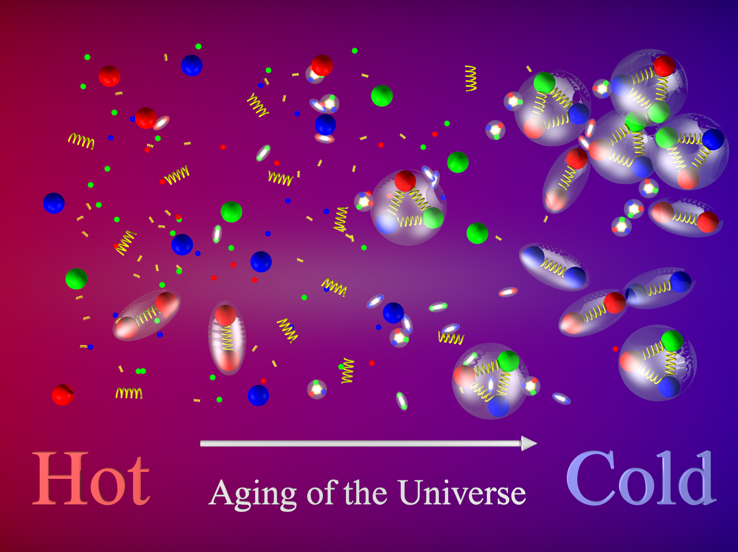



Phenomenological models of charm hadron production in Pythia8
CERN Summer School 2019
Joshua Winter
School of Physics and Astronomy, The University of Manchester, UK
Performed under the supervision of Gian Michele Innocenti

Slide 2
Motivation
At LHC energies, pp collisions are not expected to produce a thermalised medium, such as the QGP;
Traces of collectivity have been observed in ALICE, by probing pp events for light and heavy flavour hadrons;
The measured production ratios of charmed baryons to mesons versus p_{T} and multiplicity are not consistent with previously tested phenomenological models.

Slide 3
Objective
Illustrate the effect of various models of colour reconnection (CR) and rope hadronisation (RH) on charmed hadron production in pp collisions at 13 TeV, as generated in PYTHIA8.2.

Slide 4
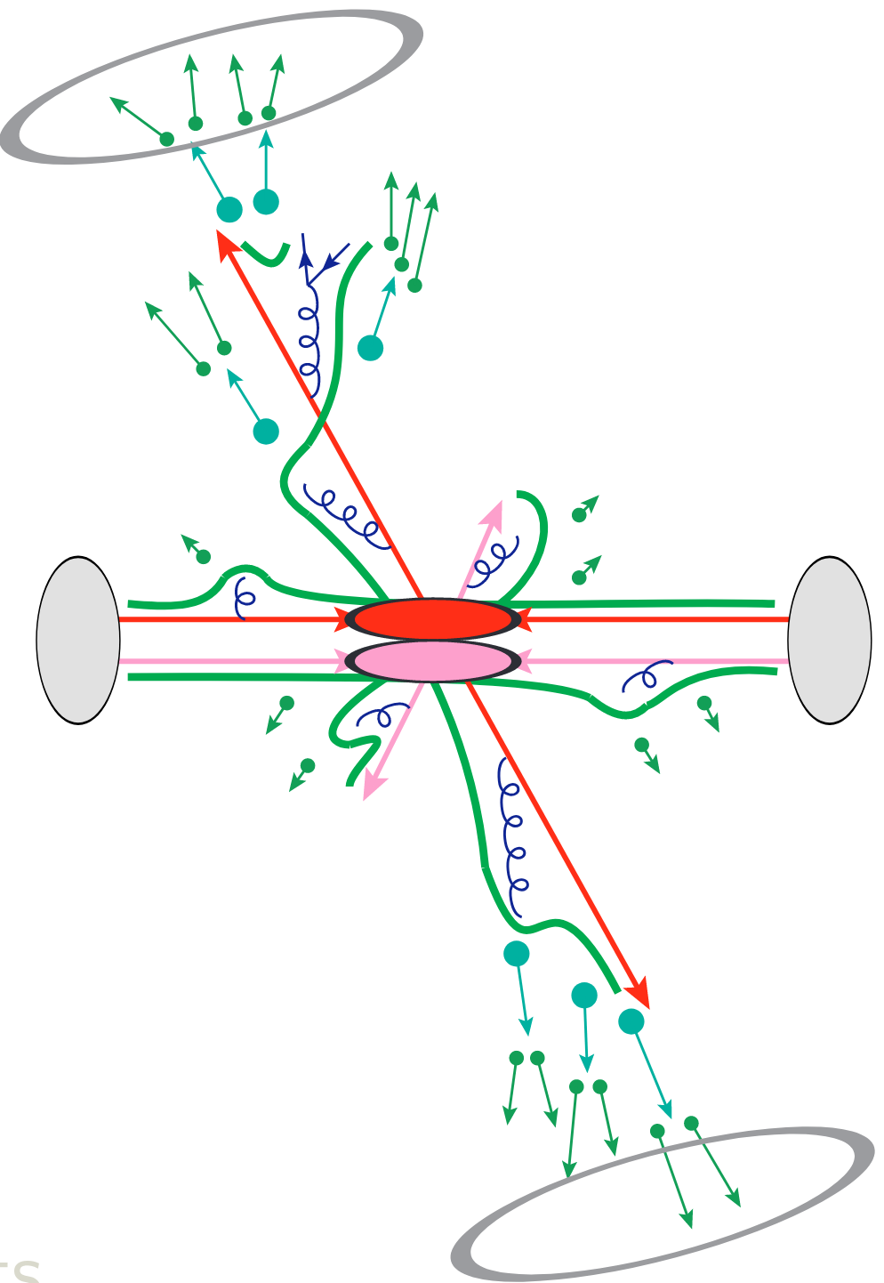
The PYTHIA8 Event Generator
PYTHIA8 recreates the main physical processes of a standard particle collision, namely:
Hard processes (PDFs, LO perturbative QCD calculations)
Initial and final state radiation (ISR and FSR. First order corrections)
Multiparton interactions (MPIs)
Fragmentation and Hadronisation (Lund strings)
Particle and resonance decays
Models of each of these processes can implemented in PYTHIA through a series of built-in configurable parameters. A particular configuration of these settings is known as a tune.
Adapted from [1]

Slide 5
The Tunes of PYTHIA
General Configurations
Default PYTHIA8.2 configurations include
  the Monash 13 for the most up to date ISR, FSR, string fragmentation and hadronisation parameters
  The LHAPDF 5 and 6 libraries for experimentally developed configurations of proton PDFs

Slide 6
The Tunes of PYTHIA: Colour Reconnection
Leading Colour (No CR) Models
The simplest MPI models treat each partonic scattering individually.
Implementation of QCD rules only accounts for correlated colour-anticolour triplet states.
Interactions with the beam remnant restore colour neutrality of each hard scattering system.

Slide 7
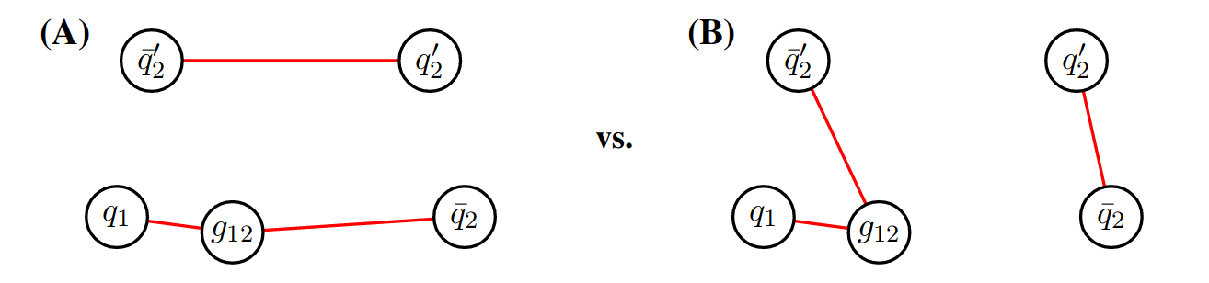
The Tunes of PYTHIA: Colour Reconnection
The MPI-Based Model
Default method of colour reconnection in PYTHIA8.
Iterating over MPIs with increasing p_{T}, the gluons of a system will be merged into the higher p_{T} MPI, minimising total string length, with a probability
Leading Colour
Relevant parameters:
MultipartonInteractions:pT0Ref
ColourReconnection:range
MPI-Based
Adapted from [2]

Slide 8
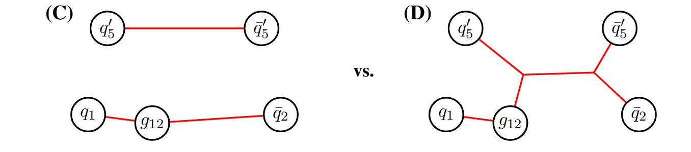
The Tunes of PYTHIA: Colour Reconnection
The More-QCD-Based Model
Introduces more complex topologies (e.g. junctions), that enhance baryon production and accounts for colour singlet states to be formed by uncorrelated triplet-antitriplet pairs.
(Anti)quarks given (anti)colour indices from 1 to 9; gluons carry distinct colour-anticolour indices.
Quark-antiquark pairs with matching colour indices can connect.
Three triplets with colour indices (1,4,7), (2,5,8) or (3,6,9) can form a colour neutral state.
Leading Colour
More-QCD-Based
Adapted from [2]

Slide 9
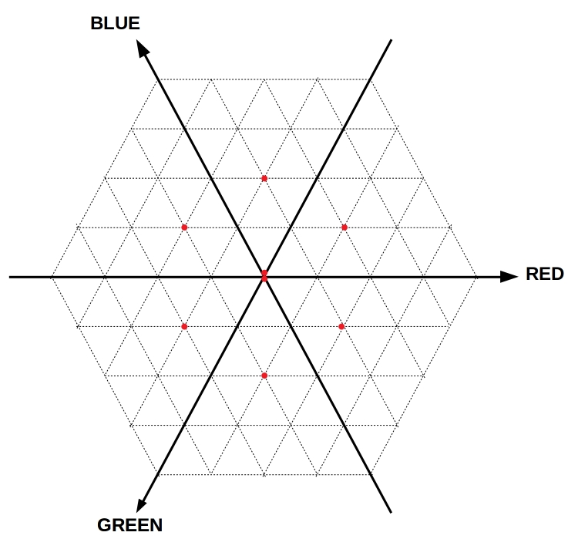
The Tunes of PYTHIA: Rope Hadronisation
Flavour Rope Model
A rope describes the coherent behaviour of closely spaced, interacting Lund strings.
Colour charge of a rope can be represented by the multiplet (p, q).
  p(q): number of coherent colour(anticolour) triplets required to form the state.
QCD calculations give effective rope tension to string tension ratio
Adapted from [3]

Slide 10
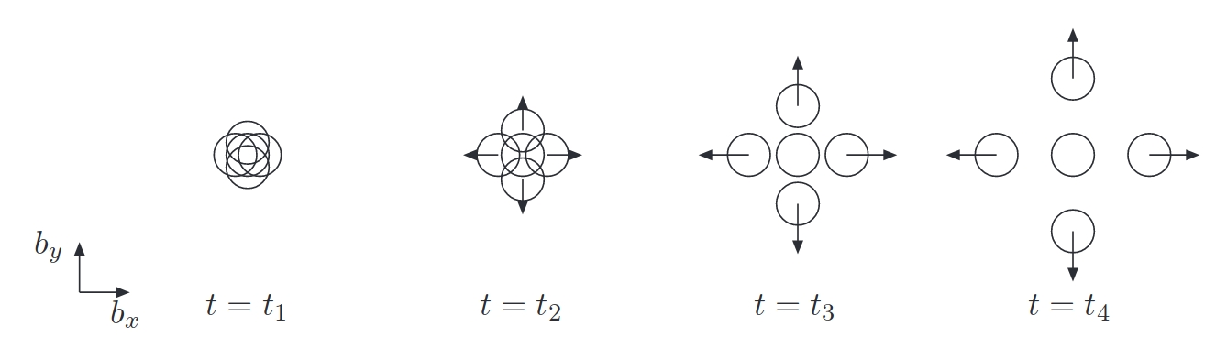
The Tunes of PYTHIA: Rope Hadronisation
Shoving Rope Model
Looks to describe how repulsive forces between ropes can lead to collectivity in p-p collisions.
Higher energy densities within regions of overlapping strings create a dynamically evolving outward pressure.
Time iterative and evaluated between pairs of strings, in small rapidity ranges.
At each time step, change in p_{T},
Adapted from [4]

Slide 11
Event Generation and Selection
Hard process ccbar events were generated in p-p collisions at 13 TeV, to study D⁰, D_{s}⁺ and Λ_{c}⁺ production in association to their respective antiparticles.
  D⁰ → K⁻ + π⁺
  D_{s}⁺ → π⁺ + φ⁰, φ⁰ → K⁺ + K⁻
  Λ_{c}⁺ → p + K⁰, K⁰ → π⁺ + π⁻
Particles and resonances were forced into respective decay channels.

Slide 12
Event Generation and Selection
 | No CR | MPI-Based | More-QCD-Based | Flavour Ropes | Shoving Ropes
D⁰ (200k) | 61222 (30.6%) | 61364 (30.7%) | 57292 (28.6%) | 60661 (30.3%) | 61641 (30.8%)
D_{s} (400K) | 3824 (0.96%) | 3897 (0.97%) | 3709 (0.93%) | 4213 (1.05%) | 3841 (0.96%)
Λ_{c} (500K) | 966 (0.19%) | 1041 (0.21%) | 5167 (1.03%) | 1045 (0.21%) | 990 (0.20%)

Slide 13
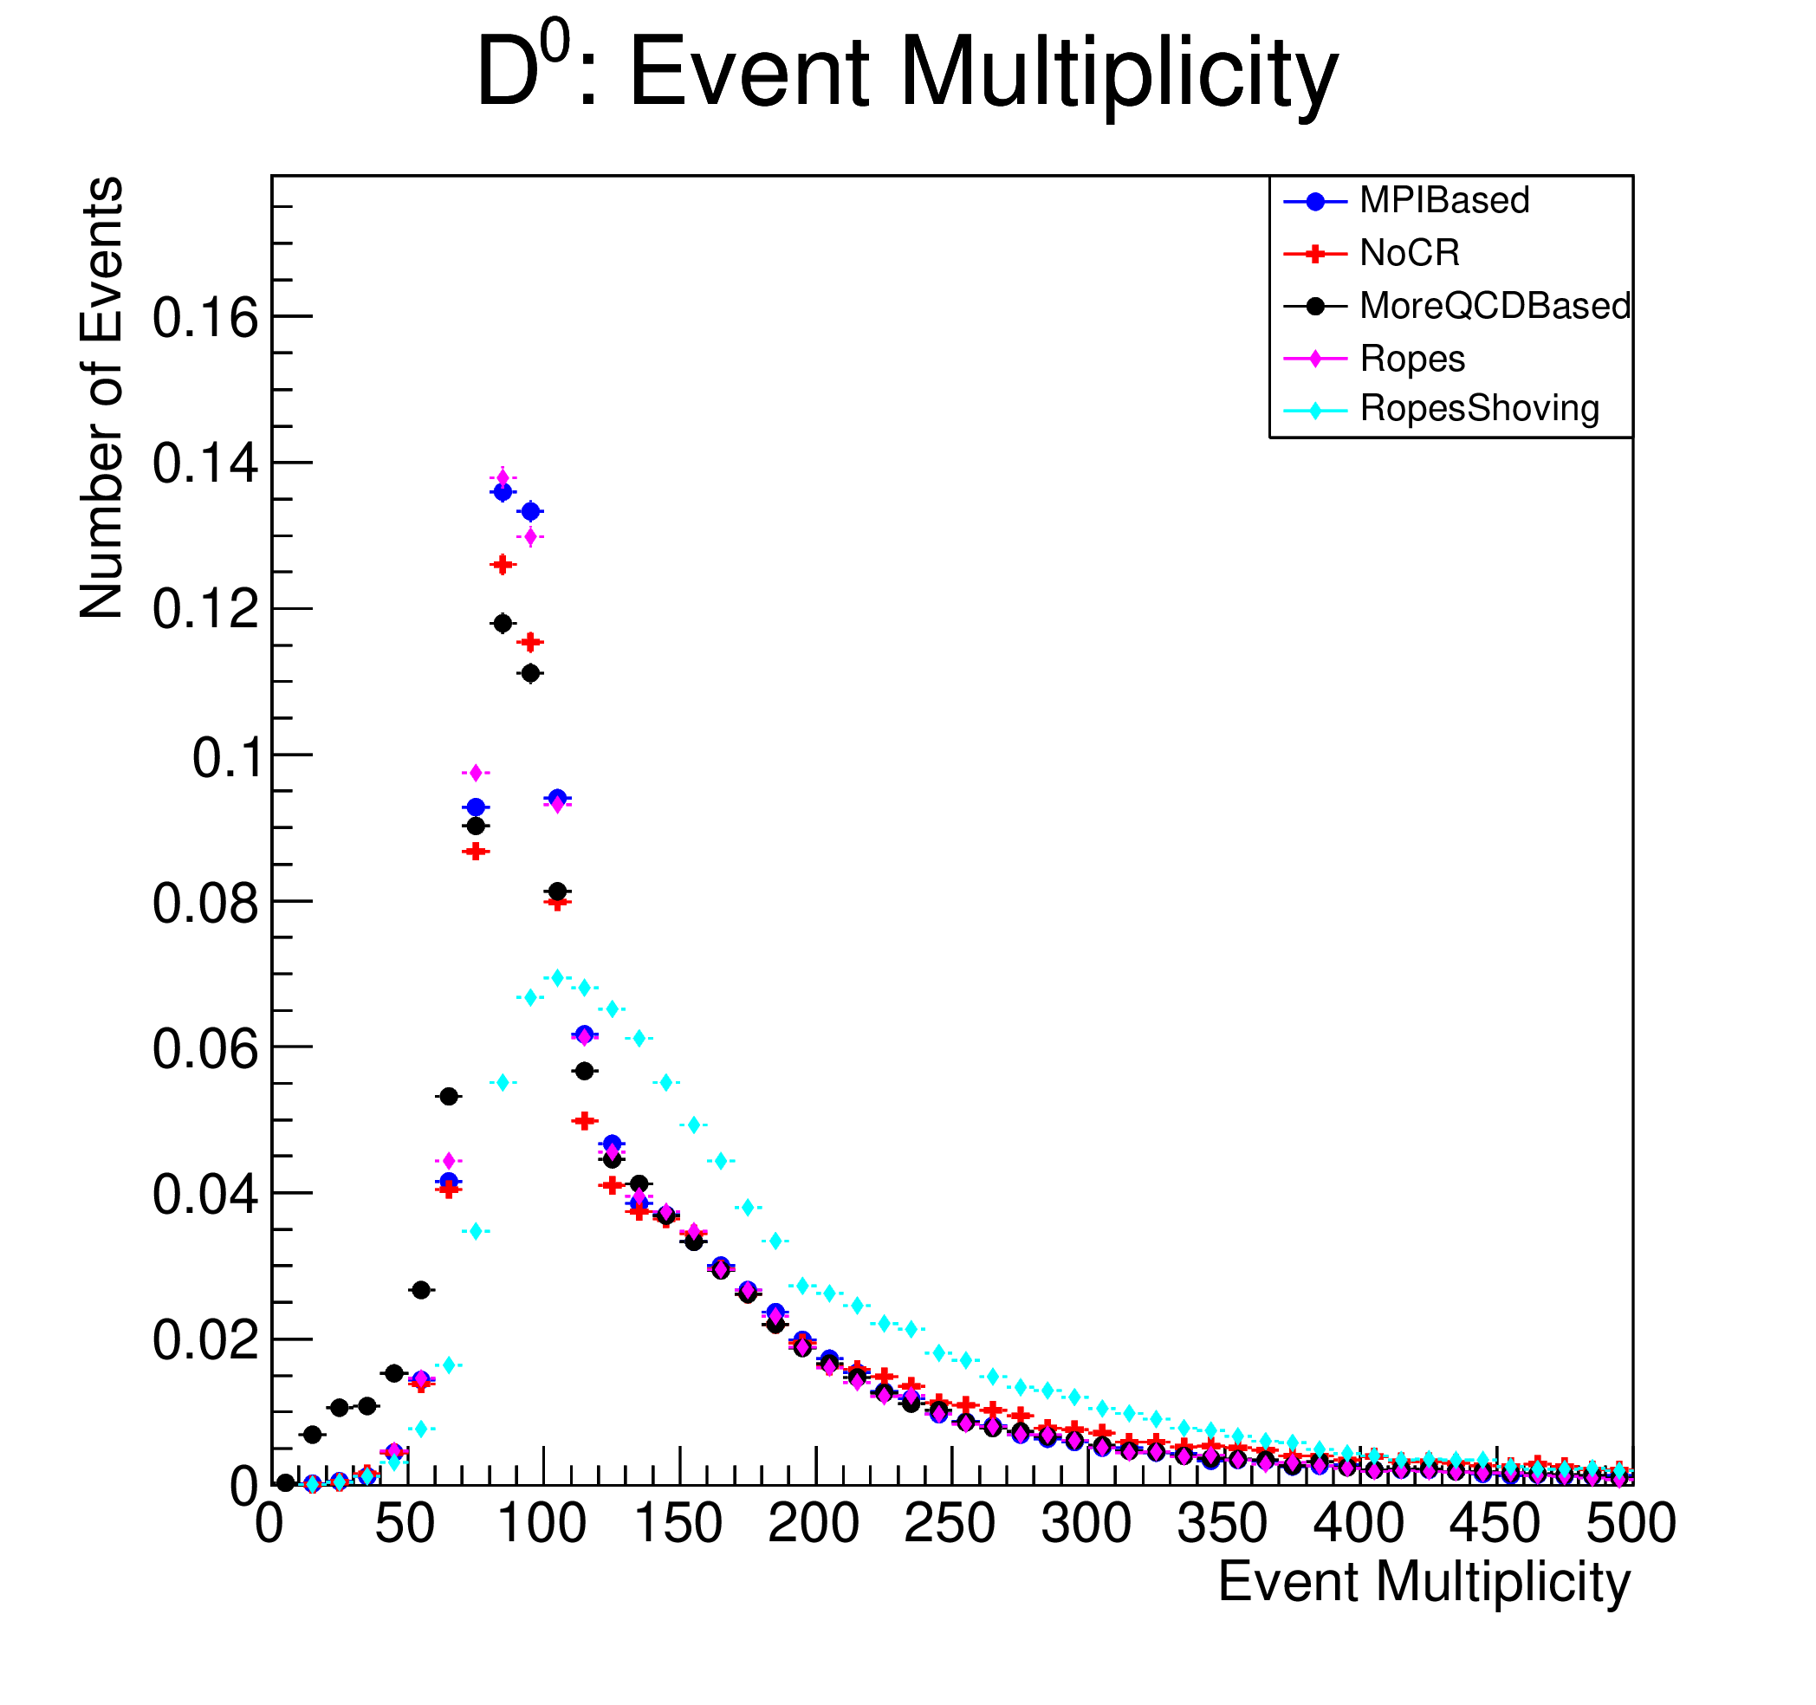
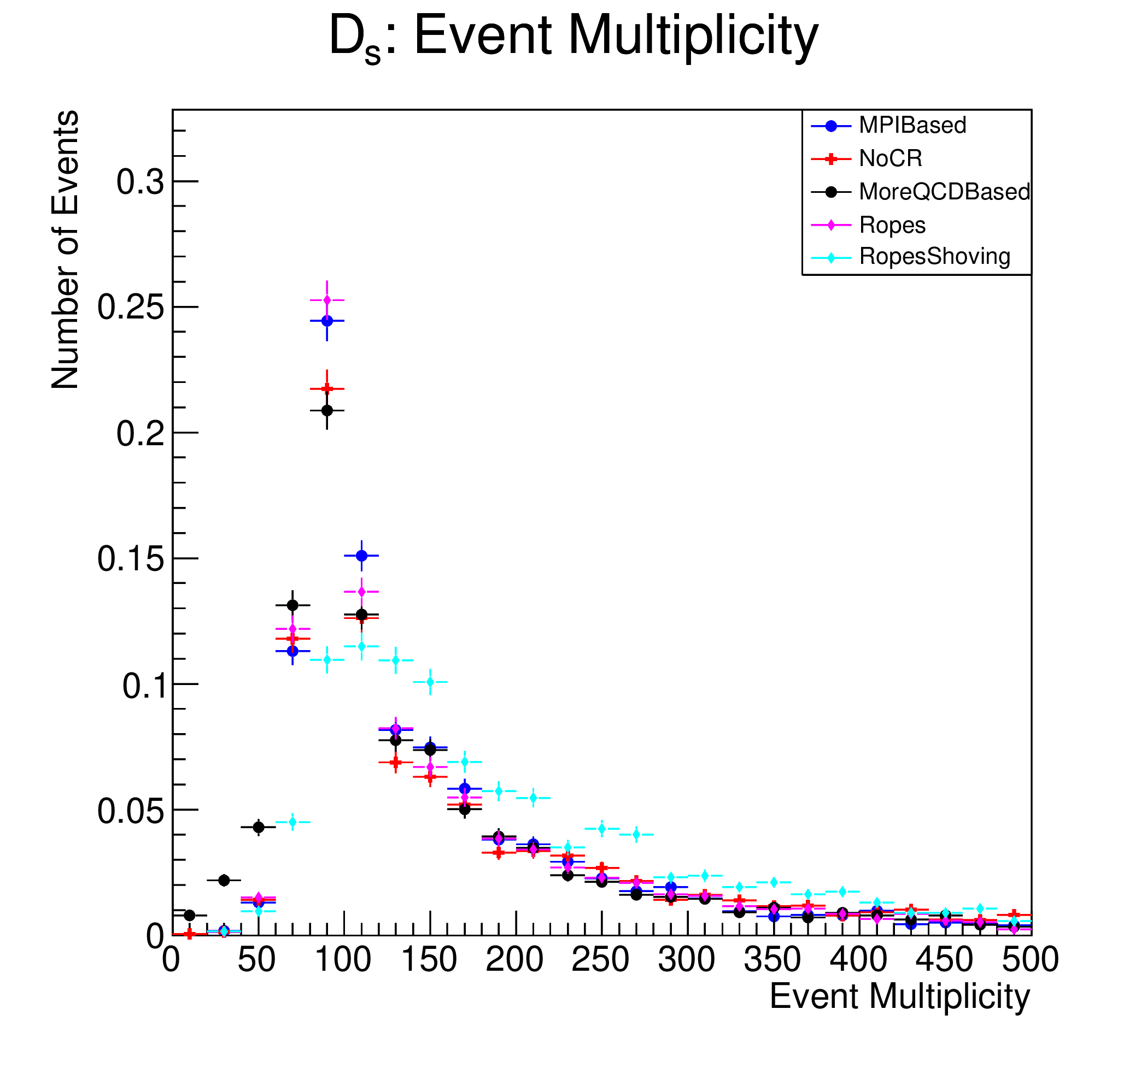
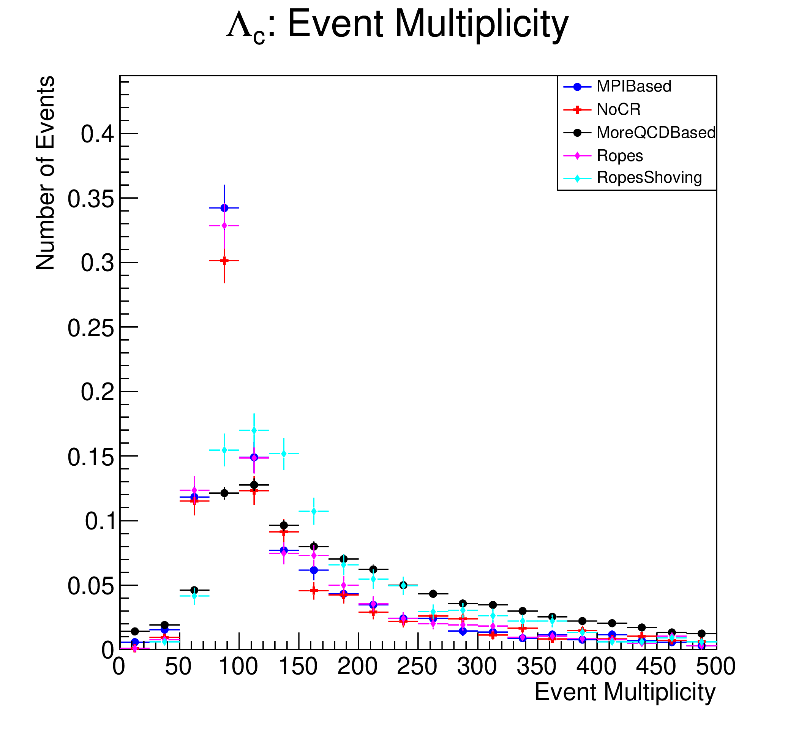
Multiplicity
Multiplicity measured via number of final particles in the event.

Slide 14
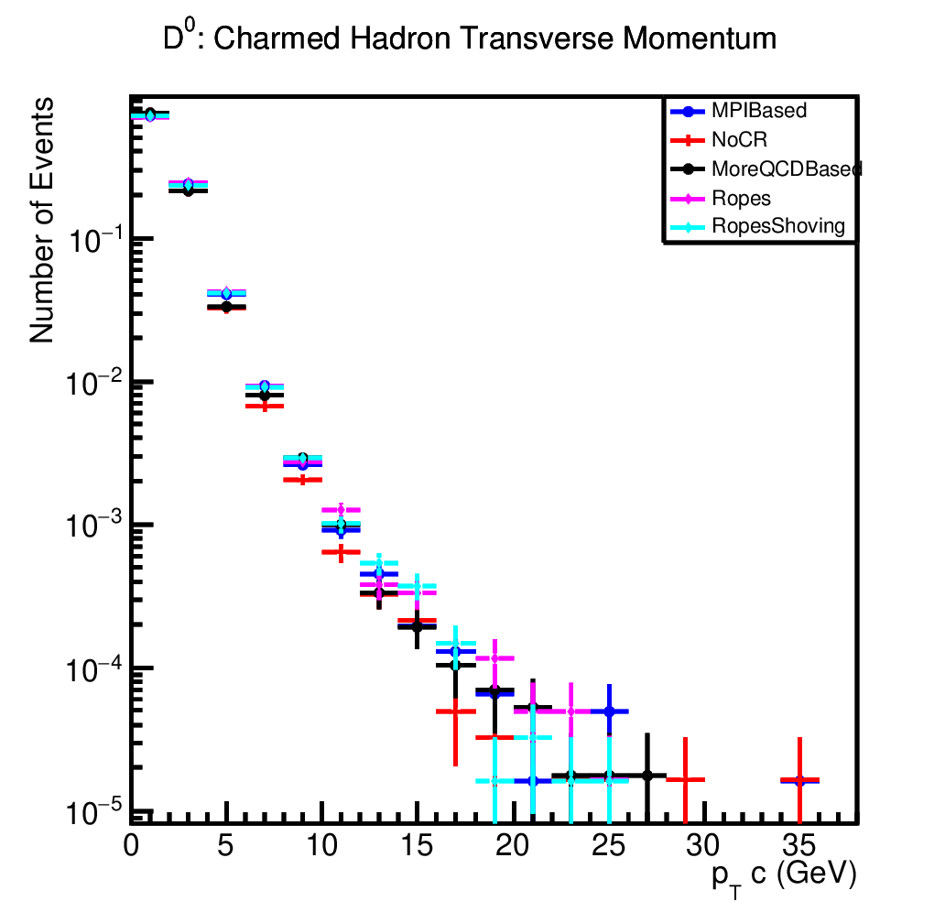
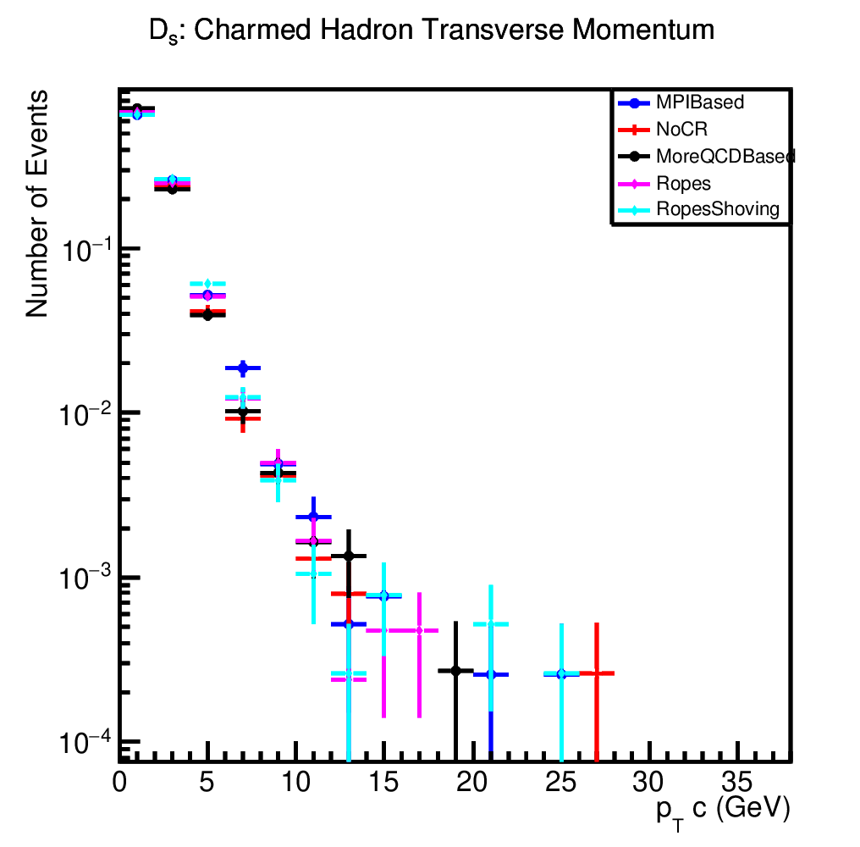
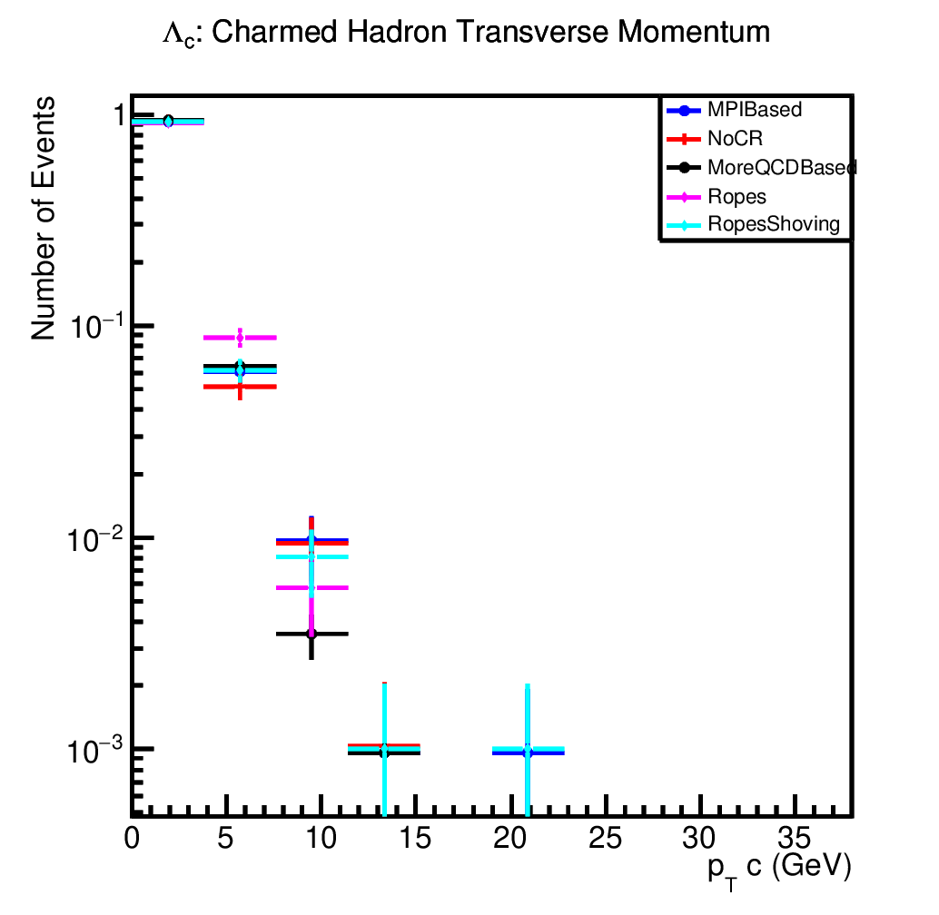
Kinematic Variables: p_{T}

Slide 15
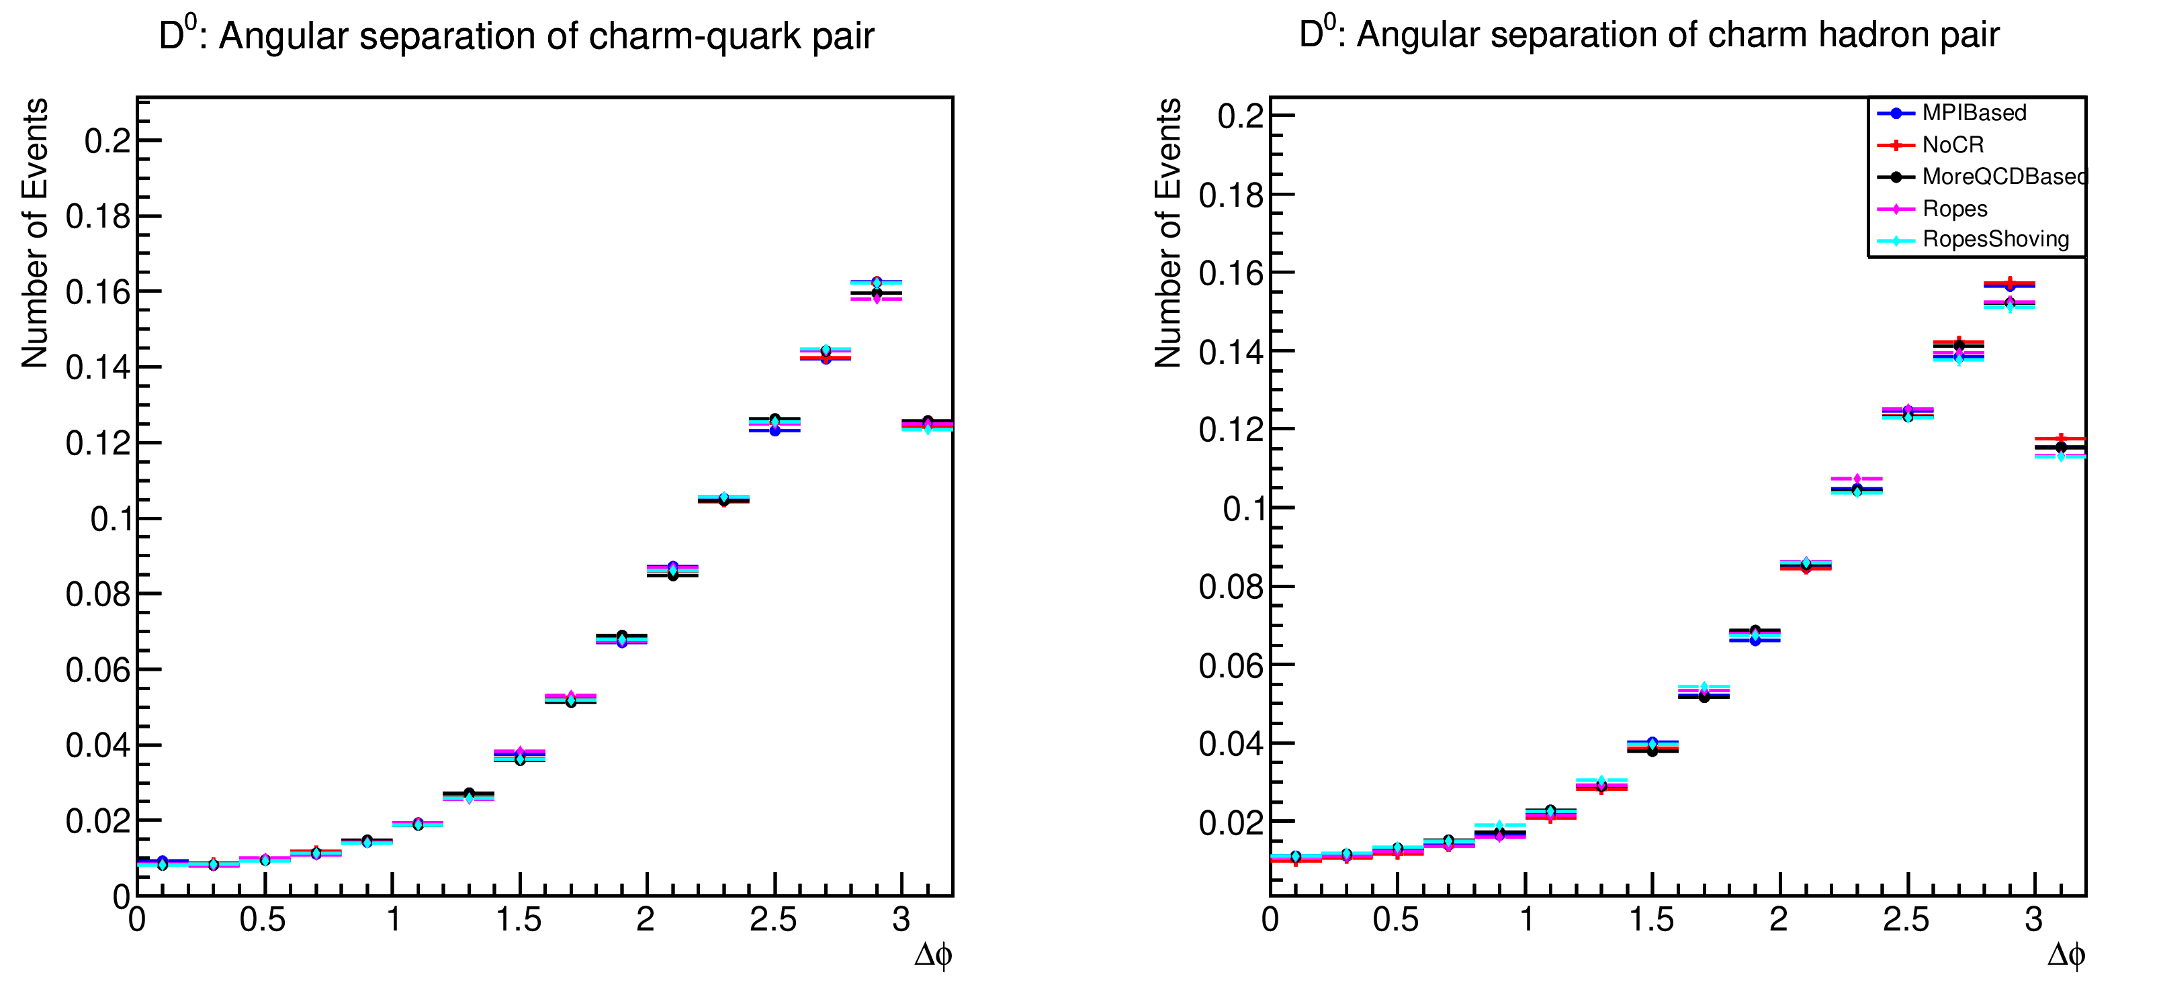
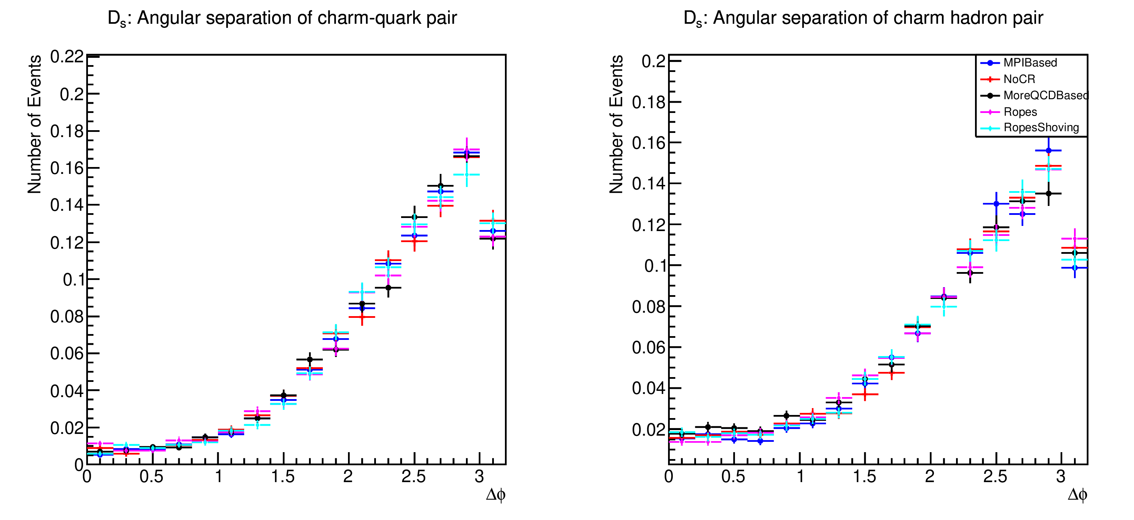
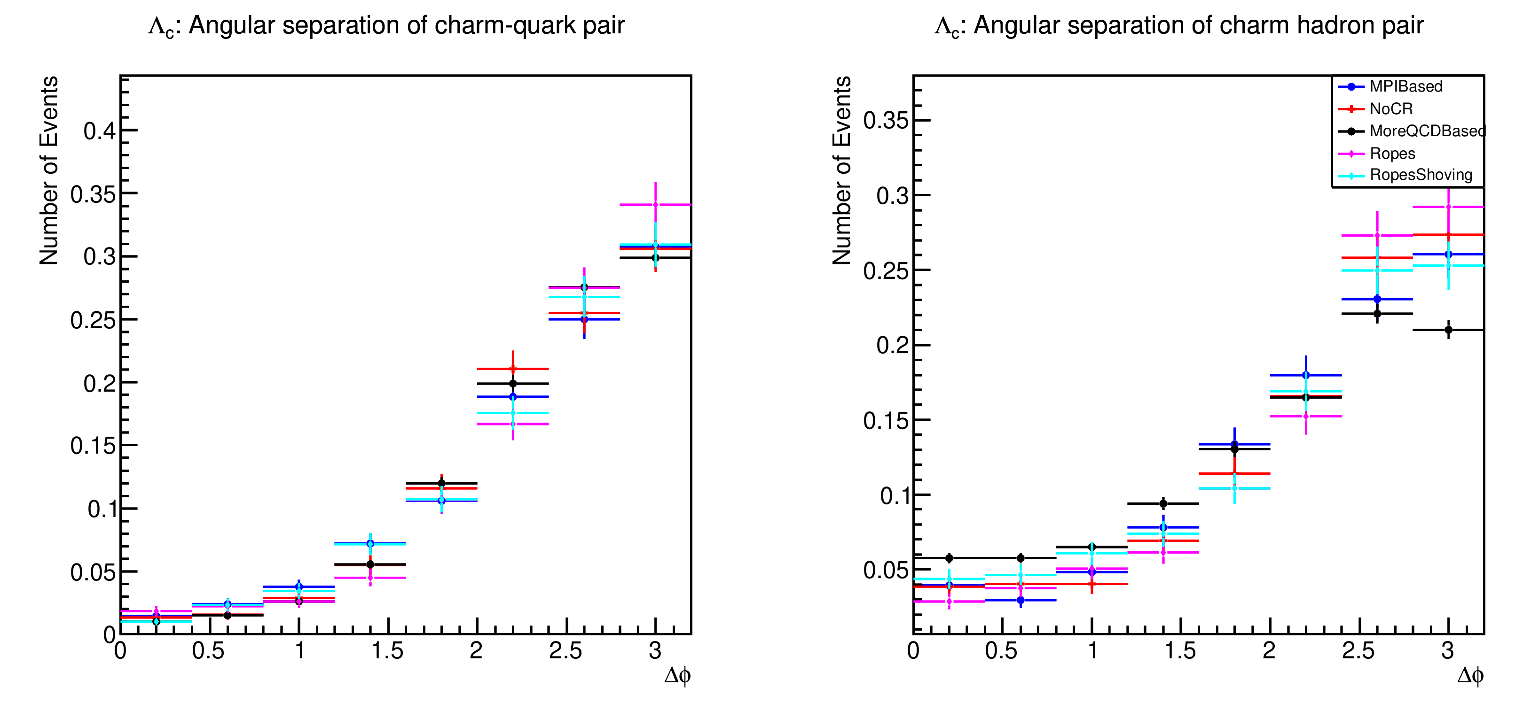
Kinematic Variables: Δφ

Slide 16
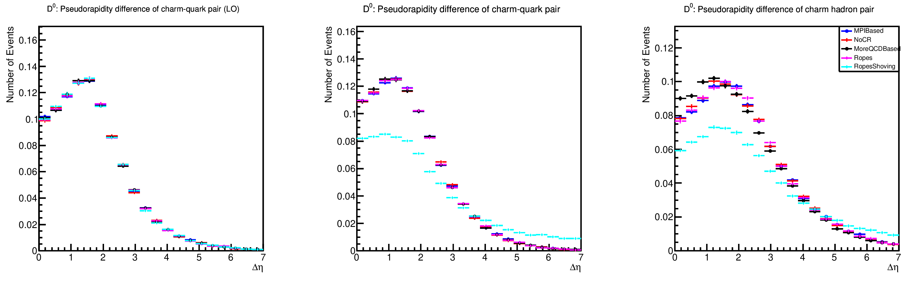
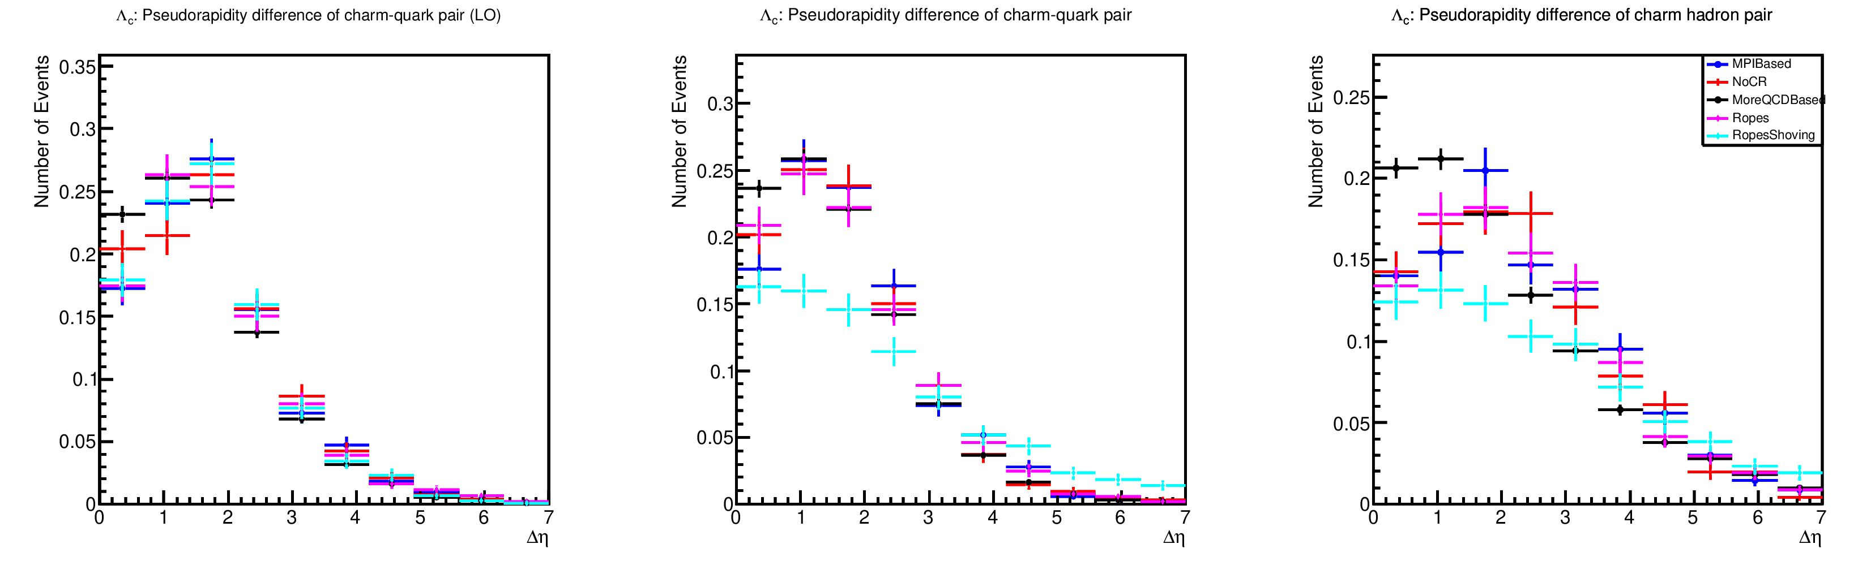
Kinematic Variables: Δη

Slide 17
Pt mothers vs daughters (???)
I have 40 plots for this, for each mother to each daughter. Which ones do I include?

Slide 18
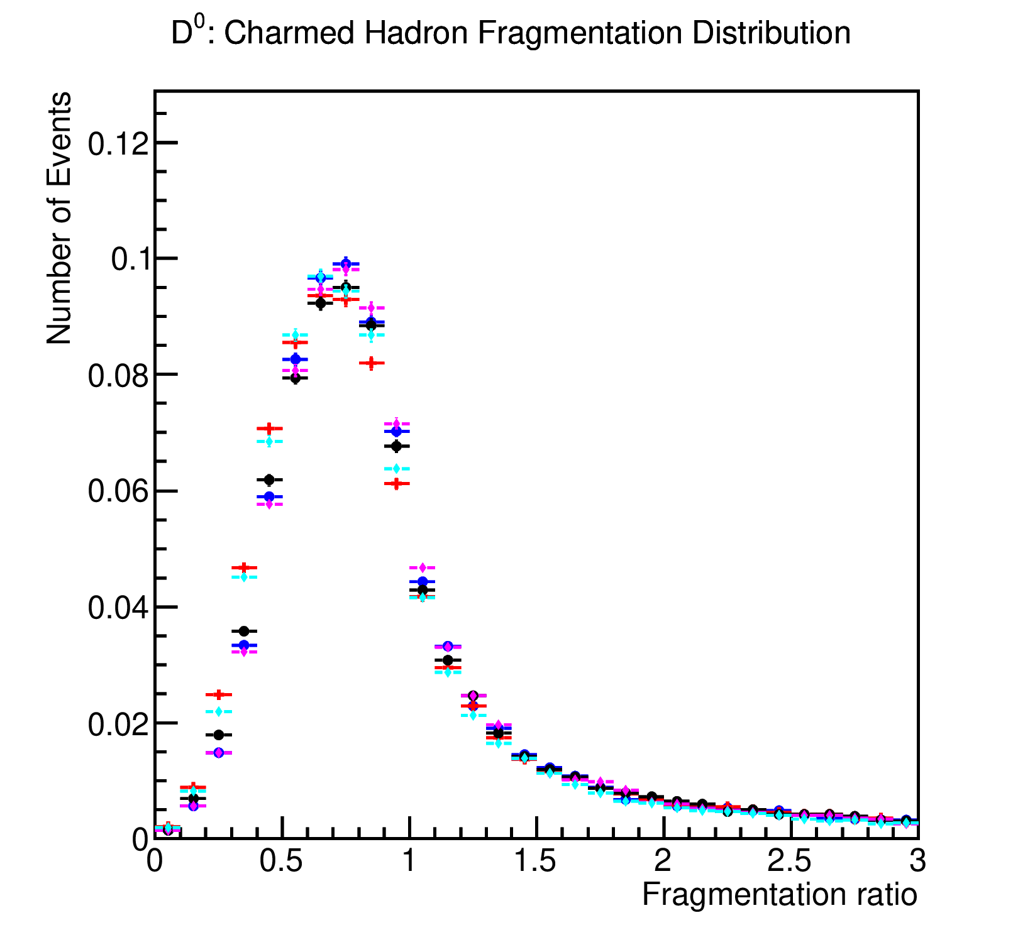
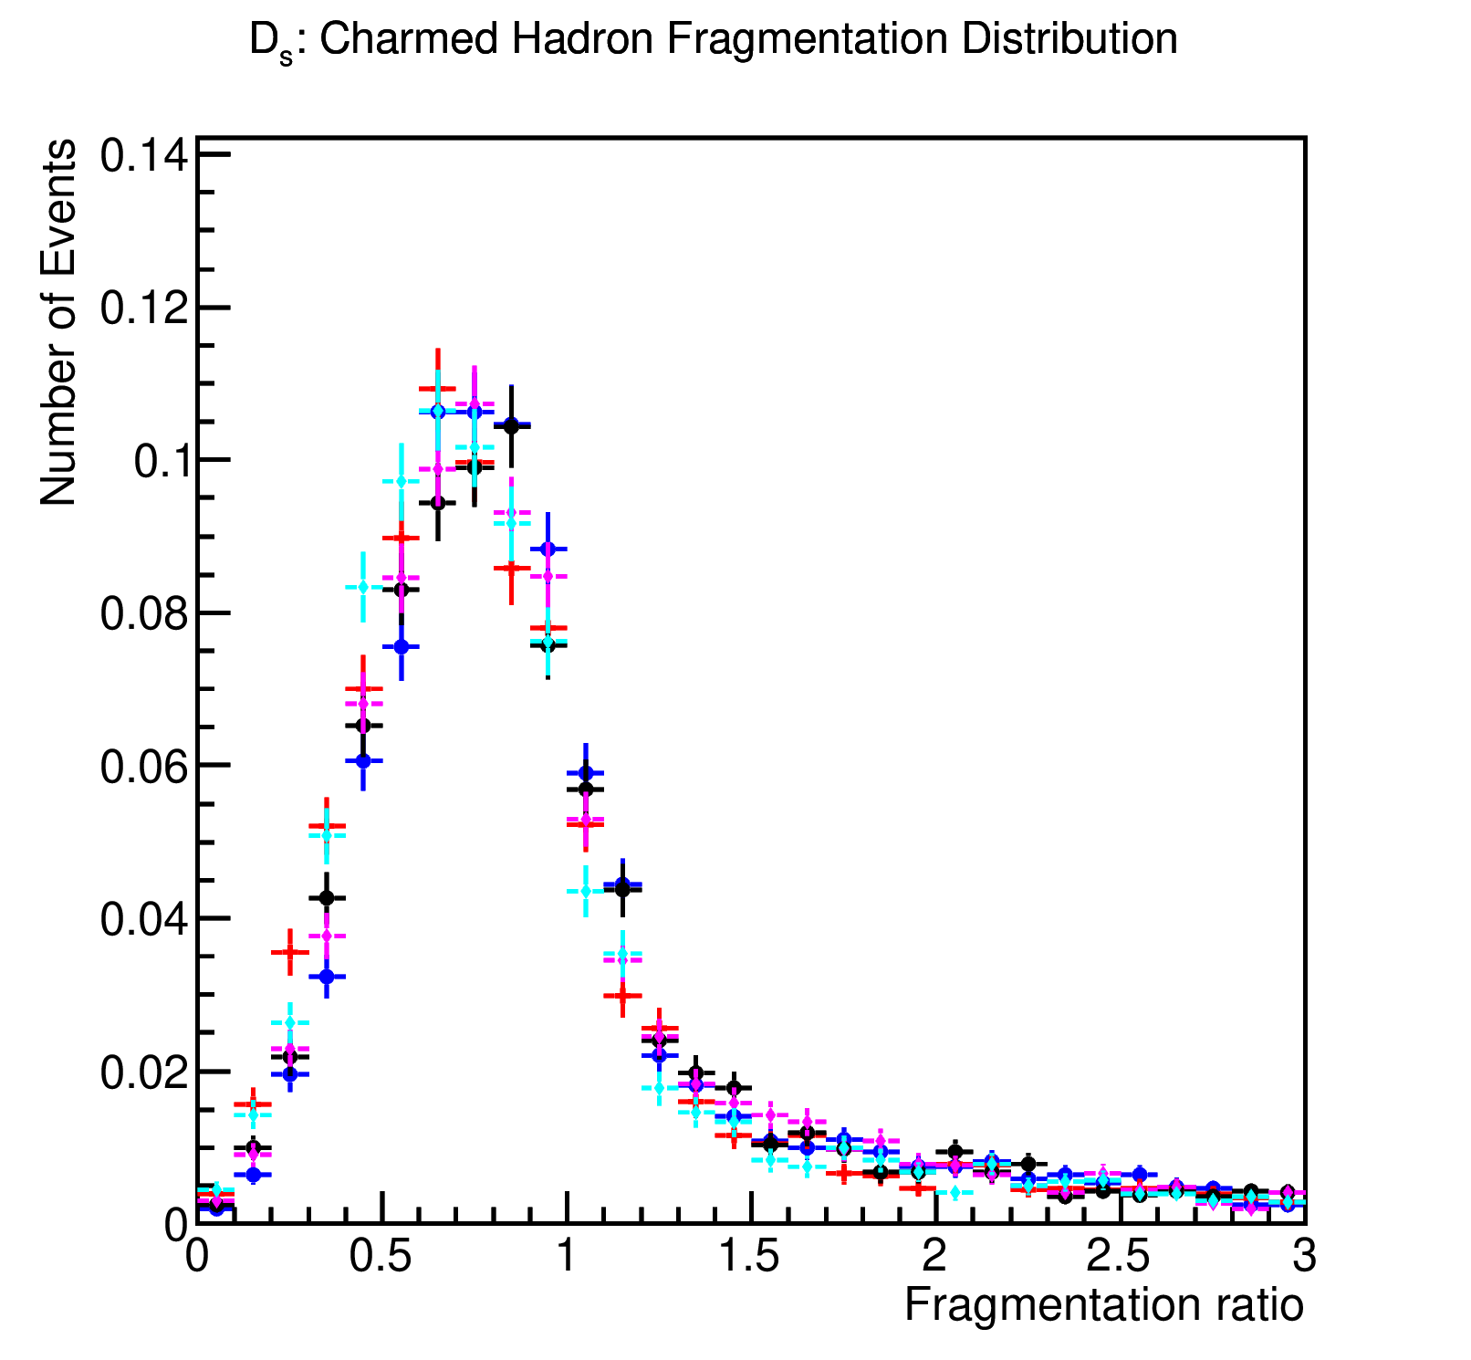
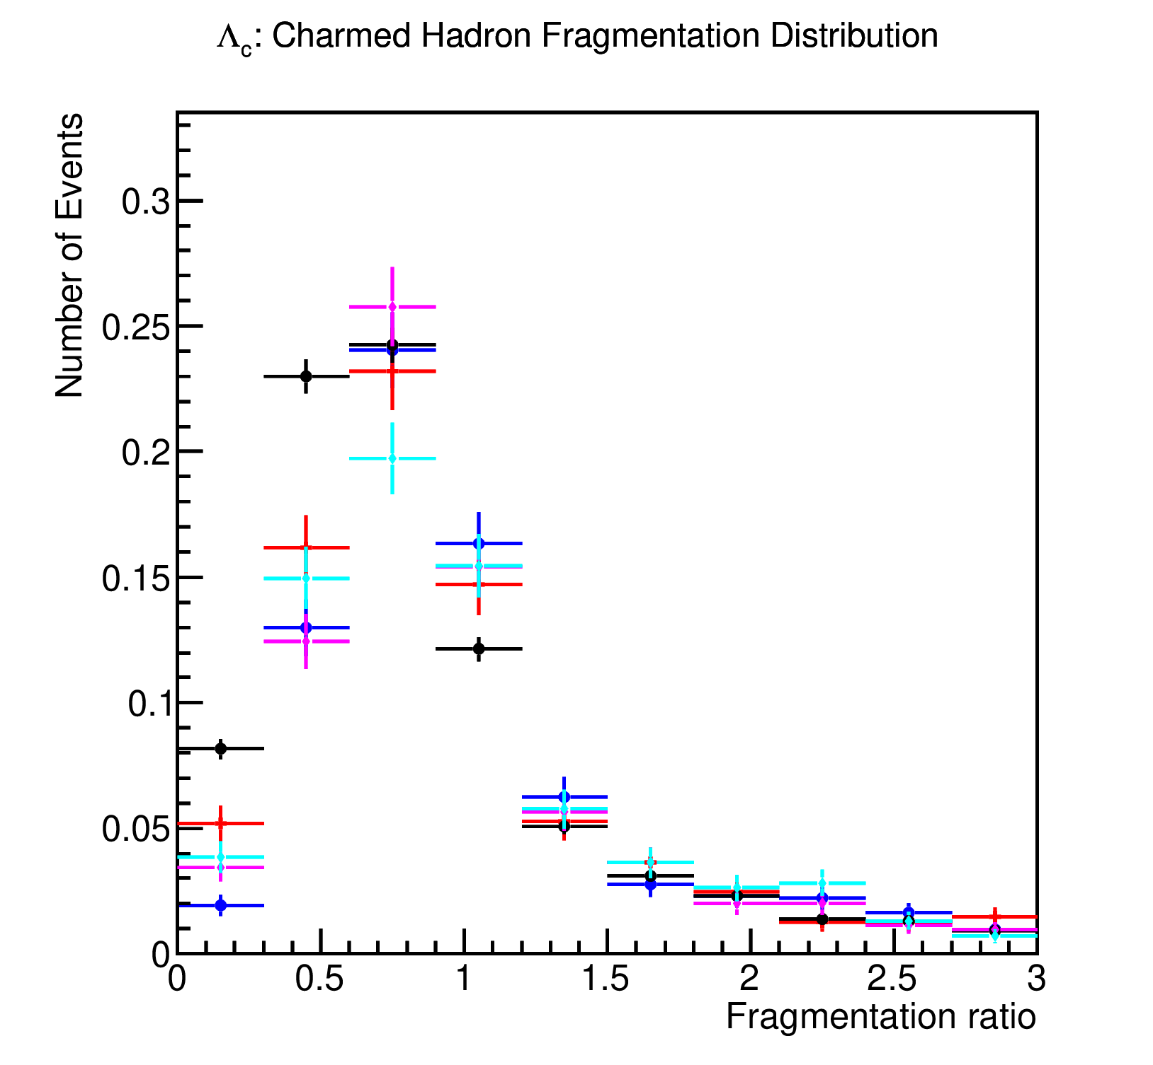
Fragmentation Functions
Fragmentation function: ratio of the hadron transverse momentum to the scalar sum of transverse momenta of final particles within a cone of radius R=0.7 around the hadron.

Slide 19
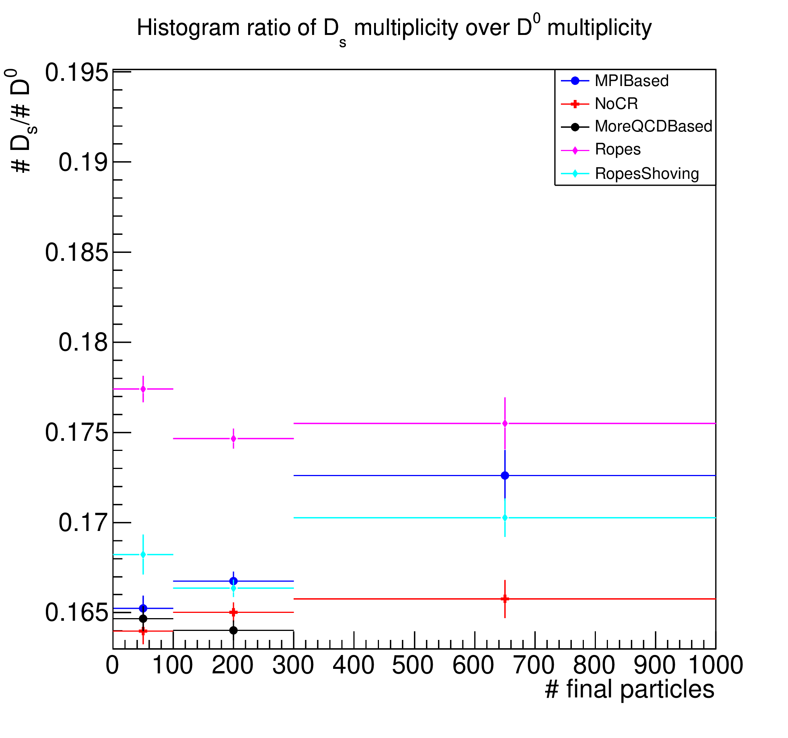
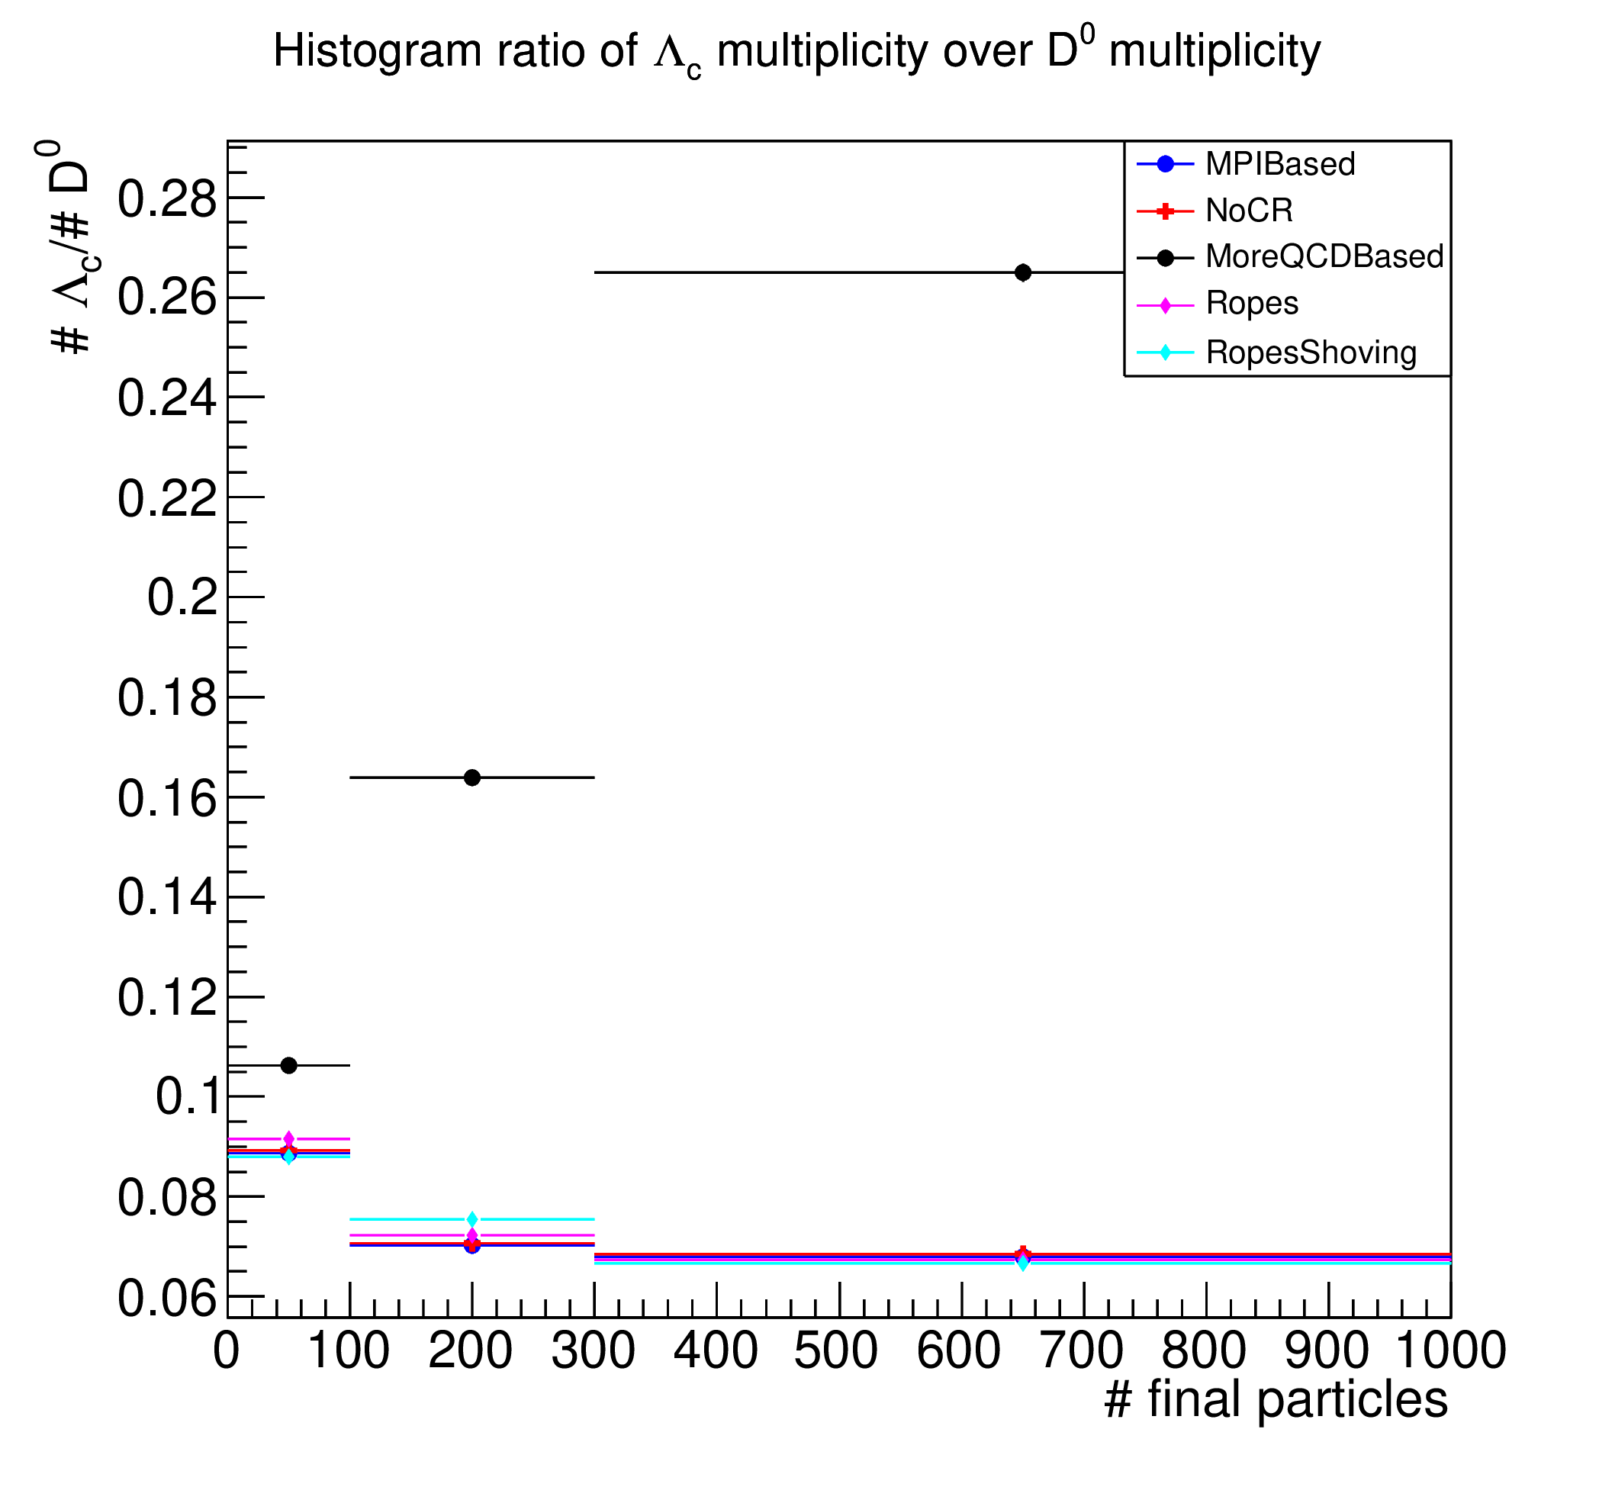
Hadronic production ratios

Slide 20
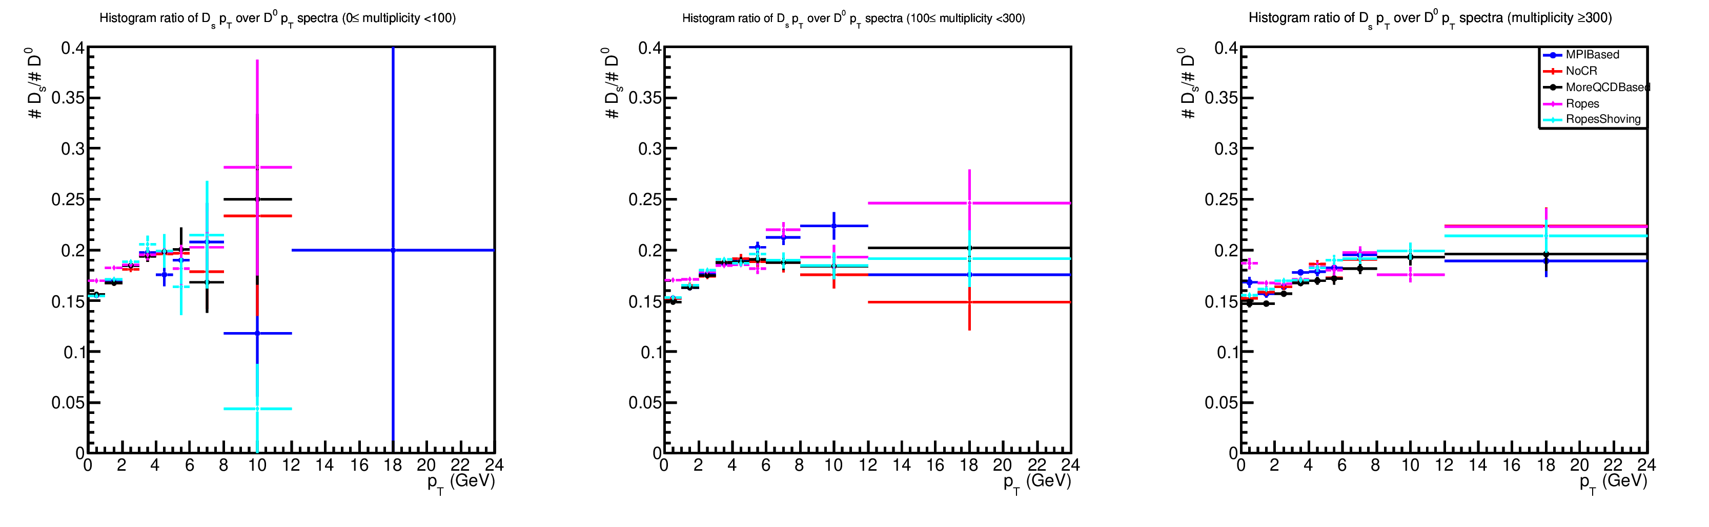
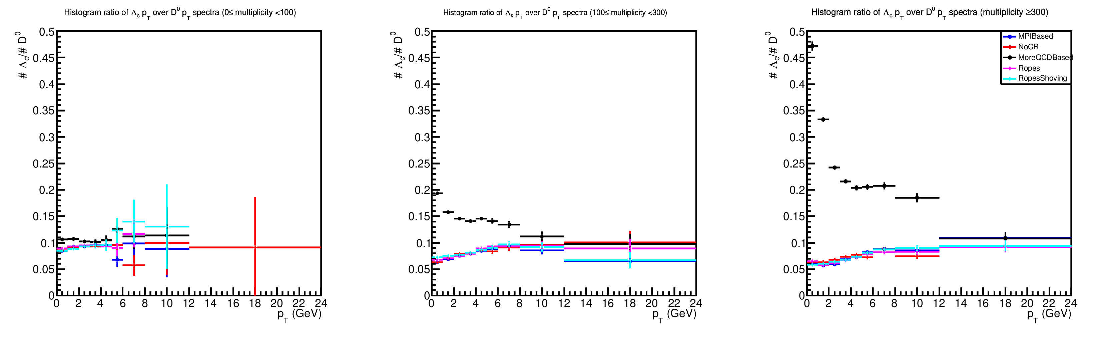
p_{T}-differential hadronic production ratios

Slide 21
Bibliography
[1] S. Prestel, The Lund Hadronization Model (Hadronization in HEP Event Generators), 2018,
available at: http://home.thep.lu.se/~torbjorn/talks/PrestelNu18.pdf
[2] J. Christiansen and P. Skands, String Formation Beyond Leading Colour, (2015), arXiv:1505.01681v1 [hep-ph].
[3] T. Biro et al., Colour rope model for extreme relativistic heavy ion collisons, Nucl.Phys. B245 (1984) 449.
[4] C. Bierlich, G. Gustafson and L. Lönnblad, A shoving model for collectivity in hadronic collisions, Department of Astronomy and Theoretical Physics, Lund University, (2016),
arXiv:1612.05132v1 [hep-ph].

