Slide 1
Graduate Admissions in
India and Taiwan
Group #2
0513201 黃子軒、0513230 陳奕婷
0513403 陳昀萱、0513456 林芸如
0513424 李周辰浩

Slide 2
Outline
Introduction to the dataset: Graduate Admissions in India
Exploratory Data Analysis
Regression and Classification Results
Application: Shiny Web
Extended Research: Graduate Admissions in Taiwan

Slide 3
Introduction to the dataset
Dataset: Graduate Admissions
Source: https://www.kaggle.com/mohansacharya/graduate-admissions/
Attributes:
GRE Scores (out of 340)
TOEFL Scores (out of 120)
University Rating (out of 5)
Statement of Purpose Strength (out of 5)
Letter of Recommendation Strength (out of 5)
Undergraduate GPA (out of 10)
Research Experience (either 0 or 1)
Chance of Admit (ranging from 0 to 1)
Notes:
This dataset is created for prediction of Graduate Admissions from an Indian perspective.The dataset contains several parameters which are considered important during the application for Masters Programs.
GRE Scores: for people in Taiwan who want to apply for masters outside, the normal threshold is 320. That is, if you don’t get 320, you retake the test again and again until you reach 320.
TOEFL Scores: the normal threshold for TOEFL is 100.
SOP: why you want to apply to this school, why your past experience have led you to this decision

Slide 4
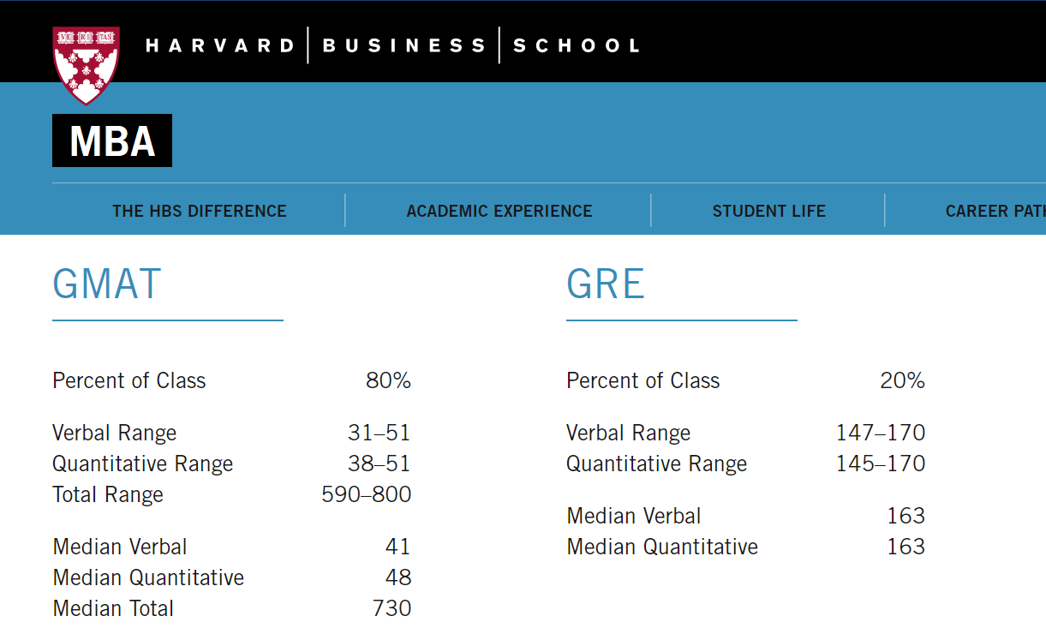
Average GRE score: 326

Slide 5
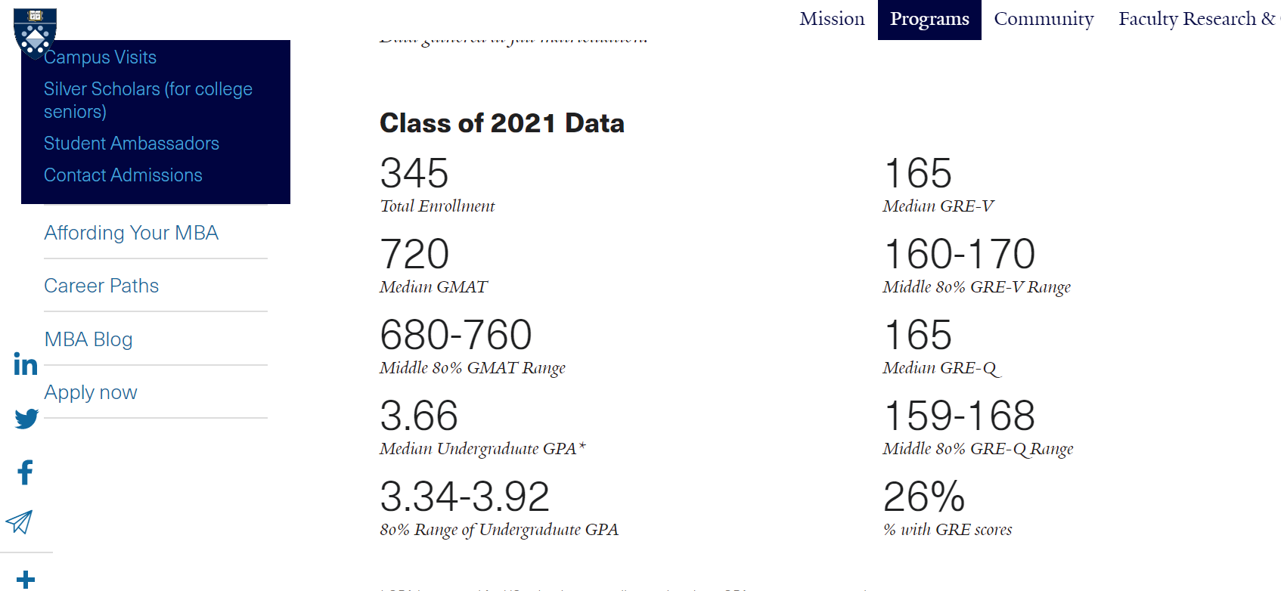
Yale School of Management
Average GRE score: 330

Slide 6
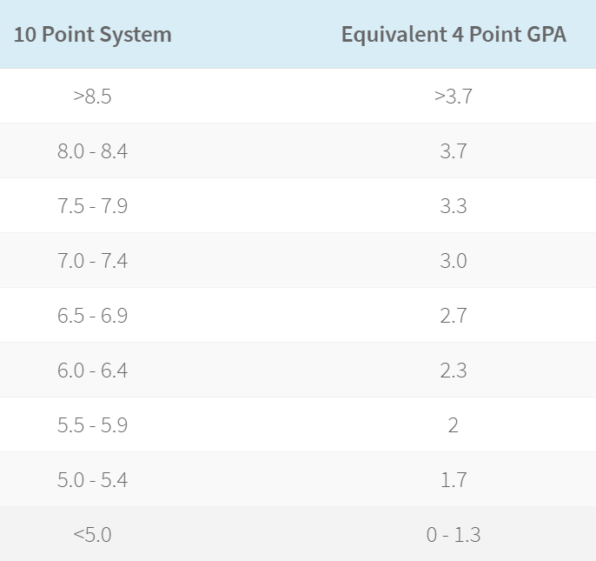
CGPA conversion to 4-point scale GPA

Slide 7
Exploratory Data Analysis

Slide 8
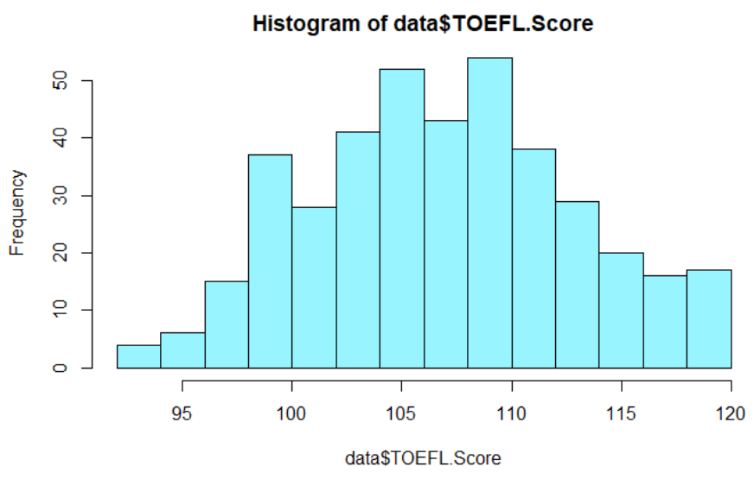
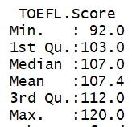
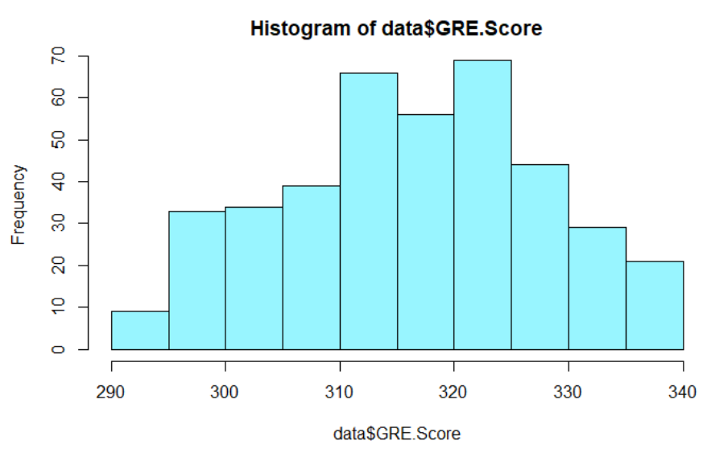
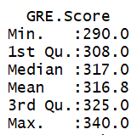
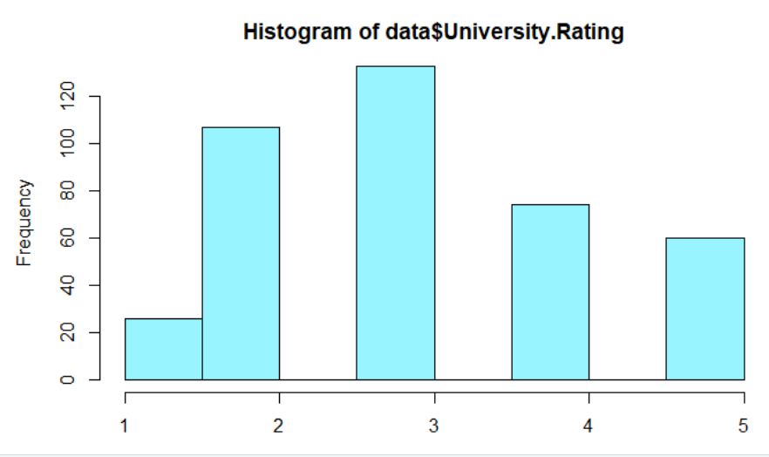
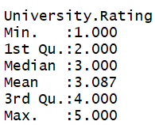
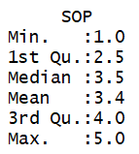
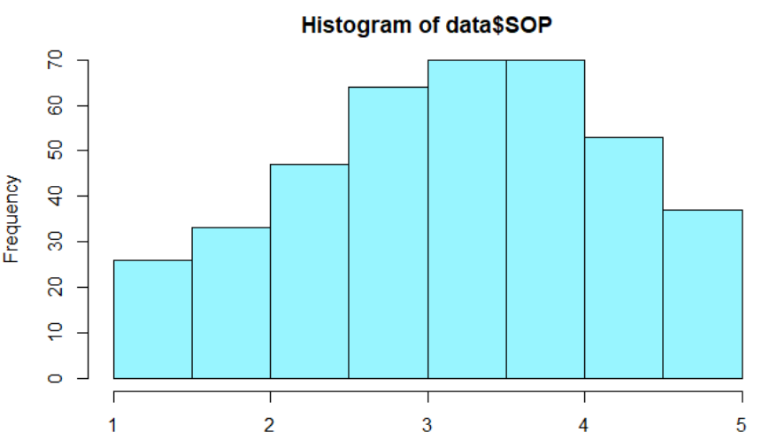
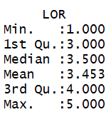
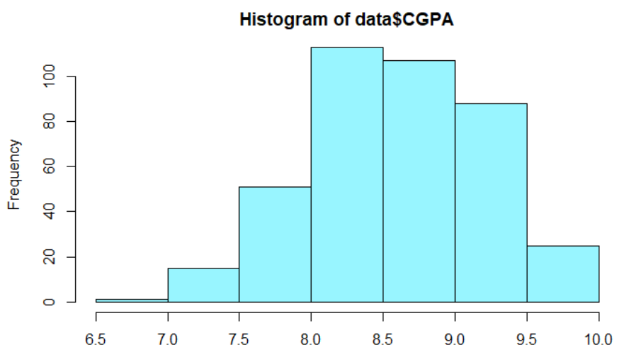
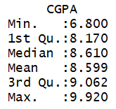
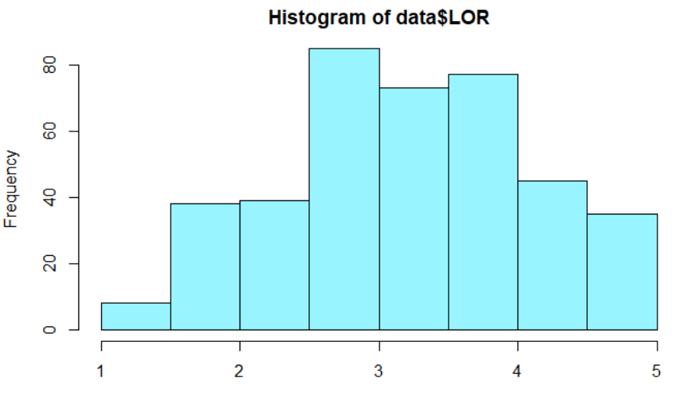
= 3.7/4.0

Slide 9
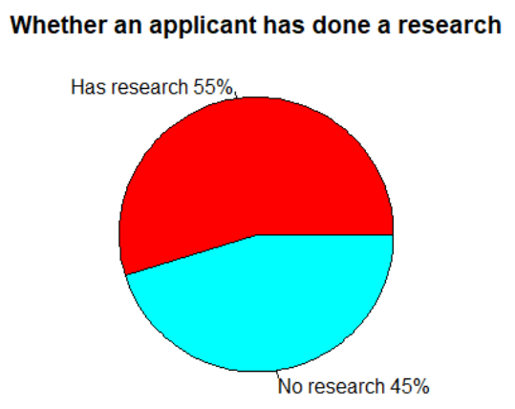
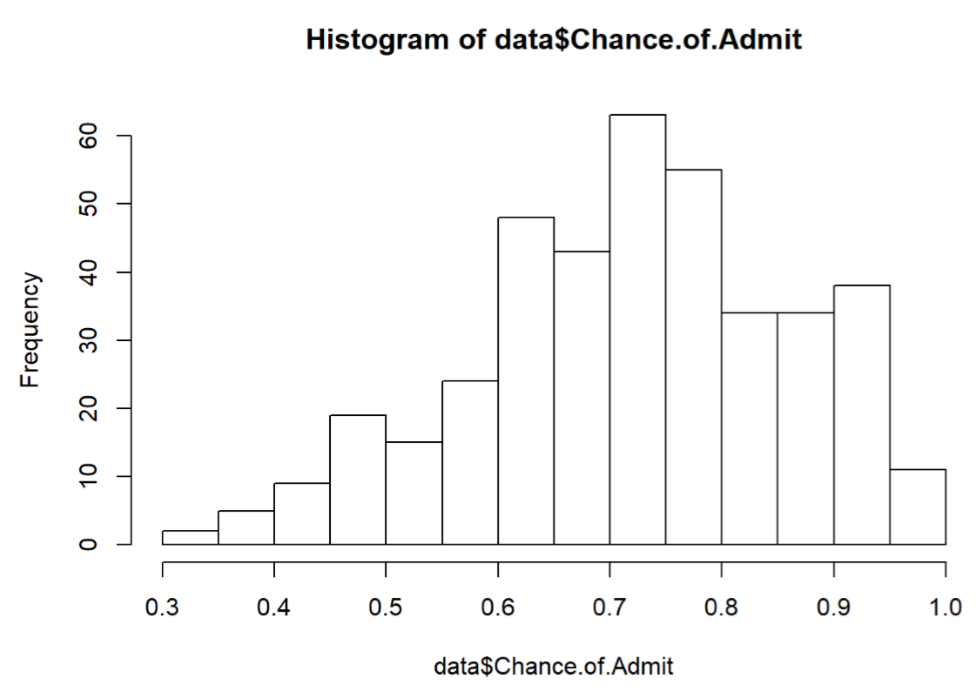
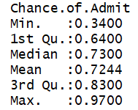

Slide 10
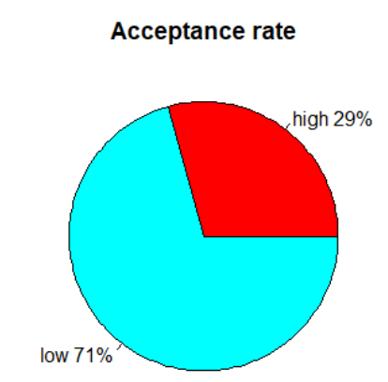
Add a new column: highacceptance
If the chance.of.admit is larger than 0.8, then the new column is 1, otherwise, it is set to 0.
Changed from continuous to binary

Slide 11
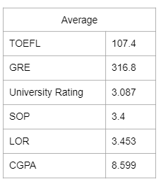
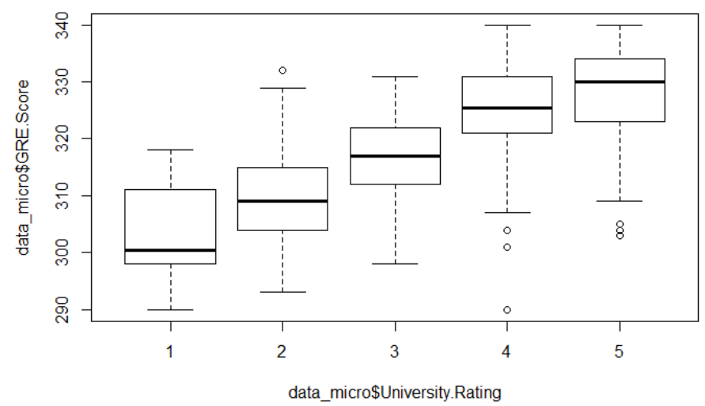
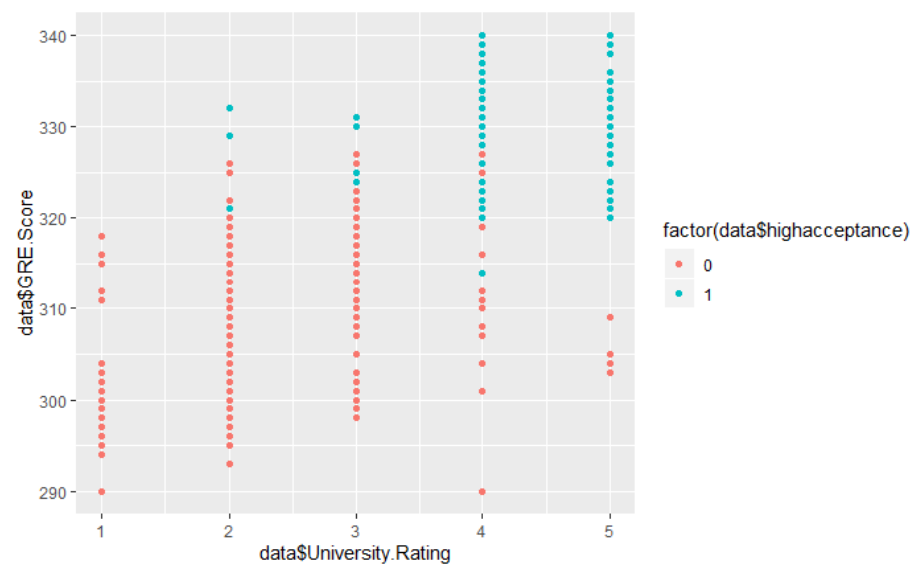
GRE threshold?

Slide 12
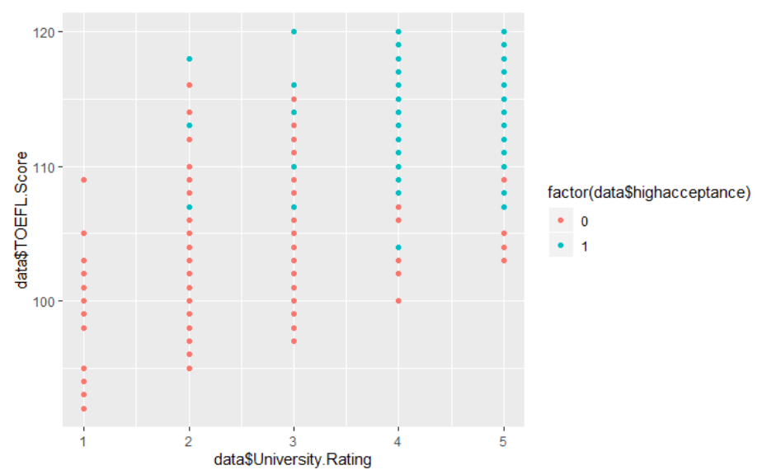
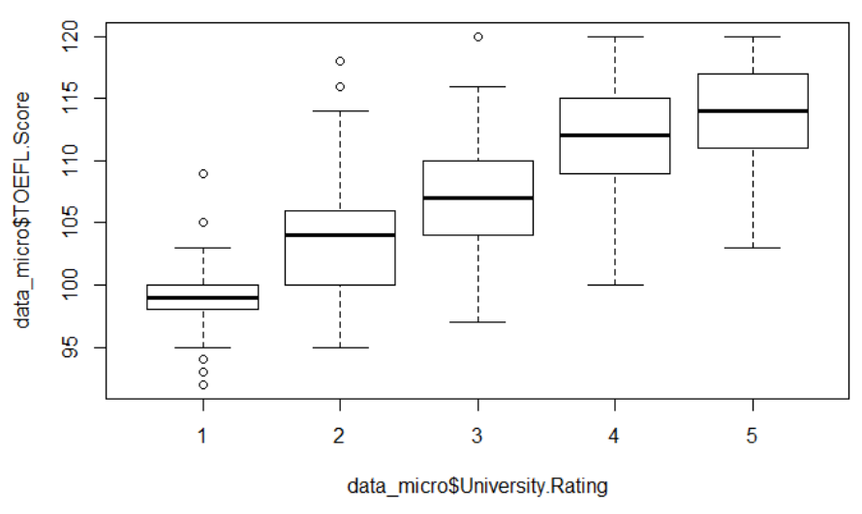
TOEFL threshold?

Slide 13
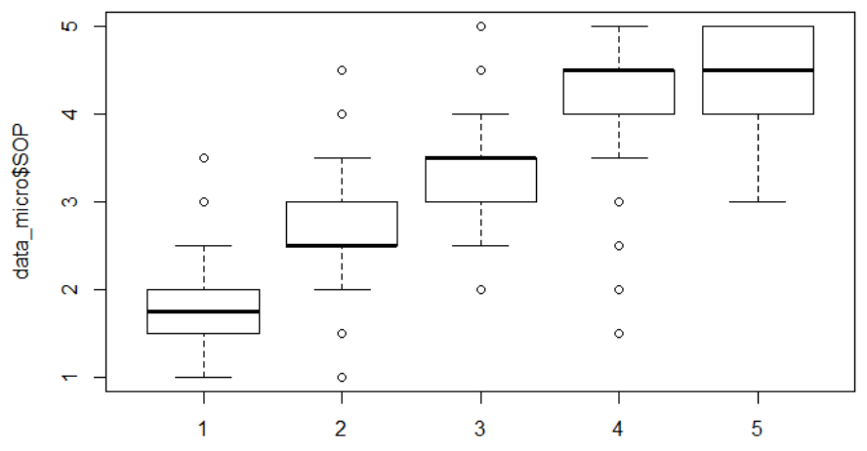
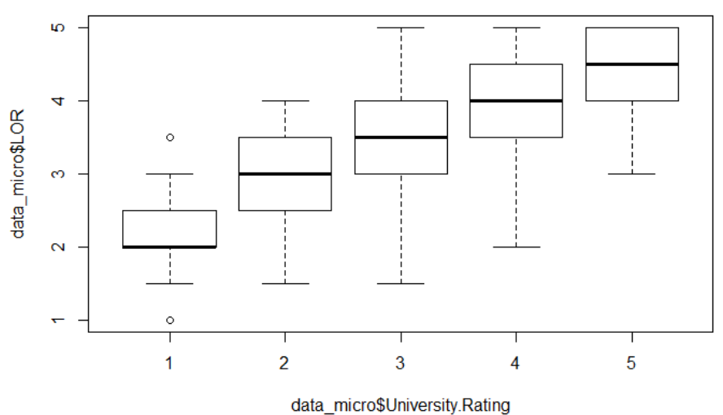
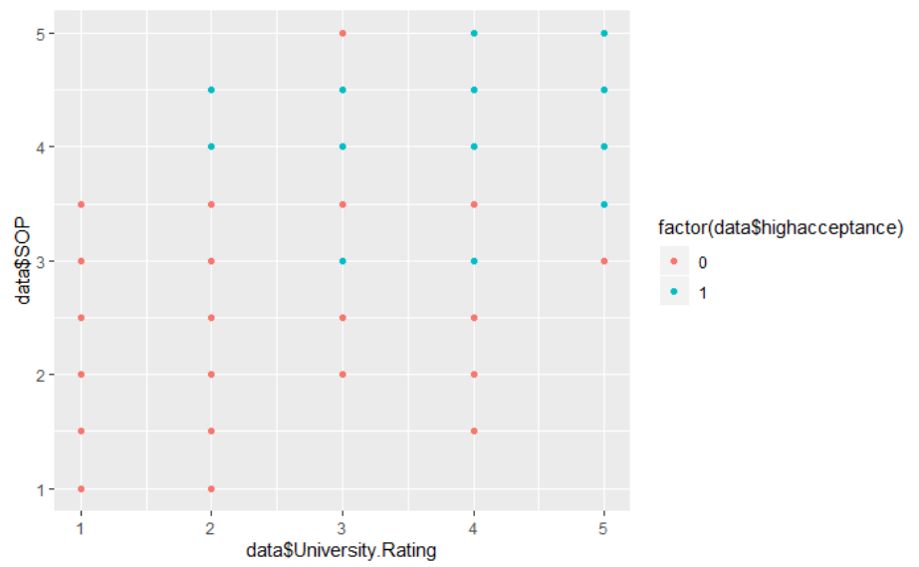
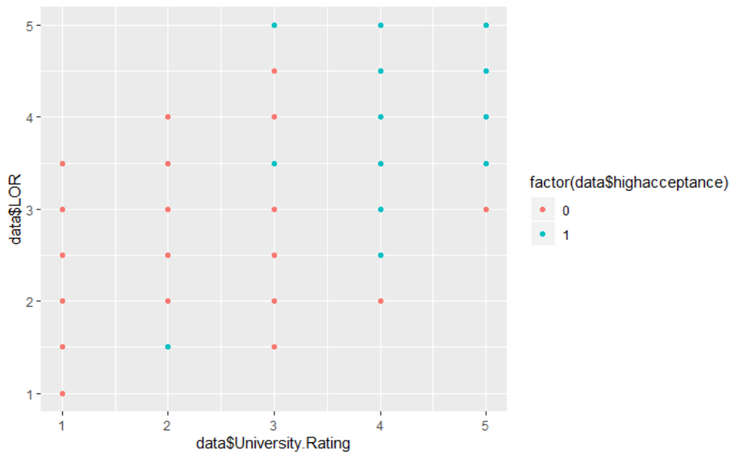
Is SOP and LOR important?
SOP
LOR

Slide 14
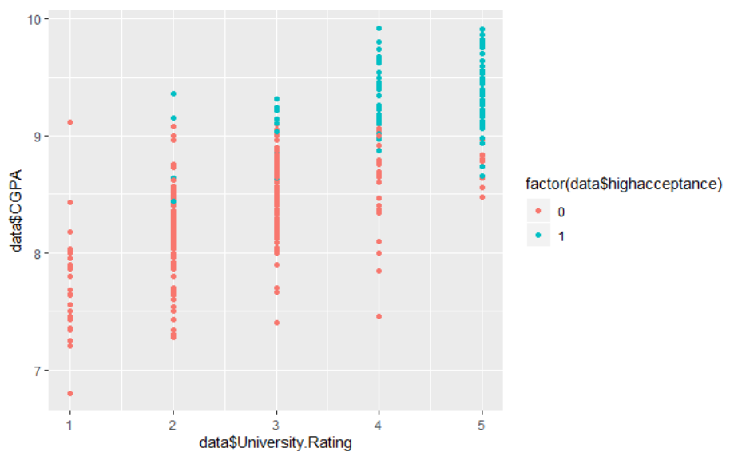
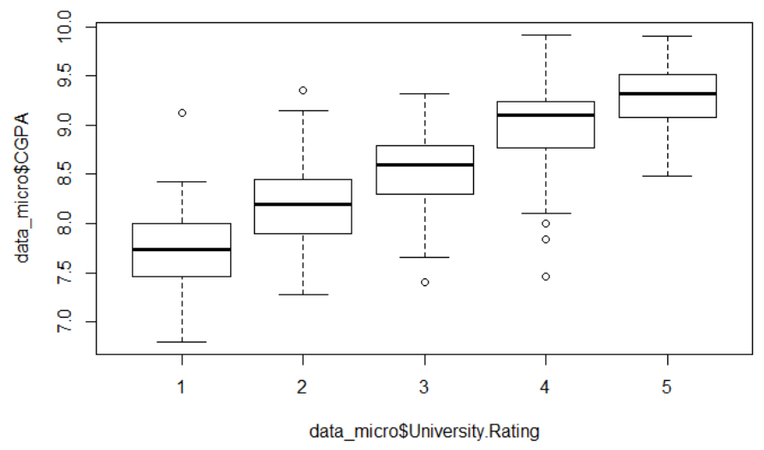
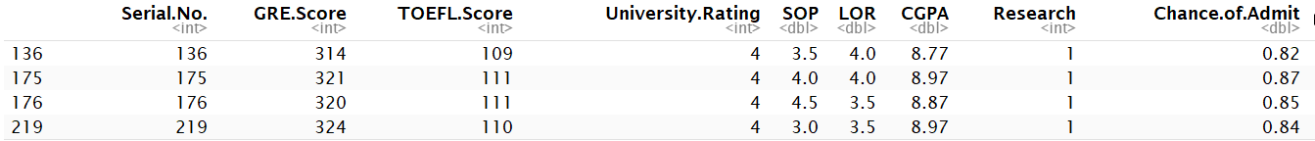
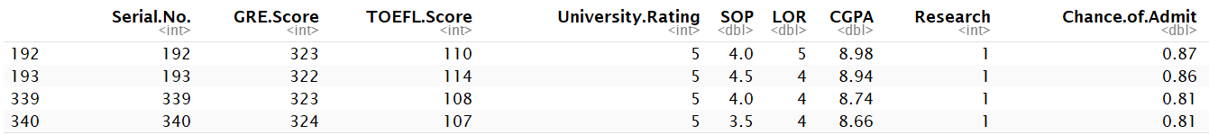
Is CGPA important?

Slide 15
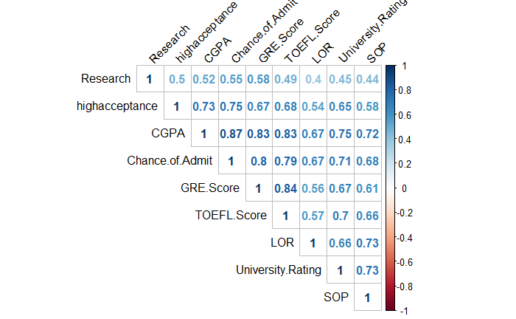
Correlation Matrix
HIGHLY CORRELATED
Chance of Admit
GRE score
TOEFL score
CGPA

Slide 16
Regression and Classification Result

Slide 17
Target
Regression:
Regress “Chance of Admit” on different attribute combinations
“Chance of Admit” is a probability (scale from 0 to 1)
Classification:
Implement different models to compare their performance
“Chance of Admit” is 0 or 1
if the original probability >= 0.8 → label = 1
else label = 0

Slide 18
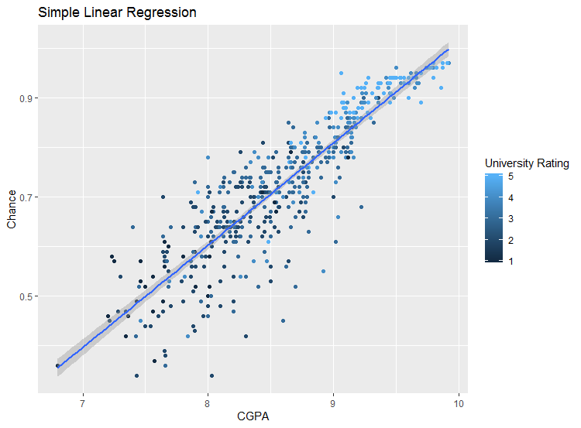
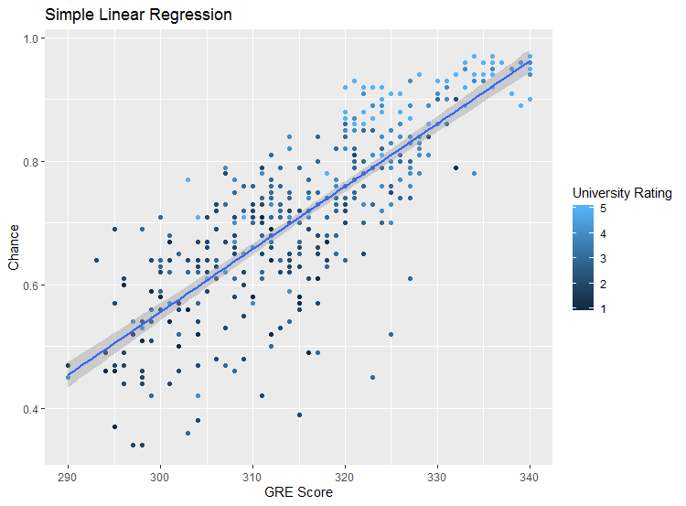
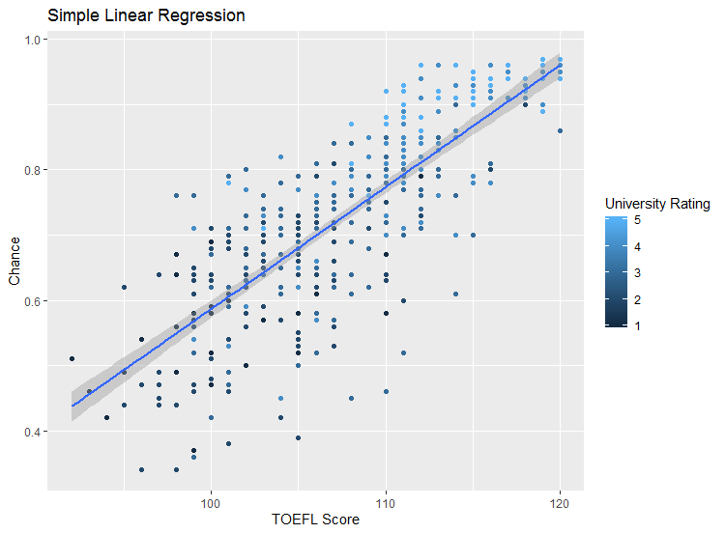
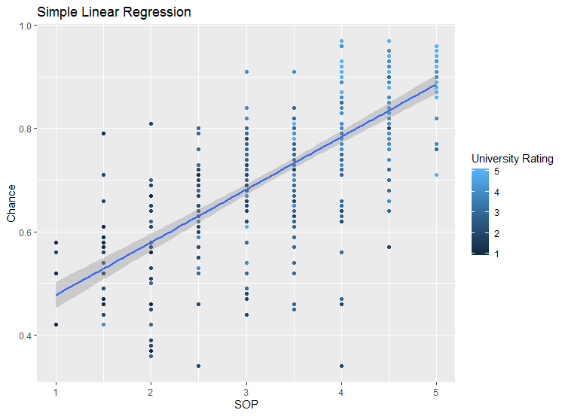
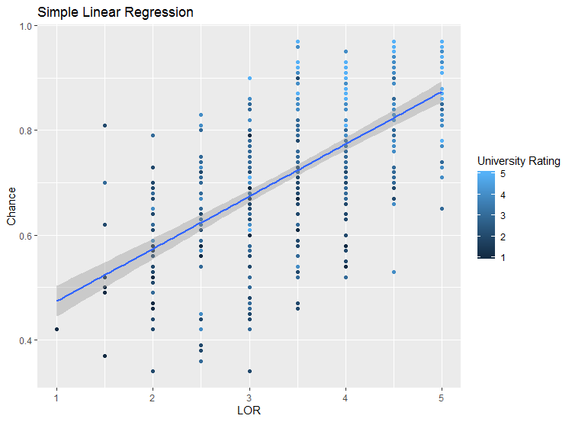
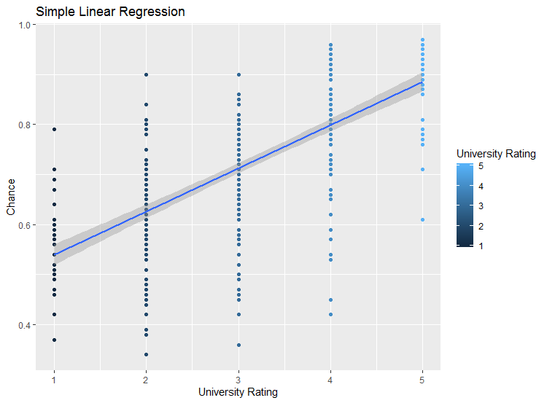
Simple Linear Regression
CGPA
GRE
TOEFL
R^2: 0.781
R^2: 0.6642
R^2: 0.627
University
Rating
SOP
LOR
R^2: 0.5095
R^2: 0.4359
R^2: 0.4928

Slide 19
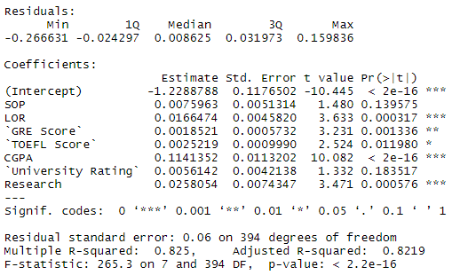

Multiple Linear Regression
All attributes
How to pick attributes?
More vaiables
→ Worse Adj. R^2
Notes:
It’s relatively easy to get high accuracy by throwing all the attributes in the model, but in real case people don’t usually do that.
So we decided to optimize adjusted r square, which gives punishment on the increase of number of using attributes, by selecting only part of the attributes.
select attributes with higher t value, and make some combinations.

Slide 20
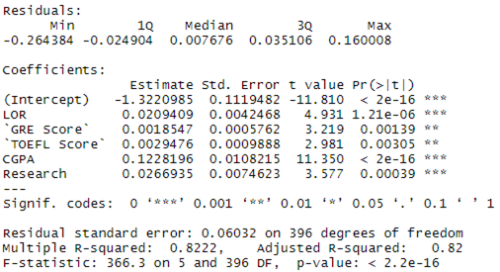
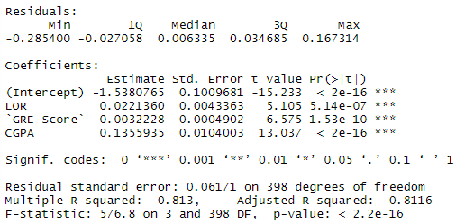
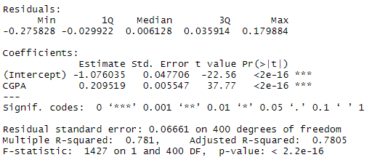
Multiple Linear Regression (variable selection)
Top 5
Top 3
Top 1
⇒ Did not show a better result lol

Slide 21
Classification Models
Model | Accuracy
Logistic Regression - All variables | 91%
Logistic Regression - Top 5 | 90%
Logistic Regression - Top 3 | 87%
Logistic Regression - Top 1(CGPA) | 87%
Naive Bayes | 88%
Decision Tree | 83%
Model | Accuracy
KNN: k = 10, 14, 16, 17, 18 | 90%
k = 11, 13, 15, 19, 20 | 89%
k = 2, 4, 6, 7, 8, 9, 12 | 86% - 88%
k = 1, 3, 5 | 78% - 83%
SVM - linear | 88%
SVM - radial | 88%

Slide 22

Shiny App

Slide 23
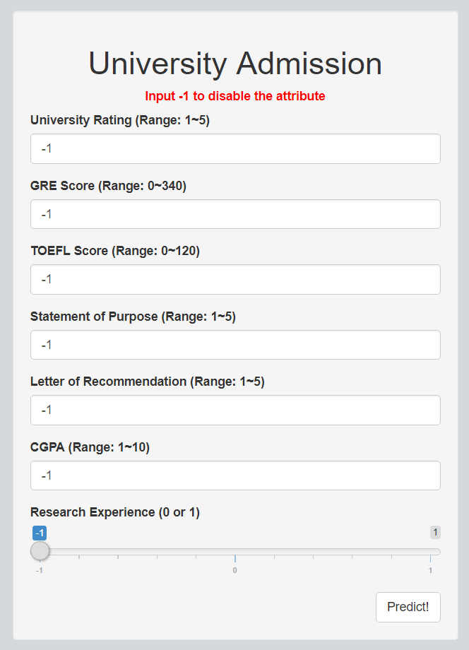
Shiny App
Model Chosen: Logistic Regression
Input: Any attribute combination the user chose to input
Output: highacceptance (1 or 0)
1: get an offer
0: failed to be admitted
Reactively trains different logistic regression models depending on the attributes chosen
Notes:
if chance of admit > 0.8

Slide 24
Shiny App Demo

Slide 25
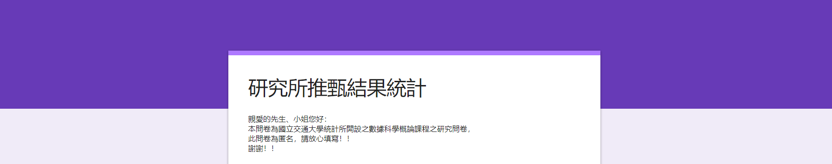
Graduate Admission Results in Taiwan?
Conduct a survey
by issuing online-questionnaire
on Facebook, Instagram and page
sample size: 222
effective sample size: 218
Notes:
發放問卷的目的
問卷內容: 1.研究所申請情形 2.個人資本資訊
問卷回收結果: 回收樣本、有效樣本

Slide 26
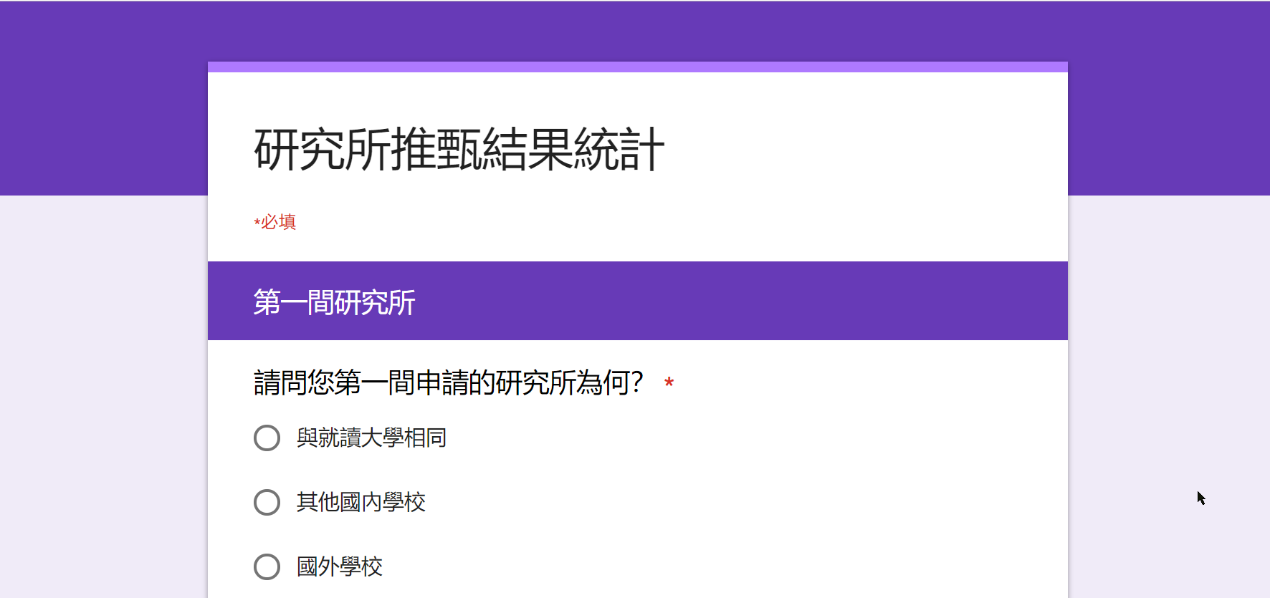
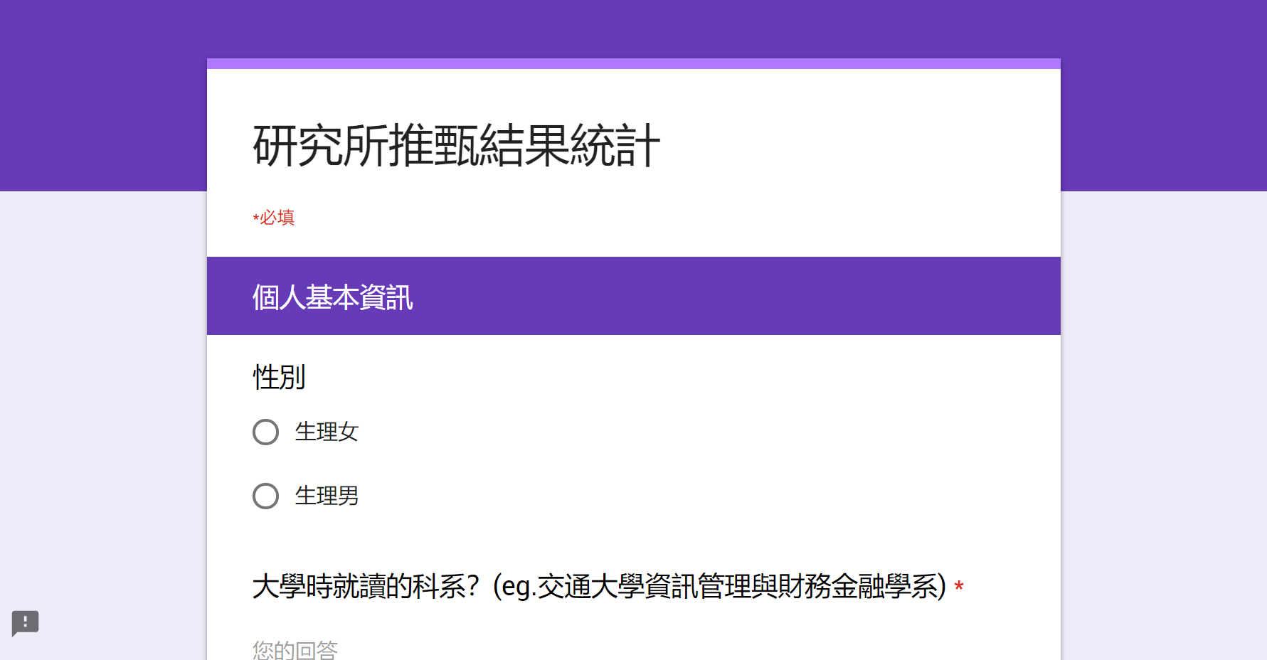
Online Questionnaire - Design
Which graduate school did you apply for?
Which department did you apply for?
Did you attend an interview?
How was the result?
Gender
English Level
University
Major, Average Score, Ranking
Experience
Thesis, Internship, Competition, Group
Notes:
發放問卷的目的
問卷內容: 1.研究所申請情形 2.個人資本資訊
問卷回收結果: 回收樣本、有效樣本

Slide 27
Online Questionnaire - Results
Attributes:
GraduateSchool
Interview
Department
Outcome
Gender
Major
AverageScore
Ranking
EnglishLevel
Thesis
Internship
Competition
SchoolTeam
DepTeam
Association
Club
Notes:
欄位類型

Slide 28
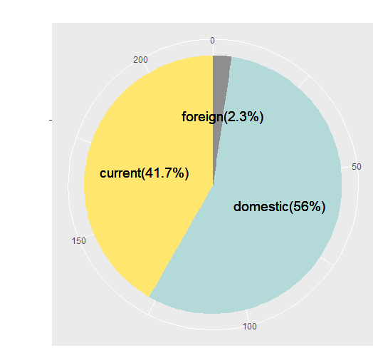
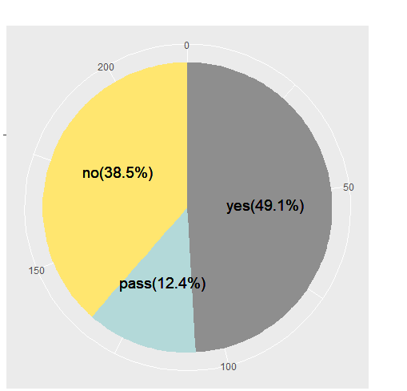
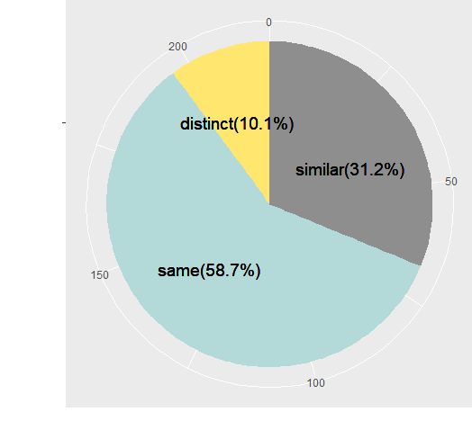

Online Questionnaire - Results
a.
b.
Attributes:
GraduateSchool
Interview
Department
Outcome
Gender
Major
AverageScore
Ranking
EnglishLevel
Thesis
Internship
Competition
SchoolTeam
DepTeam
Association
Club
c.
d.
qualify → 1
waiting → 0.5
fail → 0
Notes:
正取1
備取0.5
未錄取0

Slide 29




Online Questionnaire - Results
e.
male female
Attributes:
GraduateSchool
Interview
Department
Outcome
Gender
Major
AverageScore
Ranking
EnglishLevel
Thesis
Internship
Competition
SchoolTeam
DepTeam
Association
Club
g. h. i.
Notes:
欄位類型

Slide 30







Online Questionnaire - Results
no yes
Attributes:
GraduateSchool
Interview
Department
Outcome
Gender
Major
AverageScore
Ranking
EnglishLevel
Thesis
Internship
Competition
SchoolTeam
DepTeam
Association
Club
j. k. l. m. n. o. p.
Notes:
欄位類型

Slide 31

Online Questionnaire - Results
if students plan to study different major, they would like to apply for the graduate school different from their original school.

Slide 32


Online Questionnaire - Results
Mean：accepted < waitlisted < rejected
In general, students accepted by the school have higher ranking than the others.

Slide 33
Online Questionnaire - Results
If students plan to apply for the graduate school same as the university they’ve studied, the required ranking to be accepted would be lower.

Slide 34

Online Questionnaire - Results
Students should have better ranking if they don’t have any experiences.
*Experience = 0：SchoolTeam && DepTeam && Association && Club = 0

Slide 35


Online Questionnaire - Results
Whether students have intern or competition experience
Students that have intern or competition experience would have higher English level

Slide 36
Conclusion
GRADUATE ADMISSIONS IN THE US
GRADUATE ADMISSIONS IN TAIWAN
GRE SCORE
GRADUATE SCHOOL
TOEFL SCORE
DEPARTMENT
GPA
AVG SCORE

