Slide 1
The impact of nonnormality on parameter estimates in the multidimensional (Bi-factor) graded response model (MGRM)
College of Education
Educational Research
Jujia Li

Slide 2
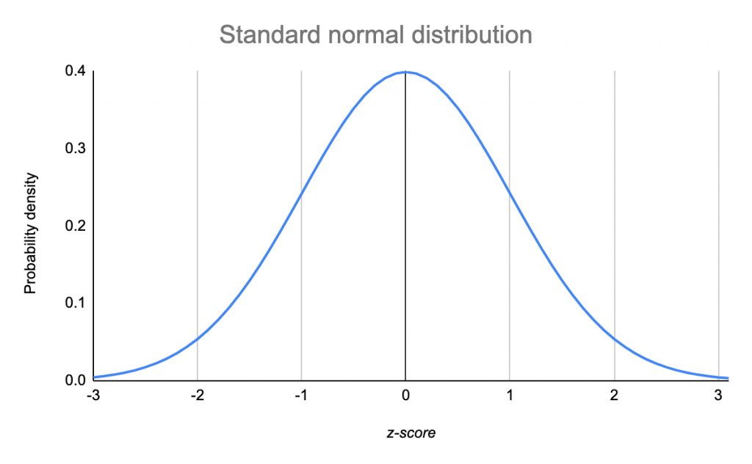
1. Normality Assumption

Slide 3
BUT

Slide 4
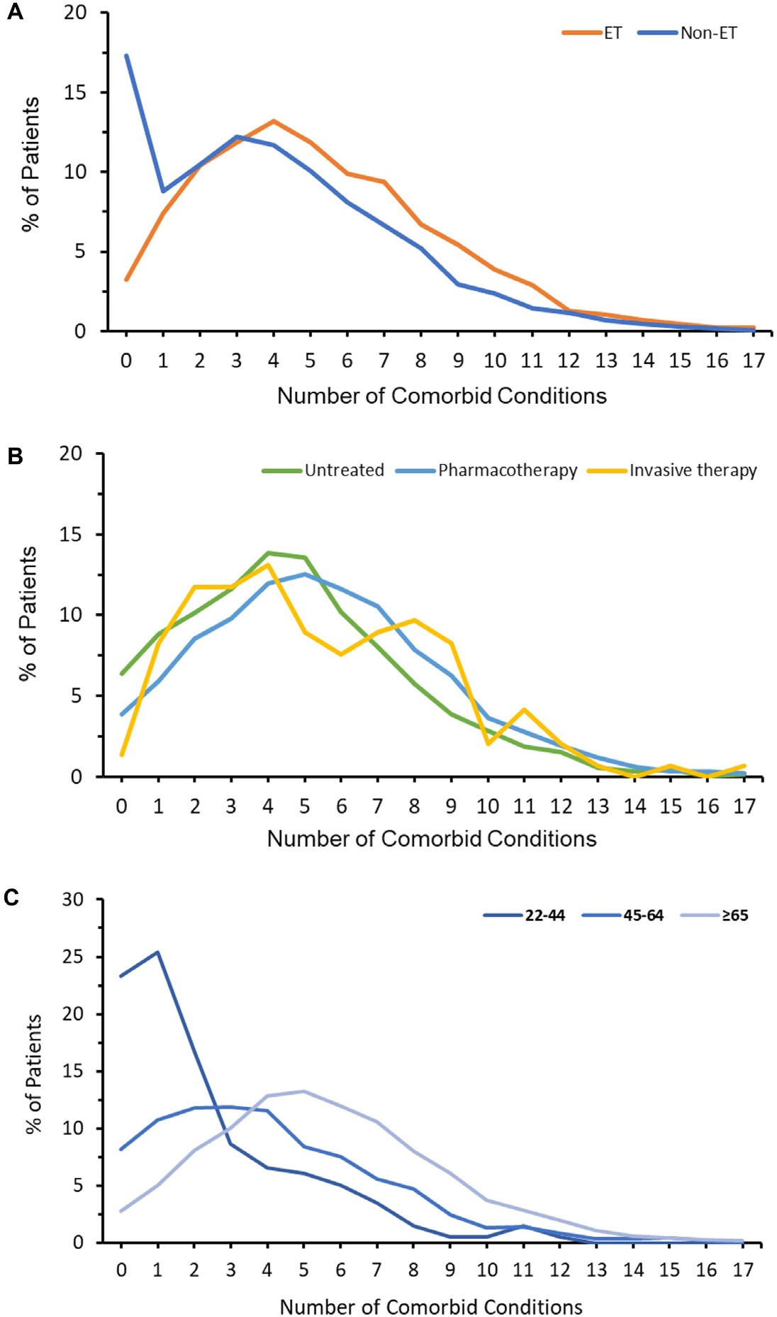

In psychology and psychiatric research area,
the impact of the nonnormality of the model is a prevalent phenomenon.
Dai, D., Samiian, A., Fernandes, J., & Coetzer, H. (2022). Multiple comorbidities, psychiatric disorders, healthcare resource utilization and costs among adults with essential tremor: a retrospective observational study in a large US commercially insured and Medicare Advantage population. Journal of Health Economics and Outcomes Research, 9(2), 37-46.

Slide 5
2. Unidimensionality
Item 1
…
Item 10
Item 11
F_{g}
…
Item 20
Item 21
…
Item 30

Slide 6
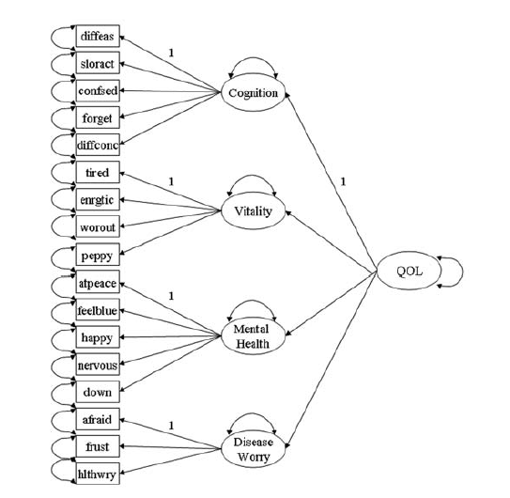
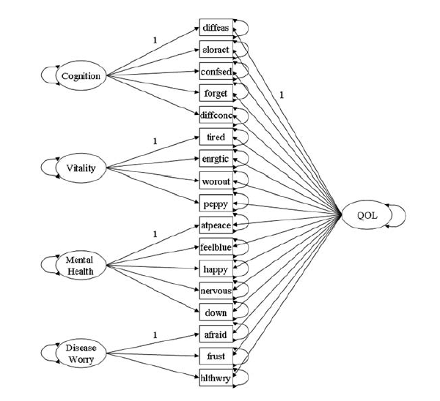
standard second-order factor model
bifactor model
Second-order factor:
Quality of Life (QOL)
high scores indicate high
quality of life.
Chen, F. F., West, S. G., & Sousa, K. H. (2006). A comparison of bifactor and second-order models of quality of life. Multivariate behavioral research, 41(2), 189-225.

Slide 7
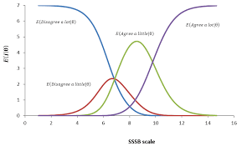
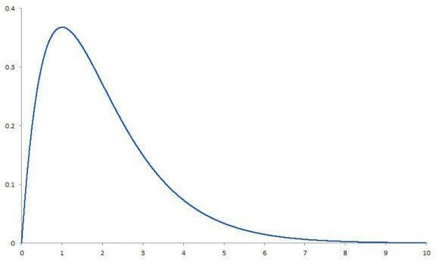
3. RESEARCH TOPIC
The impact of nonnormality on parameter estimates in the multidimensional (Bi-factor) graded response model (MGRM)
Theta θ
Latent Ability/Trait
Subject
+
+
Non-normality
Sharp
Bifactor(Multidimensional)
Structure
IRT-GRM
Model

Slide 8

4. MODEL DESIGN
Conditions: 3*2*3 = 18
$$P_{jk}^{∗}\left(θ\right)=\frac{1}{1+e^{−D\sum_{h=1}^{H}{\left[a_{jh}\left(θ_{h}−b_{jk}\right)\right]}}}$$
Correlations: 0
General and Specific Factors H: 1+2, 1+3, 1+4
Psychology & Psychiatrics
Atkinson,2018
Heinz,2022
Berkeljon,2012
Auné,2020
Raines,2015
General Factor: 1
Item in each s-Factor: 5, 10
Sample Size: 250, 500, 1000
Simulation Studies
Bader,2022 Cook,2009
Finch,1997 Mao,2022
Morgan,2015 Rijmen,2011

Slide 9
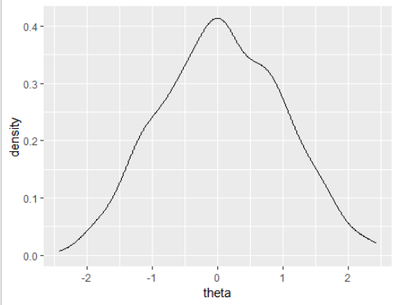
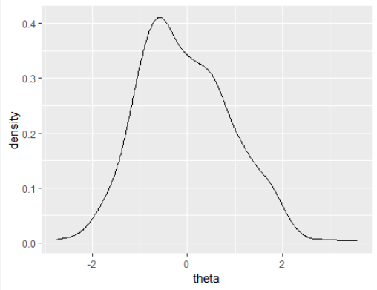
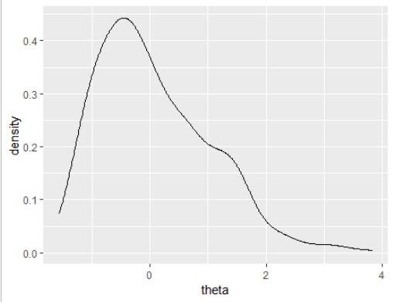
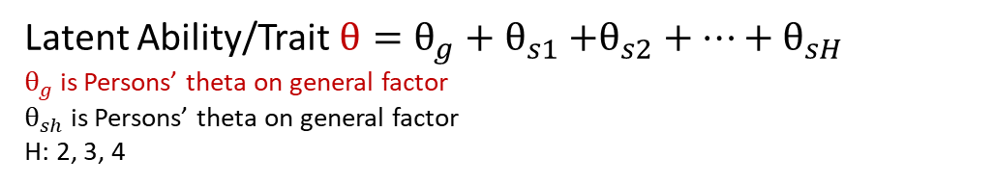
Skewness Design – Real Theta θ
Conditions: 18*3 = 54
30 Random Data for each condition
Normal
Skewness = 0
Moderately Skewed
Skewness = 0.4
Severely Skewed
Skewness = 0.8
Latent Ability/Trait $θ=θ_{g}+θ_{s1}{+θ_{s2}+…+θ}_{sH}$
$θ_{g}$ is Persons’ theta on general factor
$θ_{sh}$ is Persons’ theta on general factor
H: 2, 3, 4
Only positive skewness on the general factor are considered in this study.
In practical psychology and psychiatric research, most general latent traits are
positively skewed and play a big role.

Slide 10
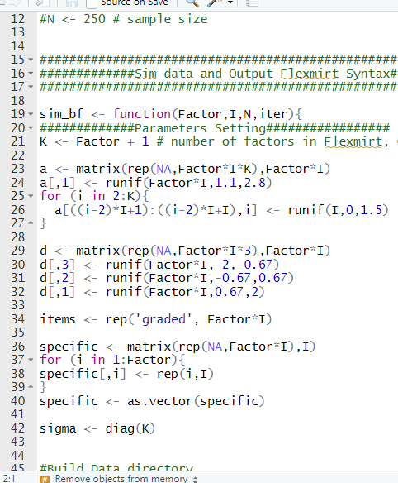
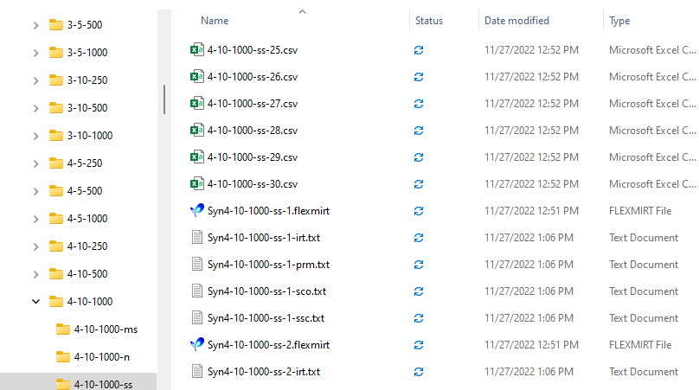

Slide 11
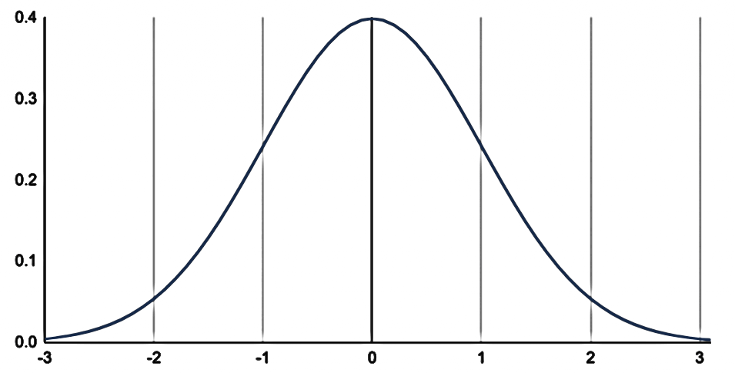


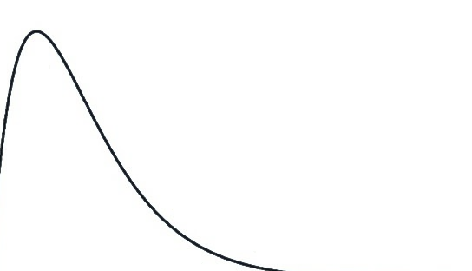

5. Result
?
R: Mirt package
Real Theta θ
Predicted Theta θ in models

Slide 12
Model Fit – Skewness Performance (calculated by MEAN of theta in 30 replications, Wang,2018)
The result from: R package-moments::skewness()

Slide 13
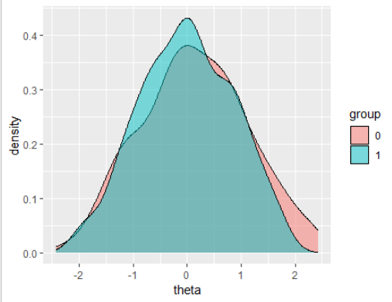
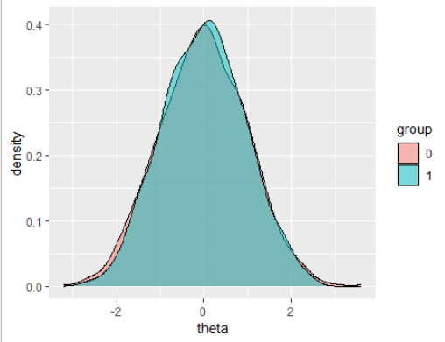
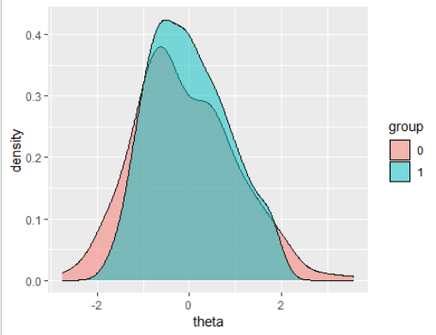
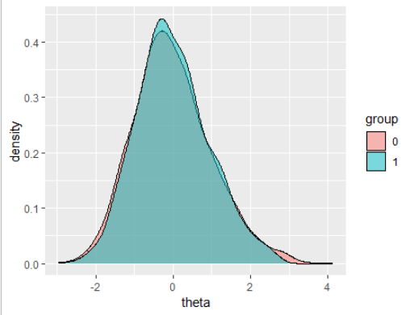
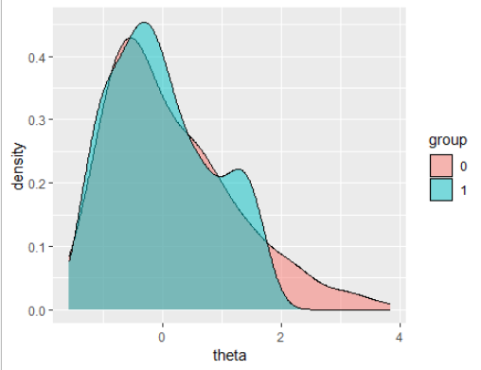
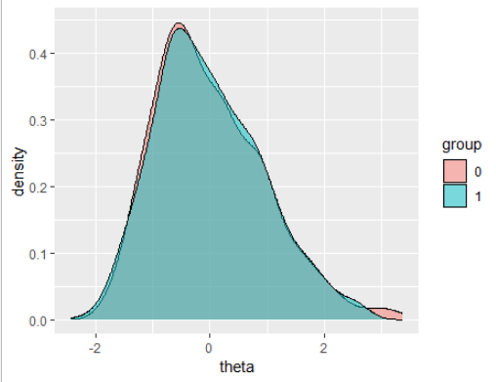
Normal
Normal
s-Factor: 2
Item: 5
Samples 250
s-Factor: 4
Item: 10
Samples 1000
Moderately
skewed
Moderately
skewed
Severely
skewed
Severely
skewed
0 is the Real Theta Density
1 is Model-Predicted Theta Density
The result from: R package-ggplot2

Slide 14
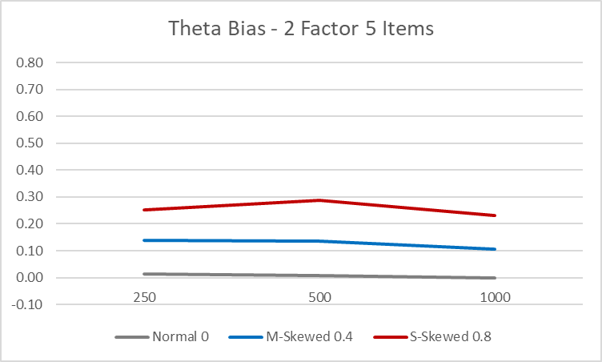
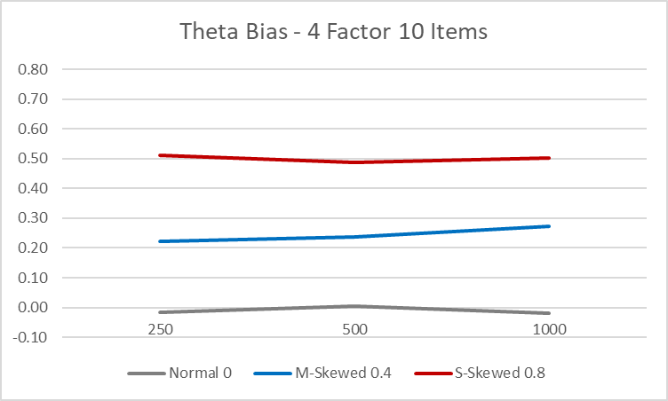
Sample Size Effect
Severely Skewed
Moderately Skewed
Normal
Conclusion 1: Sample Size has no significant effect on parameter estimate.

Slide 15
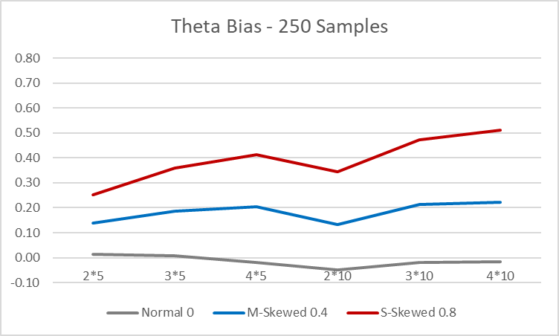
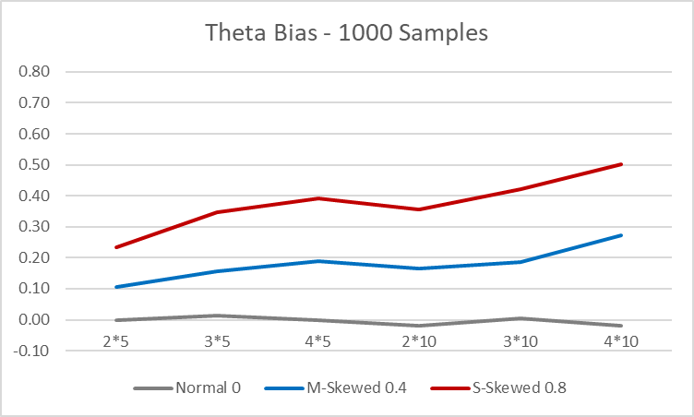
Item & Factor Effect
20 Items
4 Factor
Severely Skewed
20 Items
2 Factor
Moderately Skewed
Normal
Conclusion 2: Item numbers have significant effect on parameter estimate. Moreover, Factor numbers are more effective.
Conclusion: Factor > Item > Sample Size
I will try a smaller sample size (20 or 100) in the next phrase.

Slide 16
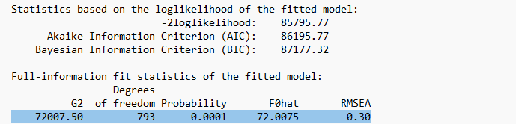
AIC and Others

Slide 17
6. NEXT STEP
Disaster
I forgot to record the post (real) parameters (a1, a2, a3, b1, b2, b3), which is simulated by Mirt package in R.
Flexmirt did not record them for me.
I cannot calculate the bias of these parameters separately.
Next Step
To test the extremely small sample size.
Kurtosis Analysis.
Nonnormality of Specific factors.
Correlations between Factors
To compare the performance of “Mirt” package in R(open-resource) and “Mplus” (commercial) with FlexMIRT (commercial).

Slide 18
Personal feelings about FlexMIRT
Package Irtplay is removed from CRAN in September this year, due to copyright problem.

