Slide 1
3D Gravity Inversion
Josh Leland, IPG 2014-2015
BSc. Honors in Geophysics, University of Saskatchewan.

Slide 2
Outline
Introduction/Gravity review
Forward Modeling
Inversion Methodology
Objective function.
Depth weighting
Linear inversion.
Non-linear: logarithmic barrier inversion.
Real data example: 2D gravity line.
Conclusions
References

Slide 3
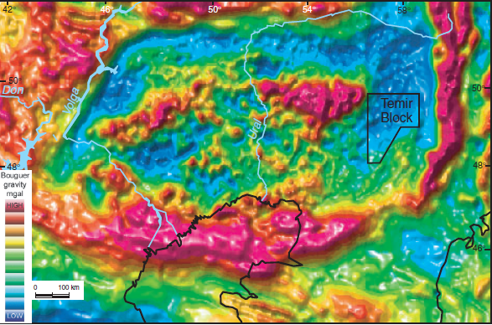
Introduction/Gravity Review
Gravity is an exploration technique that measures very small variances in earth gravitational field.
Data is collected in the field by plane or on land, and processed before it can be interpreted.
Gravity has no inherent depth resolution, so interpretation can be tricky.
Inversion can be done on the processed gravity to help get a likely density distribution that will fit he data.
Figure of Bouguer gravity from the Precaspian Basin in Kazakhstan from Barde et al. (2002)

Slide 4
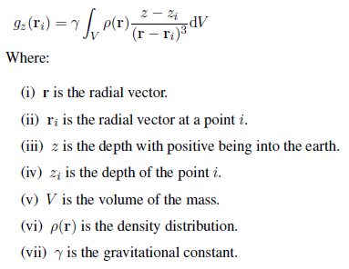

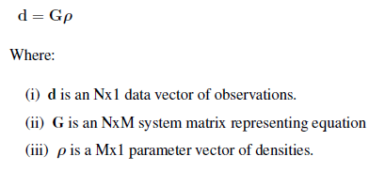
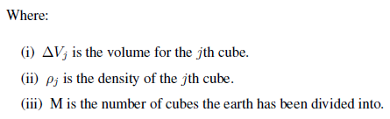
Forward modeling
Analytical solution is shown on the right. (Equation 1)
(LaFehr, 2012)
To make the equation easier to solve we discretize the equation into cubes with a constant density, which allows the density term to leave the integral. (Equation 2)
An analytical solution to the integral in equation 2 can be found in many sources, for example, Blakely (1996).The gravitational pull felt at N points can be written in a compact matrix form:
(1)
(2)
(2)

Slide 5
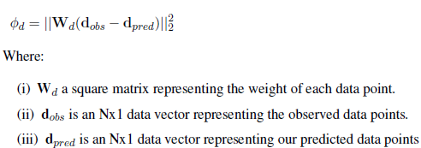



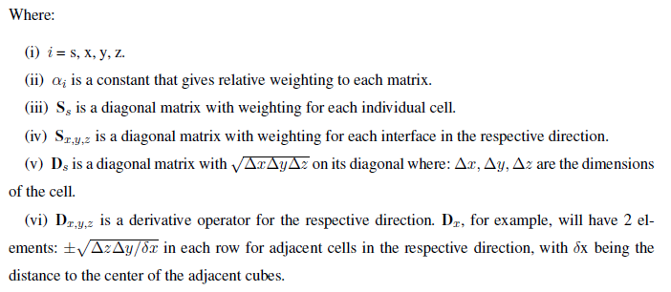
Inversion Methodology
Following Li et al. (1996), construction of a cost function had two parts:
The data part:
And the model part:
With:

Slide 6
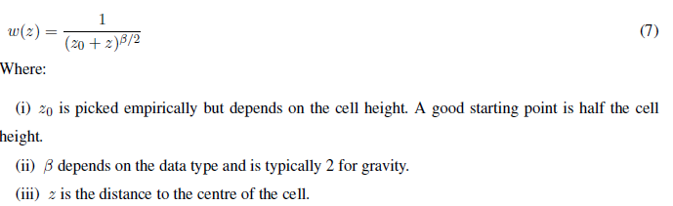
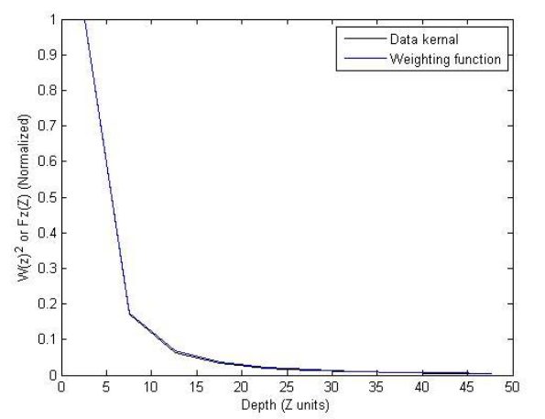
Inversion Methodology
Because gravity has no depth resolution Li et al. (1996) introduced a depth weighting function:
The idea is to mimic the data kernel decay with this function, put it into the regularization term in the objective function and then minimize it.
Figure of depth weighting function and data kernel with depth

Slide 7


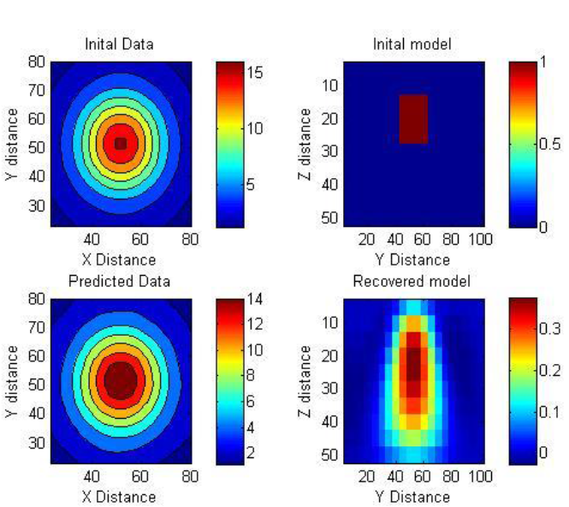
Inversion Methodology
Inversion can be carried out linearly by minimizing the objective function:
Which has a solution:
For a synthetic example of a buried cube the linear inversion gives the following solution:
Figure of linear inversion for a buried cube.

Slide 8


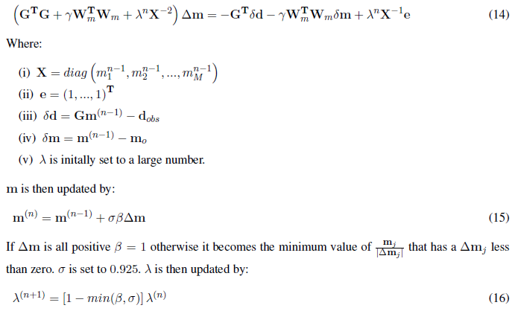
Inversion Methodology
Imposing positivity was introduced in Li et al.1996 to get rid of the tails
Li et al. 2003 suggest adding a logarithmic barrier term to impose positivity.
Which is solved by:
The algorithm stops when the logarithmic term is small compared to the objective function, and the objective function changes less than 2%.

Slide 9
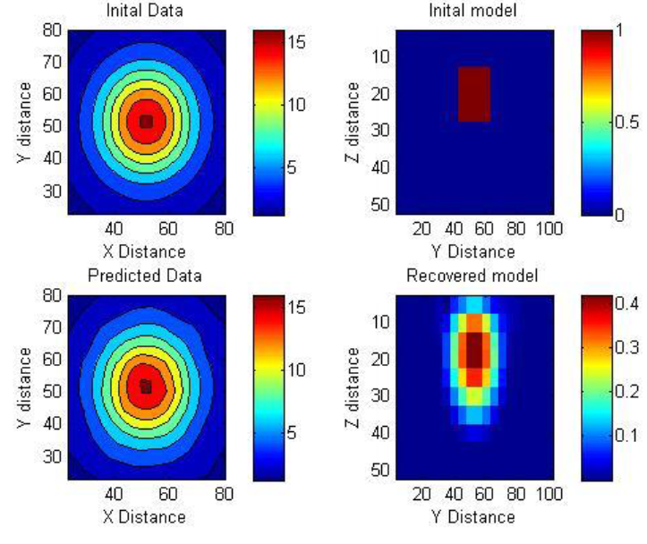
Inversion Methodology
Using the cost function with the logarithmic barrier term gives the following solution:
Figure of inversion for the a buried cub with the logarithmic barrier in the objective function.

Slide 10
Inversion Methodology
Figure showing both solutions side by side for comparison.

Slide 11
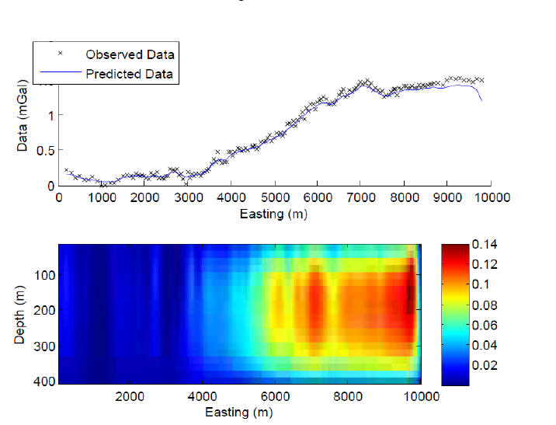
Real data example
Inversion of a 2D gravity line from the University of Saskatchewan field school. Data was Bouguer corrected and shifted. The area is believed to have a contact in the Lea Park and Judith river shales, with gravel channels.
Figure showing inverted gravity data for a contact near Bergheim, Sk.

Slide 12
Conclusions
The inversion is a technical success and it does a good job of showing the limitations of the method. Mainly no depth resolution. To get more geologically accurate solutions we need more data. (Well logs, Seismic, E&M etc.)
The inversion relies heavily on regularization from the user to get solutions to work correctly.
Even though the algorithm puts the anomaly at the depth they all have the spherical symmetry shape, which again is a product of the physics.
Gravity, in my opinion, would work best if coupled with something that does have depth resolution. (Seismic, Resistivity, etc.)
Next steps would be to: optimize the algorithm, add in the ability to add joint structural inversion with gravity and something with depth resolution.
Thank you!

Slide 13
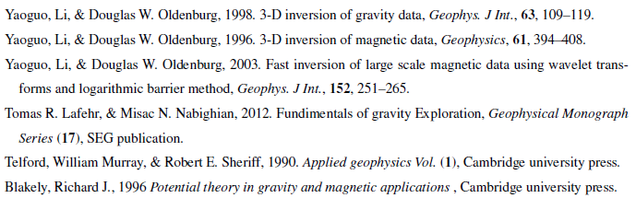
References
Barde, Jean-Pierre, et al. "Exploration at the eastern edge of the Precaspian basin: Impact of data integration on Upper Permian and Triassic prospectivity." AAPG bulletin 86.3 (2002): 399-416.

