Slide 1

World Series 2020:
Has baseball analytics gone too far?
By: Joshua Majano

Slide 2
Scenario
You are the Tampa Bay Rays in Game 6 of the World Series
World Series is a best-of-seven and you are down 2 games to 3
Score: 1-0 in your favor
Your starting pitcher is about to face the start of the Dodgers’ lineup for a third time
Question:
Do you continue with your starting pitcher or choose to make a pitching switch?

Slide 3
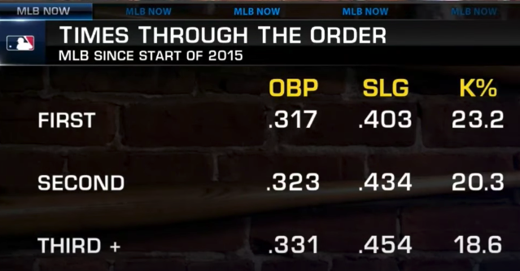
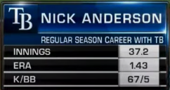
What do the numbers say?
Q: Do you make a pitching change with the batting lineup coming for the third time?
Credit: MLB Now
Your chosen relief pitcher to take over the inning

Slide 4
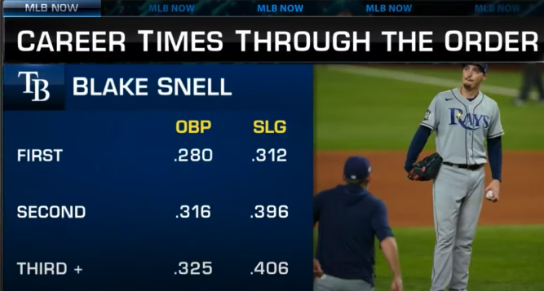
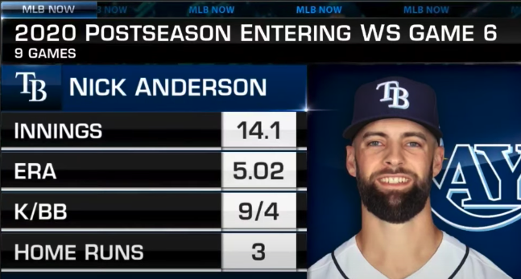
The numbers during Game 6
Overall stats going into pitching change:
Blake Snell stats through 5 innings pitched:
1 hit, 0 runs, 9 strikeouts, average exit velocity from hitters: 76.7 MPH
Credit: MLB Now

Slide 5
Takeaways
Data is useful!
Used a lot for team composition, defensive placement, batting line-up structure, in-game decision-making, etc.
Data is not the end all, be all
Point is not to make a move because of “the numbers”
The stats are a tool to be used along with other evidence to make a move

