Slide 1
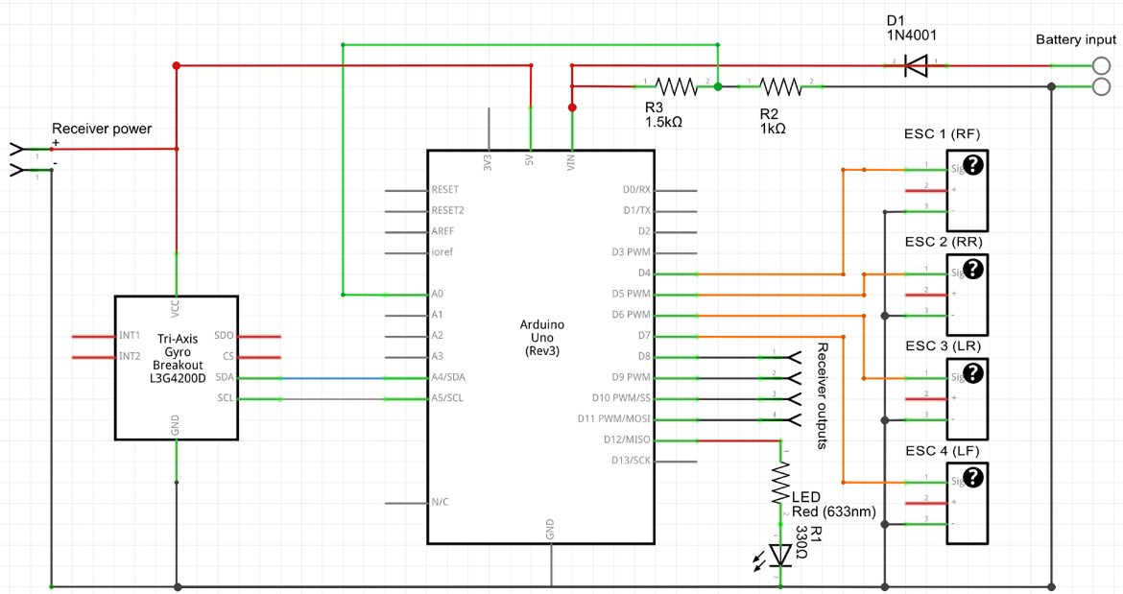
8
10
9
11
CCW
CW
1
2
3
4
5
6
BAT
Power
Ground
Signal
Signal
Ground
Power
FRAME
FRAME

