Slide 1
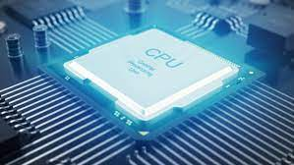
CPTR 380 Hardware Design
Custom CPU with 8-bit architecture

Slide 2

Overview
Project Tasks
Created a custom-designed instruction set
Create assembler
Design a CPU to execute instruction set
Implement this hardware by describing it in C++
Aimed at a histogram equalization routine of a simple greyscale image with up to 256 shades

Slide 3
Workflow
Brainstorming Possible Ideas
Design Process
Testing
Rinse, Repeat
Assembler
Hardware Implementation
CPU
Instruction Set
Testing

Slide 4

Instruction specs
Instructions will be 16 bits wide
16 OP codes (4 bits each)
16 8-bit registers
256 bytes of memory
No direct operations on memory (LW then ADD, not same step)
Only loading from memory (LM, use an ADD for registers and immediate)

Slide 5
Instruction Format
Type | Opcode | DestReg | SrcReg1 | SrcReg2
R | 4 bits | 4 bits | 4 bits | 4 bits
Type | Opcode | Regw/address | Unused
B | 4 bits | 4 bits | 8 bits
Type | Opcode | Register | Address
I | 4 bits | 4 bits | 8 bits

Slide 6
Instruction Library
Type | Opcode | Format | Address
Load
 | LM | LM R1, 0x45 | 0x2
Store
 | ST | ST R1, 0x45 | 0x3
Branch
 | BEQ | BEQ R1, R2, R3 | 0x6
 | BGT | BGT R1, R2, R3 | 0x7
 | BLT | BLT R1, R2, R3 | 0x8
 | B | B R3 | 0x9

Slide 7
Instruction Library
Type | Opcode | Format | Address
Add
 | ADDI | ADDI R1, R2, 5 | 0xA
 | ADD | ADD R2, R2, R3 | 0xB
Subtract
 | SUBI | SUBI R1, R2, 5 | 0xC
 | SUB | SUB R1, R2, R3 | 0xD
Shift
 | SL | SL R1, R2, 10 | 0xE
 | SR | SR R1, R2, 10 | 0xF

Slide 8
Instruction Library
Type | Opcode | Format | Address
Logic
 | AND | AND R1, R2, R3 | 0x0
 | OR | OR R1, R2, R3 | 0x1
End
 | END | END | 0x4

Slide 9
Assembler (import txt)
file = "assemblerInput.txt"
filehandle = open("assemblerInput.txt","r")
with filehandle:
for line in filehandle:
tokenized_line = line.split()

Slide 10
Assembler (instruction to binary)
if tokenized_line[0] =="LM":
r=int(tokenized_line[1][1])
hex = tokenized_line[2]
hex_list = hex.split("x")
v=int(hex_list[(1)])
b=[2,r,v>>4,v&0xF]
i=bin(b[0])
j=bin(b[1])
k=bin(b[2])
l=bin(b[3])
m=[i,j,k,l,]

Slide 11
Assembler (output to txt)
lines = m
with open('assemblerOutput.txt', 'w') as f:
for line in lines:
f.write(line)
f.write(' ')
f.write('\n')

Slide 12
Hardware Design

Slide 13
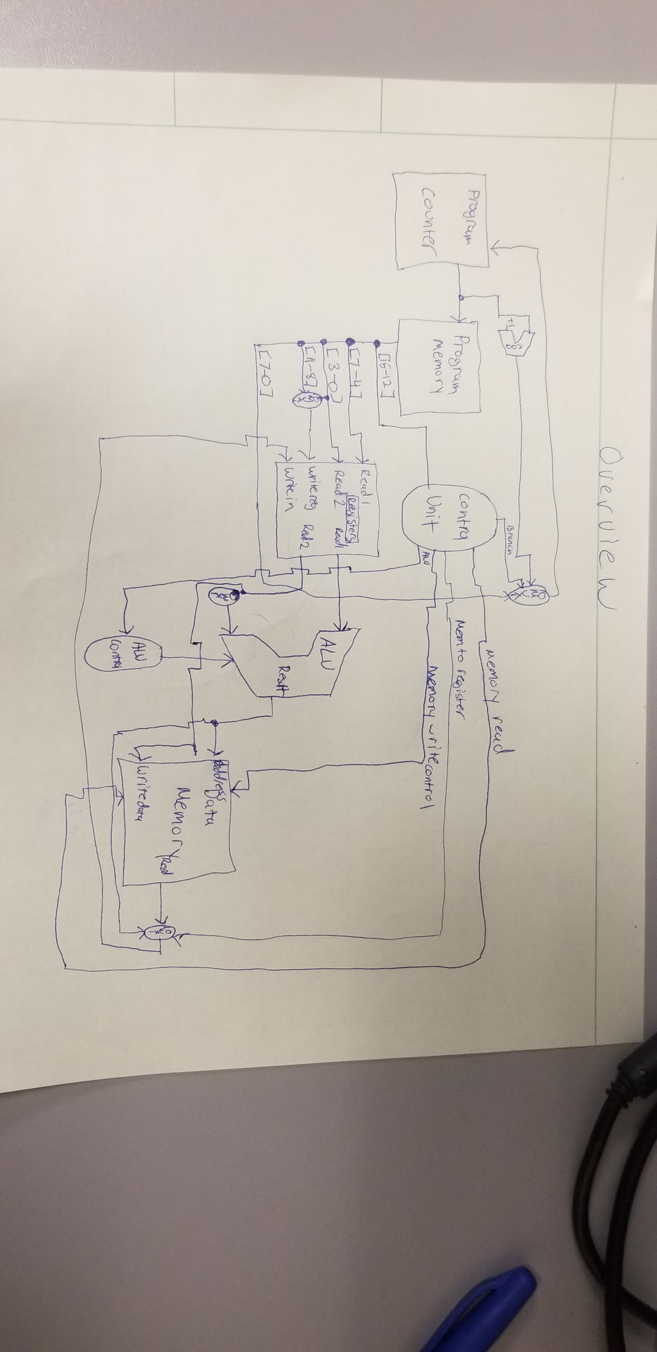
Overview

Slide 14
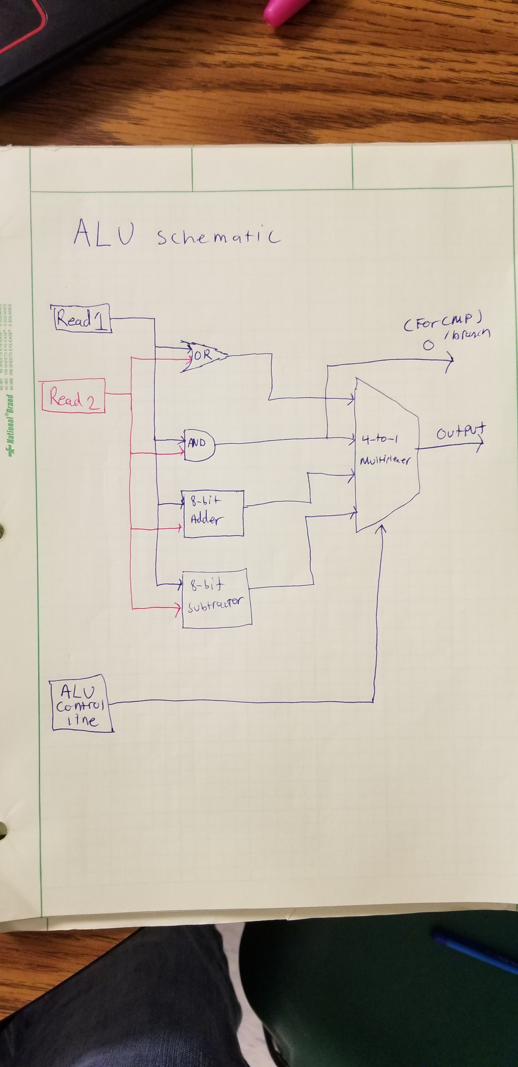
ALU Schematic

Slide 15
Software Simulation
C++
Each block (in general) is relegated to a function

Slide 16
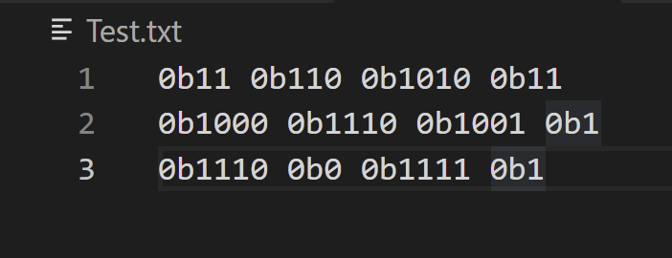
Accumulating Program Memory
Read assembler output (fstream)
Copy into a temp array (sstream)
Convert to ulong
Read into program memory

Slide 17
ALU
4 different options for arithmetic
Also has compare functionality
Control Line Selection bus
Also triggers branch flag for beq, blt, and bgt instructions

Slide 18
Bits and Pieces
Program Memory
Main Memory
Control Unit
Program Counter
Registers

Slide 19
Questions? (demonstration time permitting)

Slide 20
Thank You

