Slide 1
Intro / idea generation / target audience
Wireframes
Prototypes / Figma
HTML
CSS
API
Map customisation
Accessibility / user friendly

Slide 2
Duthie PArk Website
JS
CSS
</>
Team Dumber
HTML

Slide 3
Idea Generation
01.
02.
03.
Research
Wireframes
Prototype
Using Duthie Park’s PDF files and existing websites to determine target audience, functions and layout.
Rough sketches
Using Figma

Slide 4
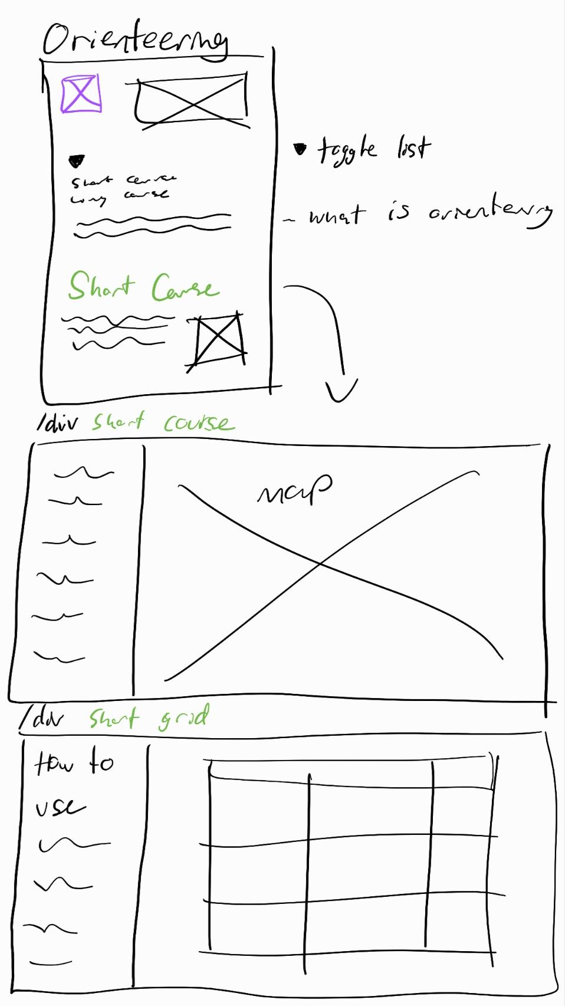
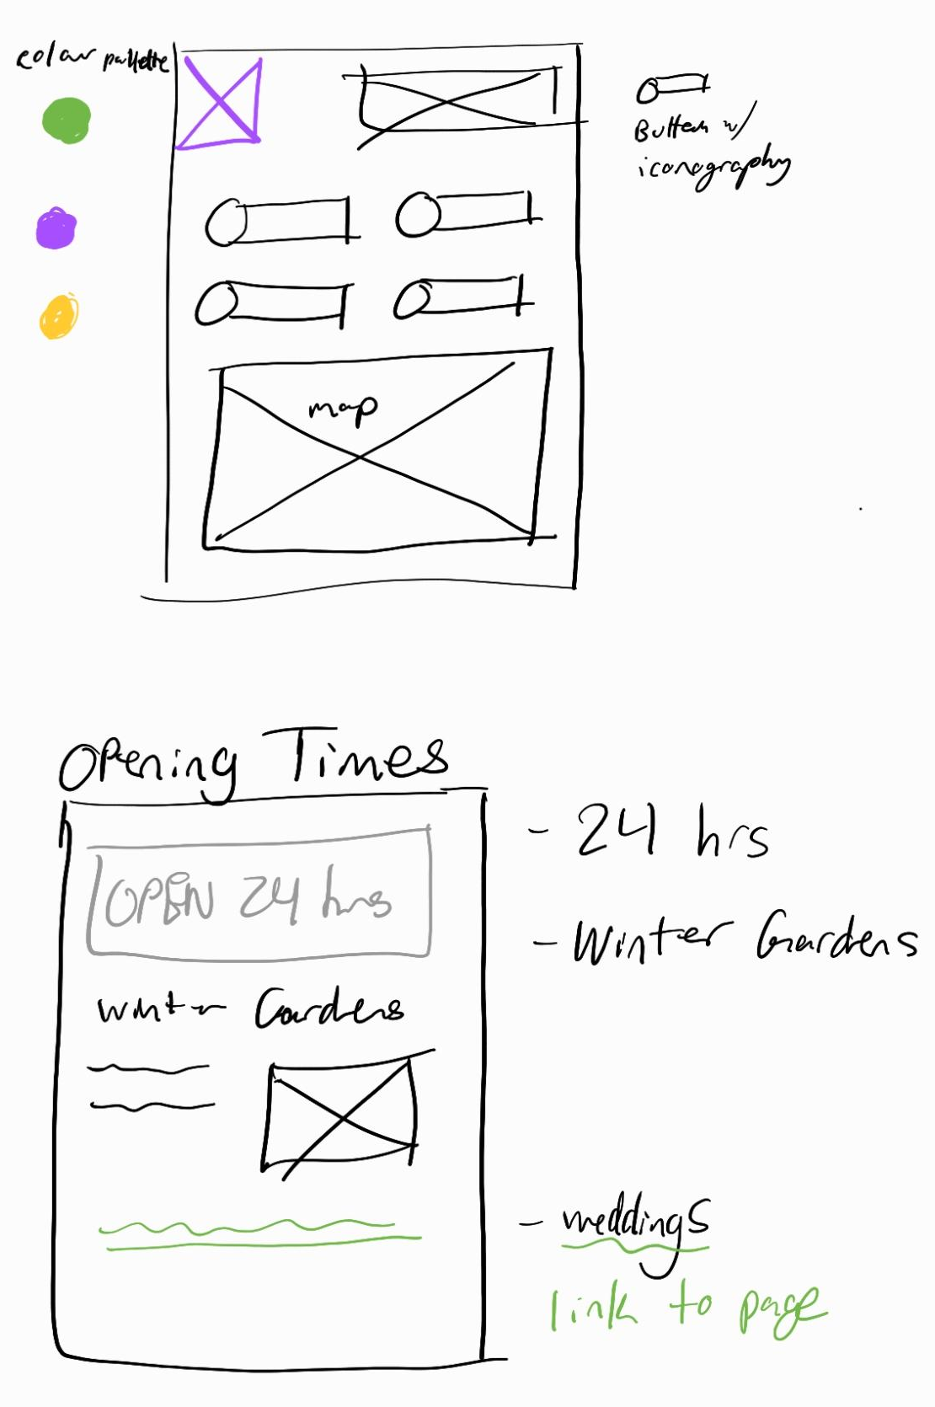
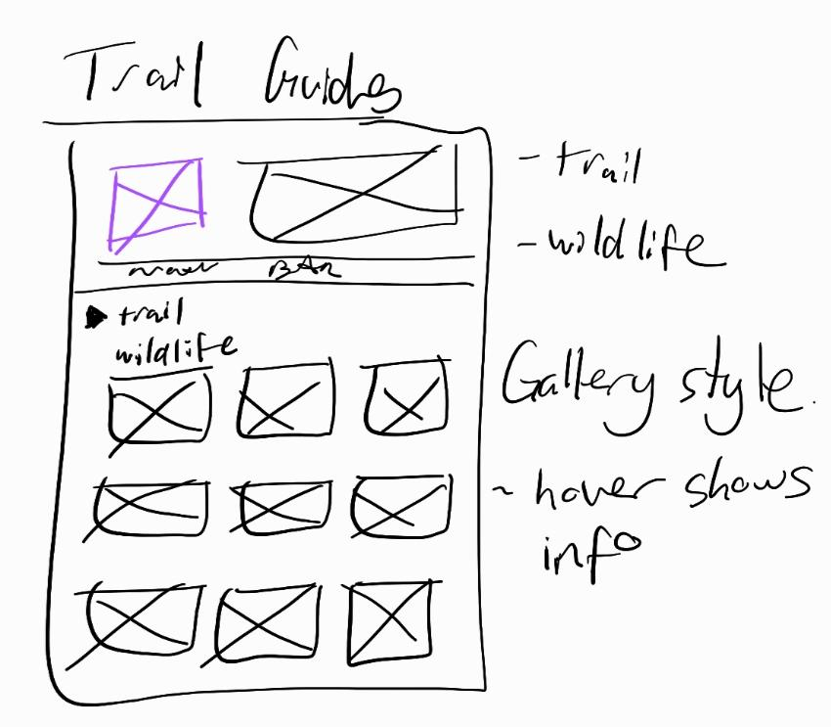
02.
Wireframes

Slide 5
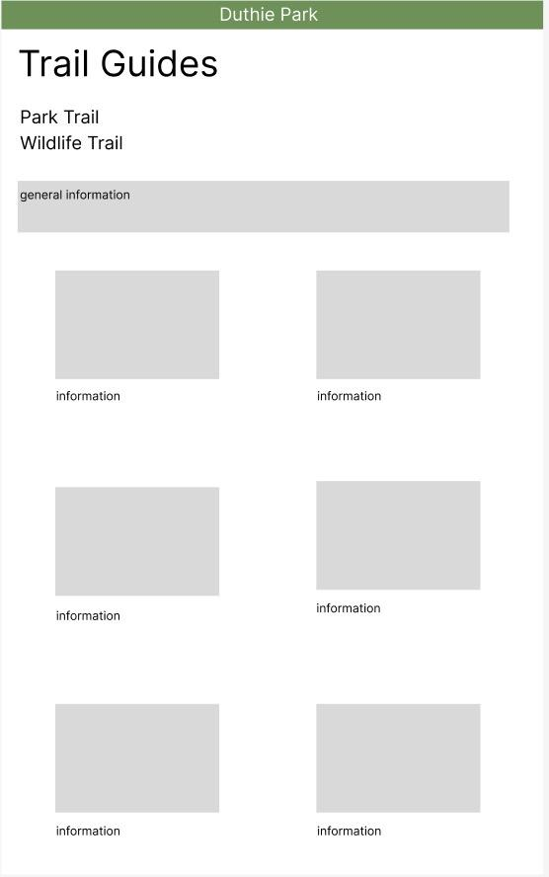
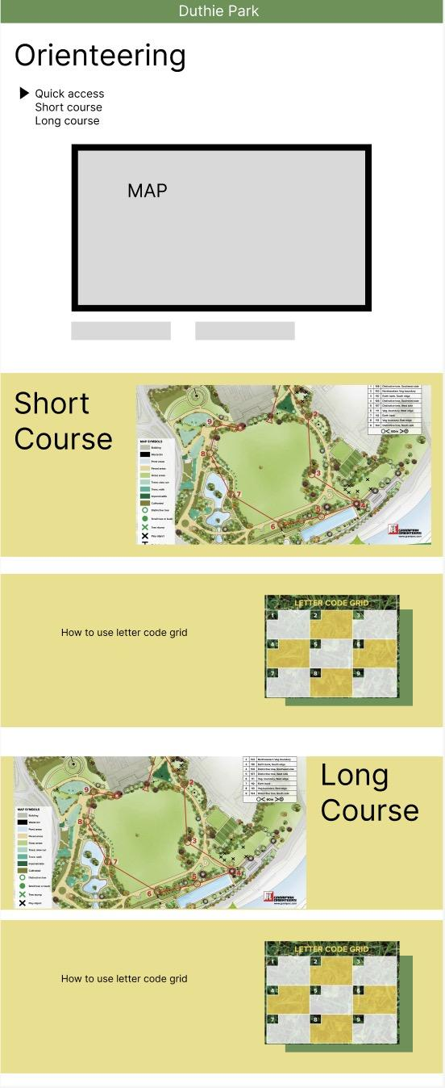
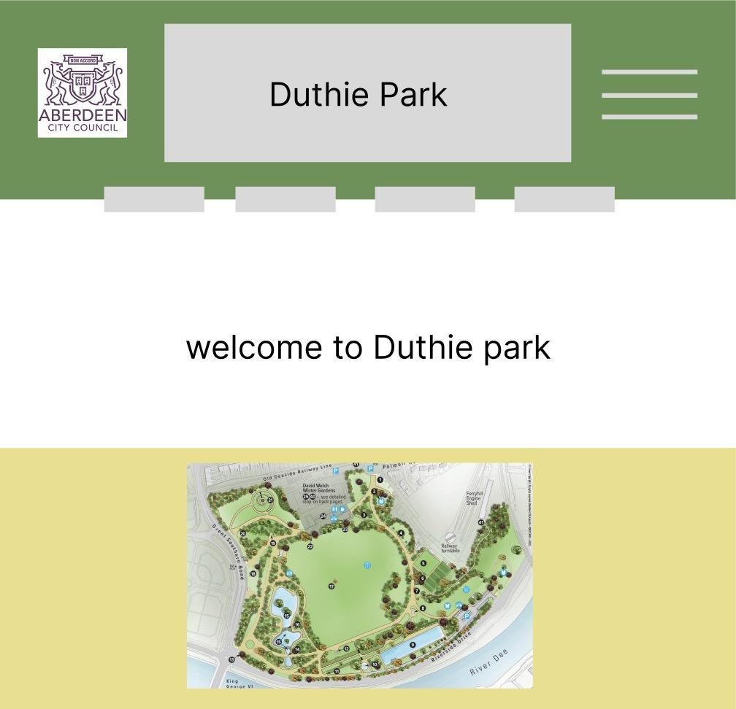
03.
Prototype

Slide 6
The Website
duthieparkexplorer.com
Notes:
Using Github
Functionality
Using API
Bus stops
Park routes

Slide 7
Considerations
Why a Website?
Layout
Accessibility
More convenient for quick access
User friendly and intuitive
Settings for visual impairment

