Slide 1
On behalf of the BASIC Fund, our Board of Directors, and the 3,375 bay area children who are currently receiving our scholarships for the 2020-21 school year, we are proud to share some information about our organization.

Slide 2
On behalf of the BASIC Fund, our Board of Directors, and the 3,375 bay area children who are currently receiving our scholarships for the 2020-21 school year, we are proud to share some information about our organization.

Slide 3
On behalf of the BASIC Fund, our Board of Directors, and the 3,375 bay area children who are currently receiving our scholarships for the 2020-21 school year, we are proud to share some information about our organization.

Slide 4
On behalf of the BASIC Fund, our Board of Directors, and the 3,375 bay area children who are currently receiving our scholarships for the 2020-21 school year, we are proud to share some information about our organization.

Slide 5
On behalf of the BASIC Fund, our Board of Directors, and the 3,375 bay area children who are currently receiving our scholarships for the 2020-21 school year, we are proud to share some information about our organization.

Slide 6
On behalf of the BASIC Fund, our Board of Directors, and the 3,375 bay area children who are currently receiving our scholarships for the 2020-21 school year, we are proud to share some information about our organization.

Slide 7
On behalf of the BASIC Fund, our Board of Directors, and the 3,375 bay area children who are currently receiving our scholarships for the 2020-21 school year, we are proud to share some information about our organization.

Slide 8
On behalf of the BASIC Fund, our Board of Directors, and the 3,375 bay area children who are currently receiving our scholarships for the 2020-21 school year, we are proud to share some information about our organization.

Slide 9
On behalf of the BASIC Fund, our Board of Directors, and the 3,375 bay area children who are currently receiving our scholarships for the 2020-21 school year, we are proud to share some information about our organization.

Slide 10
THE MISSION:
To advance educational equity for low-income families by helping offset the cost of tuition at private schools for Pre-K to 8th grade students in the bay area.
Scholarships Awarded
1998
2020
300
3,375
24,000 +
$132 million
students served
in scholarships

Slide 11
Who We Serve
Where We Serve
How We Serve
“The BASIC Fund is the single most focused, efficient, and productive non-profit that I’ve ever been associated with.”
- James H. Herbert II, CEO, First Republic Bank; BASIC Fund Director
100% of the BASIC Fund’s overhead and administrative costs are covered by the Board of Directors.

Slide 12

How BASIC Fund Scholarships Work
School Agnostic: Family requests tuition aid for private school of their choice
Needs Based: Dependent only on Family Household earnings, average Household income <$38,000 annually
Require Family Buy-In
Families must participate in paying part of tuition Provide Stability
Scholarships are guaranteed through 8th grade
Accessible
Simple bilingual application, no testing, no fees

Slide 13
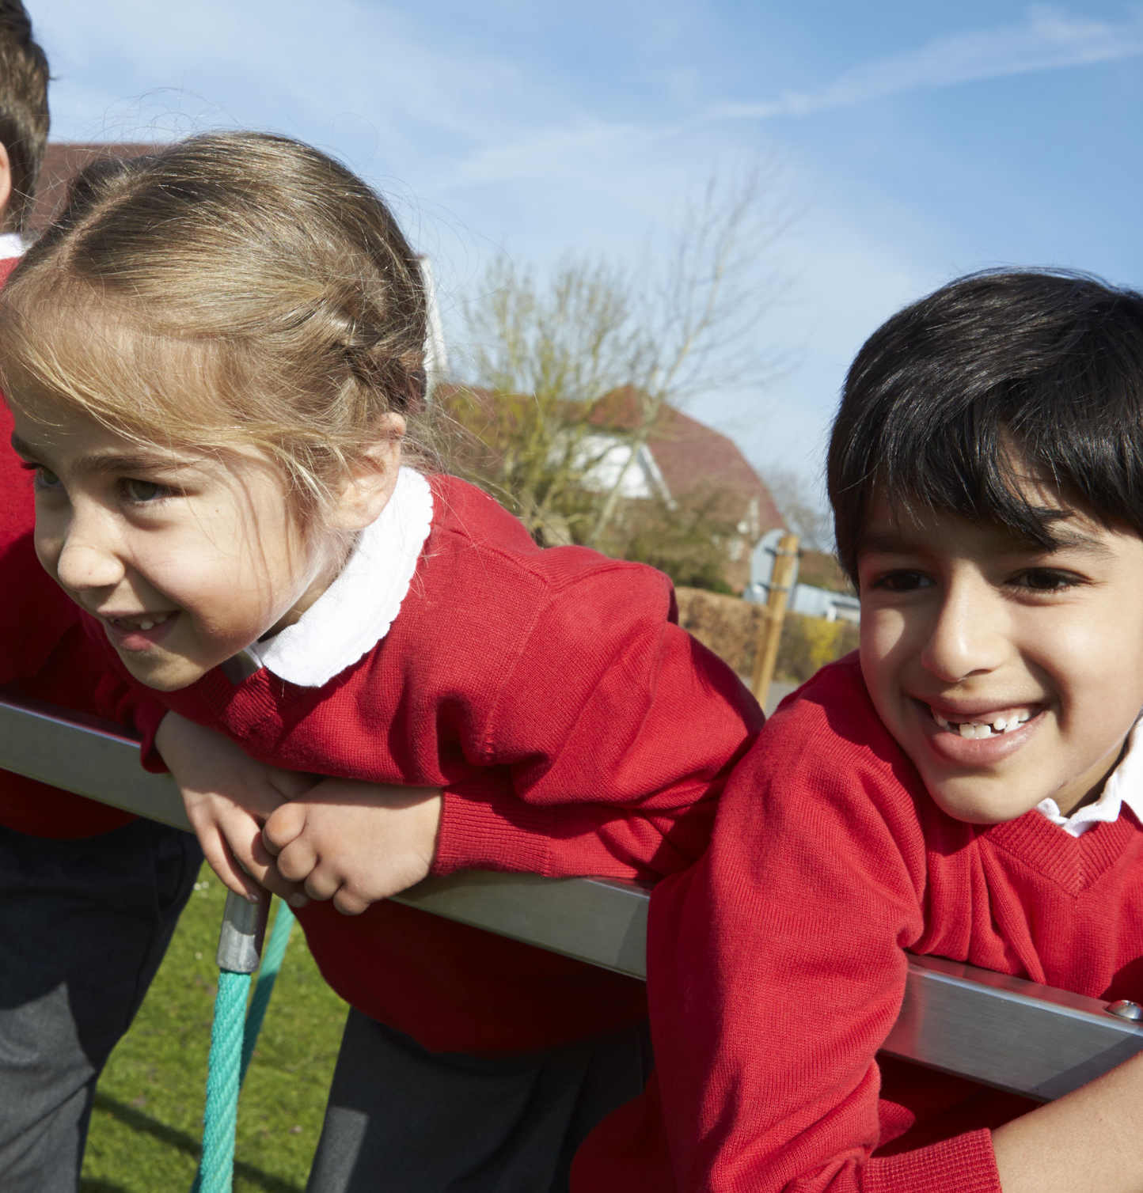
Early Intervention Is Key
By providing support early in students’ lives, they learn more than academics. Discipline, high standards, accountability and ethics lead to long-term success.
ROI
98% of our students graduate high school, compared to low-income students with public high school graduation rates of 62% in Oakland, 70% in Vallejo and 72% in San Francisco. 92% of BASIC Fund students go on to college compared to fewer than 50% for graduates of Bay Area public high schools. BASIC Fund students do not fall through the cracks.

Slide 14

CURRENT School year
3,375 Student scholarships
819 New students funded
246 different schools
357 graduates of 8th grade
Scholarship Funding
Funding for each students’ entire tenure with the BASIC Fund is put into reserves when the student begins our program. Annually, new funds raised are earmarked for the new students joining our program.

Slide 15
The need for revenue growth today
The pandemic has exacerbated the income and education gap in the Bay Area. Scholarships provide support not only for students and families, but also for schools which are critical community centers. Our 246 schools can accommodate 8,000 more Pre-K to 8th grade students
Our near-term goals:
Increase the dollar amount of scholarships
Today the average scholarship per student is $1,788 which is 22% of the average yearly tuition of $7,980.
Goal: to award 33% of a student’s annual tuition, for an average scholarship per student goal of $2,633.
Increase the number of students served
Scholarships were awarded in the fall of 2020 to 3,375 students, of which 819 were new students.
Goal: 1,000 new students annually for a total number of scholarships to be over 3,500; increasing to 1,250 new students by 2025.

Slide 16
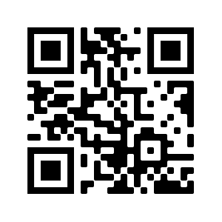
THANK YOU
Looking for more information? Scan the QR code for a short video or use this link. Reach out anytime, and visit our website www.basicfund.org

