Slide 1
Ninja Stealth Game

Slide 2

What is Ninja stealth game?
Your Objective: Guide Agent N through the base of an evil corporation as they attempt to claim some intel. Make your way to the top, grab the goods, then back to the entrance.
Dark Tactics: Use your skills to avoid notice from the patrolling guards. Progress through the puzzling levels by hiding in the shadows, avoiding the lights and outwitting guards.
Level 9 & 11
Level 10
Level 8 & 12
Level 7 & 13
Level 5 & 15
Level 6 & 14
Level 4 & 16
Level 3 & 17
Level 1 & 19
Level 2 & 18
Notes:
4 Minute long presentation – aim to be on slide 6 after 3 minutes (1 minute of questions).

Slide 3
Storyboard!
Next Level

Slide 4
Game rules!
Un-ordered list of rules:
Player can move Left, Right & Jump.
Stairs/Ladders allow the player to go up or down.
Dark spots make the player invisible to guards, however lighted areas make the player easier to spot.
Player must NOT be caught by guards. Being caught will reset the player to the last checkpoint.
High score will be earned by time-taken to complete the game (e.g. 5:12).
Progressing to the next level will create a new checkpoint.

Slide 5



Similar Games?
Oddworld: Abe’s Oddysee/New 'n' Tasty [1997] (http://store.steampowered.com/app/314660/)
Mark of the Ninja [2012] (http://store.steampowered.com/app/214560/)
Aragami [2016] (http://store.steampowered.com/app/280160/)
Notes:
Images copyright of respective companies, obtained from Steam store.

Slide 6
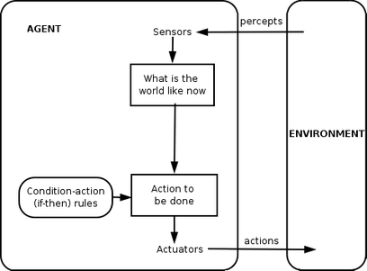
Technical focus?
My technical focus will be on creating an Intelligent Agent.
Image from: https://upload.wikimedia.org/wikipedia/commons/thumb/3/3f/IntelligentAgent-SimpleReflex.png/408px-IntelligentAgent-SimpleReflex.png

Slide 7
Any Questions?

