Slide 1
Predictive Analysis for Campus Safety: Modeling Burglary Risk at Atlanta’s Major Universities : Checkpoint 1
Alphabetically: Gunn Madan, Harini Mohan, Joshua Piña, Yuntian Wu

Slide 2
What are we trying to solve? - Part 1 Project Introduction/Scoping
Burglary related crimes frequently occur near college campuses, posing safety risks to students.
However, universities currently lack predictive tools to anticipate high-risk periods and emerging crime hotspots.
This project addresses that gap by building a data driven solution focused on Atlanta’s major campuses.

Slide 3
What exactly is our goal?- Part 1 Project Introduction/Scoping
To design and implement a predictive modeling and visualization system that:
Forecasts weekly burglary risk around major Atlanta campuses.
Identifies spatial crime hotspots within a one-mile radius of each campus.
Delivers actionable insights through an interactive dashboard to support proactive safety strategies.

Slide 4
How will we know we have reached our goal?- Part 1 Project Introduction/Scoping
Capture ≥70% of actual incidents within predicted hotspot zones.
Achieve ≥70% accuracy in predicting high-risk weeks.
Keep MAPE (Mean absolute percentage errors) below 15% for weekly burglary forecasts.

Slide 5
Tools? - Part 2 Infrastructure & Tool Setup
Component | Tool | Why?
Communication | Slack | Slack allows for easy integration of external apps.
Project Management | Notion/GitHub Projects | Notion - overall organization, GHP - to quickly raise issues
Version Control | Git/GitHub | Repository hosted on GitHub
Documentation | Google Drive | Easy to utilize online
Experiment Tracking | W&B | Professor Rec.
Database | PostGreSQL w/ PostGIS | Best dbms for our data and GIS
Frontend | Streamlit | Easy application setup
Backend | FastAPI w/Pydantic | Postgres & Streamlit integration

Slide 6
Tools? - Part 2 Infrastructure & Tool Setup
Additionally,
Architecture:
LAMBDA: Batching for training with a streaming layer to maintain an evergreen state.
Deployment:
Render to host the application; Render Cron + Prefect for scheduling
GitHub Pages serving as a static site
Python Libraries Utilized:
[Std] Pandas, Numpy, MatPlotLib, Seaborn
[ML] Scikit-Learn, Pytorch, XGBoost, StatsModels, Imblearn
[Spec] GeoPandas, Pandera, SQLAlchemy, GeoAlchemy2

Slide 7
Business Understanding - Part 3 Business & Data Understanding
Objective : Predict Burglary related crime risk around Atlanta’s major college campuses (Georgia State, Georgia Tech, Spelman, and Clark Atlanta) by forecasting weekly incident counts and identifying spatial hotspots.
DS Goals
Ingest, clean, and transform APD crime data.
Forecast weekly burglary counts per campus using ML models
Detect and visualize hotspot areas using spatial clustering
Classify “high-risk” weeks based on incident history.

Slide 8
Business Understanding - Part 3 Business & Data Understanding
Sprint 1 : Business Understanding & EDA Define objectives and success criteria. Collect APD crime data and perform exploratory analysis time period. Compare DOE data Deliverables: EDA report + modeling plan. Business & Data Understanding | Sprint 2 : Data Prep & Feature Engineering Clean and preprocess data (offense categories, dates, missing values). Filter to 1-mile campus zones and engineer temporal/spatial features. Deliverable: Final dataset and feature set for modeling. Data Prep
Sprint 3 : Modeling & Evaluation Forecast weekly crime counts near each campus using past data and trends. Classify “high-risk weeks” by predicting whether burglary levels will exceed a set threshold. Identify hotspot areas on a map using clustering and heatmaps. Deliverable: Predictive models, hotspot maps, and evaluation results. Modeling & Evaluation | Sprint 4 : Deployment & Dashboards Develop dashboard with forecasts, hotspots, and risk probabilities. Document workflow and prepare final presentation. Deliverable: Dashboard, GitHub repo, final report. Deployment

Slide 9
Data Acquisition - Part 3 Business & Data Understanding
Our Primary Data Sources
Atlanta Police Department
US Department of Education
University Annual Reports
Data Links
Atlanta Police Department (APD) - Crime Maps
Atlanta Police Department - Open Data Portal (APD-ODP)
GT Police Department - Crime Logs
US Department of Education - Campus Safety & Security (CSS)
US Department of Education - CSS (Comparison Tool)

Slide 10
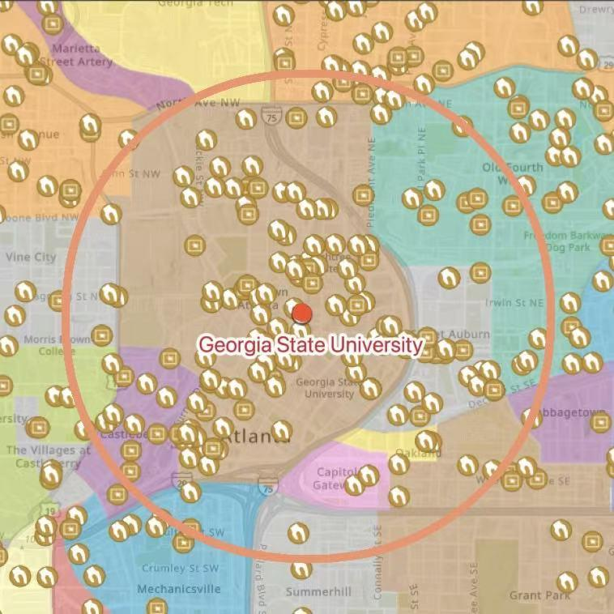
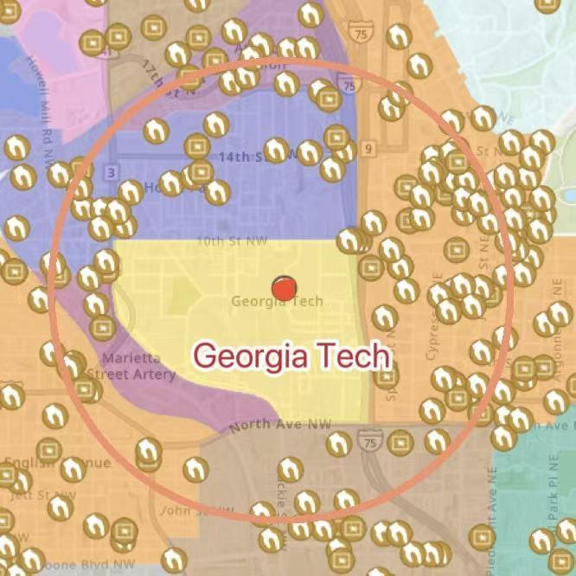
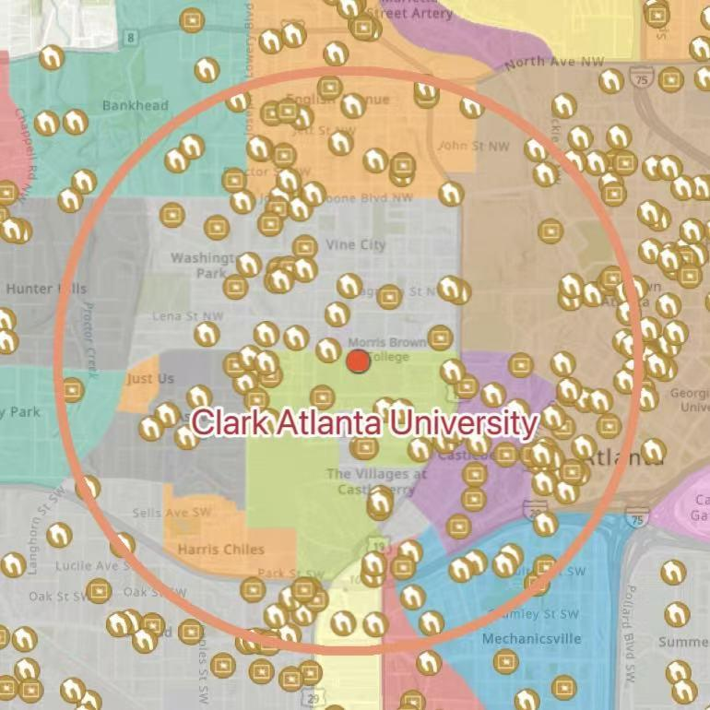
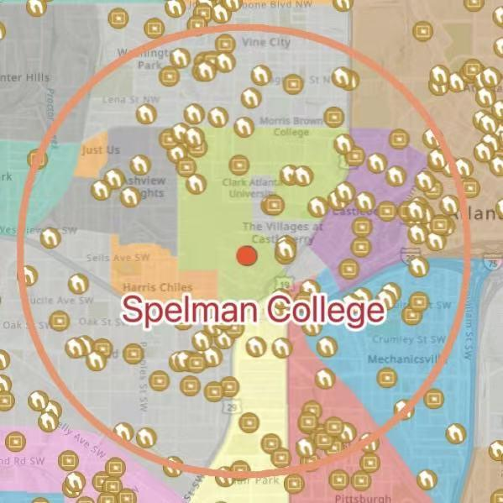
One-Mile Radius of Each Campuses.- Part 3 Business & Data Understanding

Slide 11
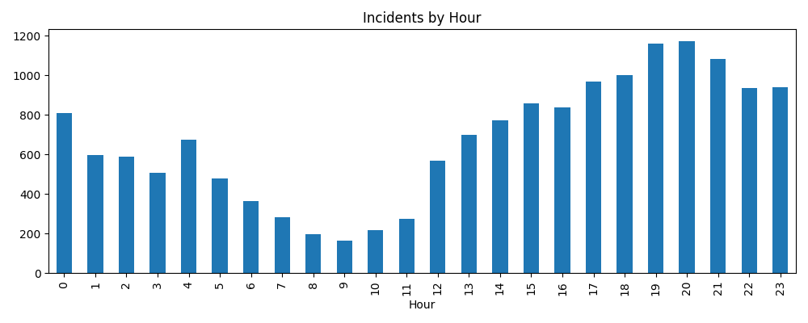
Exploratory Data Analysis - Part 3 Business & Data Understanding
Based on APD data

Slide 12
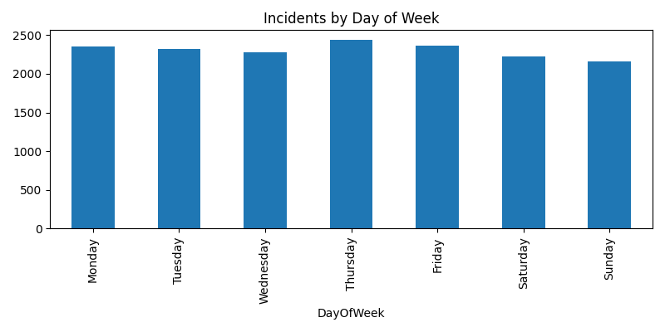
Exploratory Data Analysis - Part 3 Business & Data Understanding
Based on APD data

Slide 13
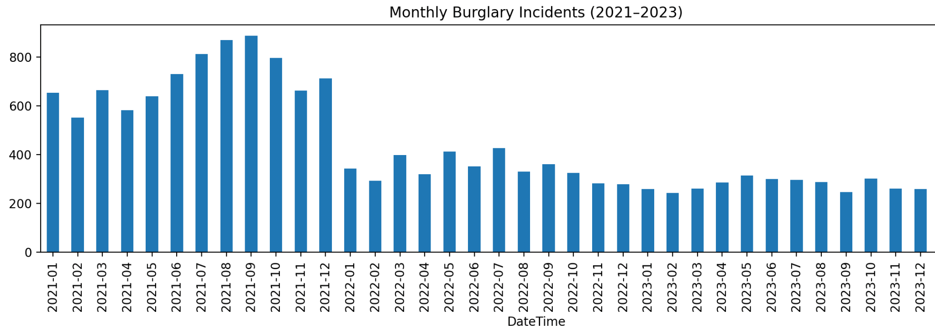
Exploratory Data Analysis - Part 3 Business & Data Understanding
Based on APD data

Slide 14
Data Quality Report
DOE data differs from APD data, further emphasizing the need for the distinction between the two.
Check | Issue Found | Action Taken
Missing value | Some rows missing coordinates, dates, or campus fields | Dropped incomplete rows; verified remaining entries align with APD and DOE records
Irrelevant Fields | DOE dataset contained non-crime categories (disciplinary, hate, fire, VAWA) | Removed all unrelated fields and kept only Criminal Offenses and Arrests
Duplicates | Repeated APD incidents with same ID and timestamp | Deduplicated based on report_number, offense_date, and location.
Formatting Differences | Columns, date formats, and field names inconsistent between APD and DOE | Renamed columns and standardized date format
Out-of-Bounds Data | Some APD coordinates outside Atlanta or invalid (0,0) | Filtered to points within Atlanta city boundary
Temporal Range | DOE data annual; APD data daily | Aggregated APD to yearly totals for alignment

Slide 15
Initial Findings - Part 3 Business & Data Understanding
Crime Concentration- Georgia State University and Georgia Tech show the highest volume of burglary and arrest incidents within a 1-mile radius, while Spelman and Clark Atlanta remain consistently lower.
Temporal Trend- Burglary incidents dipped in 2022 but rose again in 2023, aligning with DOE’s annual reports- likely linked to post-COVID campus repopulation.
Time + Day Patterns- Most incidents occur (Tue-Thu) and between 10 AM- 4 PM, suggesting daytime, opportunity-based offenses near student housing and campus centers.
Spatial Hotspots- APD data clusters heavily in downtown Atlanta, overlapping the GSU and Georgia Tech zones, validating the need for localized predictive modeling.

