Slide 1
C S
计网课程项目——Task1展示
小组成员：邱奕浩，王广浩，王德超
P 2 P

Slide 2
C S 通信
1.1 项目设计
1.2 项目核心细节
1.3 项目成果
1.4 项目优化设想
1
目 录
CONTENTS
P2P 通信
2.1 项目设计
2.2 项目核心细节
2.3 项目成果
2.4 项目优化设想
2

Slide 3
1.1
CS通信——项目设计
Part One

Slide 4
TCP
CS通信
Part One
可靠性传输
更稳定的获取数据
不使用睡眠可以发的更快

Slide 5
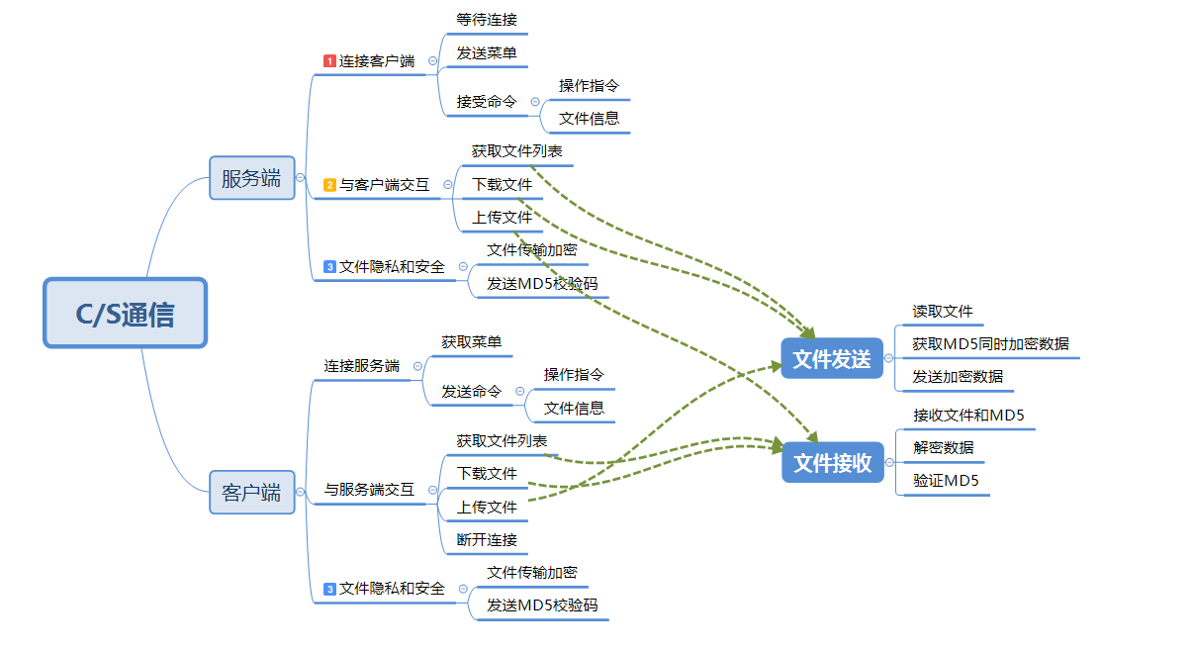

Slide 6
1.2
CS通信——核心细节
Part Two

Slide 7
TCP
CS通信
Part Two
可靠性传输
更稳定的获取数据
不使用睡眠可以发的更快

Slide 8
发送文件操作
项目核心细节
接收文件操作
文件加密和解密和MD5验证
记录操作日志

Slide 9
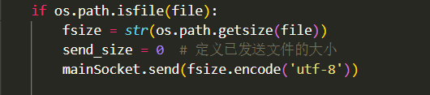
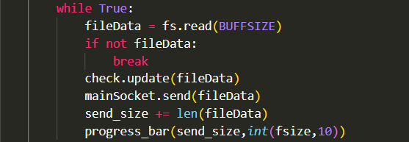
发送文件操作
先传入文件大小
循环发送数据，打印进度条
文件不存在时的处理

Slide 10

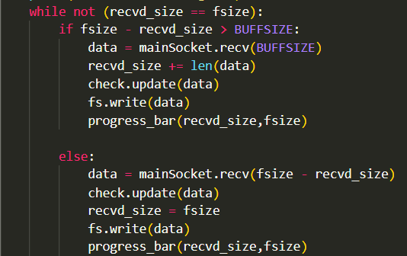
接收文件操作
先接收文件大小
循环接收数据，打印进度条
文件不存在时的处理

Slide 11
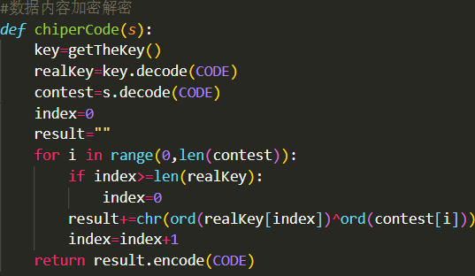

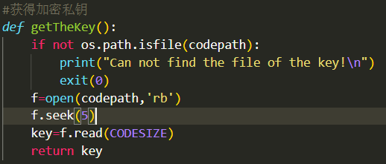
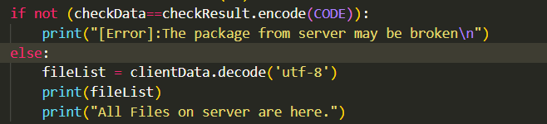

文件加密解密和MD5验证
文件加密解密函数
MD5获取验证
实验结果
加密解密函数调用

Slide 12
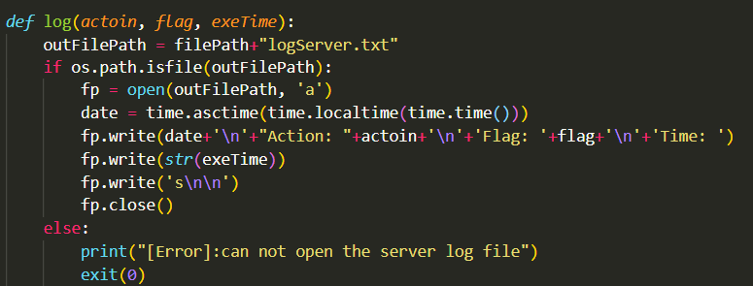
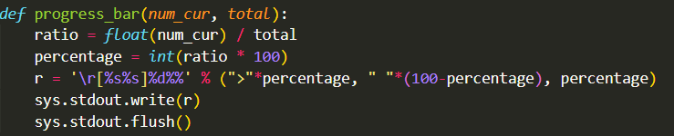
Log日志
Log函数
Log函数调用
进度条实现

Slide 13
1.3
CS通信——项目成果
Part Three

Slide 14
TCP
同一台主机不同端口
Part Three

Slide 15
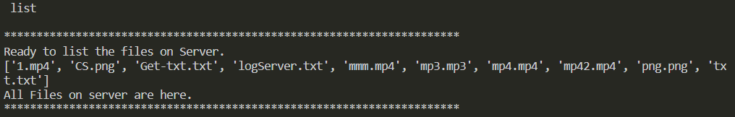
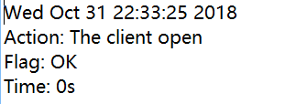
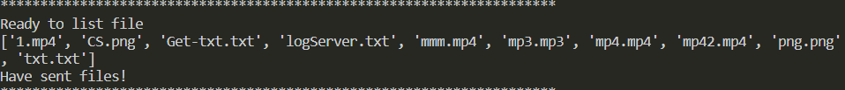
List功能
实验结果
Log日志
服务端

Slide 16
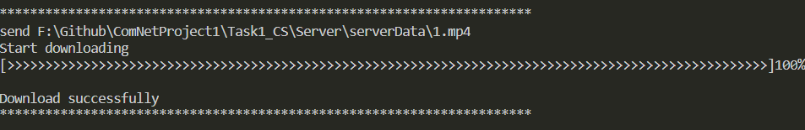
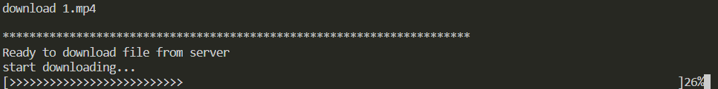
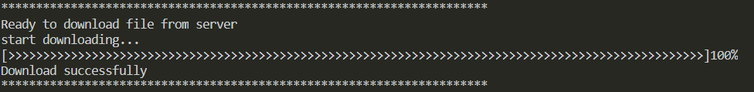
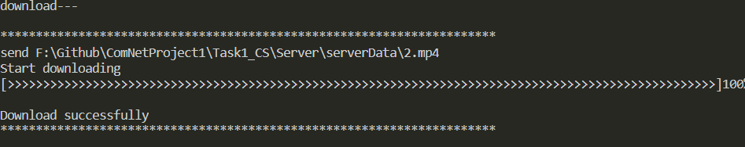
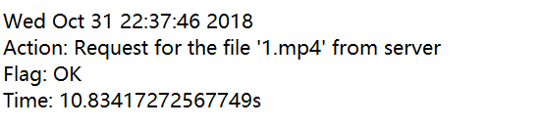
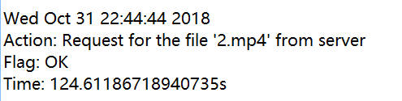
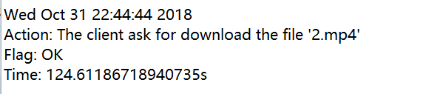
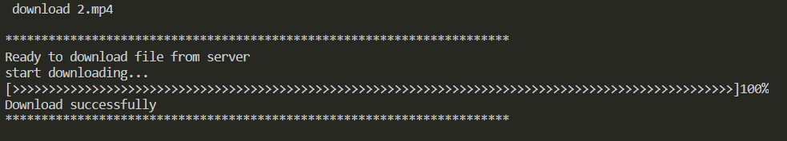
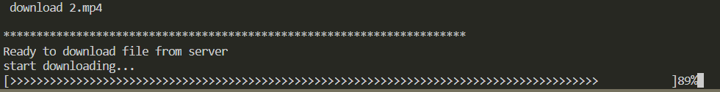
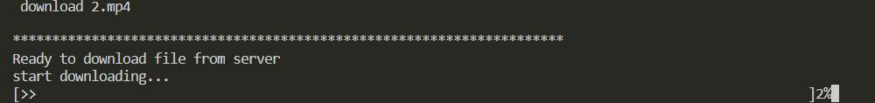
下载功能
5M视频文件实验结果 （客户端和服务端）
Log日志
大文件测试（400M视频文件）

Slide 17
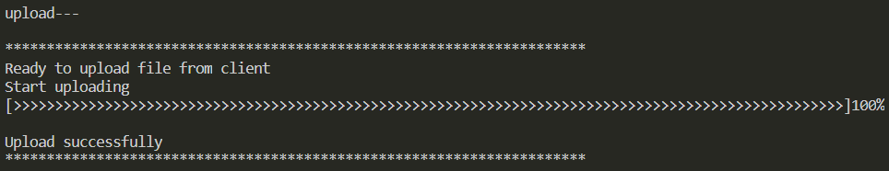
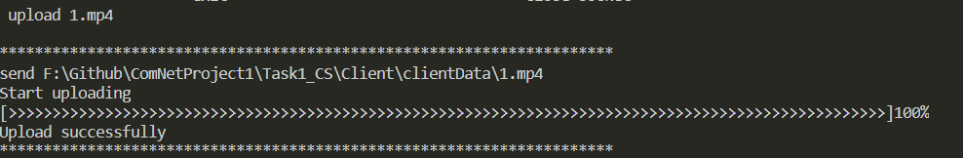
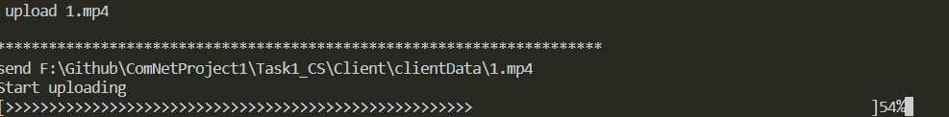
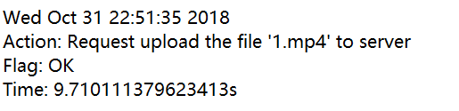
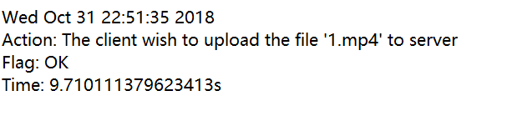
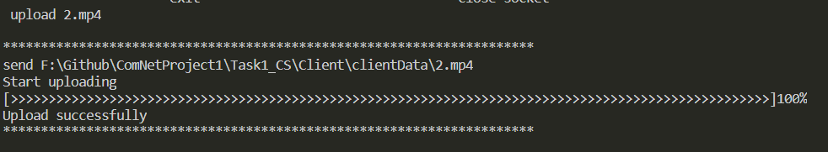
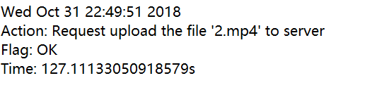
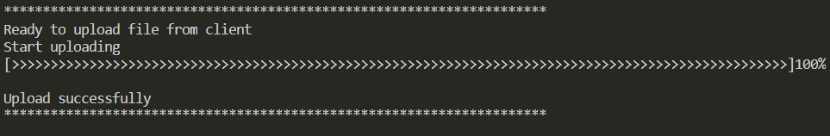
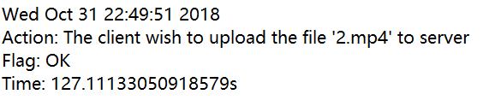
上传功能
5M视频文件实验结果 （客户端和服务端）
Log日志
大文件测试（400M视频文件）

Slide 18
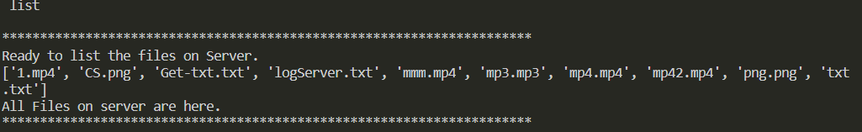
TCP
不同主机实验
Part Three

Slide 19
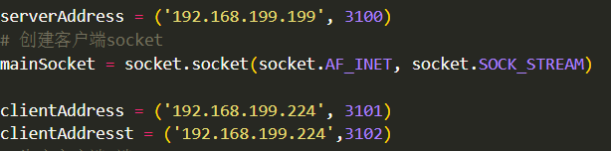
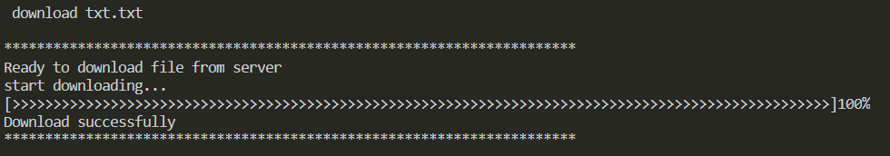
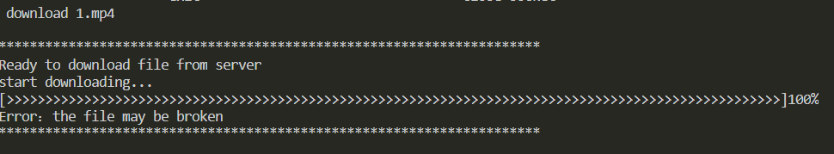
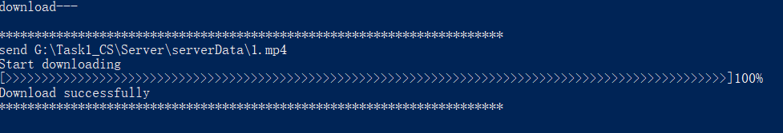
下载功能
小文件实验结果 （客户端和服务端）
大文件测试（400M视频文件）

Slide 20
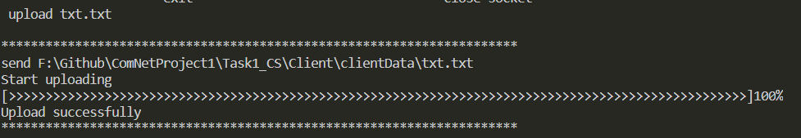
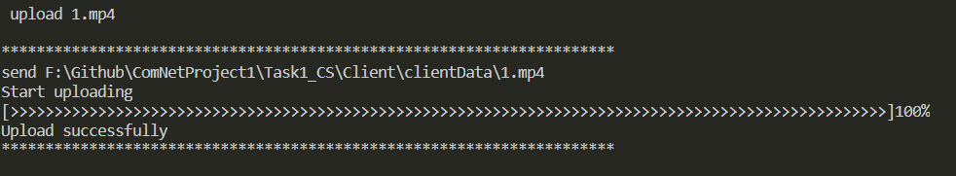
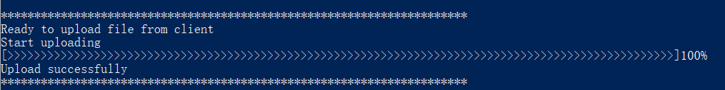
上传功能
小文件实验结果 （客户端和服务端）
大文件测试（400M视频文件）

Slide 21
1.4
采用超时重发机制
对数据包排序
采用多线程
良好的图形UI界面
Part Four

Slide 22
UDP
CS通信
Part One
更快的传输
使用睡眠避免发送过快
（由于和TCP比缺点太多，在这里不再过多描述，附有UDP版实验报告）

Slide 23
2.1
P2P通信——项目设计
Part One

Slide 24
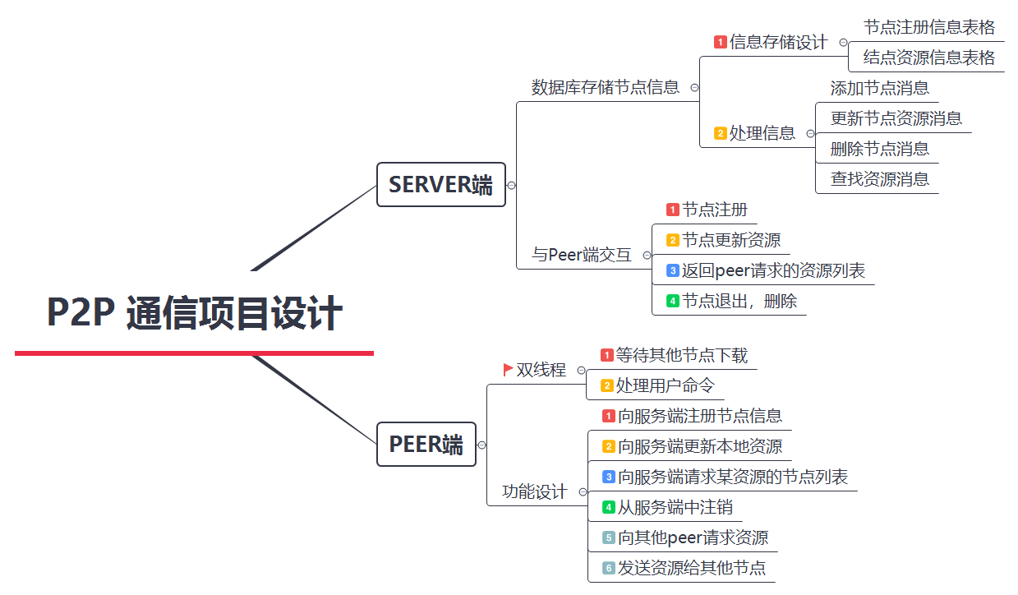

Slide 25
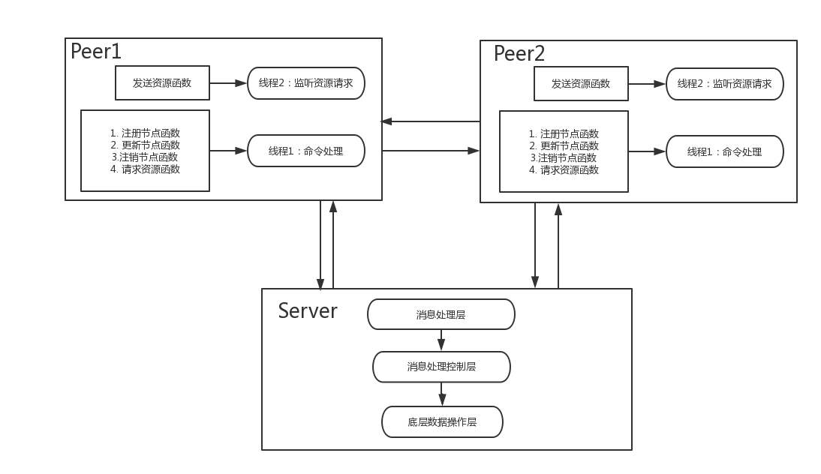
项目设计
使用UDP传输

Slide 26
2.2
P2P通信——核心细节
Part Two

Slide 27
服务端数据库设计
项目核心细节
用户双线程
文件分组发送，接收

Slide 28
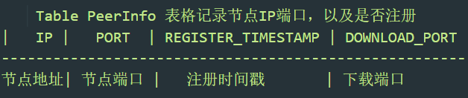
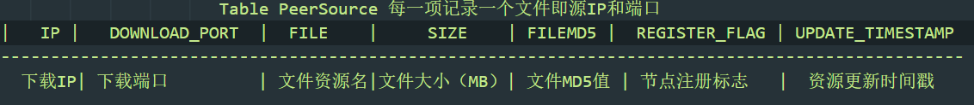
服务端数据库设计
表格设计
节点注册信息表
资源信息信息表

Slide 29
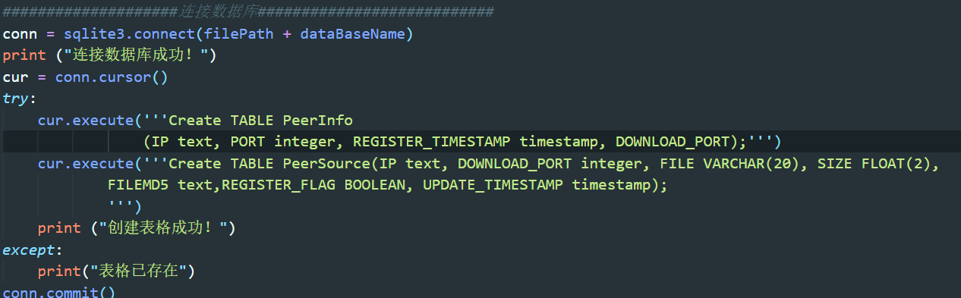
服务端数据库设计
连接SQLite数据库, python环境中使用sqlite3模块

Slide 30
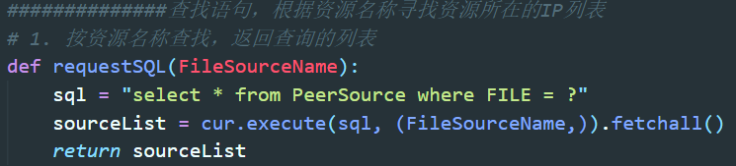
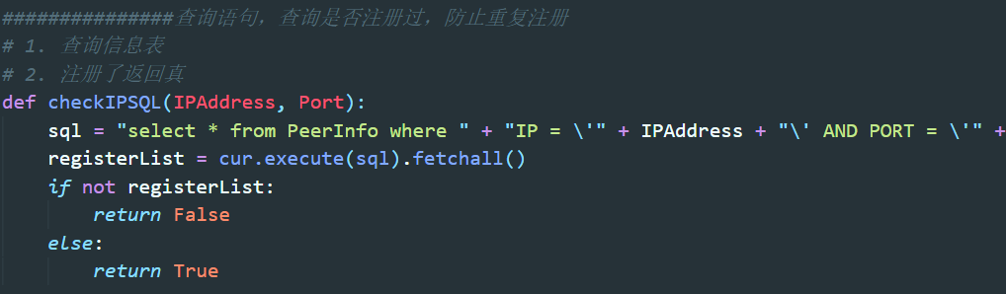
服务端数据库设计
查询资源
检查是否注册

Slide 31
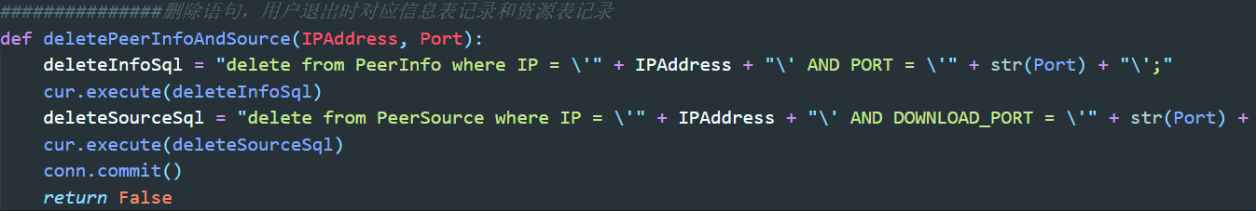
服务端数据库设计
退出节点

Slide 32
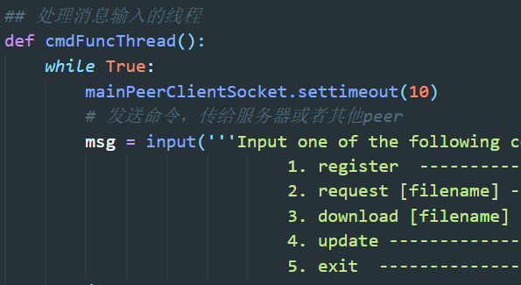
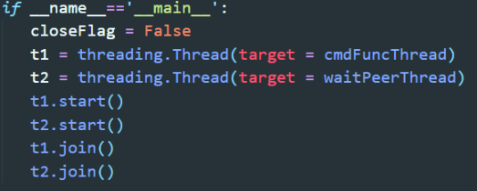
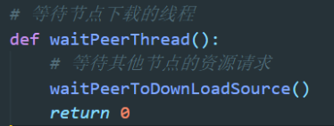
用户双线程
处理命令线程
启动双线程
处理资源请求线程
使用threading 模块，将两个线程封装在两个函数
中，以函数的形式来开启线程。

Slide 33

文件双点传输和接收
文件分组发送策略
按一定的大小循环读取文件，得到许多固定大小文件块，并且对这些文件块
按序号排好。
发送标志指定节点发送文件的标志。节点收到发送标志FLAG = 0，则单点传输；收到标志FLAG = 1，
则则该peer发送序号为奇数的文件块；若收到标志FLAG = 2, 则该peer发送序号为偶数的文件块。
二进制文件块数据，先使用base64转换为字节码，再转换为字符串，然后使用json存储文件块序号以
文件块字符串数据，编码进行网络传输。 接收时逆向进行得到二进制文件块。

Slide 34

文件双点传输和接收
文件分组接收策略

Slide 35
2.3
P2P通信——项目成果
Part Three

Slide 36
2.4
P2P通信——项目优化设想
Part Four

Slide 37
项目优化设想
增加传输节点。
根据资源节点的网络传输速度，时延等等来动态调整下载策略。
使用TCP或者基于UDP实现可靠传输，断点重传等等。
不使用命令行，使用可视化界面。
文件读写也采用异步文件操作函数，请求方向文件中写入第k块
数据的同时正从网络上下载第k+1块数据。同理，提供文件下载的
站点在读第k+1块数据的同时也正在传输地k块数据。

Slide 38
文件读写也采用异步文件操作函数，请求方向文件中写入第k块数据的同时正从网络上下载第k+1块数据。

Slide 39
感谢观看

Slide 40
请输入您的标题
Experience as your reference, prudence as your brother.
请输入您的标题
请输入您的标题
Please enter your content here, can be used to paste by copying your text and choose to keep only text.
Please enter your content here, can be used to paste by copying your text and choose to keep only text.
请输入您的标题
请输入您的标题
Please enter your content here, can be used to paste by copying your text and choose to keep only text.
Photoshop Cs6
Please enter your content here, can be used to paste by copying your text and choose to keep only text.
请输入您的标题
请输入您的标题
Please enter your content here, can be used to paste by copying your text and choose to keep only text.
Please enter your content here, can be used to paste by copying your text and choose to keep only text.

Slide 41
请输入您的标题
Experience as your reference, prudence as your brother.
请输入您的标题
Please enter your content here, can be used to paste by copying your text and choose to keep only text. Please enter your content here, can be used to paste by copying your text and choose to keep only text.

Slide 42

请输入您的标题
Experience as your reference, prudence as your brother.
请输入您的标题
Please enter your content here, can be used to paste by copying your text and choose to keep only text.
Windows 10
Please enter your content here, can be used to paste by copying your text and choose to keep only text.
37.5%
Please enter your content here, can be used to paste by copying your text and choose to keep only text. Please enter your content here, can be used to paste by copying your text and choose to keep only text.

Slide 43
请输入您的标题
Experience as your reference, prudence as your brother.
请输入标题
请输入标题
请输入标题
请输入标题
Please enter your content here, can be used to paste by copying your text and choose to keep only text.
Please enter your content here, can be used to paste by copying your text and choose to keep only text.
Please enter your content here, can be used to paste by copying your text and choose to keep only text.
Please enter your content here, can be used to paste by copying your text and choose to keep only text.

Slide 44


请输入您的标题
Experience as your reference, prudence as your brother.
Please enter your content here, can be used to paste by copying your text and choose to keep only text. Please enter your content here
Please enter your content here, can be used to paste by copying your text and choose to keep only text.
Lebron James
Allen Iverson
Experience as your reference, prudence.
Your and will brother prudence a as.
23
21

Slide 45
请输入您的标题
Experience as your reference, prudence as your brother.
请输入标题
Please enter your content here, can be used to paste by copying your text
请输入标题
Please enter your content here, can be used to paste by copying your text
04
请输入标题
Please enter your content here, can be used to paste by copying your text
请输入标题
03
Please enter your content here, can be used to paste by copying your text
02
01

Slide 46
请输入您的标题
Experience as your reference, prudence as your brother.
请输入您的标题
Please enter your content here, can be used to paste by copying your text and choose to keep only text.
请输入您的标题
请输入您的标题
Please enter your content here, can be used to paste by copying your text and choose to keep only text.
请输入您的标题
Please enter your content here, can be used to paste by copying your text and choose to keep only text.

Slide 47
请输入您的标题
Experience as your reference, prudence as your brother.
请输入您的标题
2
0
1
7
2
0
1
8
Please enter your content here, can be used to paste by copying your text and choose to keep only text.
65.2%
74.8%
请输入您的标题
Please enter your content here, can be used to paste by copying your text and choose to keep only text.

Slide 48
03
请输入您的标题
Please enter your content here, can be used to paste by copying your text and choose to keep only text.
Part Three

Slide 49
请输入您的标题
Experience as your reference, prudence as your brother.
请输入您的标题
Please enter your content here, can be used to paste by copying your text and choose to keep only text.
请输入您的标题
Please enter your content here, can be used to paste by copying your text and choose to keep only text.
Weakness
Threats
Please enter your content here, can be used to paste by copying your text and choose to keep only text.
Superiority
Opportunity
请输入您的标题
请输入您的标题
Please enter your content here, can be used to paste by copying your text and choose to keep only text.

Slide 50

请输入您的标题
Experience as your reference, prudence as your brother.
请输入您的标题
Please enter your content here, can be used to paste by copying your text and choose to keep only text. Please enter your content here, can be used to paste by copying your text and choose to keep only text.
Please enter your content here, can be used to paste by copying your text and choose to keep only text. Please enter your content here
4,465$
78%
请输入标题
请输入标题

Slide 51
请输入您的标题
Experience as your reference, prudence as your brother.
请输入您的标题
请输入您的标题
Please enter your content here, can be used to paste by copying your text and choose to keep only text.
Please enter your content here, can be used to paste by copying your text and choose to keep only text.
请输入您的标题
请输入您的标题
Please enter your content here, can be used to paste by copying your text and choose to keep only text.
Please enter your content here, can be used to paste by copying your text and choose to keep only text.

Slide 52
请输入您的标题
Experience as your reference, prudence as your brother.
78.6%
请输入您的标题
请输入您的标题
请输入您的标题
Please enter your content here, can be used to paste by copying your text and choose to keep only text.
Please enter your content here, can be used to paste by copying your text and choose to keep only text.
Please enter your content here, can be used to paste by copying your text and choose to keep only text.

Slide 53
请输入您的标题
Experience as your reference, prudence as your brother.
请输入您的标题
Please enter your content here, can be used to paste by copying your text and choose to keep only text.
Please enter your content here, can be used to paste by copying your text and choose to keep only text.
Please enter your content here, can be used to paste by copying your text and choose to keep only text.
请输入您的标题
Please enter your content here, can be used to paste by copying your text and choose to keep only text. Please enter your content here, can be used to paste by copying your text and choose to keep only text.

Slide 54
04
请输入您的标题
Please enter your content here, can be used to paste by copying your text and choose to keep only text.
Part Four

Slide 55
01
请输入您的标题
Experience as your reference, prudence as your brother.
请输入您的标题
请输入您的标题
Please enter your content here, can be used to paste by copying your text and choose to keep only text. Please enter your content here, can be used to paste by copying your text and choose to keep only text.
请输入您的标题
请输入您的标题
Please enter your content here, can be used to paste by copying your text and choose to keep only text. Please enter your content here, can be used to paste by copying your text and choose to keep only text.
请输入您的标题

Slide 56
请输入您的标题
Experience as your reference, prudence as your brother.
78.6%
Step One
Step Two
Step Three
请输入您的标题
请输入您的标题
Please enter your content here, can be used to paste by copying your text and choose to keep only text. Please enter your content here, can be used to paste by copying your text and choose to keep only text.
Please enter your content here, can be used to paste by copying your text and choose to keep only text. Please enter your content here, can be used to paste by copying your text and choose to keep only text.

Slide 57
请输入您的标题
Experience as your reference, prudence as your brother.
18.2%
33.4%
56%
North America
Please enter your content here, can be used to paste by copying your text and choose to keep only text.
China
Please enter your content here, can be used to paste by copying your text and choose to keep only text.
European
Please enter your content here, can be used to paste by copying your text and choose to keep only text.

Slide 58
请输入您的标题
Experience as your reference, prudence as your brother.
辽宁
35.6%
Please enter your content here, can be used to paste by copying your text and choose to keep only text.
山东
44.1%
Please enter your content here, can be used to paste by copying your text and choose to keep only text.
福建
16.8%
Please enter your content here, can be used to paste by copying your text and choose to keep only text.
广州
61.8%
Please enter your content here, can be used to paste by copying your text and choose to keep only text.

