Slide 1
Precision
Measurements depend on the precision of the measuring instruments used.
Precision: is indicated by the number of decimal places in a measured or calculated value.
Example:
2.861 cm is more precise than 2.86 cm because the three decimal places in 2.861 makes it precise to the nearest one-thousandth of a centimetre

Slide 2
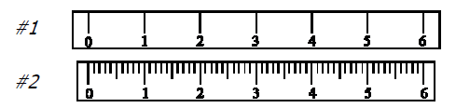
Rules for Precision
All measured quantities are expressed as precisely as possible. All digits shown are significant with any error or uncertainty in the last digit.
Example:
the measurement 87.64 cm the uncertainty is with the digit 4.
2. The precision of a measuring instrument depends on its
the size of the unit being used.
Example:
ruler #2 is more precise
than ruler #1

Slide 3
Rules for Precision
We should always try to read any instrument by estimating tenths of the smallest division.
Example:
With ruler #1 we would estimate to the nearest tenth of a centimetre (3.2 cm)
With ruler #2 we would estimate to the nearest tenth of a millimeter ( 3.24 cm).

Slide 4
Rules for Precision
The estimated digit is always shown when recording the measurement. If the object falls right on a division mark, the estimated digit would be 0.
Example:
Using a ruler calibrated in centimetres to measure a length that falls exactly on the 5 cm mark, the correct reading is 5.0 cm, not 5 cm.

Slide 5
Practice:
Use the two centimetre rulers to measure and record the length of the pen graphic.

Slide 6
PRACTICE:
5. Which of the following values of a measured quantity is most precise?
0.81 mm, 48.1 mm, 0.081 mm
0.081 mm – has 3 decimal places
b) 12.64 cm, 126 cm, 0.5400 cm, 0.304 cm
0.5400 cm has 4 decimal places

Slide 7
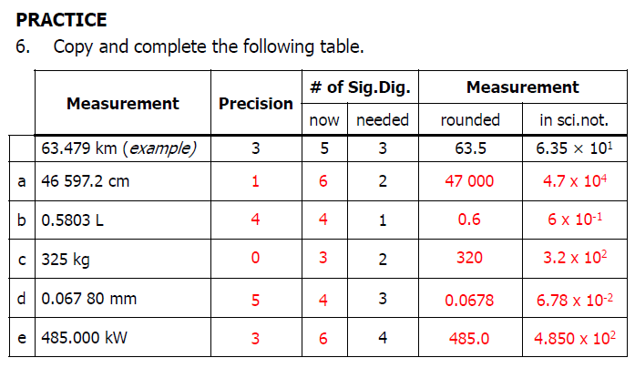


Slide 8
Error in Measurements
Many people believe that all measurements are reliable (consistent over many trials), precise (to as many decimal places as possible), and accurate (representing the actual value).
But there are many things that can go wrong when measuring.

Slide 9

Example::
The investigator may make a mistake or fail to follow the correct techniques when reading the measurement.
The instrument may be faulty or inaccurate; a similar instrument may give different readings.

Slide 10
PRACTICE:
What three things can you do during an experiment to help eliminate errors?
To be sure that you have measured correctly, you should repeat your measurements at least three times.
If your measurements appear to be reliable, calculate the mean and use that value.
To be more precise about the accuracy, repeat the measurements with a different instrument.

Slide 11
Types of Errors:
Random error :
results when the last digit is estimated.
Example:
When measuring length with a measuring tape, it is necessary to estimate between the marks on the measuring tape. If these marks are 1 cm apart, the random error will be greater and the precision will be less than if the marks are 1mm apart.

Slide 12
Types of Errors:
Systematic error :
due to a problem with the measuring device
Example:
If a balance is not zeroed at the beginning, all measurements will have a systematic error.

Slide 13
Accuracy & Precision
in science it is important to make a distinction between "accuracy" and "precision".
Accuracy: refers to how close a value is to its accepted value.
Precision: is the place value of the last measureable digit.

Slide 14
Accuracy & Precision
Example:
The position of the darts in each of the figures are analogous to measured or calculated results in a laboratory setting.
The results: in (a) are precise and accurate,
in (b) they are precise but not accurate, and
in (c) they are neither precise nor accurate.

Slide 15
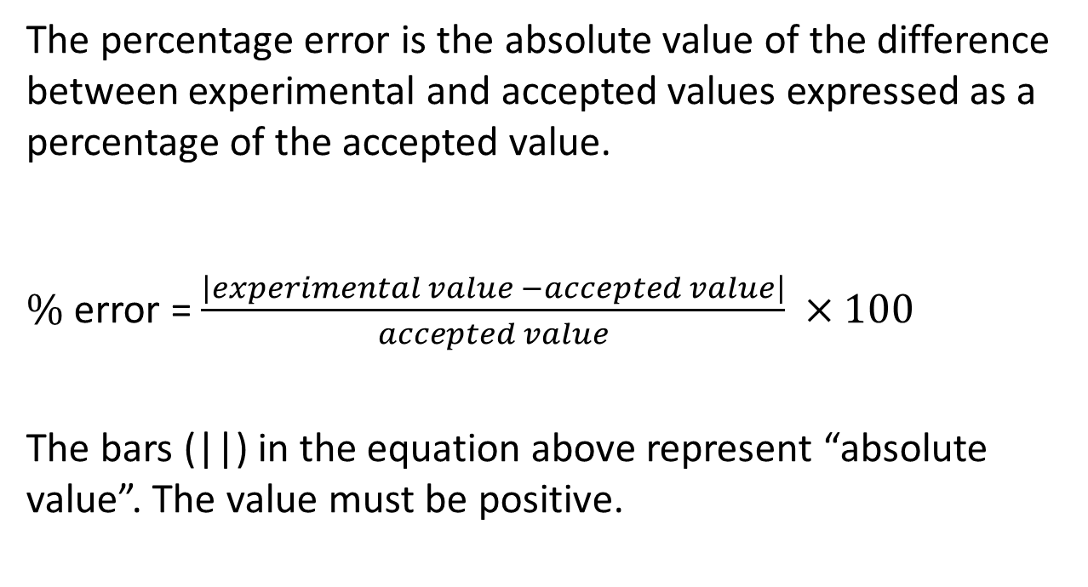
Percentage Error
The percentage error is the absolute value of the difference between experimental and accepted values expressed as a percentage of the accepted value.
$\%$ error = $\frac{\left|experimental value −accepted value\right|}{accepted value} ×100$
The bars (||) in the equation above represent “absolute value”. The value must be positive.

Slide 16
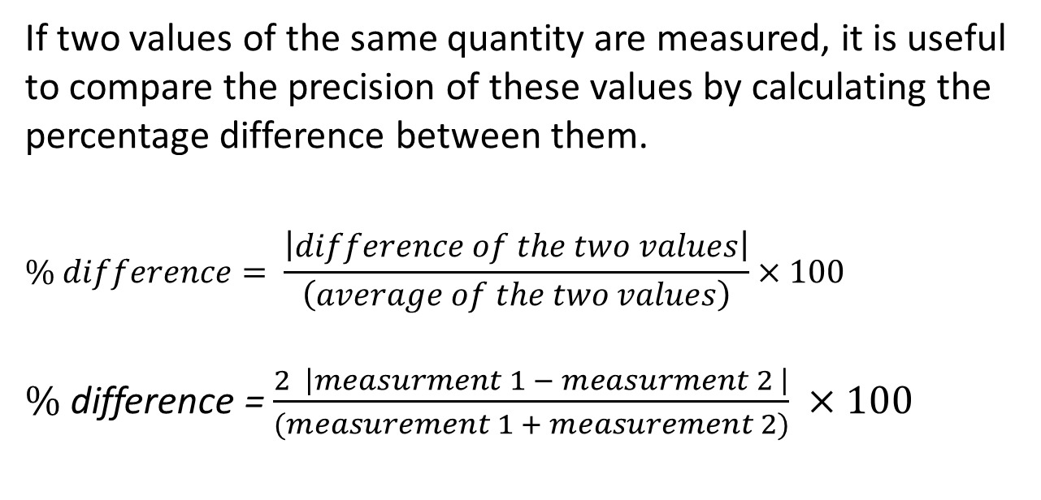
Percentage Difference
If two values of the same quantity are measured, it is useful to compare the precision of these values by calculating the percentage difference between them.
$$\% difference= \frac{\left|difference of the two values\right|}{\left(average of the two values\right)}×100$$
$\%$ difference = $\frac{2 \left|measurment 1 − measurment 2 \right|}{(measurement 1 + measurement 2)} ×100$

Slide 17



Practice:
3. At a certain location, the acceleration due to gravity is 9.82 m/s² [down]. Calculate the percentage error of the following experimental values of “g” at the location.
8.94 m/s² [down].
9.95 m/s² [down].
$a) \%$ error = $\frac{\left|8.94 −9.82\right|}{9.82} ×100=8.96 \%$
b$) \%$ error = $\frac{\left|9.95 −9.82\right|}{9.82} ×100=1. 32 \%$

Slide 18
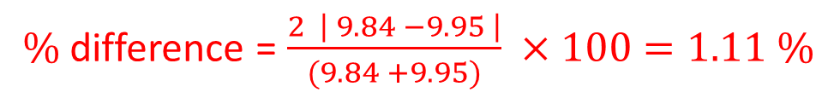
Practice:
4. Calculate the percentage difference between the two experimental values (9.84 m/s² and 9.95 m/s² ) used in question # 3.
$\%$ difference = $\frac{2 \left| 9.84 −9.95 \right|}{(9.84 +9.95)} ×100=1.11 \%$

Slide 19
Trigonometry
The three trigonometric ratios are : sine, cosine, and tangent to find the measures of unknown sides or angles in right triangles.
NOTE: DEG, RAD, and GRAD are different units/modes used for measuring angles. Make sure that your calculator is always in DEG mode.

Slide 20


Slide 23
Making Precise Measurements:
In order to make precise measurements you need to use a device that has a double scale. A double scale consists of a main scale that is an ordinary metric scale with centimetres and millimetres and a sliding or vernier scale.

Slide 24
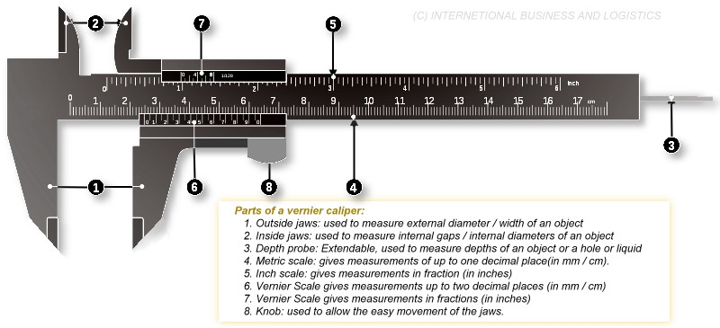
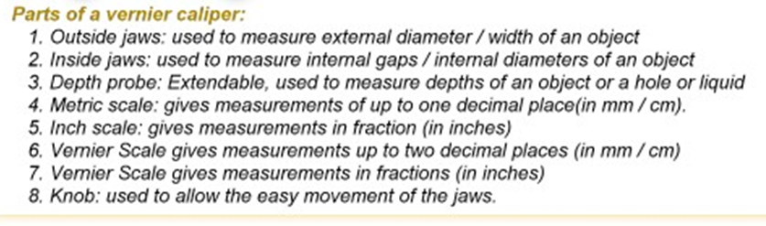

Slide 25
There are 10 graduations on the vernier scale that occupy the same space as 9 graduations on the main scale.
Therefore, only one graduation on the vernier can line up with a graduation on the main scale.

Slide 26

Using a Vernier Caliper
To find the measurement:
Find the first line (the ZERO line) on the vernier (sliding) scale.
Look on the main (stationary) scale and record the number you just passed (or are currently on) as #.# cm
5.08 cm

Slide 27
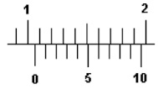
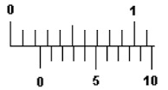
Using a Vernier Caliper
Find the FIRST pair of lines that match up perfectly.
Read the line number off the vernier (sliding) scale and add this to the measurement.
1.06
0.24

Slide 28



Uncertainty
Uncertainty is often assumed to be plus or minus half of the smallest division of the scale on the instrument.
$0.24±$ 0.05
$1.0±0.05$

