Slide 1
Kinematics

Slide 2
Kinematics
Kinematics: is the study of motion
Motion: is a change in an object’s location as measured by a particular observer.
Direction: the line an object moves along from a particular starting point.
Distance (d): the total length of the path travelled by an object in motion.

Slide 3
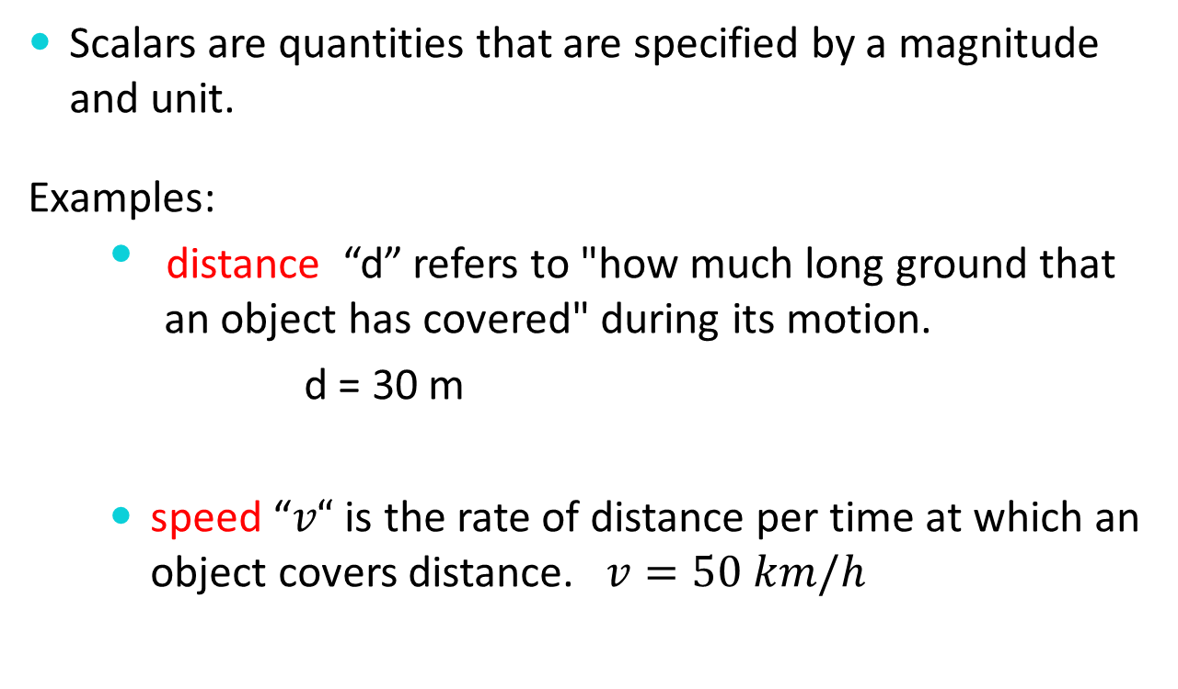
Scalars
Scalars are quantities that are specified by a magnitude and unit.
Examples:
distance “d” refers to "how much long ground that an object has covered" during its motion.
d = 30 m
speed “$v“$ is the rate of distance per time at which an object covers distance. $v=50 km/h$

Slide 4
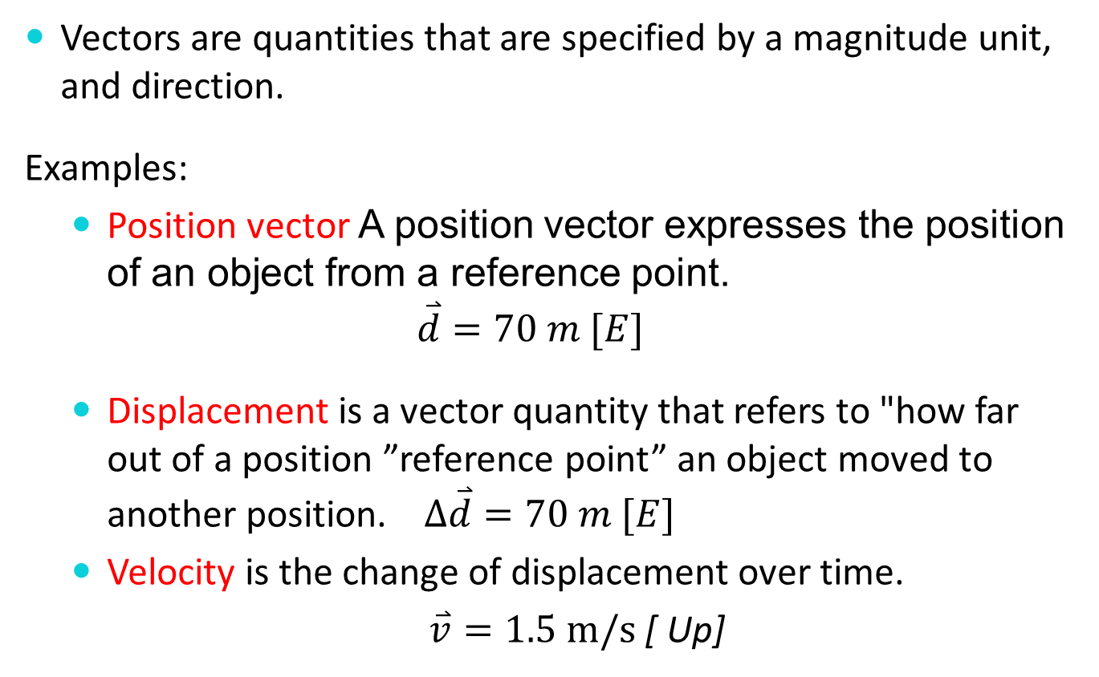
Vectors
Vectors are quantities that are specified by a magnitude unit, and direction.
Examples:
Position vector A position vector expresses the position of an object from a reference point.
$$\overset{⃑}{d}=70 m [E]$$
Displacement is a vector quantity that refers to "how far out of a position ”reference point” an object moved to another position. $∆\overset{⃑}{d}=70 m [E]$
Velocity is the change of displacement over time.
$\overset{⃑}{v}=1.5 m/s$ [ Up]

Slide 5

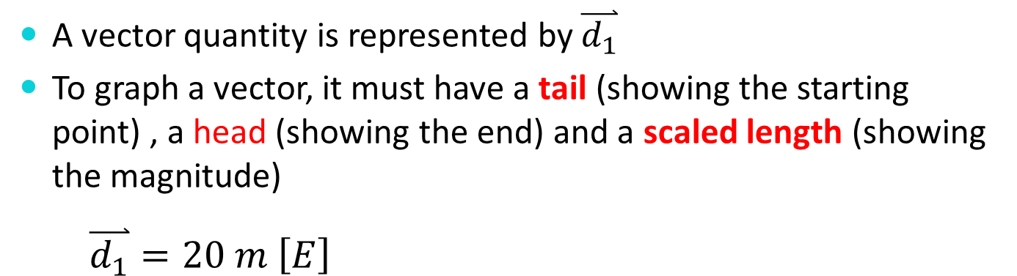
Vectors in One Dimension
A vector quantity is represented by $\overset{⃑}{d_{1}}$
To graph a vector, it must have a tail (showing the starting point) , a head (showing the end) and a scaled length (showing the magnitude)
$$\overset{⃑}{d_{1}}=20 m \left[E\right]$$
Scale 1 cm : 1 m
$$\overset{⃑}{d_{1}}=20 m$$
Reference Point

Slide 6
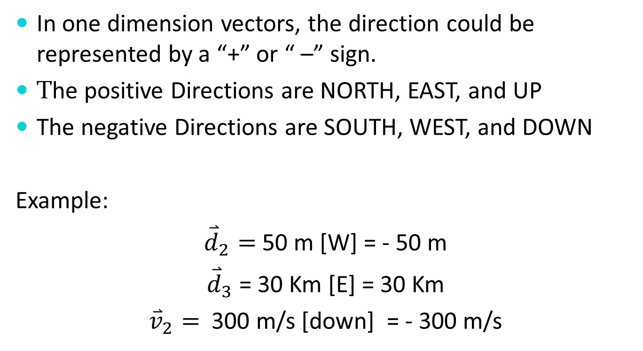
Vectors in One Dimension
In one dimension vectors, the direction could be represented by a “+” or “ –” sign.
The positive Directions are NORTH, EAST, and UP
The negative Directions are SOUTH, WEST, and DOWN
Example:
${\overset{⃑}{d}}_{2}=$50 m [W] = - 50 m
${\overset{⃑}{d}}_{3}$= 30 Km [E] = 30 Km
${\overset{⃑}{v}}_{2}=$ 300 m/s [down] = - 300 m/s

Slide 7
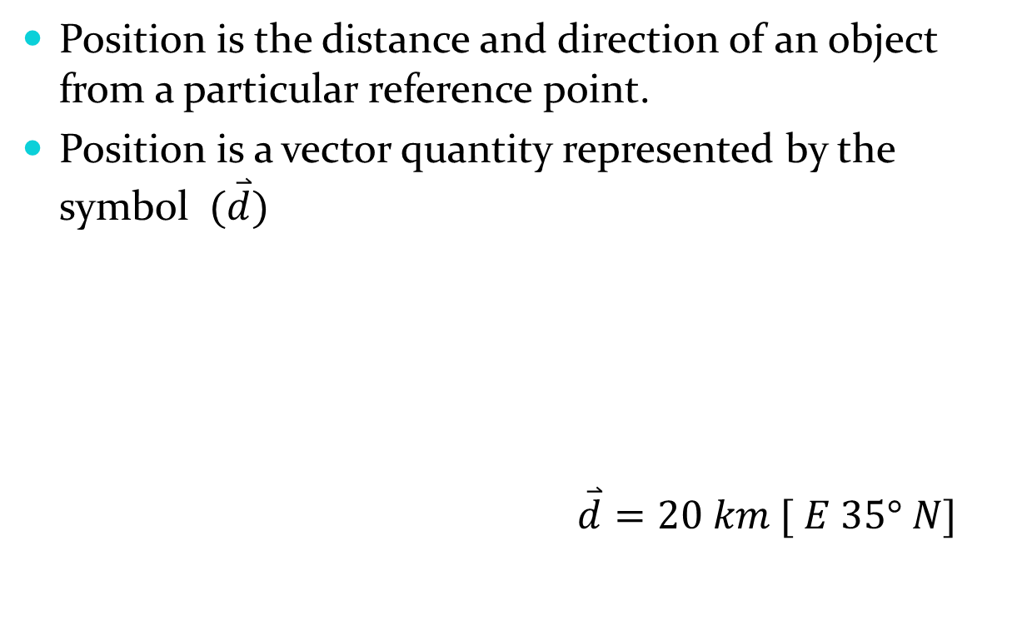

Position vector in Two Dimensions
Location
20 km
Reference point

Slide 8
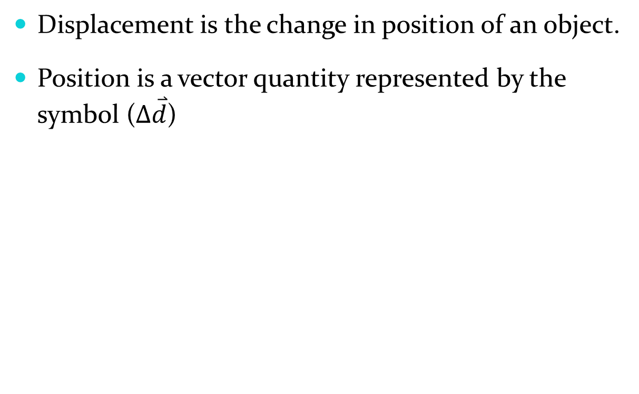


Displacement in Two dimensions
It is
Location 2
850 km
Location 1

Slide 9


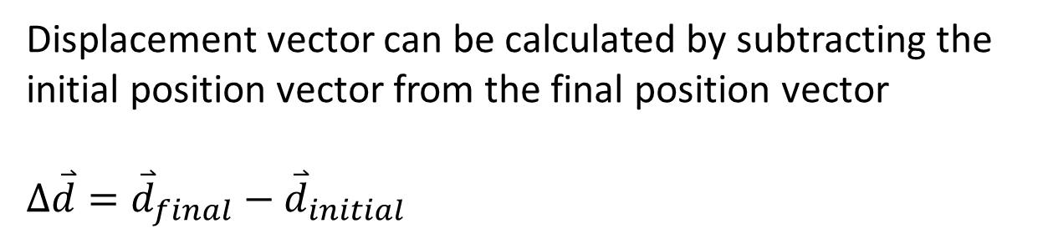

Displacement
Displacement vector can be calculated by subtracting the initial position vector from the final position vector
$$∆\overset{⃑}{d}={\overset{⃑}{d}}_{final}−{\overset{⃑}{d}}_{initial}$$
$${\overset{⃑}{d}}_{initial}$$
$$∆\overset{⃑}{d}$$
$${\overset{⃑}{d}}_{final}$$
Reference point

Slide 10


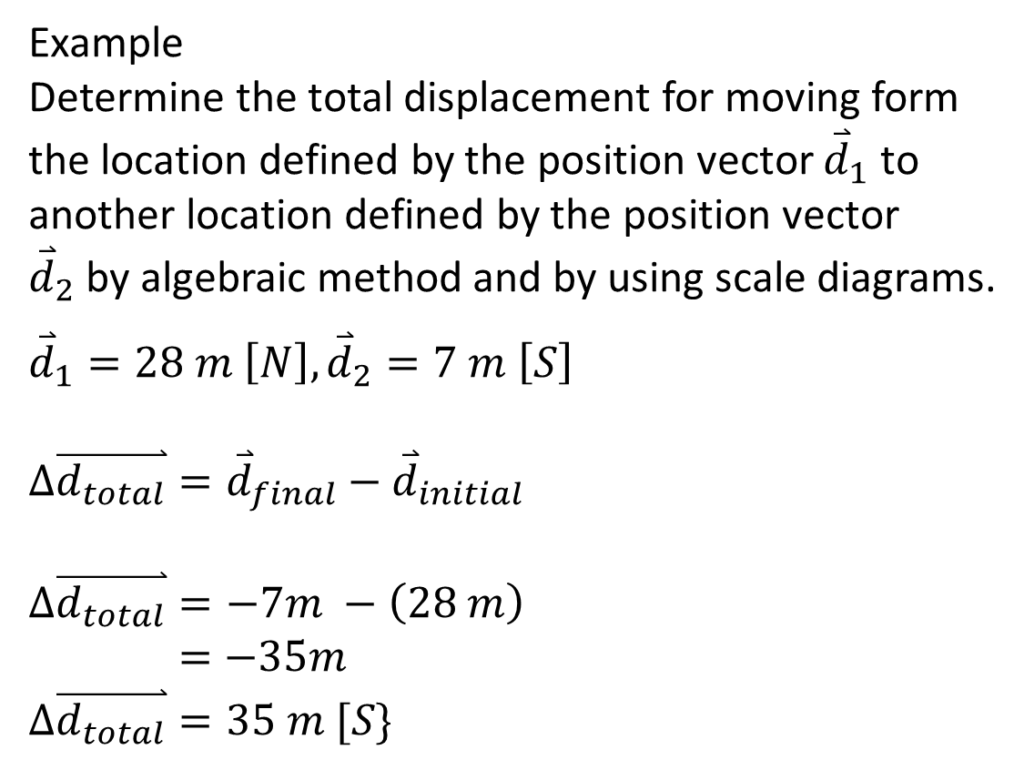

Example
Determine the total displacement for moving form the location defined by the position vector ${\overset{⃑}{d}}_{1}$ to another location defined by the position vector ${\overset{⃑}{d}}_{2}$by algebraic method and by using scale diagrams.
$${\overset{⃑}{d}}_{1}=28 m \left[N\right], {\overset{⃑}{d}}_{2}=7 m \left[S\right]$$
$$∆\overset{⃑}{d_{total}}={\overset{⃑}{d}}_{final}−{\overset{⃑}{d}}_{initial}$$
$$∆\overset{⃑}{d_{total}}=−7m −\left(28 m\right)$$
$$=−35m$$
$∆\overset{⃑}{d_{total}}=35 m [S\}$
$${\overset{⃑}{d}}_{initial}$$
$$∆\overset{⃑}{d}$$
Reference point
$${\overset{⃑}{d}}_{final}$$

Slide 11
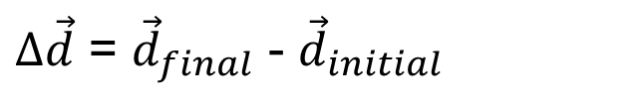



Displacement In Two Dimensions
displacement can be calculated by subtracting the initial position vector from the final position vector
Reference point

Slide 12
Displacement In Two Dimensions
Could be done graphically or mathematically
Reference point

Slide 13
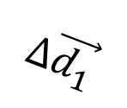
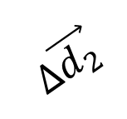
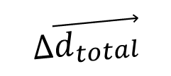
Total Displacement in Two Dimensions
Could be done graphically or mathematically

Slide 14
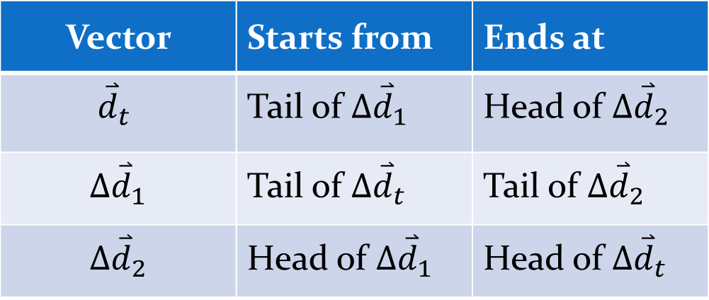
Vector | Starts from | Ends at
$${\overset{⃑}{d}}_{t}$$ | Tail of ${∆\overset{⃑}{d}}_{1}$ | Head of ${∆\overset{⃑}{d}}_{2}$
$${∆\overset{⃑}{d}}_{1}$$ | Tail of ${∆\overset{⃑}{d}}_{t}$ | Tail of ${∆\overset{⃑}{d}}_{2}$
$${∆\overset{⃑}{d}}_{2}$$ | Head of ${∆\overset{⃑}{d}}_{1}$ | Head of ${∆\overset{⃑}{d}}_{t}$

Slide 15
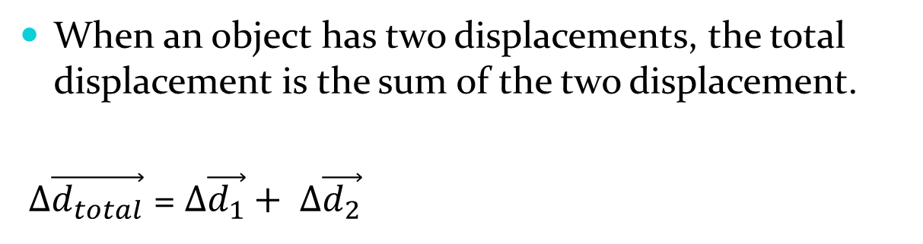




Total Displacement in One Dimension
$$∆\overset{⃑}{d_{total}}={∆\overset{⃑}{d}}_{1}+{∆\overset{⃑}{d}}_{2}$$
$${∆\overset{⃑}{d}}_{2}$$
$${∆\overset{⃑}{d}}_{1}$$
$$∆\overset{⃑}{d_{total}}$$
H W questions # 1 – 6 on page 13 of the textbook and question # 15, 17, 18, 19, 22, 23, 24 on pages 31 – 32 of the package.

Slide 16


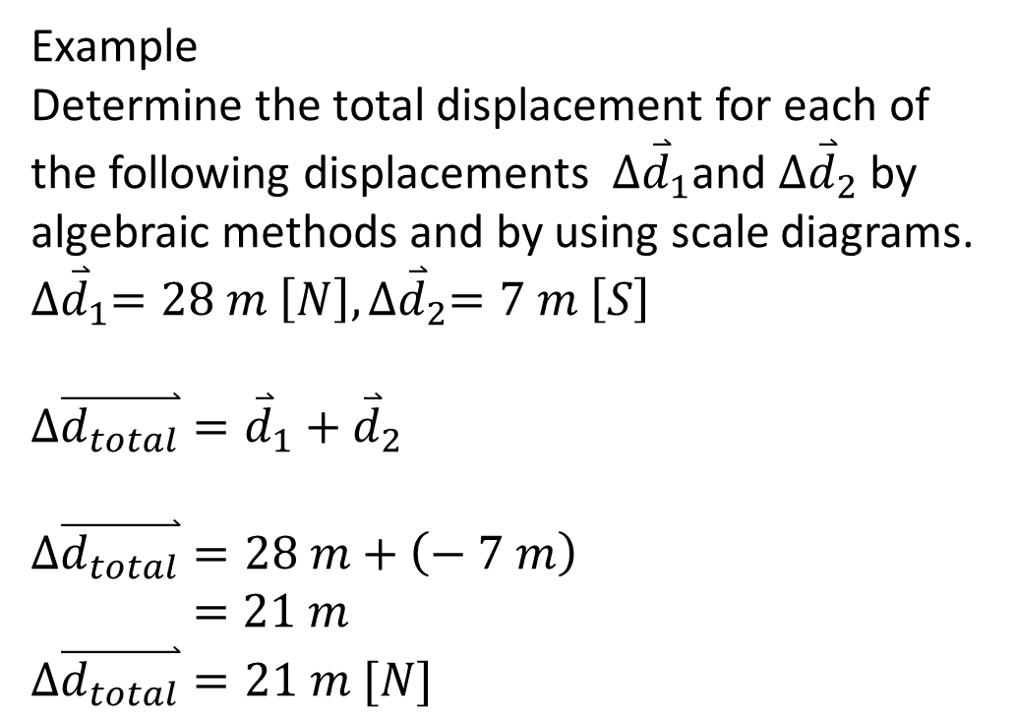

Example
Determine the total displacement for each of the following displacements $∆{\overset{⃑}{d}}_{1}$and ${∆\overset{⃑}{d}}_{2}$ by algebraic methods and by using scale diagrams.
$${∆\overset{⃑}{d}}_{1}=28 m \left[N\right], {∆\overset{⃑}{d}}_{2}=7 m \left[S\right]$$
$$∆\overset{⃑}{d_{total}}={\overset{⃑}{d}}_{1}+{\overset{⃑}{d}}_{2}$$
$$∆\overset{⃑}{d_{total}}=28 m+\left(− 7 m\right)$$
$$=21 m$$
$∆\overset{⃑}{d_{total}}=21 m [N]$
$$∆{\overset{⃑}{d}}_{2}$$
$${∆\overset{⃑}{d}}_{1}$$
$$∆\overset{⃑}{d_{total}}$$

Slide 17
Drawing Displacement/ Position Vs. Time Graph
we can collect data from a ride. Imagine a tape measure stretched out along the track from a marked point (Ticker Tape). Record the positions from that point at each 0.1 s interval as hey are displayed in Table.
Time (s) | Position (m)
0.0 | 0
0.1 | 4.0
0.2 | 8.0
0.3 | 12.0
0.4 | 16
0.5 | 20
0.6 | 24

Slide 18
Position Vs. Time in One Dimension Graph
Time is on the X-axis and position is on the Y-axis.

Slide 19
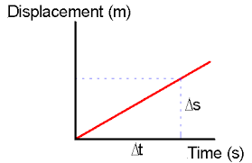
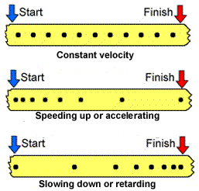
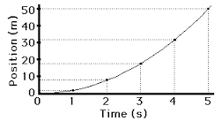
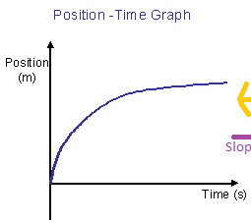
Position Vs. Time Graph in One Dimension

Slide 20
Position Vs. Time in One Dimension Graph
The given diagram recorded the time and the position for a car taking the school as a reference point.

Slide 21
Position Vs. Time in One Dimension Graph
The given data is organized in the table and graphed in the diagram.

Slide 22

Slope of Position Vs. Time graph in One Dimension
$$Slope= \frac{rise }{run}$$
$$= \frac{∆\overset{⃑}{d}}{∆t}=\frac{\left(40−0\right) m}{\left(10−0\right) s }$$
$$=\frac{40 m}{10 s}$$
$=4 m/s$
The unit of the slope shows
it is the velocity

Slide 23

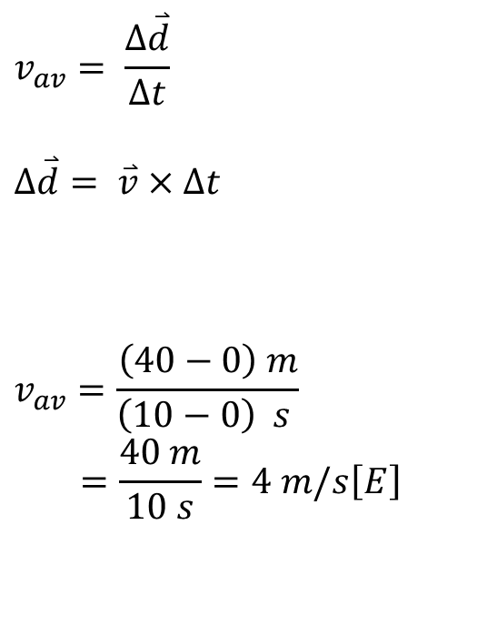
Average Velocity
The average velocity $v_{av}=$ the total displacement divided by the total time.
$$v_{av}= \frac{∆\overset{⃑}{d}}{∆t}$$
$$∆\overset{⃑}{d}= \overset{⃑}{v}×∆t$$
$$v_{av}=\frac{\left(40−0\right) m}{\left(10−0\right) s }$$
$$=\frac{40 m}{10 s}=4 m/s\left[E\right]$$

Slide 24
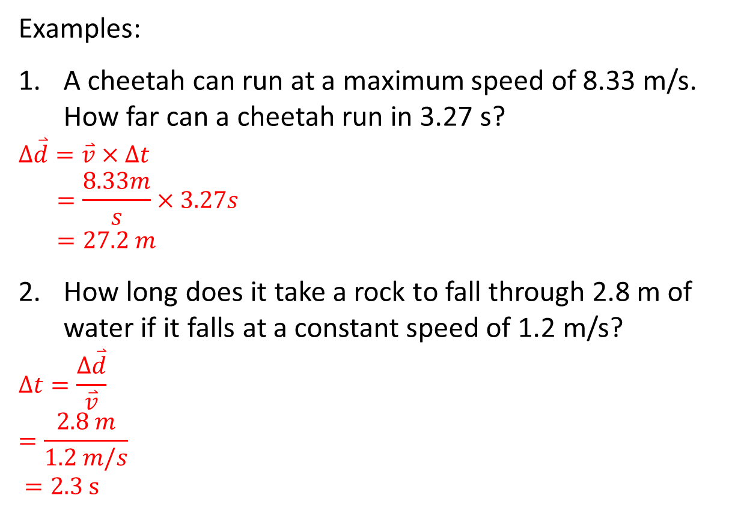
Examples:
A cheetah can run at a maximum speed of 8.33 m/s. How far can a cheetah run in 3.27 s?
$$∆\overset{⃑}{d}=\overset{⃑}{v}×∆t$$
$$=\frac{8.33m}{s}×3.27s$$
$$=27.2 m$$
How long does it take a rock to fall through 2.8 m of water if it falls at a constant speed of 1.2 m/s?
$$∆t=\frac{∆\overset{⃑}{d}}{\overset{⃑}{v}}$$
$$=\frac{2.8 m}{1.2 m/s}$$
$=2.3 s$

Slide 25
Instantaneous Velocity
To determine the instantaneous velocity of the object at a specific time, we must calculate the slope of the tangent of the line on the position–time graph at that time.

Slide 26
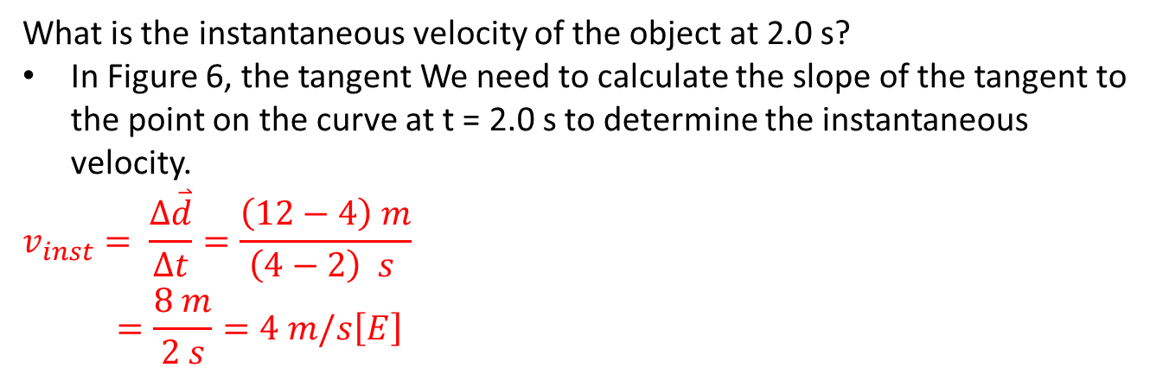
What is the instantaneous velocity of the object at 2.0 s?
In Figure 6, the tangent We need to calculate the slope of the tangent to the point on the curve at t = 2.0 s to determine the instantaneous velocity.
$$v_{inst}= \frac{∆\overset{⃑}{d}}{∆t}=\frac{\left(12−4\right) m}{\left(4−2\right) s }$$
$$=\frac{8 m}{2 s}=4 m/s\left[E\right]$$

Slide 27
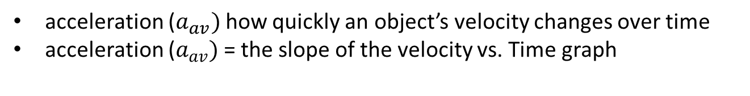
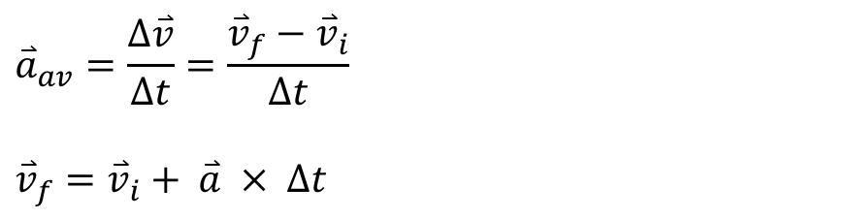
Acceleration in one Dimension
acceleration ($a_{av})$how quickly an object’s velocity changes over time
acceleration ($a_{av})$= the slope of the velocity vs. Time graph
$${\overset{⃑}{a}}_{av}=\frac{∆\overset{⃑}{v}}{∆t}=\frac{{\overset{⃑}{v}}_{f}−{\overset{⃑}{v}}_{i}}{∆t}$$
$${\overset{⃑}{v}}_{f}={\overset{⃑}{v}}_{i}+ \overset{⃑}{a} × ∆t$$

Slide 28
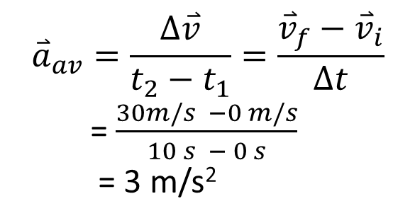
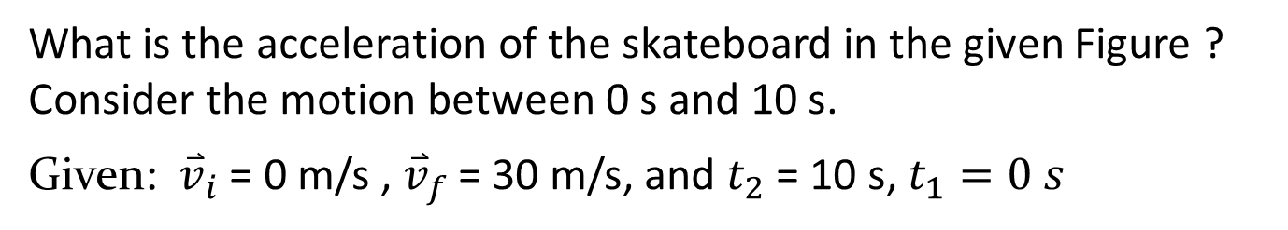
[N]
What is the acceleration of the skateboard in the given Figure ? Consider the motion between 0 s and 10 s.
Given: ${\overset{⃑}{v}}_{i}$ = 0 m/s , ${\overset{⃑}{v}}_{f}$ = 30 m/s, and $t_{2}$= 10 s, $t_{1}=0 s$
$${\overset{⃑}{a}}_{av}=\frac{∆\overset{⃑}{v}}{t_{2}−t_{1}}=\frac{{\overset{⃑}{v}}_{f}−{\overset{⃑}{v}}_{i}}{∆t}$$
= $\frac{30m/s −0 m/s}{10 s − 0 s}$
= 3 m/s²

Slide 29
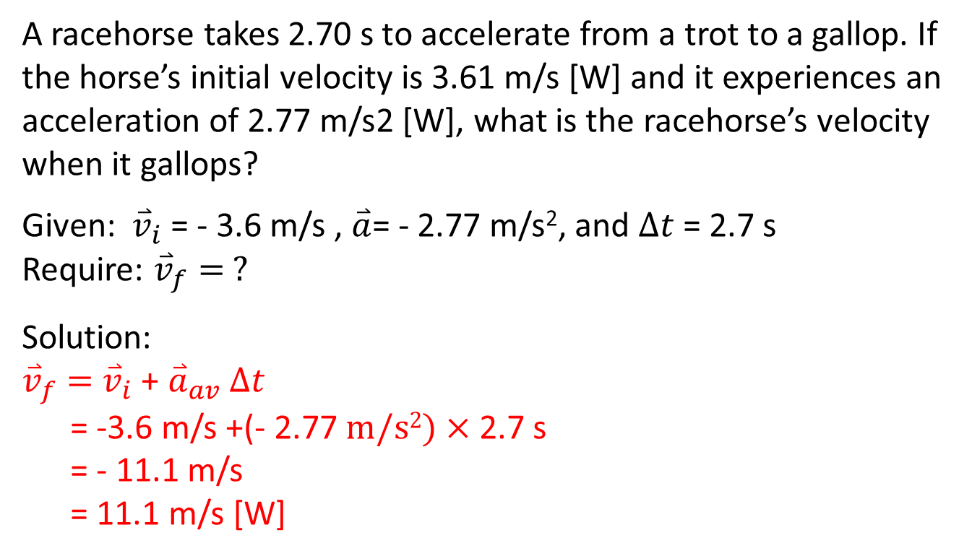
A racehorse takes 2.70 s to accelerate from a trot to a gallop. If the horse’s initial velocity is 3.61 m/s [W] and it experiences an acceleration of 2.77 m/s2 [W], what is the racehorse’s velocity when it gallops?
Given: ${\overset{⃑}{v}}_{i}$ = - 3.6 m/s , $\overset{⃑}{a}$= - 2.77 m/s², and $∆t$= 2.7 s
Require: ${\overset{⃑}{v}}_{f}= ?$
Solution:
${\overset{⃑}{v}}_{f}=$ ${\overset{⃑}{v}}_{i}$ + ${\overset{⃑}{a}}_{av}$ $∆t$
= -3.6 m/s +(- 2.77$m/s2)×$ 2.7 s
= - 11.1 m/s
= 11.1 m/s [W]
H W Questions # 1 – 5 on page 20 of the textbook

Slide 30
Constant Acceleration-Time Graphs
An acceleration-time graph is a graph that describes the acceleration of an object over time (acceleration on the y-axis and time on the x-axis).
The following diagram shows an acceleration-time graph for a cheetah.
[E]

Slide 31
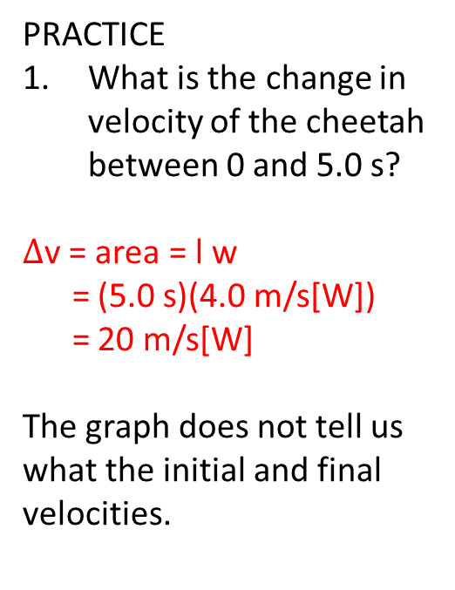
Acceleration-Time Graphs
The area under an acceleration-time graph gives the change in velocity of the object.
PRACTICE
What is the change in velocity of the cheetah between 0 and 5.0 s?
$∆$v = area = l w
= (5.0 s)(4.0 m/s[W])
= 20 m/s[W]
The graph does not tell us what the initial and final velocities.
[E]

Slide 32
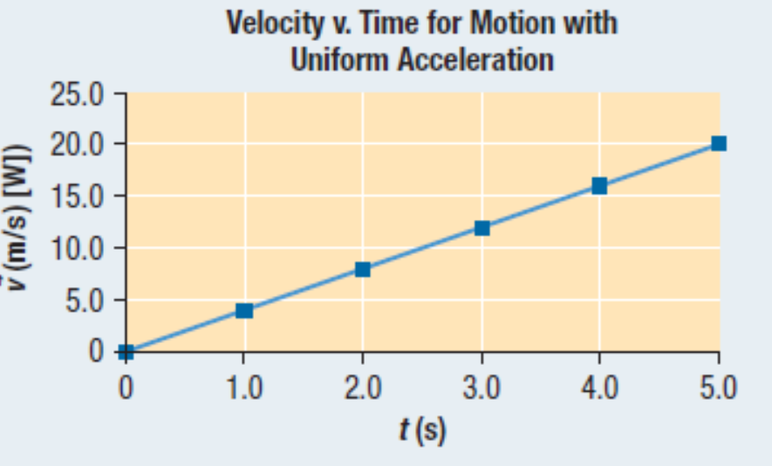
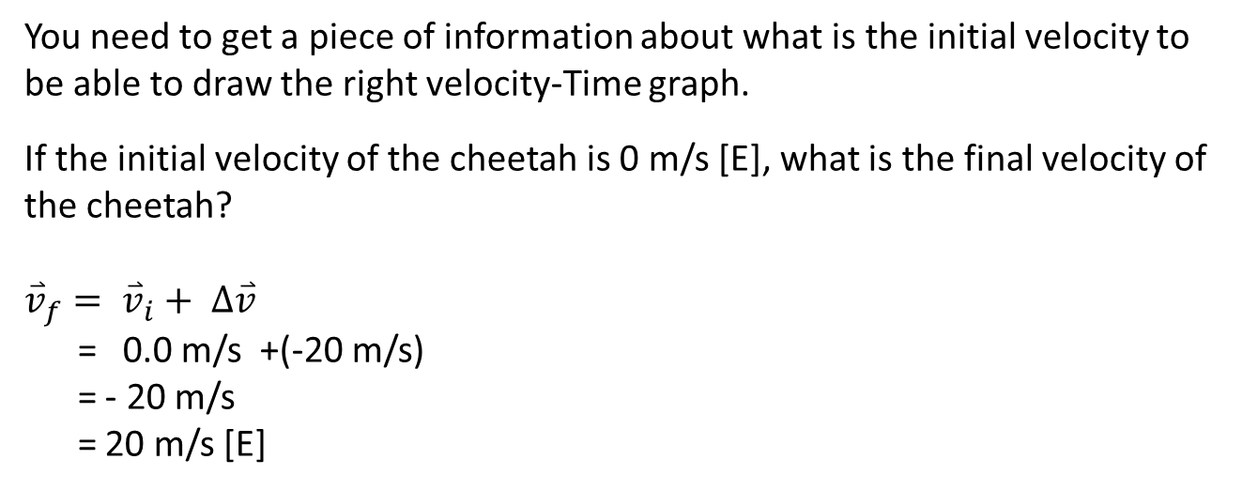
You need to get a piece of information about what is the initial velocity to be able to draw the right velocity-Time graph.
If the initial velocity of the cheetah is 0 m/s [E], what is the final velocity of the cheetah?
$${\overset{⃑}{v}}_{f}= {\overset{⃑}{v}}_{i}+ ∆\overset{⃑}{v}$$
= 0.0 m/s +(-20 m/s)
= - 20 m/s
= 20 m/s [E]
[E]

Slide 33
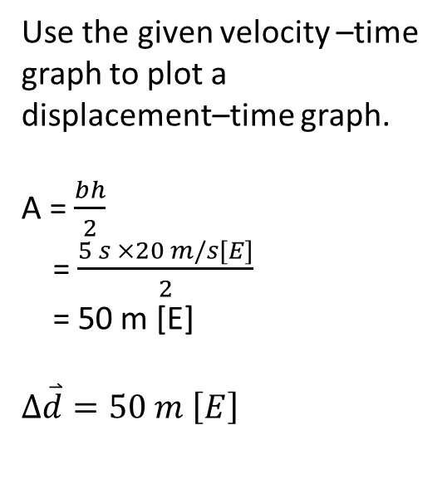
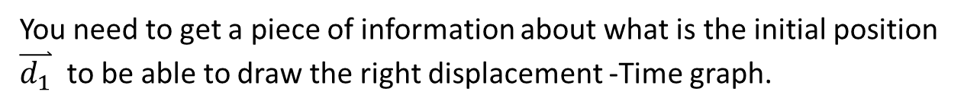
Creating a displacement –Time Graph from an Velocity –Time Graph:
Use the given velocity –time graph to plot a displacement–time graph.
A = $\frac{bh}{2}$
= $\frac{5 s ×20 m/s[E]}{2}$
= 50 m [E]
$$∆\overset{⃑}{d}=50 m \left[E\right]$$
[E]
You need to get a piece of information about what is the initial position $\overset{⃑}{d_{1}}$ to be able to draw the right displacement -Time graph.

Slide 34


If the initial position is ${\overset{⃑}{d}}_{i}=10 m [E]$, draw
the right displacement -Time graph.
$${\overset{⃑}{d}}_{f}={\overset{⃑}{d}}_{i}+∆\overset{⃑}{d}$$
${\overset{⃑}{d}}_{f}=$ 10 m [E] + 50 m [E]
= 60 m [E]
$\overset{⃑}{d}$ m/s [E]
60
10
t (s)
5
H W question 28 – 30, 34, 39, 40, 41, and 43 on pages 33 - 356 of the package and Questions # 1 – 11 on page 30 of the textbook.

