Slide 1
Adding Vectors Algebraically

Slide 2
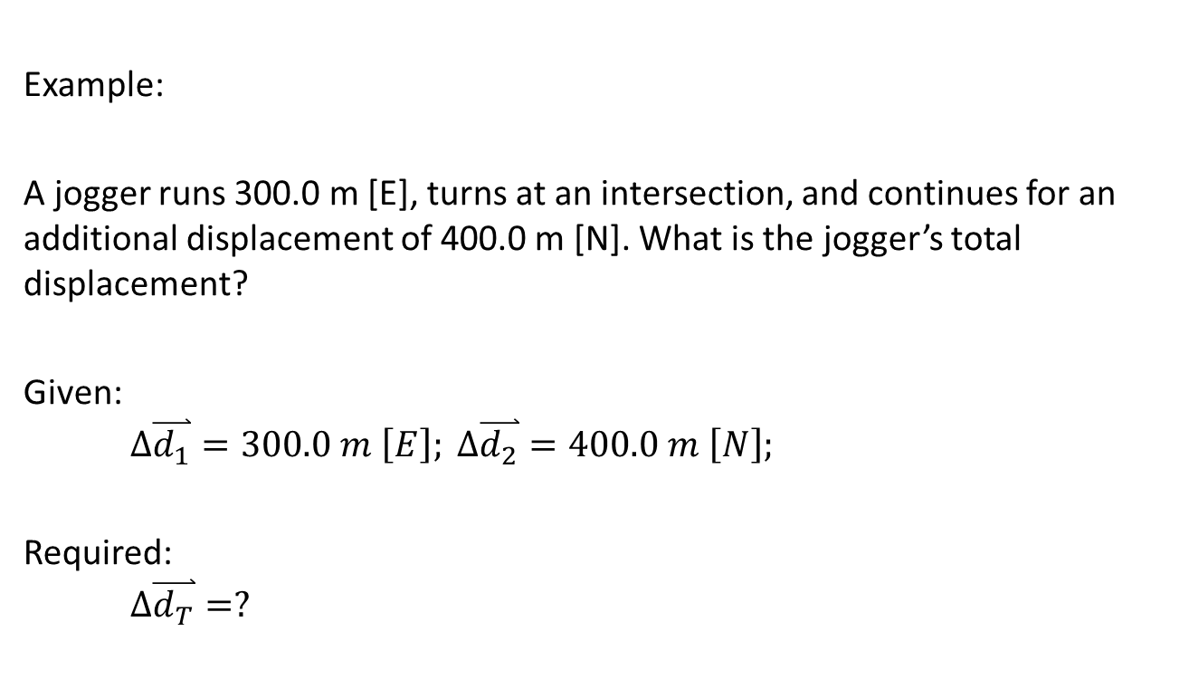
Adding Vectors in Two Dimensions Algebraically (Vectors in Right Triangles):
Example:
A jogger runs 300.0 m [E], turns at an intersection, and continues for an additional displacement of 400.0 m [N]. What is the jogger’s total displacement?
Given:
$$∆\overset{⃑}{d_{1}}=300.0 m \left[E\right]; ∆\overset{⃑}{d_{2}}=400.0 m \left[N\right];$$
Required:
$$∆\overset{⃑}{d_{T}}=?$$

Slide 3

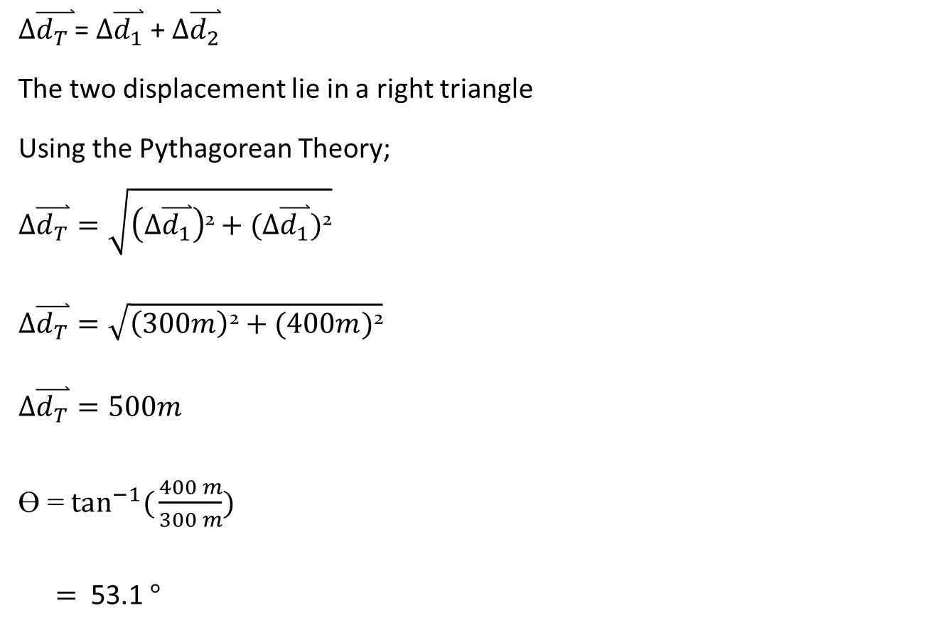
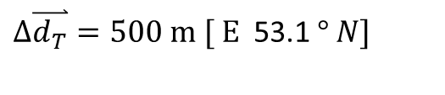
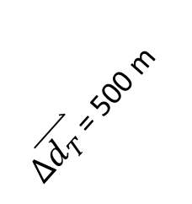

$∆\overset{⃑}{d_{T }}$= $∆\overset{⃑}{d_{1}}$ + $∆\overset{⃑}{d_{2}}$
The two displacement lie in a right triangle
Using the Pythagorean Theory;
$$∆\overset{⃑}{d_{T}}=\sqrt{\left(∆\overset{⃑}{d_{1}}\right)\text{2}+(∆\overset{⃑}{d_{1}})\text{2}}$$
$$∆\overset{⃑}{d_{T}}=\sqrt{\left(300m\right)\text{2}+(400m)\text{2}}$$
$$∆\overset{⃑}{d_{T}}=500m$$
Ɵ = $\tan^{−1}({\frac{400 m}{300 m})}$
$=$ 53.1 $°$
$∆\overset{⃑}{d_{T }}$= 500 m
$∆\overset{⃑}{d_{2}}$= 400 m
Ɵ
$∆\overset{⃑}{d_{1}}=$300 m
$∆\overset{⃑}{d_{T}}=500 m [ E$ 53.1 $° N]$

Slide 4
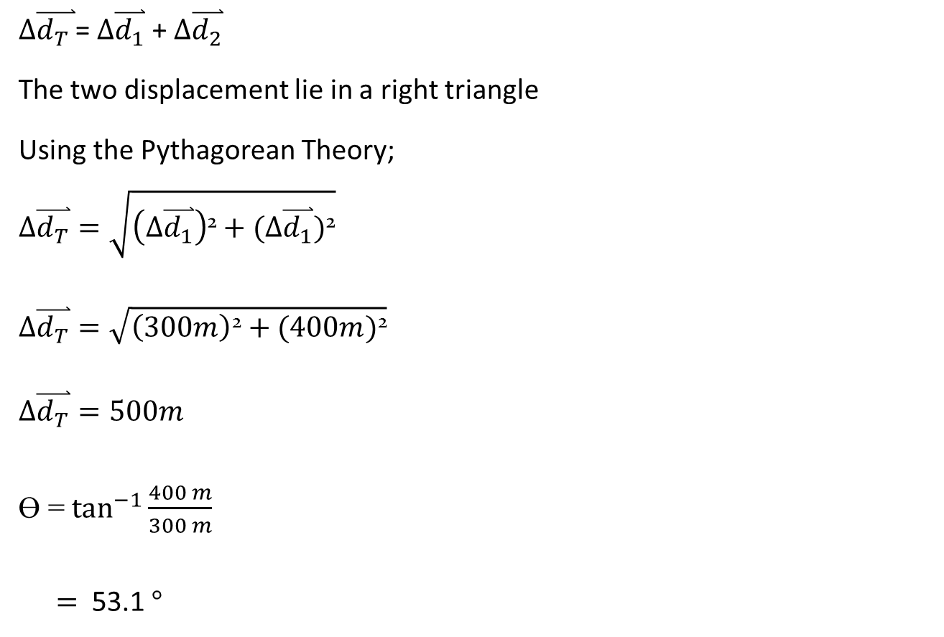
Breaking Down a Vector into two perpendicular components.
To break down the vector
$∆\overset{⃑}{d}=5.8 m \left[S 38° W\right]$ into two perpendicular components.
Extend the main direction and a perpendicular to it connecting the head and the tail of the vector.
Arrange the two vectors head to tail starting from the tail of the vector.
38 $°$
$∆\overset{⃑}{d_{ }}$= 5.8 m
$$∆\overset{⃑}{d_{y}}$$
$$∆\overset{⃑}{d_{x}}$$

Slide 5

The horizontal “X” component is the opposite side of the angle.
$\sin{{38}^{o}= \frac{opp}{adj}}$ = $\frac{∆\overset{⃑}{d_{x}}}{∆\overset{⃑}{d}}$
$$∆\overset{⃑}{d_{x}}= ∆\overset{⃑}{d} × \sin{{38}^{o}}$$
$$∆\overset{⃑}{d_{x}}=5.8 \sin{{38}^{o} m [W]}$$
$$∆\overset{⃑}{d_{x}}=3.57 m [W]$$
38 $°$
$∆\overset{⃑}{d_{ }}$= 5.8 m
$∆\overset{⃑}{d_{x}}=5.8 \sin{{38}^{o}}$ m

Slide 6


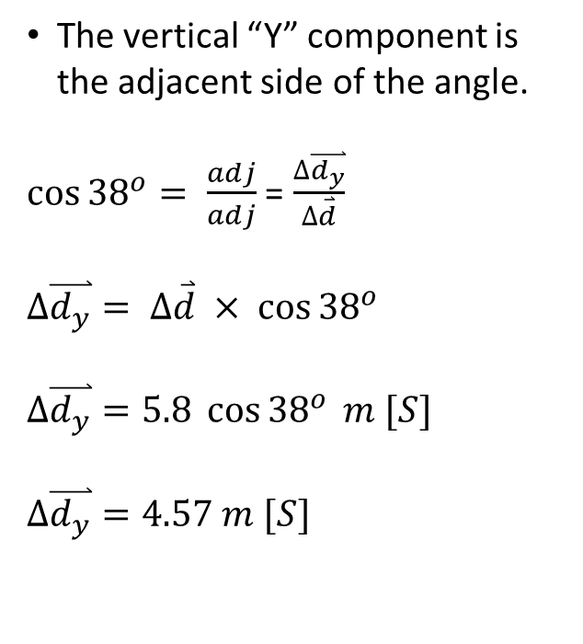
The vertical “Y” component is the adjacent side of the angle.
$\cos{{38}^{o}= \frac{adj}{adj}}$ = $\frac{∆\overset{⃑}{d_{y}}}{∆\overset{⃑}{d}}$
$$∆\overset{⃑}{d_{y}}= ∆\overset{⃑}{d} × \cos{{38}^{o}}$$
$$∆\overset{⃑}{d_{y}}=5.8 \cos{{38}^{o}} m [S]$$
$$∆\overset{⃑}{d_{y}}=4.57 m [S]$$
38 $°$
$∆\overset{⃑}{d_{ }}$= 5.8 m
$∆\overset{⃑}{d_{y}}=$ $5.8 \cos{{38}^{o}}$
$$∆\overset{⃑}{d_{x}}=5.8 \sin{{38}^{o}}$$

Slide 7

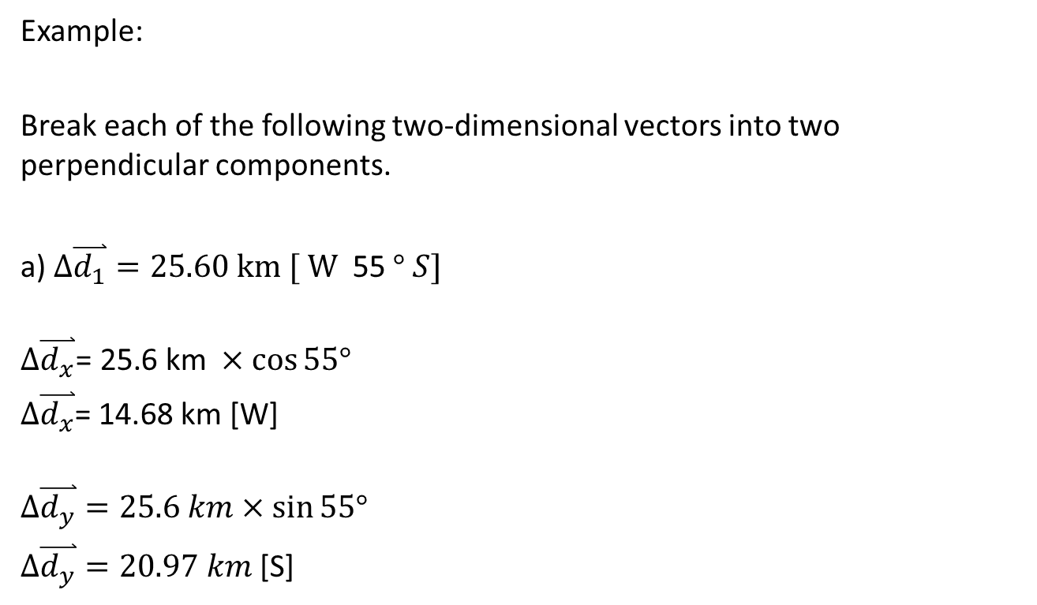

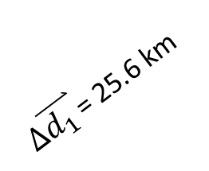

Example:
Break each of the following two-dimensional vectors into two perpendicular components.
a) $∆\overset{⃑}{d_{1}}=25.60 km [ W$ 55 $° S]$
$$∆\overset{⃑}{d_{x}}\text{= 25.6 }\text{km} ×\cos{55°}$$
$∆\overset{⃑}{d_{x}}$= 14.68 km [W]
$$∆\overset{⃑}{d_{y}}=25.6 km×\sin{55°}$$
$∆\overset{⃑}{d_{y}}=20.97 km$ [S]
$∆\overset{⃑}{d_{x}}$= 25.6 km $×\cos{55°}$
55 $°$
$$∆\overset{⃑}{d_{y}}=25.6 km×\sin{55°}$$
$∆\overset{⃑}{d_{1 }}$= 25.6 km

Slide 8

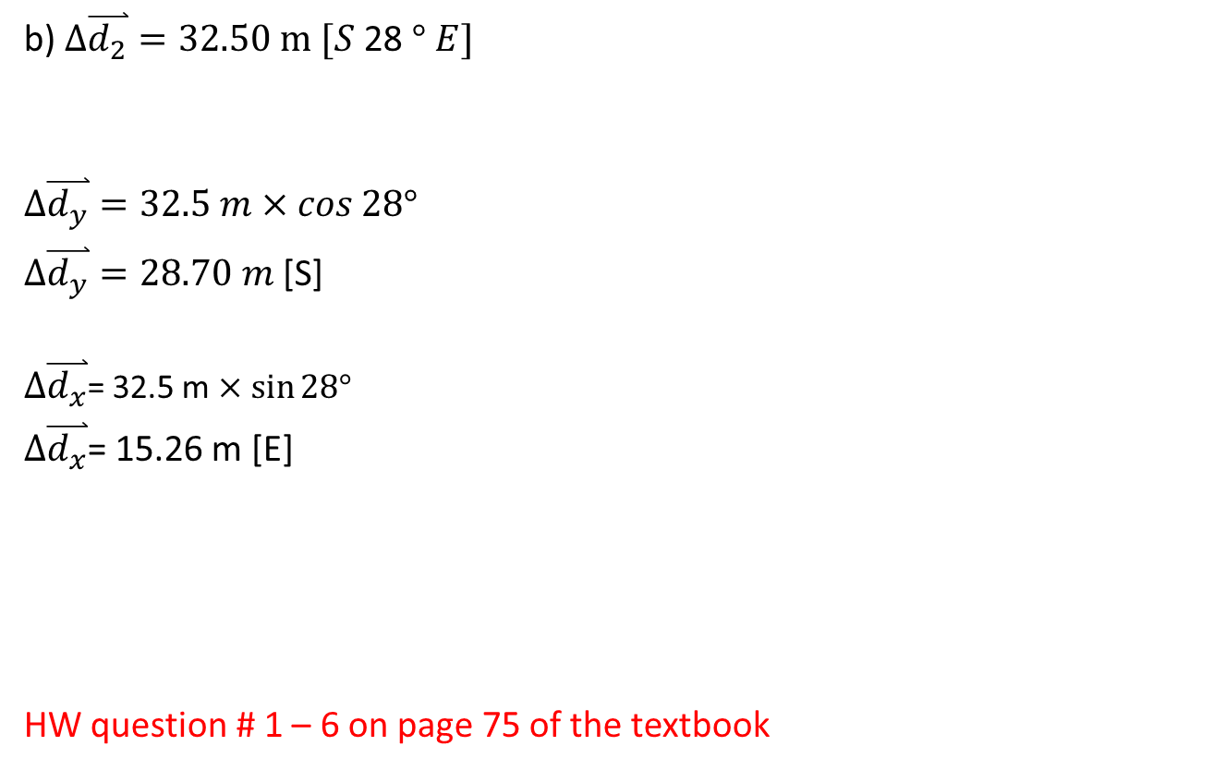

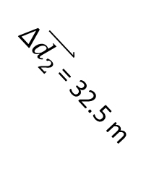

b) $∆\overset{⃑}{d_{2}}=32.50 m [S$28 $° E]$
$$∆\overset{⃑}{d_{y}}=32.5 m×\cos{28°}$$
$∆\overset{⃑}{d_{y}}=28.70 m$ [S]
$∆\overset{⃑}{d_{x}}$= 32.5 m $×\sin{28°}$
$∆\overset{⃑}{d_{x}}$= 15.26 m [E]
HW question # 1 – 6 on page 75 of the textbook
28 $°$
$∆\overset{⃑}{d_{2 }}$= 32.5 m
$$∆\overset{⃑}{d_{y}}=32.5 m×\cos{28°}$$
$∆\overset{⃑}{d_{x}}$= 32.5 m $×\sin{28°}$

Slide 9






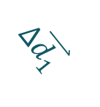
Adding Two 2-D Vectors by the Component Method
The X component of the resultant vector $∆\overset{⃑}{d_{Tx}}$ equals the sum of the x components $∆\overset{⃑}{d_{1x}}$ and $∆\overset{⃑}{d_{2x}}$ .
The Y component of the resultant vector $∆\overset{⃑}{d_{Ty}}$ equals the sum of the Y components $∆\overset{⃑}{d_{1y}}$ and $∆\overset{⃑}{d_{2y}}$ .
$$∆\overset{⃑}{d_{2x}}$$
$$∆\overset{⃑}{d_{2}}$$
$$∆\overset{⃑}{d_{2y}}$$
$$∆\overset{⃑}{d_{1x}}$$
$$∆\overset{⃑}{d_{Ty}}$$
$$∆\overset{⃑}{d_{T}}$$
$$∆\overset{⃑}{d_{1}}$$
$$∆\overset{⃑}{d_{1y}}$$
$$∆\overset{⃑}{d_{Tx}}$$

Slide 10
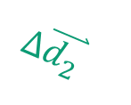
Adding Two Vectors by the Component Method
$$∆\overset{⃑}{d_{2x}}$$
$$∆\overset{⃑}{d_{2}}$$
$$∆\overset{⃑}{d_{2y}}$$
$$∆\overset{⃑}{d_{Tx}}=∆\overset{⃑}{d_{1x}}+∆\overset{⃑}{d_{2x}}$$
$∆\overset{⃑}{d_{Ty}}=∆\overset{⃑}{d_{1y}}$ + $∆\overset{⃑}{d_{2y}}$
$$∆\overset{⃑}{d_{1x}}$$
$$∆\overset{⃑}{d_{1}}$$
$$∆\overset{⃑}{d_{1y}}$$

Slide 11

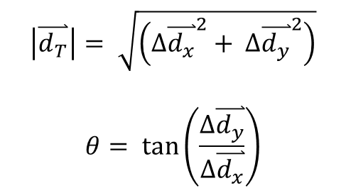

Adding Two Vectors by the Component Method
$$\left|\overset{⃑}{d_{T}}\right|= \sqrt{\left({∆\overset{⃑}{d_{x}}}^{2}+ ∆{\overset{⃑}{d_{y}}}^{2}\right)}$$
$$θ= \tan\left(\frac{∆\overset{⃑}{d_{y}}}{∆\overset{⃑}{d_{x}}}\right)$$
$$∆\overset{⃑}{d_{y}}$$
$$∆\overset{⃑}{d_{T}}$$
$$θ$$
$$∆\overset{⃑}{d_{x}}$$

Slide 12
Adding Displacement Vectors by Components

Slide 13
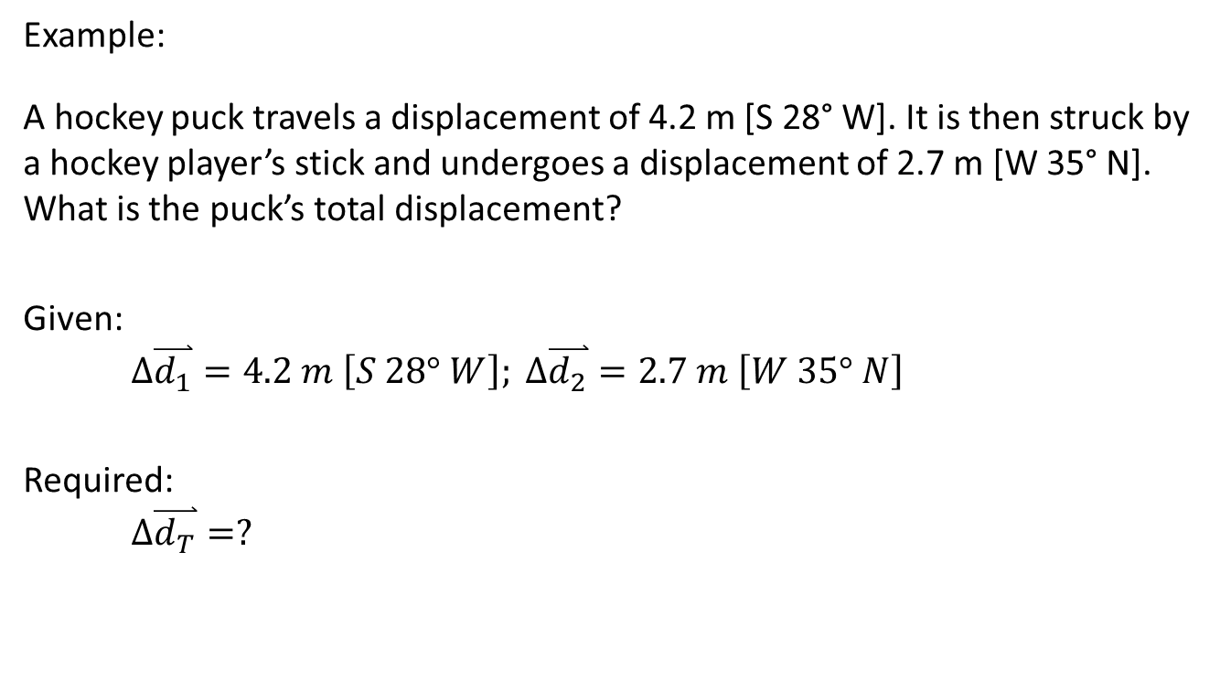
Example:
A hockey puck travels a displacement of 4.2 m [S 28° W]. It is then struck by a hockey player’s stick and undergoes a displacement of 2.7 m [W 35° N]. What is the puck’s total displacement?
Given:
$$∆\overset{⃑}{d_{1}}=4.2 m \left[S 28° W\right]; ∆\overset{⃑}{d_{2}}=2.7 m \left[W 35° N\right]$$
Required:
$$∆\overset{⃑}{d_{T}}=?$$

Slide 14



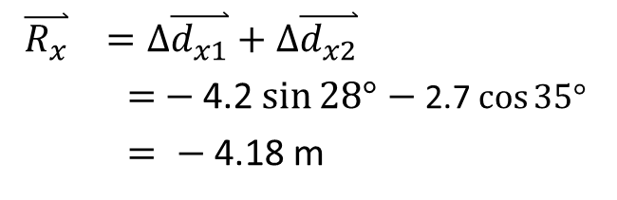


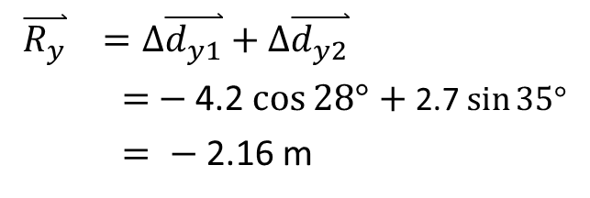
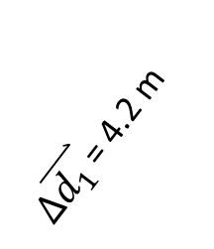


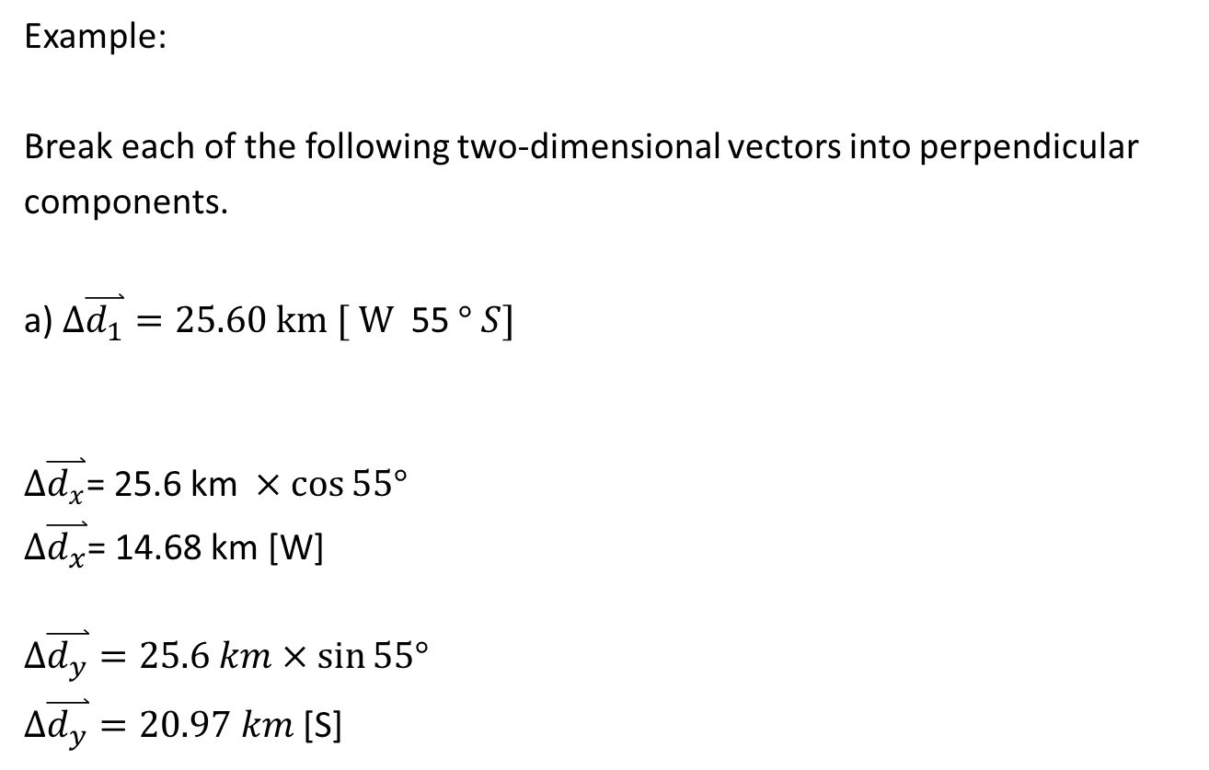
$∆\overset{⃑}{d_{1}}=4.2 m \left[S 28° W\right] ∆\overset{⃑}{d_{2}}=2.7 m \left[W 35° N\right]$
28 $°$
$∆\overset{⃑}{d_{1 }}$= 4.2 m
$$∆\overset{⃑}{d_{y1}}=4.2 \cos{28°}$$
$∆\overset{⃑}{d_{2 }}$= 2.7 m
$∆\overset{⃑}{d_{y2}}=$ 2.7 $\sin{35°}$
35 $°$
$∆\overset{⃑}{d_{x1}}$= 4.2 $\sin{28°}$
$∆\overset{⃑}{d_{x2} }$= 2.7 $\cos{35°}$
$\overset{⃑}{R_{y}} =∆\overset{⃑}{d_{y1}}+∆\overset{⃑}{d_{y2}}$
$=$ $−$4.2 $\cos{28°}$ $+$ 2.7 $\sin{35°}$
$= −$ 2.16 m
$\overset{⃑}{R_{x}} =∆\overset{⃑}{d_{x1}}+∆\overset{⃑}{d_{x2}}$
$=$ $−$4.2 $\sin{28°}$ $−$ 2.7 $\cos{35°}$
$= −$ 4.18 m

Slide 15



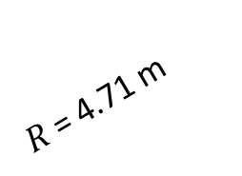

$\overset{⃑}{R_{x}} =−$ 4.18 m
$\overset{⃑}{R_{y}} =−$ 2.16 m
$$\left|\overset{⃑}{R}\right|=\sqrt{\left(R_{x}\right)2+\left(R_{y}\right)2}$$
$=\sqrt{\left(4.18\right)2+\left(2.16\right)2}$
$= 4.71 m$
$$θ=\tan^{−1}\left(\frac{2.16}{4.18}\right)$$
$=27.3°$
$∆\overset{⃑}{d_{T}}=4.7$1 m [ W 27.3$° S]$
$\overset{⃑}{R_{x} }$= 4.18 m
27.3 $°$
$$R_{y}=2.16 m$$
$R$= 4.71 m

Slide 16

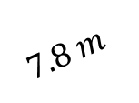

Example:
A sailboat travels 6.3 m [S 17°W], and then moves 7.8 m [E 25°N]. What is the sailboat’s total displacement?.
Given:
$$7.8 m$$
6.3 m
$$17°$$
$$25°$$

Slide 17






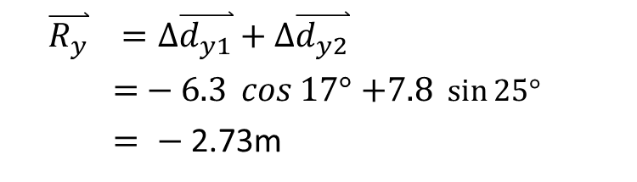
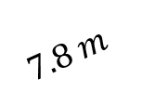
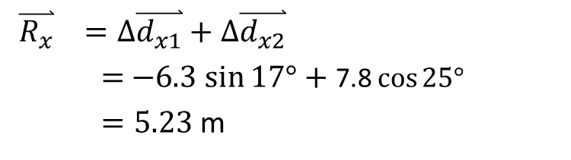
$$7.8 m$$
6.3 m
$$17°$$
7.8 $\sin{25° }$
6.3 $\cos{ 17° }$
$$25°$$
7.8 $\cos{25° }$
6.3 $\sin{17° }$
$\overset{⃑}{R_{x}} =∆\overset{⃑}{d_{x1}}+∆\overset{⃑}{d_{x2}}$
$=$ $−6.3$ $\sin{17°}$ $+$ 7.8 $\cos{25°}$
$=5.23$ m
$\overset{⃑}{R_{y}} =∆\overset{⃑}{d_{y1}}+∆\overset{⃑}{d_{y2}}$
$=$ $− 6.3 \cos{17°}$ $+7.8 \sin{25°}$
$= −$ 2.73m

Slide 18

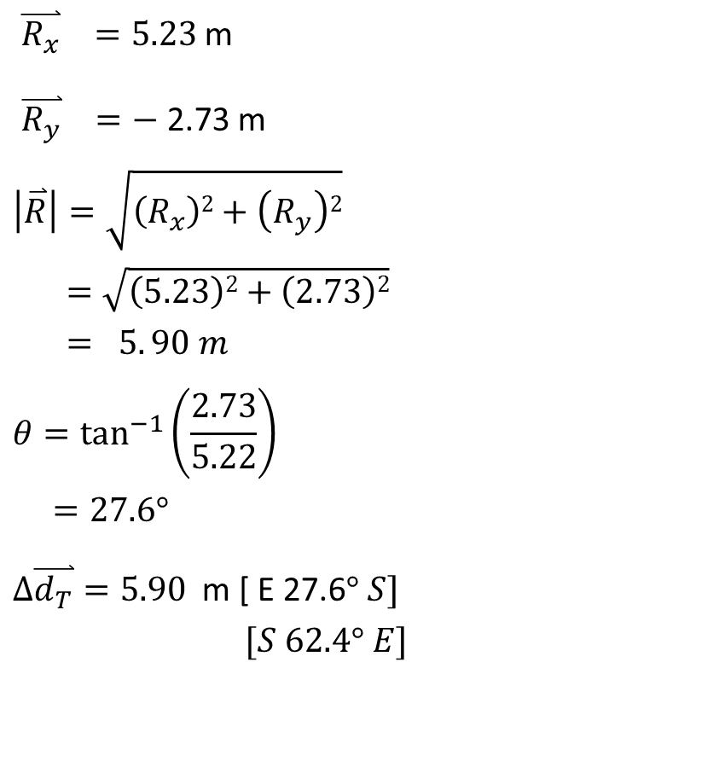

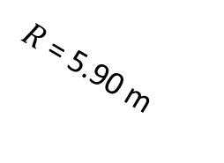

$\overset{⃑}{R_{x}} =5.23$m
$\overset{⃑}{R_{y}} =−$ 2.73 m
$$\left|\overset{⃑}{R}\right|=\sqrt{\left(R_{x}\right)2+\left(R_{y}\right)2}$$
$=\sqrt{\left(5.23\right)2+\left(2.73\right)2}$
$= 5. 90 m$
$$θ=\tan^{−1}\left(\frac{2.73}{5.22}\right)$$
$=27.6°$
$∆\overset{⃑}{d_{T}}=5.90$ m [ E 27.6$° S]$
$[S 62.4° E]$
$\overset{⃑}{R_{x} }$= 5.23 m
27.6 $°$
$$R_{y}=2.73 m$$
$R$= 5.90 m
H W questions # 7 – 10 on page 75 of the textbook using components Method

Slide 19
Adding Displacement Vectors by Trigonometry
A sailboat travels 23 km [E25°N], and then moves 45 km [N40°W]. What is the sailboat’s total displacement?.
Method 2: Using Trigonometry
Given:
23 km
45 km
25º
40º

Slide 20
45 km
23 km
25º
40º

Slide 21
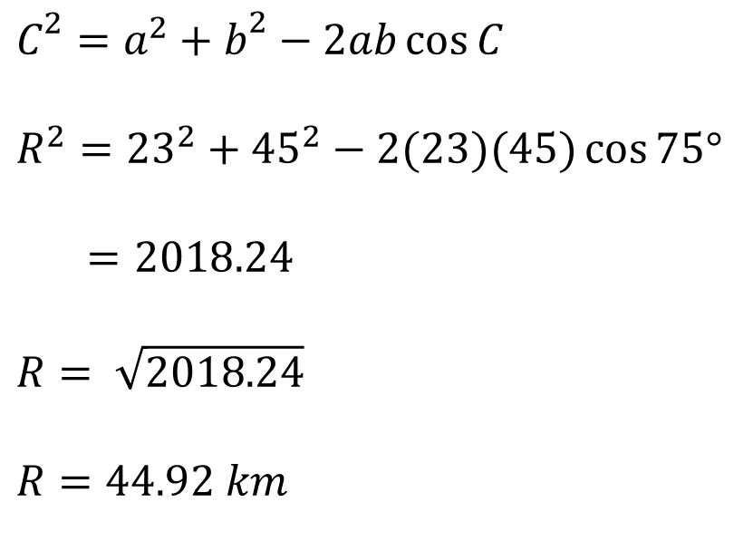

$$C^{2}=a^{2}+b^{2}−2ab\cos{C}$$
$$R^{2}={23}^{2}+{45}^{2}−2(23)(45)\cos{75°}$$
$=2018.24$
$$R= \sqrt{2018.24}$$
$$R=44.92 km$$
45 km
R
40º
75º
23 km
65º
Φ
25º
$$180°−\left(65°+40°\right)=75°$$

Slide 22
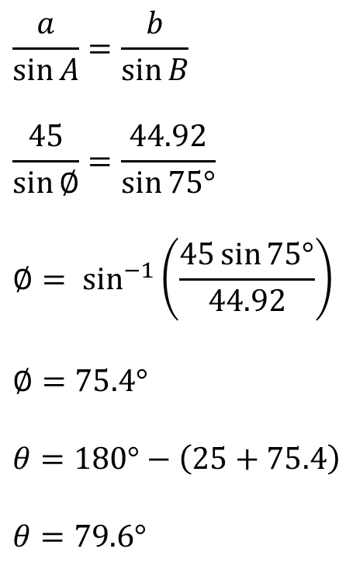
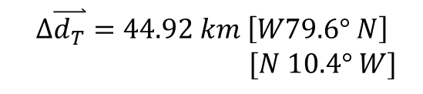

$$\frac{a}{\sin{A}}=\frac{b}{\sin{B}}$$
$$\frac{45}{\sin{∅}}=\frac{44.92}{\sin{75°}}$$
$$∅= \sin^{−1}\left(\frac{45\sin{75°}}{44.92}\right)$$
$$∅=75.4°$$
$$θ=180°−\left(25+75.4\right)$$
$$θ=79.6°$$
45 km
44.92 km
75º
23 km
$$θ$$
Φ
25º
$$∆\overset{⃑}{d_{T}}=44.92 km \left[W79.6° N\right]$$
$[N 10.4° W]$

Slide 23
The last example:
A sailboat travels 6.3 m [S 17°W], and then moves 7.8 m [E 25°N]. What is the sailboat’s total displacement?.
Method 1: Vector Addition Using Component
Given:
$$7.8 m$$
6.3 m
$$17°$$
$$25°$$

Slide 24
$$7.8 m$$
6.3 m
$$17°$$
7.8 $\sin{25° }$
6.3 $\cos{ 17° }$
$$25°$$
7.8 $\cos{25° }$
6.3 $\sin{17° }$
$\overset{⃑}{R_{x}} =∆\overset{⃑}{d_{x1}}+∆\overset{⃑}{d_{x2}}$
$=$ $−6.3$ $\sin{17°}$ $+$ 7.8 $\cos{25°}$
$=5.23$ m
$\overset{⃑}{R_{y}} =∆\overset{⃑}{d_{y1}}+∆\overset{⃑}{d_{y2}}$
$=$ $− 6.3 \cos{17°}$ $+7.8 \sin{25°}$
$= −$ 2.73m

Slide 25
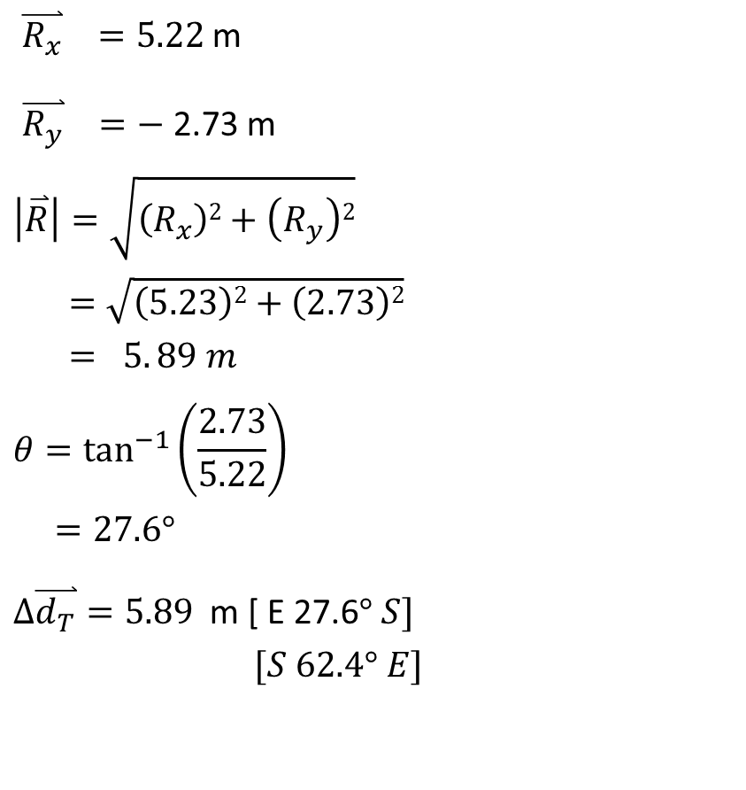

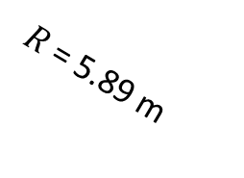

$\overset{⃑}{R_{x}} =5.22$m
$\overset{⃑}{R_{y}} =−$ 2.73 m
$$\left|\overset{⃑}{R}\right|=\sqrt{\left(R_{x}\right)2+\left(R_{y}\right)2}$$
$=\sqrt{\left(5.23\right)2+\left(2.73\right)2}$
$= 5. 89 m$
$$θ=\tan^{−1}\left(\frac{2.73}{5.22}\right)$$
$=27.6°$
$∆\overset{⃑}{d_{T}}=5.89$ m [ E 27.6$° S]$
$[S 62.4° E]$
$\overset{⃑}{R_{x} }$= 5.22 m
27.8 $°$
$$R_{y}=2.73 m$$
$R$= 5.89 m

Slide 26
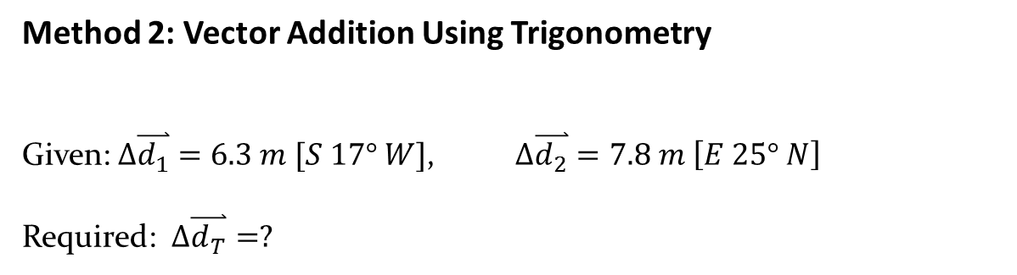
Method 2: Vector Addition Using Trigonometry
Given: $∆\overset{⃑}{d_{1}}=6.3 m [S 17° W]$, $∆\overset{⃑}{d_{2}}=7.8 m \left[E 25° N\right]$
Required: $∆\overset{⃑}{d_{T}}=?$
6.3 m
$$7.8 m$$
$$17°$$
$$25°$$

Slide 27
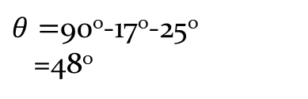


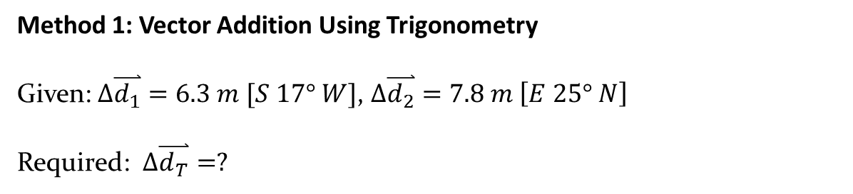

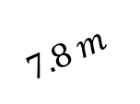
Method 1: Vector Addition Using Trigonometry
Given: $∆\overset{⃑}{d_{1}}=6.3 m [S 17° W]$, $∆\overset{⃑}{d_{2}}=7.8 m \left[E 25° N\right]$
Required: $∆\overset{⃑}{d_{T}}=?$
$θ=$90º-17º-25º
=48º
$$17°$$
6.3 m
$$7.8 m$$
$$17°$$
$$25°$$
$$48°$$

Slide 28
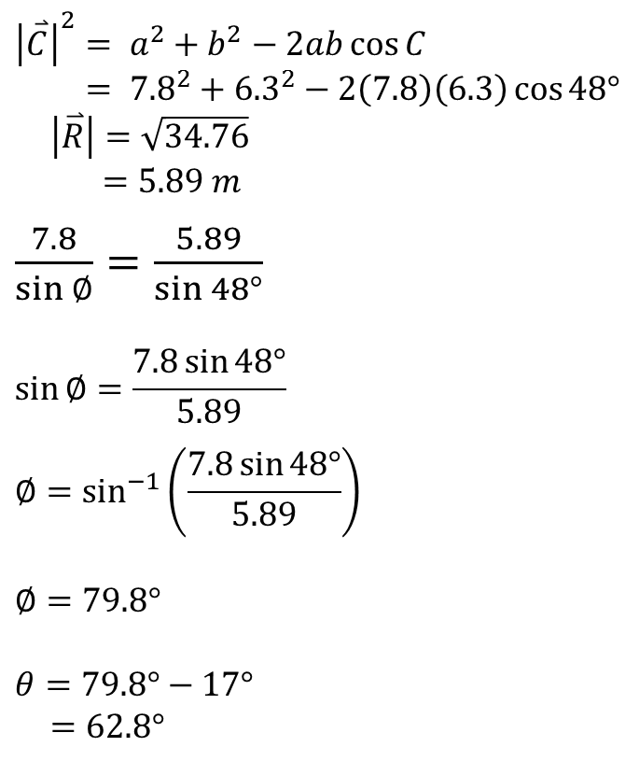




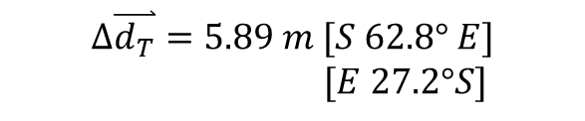
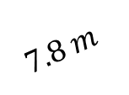

$${\left|\overset{⃑}{C}\right|}^{2}= a^{2}+b^{2}−2ab\cos{C}$$
$= {7.8}^{2}+{6.3}^{2}−2\left(7.8\right)\left(6.3\right)\cos{48°}$
$\left|\overset{⃑}{R}\right|=\sqrt{34.76}$
$=5.89 m$
$\frac{7.8}{\sin{∅}}=\frac{5.89}{\sin{48°}}$
$$\sin{∅}=\frac{7.8\sin{48°}}{5.89}$$
$$∅=\sin^{−1}\left(\frac{7.8\sin{48°}}{5.89}\right)$$
$∅=79.8°$
$$θ=79.8°−17°$$
$=62.8°$
$$Φ$$
$$\overset{⃑}{R}$$
$$17°$$
$$θ$$
6.3 m
$$17°$$
$$48°$$
$$7.8 m$$
$$25°$$
$$∆\overset{⃑}{d_{T}}=5.89 m [S 62.8° E]$$
$[E 27.2°S]$
H W questions # 5 - 6 on page 75 of the textbook using Trigonometry

