Slide 1
Thermal Energy and Heat Transfer

Slide 2
kinetic molecular theory
• All matter is made up of small, constantly moving particles called atoms and groups of atoms called molecules.
• They are vibrating continuously. If they move too close to each other, a repulsive force pushes them apart. Likewise, if they move too far apart, an attractive force brings them together.
• The distances between molecules and the strength of force between them are responsible for the three physical states of matter: solid, liquid, and gas.

Slide 3
In solids, strong forces hold the vibrating atoms and molecules so closely and remain in a fixed position.
In liquids, the vibrating atoms are still bound together, but with greater speeds. The particles can move from place to place in the liquid. The liquid take the shape of the container without changing volume.
In Gases, the atoms are held by weak forces of attraction. Gases expand in volume to take the shape of the container they are in. The particles can move from place to place in the gas.

Slide 4
Thermal Energy and Temperature
Thermal Energy is the kinetic energy of matter at the atomic and molecular levels.
Thermal energy affects the atomic and molecular kinetic energies of the particles, causing an increase/decrease in the average distance between them.
Temperature is simply a way to measure the average kinetic energy of all of the particles in a quantity of matter.

Slide 5
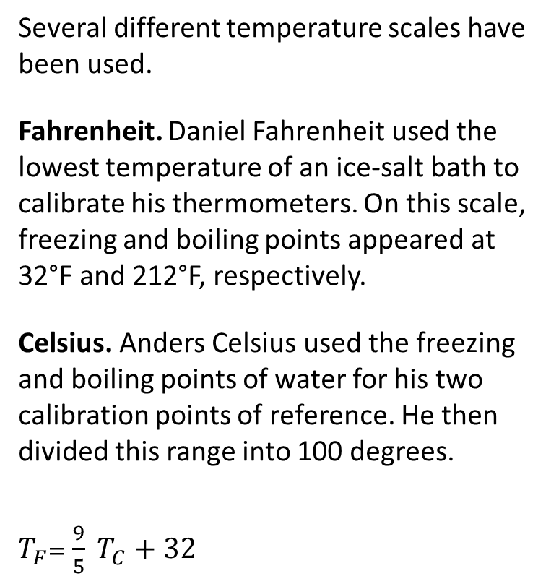
Several different temperature scales have been used.
Fahrenheit. Daniel Fahrenheit used the lowest temperature of an ice-salt bath to calibrate his thermometers. On this scale, freezing and boiling points appeared at 32°F and 212°F, respectively.
Celsius. Anders Celsius used the freezing and boiling points of water for his two calibration points of reference. He then divided this range into 100 degrees.
$T_{F}$= $\frac{9}{5} T_{C}+32$

Slide 6
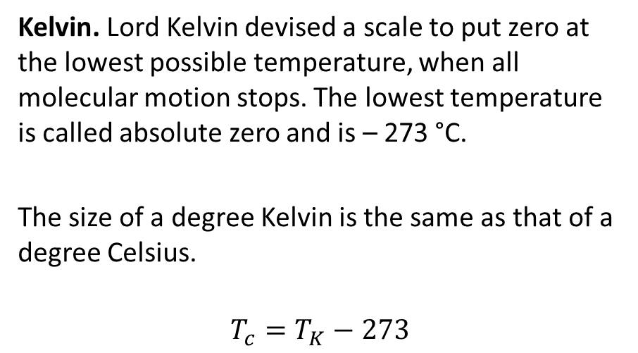
Kelvin. Lord Kelvin devised a scale to put zero at the lowest possible temperature, when all molecular motion stops. The lowest temperature is called absolute zero and is – 273 °C.
The size of a degree Kelvin is the same as that of a degree Celsius.
$$T_{c}=T_{K}−273$$

Slide 7
Methods of Transferring Thermal Energy
Conduction: the transfer of thermal energy that occurs when warmer objects are in physical contact with colder objects
Convection: the transfer of thermal energy through a fluid that occurs when colder, denser fluid falls and pushes up warmer,
less dense fluid.
Radiation: the movement of thermal energy as electromagnetic waves.

Slide 8
Specific Heat Capacity
Heat transfer to any substance depends on :
Temperature difference.
Mass of substance.
Type of substance.
Every substance has its own Specific Heat Capacity.
Specific Heat Capacity (c) the amount of energy, in joules, required to increase the temperature of 1 kg of a substance by 1 °C; units are J/(kg .°C)

Slide 9
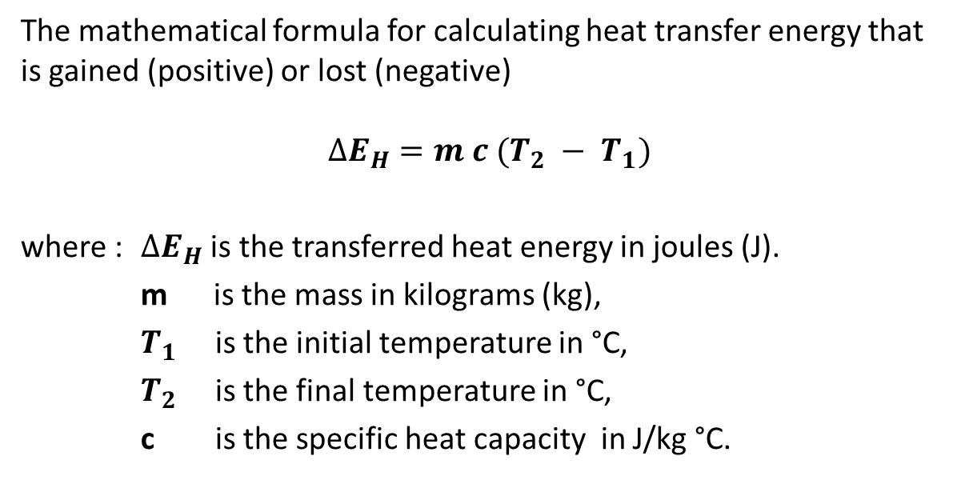
Thermal Energy Transferred
The mathematical formula for calculating heat transfer energy that is gained (positive) or lost (negative) thermal energy gained or lost by an object.
$$∆E_{H}=m c (T_{2} − T_{1})$$
where : $∆E_{H}$ is the transferred heat energy in joules (J).
m is the mass in kilograms (kg),
$T_{1}$ is the initial temperature in °C,
$T_{2}$ is the final temperature in °C,
c is the specific heat capacity in J/kg °C.

Slide 10
Example:
How much heat energy is required to heat a 2.5 kg piece of copper pipe
from 25.0°C to 66.0°C?

Slide 11

Example:
A 0.50 kg block of iron at 80.0 °C is cooled by removing 2.28 $×$ 10⁴ J of
heat energy. What will the final temperature of the metal be?

Slide 12
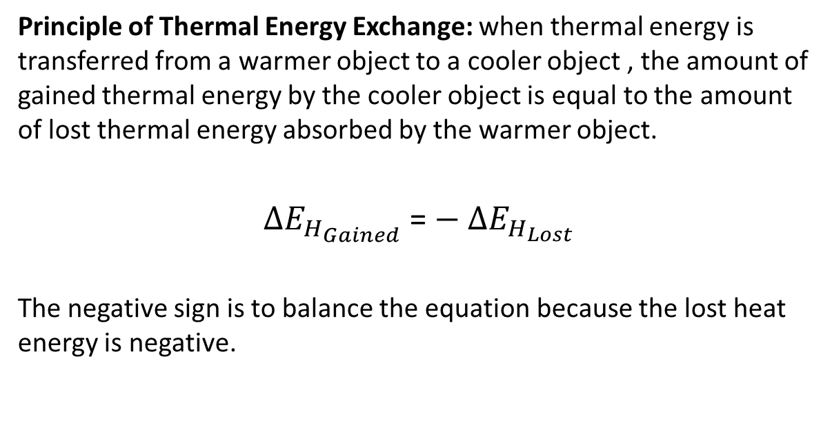
Conservation of Heat Energy
Principle of Thermal Energy Exchange: when thermal energy is transferred from a warmer object to a cooler object , the amount of gained thermal energy by the cooler object is equal to the amount of lost thermal energy absorbed by the warmer object.
$∆E_{H_{Gained}}$ = $− ∆E_{H_{Lost}}$
The negative sign is to balance the equation because the lost heat energy is negative.

Slide 13
Example:
A 0.500 kg of hot water has cooled to 40.0°C. How much freshly boiled water must be added to raise the temperature of the water to a respectable 65.0°C?

Slide 14
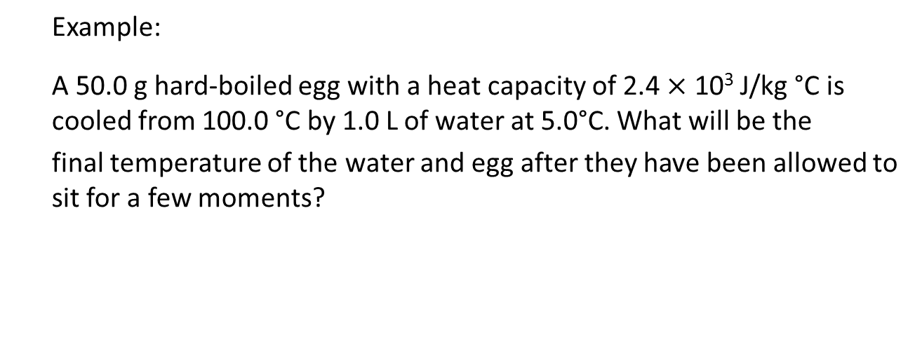
Example:
A 50.0 g hard-boiled egg with a heat capacity of 2.4 $×$ 10³ J/kg °C is cooled from 100.0 °C by 1.0 L of water at 5.0°C. What will be the
final temperature of the water and egg after they have been allowed to sit for a few moments?

Slide 15
Changes of State and Latent Heat
When solids, liquids, or gases absorb/release enough thermal energy, they may change state from solid into a liquid or from a liquid into a gas or the opposite.

Slide 16
Heating Graph: a graph that shows the temperature changes that occur while thermal energy is absorbed by a substance

Slide 17
Cooling Graph: a graph that shows the temperature changes that occur while thermal energy is being removed from a substance

Slide 18
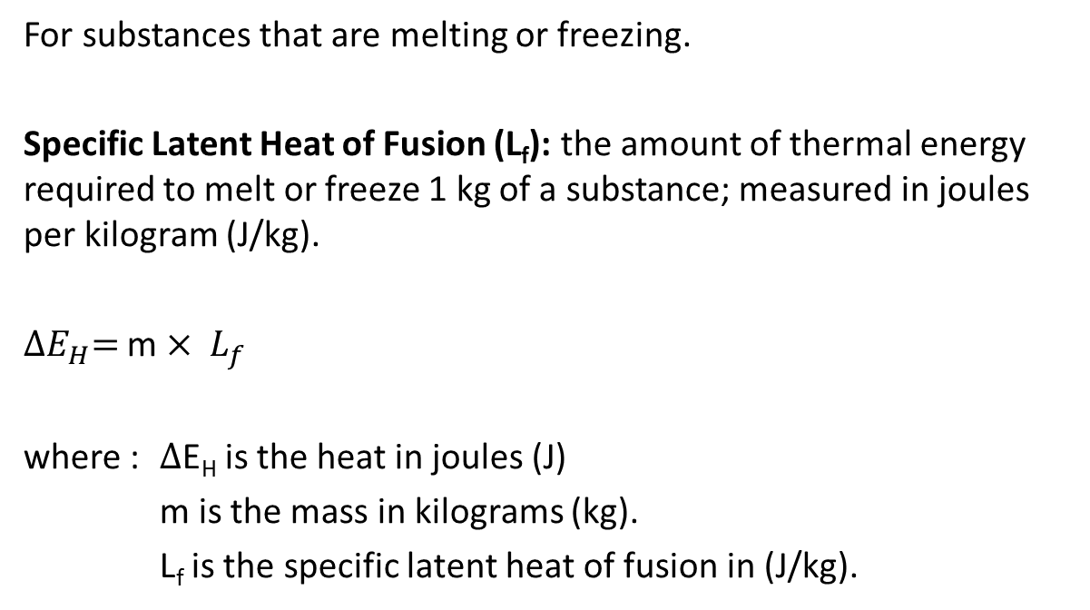
Latent Heats of Fusion
For substances that are melting or freezing.
Specific Latent Heat of Fusion (L_{f}): the amount of thermal energy required to melt or freeze 1 kg of a substance; measured in joules per kilogram (J/kg).
${∆E}_{H}=$m $× L_{f}$
where : $∆$E_{H} is the heat in joules (J)
m is the mass in kilograms (kg).
L_{f} is the specific latent heat of fusion in (J/kg).

Slide 19
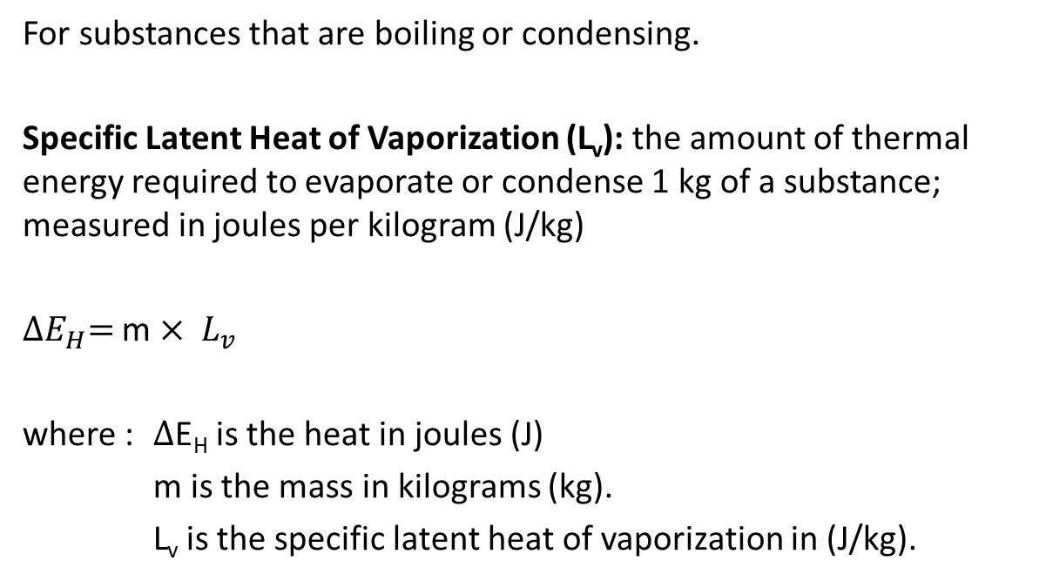
Latent Heats of Vaporization
For substances that are boiling or condensing.
Specific Latent Heat of Vaporization (L_{v}): the amount of thermal energy required to evaporate or condense 1 kg of a substance; measured in joules per kilogram (J/kg)
${∆E}_{H}=$m $× L_{v}$
where : $∆$E_{H} is the heat in joules (J)
m is the mass in kilograms (kg).
L_{v} is the specific latent heat of vaporization in (J/kg).

Slide 21
Example:
How much heat is required to change 0.20 kg of water from a liquid state at a temperature of 100 º C to vapour at the same temperature?

Slide 22

Thermal Energy Involving Change of State
$∆E_{H_{T} }=$ $∆E_{H}( solid$) + $∆E_{H}$ (fusion) + $∆E_{H}$ (liquid)
+ $∆E_{H}$ (vaporization) + $∆E_{H}$ (gas)

Slide 23
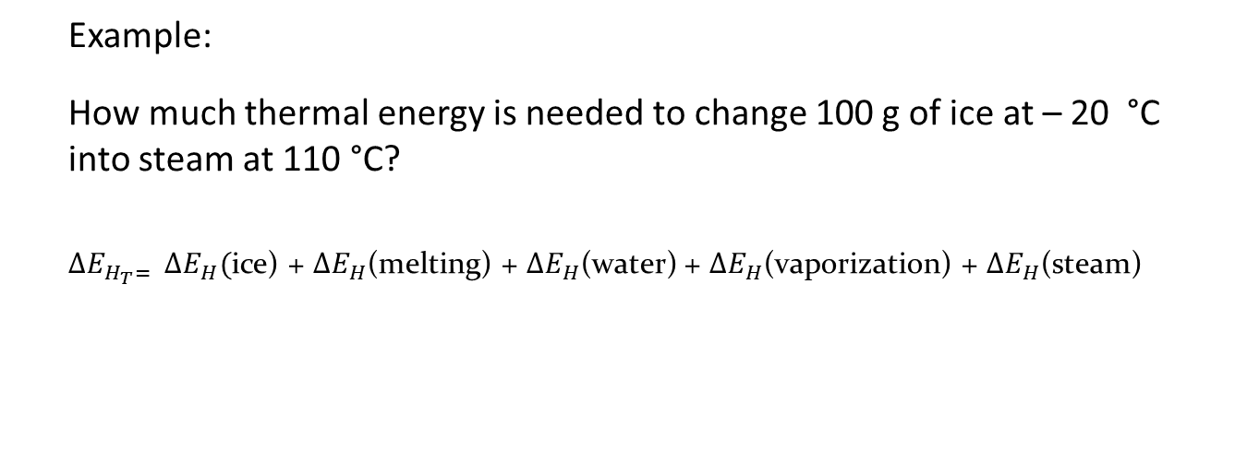
Example:
How much thermal energy is needed to change 100 g of ice at – 20 °C into steam at 110 °C?
$∆E_{H_{T}= }$ $∆E_{H}($ice) + $∆E_{H}$(melting) + $∆E_{H}$(water) + $∆E_{H}$(vaporization) + $∆E_{H}$(steam)

Slide 24
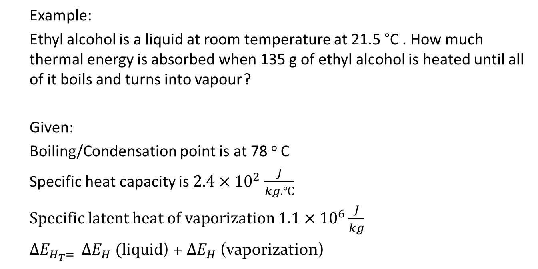
Example:
Ethyl alcohol is a liquid at room temperature at 21.5 °C . How much thermal energy is absorbed when 135 g of ethyl alcohol is heated until all of it boils and turns into vapour ?
Given:
Boiling/Condensation point is at 78 º C
Specific heat capacity is $2.4×{10}^{2}$ $\frac{J}{kg.℃}$
Specific latent heat of vaporization $1.1×{10}^{6}\frac{J}{kg}$
$∆E_{H_{T}= }$ $∆E_{H} (liquid$) + $∆E_{H}$ (vaporization)

Slide 25
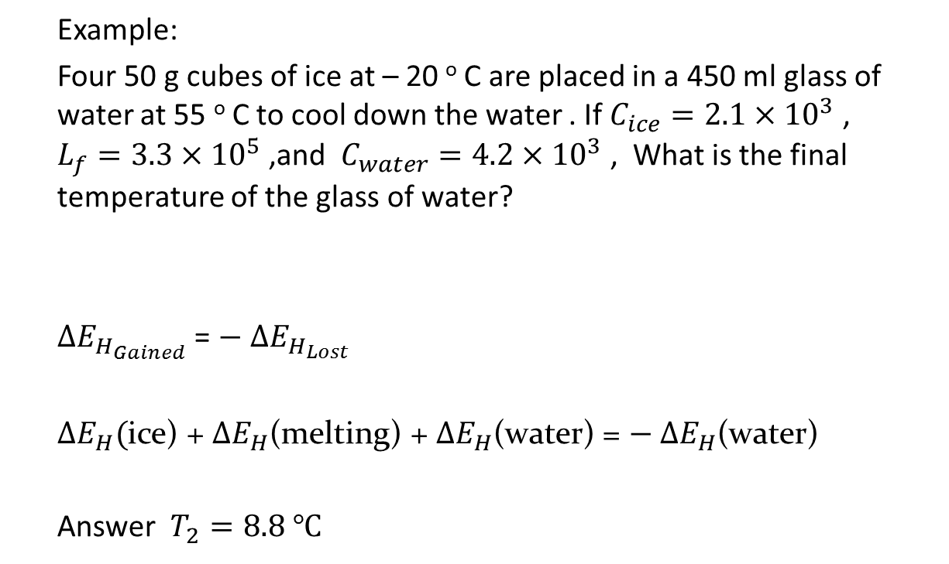
Example:
Four 50 g cubes of ice at – 20 º C are placed in a 450 ml glass of water at 55 º C to cool down the water . If $C_{ice}=2.1×{10}^{3}$ , $L_{f}=3.3×{10}^{5}$ ,and $C_{water}=4.2×{10}^{3}$ , What is the final temperature of the glass of water?
$∆E_{H_{Gained}}$ = $− ∆E_{H_{Lost}}$
$∆E_{H}($ice) + $∆E_{H}$(melting) + $∆E_{H}$(water) = $− ∆E_{H}$(water)
Answer $T_{2}=8.8 ℃$

Slide 26
Heating and Cooling Systems

Slide 27
Conventional Heating Systems
Electrical heating system: a system that uses electricity to produce thermal energy for heating.
Forced-air heating system: a system that moves hot air to heat a building.
Hot water heating system: a system that uses hot water to heat a building

Slide 28
Conventional Cooling Systems
Air conditioners and refrigerators use the evaporation of a liquid to absorb thermal energy from air.
First, a compressor puts a special type of gas, called a refrigerant, under pressure.
Whenever a gas is compressed, its temperature increases. The warm refrigerant gas runs through a coil of tubes, to release some of its thermal energy.

Slide 29
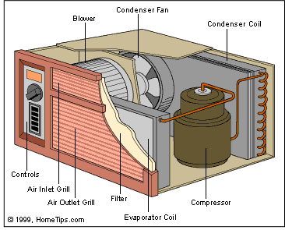
As the refrigerant cools, it changes into a liquid. The liquid refrigerant then passes through an expansion valve, moving from a high-pressure area to a low-pressure area.
At this point, the liquid refrigerant absorbs thermal energy from the surrounding air and evaporates back into a gas. The surrounding air cools down as a result.

Slide 30
Geothermal Systems
geothermal system a system that transfers thermal energy from under Earth’s surface into a building to heat it, and transfers thermal energy from the building into the ground to cool the building.

