Slide 1
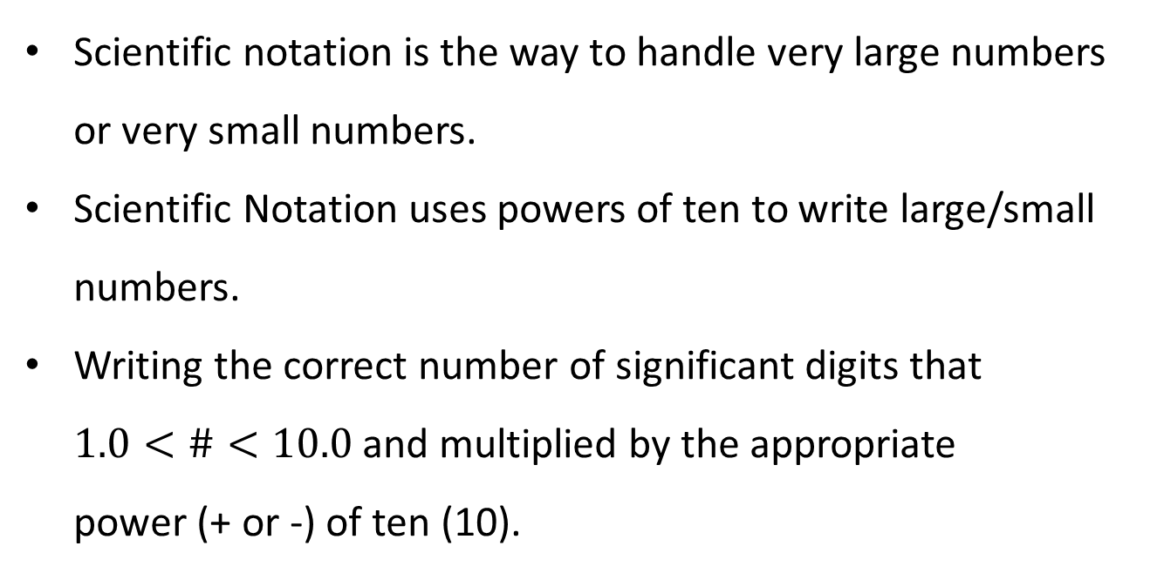
Scientific Notation (P.650)
Scientific notation is the way to handle very large numbers or very small numbers.
Scientific Notation uses powers of ten to write large/small numbers.
Writing the correct number of significant digits that $1.0<\#<10.0$ and multiplied by the appropriate
power (+ or -) of ten (10).

Slide 2
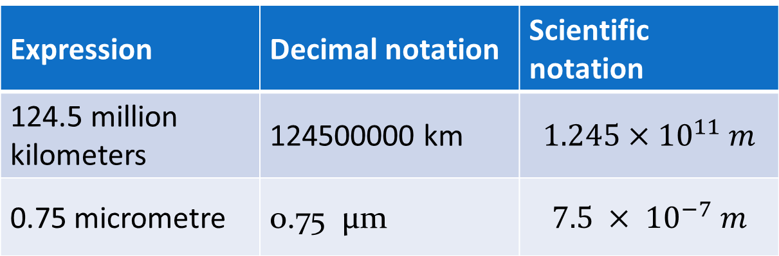
Expression | Decimal notation | Scientific notation
124.5 million kilometers | 124500000 km | $$1.245×{10}^{11} m$$
0.75 micrometre | 0.75 µm | $$7.5 × {10}^{−7} m$$
Scientific notation also enables us to show the correct number of significant digits. (discussed later).
For example: 2 394 = 2.394 x 1000
= 2.394 x 10³
0.067 = 6.7 x 0.01
= 6.7 x 10 ⁻²

Slide 3
PRACTICE
Express each of the following in scientific notation.
(a) 6 807 = 6.807 x 10³
(b) 0.000 053 = 5.3 x 10⁻⁵
(c) 39 879 280 000 = 3.987928 x 10¹⁰
(d) 0.000 000 813 = 8.13 x 10⁻⁷
(e) 0.070 40 = 7.040 x 10⁻²
(f) 400 000 000 000 = 4 x 10¹¹
(g) 0.80 = 8.0 x 10⁻¹
(h) 68 = 6.8 x 10¹

Slide 4

PRACTICE
2. Express each of the following in common notation.
(a) 7 × 10¹ = 70
(b) 5.2 × 10³ = 5 200
(c) 8.3 × 10⁹ = 8 300 000 000
(d) 10.1 × 10⁻² = 0.101
(e) 6.386 8 × 10³ = 6 386.8
(f) 4.086 × 10⁻³ = 0.004 086
(g) 6.3 × 10² = 630
(h) 35.0 × 10⁻³ = 0.035 0

Slide 5

International System of Units (SI)
PRACTICE
1. Use the chart to convert each of the following measurements to their base unit.
$5.7×{10}^{9}$ W
$7.2×{10}^{−1}$ m
$6.0×{10}^{−6}$ C
$$5.0×{10}^{5} J$$
$6.8×{10}^{−3}$ L
$5.48×{10}^{−7}$ m
$$7.5×{10}^{−1} kg$$

Slide 6
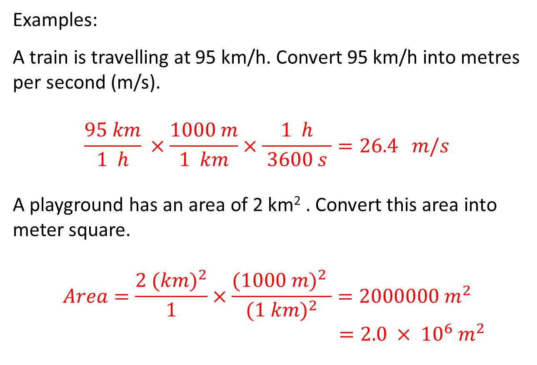
Examples:
A train is travelling at 95 km/h. Convert 95 km/h into metres per second (m/s).
$$\frac{95 km}{1 h} ×\frac{1000 m}{1 km}×\frac{1 h}{ 3600 s }=26.4 m/s$$
A playground has an area of 2 km² . Convert this area into meter square.
$$Area=\frac{2 {(km)}^{2}}{1}×\frac{{(1000 m)}^{2} }{{(1 km)}^{2}}=2000000 m^{2}$$
$=2.0 × {10}^{6} m^{2}$

Slide 7
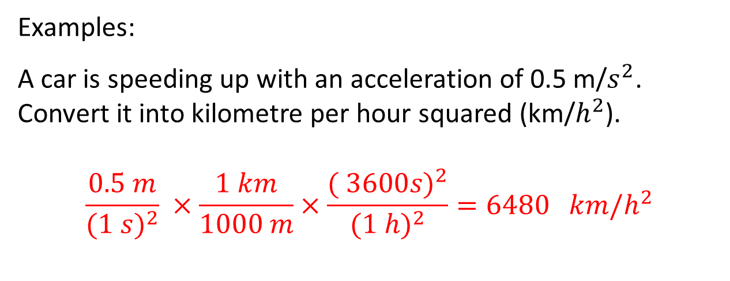
Examples:
A car is speeding up with an acceleration of 0.5 m/$s^{2}$. Convert it into kilometre per hour squared (km/$h^{2}$).
$$\frac{0.5 m}{(1 {s)}^{2}} ×\frac{1 km}{1000 m}×\frac{({ 3600s)}^{2}}{(1 {h)}^{2}}=6480 km/h^{2}$$

Slide 8
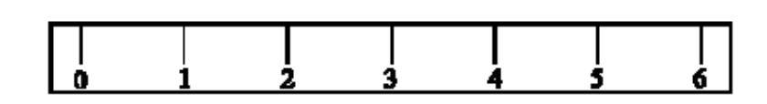
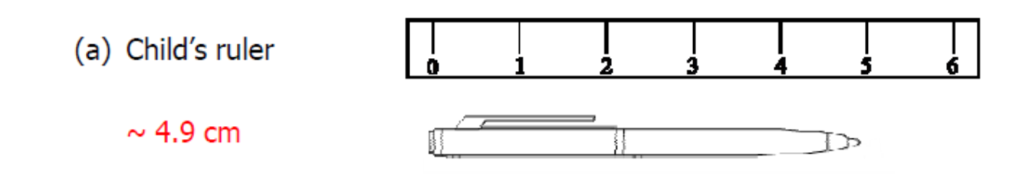
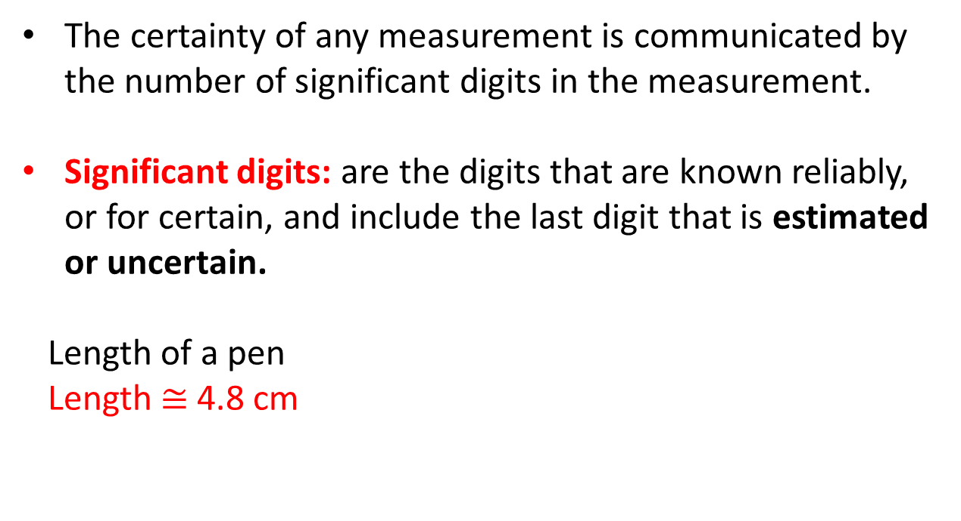
Uncertainty in Measurements
The certainty of any measurement is communicated by the number of significant digits in the measurement.
Significant digits: are the digits that are known reliably, or for certain, and include the last digit that is estimated or uncertain.
Length of a pen
Length $≅$ 4.8 cm

Slide 9
As such, there are a set of rules that can be used to determine whether or not a digit is significant:
digits that are certain plus one estimated digit
indicates the certainty of a measurement

Slide 10
Uncertainty in Measurements
WHEN DIGITS ARE SIGNIFICANT:
All non-zero digits (i.e., 1-9) are significant.
For example: 259.69 has five significant digits
61.2 has three significant digits
Any zeros between two non-zero digits are significant.
For example: 606 has three significant digits
6006 has four significant digits

Slide 11
WHEN DIGITS ARE SIGNIFICANT:
Any zeros to the right of both the decimal point and a non-zero digit are significant.
For example: 7.100 has four significant digits
7.10 has three significant digits
All digits (zero or non-zero) used in scientific notation are significant.
For example: 3.4 x 10³ has two significant digits
3.400 x 10³ has four significant digits

Slide 12
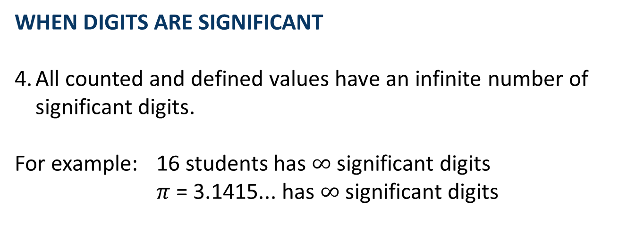
WHEN DIGITS ARE SIGNIFICANT
All counted and defined values have an infinite number of significant digits.
For example: 16 students has $∞$ significant digits
$π$ = 3.1415... has $∞$significant digits

Slide 13
WHEN DIGITS ARE NOT SIGNIFICANT
1. If a decimal point is present, zeros to the left of other digits (leading zeros) are not significant – they are placeholders.
For example: 0.22 has two significant digits
0.000 22 has two significant digits
2. If a decimal point is not present, zeros to the right of the last non-zero digit (trailing zeros) are not significant – they are placeholders.
For example: 98 000 000 has two significant digits
25 000 has two significant digits

Slide 14


Slide 16
Calculations Using Measurements
RULES FOR ROUNDING
When the first digit to be dropped is 4 or less, the last digit retained should not be changed.
For example: 3.141 326 rounded to 4 digits is 3.141
When the first digit to be dropped is greater than 5, or if it is a 5 followed by at least one digit other than zero, the last digit retained is increased by 1 unit.
For example: 2.221 372 rounded to five digits is 2.2214
4.168 501 rounded to four digits is 4.169

Slide 17
RULES FOR ROUNDING
When the first digit discarded is five or a five followed by only zeros, the last digit retained is increased by 1 if it is odd, but not changed if it is even.
For example: 2.35 rounded to two digits is 2.4
2.45 rounded to two digits is 2.4
6.35 rounded to two digits is 6.4
NOTE: This is sometimes called the even-odd rule.

Slide 18
RULES FOR ADDING & SUBTRACTING
When adding and/or subtracting, the answer has the same number of decimal places as the measurement with the fewest decimal places.
For example: 6.6 cm + 18.74 cm + 0.766 cm
= 26.106 cm
= 26.1 cm
NOTE:
It is rounded to 26.1 cm because the first measurement (6.6 cm) limits the precision to a tenth of a centimetre.

Slide 19
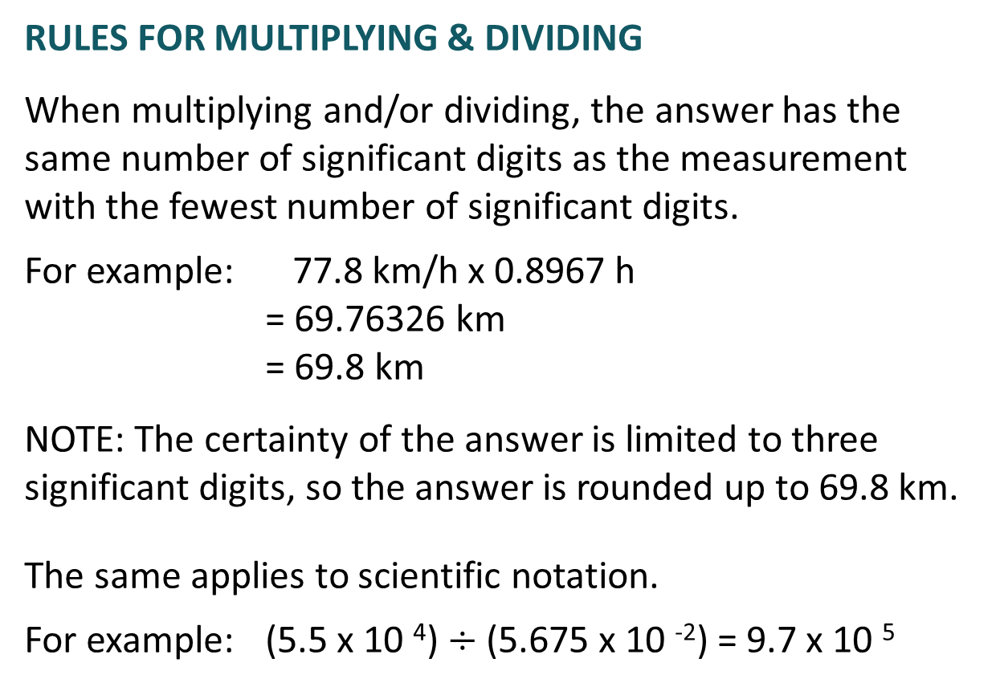
RULES FOR MULTIPLYING & DIVIDING
When multiplying and/or dividing, the answer has the same number of significant digits as the measurement with the fewest number of significant digits.
For example: 77.8 km/h x 0.8967 h
= 69.76326 km
= 69.8 km
NOTE: The certainty of the answer is limited to three significant digits, so the answer is rounded up to 69.8 km.
The same applies to scientific notation.
For example: (5.5 x 10 ⁴) $÷$ (5.675 x 10 ⁻²) = 9.7 x 10 ⁵

Slide 20
RULES FOR MULTISTEP CALCULATIONS
For multistep calculations, round-off errors occur if you use the rounded-off answer from an earlier calculation in a subsequent calculation.
Thus, leave all digits in your calculator until you have finished all your calculations and then round the final answer.

Slide 21
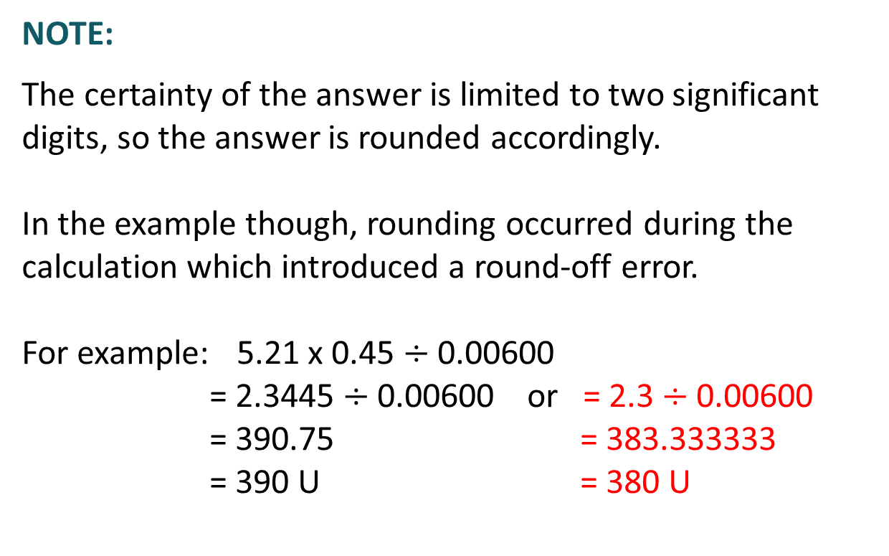
NOTE:
The certainty of the answer is limited to two significant digits, so the answer is rounded accordingly.
In the example though, rounding occurred during the calculation which introduced a round-off error.
For example: 5.21 x 0.45 $÷$ 0.00600
= 2.3445 $÷$ 0.00600 or = 2.3 $÷$ 0.00600
= 390.75 = 383.333333
= 390 U = 380 U

Slide 22
Calculations – Summary
ADDING & SUBTRACTING: fewest decimal places
MULTIPLYING & DIVIDING: fewest number of significant digits
MULTISTEP CALCULATIONS: leave all digits in the calculator until finished and then round
NOTE:
If a combination of addition, subtraction, multiplication and division are involved, follow the rules for multiplying and dividing.

Slide 23


Slide 24



