Slide 1
Projectile Motion

Slide 2


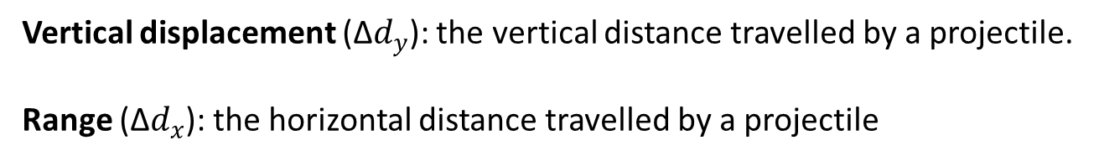
Projectile Motion:
Projectile : an object that moves along a two-dimensional curved trajectory in response to gravity.
Projectile Motion: the motion of a projectile under only gravity
Time of flight: the time taken for a
projectile to complete its motion just before hitting the ground.
∆$d_{y}$
Range (∆$d_{x})$
Vertical displacement (∆$d_{y}$): the vertical distance travelled by a projectile.
Range (∆$d_{x}$): the horizontal distance travelled by a projectile.

Slide 3
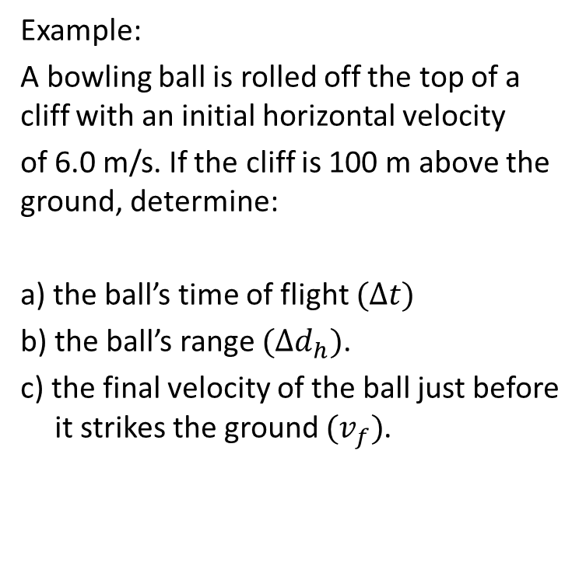
A horizontal projectile
Example:
A bowling ball is rolled off the top of a cliff with an initial horizontal velocity
of 6.0 m/s. If the cliff is 100 m above the ground, determine:
a) the ball’s time of flight $(∆t)$
b) the ball’s range $(∆d_{h})$.
c) the final velocity of the ball just before it strikes the ground $(v_{f})$.

Slide 4
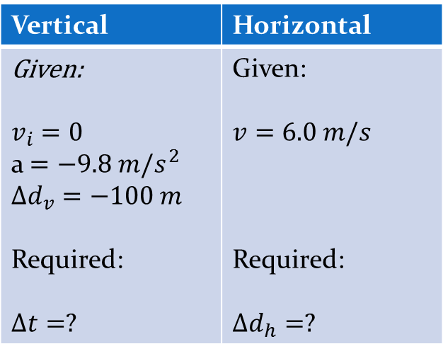
a) the ball’s time of flight.
Vertical | Horizontal
Given: $$v_{i}=0$$ a $=−9.8 m/s^{2}$ $$∆d_{v}=−100 m$$ Required: $$∆t=?$$ | Given: $$v=6.0 m/s$$ Required: $$∆d_{h}=?$$

Slide 5
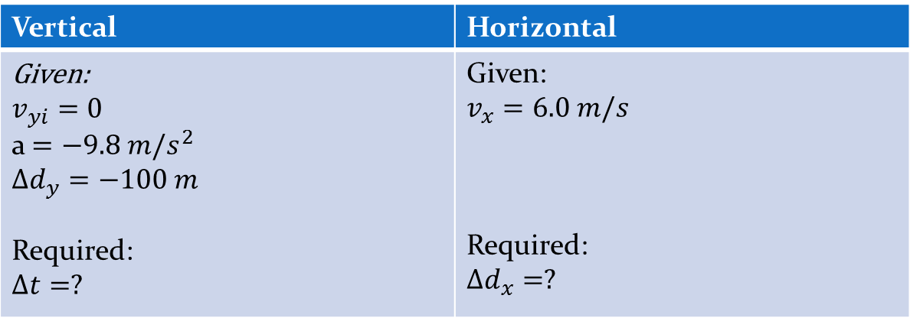
Vertical | Horizontal
Given: $$v_{yi}=0$$ a $=−9.8 m/s^{2}$ $$∆d_{y}=−100 m$$ Required: $$∆t=?$$ | Given: $$v_{x}=6.0 m/s$$ Required: $$∆d_{x}=?$$

Slide 6
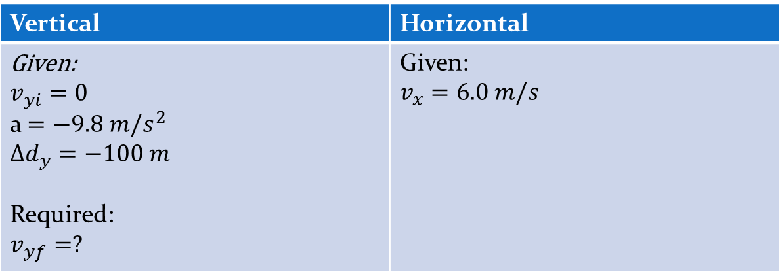
Vertical | Horizontal
Given: $$v_{yi}=0$$ a $=−9.8 m/s^{2}$ $$∆d_{y}=−100 m$$ Required: $$v_{yf}=?$$ | Given: $$v_{x}=6.0 m/s$$

Slide 8
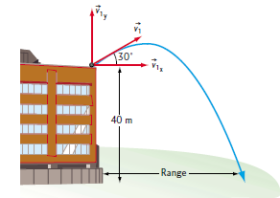
Example:
A golf ball is launched from the roof of a school with a velocity of 20 m/s at an angle of 30° above the horizontal. If the roof is 40 m above the ground, calculate:
The maximum height
the ball’s time of flight.
the ball’s horizontal displacement.
The final velocity of the ball before hitting the ground.

Slide 9
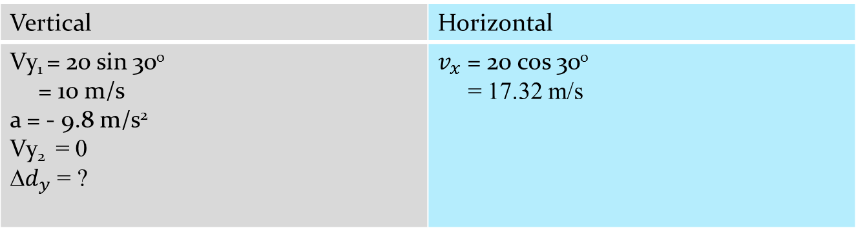
20 m/s
20 sin 30º
30º
20 cos 30º
Vertical | Horizontal
Vy₁ = 20 sin 30⁰ = 10 m/s a = - 9.8 m/s² Vy₂ = 0 ∆$d_{y}$ = ? | $v_{x}$ = 20 cos 30⁰ = 17.32 m/s

Slide 10
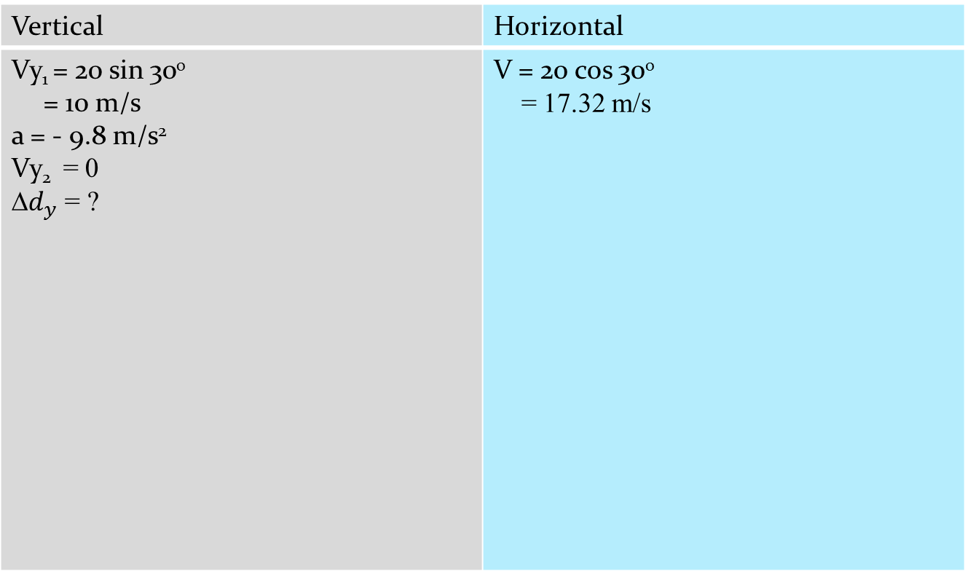
Vertical | Horizontal
Vy₁ = 20 sin 30⁰ = 10 m/s a = - 9.8 m/s² Vy₂ = 0 ∆$d_{y}$ = ? | V = 20 cos 30⁰ = 17.32 m/s

Slide 11
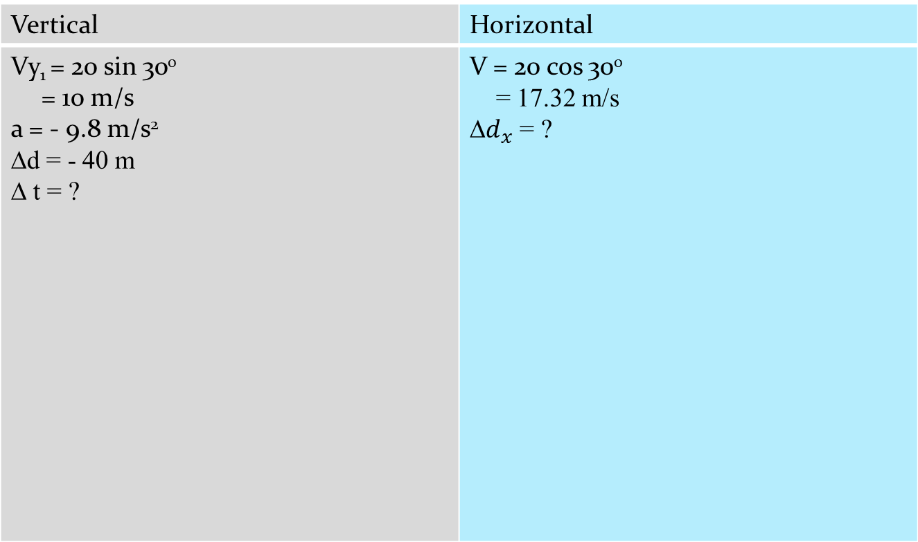
Vertical | Horizontal
Vy₁ = 20 sin 30⁰ = 10 m/s a = - 9.8 m/s² ∆d = - 40 m ∆ t = ? | V = 20 cos 30⁰ = 17.32 m/s ∆$d_{x}$ = ?

Slide 12
Vertical | Horizontal
V₁ = 20 sin 30⁰ = 10 m/s a = - 9.8 m/s² ∆d = - 40 m V₂ = ? | V = 20 cos 30⁰ = 17.32 m/s

Slide 13
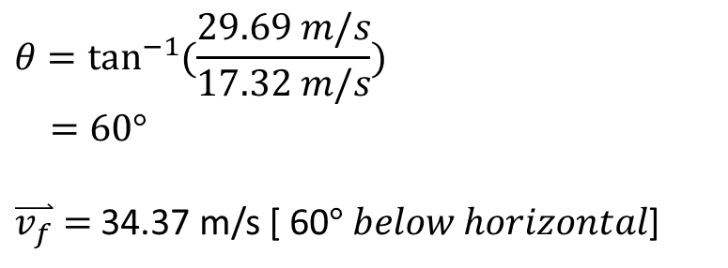
17.32 m/s
Ɵ
29.69 m/s
$$θ=\tan^{−1}{(\frac{29.69 m/s}{17.32 m/s}})$$
$=60°$
$\overset{⃑}{v_{f}}=$ 34.37 m/s [ 60$° below horizontal$]

Slide 14
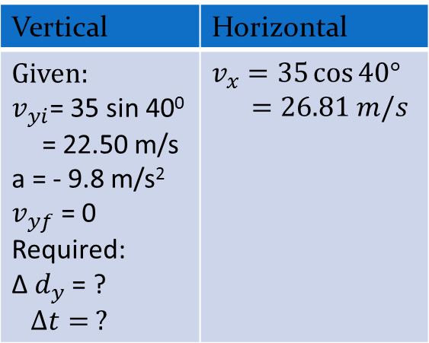
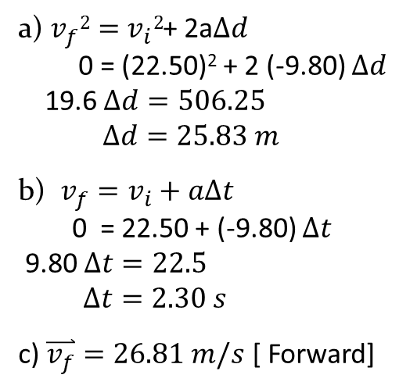
Example:
Blasto the Magnificent is fired from a cannon on the ground inclined at 40° to the horizontal. If Blasto leaves the cannon at a speed of 35 m/s:
a) What is his maximum height?
b) how long will it take him to reach his maximum height?
c) What is the velocity at the max. height?
a) $v_{f}2=$ $v_{i}2$+ 2a$∆d$
0 = (22.50)² + 2 (-9.80) $∆d$
19.6 $∆d=506.25$
$$∆d=25.83 m$$
b) $v_{f}=v_{i}+a∆t$
0 = 22.50 + (-9.80) $∆t$
9.80 $∆t=22.5$
$∆t=2.30 s$
c) $\overset{⃑}{v_{f}}=26.81 m/s$ [ Forward]
Vertical | Horizontal
Given: $v_{yi}$= 35 sin 40⁰ = 22.50 m/s a = - 9.8 m/s² $v_{yf}$ = 0 Required: ∆ $d_{y}$ = ? $$∆t= ?$$ | $$v_{x}=35\cos{40°}$$ $=26.81 m/s$

Slide 15
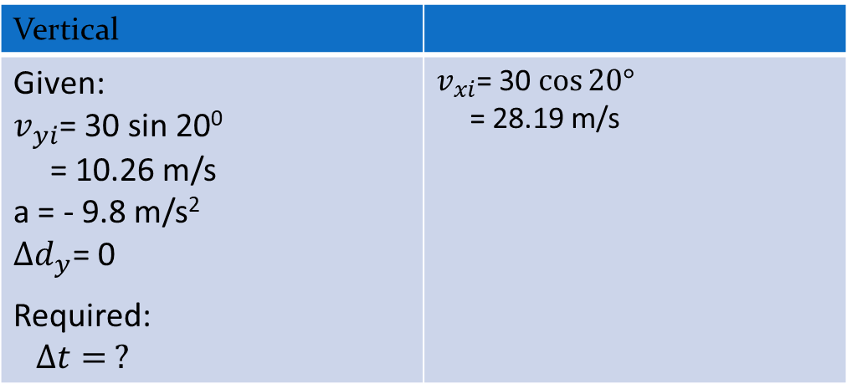
Example:
Bounder of Adventure is trying to cross a piranha-infested pool of water in his Humvee. He races up a ramp with a velocity of 30 m/s [20º above the horizontal] . There is an identical ramp on the other side of the pool. What is the maximum width of the pool that Bounder of Adventure can successfully cross?
Vertical
Given: $v_{yi}$= 30 sin 20⁰ = 10.26 m/s a = - 9.8 m/s² $∆d_{y}$= 0 Required: $$∆t= ?$$ | $v_{xi}$= 30 $\cos{20°}$ = 28.19 m/s

Slide 16
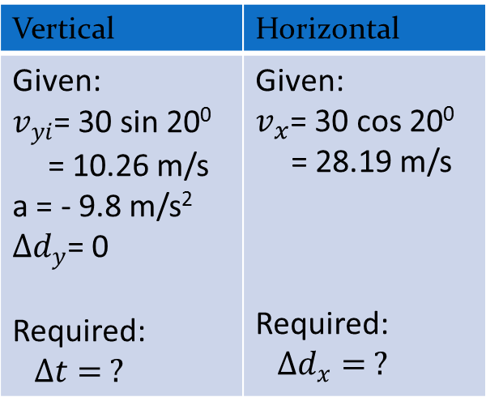
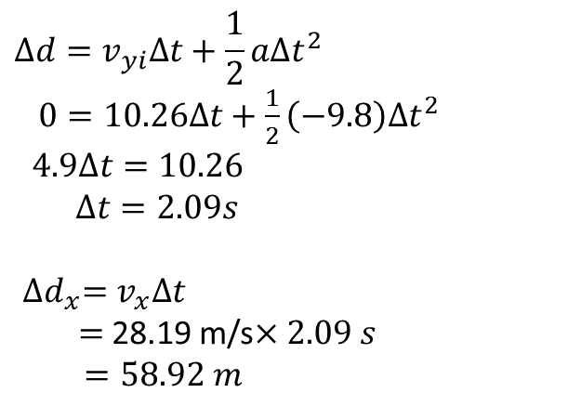
Vertical | Horizontal
Given: $v_{yi}$= 30 sin 20⁰ = 10.26 m/s a = - 9.8 m/s² $∆d_{y}$= 0 Required: $$∆t= ?$$ | Given: $v_{x}$= 30 cos 20⁰ = 28.19 m/s Required: $$∆d_{x}= ?$$
$$∆d=v_{yi}∆t+\frac{1}{2}a∆t^{2}$$
$0=10.26∆t+\frac{1}{2}\left(−9.8\right)∆t^{2}$
$4.9∆t=10.26$
$∆t=2.09s$
${∆d}_{x}=v_{x}∆t$
$=$28.19 m/s$×2.09 s$
$=58.92 m$

Slide 17


Example:
Will a tennis ball served horizontally at 100 km/h from a height of 2.2 m clear a net 0.9 m high and 10 m away? Solve in two different ways.
$$∆d_{y}=−1.3 m$$
$$∆d_{x}=$$
10.0 m

Slide 18
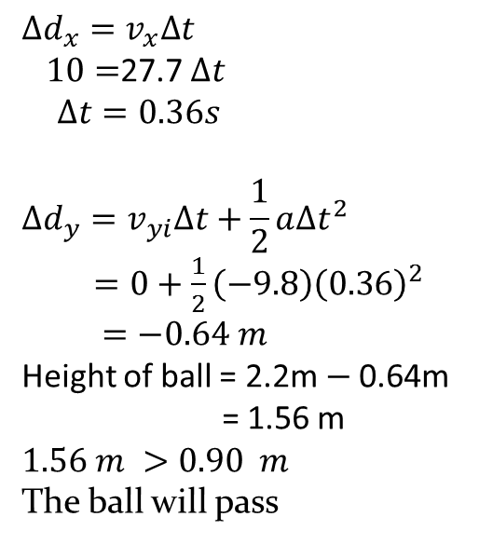
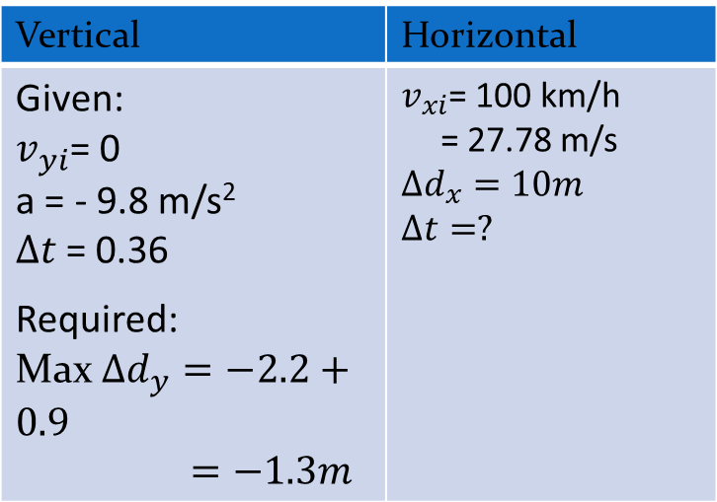
Example:
Will a tennis ball served horizontally at 100 km/h from a height of 2.2 m clear a net 0.9 m high and 10 m away? Solve in two different ways.
Method 1:
$$∆d_{x}=v_{x}∆t$$
$10=$27.7 $∆t$
$∆t=0.36s$
$$∆d_{y}=v_{yi}∆t+\frac{1}{2}a∆t^{2}$$
$=0+\frac{1}{2}\left(−9.8\right){\left(0.36\right)}^{2}$
$=−0.64 m$
Height of ball = 2.2m $−$0.64m
= 1.56 m
$$1.56 m >0.90 m$$
The ball will pass
Vertical | Horizontal
Given: $v_{yi}$= 0 a = - 9.8 m/s² $∆t$= 0.36 Required: Max $∆d_{y}=−2.2+0.9$ $=−1.3m$ | $v_{xi}$= 100 km/h = 27.78 m/s $$∆d_{x}=10m$$ $$∆t=?$$

Slide 19
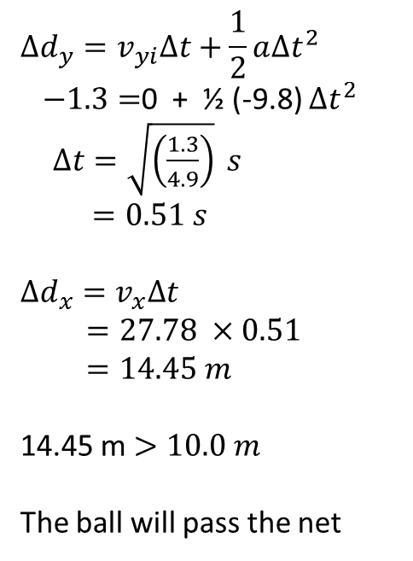
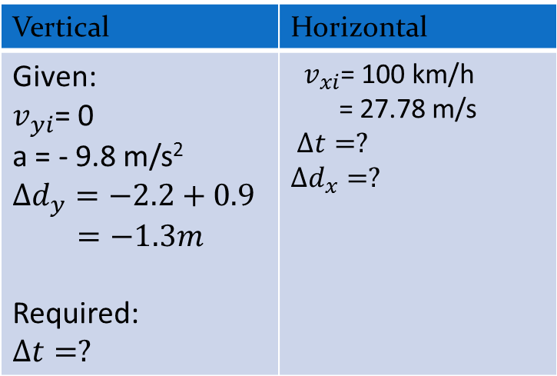
Method 2:
Vertical | Horizontal
Given: $v_{yi}$= 0 a = - 9.8 m/s² $$∆d_{y}=−2.2+0.9$$ $=−1.3m$ Required: $$∆t=?$$ | ${ v}_{xi}$= 100 km/h = 27.78 m/s $$∆t=?$$ $$∆d_{x}=?$$
$$∆d_{y}=v_{yi}∆t+\frac{1}{2}a∆t^{2}$$
$−1.3=$0 + ½ (-9.8) $∆t^{2}$
$∆t=\sqrt{\left(\frac{1.3}{4.9}\right)} s$
$=0.51 s$
$$∆d_{x}=v_{x}∆t$$
$=27.78 ×0.51$
$=14.45 m$
14.45 m $>10.0 m$
The ball will pass the net

Slide 20
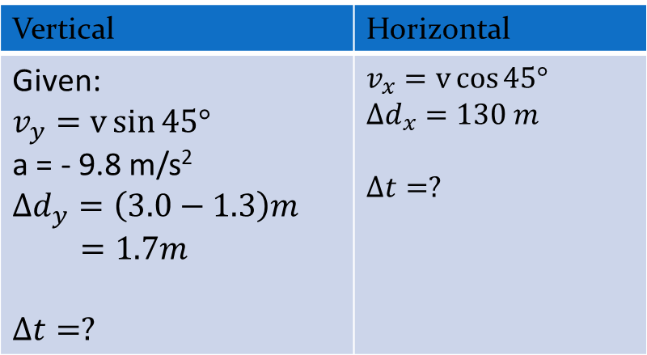
Example:
A baseball player makes perfect contact with the ball, striking it 45° above the horizontal at a point 1.3 m above the ground. His home run
hit just clears the 3.0 m wall 130 m from home plate. With what velocity did the baseball player strike the ball?
Vertical | Horizontal
Given: $$v_{y}=v\sin{45°}$$ a = - 9.8 m/s² $$∆d_{y}=\left(3.0−1.3\right)m$$ $=1.7m$ $$∆t=?$$ | $$v_{x}=v\cos{45°}$$ $$∆d_{x}=130 m$$ $$∆t=?$$

Slide 21
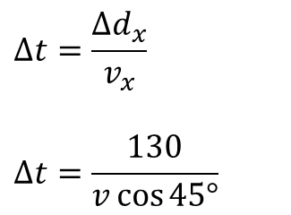
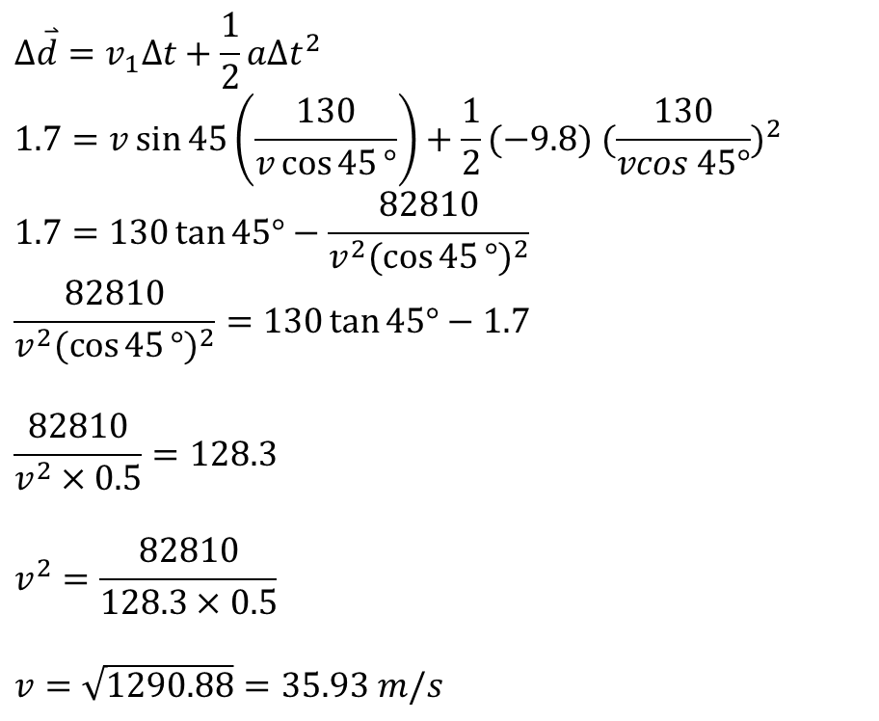
Vertical | Horizontal
$$∆\overset{⃑}{d}=v_{1}∆t+\frac{1}{2}a∆t^{2}$$
$$1.7=v\sin{45}\left(\frac{130}{v\cos{45}°}\right)+\frac{1}{2}(−9.8) {(\frac{130}{vcos 45°})}^{2}$$
$$1.7=130\tan{45°−\frac{82810}{v^{2}{(\cos{45}°)}^{2}}}$$
$$\frac{82810}{v^{2}{(\cos{45}°)}^{2}}=130\tan{45°}−1.7$$
$$\frac{82810}{v^{2}×0.5}=128.3$$
$$v^{2}=\frac{82810}{128.3×0.5}$$
$$v=\sqrt{1290.88}=35.93 m/s$$
$$∆t=\frac{∆d_{x}}{v_{x}}$$
$$∆t=\frac{130}{v\cos{45°}}$$

Slide 22
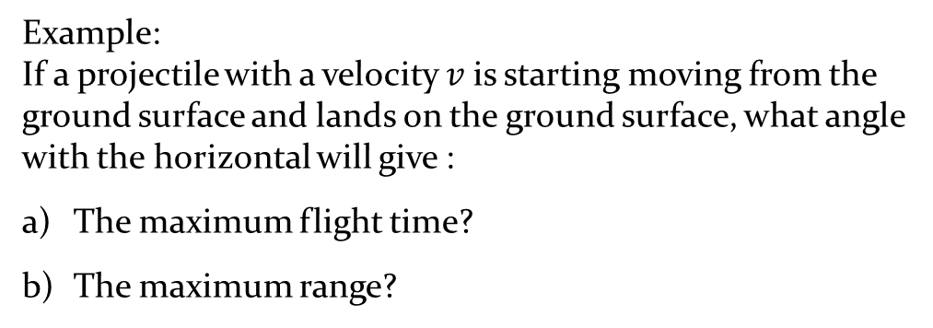




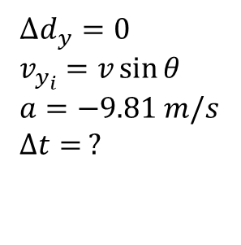

Maximum Flight Time and Range
Example:
If a projectile with a velocity $v$is starting moving from the ground surface and lands on the ground surface, what angle with the horizontal will give :
The maximum flight time?
The maximum range?
$$v$$
$$v_{y}=v\sin{θ}$$
$$θ$$
$$v_{x}=v\cos{θ}$$
Vertical | Horizontal
∆$d_{y}=0$
$$v_{y_{i}}=v\sin{θ}$$
$$a=−9.81 m/s$$
$$∆t= ?$$
$$v_{x}=v\cos{θ}$$

Slide 23
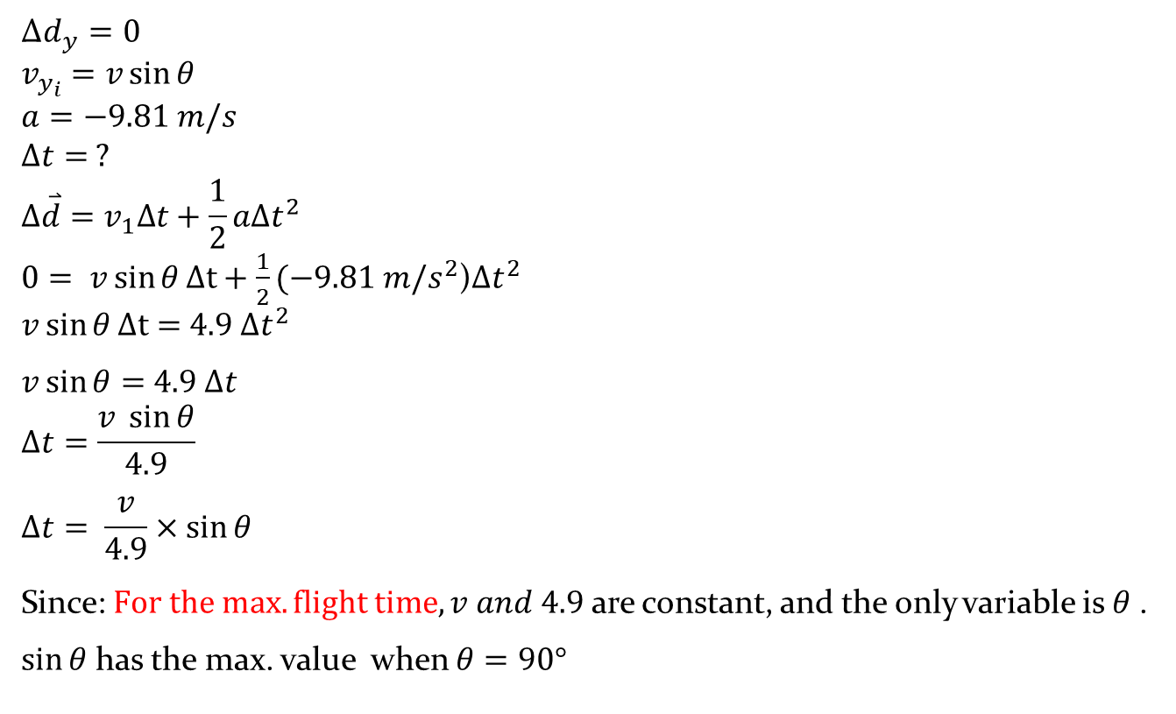
The maximum flight time?
Vertical
∆$d_{y}=0$
$$v_{y_{i}}=v\sin{θ}$$
$$a=−9.81 m/s$$
$$∆t= ?$$
$$∆\overset{⃑}{d}=v_{1}∆t+\frac{1}{2}a∆t^{2}$$
$0= v\sin{θ}∆t+\frac{1}{2}(−9.81 m/s^{2}$)$∆t^{2}$
$v\sin{θ}∆t=$ $4.9 ∆t^{2}$
$v\sin{θ}=$ $4.9 ∆t$
$$∆t=\frac{v \sin{θ}}{4.9}$$
$$∆t= \frac{v}{4.9}×\sin{θ}$$
Since: $For the max. flight time, v and 4.9$ are constant, and the only variable is $θ$.
$\sin{θ}$ has the max. value when $θ=90°$
1

Slide 24

b) The maximum range?
 | Horizontal
$$v_{x}=v\cos{θ}$$
$$∆d=v_{x}×∆t$$
$$∆t= \frac{v}{4.9}×\sin{θ}$$
Sub (1) in (2)
$$∆d= v\cos{θ} ×\frac{v}{4.9}×\sin{θ}$$
$$∆d= \frac{v^{2}}{4.9}×\sin{θ}\cos{θ}$$
$$\sin{2θ=2}\sin{θ}\cos{θ}$$
$$\sin{θ}\cos{θ}= \frac{1}{2}\sin{(2θ)}$$
2
1
3
4

Slide 25
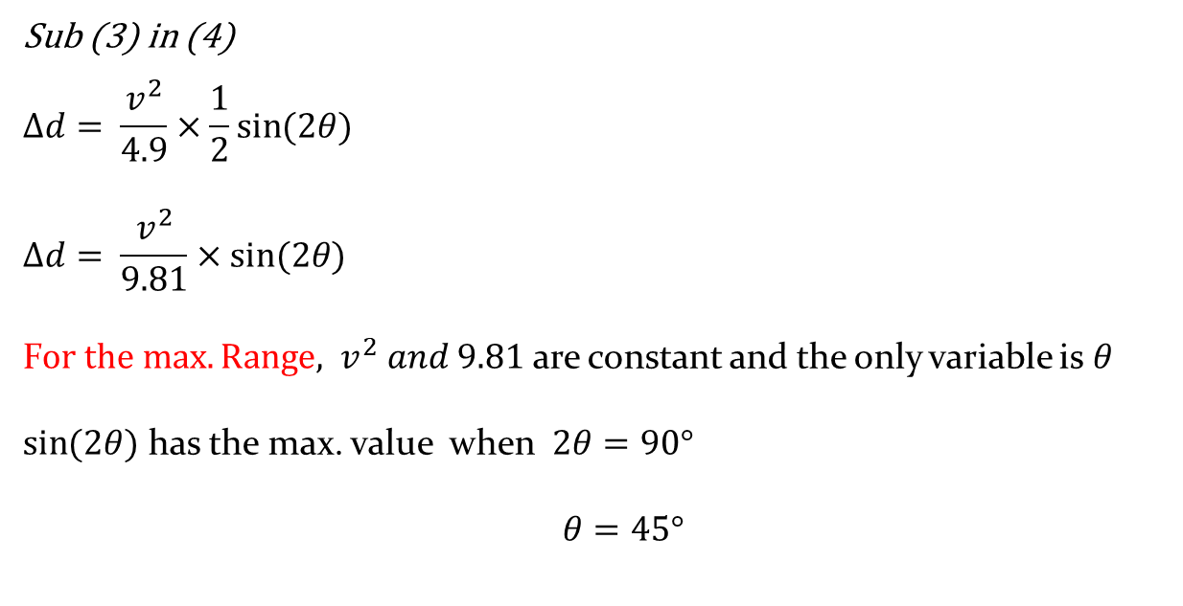
b) The maximum range?
 | Horizontal
Sub (3) in (4)
$$∆d= \frac{v^{2}}{4.9}×\frac{1}{2}\sin{(2θ})$$
$$∆d= \frac{v^{2}}{9.81}×\sin{(2θ)}$$
F$or the max. Range, v^{2} and 9.81$ are constant and the only variable is $θ$
$\sin{(2θ)}$ has the max. value when $2θ=90°$
$θ=45°$
HW All question on the additional sheet

