Slide 1
Acceleration in two dimensions

Slide 2
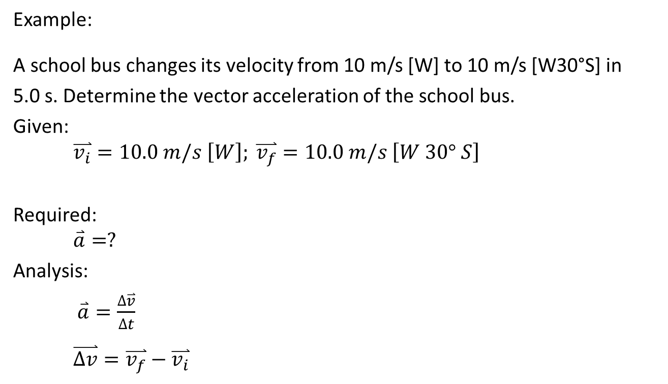
Adding Displacement Vectors by Components
Example:
A school bus changes its velocity from 10 m/s [W] to 10 m/s [W30°S] in
5.0 s. Determine the vector acceleration of the school bus.
Given:
$$\overset{⃑}{v_{i}}=10.0 m/s \left[W\right]; \overset{⃑}{v_{f}}=10.0 m/s \left[W 30° S\right]$$
Required:
$$\overset{⃑}{a}=?$$
Analysis:
$\overset{⃑}{a}=\frac{∆\overset{⃑}{v}}{∆t}$
$$\overset{⃑}{∆v}=\overset{⃑}{v_{f}}−\overset{⃑}{v_{i}}$$

Slide 3

Adding Displacement Vectors by Components
$$\overset{⃑}{v_{i}}=10.0 m/s \left[W\right]; \overset{⃑}{v_{f}}=10.0 m/s \left[W 30° S\right]$$

Slide 4
Relative Velocity with Two Dimension Vectors

Slide 5
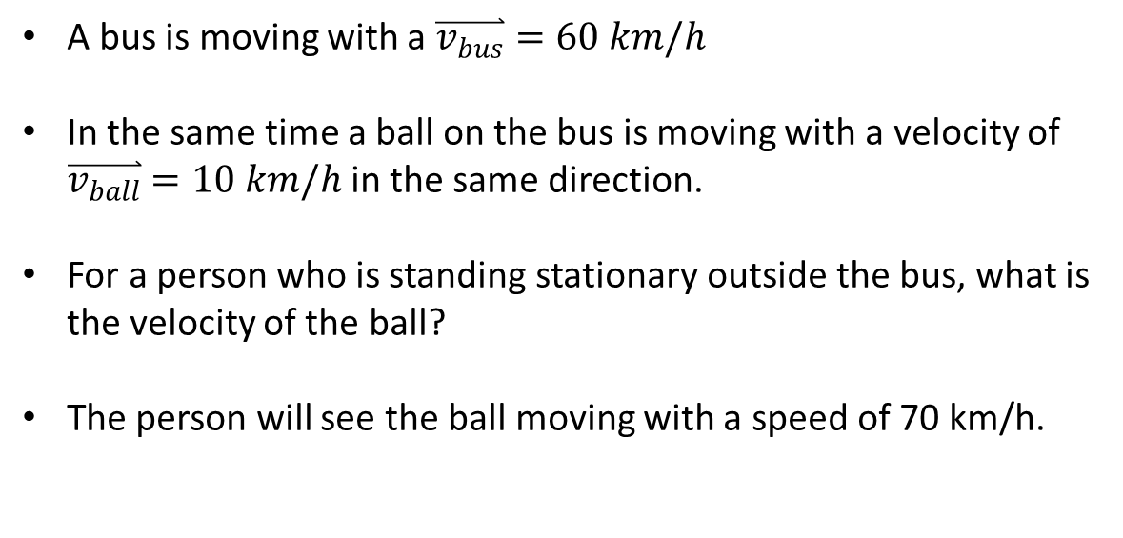
A bus is moving with a $\overset{⃑}{v_{bus}}=60 km/h$
In the same time a ball on the bus is moving with a velocity of $\overset{⃑}{v_{ball}}=10 km/h$ in the same direction.
For a person who is standing stationary outside the bus, what is the velocity of the ball?
The person will see the ball moving with a speed of 70 km/h.

Slide 6
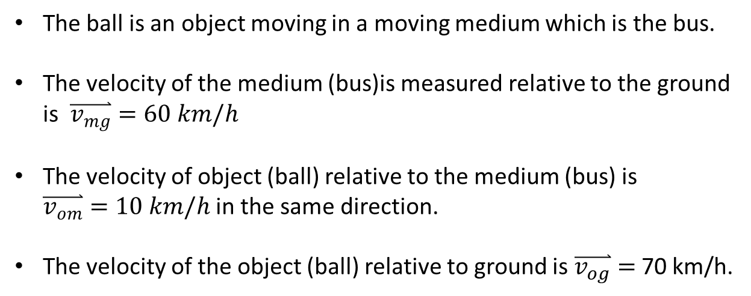
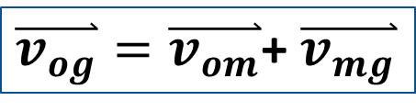
The ball is an object moving in a moving medium which is the bus.
The velocity of the medium (bus)is measured relative to the ground is $\overset{⃑}{v_{mg}}=60 km/h$
The velocity of object (ball) relative to the medium (bus) is $\overset{⃑}{v_{om}}=10 km/h$ in the same direction.
The velocity of the object (ball) relative to ground is $\overset{⃑}{v_{og}}=$70 km/h.
$\overset{⃑}{v_{og}}=\overset{⃑}{v_{om}}$+ $\overset{⃑}{v_{mg}}$

Slide 7
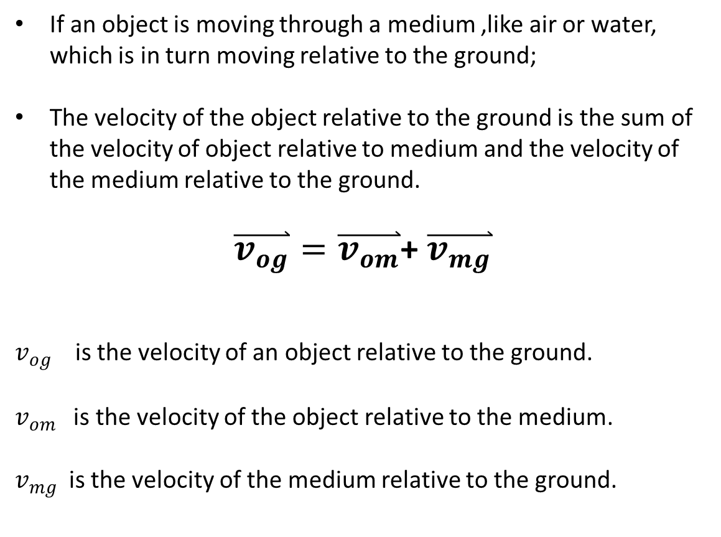
If an object is moving through a medium ,like air or water, which is in turn moving relative to the ground;
The velocity of the object relative to the ground is the sum of the velocity of object relative to medium and the velocity of the medium relative to the ground.
$\overset{⃑}{v_{og}}=\overset{⃑}{v_{om}}$+ $\overset{⃑}{v_{mg}}$
$v_{og}$ is the velocity of an object relative to the ground.
$v_{om}$ is the velocity of the object relative to the medium.
$v_{mg}$ is the velocity of the medium relative to the ground.

Slide 8
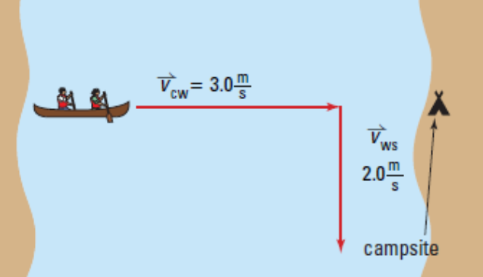

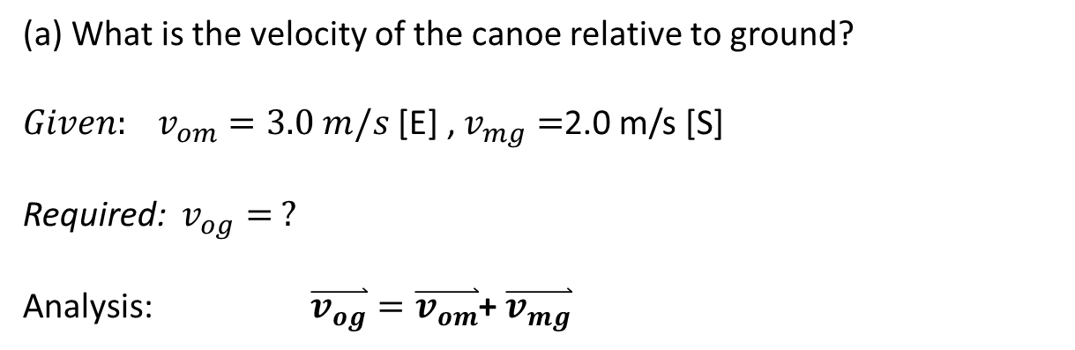


Example:
A canoeist is planning to paddle to a campsite directly across a river that is 624 m wide. The velocity of the river is 2.0 m/s[S]. In still water, the canoeist can paddle at a speed of 3.0 m/s [E].
$v_{om}$=3.0m/s
$v_{mg}$=
(a) What is the velocity of the canoe relative to ground?
${Given: v}_{om}=3.0 m/s$ [E] , $v_{mg}=$2.0 m/s [S]
Required: $v_{og}= ?$
Analysis: $\overset{⃑}{v_{og}}=\overset{⃑}{v_{om}}$+ $\overset{⃑}{v_{mg}}$

Slide 9
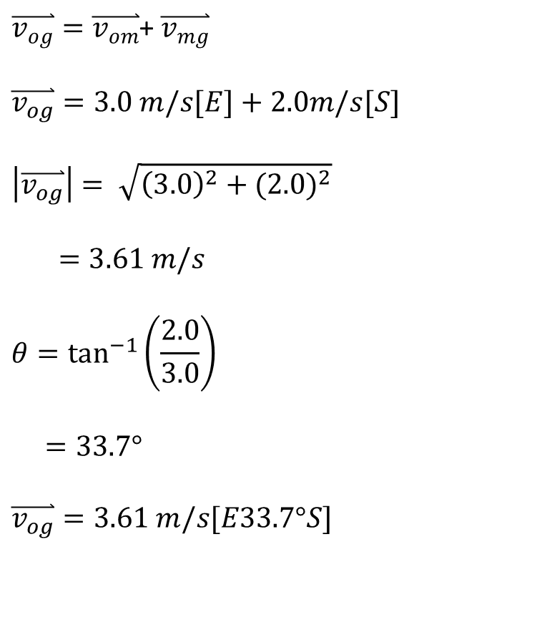

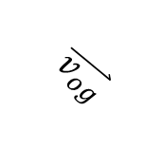

$\overset{⃑}{v_{og}}=\overset{⃑}{v_{om}}$+ $\overset{⃑}{v_{mg}}$
$$\overset{⃑}{v_{og}}=3.0 m/s[E]+2.0m/s[S]$$
$$\left|\overset{⃑}{v_{og}}\right|= \sqrt{{\left(3.0\right)}^{2}+{(2.0)}^{2}}$$
$=3.61 m/s$
$$θ=\tan^{−1}\left(\frac{2.0}{3.0}\right)$$
$=33.7°$
$$\overset{⃑}{v_{og}}=3.61 m/s[E33.7°S]$$
$$θ$$
$v_{mg}$=
$$\overset{⃑}{v_{og}}$$

Slide 10


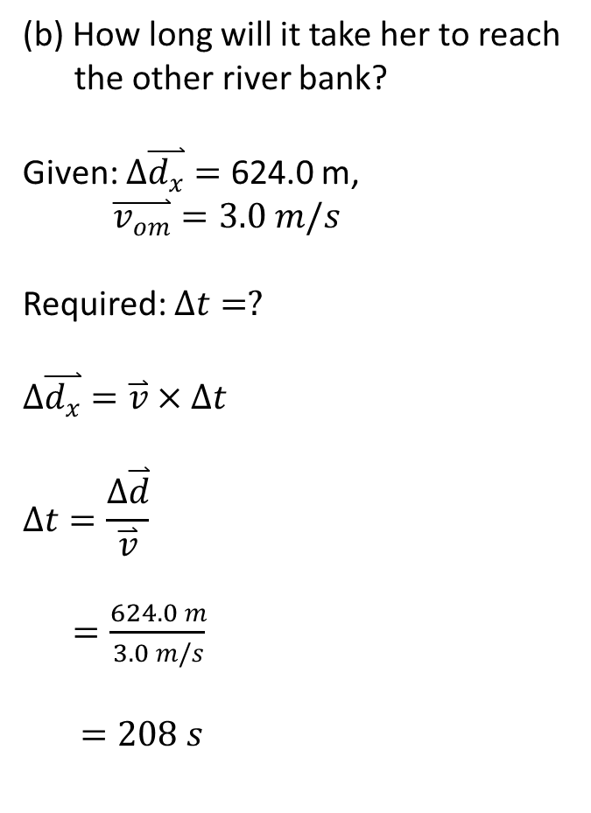
(b) How long will it take her to reach the other river bank?
Given: $∆\overset{⃑}{d_{x}}=$ 624.0 m,
$\overset{⃑}{v_{om}}=3.0 m/s$
Required: $∆t=?$
$$∆\overset{⃑}{d_{x}}=\overset{⃑}{v}×∆t$$
$$∆t=\frac{∆\overset{⃑}{d}}{\overset{⃑}{v}}$$
$=\frac{624.0 m}{3.0 m/s}$
$=208 s$
$$33.7°$$
$v_{mg}$=
$$\overset{⃑}{v_{og}}$$

Slide 11

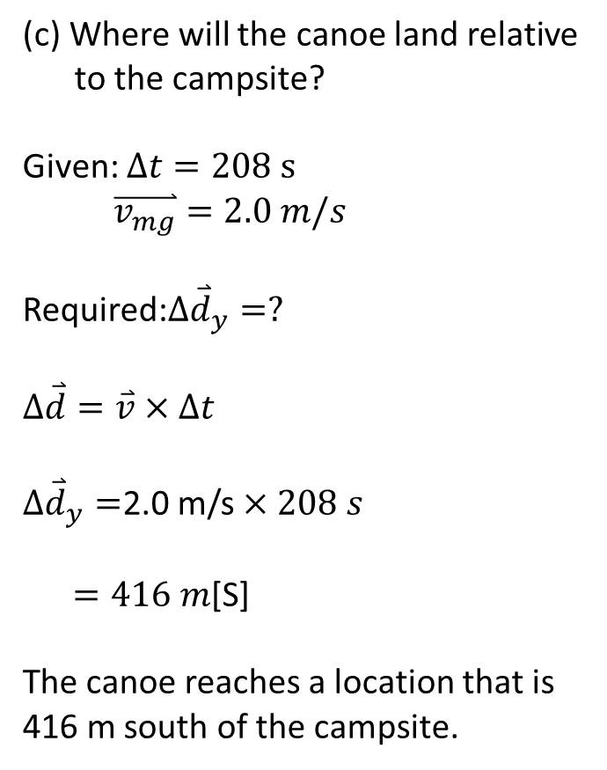

(c) Where will the canoe land relative to the campsite?
Given: $∆t=208 s$
$\overset{⃑}{v_{mg}}=2.0 m/s$
Required:$∆{\overset{⃑}{d}}_{y}=?$
$$∆\overset{⃑}{d}=\overset{⃑}{v}×∆t$$
$∆{\overset{⃑}{d}}_{y}=$2.0 m/s $×208 s$
$=416 m$[S]
The canoe reaches a location that is 416 m south of the campsite.
$$33.7°$$
$v_{mg}$=
$$\overset{⃑}{{∆d}_{x}}=416 m$$
$$33.7°$$
$$\overset{⃑}{{∆d}_{y}}$$

Slide 12

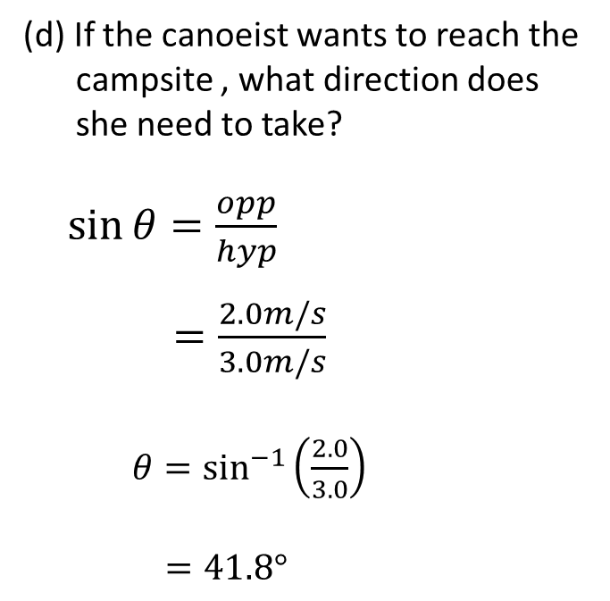


(d) If the canoeist wants to reach the campsite , what direction does she need to take?
$\sin{θ=\frac{opp}{hyp}}$
$=\frac{2.0m/s}{3.0m/s}$
$θ=\sin^{−1}\left(\frac{2.0}{3.0}\right)$
$=41.8°$
$v_{mg}$=2.0m/s
$$θ$$

Slide 13
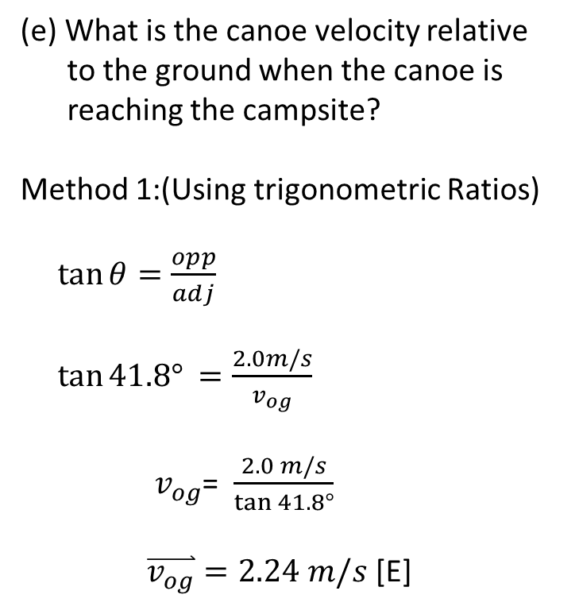

(e) What is the canoe velocity relative to the ground when the canoe is reaching the campsite?
Method 1:(Using trigonometric Ratios)
$\tan{θ=\frac{opp}{adj}}$
$\tan{41.8°}$ $=\frac{2.0m/s}{v_{og}}$
$v_{og}$= $\frac{2.0 m/s}{\tan{41.8°}}$
$\overset{⃑}{v_{og}}=2.24 m/s$ [E]
$v_{mg}$=2.0m/s
$$41.8°$$

Slide 14
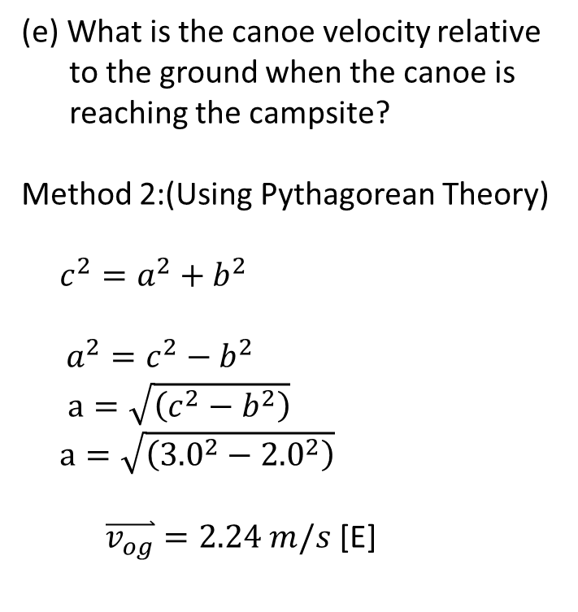
(e) What is the canoe velocity relative to the ground when the canoe is reaching the campsite?
Method 2:(Using Pythagorean Theory)
$c^{2}=a^{2}+b^{2}$
$$a^{2}=c^{2}−b^{2}$$
$a=\sqrt{\left(c^{2}−b^{2}\right)}$
$a=\sqrt{\left({3.0}^{2}−{2.0}^{2}\right)}$
$\overset{⃑}{v_{og}}=2.24 m/s$ [E]
$v_{mg}$=2.0m/s
$$41.8°$$

Slide 15

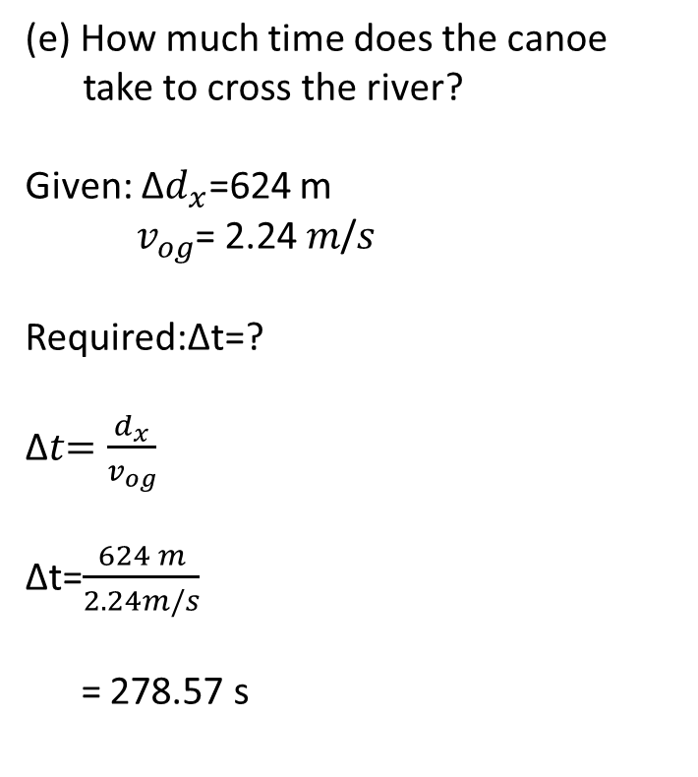




(e) How much time does the canoe take to cross the river?
Given: ∆$d_{x}$=624 m
$v_{og}$= 2.24 𝑚/𝑠
Required:∆t=?
∆𝑡$=\frac{d_{x}}{v_{og}}$
∆t=$\frac{624 m}{2.24m/s}$
= 278.57 s
$v_{mg}$=2.0m/s
$$41.8°$$
$v_{og}$= 2.24 𝑚/𝑠
$$41.8°$$
$$∆d_{x}=624 m$$

Slide 16
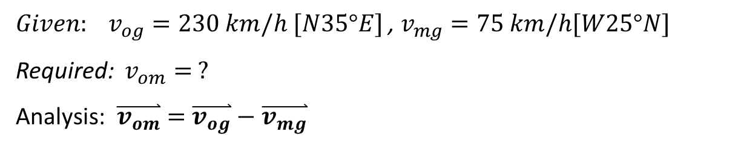
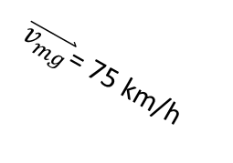
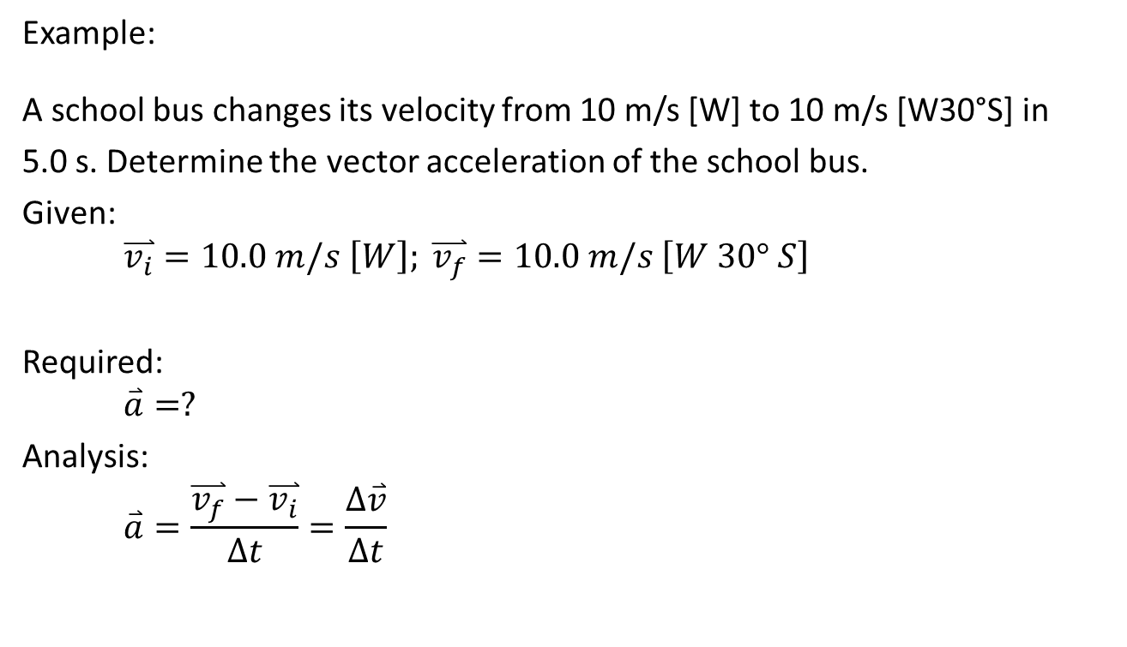


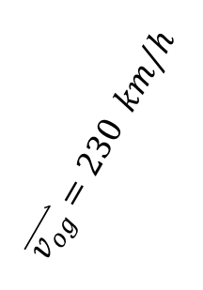
Example:
The pilot of a plane wants to achieve a velocity of 230 km/h [N 35$°$ E] while the wind is blowing at 75 km/h [W 25$°$ N]. What must be the heading velocity of the plane to achieve that?
${Given: v}_{og}=230 km/h [N35°E]$ , $v_{mg}=75 km/h[W25°N]$
Required: $v_{om}= ?$
Analysis: $\overset{⃑}{v_{om}}=$ $\overset{⃑}{v_{og}}−\overset{⃑}{v_{mg}}$
$$\overset{⃑}{v_{og}}=230 km/h$$
$\overset{⃑}{v_{mg}}$= 75 km/h
35 $°$
25 $°$

Slide 17
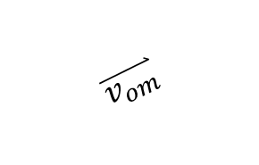
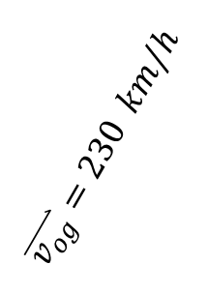

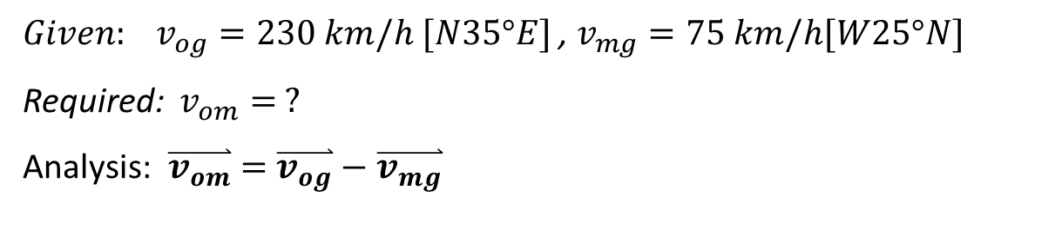
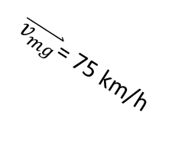
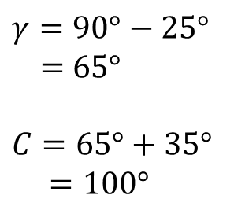
${Given: v}_{og}=230 km/h [N35°E]$ , $v_{mg}=75 km/h[W25°N]$
Required: $v_{om}= ?$
Analysis: $\overset{⃑}{v_{om}}=$ $\overset{⃑}{v_{og}}−\overset{⃑}{v_{mg}}$
$$γ=90°−25°$$
= 65$°$
$$C=65°+35°$$
$=100°$
$$\overset{⃑}{v_{om}}$$
$$\overset{⃑}{v_{og}}=230 km/h$$
35 $°$
$\overset{⃑}{v_{mg}}$= 75 km/h
65 $°$
25 $°$

Slide 18
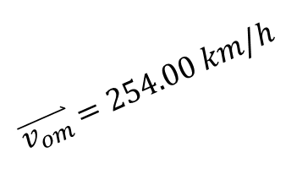

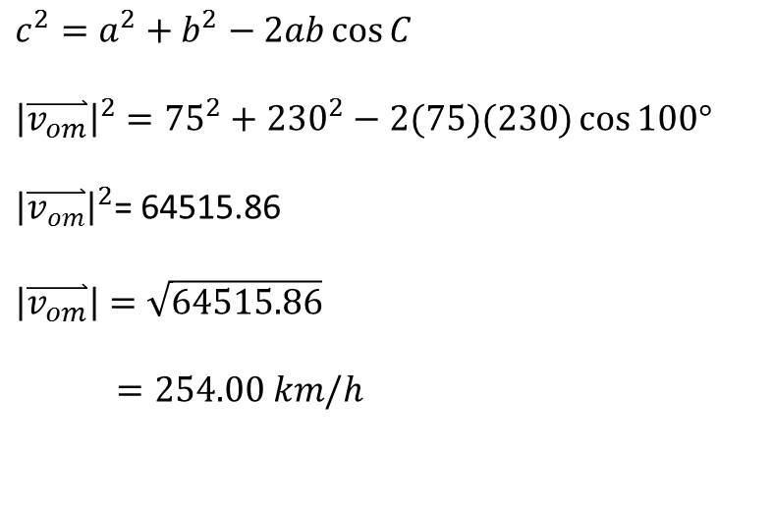
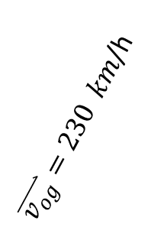
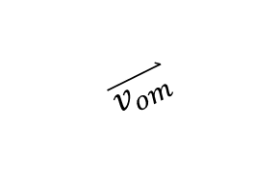
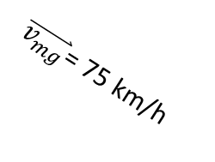

$$c^{2}=a^{2}+b^{2}−2ab\cos{C}$$
$${\left|\overset{⃑}{v_{om}}\right|}^{2}={75}^{2}+{230}^{2}−2(75)(230)\cos{100°}$$
${\left|\overset{⃑}{v_{om}}\right|}^{2}$= 64515.86
$$\left|\overset{⃑}{v_{om}}\right|=\sqrt{64515.86}$$
$=254.00 km/h$
$\overset{⃑}{v_{om}}$ $=254.00 km/h$
$$\overset{⃑}{v_{om}}$$
$\overset{⃑}{v_{og}}=230 km$/h
100 $°$
$\overset{⃑}{v_{mg}}$= 75 km/h
25 $°$

Slide 19


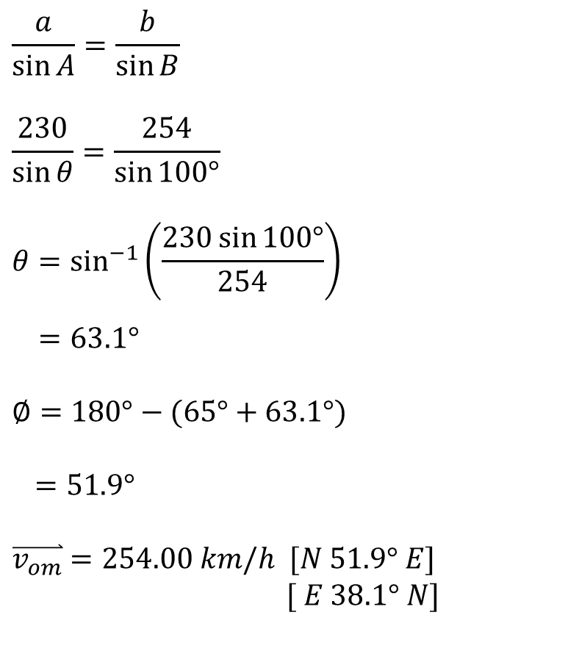

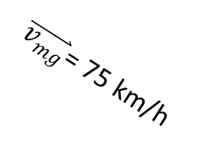


$$\frac{a}{\sin{A}}=\frac{b}{\sin{B}}$$
$$\frac{230}{\sin{θ}}=\frac{254}{\sin{100°}}$$
$$θ=\sin^{−1}\left(\frac{230\sin{100°}}{254}\right)$$
$$=63.1°$$
$$∅=180°−(65°+63.1°)$$
$=51.9°$
$\overset{⃑}{v_{om}}$ $=254.00 km/h [N 51.9° E]$
$[ E 38.1° N]$
$\overset{⃑}{v_{om}}$ $=254.00 km/h$
51.9 $°$
$$∅$$
$\overset{⃑}{v_{og}}=230 km$/h
$$θ$$
$$63.1°$$
65 $°$
100 $°$
25 $°$
$\overset{⃑}{v_{mg}}$= 75 km/h

Slide 20
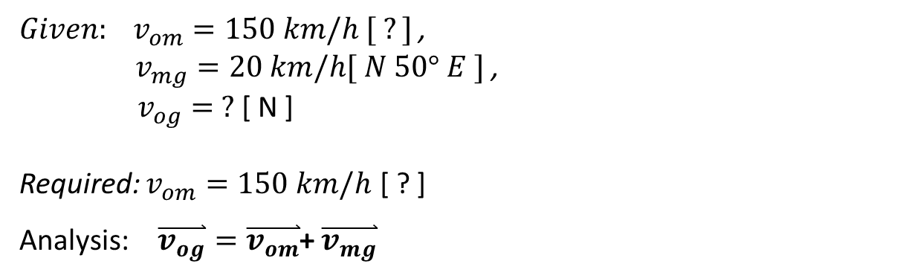
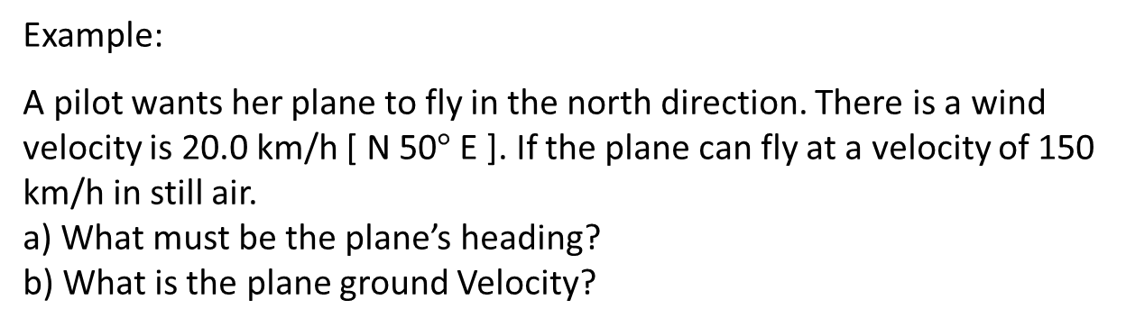


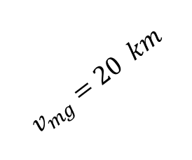
Example:
A pilot wants her plane to fly in the north direction. There is a wind velocity is 20.0 km/h [ N 50$°$ E ]. If the plane can fly at a velocity of 150 km/h in still air.
a) What must be the plane’s heading?
b) What is the plane ground Velocity?
${Given: v}_{om}=150 km/h [ ?]$ ,
$v_{mg}=20 km/h[ N 50° E ]$ ,
$v_{og}= ?$ [ N ]
Required: $v_{om}=150 km/h$ [ ? ]
Analysis: $\overset{⃑}{v_{og}}=\overset{⃑}{v_{om}}$+ $\overset{⃑}{v_{mg}}$
$\overset{⃑}{v_{og}}$= ? km
50 $°$
$$v_{mg}=20 km$$

Slide 21

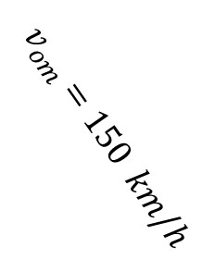
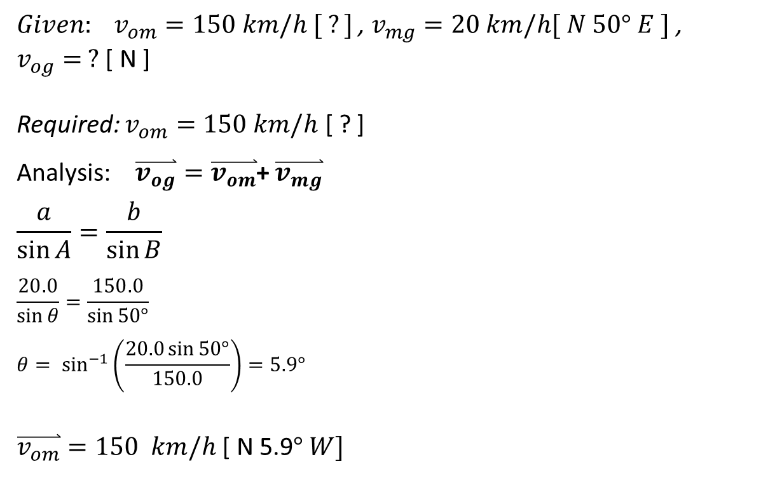


${Given: v}_{om}=150 km/h [ ?]$ , $v_{mg}=20 km/h[ N 50° E ]$ , $v_{og}= ?$ [ N ]
Required: $v_{om}=150 km/h$ [ ? ]
Analysis: $\overset{⃑}{v_{og}}=\overset{⃑}{v_{om}}$+ $\overset{⃑}{v_{mg}}$
$$\frac{a}{\sin{A}}=\frac{b}{\sin{B}}$$
$$\frac{20.0}{\sin{θ}}=\frac{150.0}{\sin{50°}}$$
$$θ= \sin^{−1}\left(\frac{20.0\sin{50°}}{150.0}\right)=5.9°$$
$\overset{⃑}{v_{om}}=150 km/h$ [ N 5.9$° W]$
$$v_{om}=150 km/h$$
$$5.9°$$
$\overset{⃑}{v_{og}}$= ? km
$$5.9°$$
50 $°$
$$v_{mg}=20 km$$

Slide 22

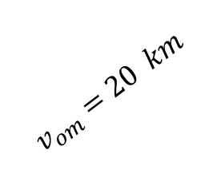

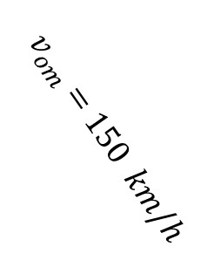



b) what is the plane’s ground velocity?
Using the Sine Law:
$$∅=180°−\left(50°+5.9°\right)$$
$=124.1°$
$$\frac{a}{\sin{A}}=\frac{b}{\sin{B}}$$
$$\frac{v_{og}}{\sin{124.1°}}=\frac{150.0}{\sin{50°}}$$
$$v_{og}=\frac{150\sin{124.1°}}{\sin{50°}}$$
$=162.14 km/h$
$\overset{⃑}{v_{og}}=162.14 km/h$ [ N]
$$v_{om}=150 km/h$$
$$5.9°$$
$\overset{⃑}{v_{og}}$= 162.14 km/h
$\overset{⃑}{v_{og}}$= ? km
$$5.9°$$
124.1 $°$
$$v_{om}=20 km$$
50 $°$

Slide 23
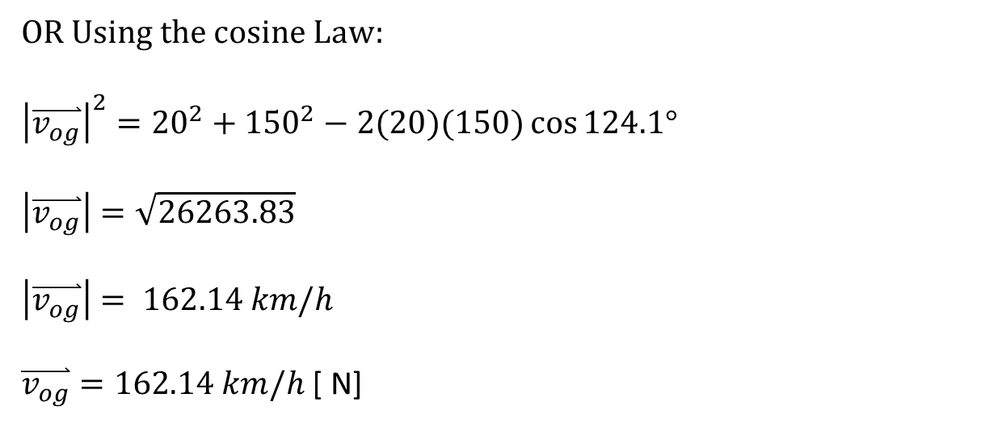
b) what is the plane’s ground velocity?
OR Using the cosine Law:
$${\left|\overset{⃑}{v_{og}}\right|}^{2}={20}^{2}+{150}^{2}−2(20)(150)\cos{124.1°}$$
$$\left|\overset{⃑}{v_{og}}\right|=\sqrt{26263.83}$$
$\left|\overset{⃑}{v_{og}}\right|= 162.14 km/h$
$\overset{⃑}{v_{og}}=162.14 km/h$ [ N]
$$v_{om}=150 km/h$$
$$5.9°$$
$\overset{⃑}{v_{og}}$= ? km
$$5.9°$$
124.1 $°$
$$v_{om}=20 km$$
50 $°$
HW questions # 54 – 62 on page 116 of the package

