Slide 1
Video Game Sales Analysis
Joshua Vach

Slide 2
Project Overview
This project analyzes a data set holding over 16,000 video games with data about their publisher, platform, release year, and sales in various regions.
Analysis will focus on trends based on sales within various regions and how different variables will affect them.

Slide 3
Discovery Questions
Do publishers do better in their home markets or in other countries and does the platform or year affect this outcome? This question is interesting because it can show whether a company is more likely to find success in releasing their game abroad or not, and whether or not the platform matters in its success abroad.
Which platforms sold the most video games each year and were these dominated by specific games or a more broad spread. This can help find which platform was the largest in a specific year and if it was just a fluke due to one big game or a larger dominance in the market.
How have total sales changed over the years in the different major markets. This can tell us a lot about the economic situation in markets around the world because video games, being an entertainment good, are very likely to change in the face of economic growth or strife.

Slide 4
Methods Used (K-Means)
K-Means: 3 implementations used for more specific data points
First: Compares the sales for the three main regions, North America, Japan, and Europe, and made a percentage of these compared to total game sales.
Second: Compares the top game of a certain platform and compares it to the total sales of the games released on that platform that year and compares the ratio between these two data points.
Third: Compares the total yearly sales to each major regions yearly sales

Slide 5
Methods Used (Cont.)
FPGrowth: Creates 3 indicators for games with higher than average sales in the three main markets, Japan, North America, and Europe. This alongside the datasets other variables was used to create the top predictors for the three markets
Isolation Forest: Focuses on the sales in the 3 major markets as well as other sales and total sales to show games that overperform in certain areas.

Slide 6
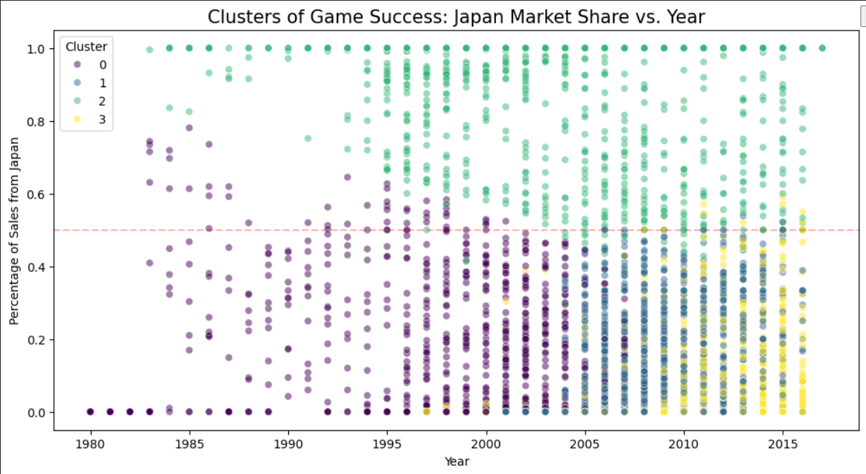
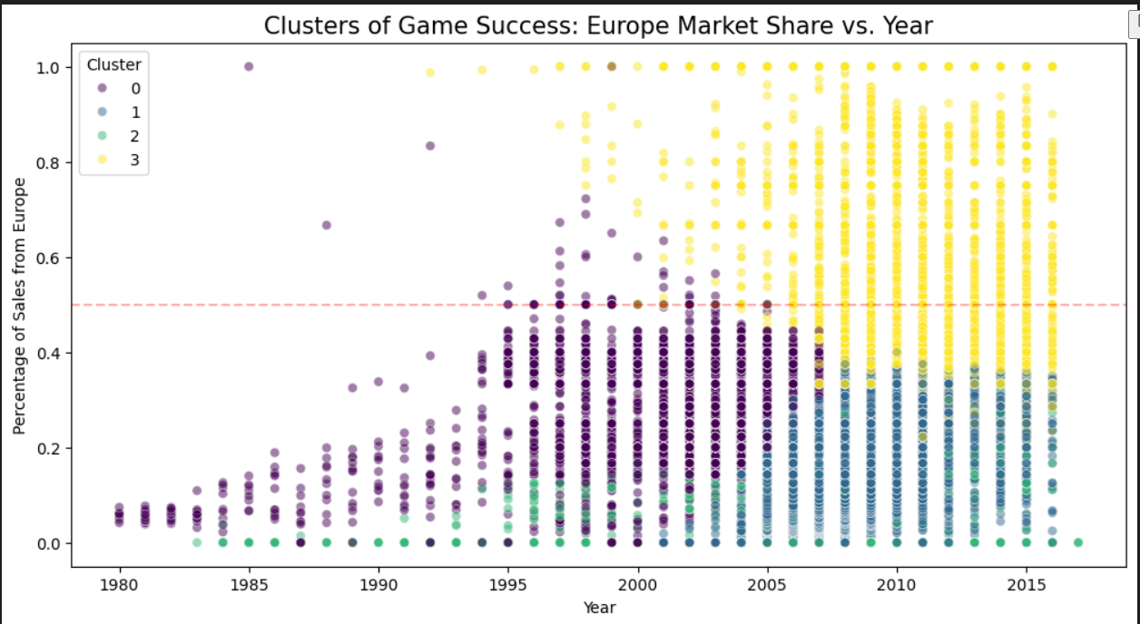
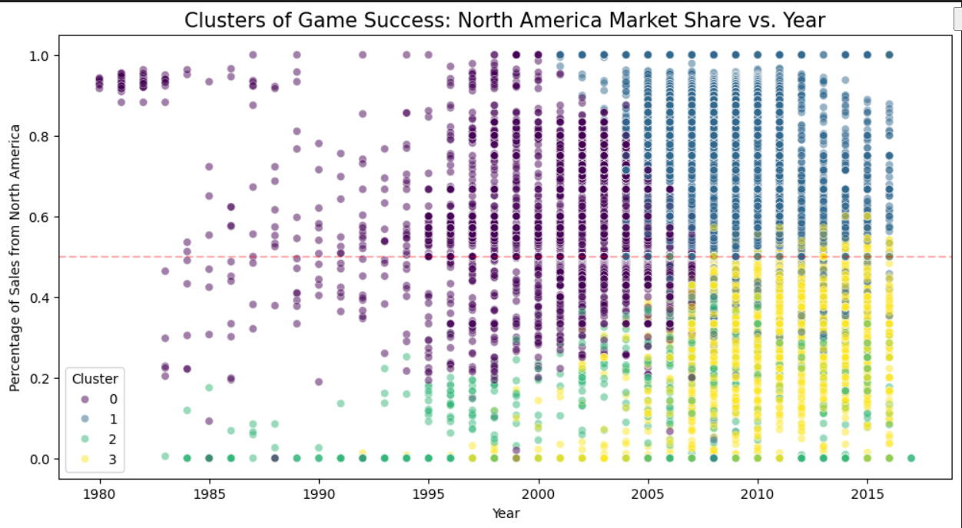
Results K-Means (Question 1)
Cluster 2 is the cluster focused mainly on Japanese games with many of them having most of their sales only in Japan showing a clear relationship with Japan having more exclusive games that than other markets.
Cluster 3 is focused mainly on Europe which mainly begins to appear after the year 2000 showing their consumer base is relatively recent while still having a decent number of games that are popular in Europe and nowhere else.
Cluster 0 and 1 are both North American centric clusters with 0 being the earlier stages mainly early 2000s and 1 being focused mostly post-2005. This shows multiple games also having almost 100% of their sales in North America in line with the other two markets.
Due to every market containing games that only perform well in one region this shows that markets have preferences that others do not and many developers do capitalize on this to create games for specific markets. While this does not directly tell whether these were made by developers in these regions it is likely that they are.

Slide 7
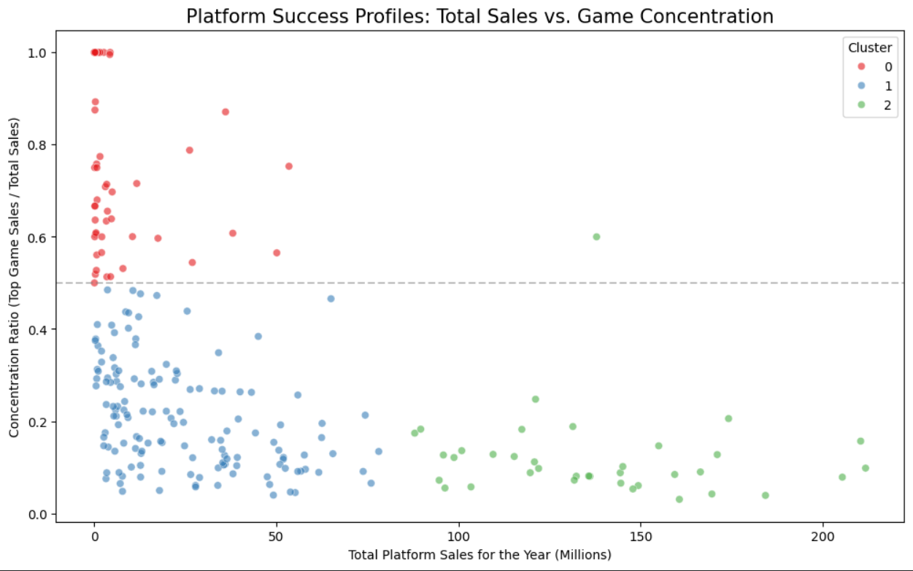
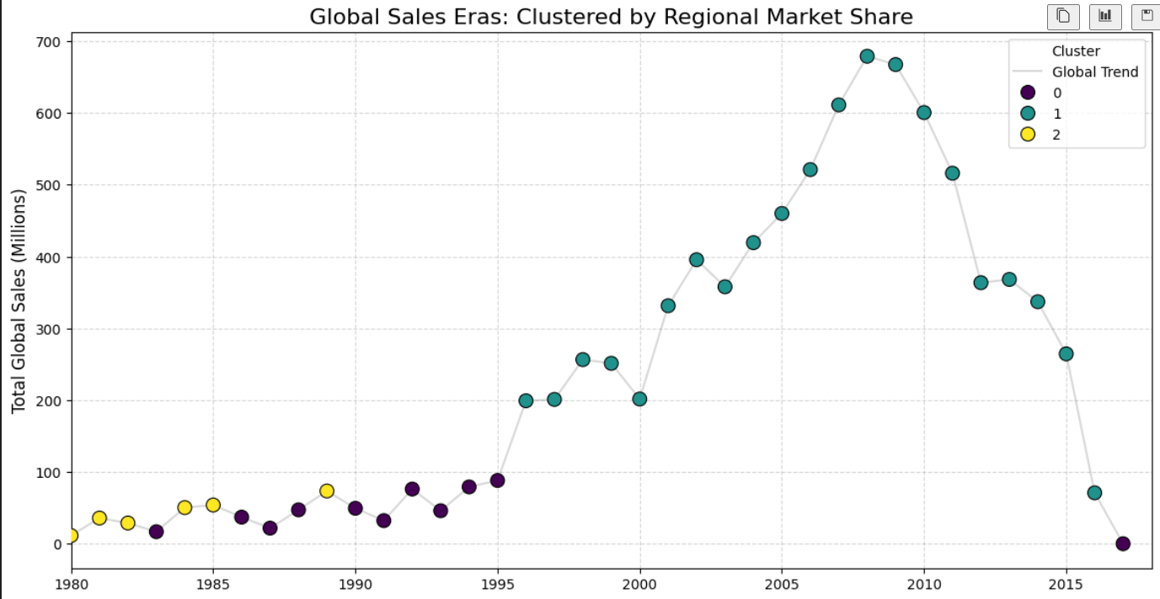
Results: K-Means (Questions 2 and 3)
Question 2: The 3 Clusters show 3 different types of platforms. Cluster 0 shows platforms that did poorly overall and most of that success was one game. Cluster 1 shows games that did poorly but had various different games make up those sales. Cluster 2 shows games that performed well and were not dominated by any one game. This shows that if a platform did well it was unlikely to by dominated by just one game and overall have a healthy ecosystem, but if a console performed poorly, it was likely pushed with very few games leading to certain games dominating
Question 3: The 3 clusters in this contained data on how much of that years sales were in each region. Cluster 0 is composed mostly of sales in Japan with over 50% of sales being in Japan showing that in the late 80s early 90s Japan was dominating the video game market while North America remained in 2nd. Cluster 1 is mainly composed by North America with 47% followed by Europe with 29% showing a significant shift away from Japan in the late 90s towards North America and Europe. Cluster 2 is Dominated by North America with over 78% of sales being in North America showing North America had a commanding lead at the start.

Slide 8
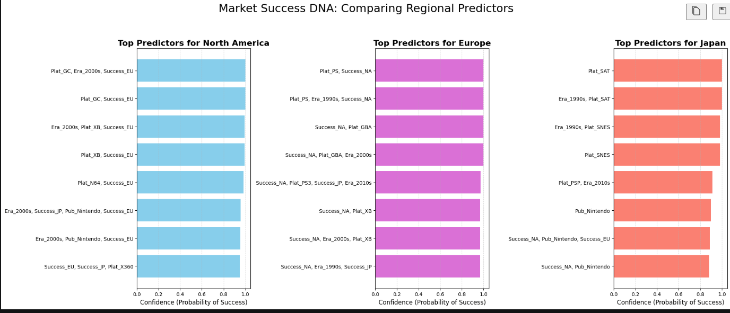
Results (FPGrowth)
Question 1: Overall the publisher of a game has very little effect on the success of a game with platform and success in other regions being more important. The one exception is Nintendo which succeeds more often than not in Japan and in the 2000s in North America
Question 2: Healthy platforms contain lots of gamesthat succeed and the FPGrowth shows this with theGame Cube, XBox, Playstation, Sega Saturn, andSNES.
Question 3: The 90s and 2000s are the periods with the most appearances in the top predictors showing that games sold in this time were most successful while the 2010s shows less often but still more than the 80s which does not appear.

Slide 9
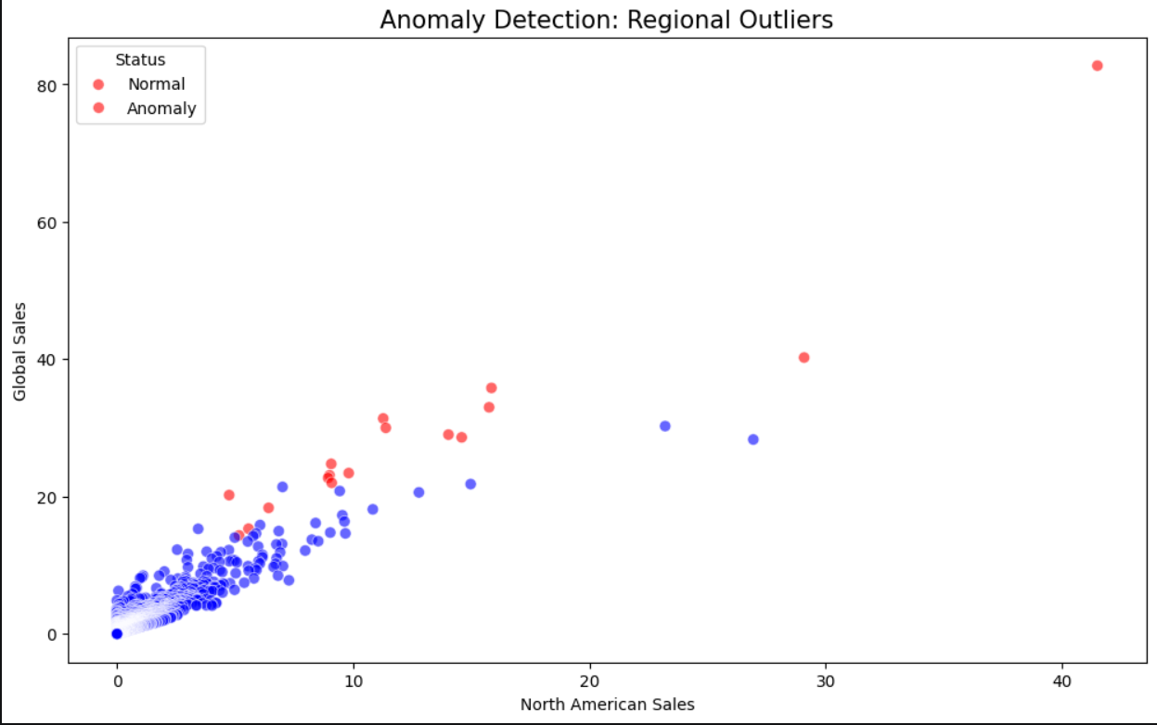
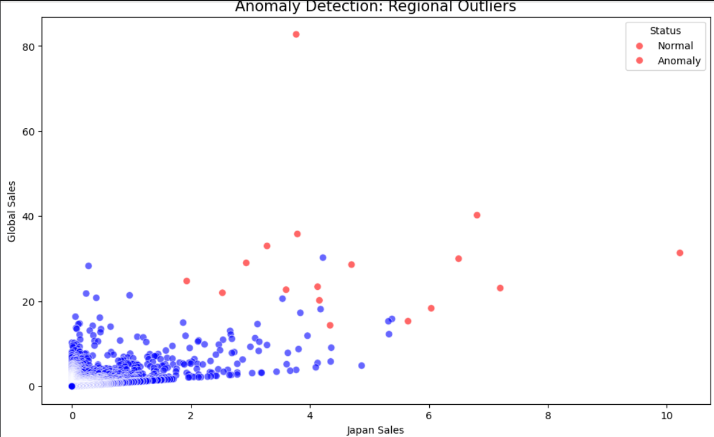
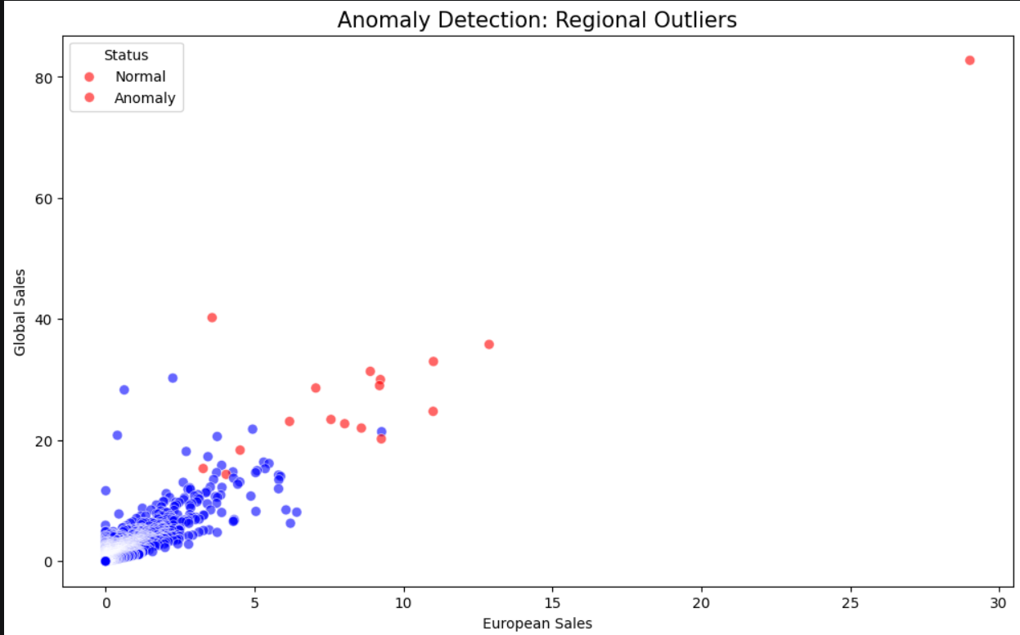
Results (Isolation Forest)
The graph itself shows very little as the anomalies are all the highest sellers in the three major markets
All games in the top 10 anomalies were published by Nintendo once again showcasing that Nintendo is the outlier when it comes to publishers

Slide 10
Conclusion
Question 1: The data shows that publishers have very little effect on sales meaning, with the exception of Nintendo which performs well in its homeland of Japan as well as North America in the 2000s. While the markets have games that only sell well in certain markets there is not enough evidence to prove this is because of the publisher.
Question 2: Platforms that perform well are almost always healthy as lots of games are released on them not allowing for any one game to dominate the platform. Platforms that sell poorly however are much more prone to having one game make up most of the sales crushing all competition.
Question 3: There are 3 main stages in the video game market as of now. The first stage is the early stage dominated by American and Japanese markets making comparatively small sales in the 80s , dominated by North America, and early 90s, dominated by Japan. The second stage is from the late 90s to the 2010s with a massive increase in sales as well as leaving Japan behind while Europe begins to enter the fray. The final stage is the 2010s to the present where total sales begin to decrease.

Slide 11
Q&A
Why did I chose FPGrowth and K-Means?
Where there any limitations in the dataset?
How confident am I in my conclusions

