Slide 1
Why the Government Shouldn't Have the Power to Shutdown Companies Without
Due Process
By Joshua Varner

Slide 2
Introduction
The proposition of granting the government unchecked power
Historical examples of authoritarian leaders that shut down companies: Hitler, Mao, and Mussolini

Slide 3
Threat to the Rule of Law
Arbitrary power undermines the legal system
Companies subject to political whims and vendettas

Slide 4
Erosion of Individual Liberties
Suppression of dissenting voices
Creation of an environment of fear and oppression

Slide 5

Distortion of the Free Market Economy
Deterring risk-taking and innovation
Stifling competition

Slide 6
Most popular social media stocks owned by congress members
Facebook Stock is owned by 32 congress members
Google is owned by 45 congress members
Source:
https://www.businessinsider.com/congress-holding-stocks-facebook-twitter-disney-fox-news-2021-12

Slide 7
Main Arguments for Banning TikTok
Potential abuse of privacy by the Chinese government is concerning
Chinese government propaganda
Source: apnews.com/article/why-is-tiktok-being-banned-7d2de01d3ac5ab2b8ec2239dc7f2b20d

Slide 8
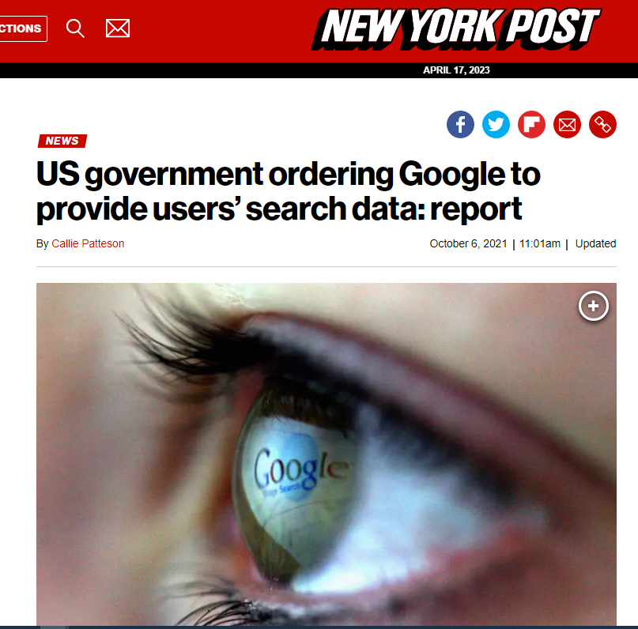
Source:
https://nypost.com/2021/10/06/us-government-ordering-search-engines-to-provide-search-data/

Slide 9
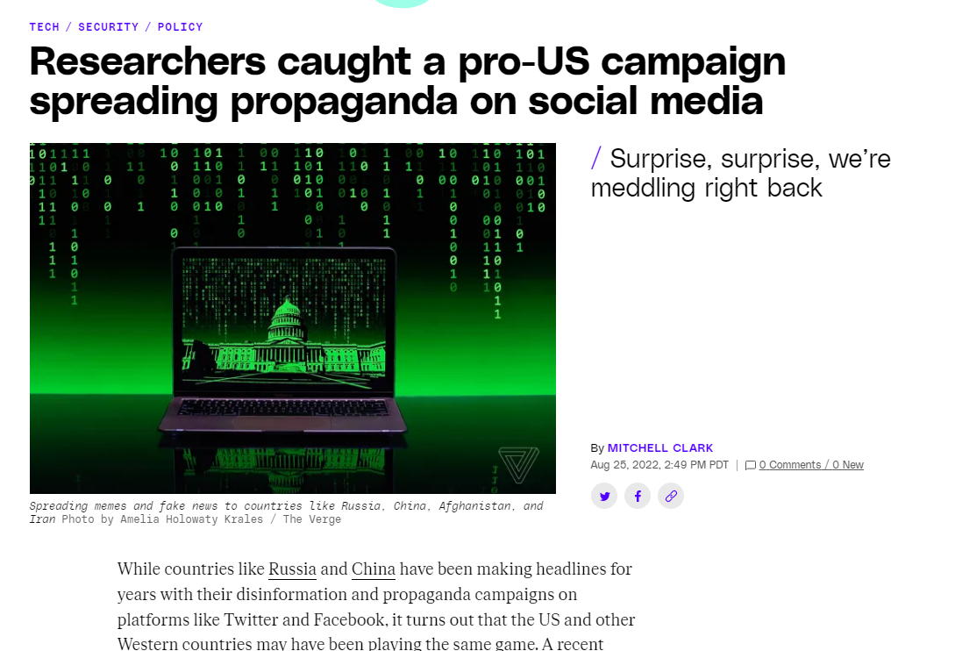
Source:
theverge.com/

Slide 10
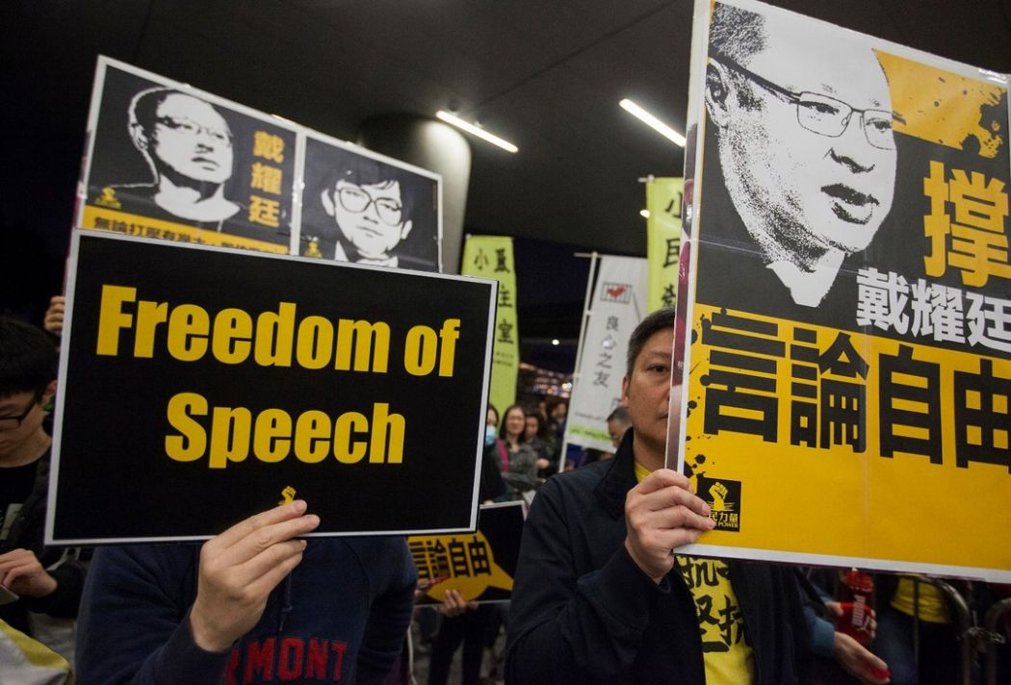
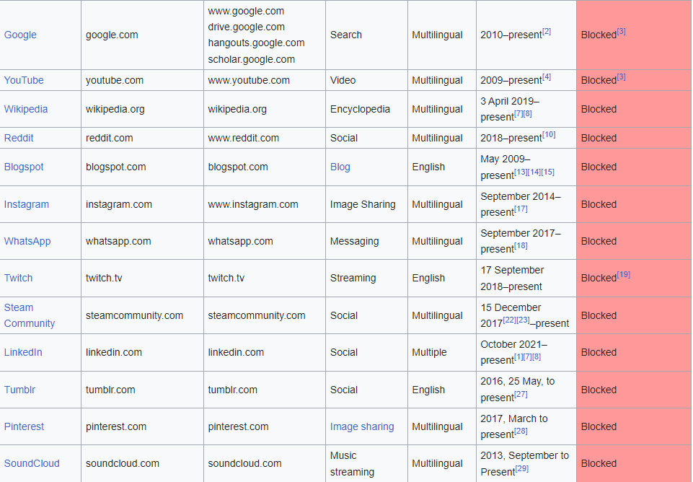
Websites and Social media blocked in China
Source:
ts.yale.edu

Slide 11
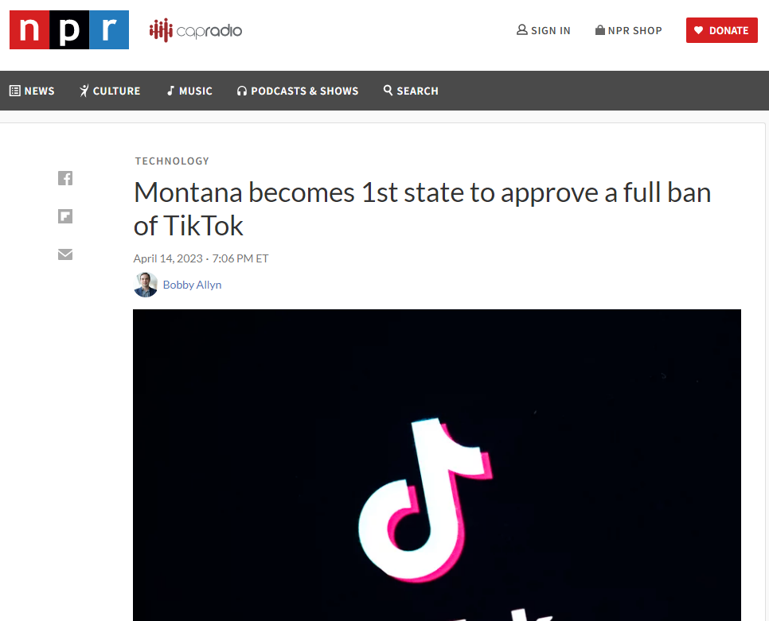
Source:
npr.org/2023/04/14/1170204627/montana-becomes-1st-state-to-approve-a-full-ban-of-tiktok

Slide 12
Conclusion
Defending democratic values
Maintaining the balance of power
Learning from the tragedies of the past

