Slide 1
building database with a web crawler and firebase

Slide 2
outline
Extract information from a website by crawler
Build up dataset with firebase
Retrieve database from firebase

Slide 3
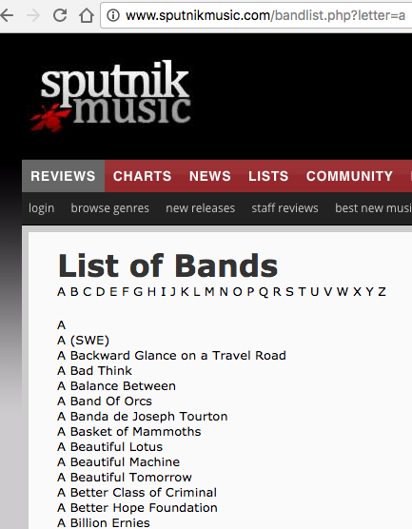
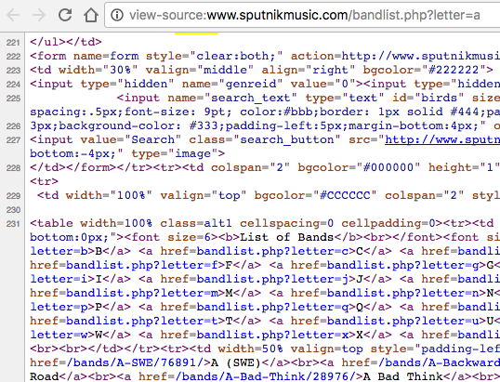
Extracting information from a website by crawler
List of bands

Slide 4
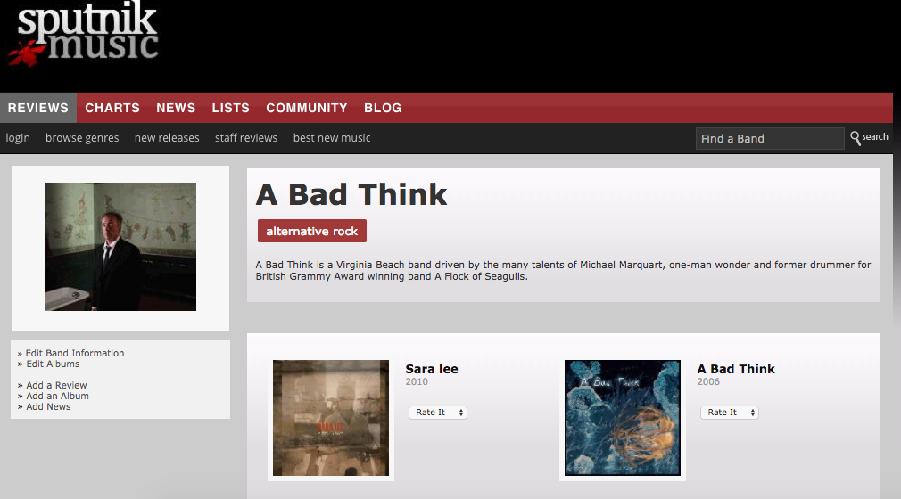
Extracting information from a website by crawler
Artist page

Slide 5
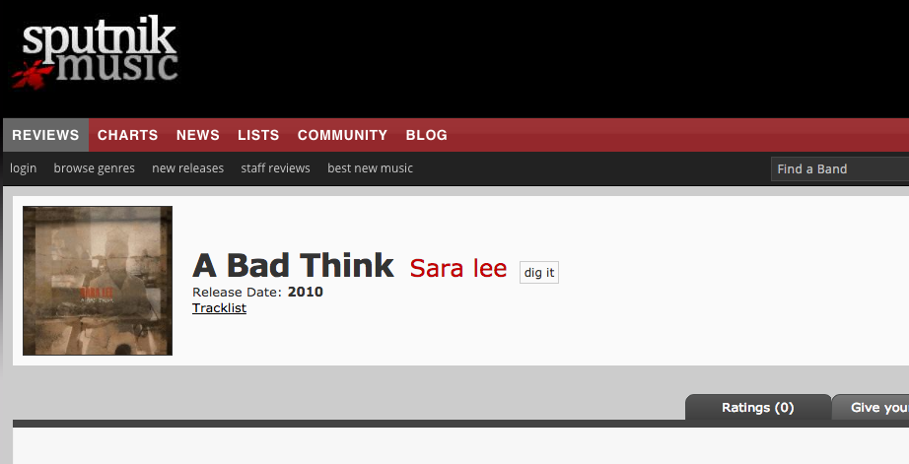
Extracting information from a website by crawler
Album page

Slide 6
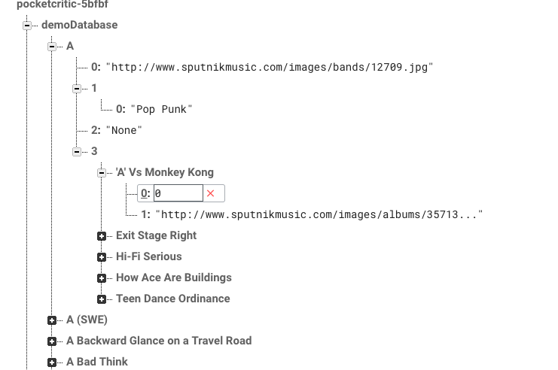
Build up dataset with firebase

Slide 7
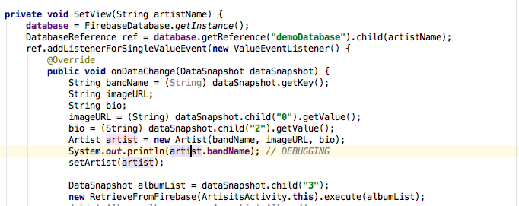
Retrieve database from firebase

Slide 8
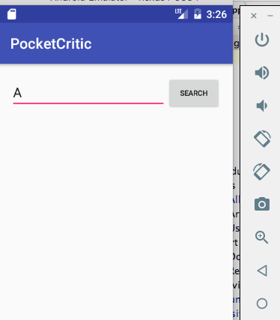
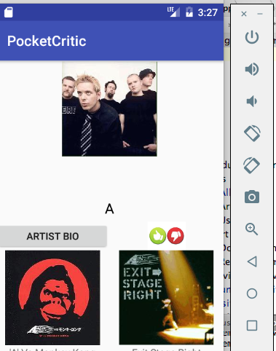
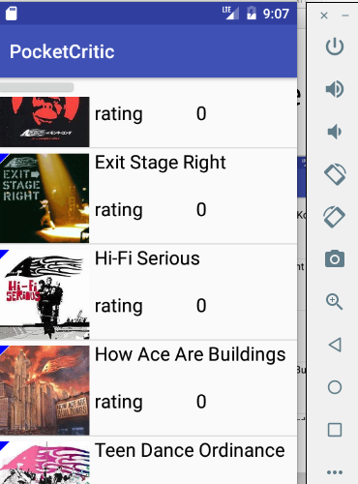
Retrieve database from firebase

