Slide 1
building database with a web crawler and firebase

Slide 2
outline
Extract information from a website by crawler
Build up dataset with firebase
Retrieve data from firebase

Slide 3
Extract information from a website by crawler
Tools:
BeautifulSoup package
Process:
Making the soup!
Read the html file and store them in the string
Load the string into beautiful soup class
Content of soup: Tag, Name, Attribute, Text
Find what we want in the soup!
Function: find and find_all
Method: Utilize regular expression with content of soup

Slide 4
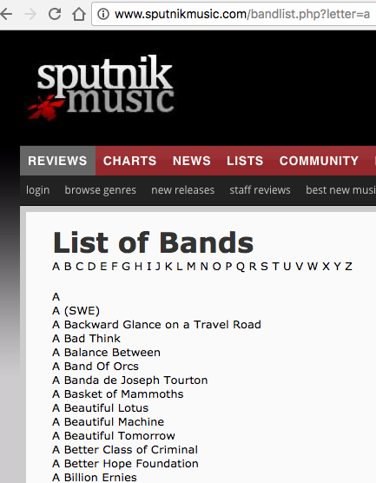
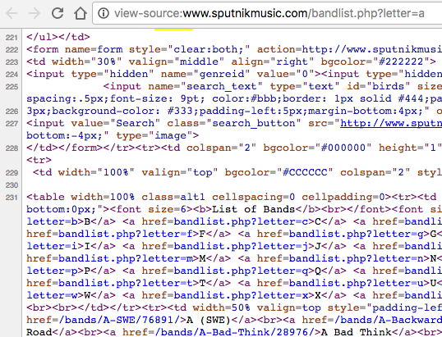
Extract information from a website by crawler
List of bands

Slide 5
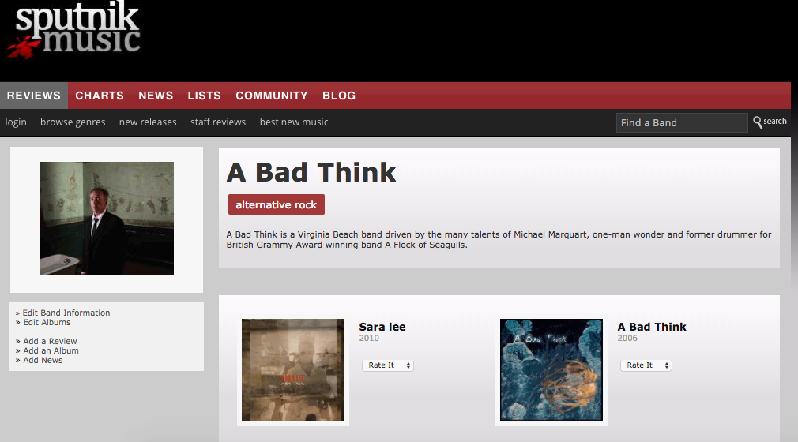
Extract information from a website by crawler
Artist page

Slide 6
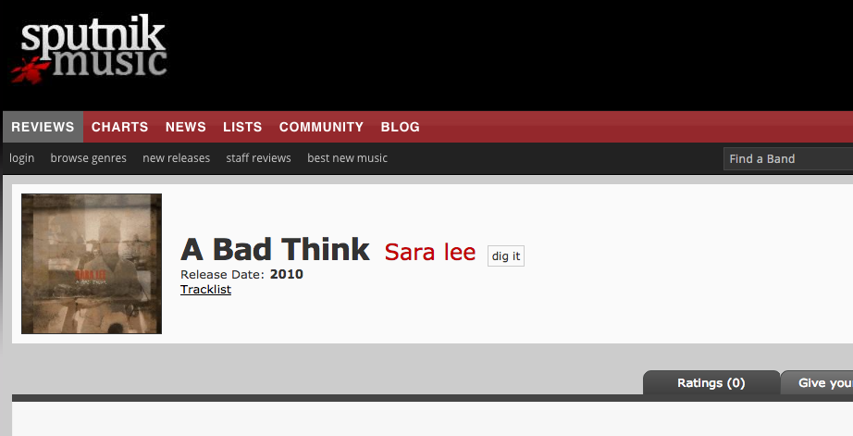
Extract information from a website by crawler
Album page

Slide 7
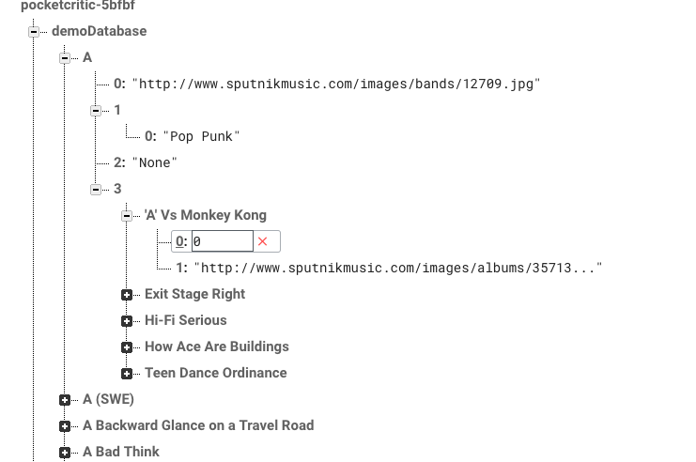
Build up dataset with firebase

Slide 8
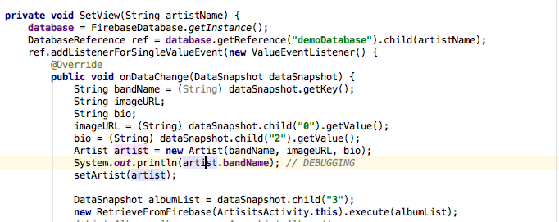
Retrieve data from firebase

Slide 9
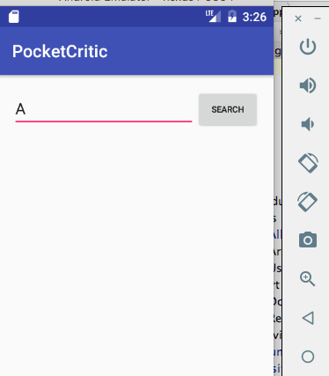
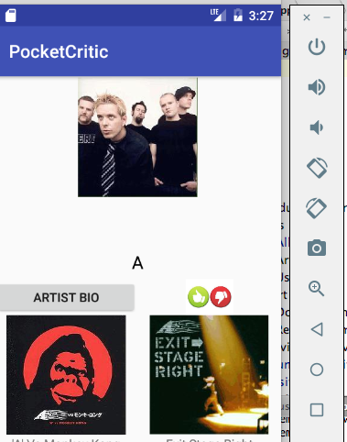
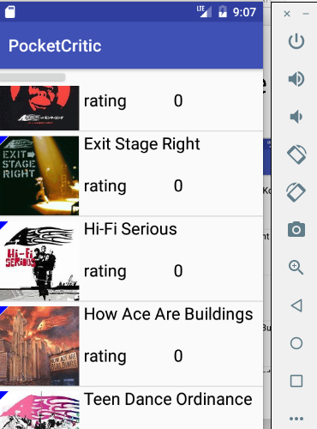
Retrieve data from firebase

