Slide 1
Diving into DNA-Protein Interaction with Machine Learning
Jun Wang

Slide 2
Outline
Background
Introduction
Features
Models
Evaluation
Current progress
Data
Naïve bayes model
Next step

Slide 3
Background
DNA-protein interaction is an important component for gene regulation system. Finding the interaction sites on protein and DNA molecules would be a critical step for drug design and researches on the metabolic network.
Methods for investigating the binding sites:
Experimental identification in the lab
Analysis from 3-d structure of the molecules
Inference from some other data like residue sequence
Considering the disadvantages of the first two methods, more and more researchers focused to investigate some methods of the third way.
Ofran, Y, et al. Bioinformatics (2007)

Slide 4
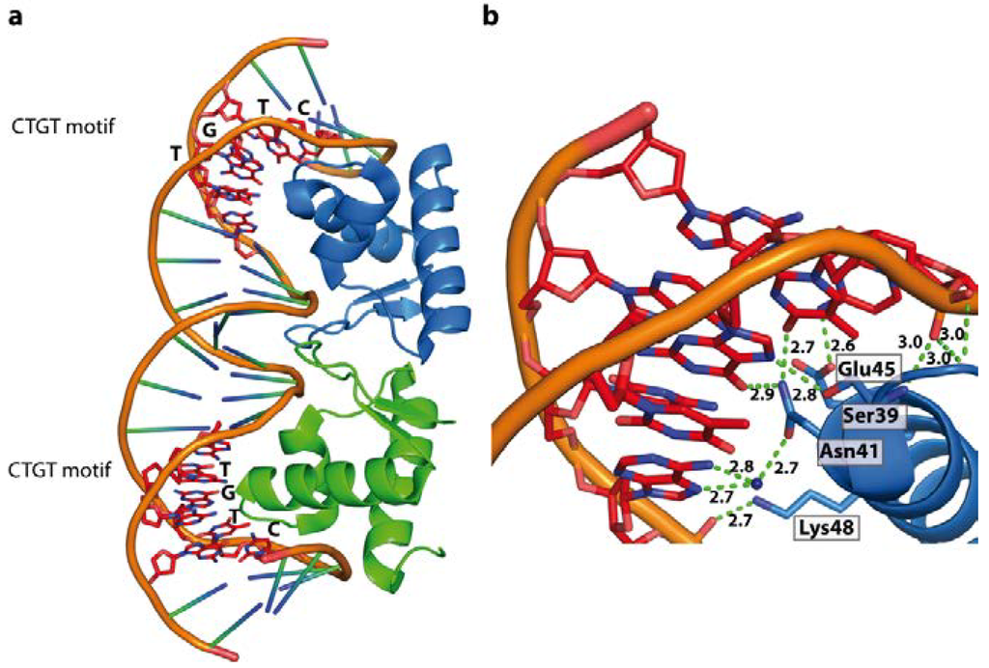
Background
Interaction between protein and DNA

Slide 5
Background
Features
Sequence-Based Features
Structural-Based Features
Physical and Chemical Features
Algorithms:
Support vector machines
Artificial neural networks (ANN)
Bayesian learning
Random forest
Decision tree
Si, J, et al. International Journal of Molecular Sciences (2015)
Chu, W. Y., et al. Nucleic Acids Research (2009)
Tjong, H., et al. Nucleic Acids Research (2007)
Yan, C. Identification of interface residues involved in protein-protein and protein-DNA interactions from sequence using machine learning approaches. (2005)

Slide 6
Introduction: Features
Considerable Features
Sequenced-based features: Sequence of residues
Structural-based features: Structural neighbors
Physical and Chemical Features: Electrostatic potential
Feature Selection:
Information gain
Filter method
Wrapper method

Slide 7
Introduction: Models and Evaluation
Models
Naïve Bayes model
Support Vector Machine
Artificial Neural Network
Evaluation
Leave-one-out cross validation within each model
T-test on average performance between different models

Slide 8
Current Progress: Data
Data component:
Residue sequences for a chain in different proteins
List of residues which are binding to DNA molecules on the corresponding chains of proteins
Structural information and physical properties
Data source: NPIDB
PDB file (protein data bank)
Interaction file
Reference

Slide 9
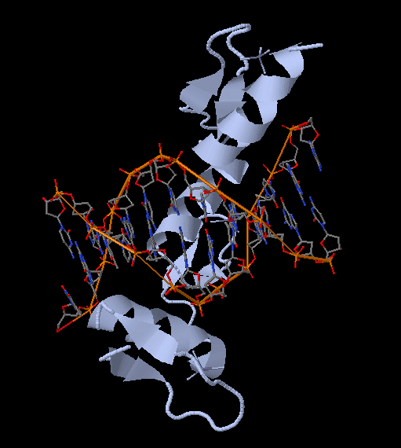
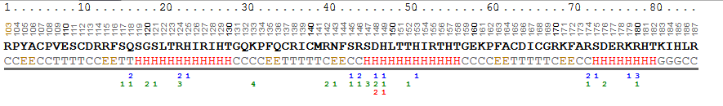
Current Progress: Data
Data preprocess
Residue sequence:
Extract the sequence of residues from PDB files and convert them into a list of residue names with single letter in fasta form.
Example:
The first four residues extracted from 1a1h.pdb file is ” R P Y A” which represents four residues.

Slide 10
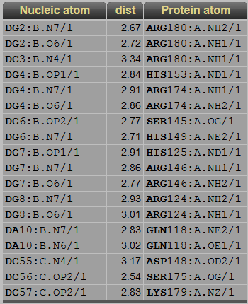
Current Progress: Data
Data preprocess
Label for each residue:
Download the interaction data from the database named NPIDB. We say 3.7 Angstrom is the cutoff distance to determine whether the atoms on protein and DNA has interaction and mark the label for this residue as 1, otherwise, mark the label for this residue as 0.
Example:
The labels of the corresponding residues in the previous example is “0 0 0 0”.

Slide 11
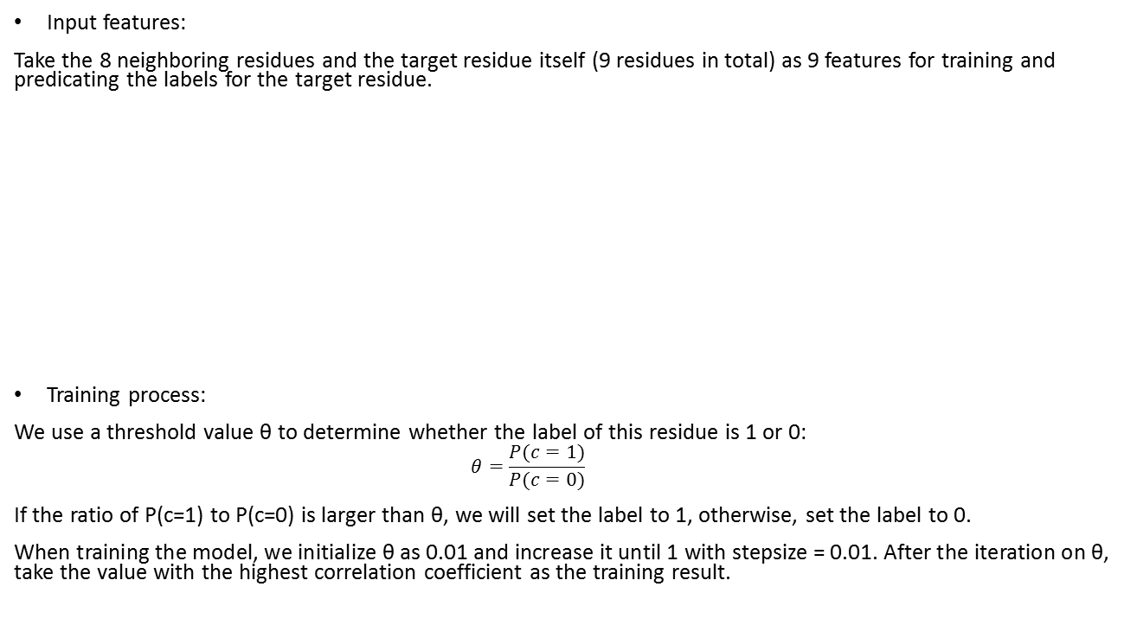
Current Progress: Naïve Bayes Model
Input features:
Take the 8 neighboring residues and the target residue itself (9 residues in total) as 9 features for training and predicating the labels for the target residue.
Training process:
We use a threshold value θ to determine whether the label of this residue is 1 or 0:
$$θ=\frac{P(c=1)}{P(c=0)}$$
If the ratio of P(c=1) to P(c=0) is larger than θ, we will set the label to 1, otherwise, set the label to 0.
When training the model, we initialize θ as 0.01 and increase it until 1 with stepsize = 0.01. After the iteration on θ, take the value with the highest correlation coefficient as the training result.
<s> | <s> | <s> | <s> | X₄ | X₅ | X₆ | X₇ | X₈
-1 | -1 | -1 | -1 | 1 | 0 | 0 | 0 | 1

Slide 12
<s> | <s> | <s> | <s> | X₄ | X₅ | X₆ | X₇ | X₈
-1 | -1 | -1 | -1 | 1 | 0 | 0 | 0 | 1
X1 | X2 | X3 | X4 | X₄ | </s> | </s> | </s> | </s>
0 | 1 | 0 | 0 | 1 | -1 | -1 | -1 | -1

Slide 13
Current Progress: Naïve Bayes Model
Theta value

Slide 14
Current Progress: Naïve Bayes Model
Traing accuracy

Slide 15
Current Progress: Naïve Bayes Model
Test accuracy

Slide 16
Current Progress: Naïve Bayes Model
Implementation Result:
The average test accuracy is: 80.4%, the standard deviation is 0.052.
Comparison with the reference:
The average test accuracy on the reference is around 77% when using the 9 neighboring residues as the features
Causes for the difference between these two results:
Using different standards to classify the residues into two classes: binding residues and non-binding residues
Taking the residue sequences from different chains when analyzing the same proteins.
Arithmetic calculation details might also affect the result slightly.

Slide 17
Next step
Implementation of other models:
Support Vector Machine
Artificial Neural Network
Add more features
Considering the electrostatic potential for residues
Structural Neighbors
Filtering the features
Information gain
Filter method
Wrapper method

Slide 18
Thank you!

