Slide 1
Note
Jun

Slide 2
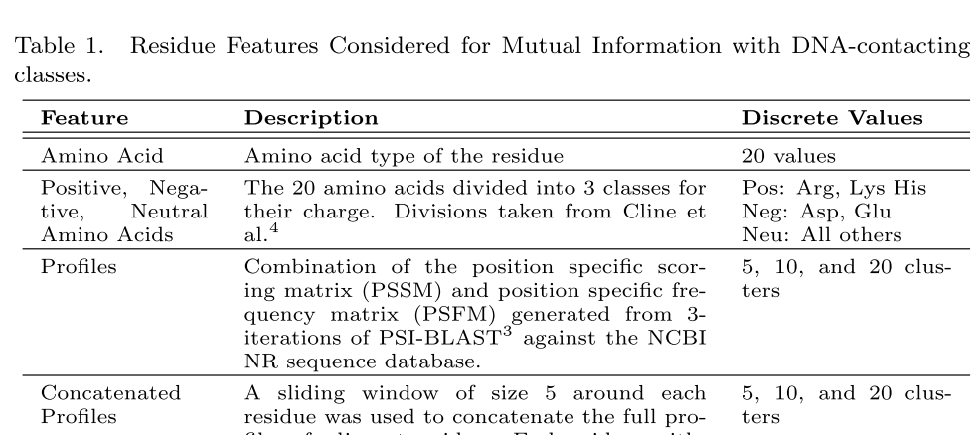
Kauffman, C., & Karypis, G. (2008). An analysis of information content present in protein-DNA interactions.
Pacific Symposium on Biocomputing. Pacific Symposium on Biocomputing, 488, 477–88.
Retrieved from http://www.ncbi.nlm.nih.gov/pubmed/18229709

