Slide 1

Farming and Market Insights
2025
Joshua Wacks

Slide 2
The High Level Requirement
Bring innovative and fresh insights on the farming and market data, in the context of the following questions:
How can farming practices be optimised while promoting sustainability and reducing environmental impact?
How can agriculture be transformed into a resource-efficient and profitable endeavour?
What trends within the data can be identified with reasoning and solutioning where possible?
Design a separate out of the box question and answer based off the data

Slide 3
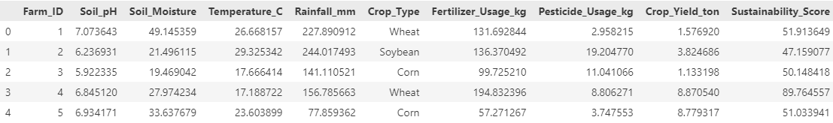
The Farming Data
Very Clean Data overall
No missing values
No outliers
No duplicate records
Considered changing the ‘Crop_Yield_ton’ column to ‘Crop_Yield_Kg’ to have standard units for this analysis, but was not necessary.
Only one categorical variable that needed to be handled: ‘Crop_Type’

Slide 4
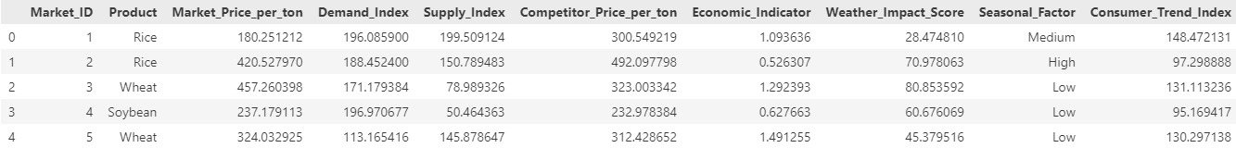
The Market Data
Very Clean Data overall
No missing values
No outliers
No duplicate records
Considered changing the price per ton to price per kg to have standard units for this analysis, but was not necessary.
Two categorical variable that needed to be handled: ‘Product’ and ‘Seasonal_Factor’

Slide 5
Question 1
How can farming practices be optimised while promoting sustainability and reducing environmental impact?

Slide 6
Question 1
No linear relationships between any of the farming techniques and crop yield.
No crop significantly yields more than the other crops.
No linear relationships between any one of the farming techniques and sustainable farming.
No crop is significantly more sustainable than the others.
To improve sustainable farming and increase crop yield, it must be done on a per crop level.
Key Insights

Slide 7
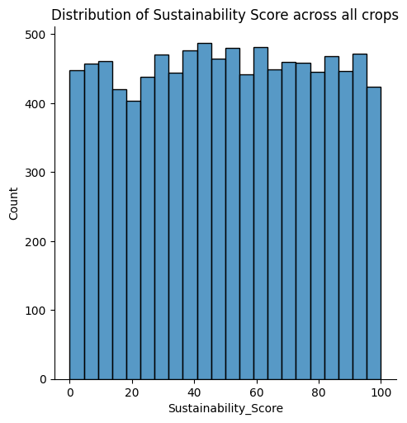
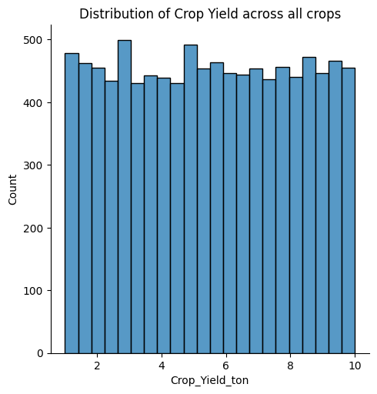
Question 1: Overall Data Analysis
No large skew in the distribution of either the sustainability score or the crop yield.

Slide 8
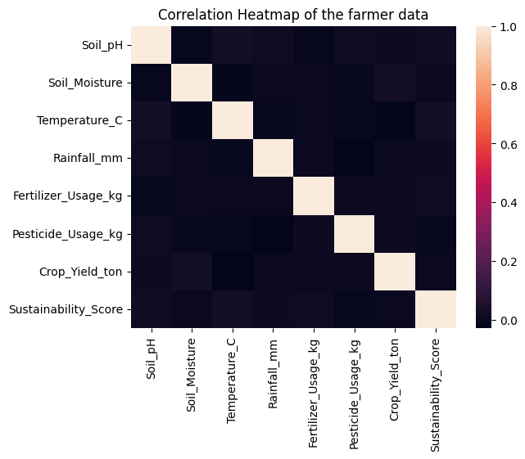
Question 1: Overall Data Analysis
Correlation heatmap clearly shows only weak/ no correlation between the two metrics we are investigating; ‘Sustainability_Score’ and ‘Crop_Yield_ton’. To gain further insight we need to do a per crop analysis which makes sense as crops generally have different ideal conditions required to grow, such as different levels of pesticide and fertilizer.

Slide 9
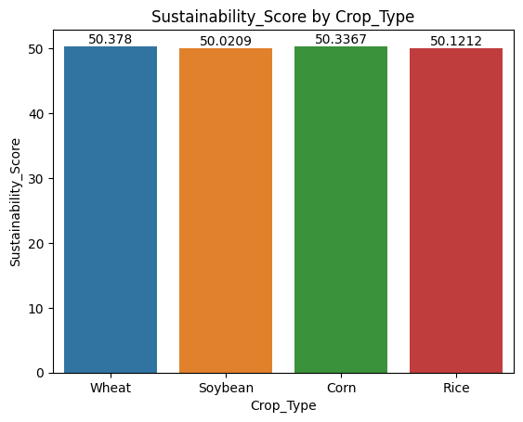
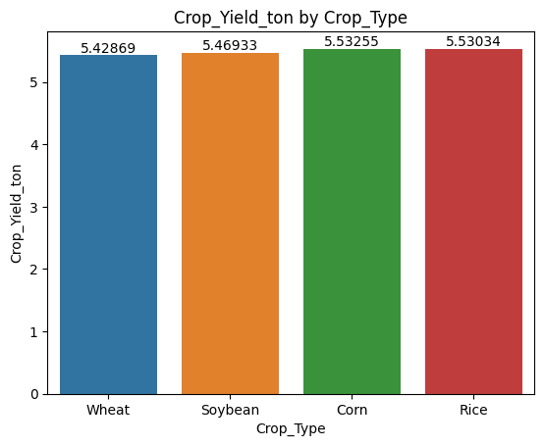
Question 1: Per Crop Analysis
Is there a crop that has a statically significant difference in their Sustainability_Score or Crop_Yield_ton?
Using a one-way ANOVA test, with the independent variable being crop type, the differences above were found to be statistically insignificant as the p-value for the test for the Sustainability_Score was 0.966 and the p-value for the Crop_Yield_Ton was 0.424. As both p-values were greater than 0.05 the null hypothesis is not rejected.

Slide 10
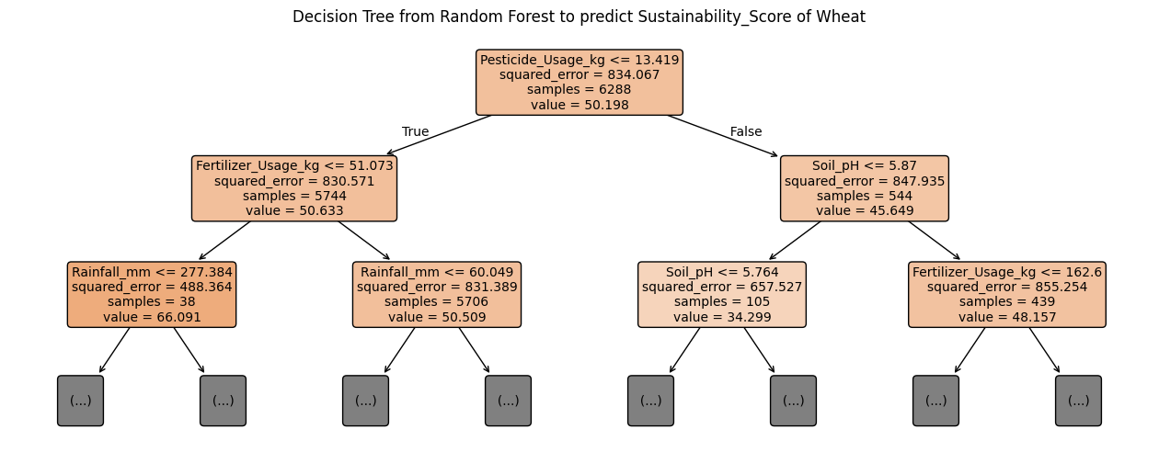
Question 1: Random Forest Analysis
Built a random forest regressor to predict the sustainability score and crop yield on a per crop basis. Each model achieved at least 80% on each crop type, suggesting it was able to capture non-linear relationships in the data.
Each crop had different features the model found to be most influential in predicting the sustainability score and crop yield.
Features that affect sustainability score and crop yield across all crops:
Fertilizer Usage
Rainfall
Soil pH
Pesticide Usage
Soil Moisture

Slide 11
Question 2
How can agriculture be transformed into a resource-efficient and profitable endeavour?

Slide 12
Question 2
Use findings from Question 1 to optimise resource usage on farms on a per-crop level.
Increase rice production as it is the only product where demand is currently less than supply and performs well on all other metrics.
Key Insights

Slide 13
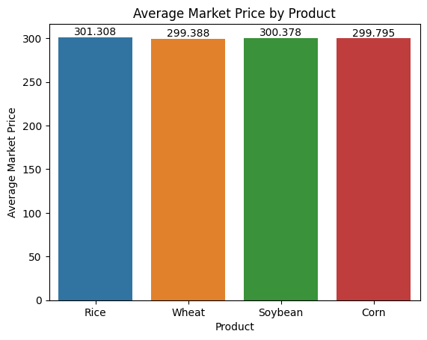
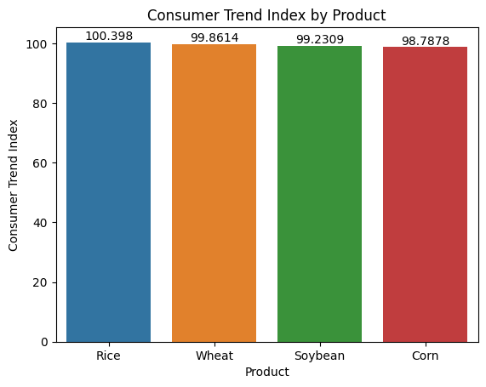
Question 2: Comparing By Crop
Performing an analysis on each of the factors such as economic indicator and consumer trend index in the data, showed no significant difference in these values across crops at each of the markets.
Furthermore, creating an average price feature( [Market_Price_per_ton + Competitor_Price_per_ton]/2) for each of the markers showed no significant difference between the products.

Slide 14
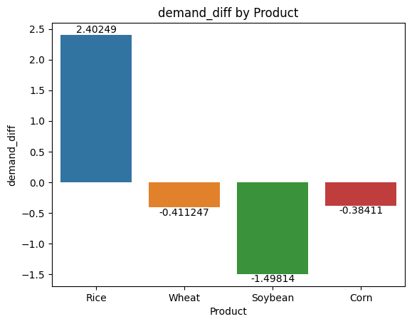
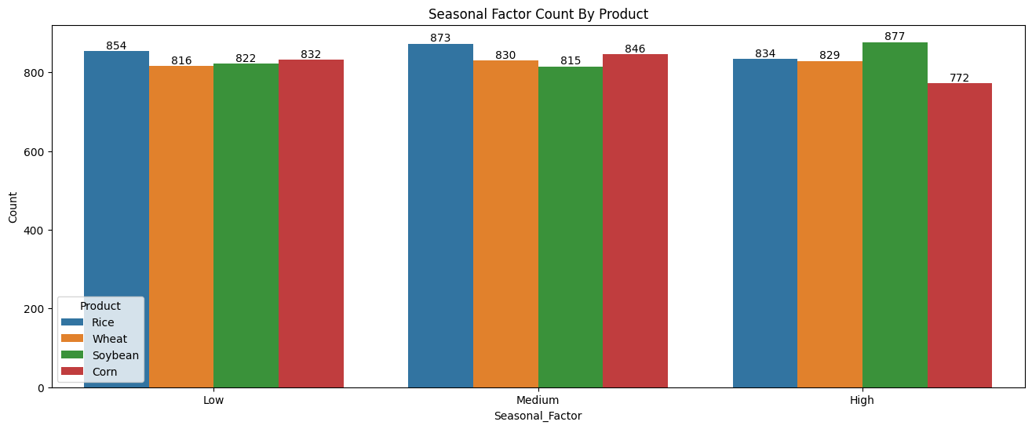
Question 2: Comparing By Crop Cont
Creating a feature which captured the difference between the demand and supply did show there was a product in short supply at the markets, rice which was the only product with a demand greater than supply. As well as this, rice has a low seasonal factor at markets making it viable product to invest in.

Slide 15
Question 3
What trends within the data can be identified with reasoning and solutioning where possible?

Slide 16
Question 3
Slight increase in demand when seasonal factor is low vs supply which is not influenced by seasonal factor.
Specifically difficult to identify trends in non time-scale based data.
Key Insights

Slide 17
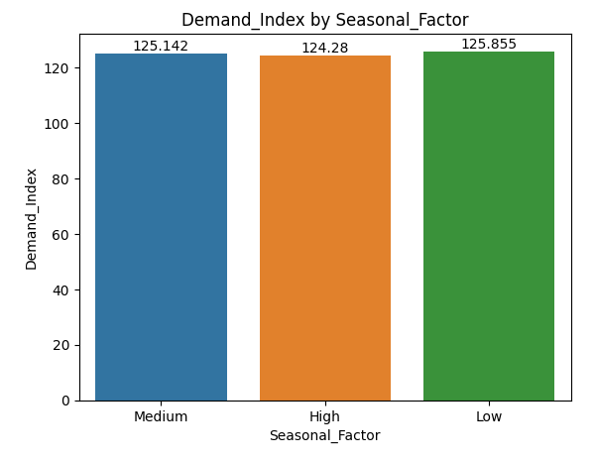
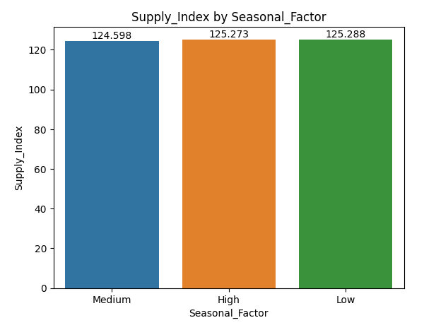
Question 3
Slight increase in demand when seasonal factor is low vs supply which is not influenced by seasonal factor.

Slide 18
Question 4
Question Chosen: Can we group farms beyond crop type, on other characteristics, to optimise crop yield and sustainability?

Slide 19
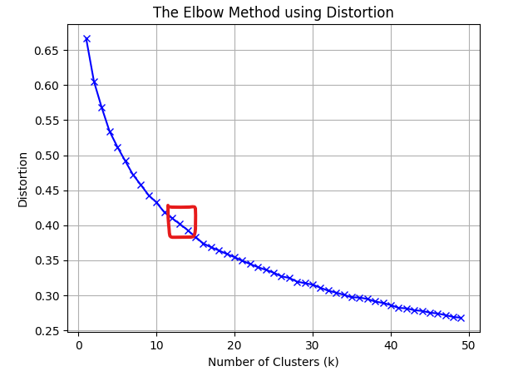
Question 4: Approach
Grouped the farms using an unsupervised machine learning method to find similar farms, separate from the crop type identified earlier. Two different approaches were investigated:
The DBSCAN algorithm. Iterated through many different parameter values but was not able to find sufficient clusters.
K-Means algorithm. Used the ‘elbow method’ on Distortion and Inertia distance metrics and an optimal number of clusters was found to be 15.

Slide 20
Question 4: Findings
Using this clustering we could communicate the information to each of the 15 groups of farms that there are other farms that share similar characteristics in terms of the following features:
Soil pH
Soil Moisture
Temperature
Rainfall
Fertilizer Usage
Pesticide Usage
Allowing the farmers to learn and share information with one another, specifically knowing that these are farmers that grow crops under the same conditions they do.

Slide 21
Farming and Market Insights
max growth
Joshua Wacks

