Slide 1
GPS2 Scene Mockup
2D Version 1.0

Slide 2
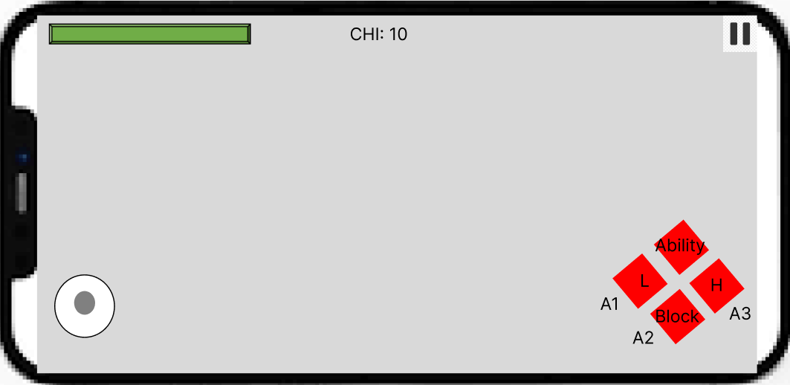
Control Scheme V3

Slide 3
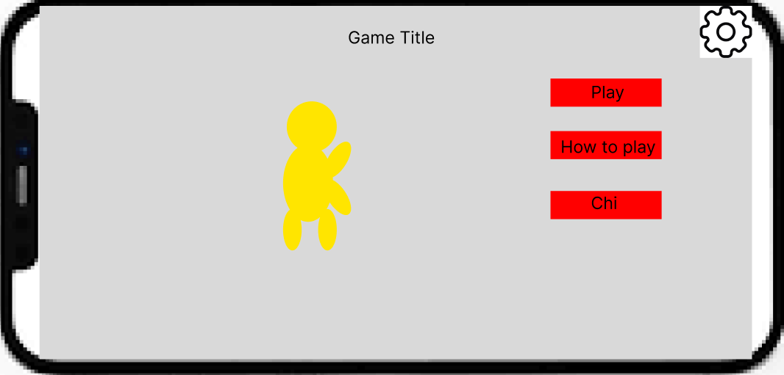
Main Menu V2

Slide 4
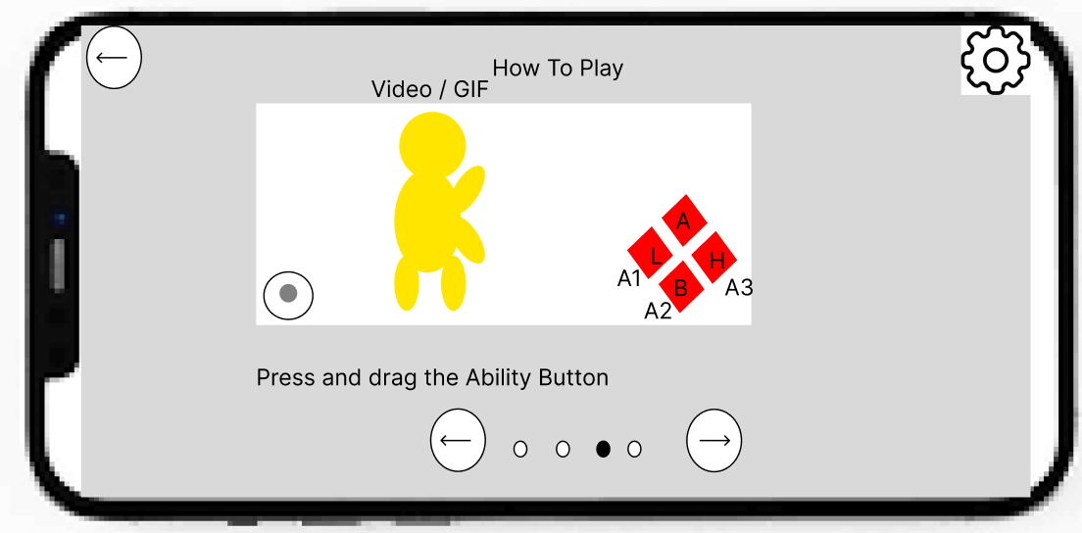
How To Play

Slide 5
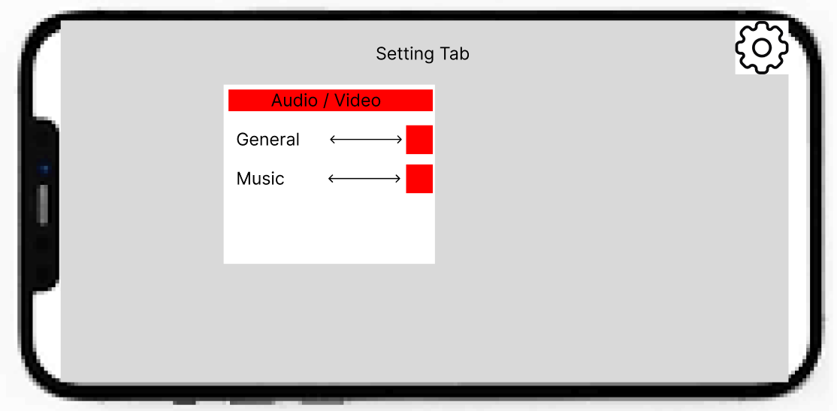
Setting Tab

Slide 6
Pause Tab

Slide 7
Canceled & Old Design

Slide 8
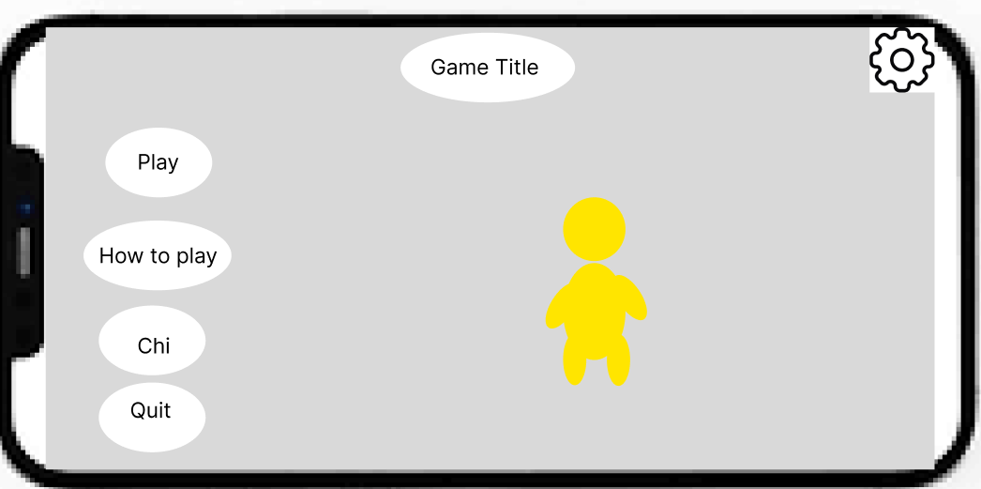
Main Menu V1

Slide 9
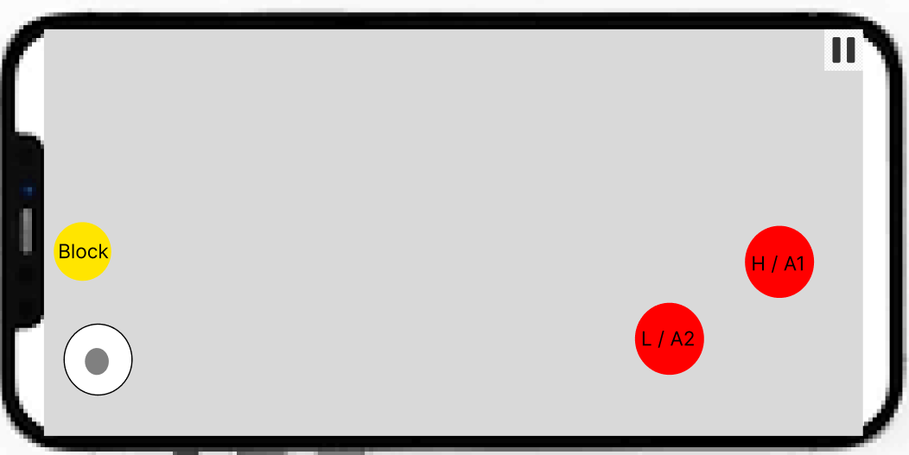
Control Scheme V1

Slide 10
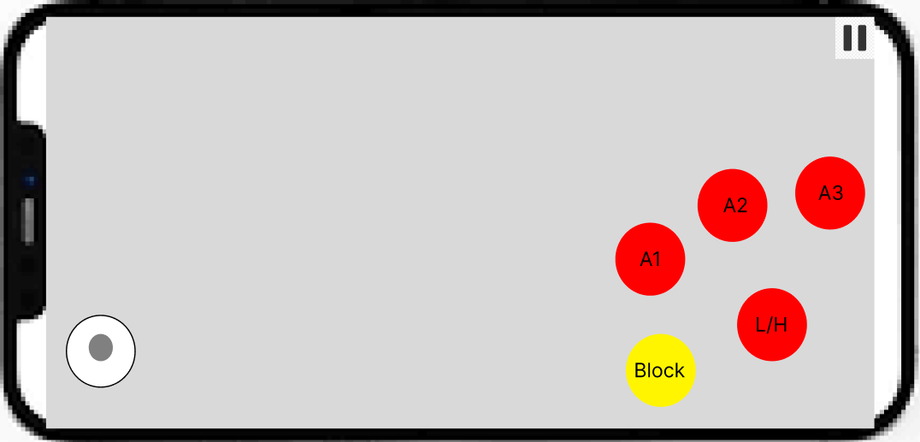
Control Scheme V2

Slide 11
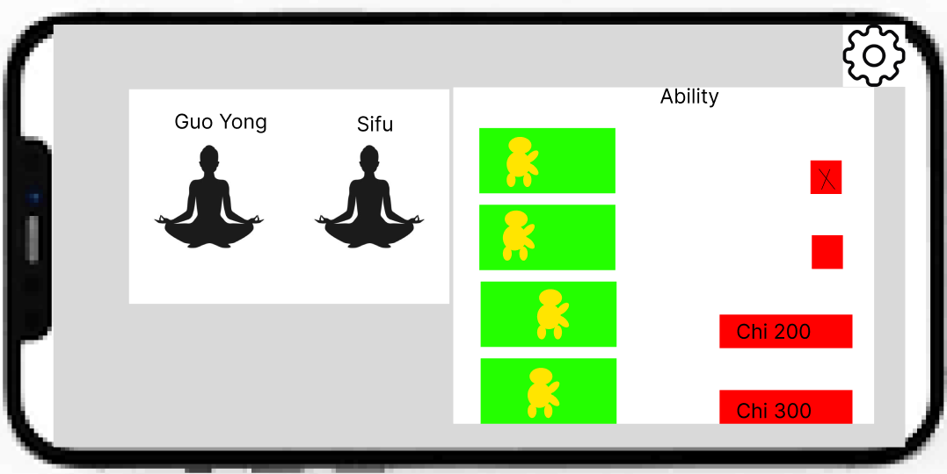
Chi Upgrade

