Slide 1
GPS2 Scene Mockup
Drawing Version 1.0

Slide 2
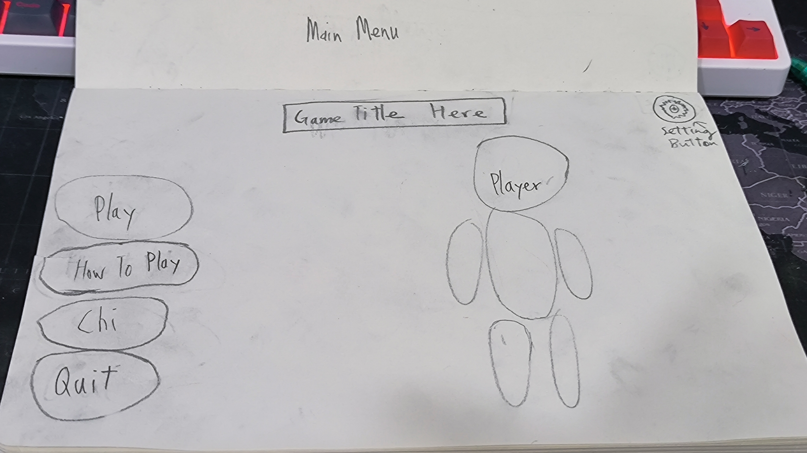
Main Menu V1

Slide 3
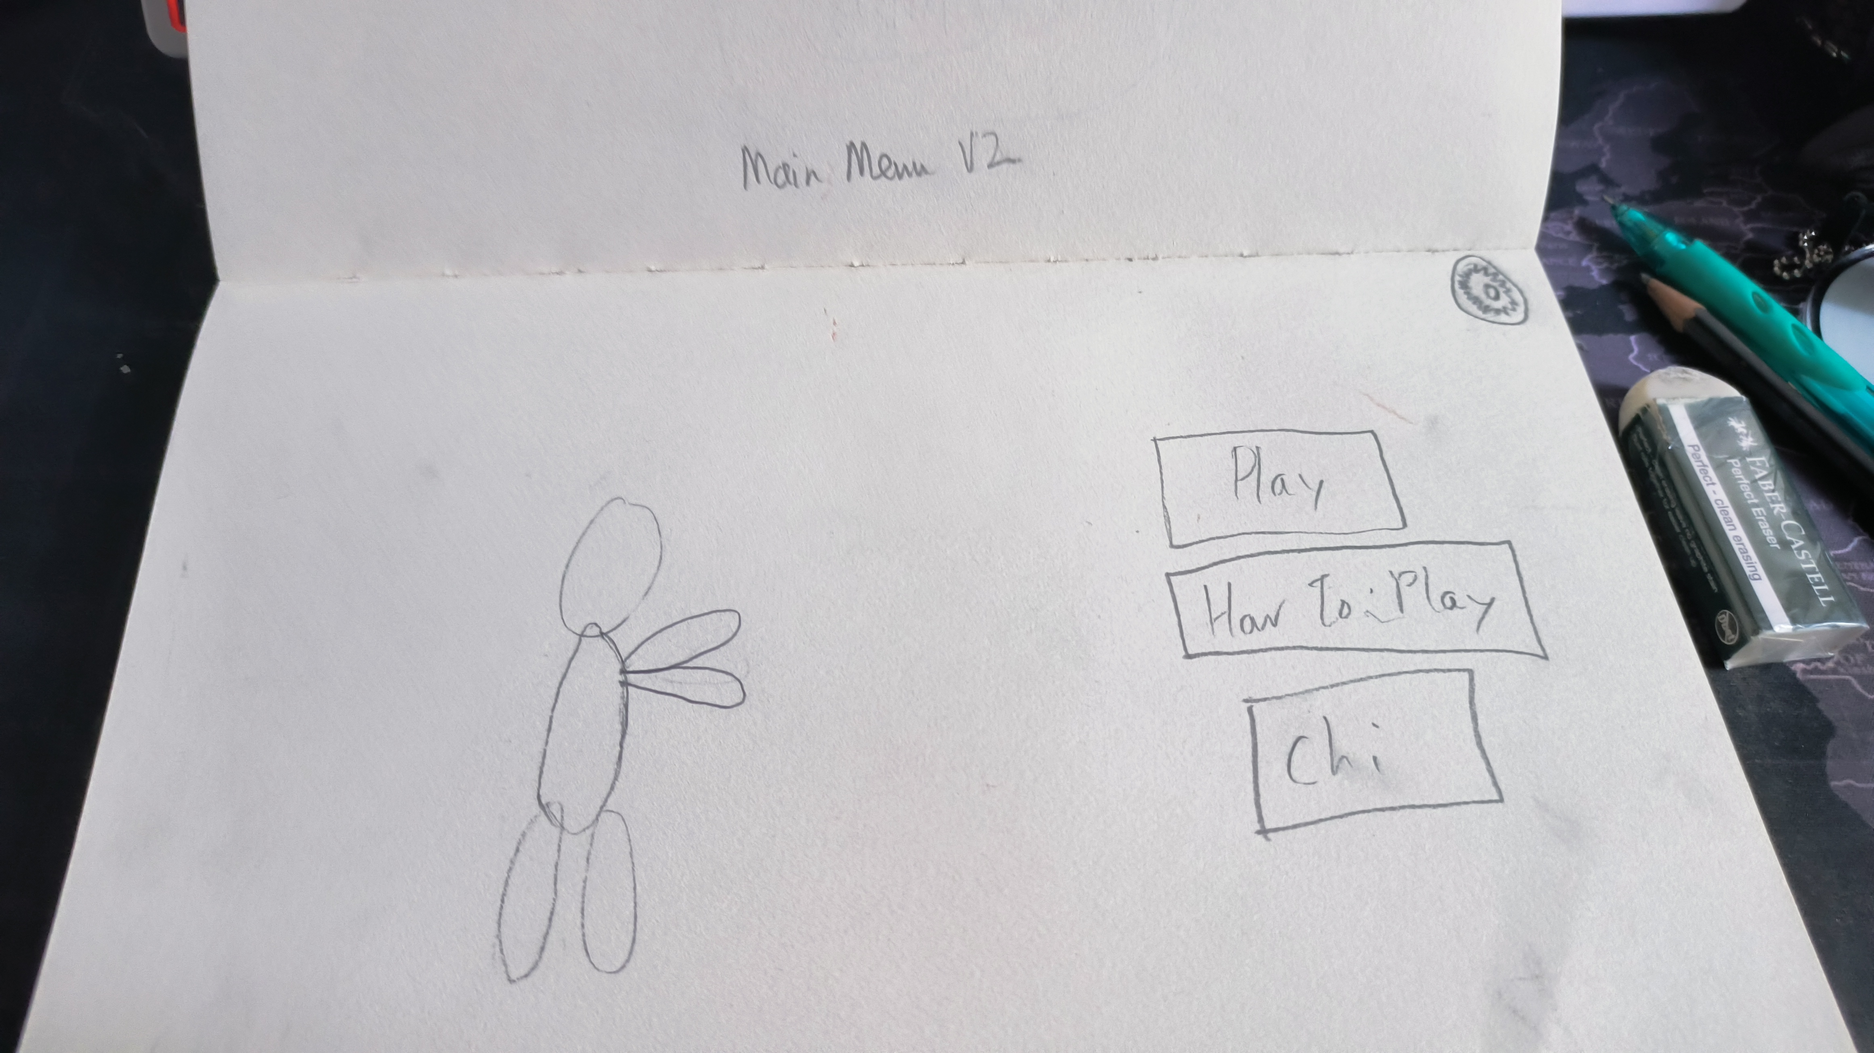
Main Menu 2

Slide 4
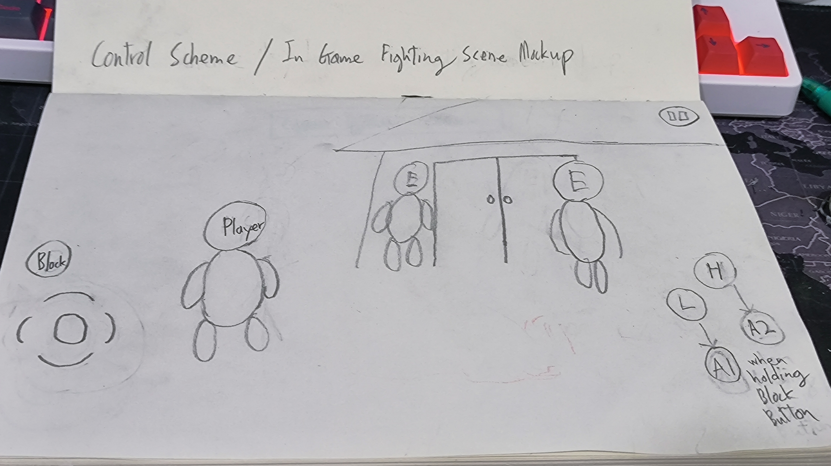
Control Scheme Mockup V1

Slide 5
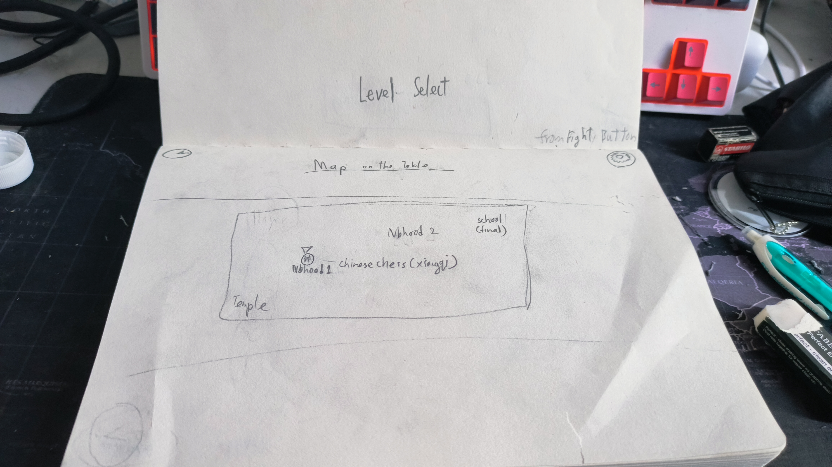
Level Select

Slide 6
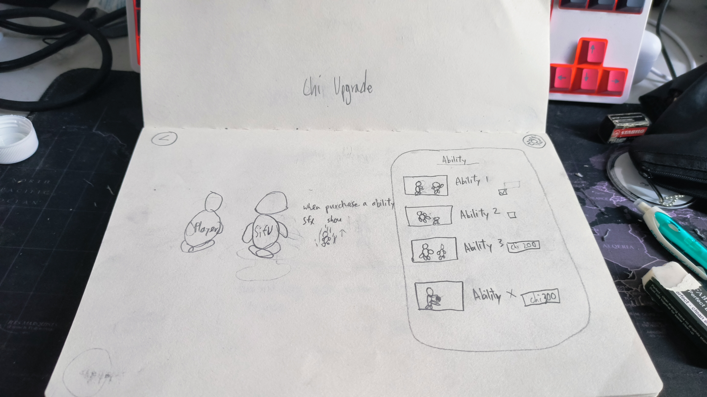
Chi Upgrade

Slide 7
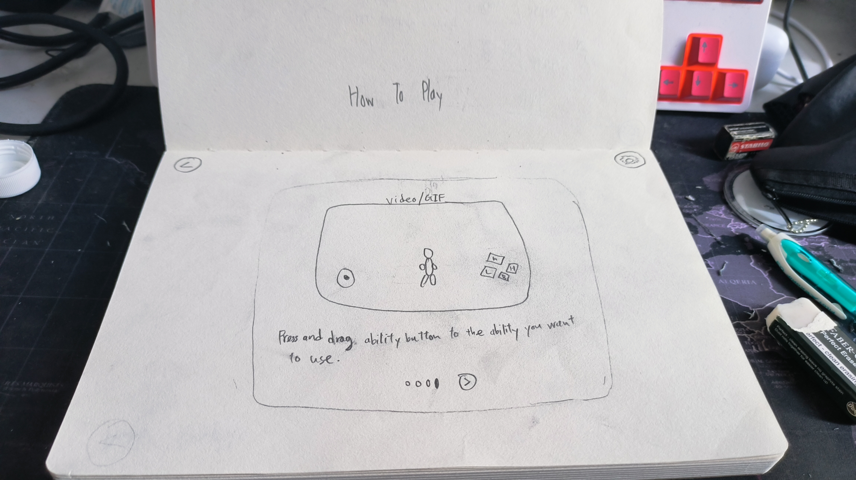
How To Play

Slide 8
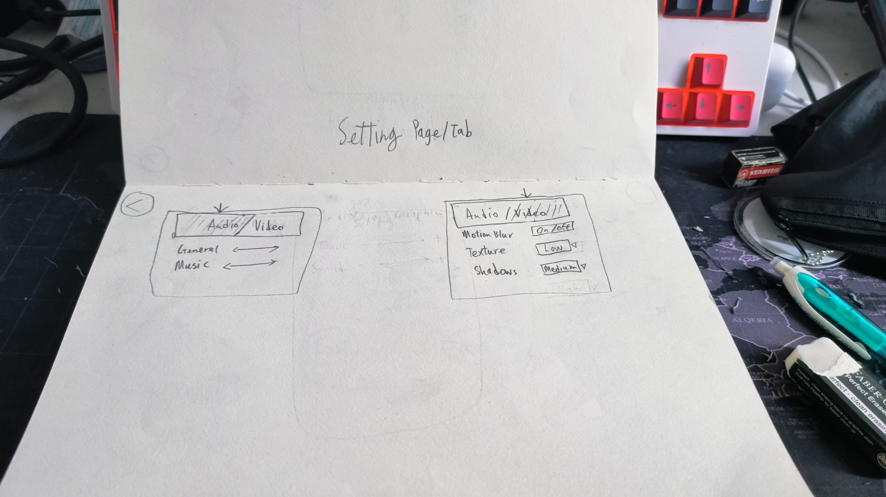
Setting Tab

Slide 9
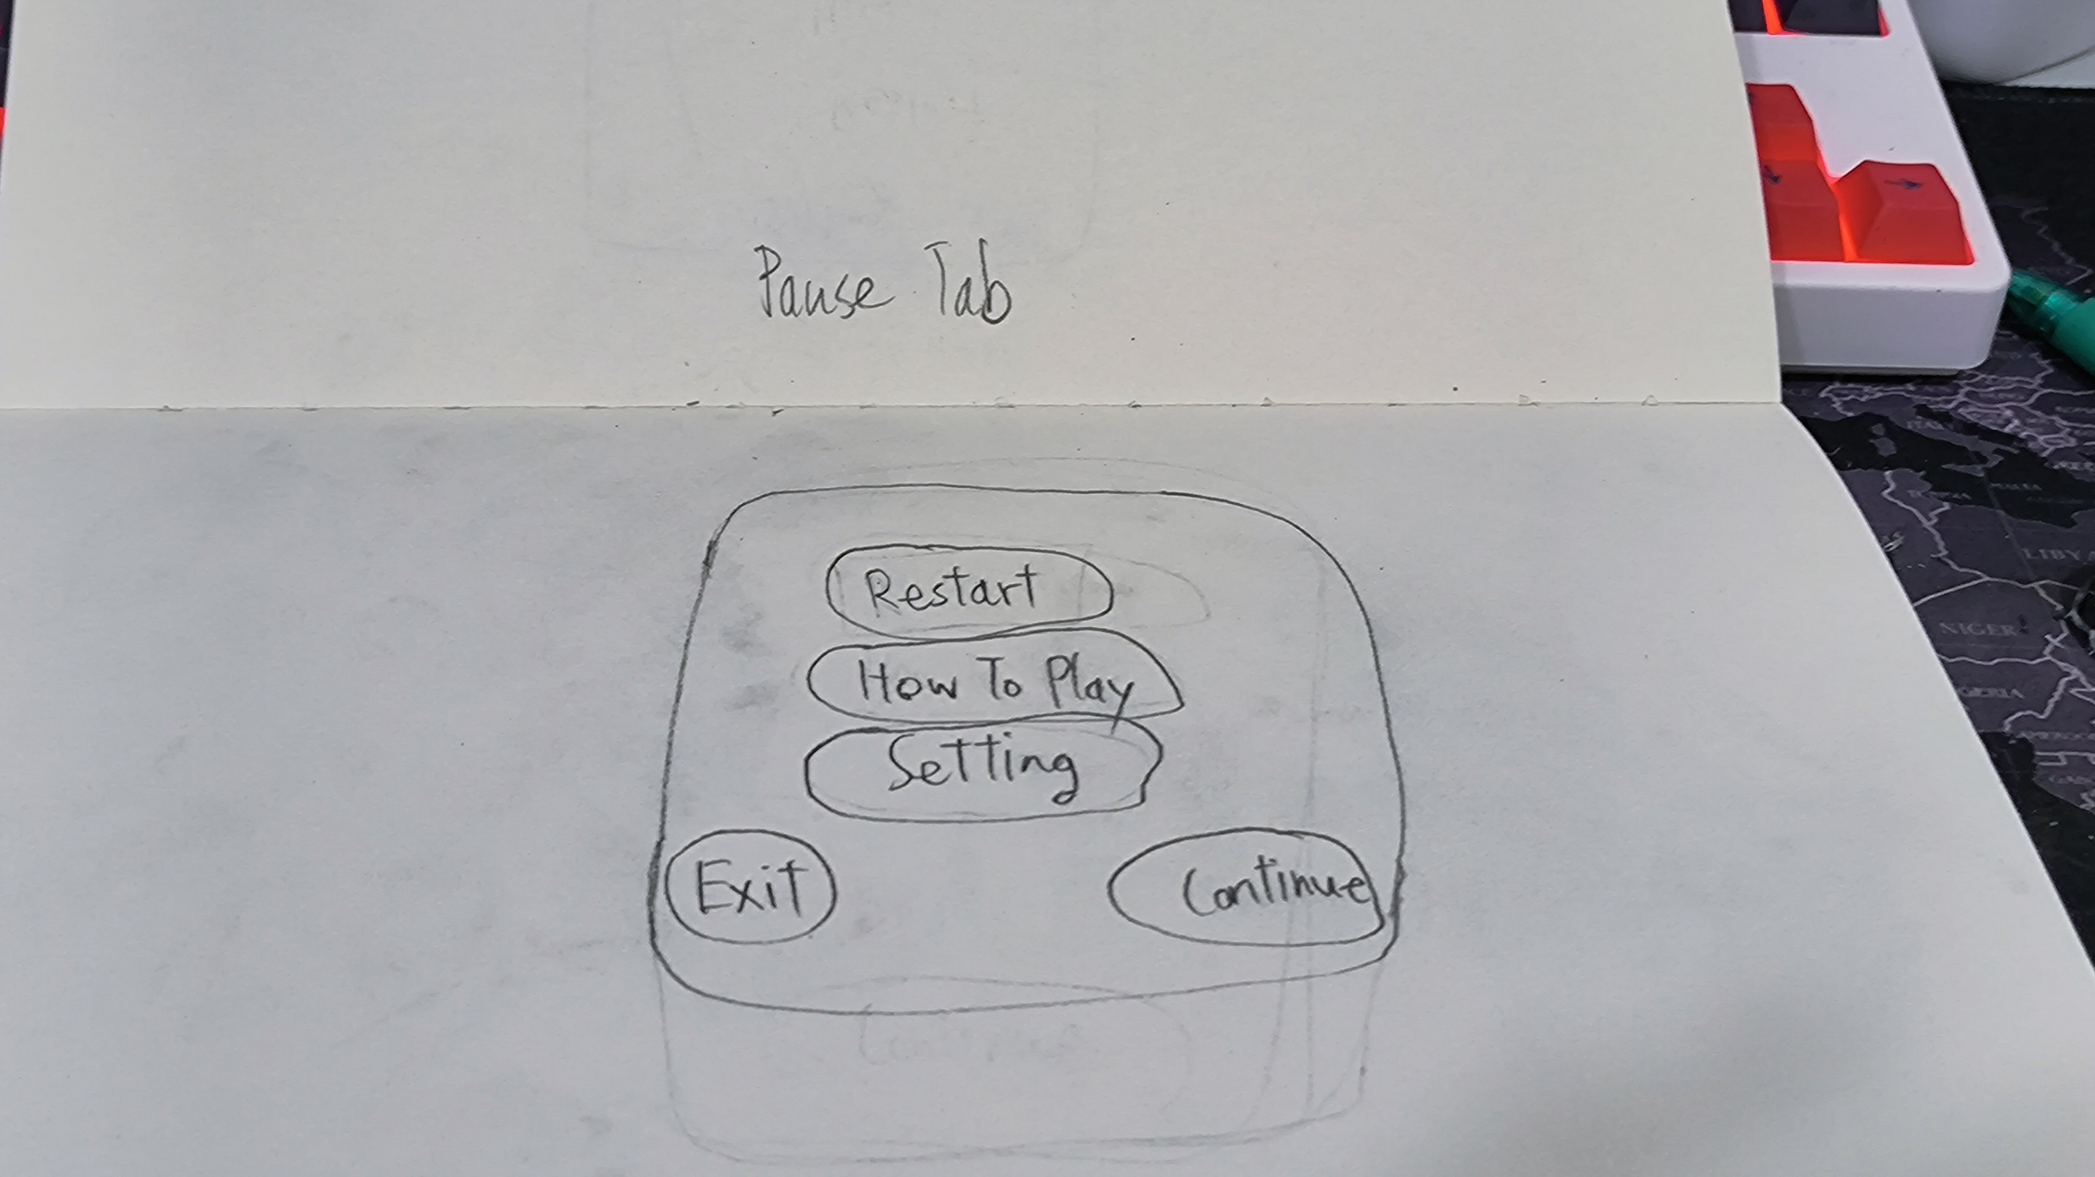
Pause Tab

Slide 10
References
https://interfaceingame.com/games/dota-underlords-mobile/
https://interfaceingame.com/games/sifu/
https://www.youtube.com/watch?v=tROJ9eMXpf4&ab_channel=RootGames

