Slide 1







Game Idea Pitch
GPS 2 Proposal

Slide 2





Contents
01
02
03
Introduction
The team
Proposal 1
04
05
06
Proposal 2
Proposal 3
Q&A Session

Slide 3

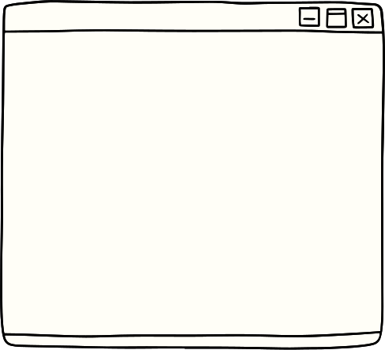


Introduction

Slide 4






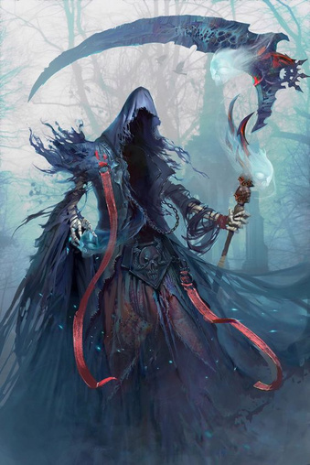
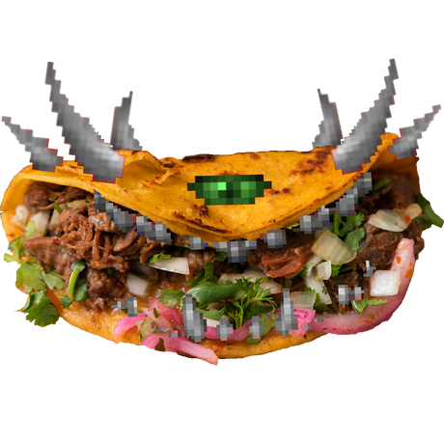
Dragon Punch Studios
Jasper Wong
Sim Yong An
Paven
Artist
Designer
Tech
Made by Jasper
Cryst
Lau Jaw Cherng
Joshua Yeoh
Artist
Designer
Tech

Slide 5

Proposal 1
Codename: The Seeker

Slide 6
Genre: Casual, Action RPG, Alien relationship
Settings: cyberpunk where the worst and miserable place
Story Overview:
Jake set out to become the richest man in the galaxy, but all of a sudden he realized that he needed a job before he could become wealthy, and that job just so happened to land at his feet. He looked at it and saw that a bounty hunter was needed for hire.

Slide 7
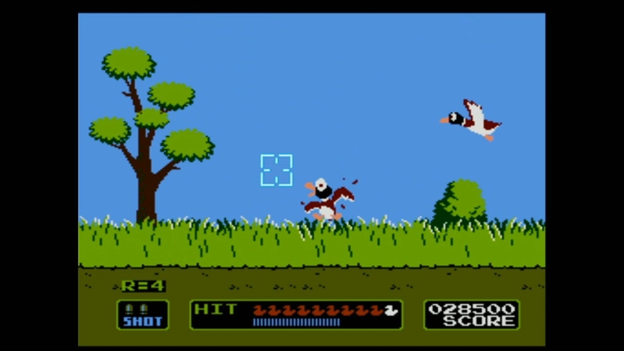
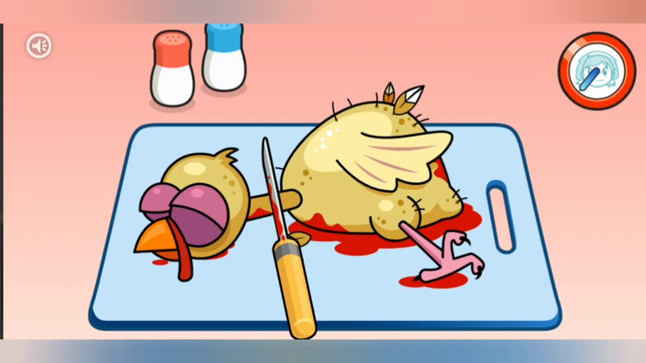
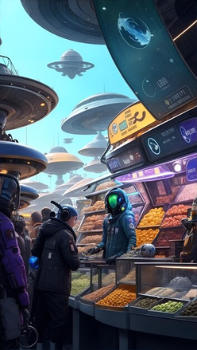
Game Design Pillars
The Hunt:
  Search and hunt down your bounty and resources.
  Mini game like duck hunt will pop out which has a limited resource and time to take down your target.
Dissect the Alien:
  Dissect your prey for a better bounty reward
  Get the correct “parts” for your employer
Sell them at your price:
  Sell organ to the highest bid
  make some side cash
  rip off your employer

Slide 8
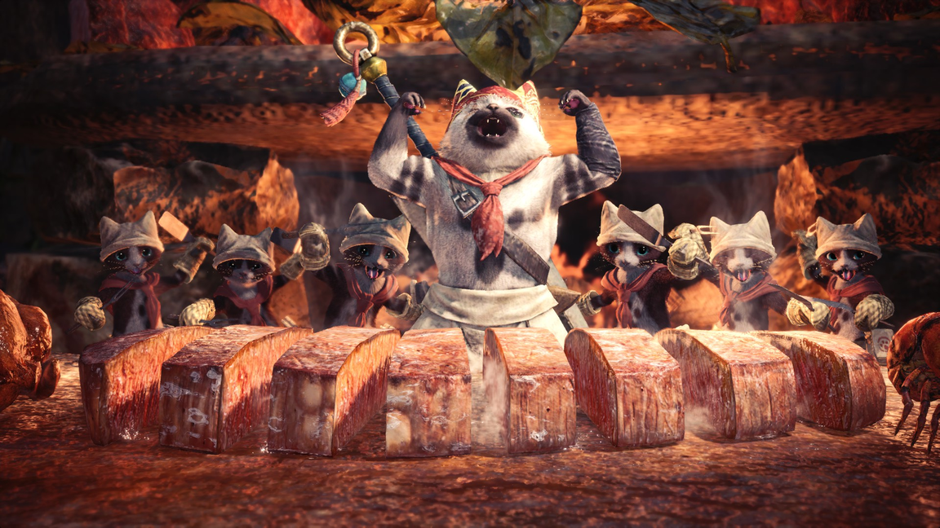
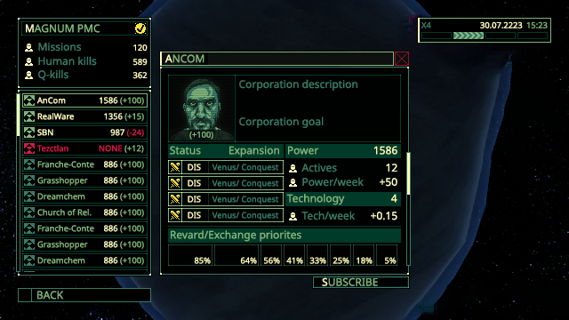
Gameplay Reference
Monster Hunter
Quasimorph

Slide 9
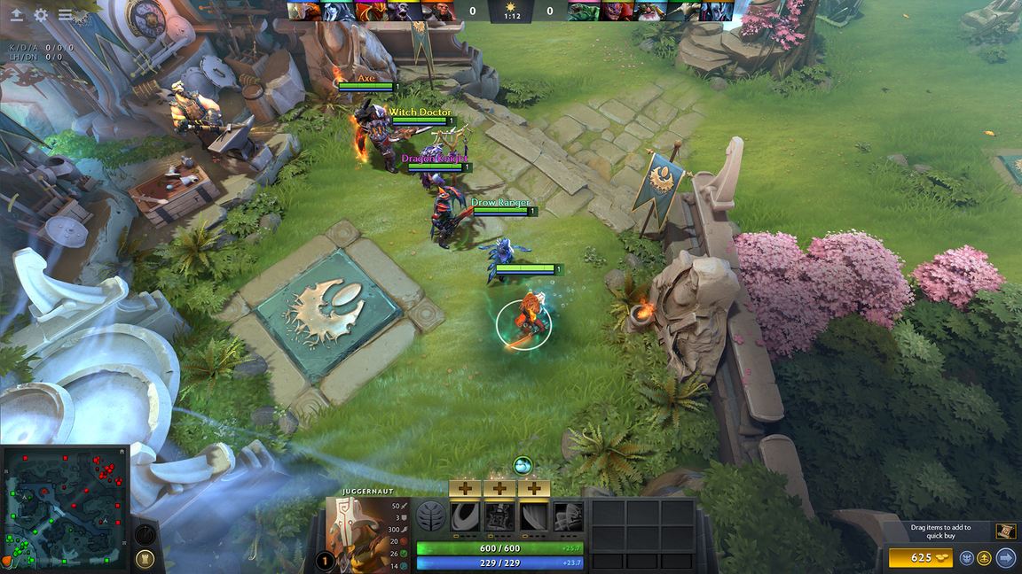
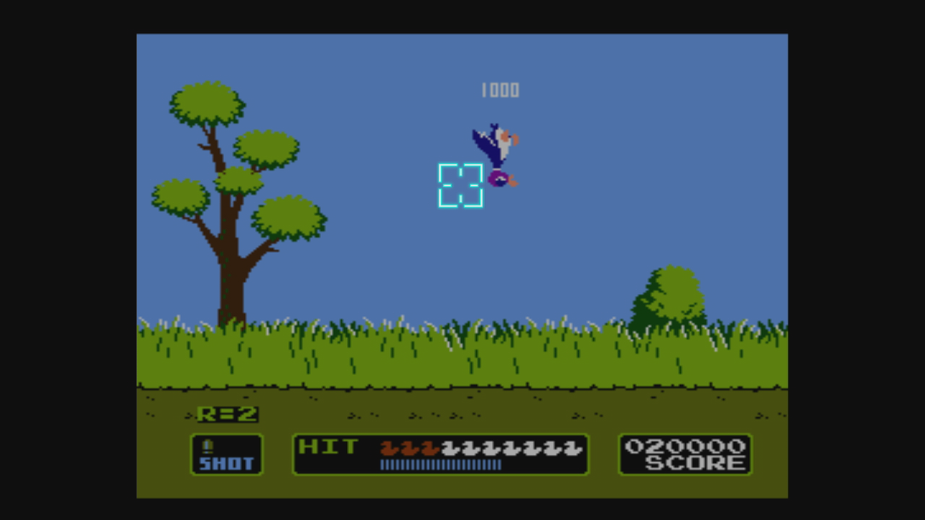
Gameplay Reference
Dota 2
Duck Hunt

Slide 10

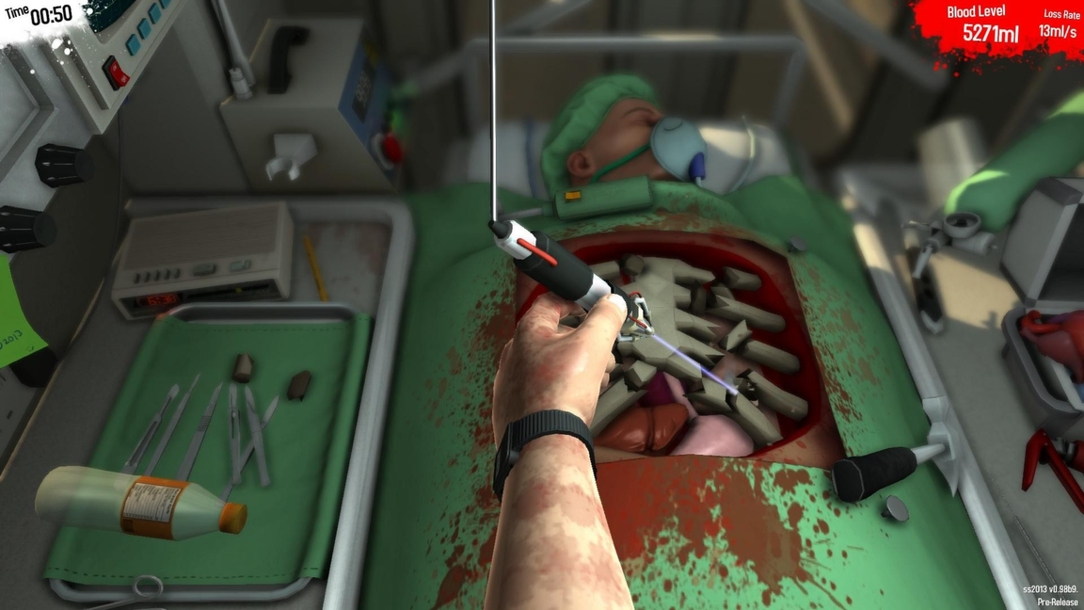
Gameplay Reference
Cooking Mama: Cookstar
Surgeon Simulator

Slide 11
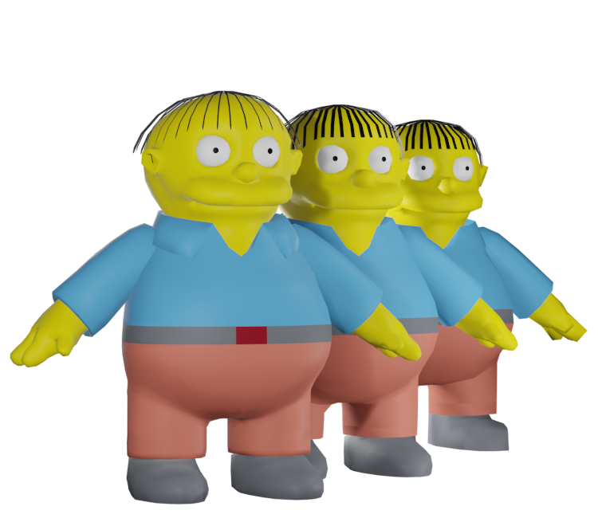

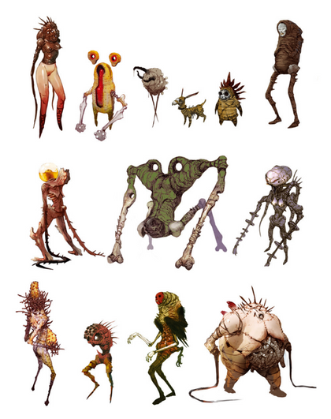
Artstyle
Comparable to Cooking Mama and Monster Hunter The character and monster in the 3D model will have a low poly model (like from PSP The Simpson) aesthetic.
The color scheme will resemble the theme of Fairyland.
Something like from ( I hate the fairyland )

Slide 12
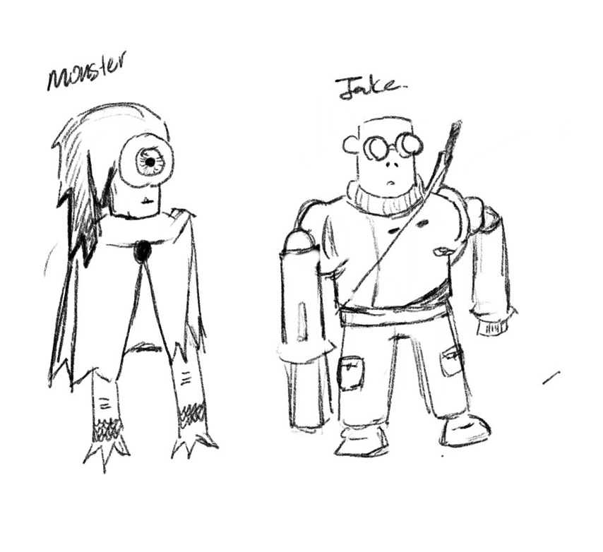
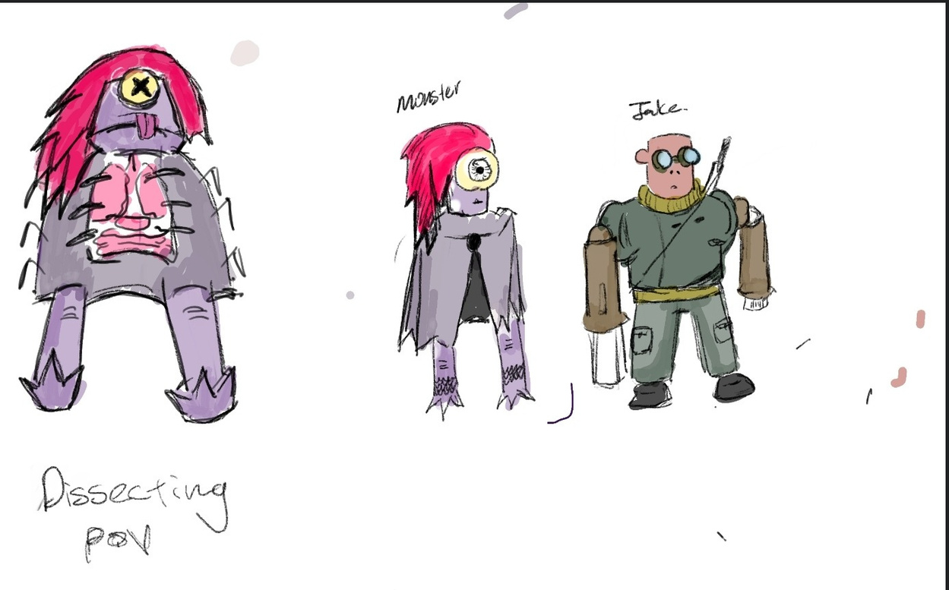
Concept Art

Slide 13
Proposal 2
Codename: Gourmet Titan

Slide 14

Genre: ASEAN LEGENDS, Survival-Action RPG
Settings: Shadowed Culinary Realms blending culinary arts with ancient traditions inspired by ASEAN countries.
Story Overview:
In the mystical realm of Shadowed Culinary Realms, an unknown force seeks to harness the forbidden culinary secrets for their nefarious purposes. Whispers spread of an ancient recipe, said to grant unimaginable power to those who unlock its mysteries. Players step into the shoes of Rian, a seasoned culinary warrior, as they embark on a perilous journey to uncover the forbidden recipe.

Slide 15


Game Design Pillars
Culinary Dark Fantasy:
  Embrace the fusion of culinary arts and dark fantasy.
  Combine the allure of culinary creativity.
Dynamic Combat Design:
  Design fast-paced vibe in game.
  Encourage players to experiment with different culinary tools and spells.
Survival in Shadows:
  Manage resources.
  Gather magical ingredients.
  Cook powerful dishes.
  Unlock more POWERs.

Slide 16
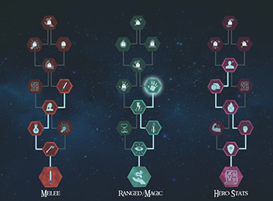
Tech Framework
Culinary Arts Skill Tree System:
  Skill tree system for Rian’s dark arts abilities.
  Allow players to customize Rian's playstyle.
Umbral Creatures AI System:
  Implement sophisticated AI algorithms.
  Adapt to players' combat strategies, offering challenging and dynamic encounters.
Real-time Combat System:
  Seamlessly integrates culinary tools and dark magic.
  Complex combos, cast spells, culinary techniques.

Slide 17
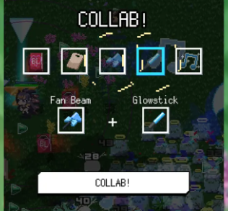
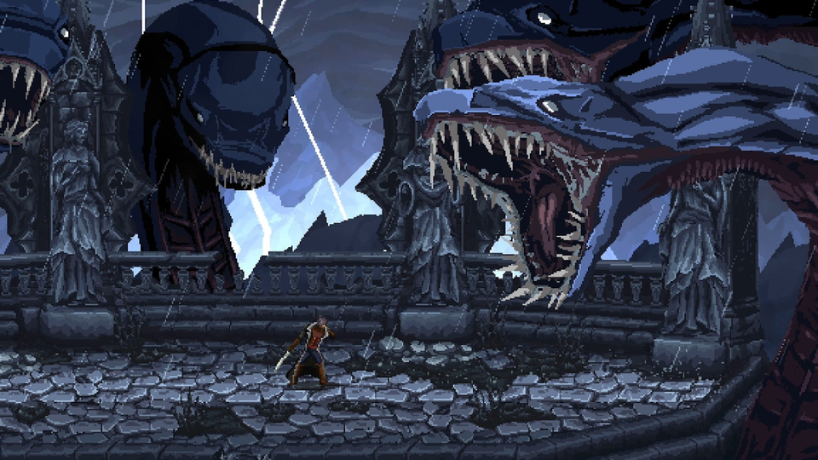
Artstyle
Culinary weaponry and Dark Spells:
  Fuse culinary charm and ominous magic.
  Provide players with a diverse and visually engaging arsenal.
Gothic Culinary Aesthetic:
  Combines culinary aesthetics with dark fantasy elements.
  Draped in an atmosphere of shadows and mystery.

Slide 18
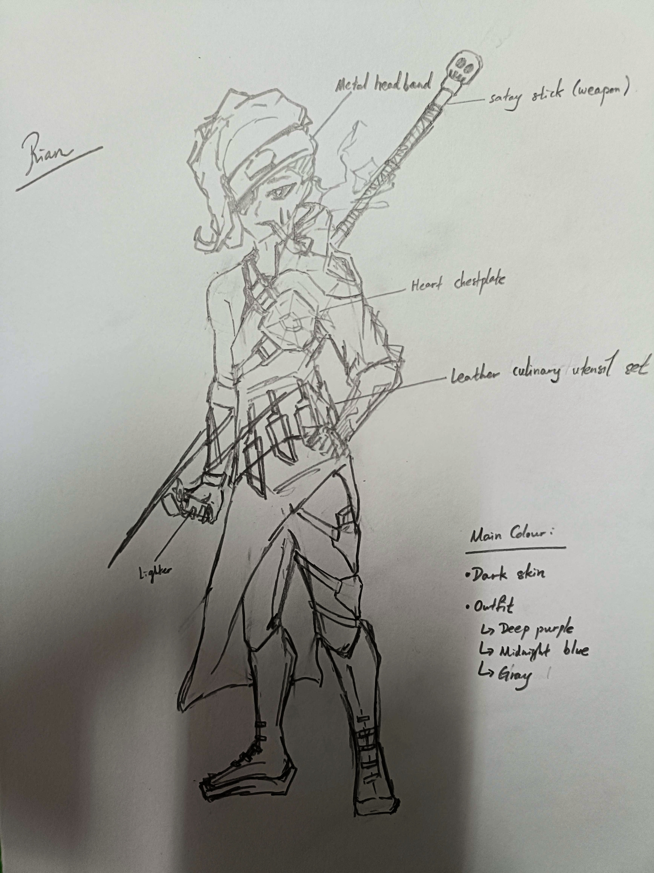
Character Concept Art
Made by Jaw Cherng

Slide 19
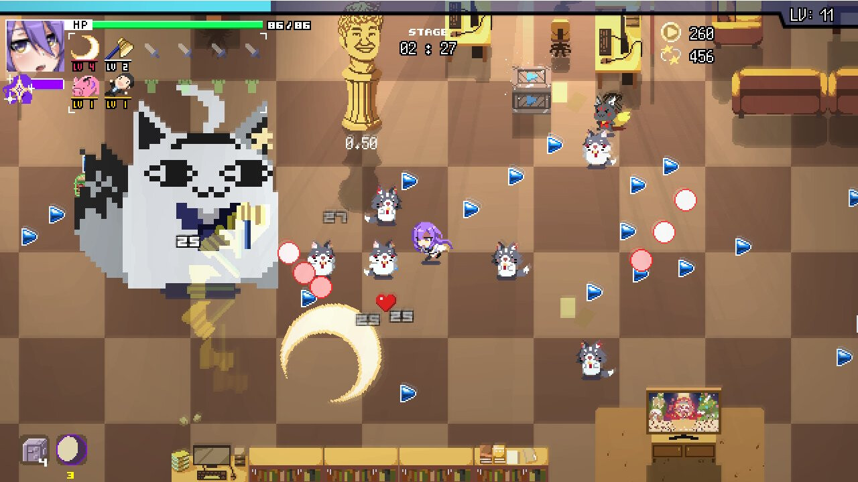
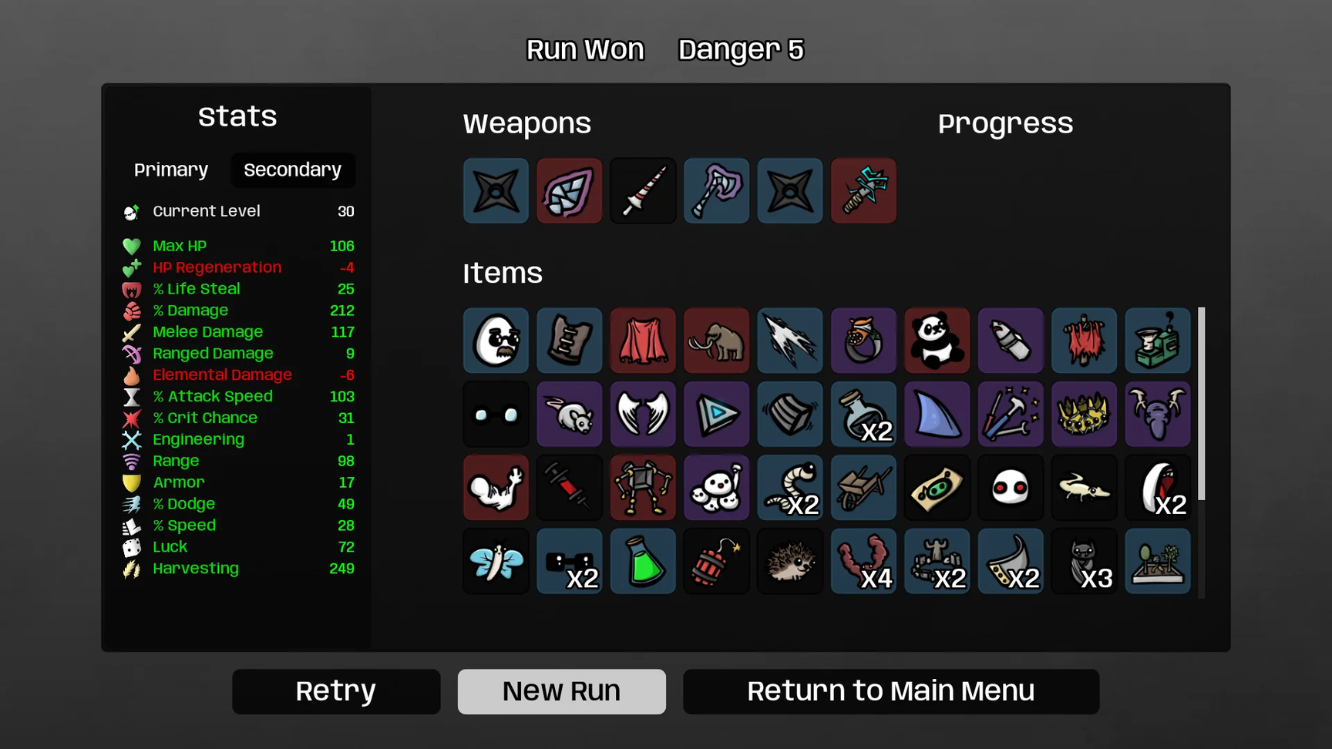
Gameplay Reference:
  Vampire Survivor
  Holocure
  Brotato

Slide 20
Proposal 3
Codename: ExorFist
Wuxia & Like A Dragon

Slide 21
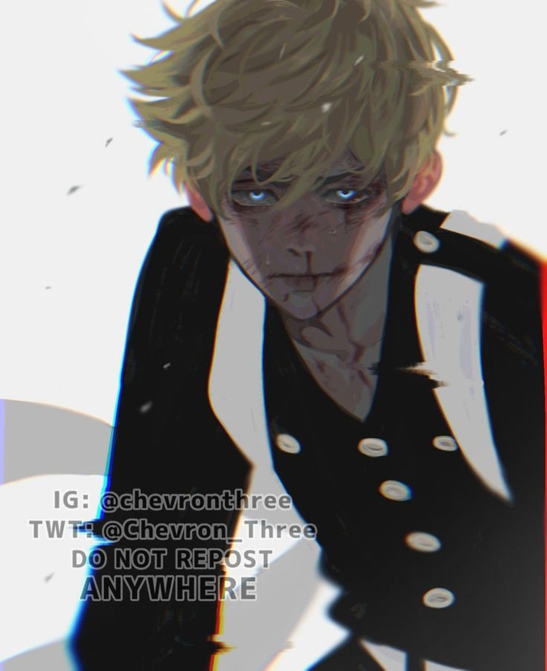
Genre: 3D Action, Abilities, Beat Em Up
Settings: Dark and atmospheric, Urban City
Story Overview:
Guo Yong, a legendary street punk with a heart of gold, known as the "Dragon Delinquent" in Héxié city lost his best friend to a haunting incident involving a yaoguai; Power-obsessed demon-like entities that terrorizes innocent civilians to feast on their chi.
Guo Yong’s master and savior, his shifu, teaches him the martial ways of the Exorfist while assisting him with clearing the streets of Héxié from ghostly terrors.
(Takemichi Hanagaki from Tokyo Revengers | Fanart)

Slide 22

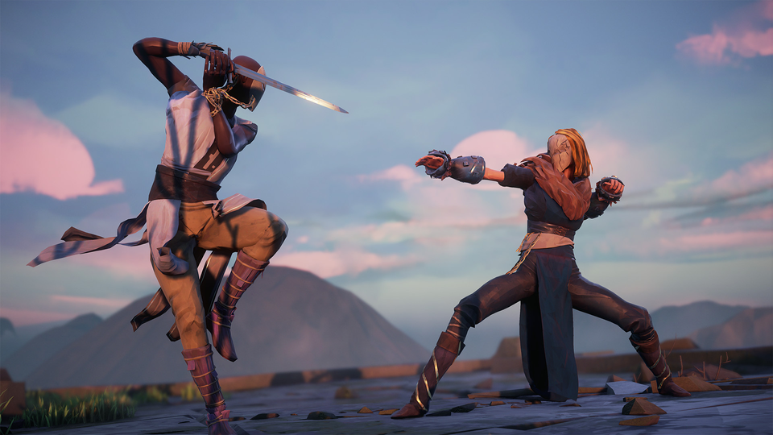
Objective and Goals
Narrative Goal
Gameplay Goal
Find the yaoguai that murdered your best friend and uncover the secret behind Guo Yong’s innate martial capabilities.
Cleanse the streets of Héxié to save it from yaoguai.
Beat yaoguai up, beat the boss at the end of the stage, collect chi to upgrade and enhance Guo Yong’s abilities.
Complete levels and achieve a high rank for each stage!
Absolver
Developed by Sloclap

Slide 23


Game Design Pillars
Technical and Flashy Combat
Master and Student Relationship
Unleash your martial prowess with proper technique.
A 3D Beat Em Up combat system with a combo mechanic, score rating and abilities.
Deepen your bond with your shifu.
Practice with him, earn his respect as well his martial secrets in order to defeat Yaoguai more effectively.
Mastery Progression
Replay stages in order to unlock more of Guo Yang’s potential.
Better upgrades become available to you as you get a better score on levels, prove yourself!

Slide 24

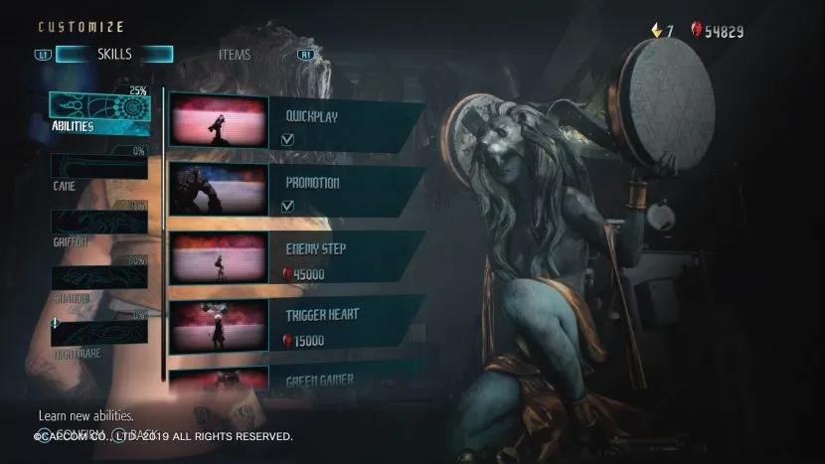
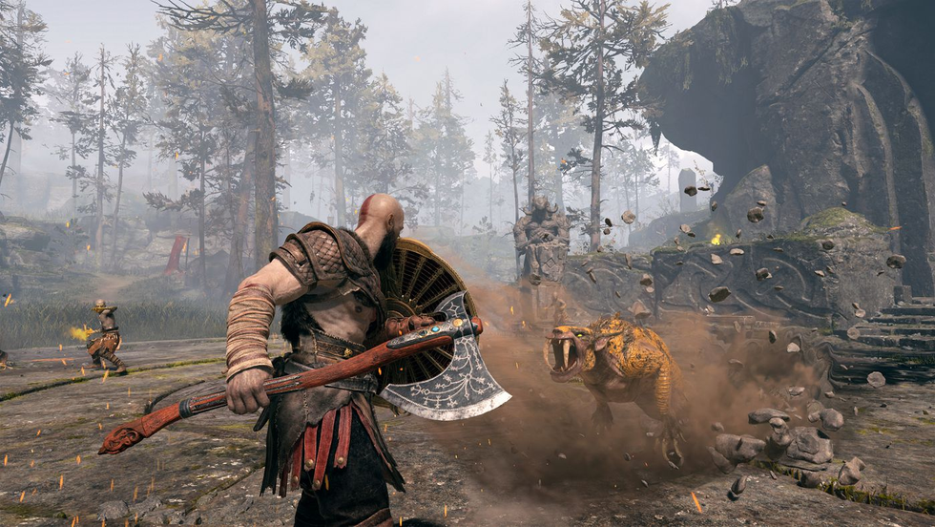
Game Mechanics
Upgrade System with currency
3D Action Combat
Devil May Cry 5
(Developed by Capcom)
God Of War
(Developed by Santa Monica Studio)

Slide 25

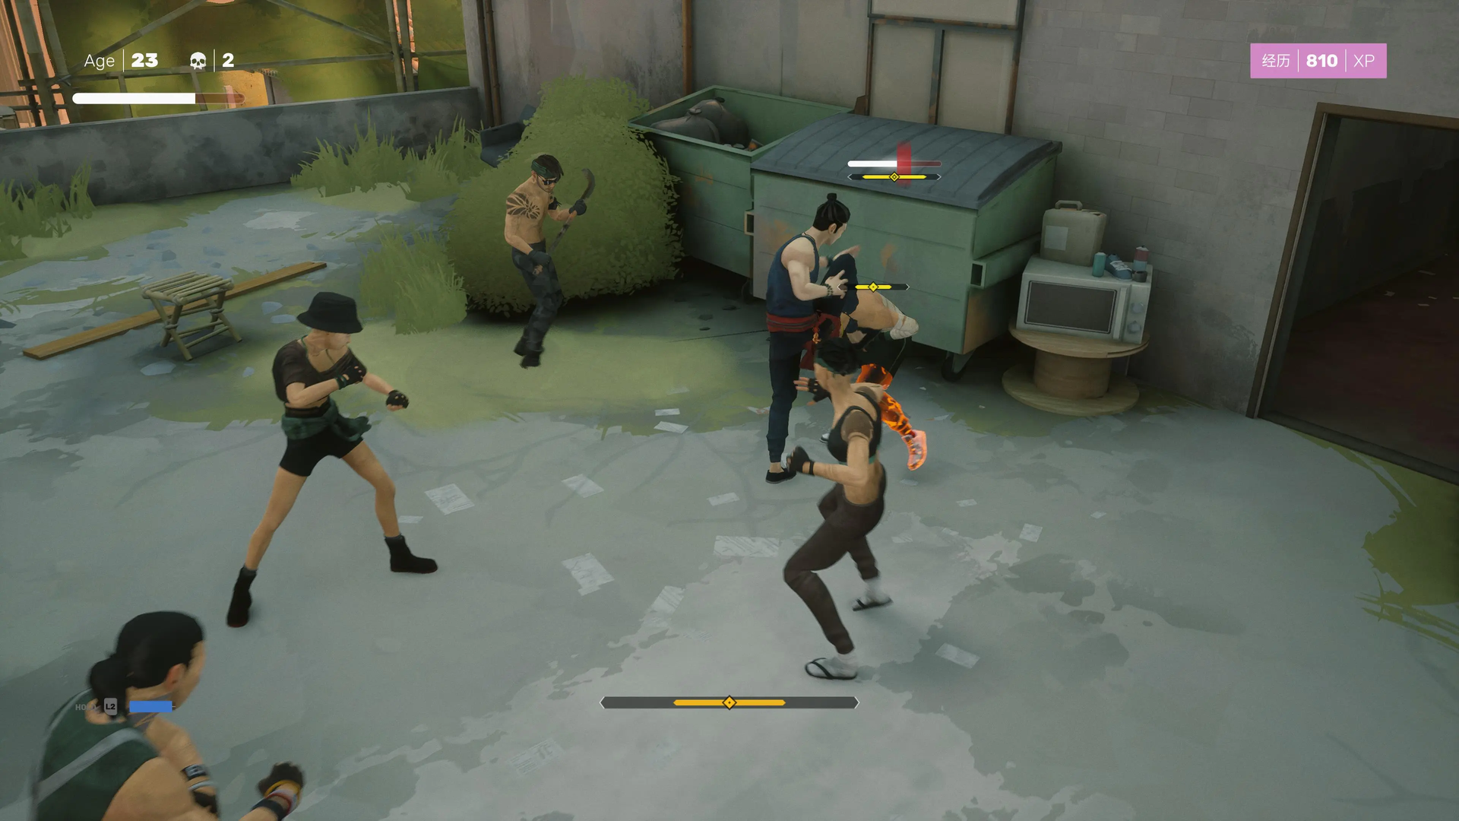
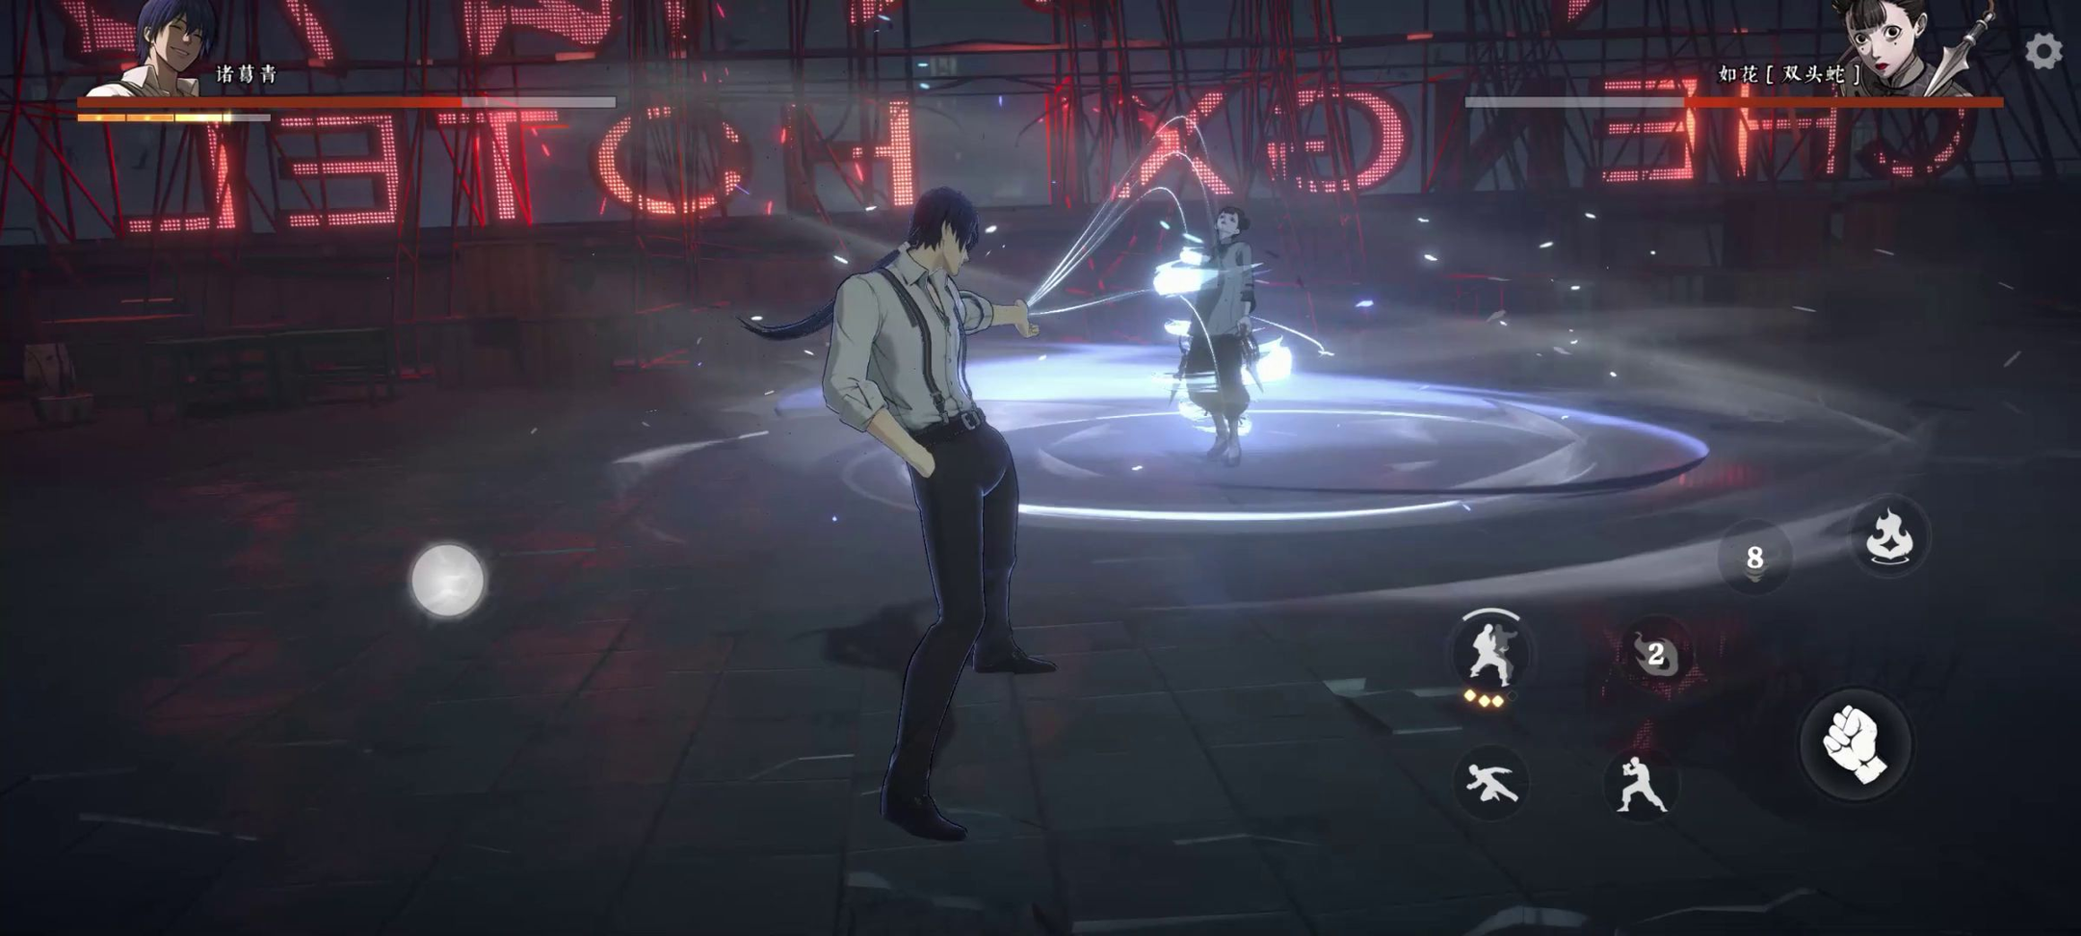
Major Gameplay References:
  Sifu
  Hitori No Shita : The Outcast
  Hi-Fi Rush
Sifu
(Developed by Sloclap Entertainment)
Hitori No Shita : The Outcast
(Developed by MoreFun Studios)

Slide 26
Tech Framework
(and tech direction)
Hierarchical State Machine
NPR Shading and VFX
Player controls are categorized via the different states they can be in.
If a player is moving forward, then the player shifts to a “moving” state and the game reads that and responds to additional inputs as required.
NPR Shading gives our game visual clarity while saving on processing power for the phone.
VFX will be added into the game using Unity’s Particle System as well as a mix of typical 2D vfx implementation using shaders.

Slide 27
Art Style

Slide 28
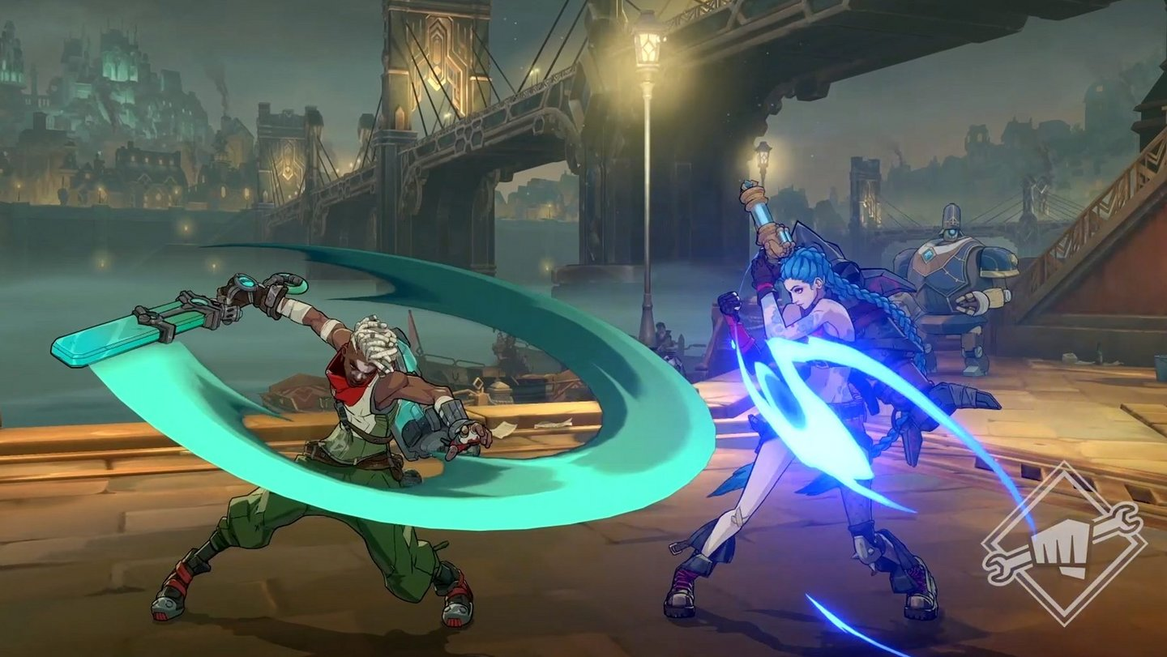
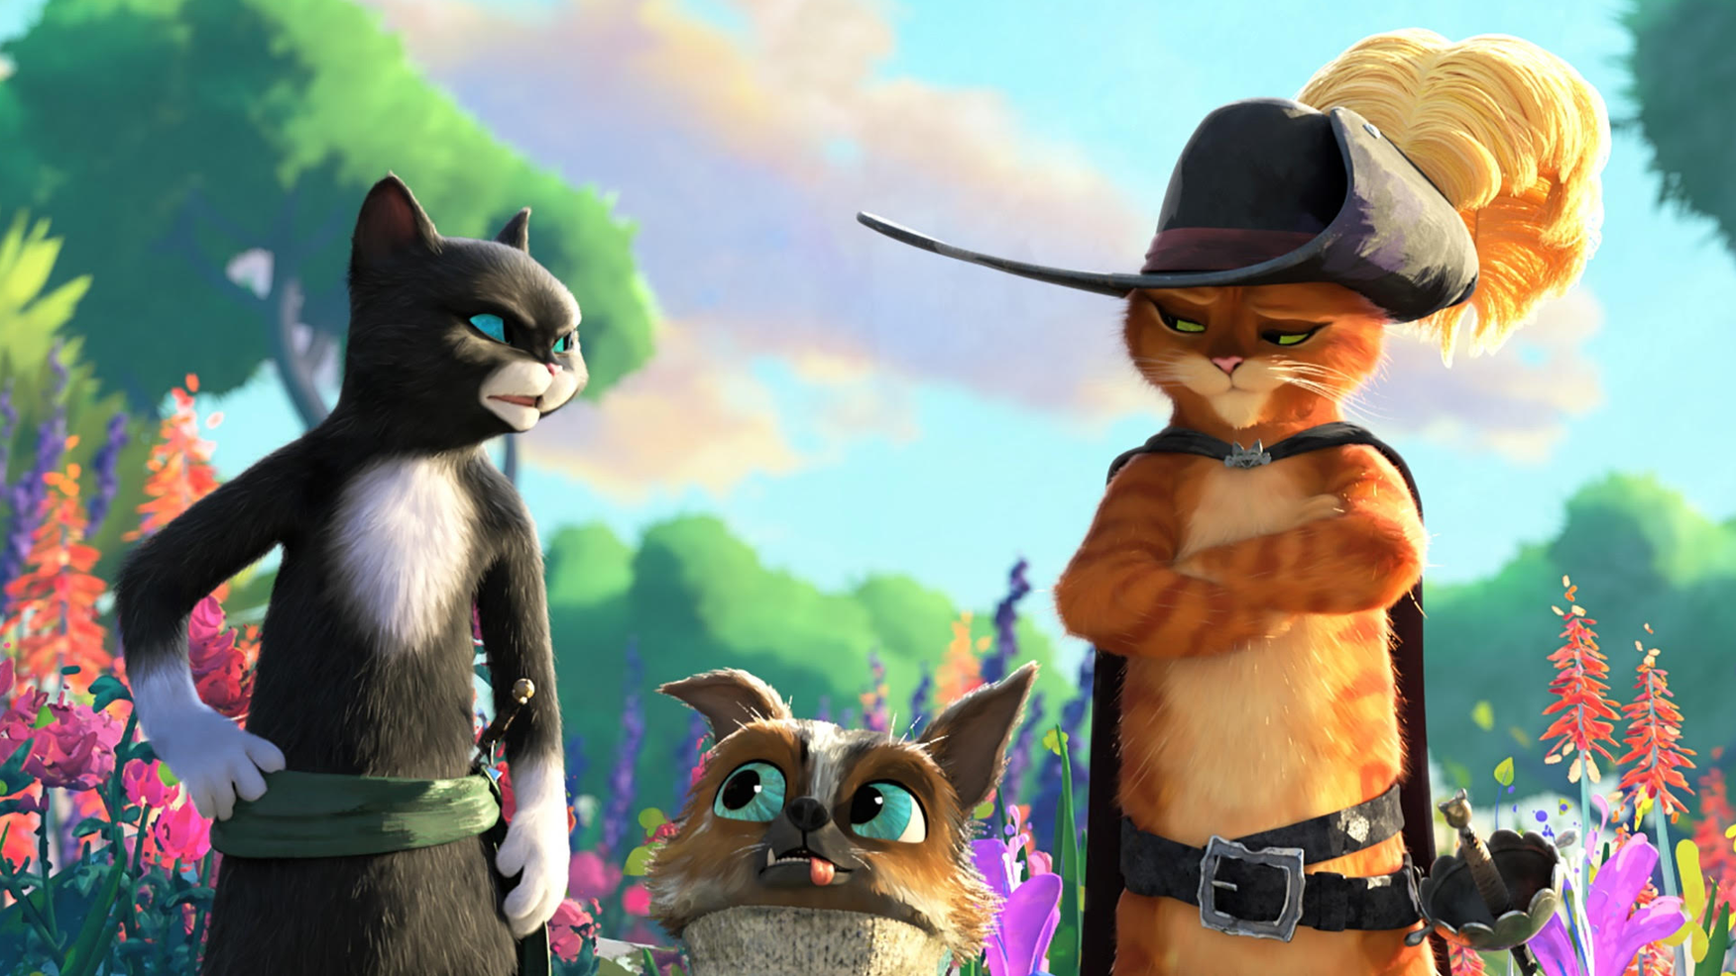
Art References:
  Valorant
  Puss In Boots 2
  Project L
  Legend of Zelda : BOTW
  Across The Spiderverse
Project L
(Developed by Riot Games)
Puss in Boots 2
(Animated by DreamWorks)

Slide 29
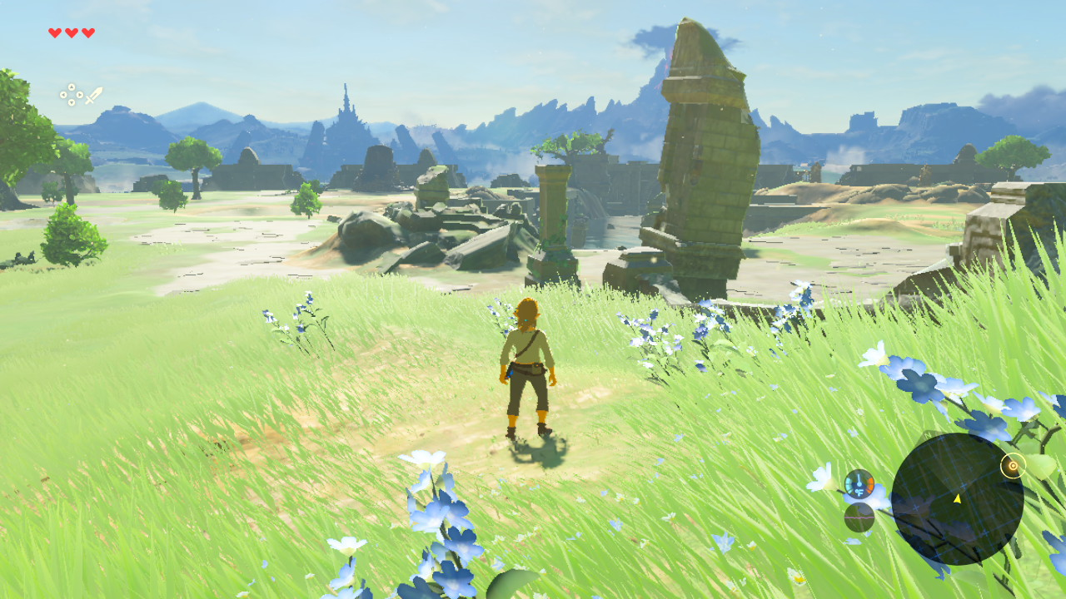
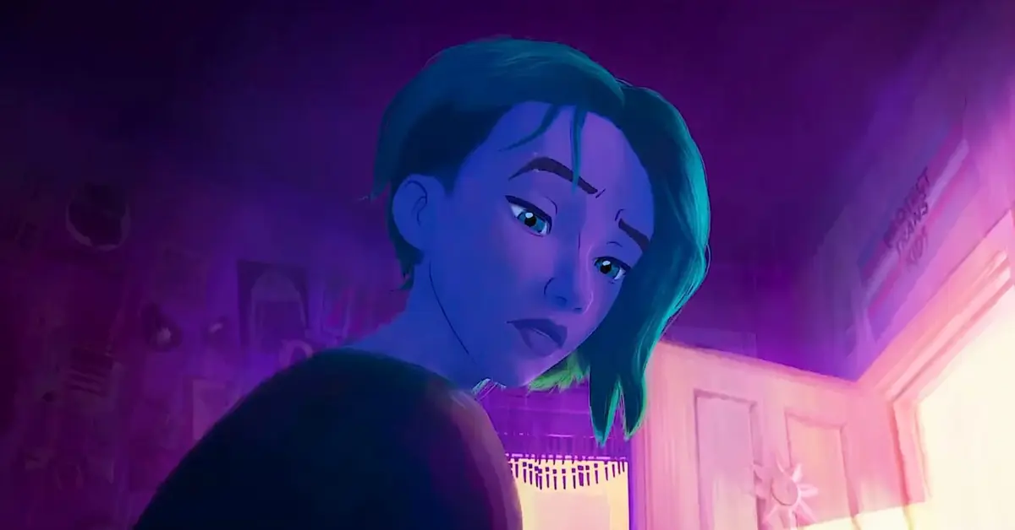
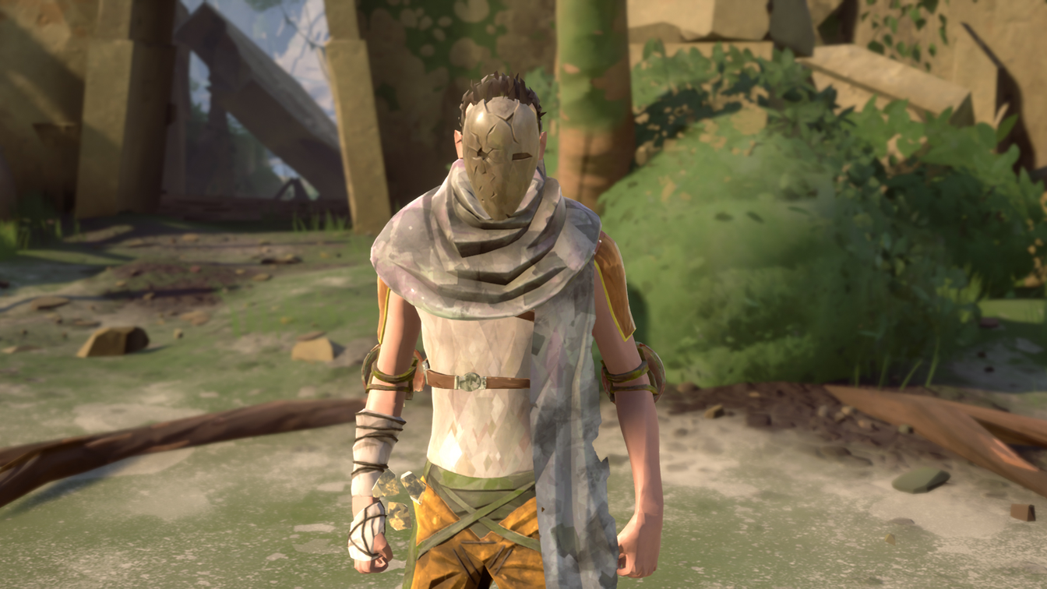
Legend of Zelda : Breath of The Wild
(Developed by Nintendo)
Project L
(Developed by Riot Games)
Absolver
(Developed by Sloclap Entertainment)

Slide 30
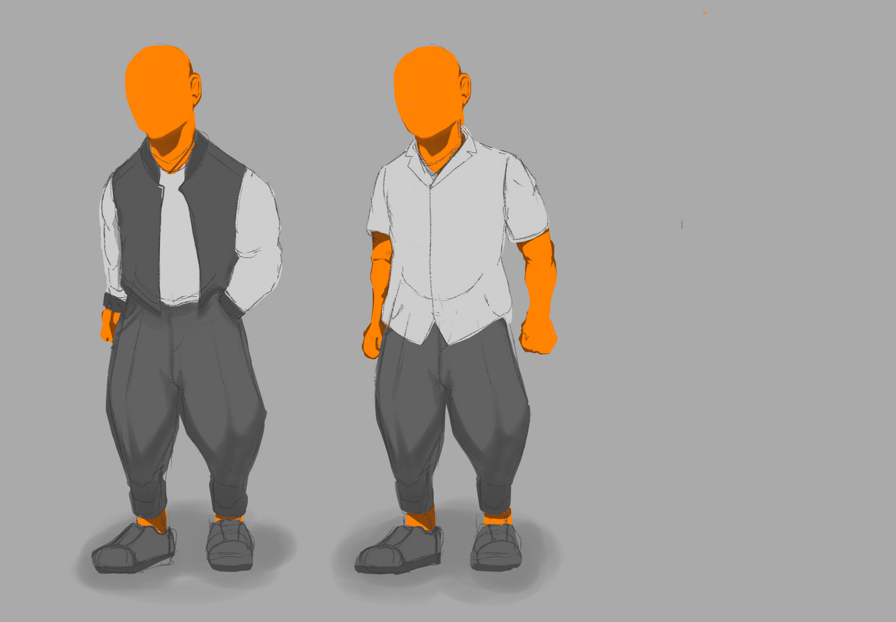
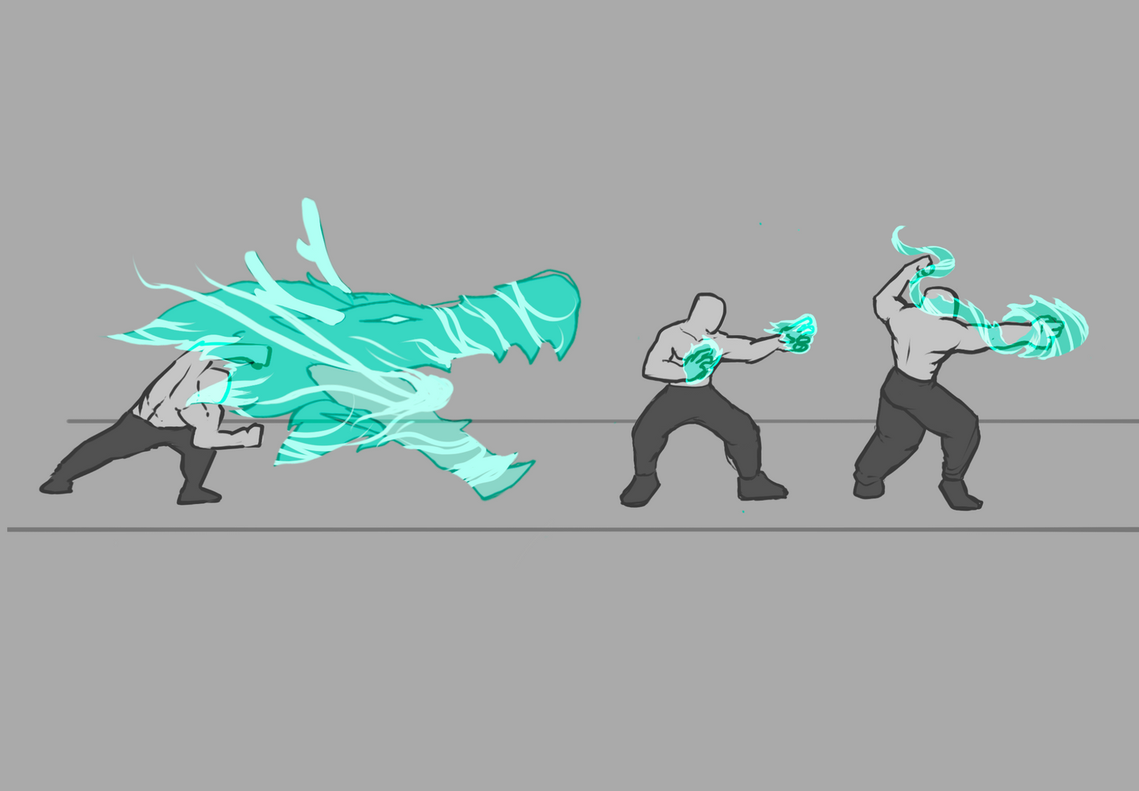
Concept Art
Outfit
VFX

Slide 31


QnA
Time

Slide 32




















Resource page

