Slide 1



Money, medicine or therapy?
Which intervention could most reduce cognitive impairment among older adults in rural South Africa
HAALSI Waves 1–3 · HAALSI Data Hackathon, Oct 2026 · [Names]
Notes:
Hi everyone, we're [team name]. Our question is simple: if you could fund one intervention, money, medicine or therapy, which would most reduce cognitive impairment among older adults in rural South Africa? We used all three waves of HAALSI to find out. In the next five minutes we'll show three findings, compare the three options head to head, and finish with what we can and cannot claim.

Slide 2
The question
Three candidates
1 in 5
Money
Cash transfer · financial security
older adults in the study have low cognition
Medicine
Bottom 20% at Wave 1
Hypertension care
Prevention evidence in low/middle-income countries is thin
Therapy
Psychotherapy for depression
Notes:
Start with the scale. About one in five older adults in the study have low cognition, which we define as the bottom twenty percent of scores at Wave 1. Yet evidence on preventing it in low and middle-income countries is thin; most studies come from rich countries. So we compared three realistic candidates: a cash transfer for financial security, hypertension care, and psychotherapy for depression.

Slide 3



Data & approach
Data
Measures
Methods
HAALSI · Agincourt, South Africa
5,059 adults aged 40+
3 waves over ~6 years
Outcome: cognition score (orientation + word recall, Wave 1 SD units)
Low cognition: below 20th percentile
Exposures: household assets · hypertension (none / untreated / treated) · depressive symptoms (CES-D)
Linear + logistic regression
Mixed model for change
Simulate each intervention: prevalence before vs after
Bootstrap 95% CI
Adjusted for age, sex, education
They come before the exposures. Not adjusted for BMI, hypertension or depression in the wealth model: they may be pathways.
Notes:
Our data is HAALSI, from Agincourt, South Africa: 5,059 adults aged forty and over, followed across three waves over about six years. The outcome is a cognition score combining orientation and word recall, in Wave 1 standard deviations, plus a low-cognition flag. We adjusted for age, sex and education because they come first. We did not adjust for BMI, hypertension or depression in the wealth model, because those may be the pathways. Then we used regression, a mixed model for change, and simulated each intervention.

Slide 4
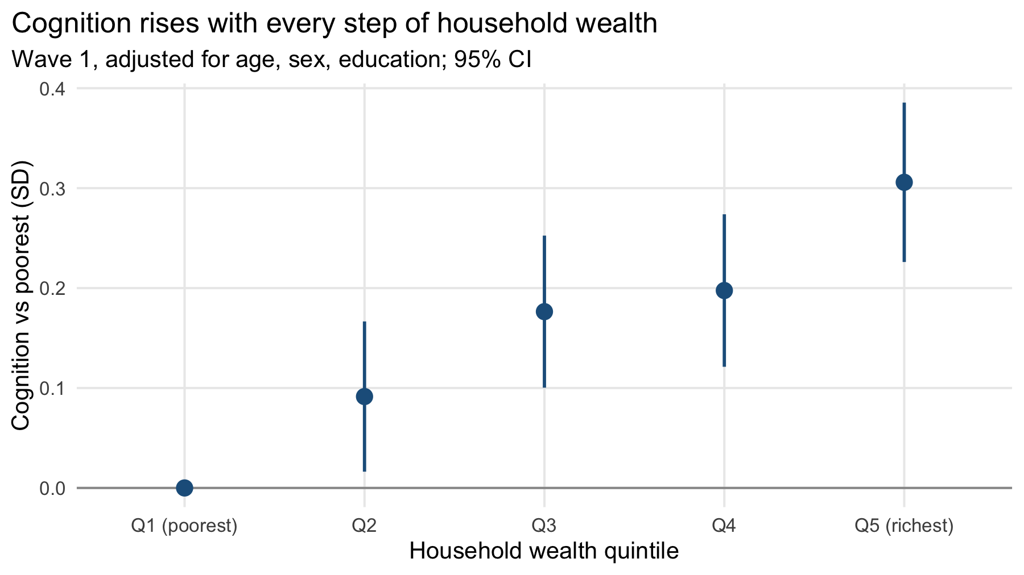
Finding 1 · Wealth: a steady gradient
+0.31 SD
OR 0.70
0.70–0.75
E-value 1.67
richest vs poorest quintile
per 1 SD assets · CI 0.63–0.78
OR with extra controls
confounder RR needed
Notes:
Finding one: wealth. Cognition rises with every step of household wealth; the richest fifth score 0.31 standard deviations above the poorest. Each standard deviation more in household assets means thirty percent lower odds of low cognition, an odds ratio of 0.70. That barely moves, staying between 0.70 and 0.75, when we add marital status, household size and birthplace. And an unmeasured confounder would need a risk ratio of 1.67 with both wealth and cognition to explain it away.

Slide 5
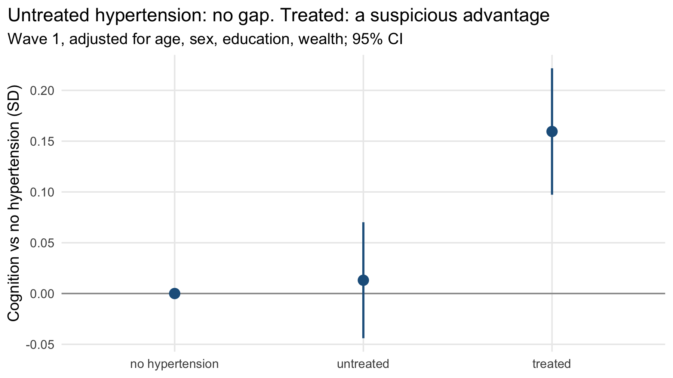
Finding 2 · Hypertension: who gets treated, not what pills do
+0.01 SD
+0.16 SD
66.8 vs 62.5
47% vs 40%
untreated · CI −0.04 to 0.07
treated · CI 0.10 to 0.22
treated are 4 years older
treated are richer (top 2 quintiles)
Notes:
Finding two: hypertension, and here we have to be careful. People with untreated hypertension score the same as people without it. People on treatment score 0.16 standard deviations higher. Pills that make you sharper? Probably not. The treated group is four years older, 66.8 versus 62.5, and richer: 47 percent are in the top two wealth quintiles versus 40 percent. This shows who gets treated, people with access to care, not what the pills do.

Slide 6
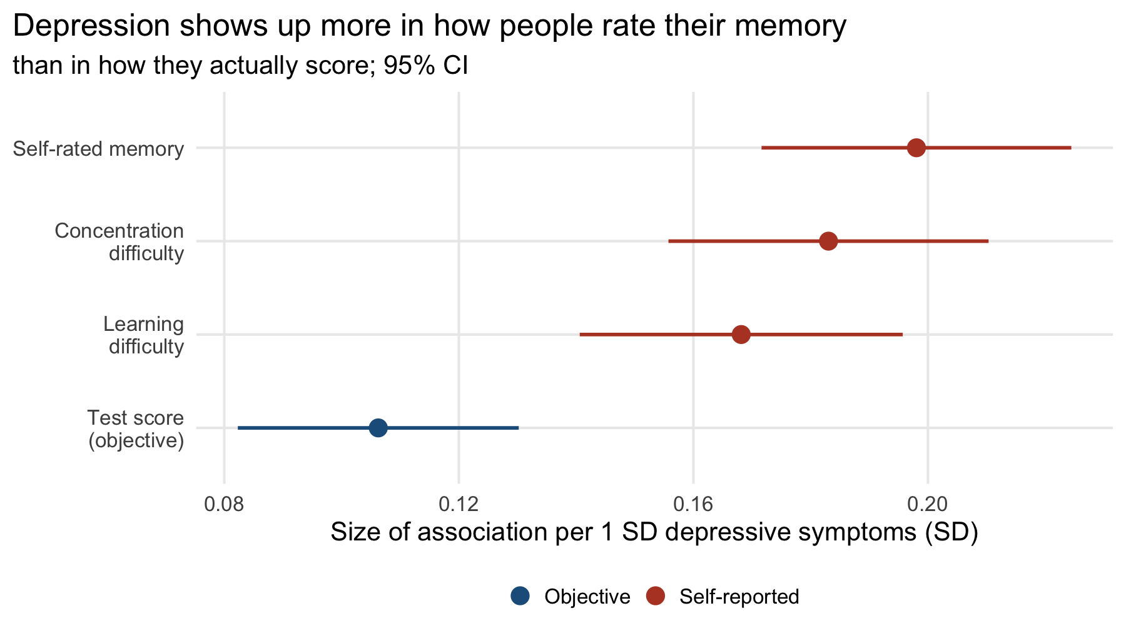
Finding 3 · Depression: felt more than measured
−0.11 SD
+0.17 to +0.20 SD
Almost 2×
test score per 1 SD more symptoms
self-reported difficulty
self-reports would over-flag the depressed
Notes:
Finding three: depression. One standard deviation more depressive symptoms goes with a test score 0.11 standard deviations lower. But for self-reported difficulty with memory, concentration and learning, the association is 0.17 to 0.20, almost twice as large. So depression shows up much more in how people rate their memory than in how they actually score. The practical point: screening with self-reports would over-flag depressed people as impaired.

Slide 7
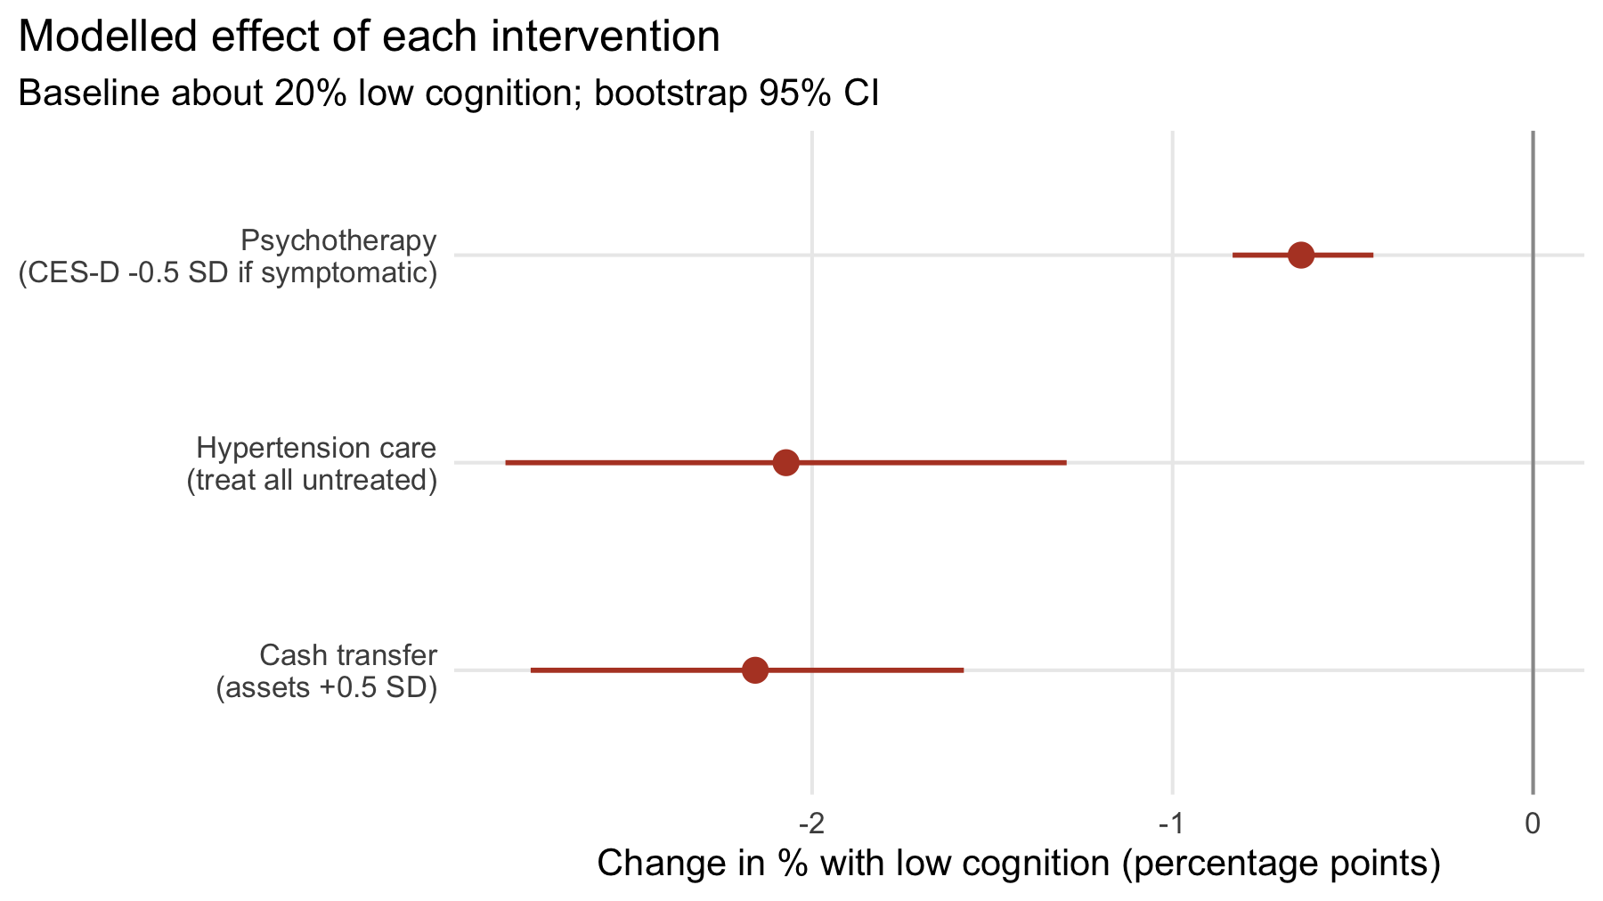
What could each intervention achieve?
VERDICT
Cash transfer
−2.2 pp
95% CI −2.8 to −1.6 · about 11% of cases
Largest effect
Most credible
Backed by SA Old Age Pension research (Case 2001; Duflo 2003)
Helps the whole household
Hypertension care −2.1 pp (−2.9 to −1.3): least trustworthy (Finding 2)
Psychotherapy −0.6 pp (−0.8 to −0.4)
Notes:
Now head to head. We simulated each intervention and predicted the share with low cognition before and after. A cash transfer raising assets by half a standard deviation cuts it by 2.2 percentage points, about eleven percent of cases. Treating all untreated hypertension gives a similar 2.1, but that's the estimate we trust least, because of Finding two. Psychotherapy gives 0.6. Our verdict: financial security. It's the largest, the most credible, backed by South Africa's Old Age Pension research, and it helps the whole household.

Slide 8
Limitations & implications
1
Observational
IMPLICATIONS
Wealth may proxy lifelong advantage (childhood, ability). E-value 1.67 shows how strong that would need to be.
Prioritise cash transfers and pension coverage
2
Access to care
Treated vs untreated hypertension is confounded by who reaches a clinic.
Test it causally
Regression discontinuity at the pension-eligibility age of 60
3
Practice & attrition
Scores rise ~0.08 SD/yr from practice; ~1 in 5 died by Wave 3. Change estimates lean upward.
Notes:
Three limitations. First, this is observational: wealth may stand in for lifelong advantage, like childhood conditions or ability, and the E-value of 1.67 tells you how strong that hidden factor would need to be. Second, the hypertension comparison is confounded by access to care. Third, scores rise about 0.08 per year from practice, and about one in five died by Wave 3, so change estimates lean upward. So: prioritise cash transfers and pension coverage, and test it causally at the pension age of sixty.

Slide 9
Thank you
Questions?
HAALSI is sponsored by the National Institute on Aging (P01 AG041710) and conducted by the Harvard Center for Population and Development Studies in partnership with the University of the Witwatersrand.
Notes:
To sum up: in this data, money beats medicine and therapy, both in the size of the effect and in how much we trust it. Thank you to the HAALSI team, the National Institute on Aging, Harvard and Wits for the data, and to the organisers. We're happy to take your questions.

