Slide 1

Higgs Machine Learning Project
Quarks Team

Slide 2
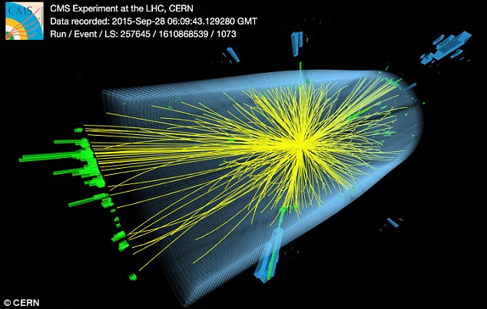
Task: Train a classifier based on the training data with the goal of maximizing the AMS on a held out (test) data set
Challenge: Incorporate the objective function into the classifier

Slide 3
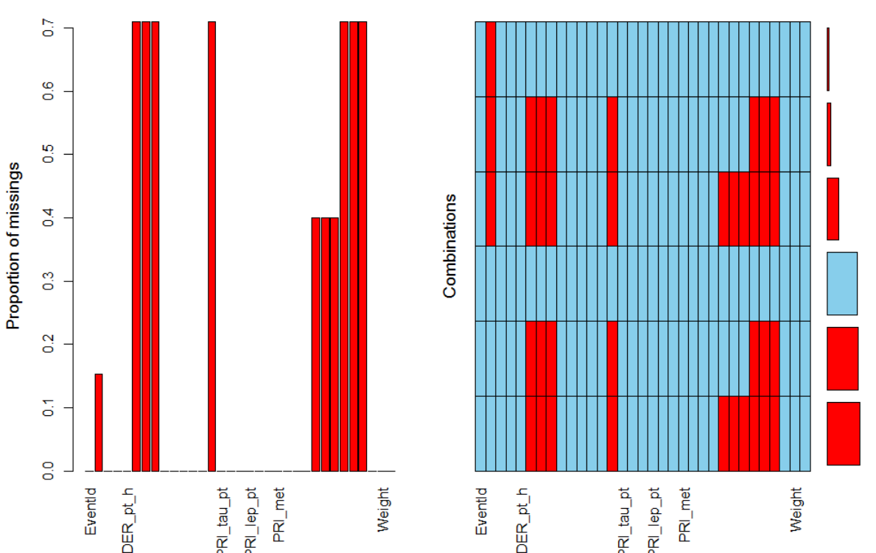
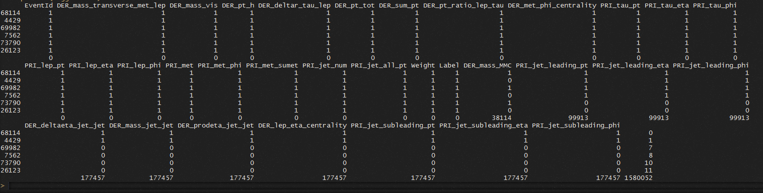
Missing
Value
Pattern

Slide 4
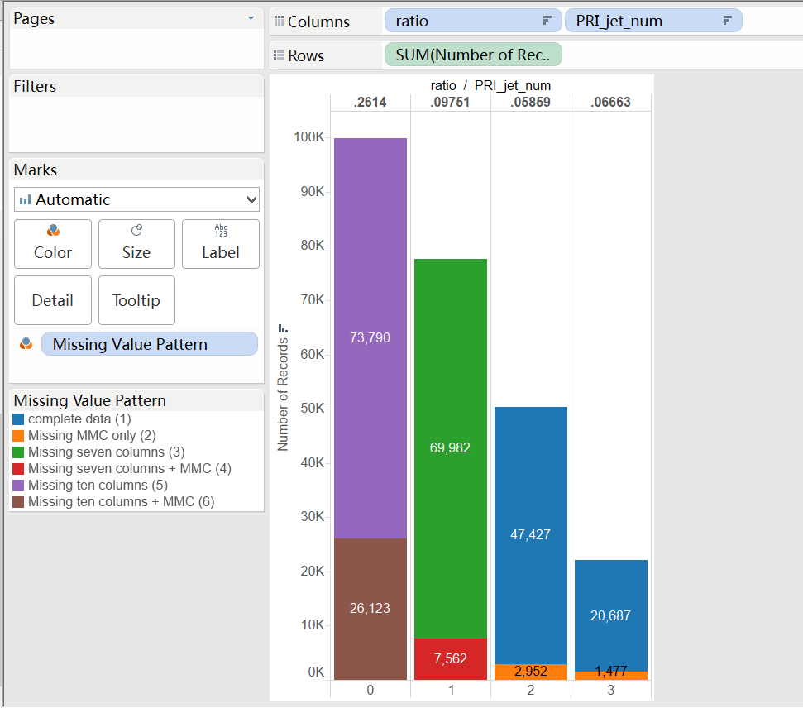
Missing Value Pattern For training set

Slide 5
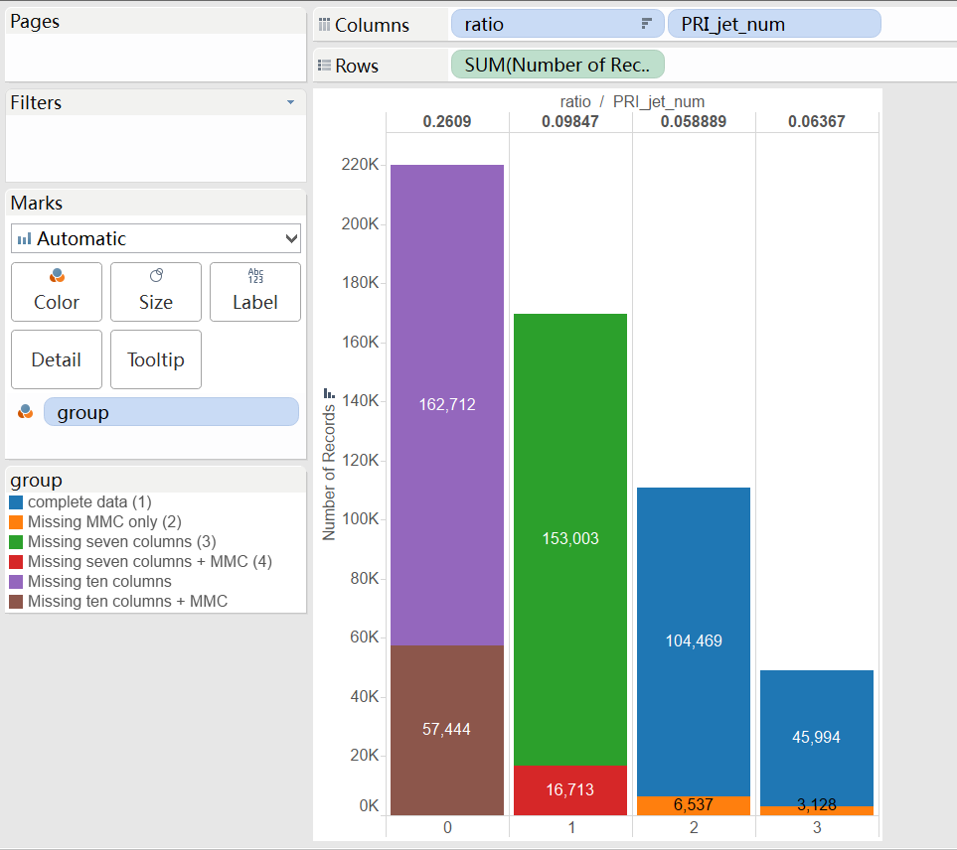
Missing Value Pattern For test set

Slide 6
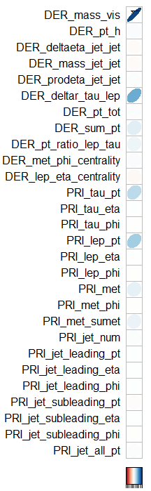
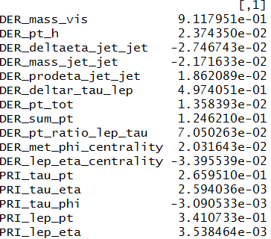
Imputation
Multivariate Imputation by Chained Equations
Mice

Slide 7
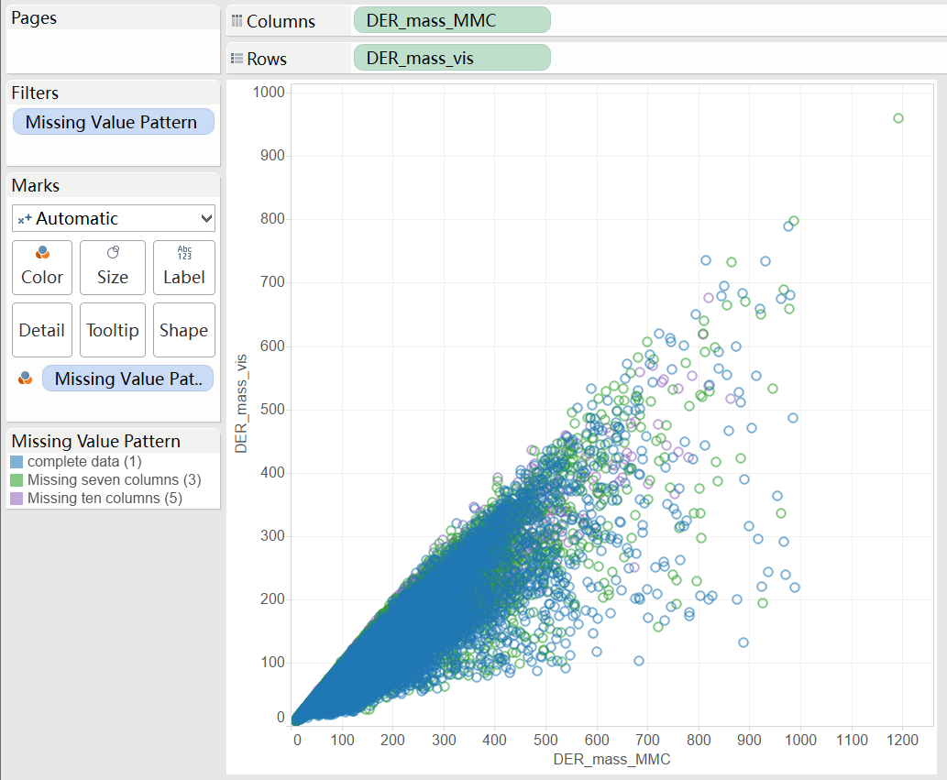

Slide 8
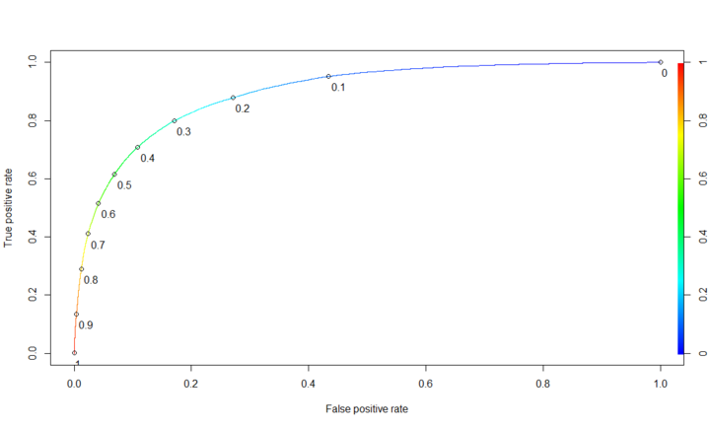
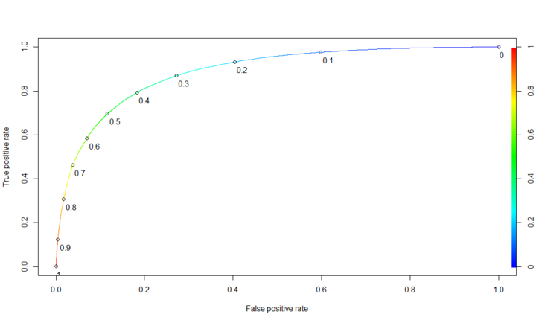
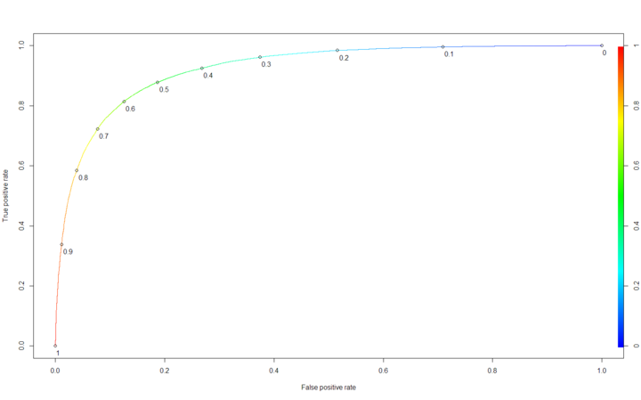
AUC of Random Forest
Group 1 (interger: 0)
AUC: 0.8961
Threshold: 0.282
Group2(interger:1)
AUC: 0.8866
Threshold: 0.384
Group 3(interger: 2/3)
AUC: 0.9245
Threshold: 0.539

Slide 9
Insight
(1) The Training set and the test set are splited based on PRI_jet_num
(2) DER_mass_MMC might be a very important variable
(3) The missing value of for PRI_jet_num 2/3 might came from the same mechamism

