Slide 1

Higgs Machine Learning Project
Quarks Team

Slide 2
Flow
Introduction
Missing Data Pattern
Imputation
Logistic Regression
Random Forest
GBM
Conclusion

Slide 3
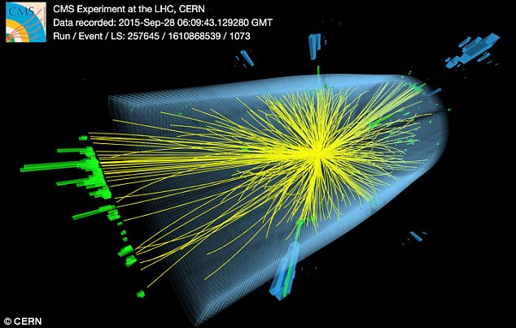
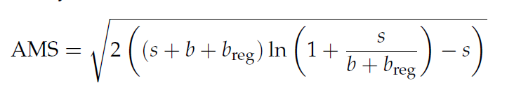
Higgs Boson
Task: Train a classifier based on the training data with the goal of maximizing the AMS on a held out (test) data set

Slide 4
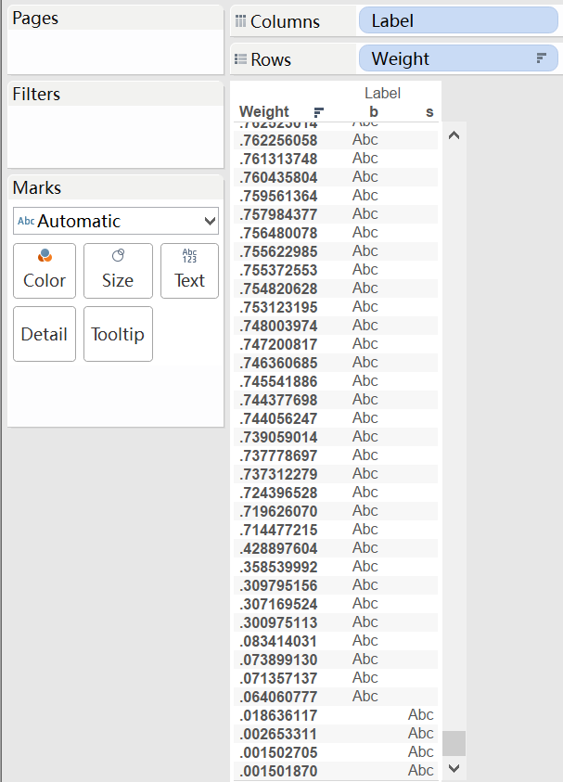
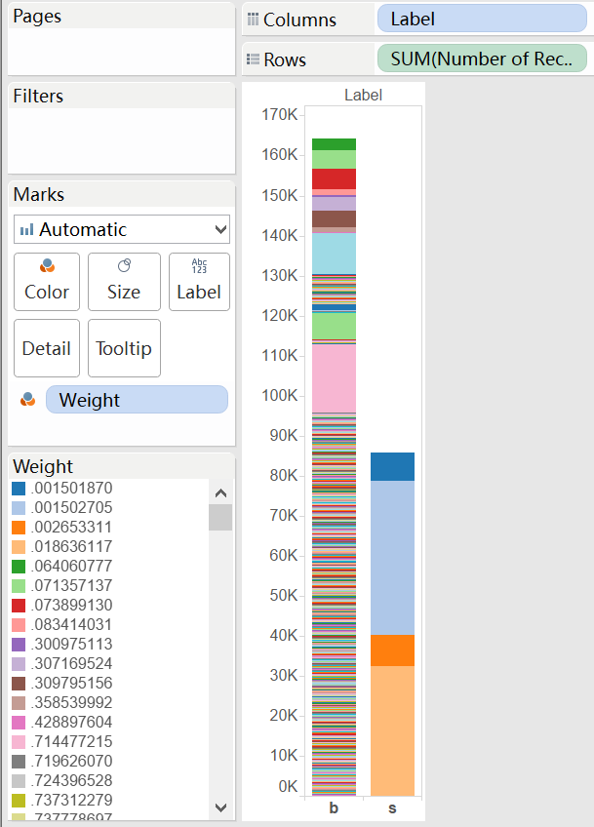
Exploratory Data Analysis

Slide 5
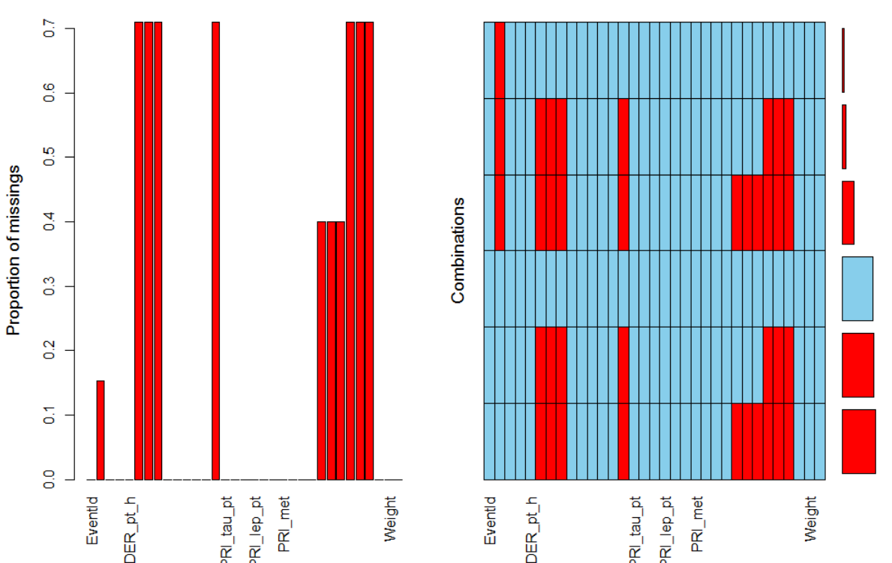
Missing Value Pattern
All missing features are related to PRI jet num, except DER mass MMC

Slide 6
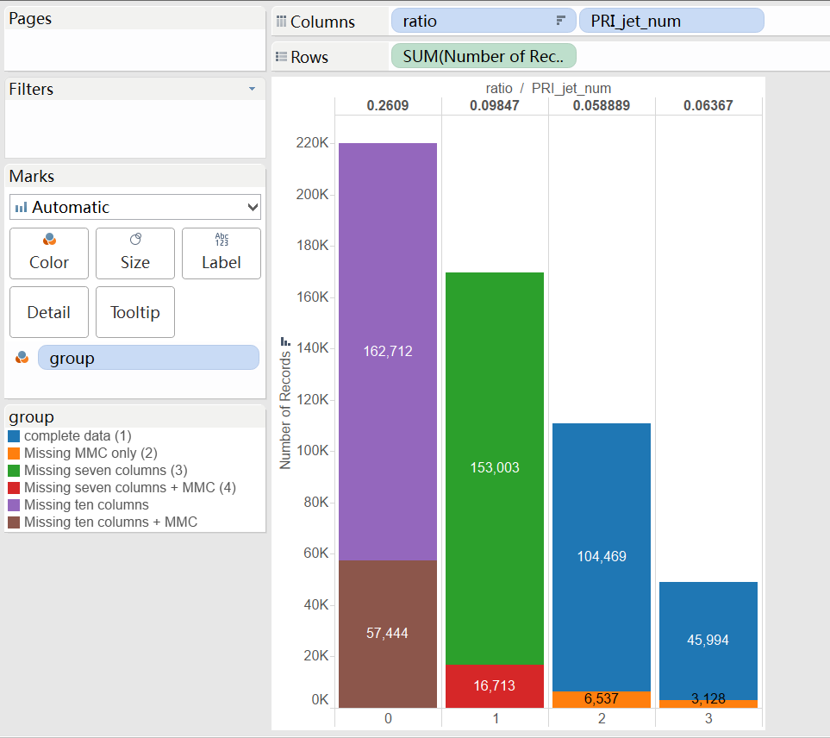
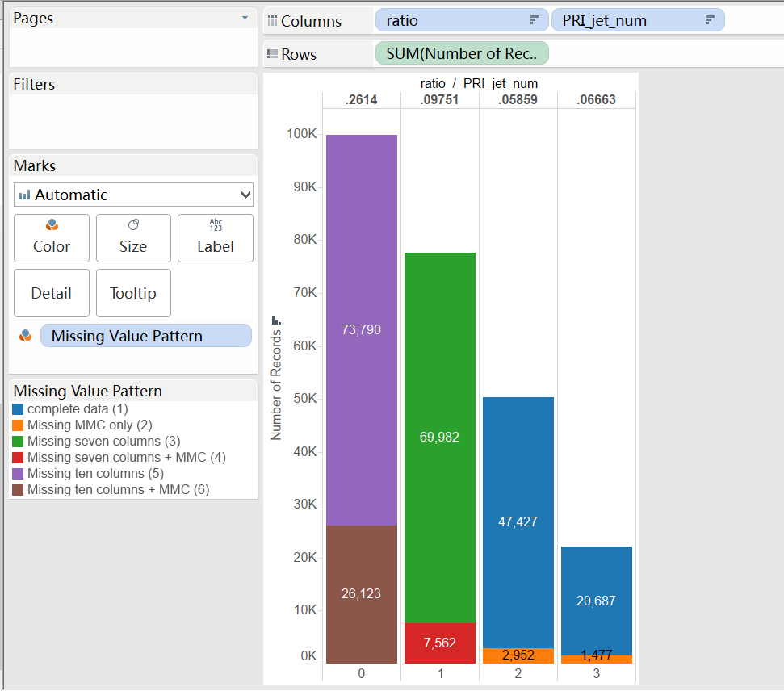
Missing Value Pattern For training set
Test
Train
Proportion of missingness is the same between the Test and the Training data set
The missingness is not completely at random.

Slide 7
EDA Insight
DER_mass_MMC might be very important
The missing value of for PRI_jet_num 2/3 might come from the same mechanism

Slide 8
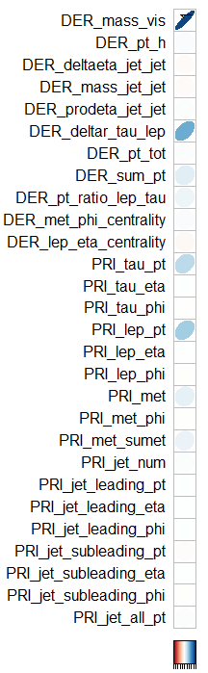
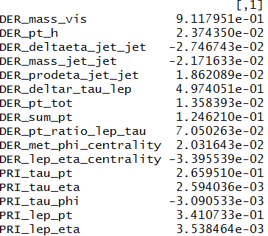
Imputation
Multivariate Imputation by Chained Equations (MICE)

Slide 9
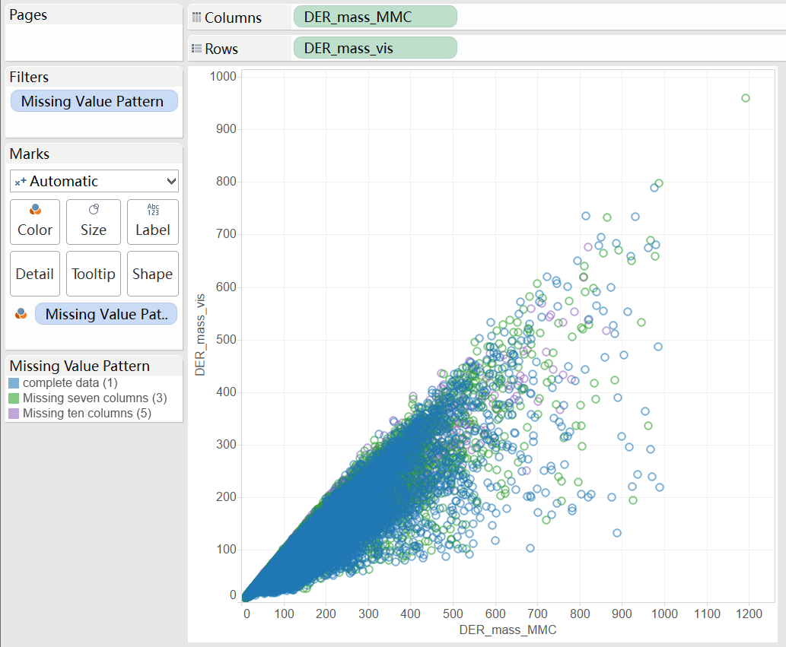
Positive correlation between DER_mass_MMC and DER_mass_vis

Slide 10
Logistic Regression
Fast computation time
Try to model linear relationship
Interpretable
Understand data, cutoff value and ROC

Slide 11
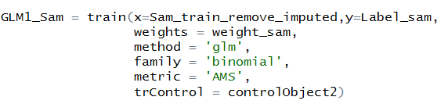
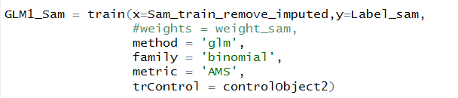
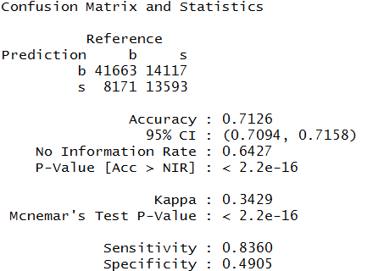
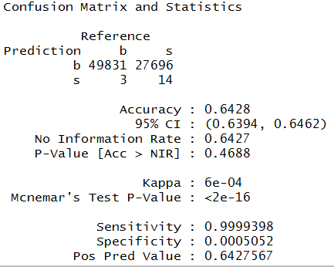
Logistic Regression

Slide 12
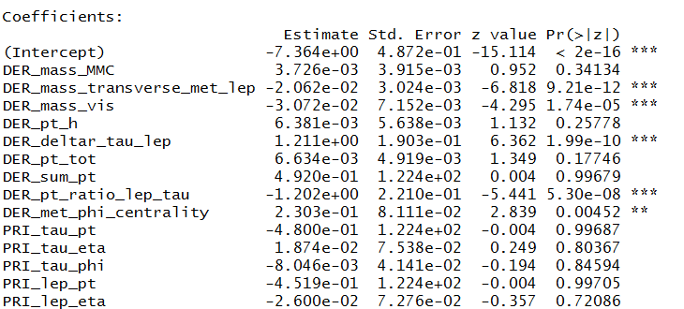
Logistic Regression
AMS score = 2.034

Slide 13
Random Forest
Used a non-linear method to try to have a better fit
Determine variable importance
Robust against outliers

Slide 14
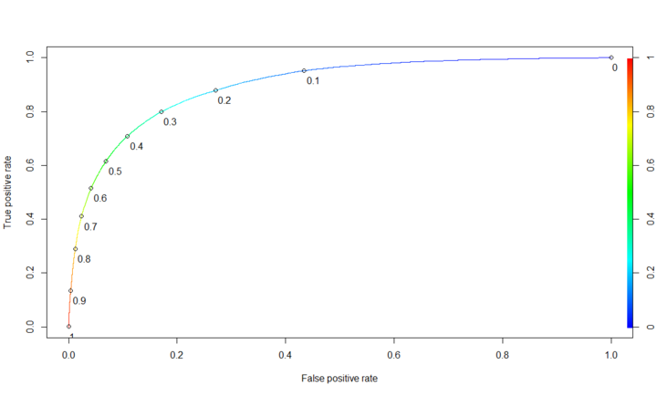
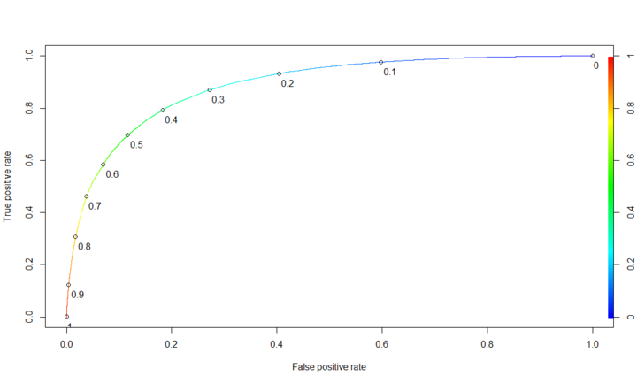
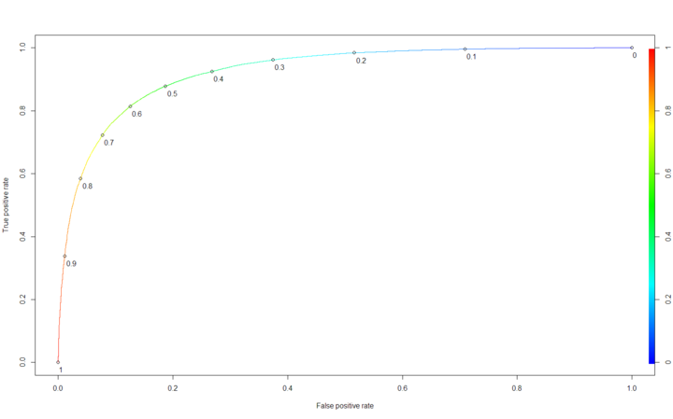
ROC of Random Forest
ntree = 1000, mtry=c(4, 6, 8, 10)
PRI-Jetnum =0
AUC: 0.8961
Threshold: 0.282
Mtry used = 5
PRI-Jetnum = 1
AUC: 0.8866
Threshold: 0.384
Mtry used = 5
PRI-Jetnum = 2-3
AUC: 0.9245
Threshold: 0.539
Mtry used= 6

Slide 15
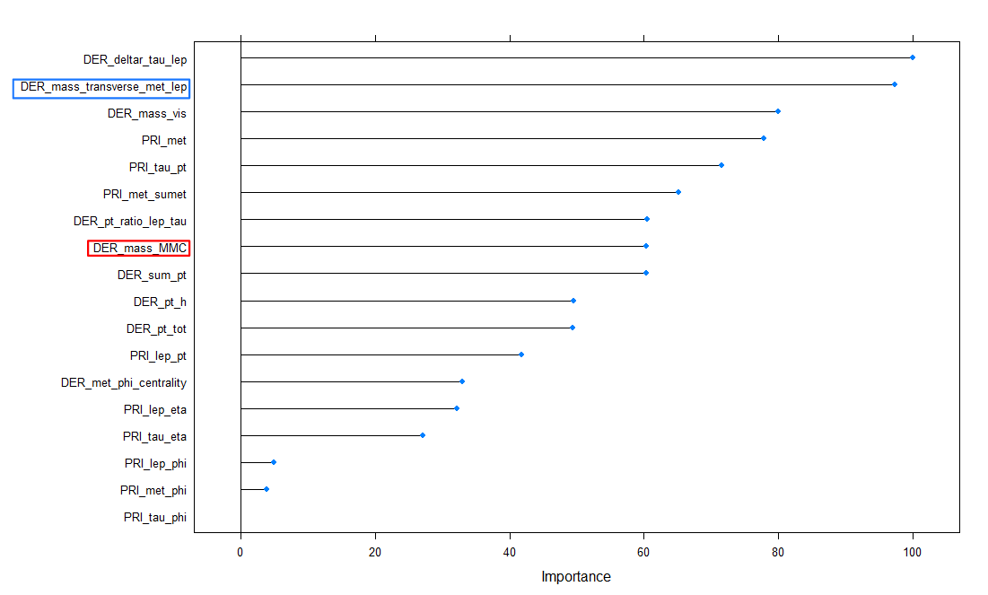
Variable of Importance based on random forest
(PRI-Jetnum = 0)

Slide 16
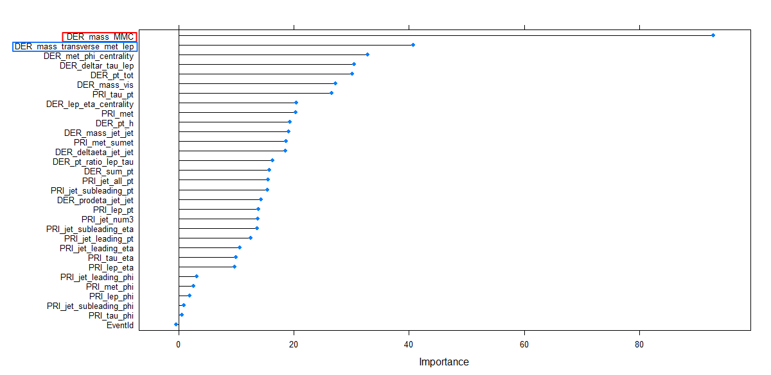
Variable of Importance based on random forest
(PRI-Jetnum = 1)

Slide 17
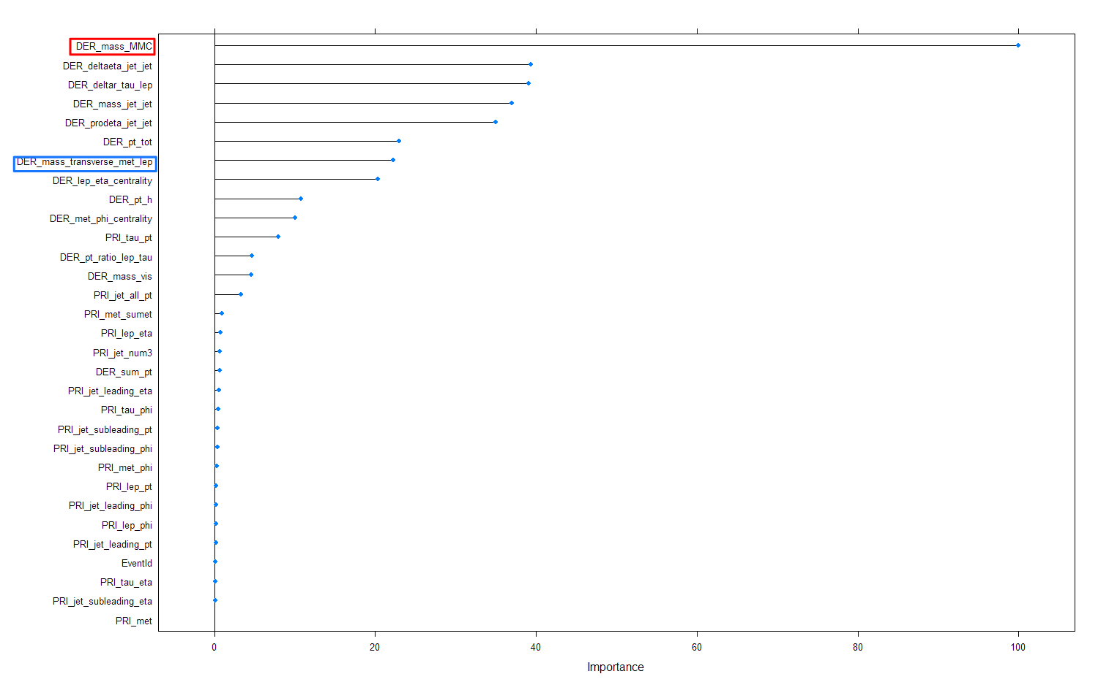
Variable of Importance based on random forest
(PRI-Jetnum = 2/3)
AMS score = 2.328

Slide 18
Boosting
General better predictive accuracy than traditional models
Principle of ensemble: model outcomes are weighted based on previous instances. This combination of weak learners delivers improved accuracy

Slide 19
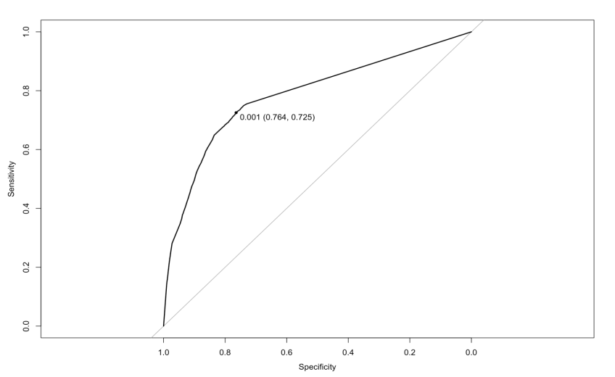
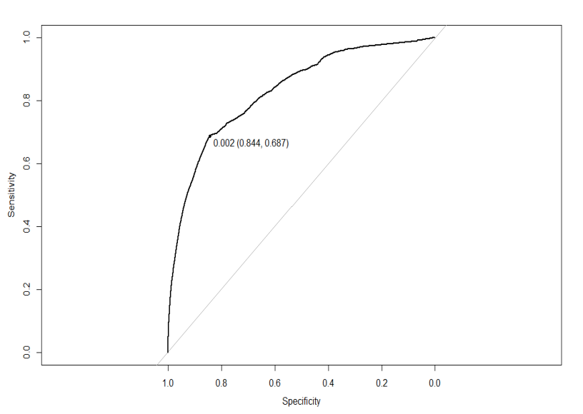
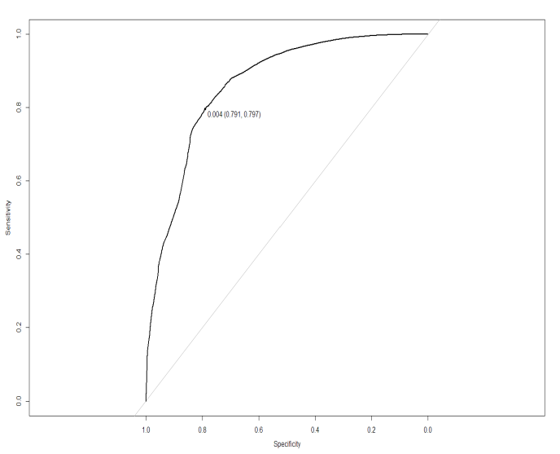
ROC of Boosting
PRI-Jetnum =0
ntree = 1000,
shrinkage = 0.001
n.minobsinnode =100
interaction.depth = 1
AUC: 0.7845
Threshold: 0.001
PRI-Jetnum =1
ntree = 1000,
shrinkage = 0.001
n.minobsinnode =100
interaction.depth = 5
AUC: 0.8299
Threshold: 0.002
PRI-Jetnum =2,3
ntree = 1000,
shrinkage = 0.001
n.minobsinnode =100
interaction.depth = 5
AUC: 0.8961
Threshold: 0.004

Slide 20
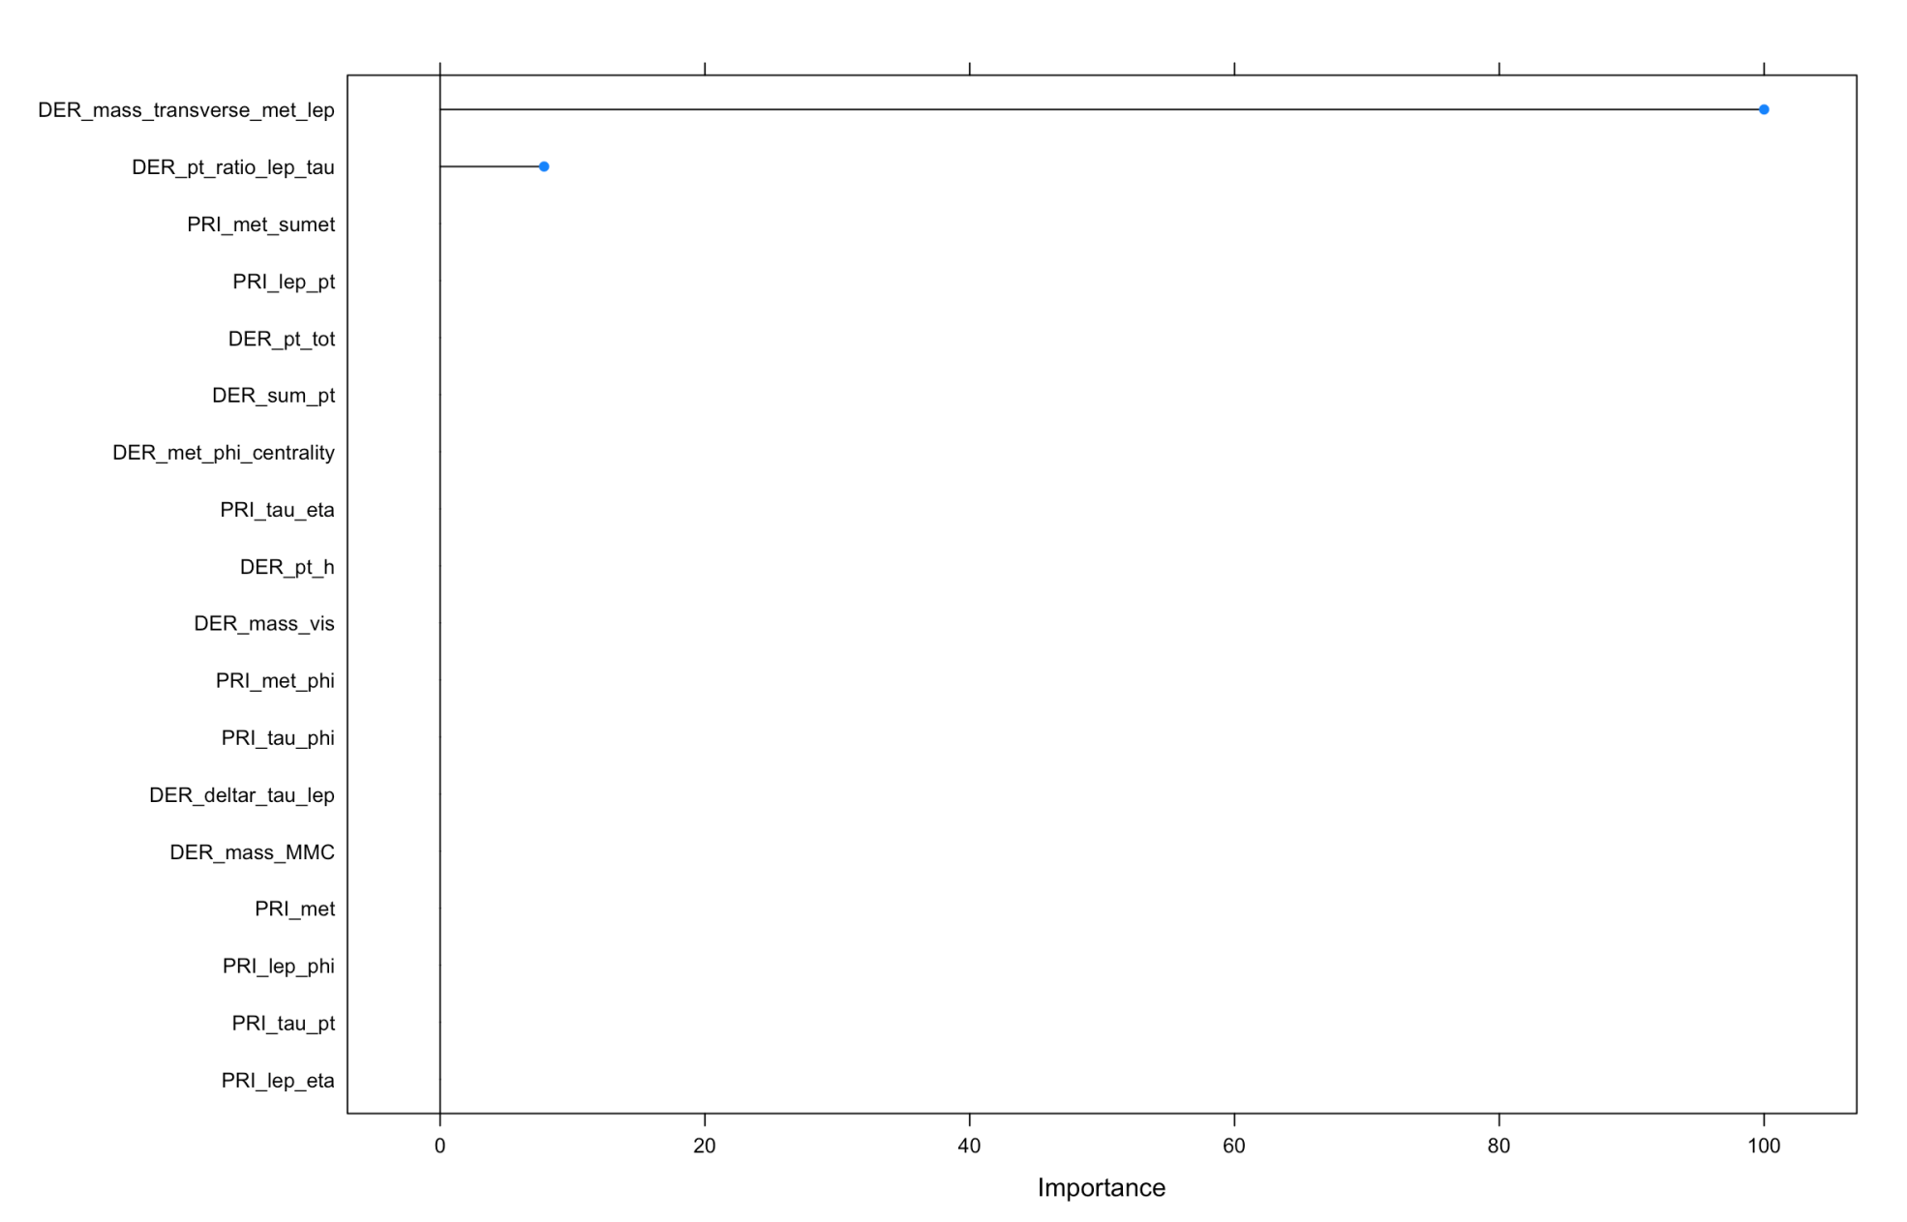
Variable of Importance based on Boosting
(PRI-Jetnum = 0)

Slide 21
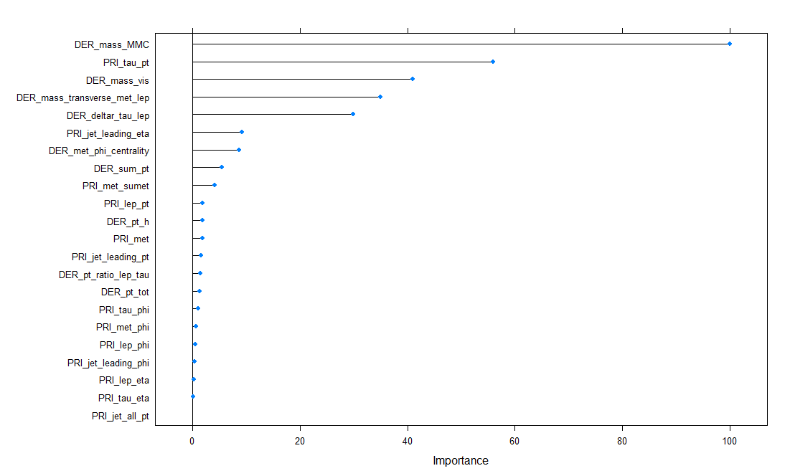
Variable of Importance based on Boosting
(PRI-Jetnum = 1)

Slide 22
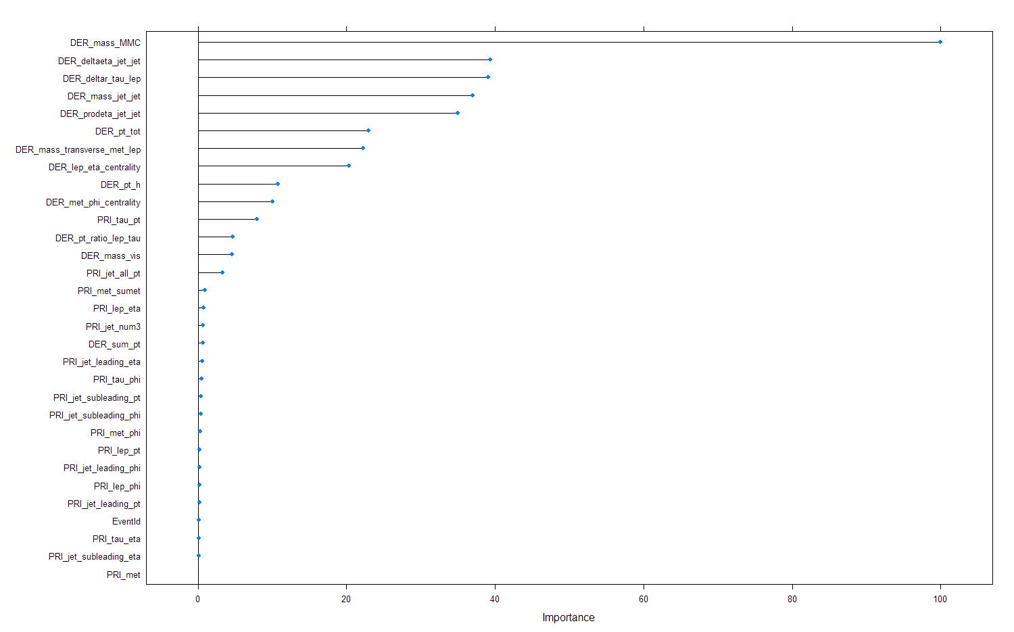
Variable of Importance based on Boosting
(PRI-Jetnum: 2,3)
AMS score = 1.411

Slide 23
Lessons learned
Inputation itself is a model:a predictive model within a predictive model
It’s important to understand why the values are missing
Before you gain enough domain knowledge, don’t let the machine to learn your bias
Ask question, and make mistakes

