Slide 1
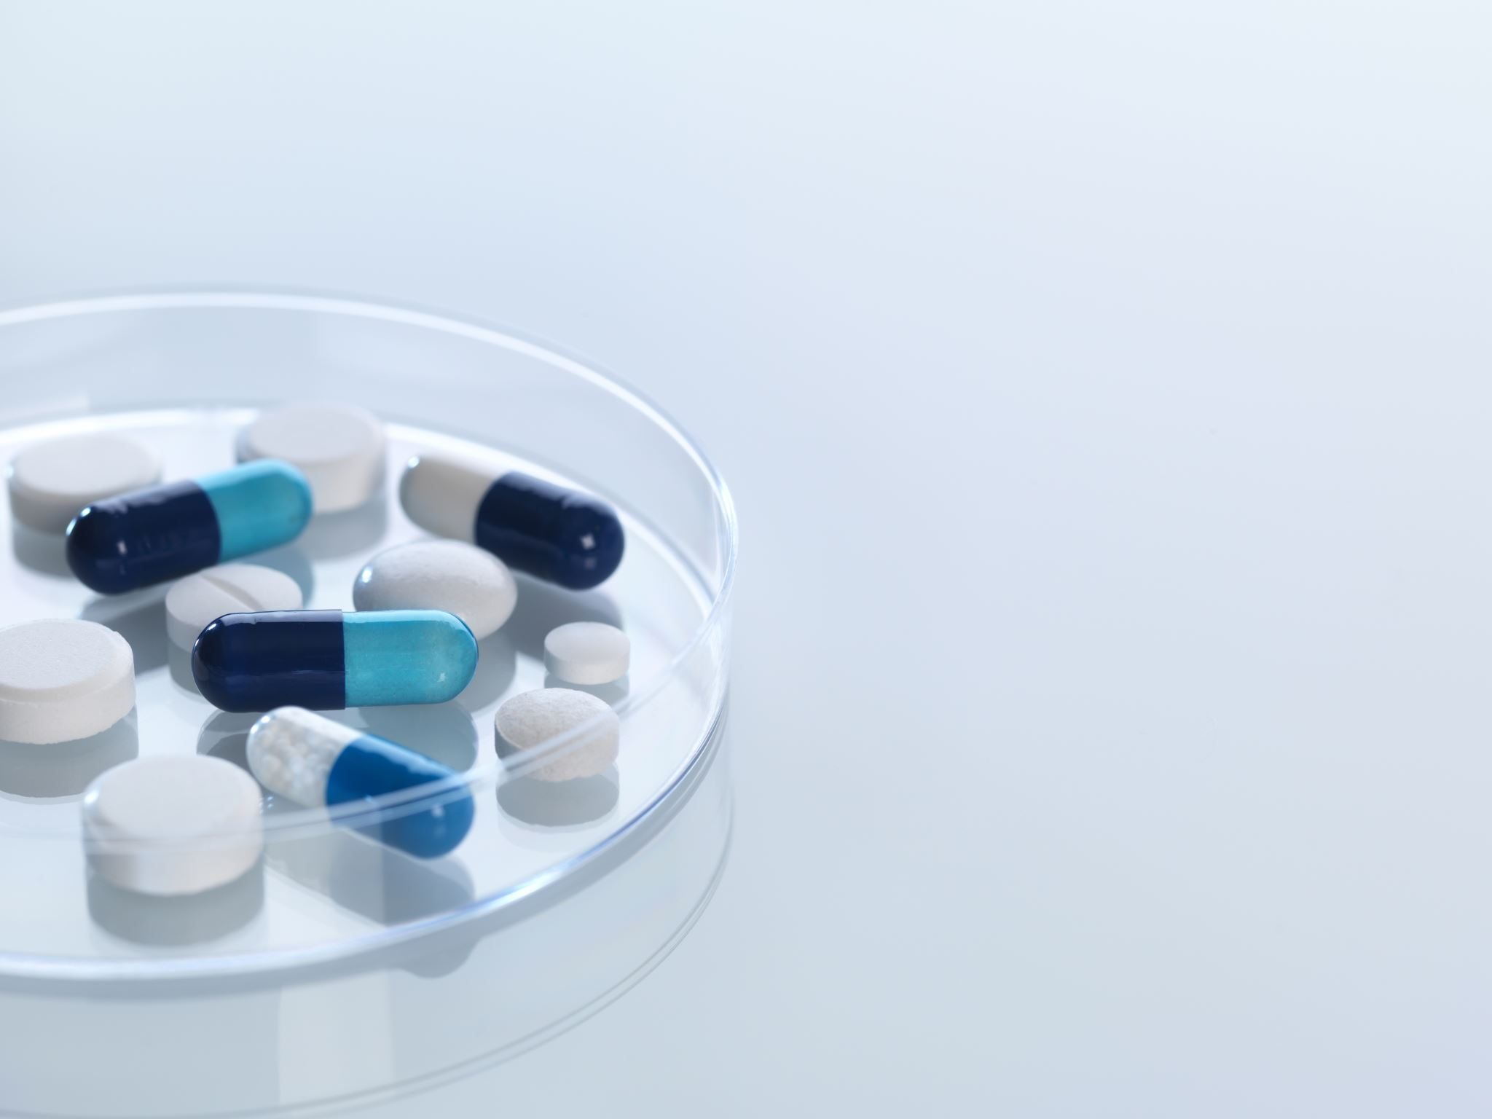
PillPulse AI
Intelligent Medication Accountability System
-Joshua A

Slide 2

Introduction
Medication adherence is a major healthcare challenge.
Many patients forget or incorrectly follow prescriptions.
Manual entry of medicines in reminder apps is inconvenient.
Doctor prescriptions are often handwritten and difficult to interpret.
PillPulse AI aims to simplify medication management using intelligent automation.

Slide 3
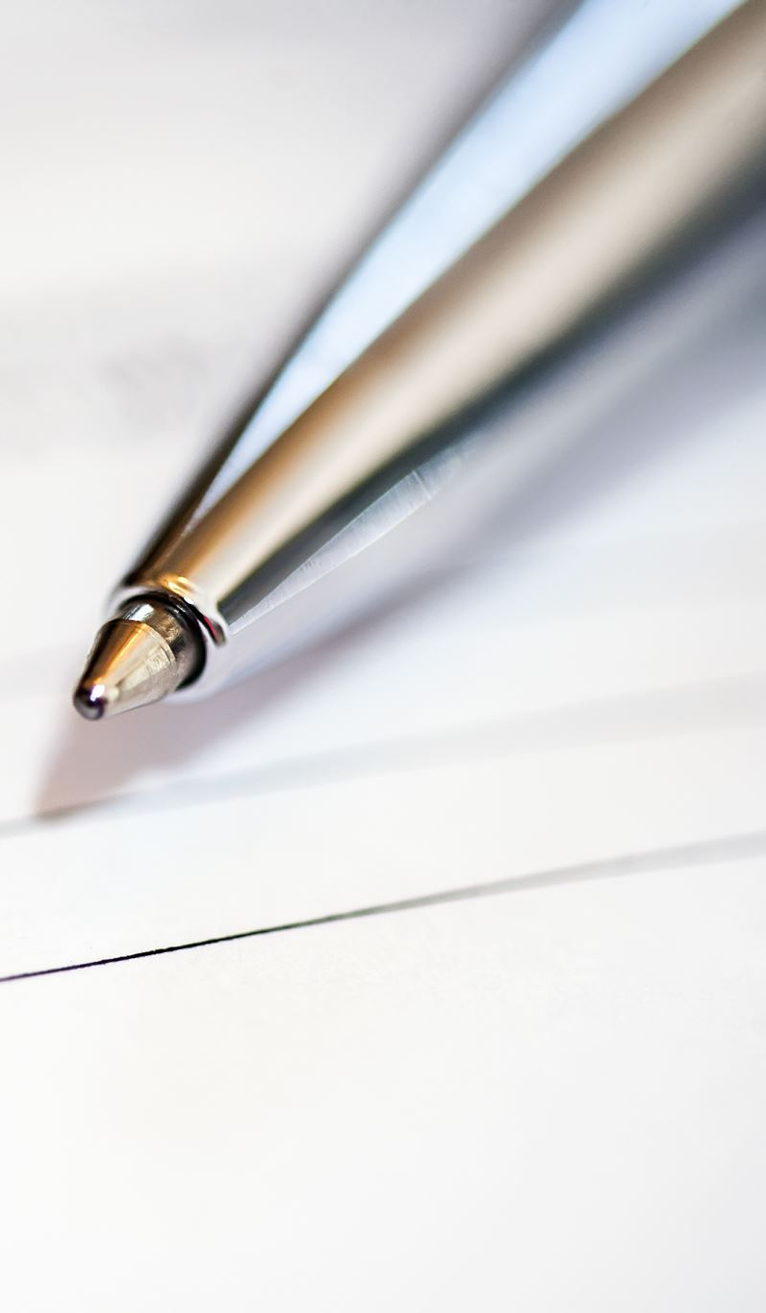
Problem Statement
Patients struggle to understand handwritten prescriptions.
Manual entry of medicines in apps leads to errors.
Medication reminders can be ignored or misconfigured.
Incorrect dosage or missed medication can lead to health risks.
There is a need for a system that automatically converts prescriptions into medication schedules.

Slide 4
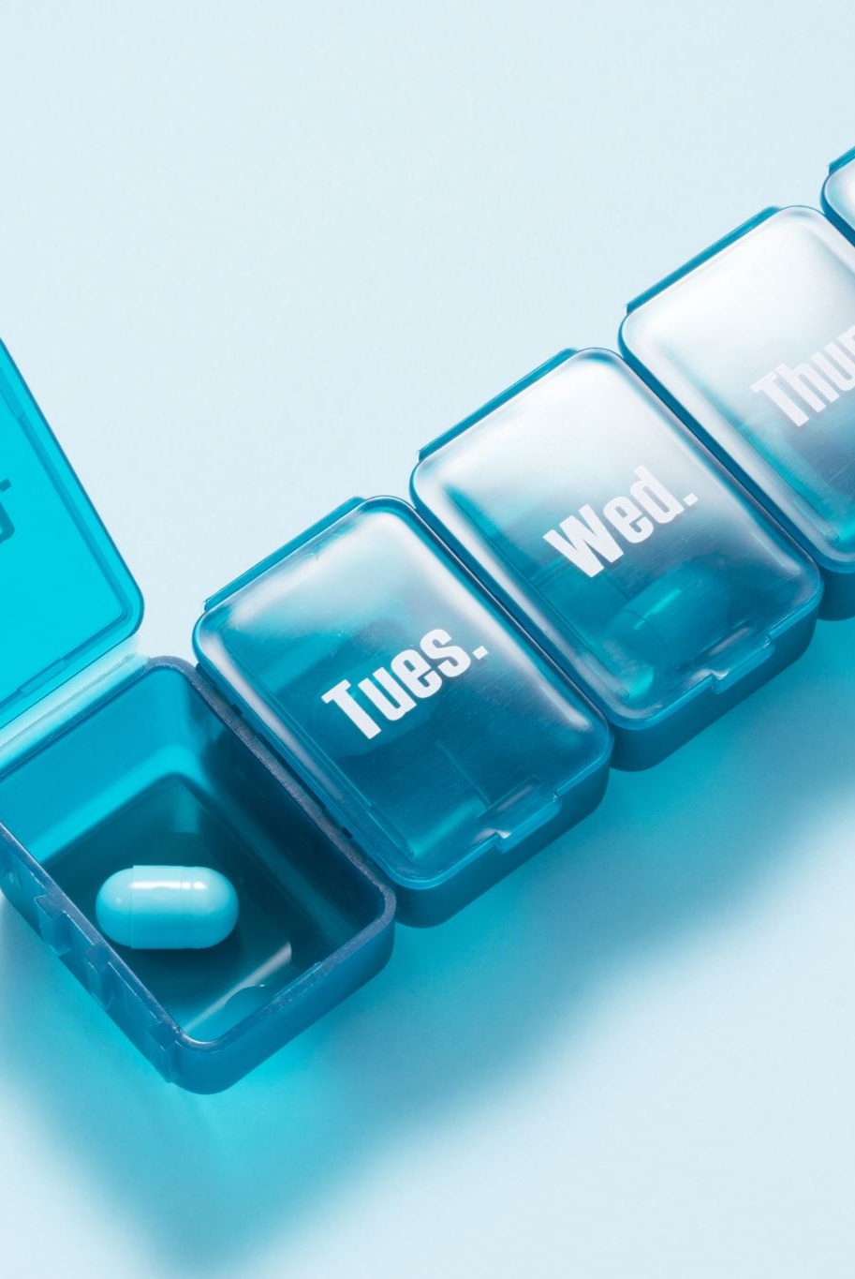
Proposed Solution / Methodology
User uploads an image of a doctor’s prescription.
AI model interprets handwritten prescription text.
System extracts medicines, dosage, and schedule information.
Medication schedule is automatically generated.
Reminders and adherence tracking are configured automatically.
User can confirm doses and monitor medication adherence.

Slide 5
Results / Outcomes
Automatic conversion of prescription images into structured medication schedules.
Reduced manual effort for patients entering medicines.
Improved medication adherence tracking.
Clear visualization of medicine schedules and reminders.
Improved accessibility for elderly or non‑technical users.

Slide 6

Conclusion & Future Scope
PillPulse AI simplifies medication management by interpreting prescriptions automatically.
The system reduces errors in medication scheduling.
Future improvements include:
- Drug interaction detection
- Caregiver monitoring dashboard
- Smart refill prediction
- Integration with pharmacies and hospitals

